Slide 1
E‑Commerce Project Review
A walk-through of the MERN stack-based e-commerce application with user and admin flows.

Slide 2
Project Overview
Full‑stack e‑commerce app built with MERN (MongoDB, Express, React, Node).
Core flows: browse products, cart, checkout flow.
Auth: JWT cookie; role‑based access for Admin and User.
Admin panel: manage products & users.

Slide 3
Tech Stack
Frontend: React + React Router, ContextAPI for Cart & Auth, Tailwind CSS UI.
Backend: Node.js + Express REST APIs.
Database: MongoDB (Mongoose models for users, products, orders).
Auth: JWT in httpOnly cookie; protected routes and RBAC via middlewares;

Slide 4
Key Features
Frontend: Responsive UI, product browsing, filtering, and cart management, checkout flow.
Backend: Secure APIs for products, orders, and users with validation.
Database: Persistent storage for products, users, orders, and carts, hashed passwords.
Auth: Role-based access, JWT authentication, and secure cookies.
Payments: Flexible placeholder methods, future-ready for payment gateway integration.

Slide 5
Register Page
Simple form for creating an account with name, email, and password.
Passwords encrypted with bcrypt.
On success, user can proceed to login and access user pages.

Slide 6
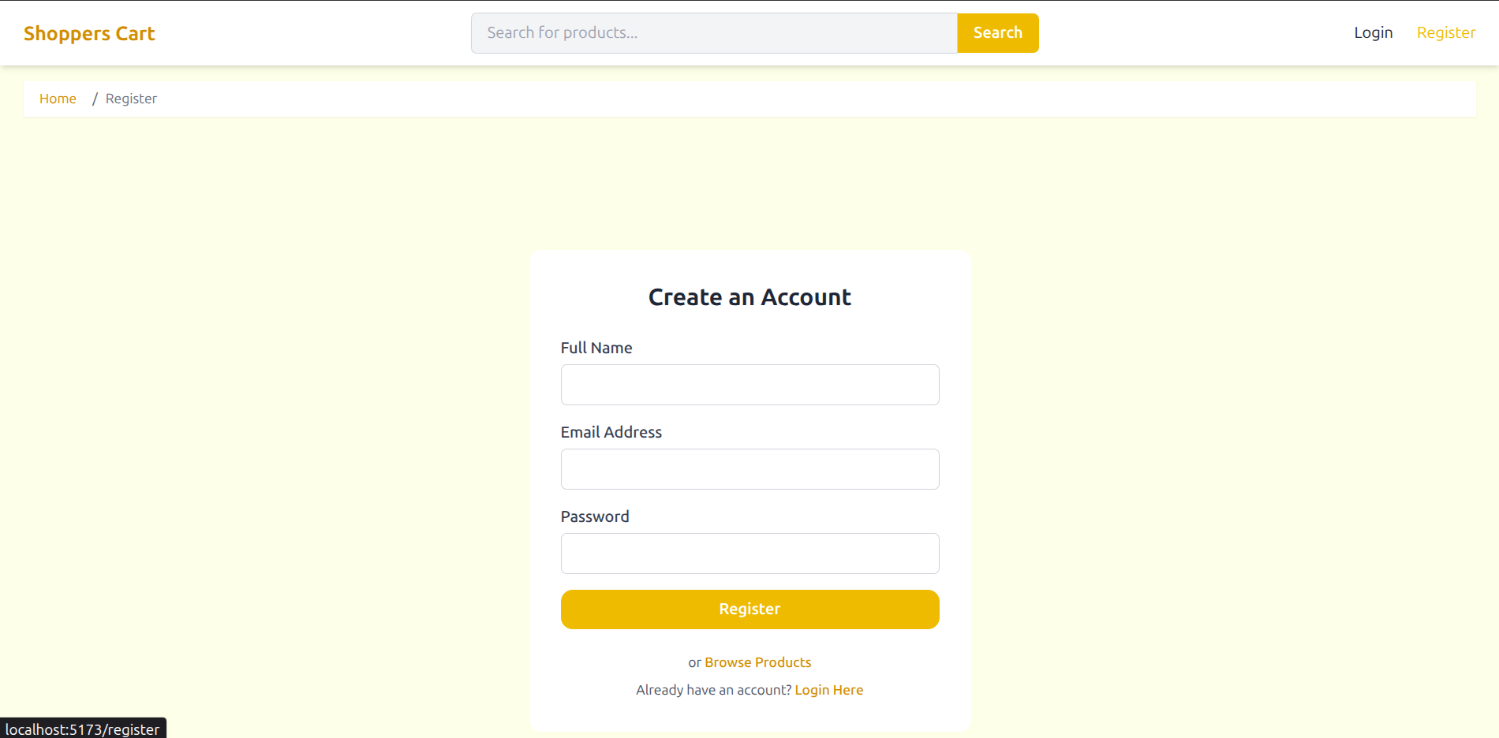
Register Page

Slide 7
Login Page(Conditional Admin/User)
JWT cookie is set upon successful login.
Admin login redirects to Admin Panel, user login redirects to intended page.
Ensures role-based redirection.

Slide 8
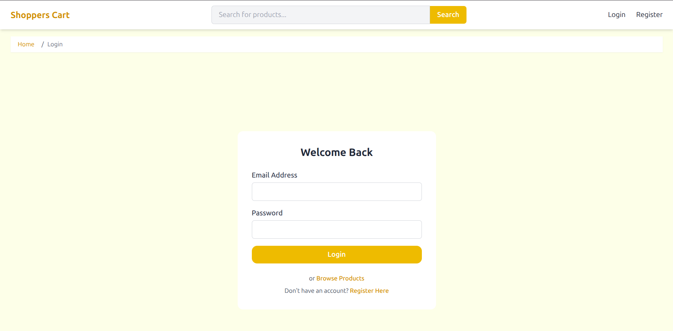
Login Page(Conditional Admin/User)

Slide 9
Home Page
Clean landing page with category shortcuts, recently visited products, top rated, featured products, new arrivals.
Global search box to quickly finding products.
Cart, profile and log options accessible in the navbar throughout all pages.
Accessible to users without logging in.

Slide 10
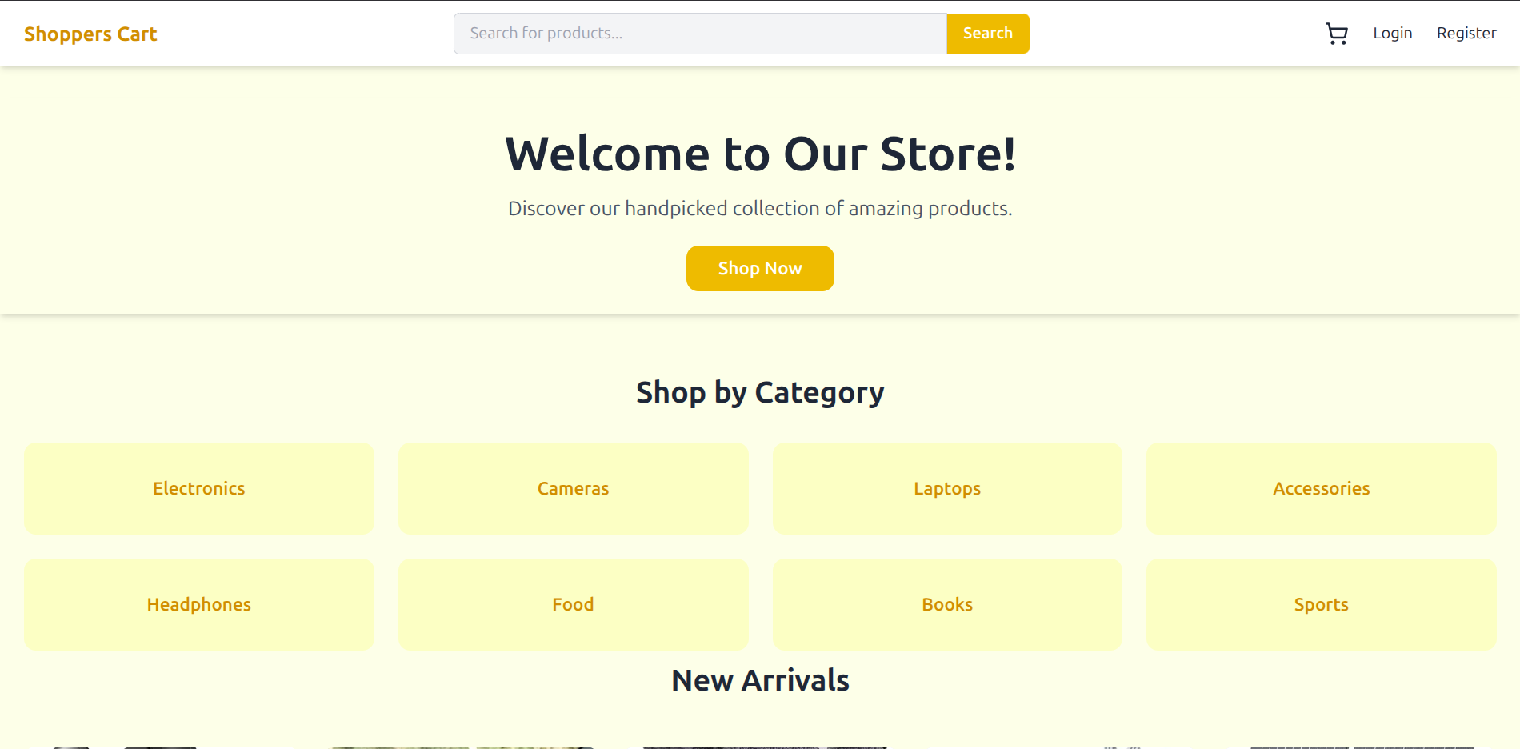
Home Page

Slide 11
Products Listing Page
Grid view with product images, prices, and details.
Filter options: price range, category, and sorting.
Pagination for browsing through multiple product pages.
Accessible to users without logging in.

Slide 12
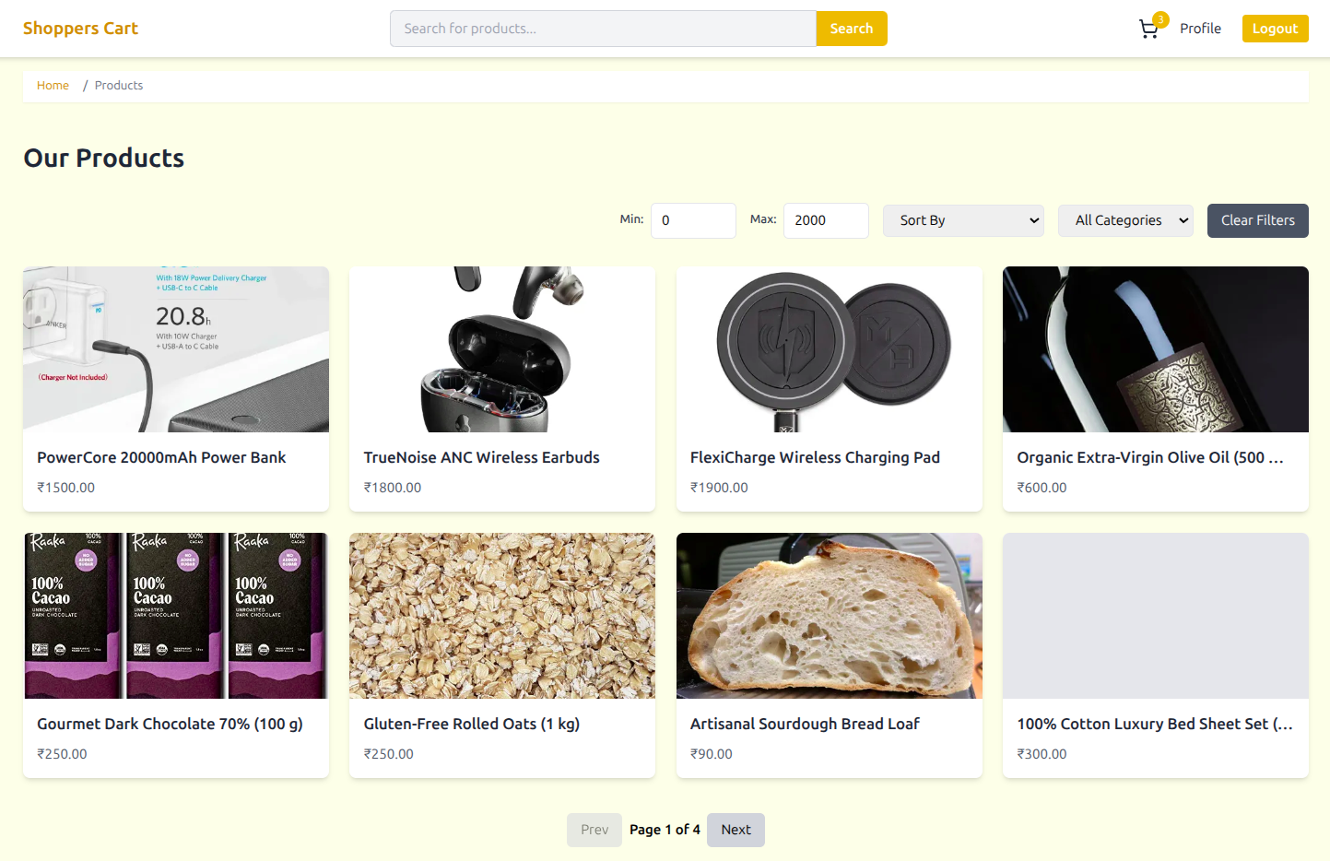
Products Listing Page

Slide 13
Product Detail Page
Image gallery with zoom and lightbox feature.
Add to Cart option secured by stock and authentication checks. If user not logged in, redirected to login and redirected back to the product detail page.
Quick 'Place Order' button to jump to the cart.
Add to cart button and remove cart buttons.
Ability to update quantity after an item is added to cart.
Shows the product ratings of the users who gave reviews.
Ability for users to add reviews and give ratings.

Slide 14
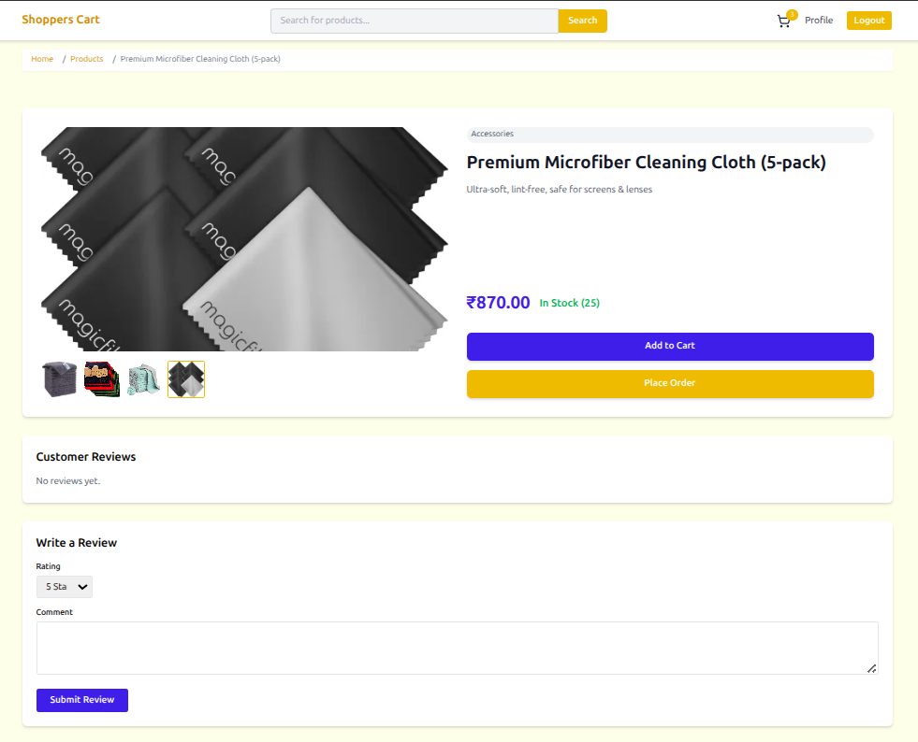
Product Detail Page

Slide 15
Cart Page
Displays products with image and quantity selected.
Ability to control quantity, and remove option.
Automatic GST calculation (18%) with total price.
Stock check before proceeding to checkout.

Slide 16
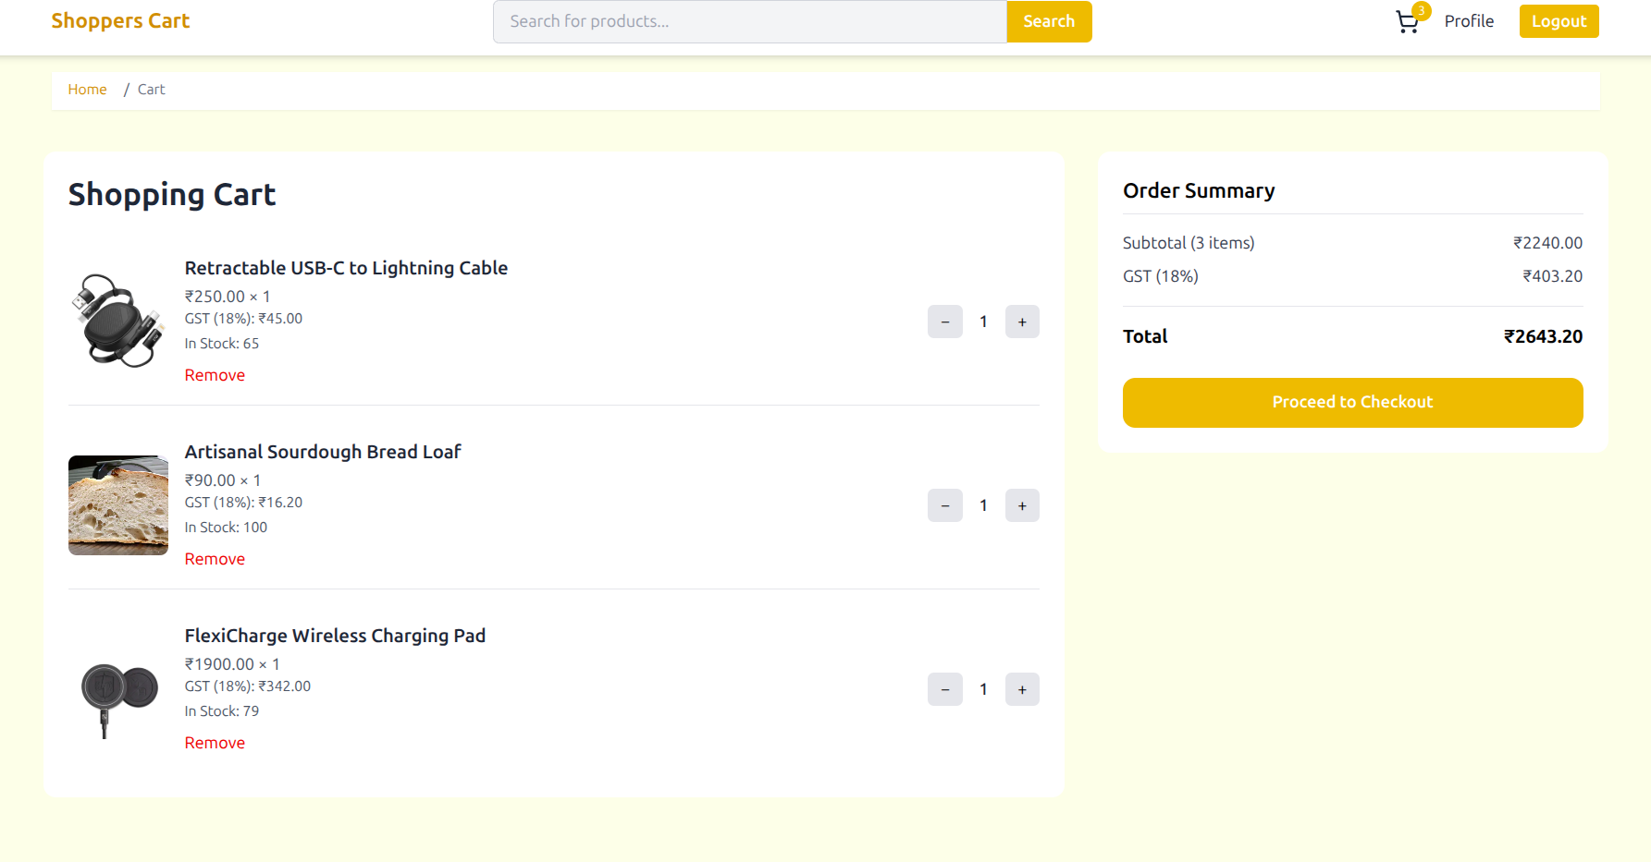
Cart Page

Slide 17
Checkout – I) Shipping
Address form with option to select a previous address.
Stores shipping info for the next steps in checkout.
Validation for all required fields including phone number.
Other checkout pages for confirming the stock availability before redirecting to the dummy payment page.

Slide 18
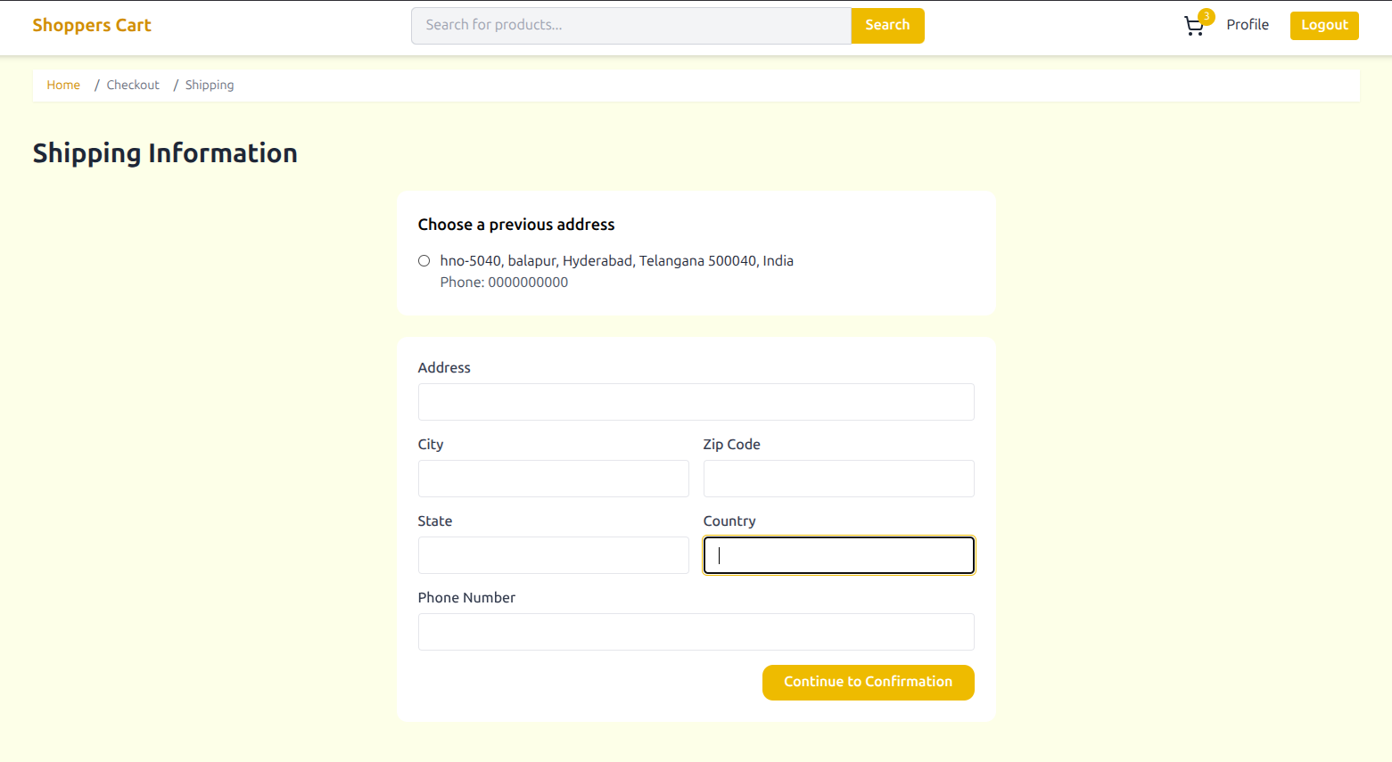
Checkout – I) Shipping Page

Slide 19
Checkout – II) Order confirm Page
Last check before payment page redirection.
Ability to change the cart quantity of the order.
Checking the stock in case of race conditions and asking the user to change the quantity in the same page/remove product from cart.
After successful stock validation redirect to the dummy payment page.(future scope of payment gateway integration).

Slide 20
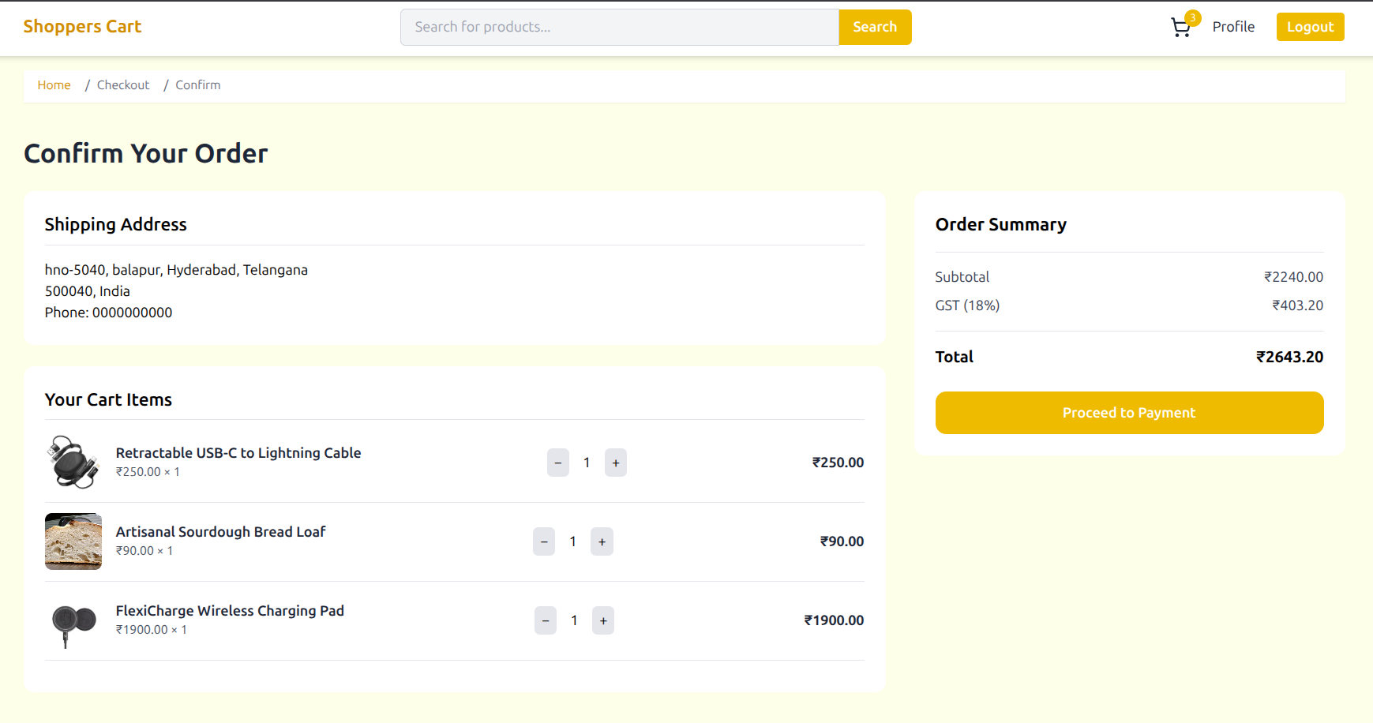
Checkout- II)Order confirm page

Slide 21
Profile Page
Showing the user’s data along with ability to change name of the user.
Ability to change password with mean-time between password changes.
Redirecting the user to re-login after successful password change.
A sections showing the Orders placed by the users.
Redirecting to a order detail page to show the order details.

Slide 22
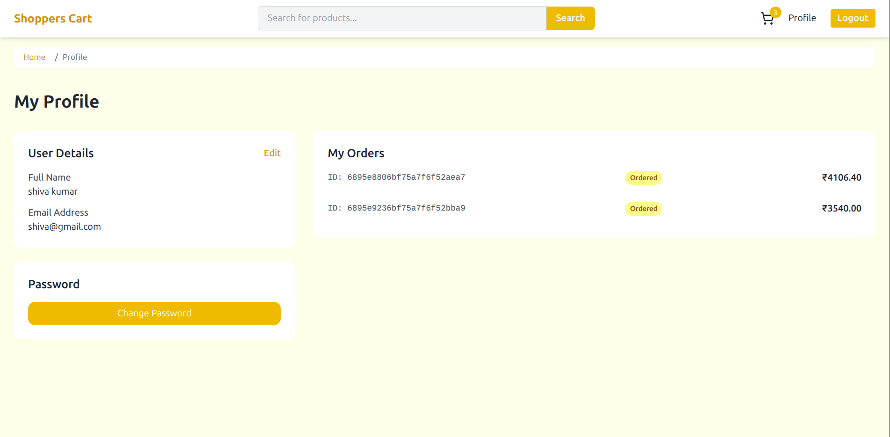
Profile Page

Slide 23
Admin Dashboard
Displays key metrics such as real time data like total users, products, and today's sales.
Provides quick access to admin management sections.
Acts as the entry point for all administrative actions.

Slide 24
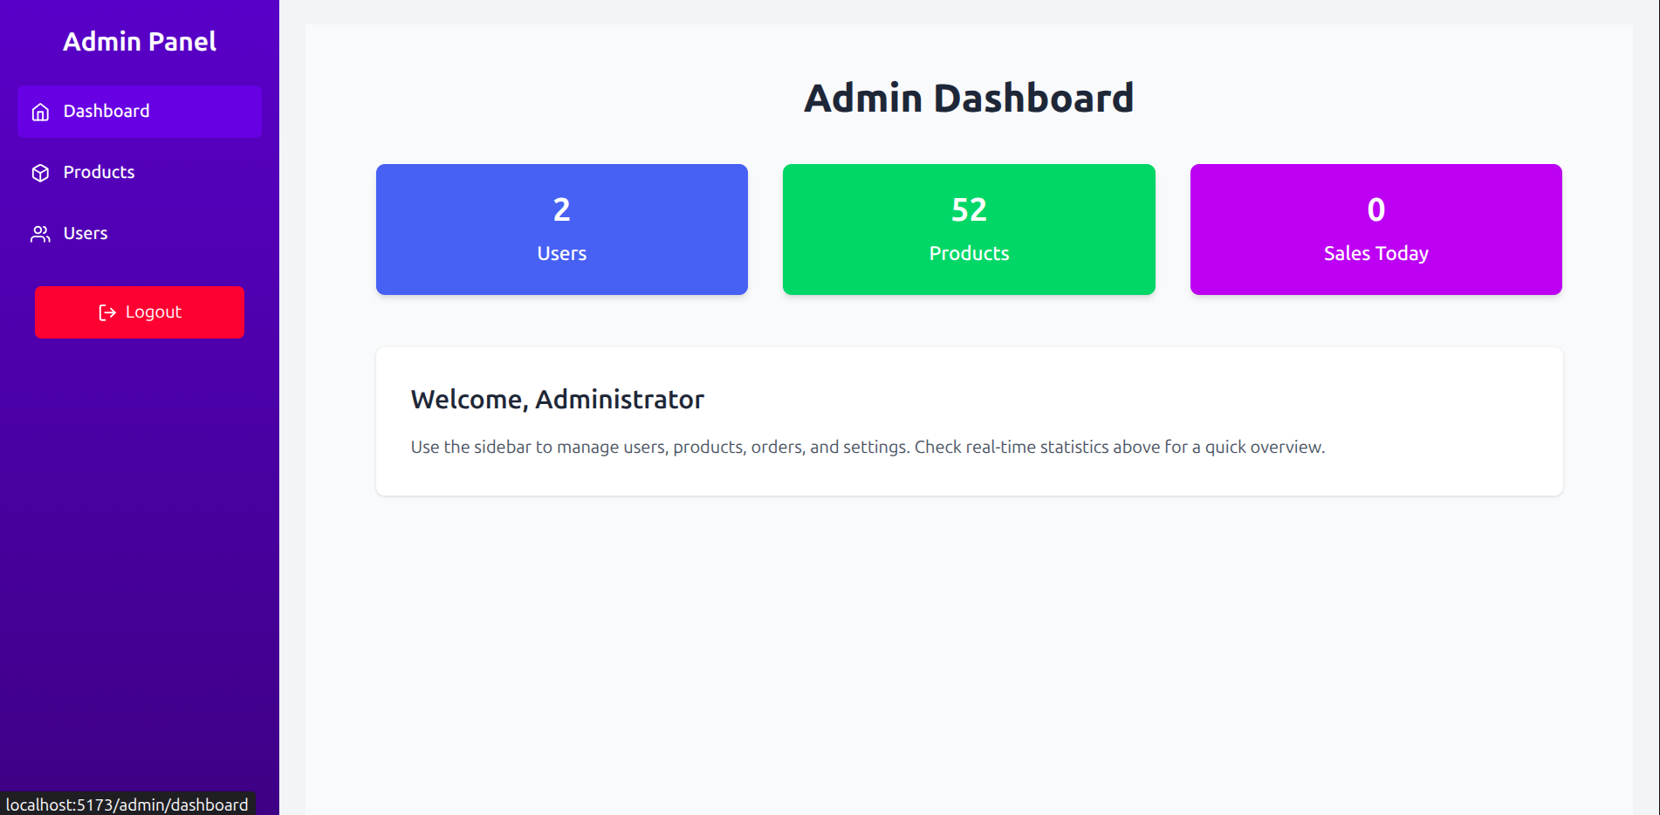
Admin Dashboard

Slide 25
Admin – Manage Products
List of all products with images, titles, prices, and stock levels in a fixed scrolling table.
Options to add, edit, or delete products by redirecting to respective pages.
Secured actions accessible only to Admin users.

Slide 26
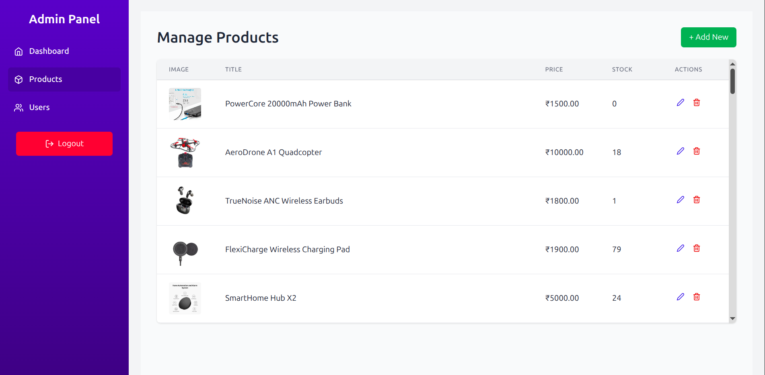
Admin – Manage Products

Slide 27
Admin – Manage Users
List of registered users with names, emails, and roles.
Option to delete users with server-side checks.
Only accessible to Admins via protected routes.

Slide 28
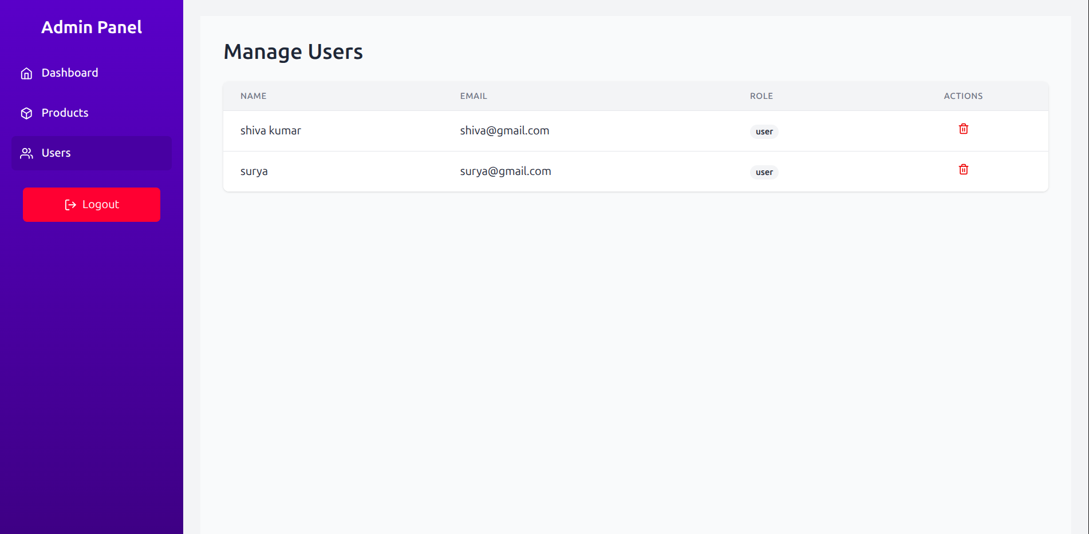
Admin – Manage Users

Slide 29
Future Scope
Integrate a real payment gateway with order webhooks.
Enhance security with CSRF protection and rate limiting.
Implement coupons and promotional discounts.
Add better analytics and reporting tools.
Improve product recommendation system using AI.
Integrating order management with third-party delivery agencies for advanced features.

