Slide 1
Training and Deployment Safety in On-Policy and Off-Policy RL
Farina Salman • Rachna Sunilkumar Deshpande • Abdulaziz Al-Tayar • Harsh Patel
University of Ottawa — CSI 5180 / CEG 5270: Topics in AI
April 2026

Slide 2
Agenda
1. Motivation & Problem Statement
2. Gap in the Literature
3. Research Questions
4. Experimental Methodology
5. Results — MuJoCo Environments (Hopper-v4, HalfCheetah-v4)
6. Results — Safety-Gymnasium (SafetyPointGoal1-v0)
7. Qualitative Video Analysis
8. Discussion & Algorithmic Insights
9. Limitations & Future Work
10. Conclusion & References

Slide 3
1. Motivation
• RL is being deployed in safety-critical domains: autonomous vehicles, robotic surgery, industrial control
• PPO (on-policy) and SAC (off-policy) achieve high rewards, but behave very differently in terms of stability, safety, and reliability
• An unsafe action in a real-world system can cause physical damage, injury, or catastrophic failure
• We need to understand which algorithm is safer before deploying RL in the real world
Core Question:
If we give PPO and SAC the exact same compute budget, environments, and evaluation protocol — which one produces policies that are safer to deploy on a physical robot?

Slide 4
2. Gap in the Literature
What prior work covers:
What is missing:
• Cumulative reward comparisons [Schulman'17, Haarnoja'18]
• Sample efficiency benchmarks [Henderson'18]
• Implementation details [Engstrom'20]
• On-policy best practices [Andrychowicz'21]
• Training and deployment safety comparison
• Policy smoothness under matched conditions
• Constraint adherence in safety-critical envs
• Recovery from perturbations
• Risk sensitivity analysis
Our Contribution: A direct, reproducible safety comparison of PPO vs SAC using practical deployment metrics (action smoothness, constraint violations, recovery, gradient stability) across both standard and constrained environments.

Slide 5
3. Research Questions
Primary RQ:
In which environmental conditions will PPO have more stable and safer behavior compared to SAC for both training and deployment, when they both have the same compute budgets and evaluation protocols?
Secondary RQ:
What are the algorithmic mechanisms that cause the observed differences in stability and safety between PPO and SAC?
We evaluate the secondary RQ through gradient norm analysis, Q-value variance tracking, and policy entropy evolution — linking behavioral differences to on-policy vs. off-policy mechanics.

Slide 6
4. Experimental Methodology
Component | Details
Algorithms | PPO (on-policy) vs SAC (off-policy) via Stable-Baselines3
Network | MLP Policy & Value: 2×256 ReLU
Environments | Hopper-v4, HalfCheetah-v4 (MuJoCo) + SafetyPointGoal1-v0 (Safety-Gym)
Baseline | Random policy (per environment)
Budget | 1,000,000 environment steps per run (matched)
Seeds | 10 independent seeds per condition (60 total runs)
Parallelization | 8× SubprocVecEnv (vectorized environments)
Hardware | 2× NVIDIA RTX 3070 (8GB VRAM), 36 CPU cores
HP Search | LR ∈ {1e-4, 3e-4, 1e-3}, γ ∈ {0.99, 0.995}, BS ∈ {256, 1024}
Evaluation | 100 deterministic episodes per seed

Slide 7
Safety & Stability Metrics
Metric | What It Measures | Why It Matters
Action Smoothness | L2 norm of consecutive action differences | Jerky actions = mechanical wear on real robots
Constraint Violations | Hazard boundary breaches per episode | Direct measure of safety compliance
Feasibility Rate | % episodes with zero violations | Reliability of safe operation
Recovery Ratio | Performance after state perturbation | Robustness to unexpected disturbances
Policy Entropy | Randomness of action selection | Exploration vs. exploitation balance
Q-Value Variance | Uncertainty of value estimates (SAC) | Confidence in decision making
Gradient Norms | Magnitude of parameter updates | Training stability indicator

Slide 8
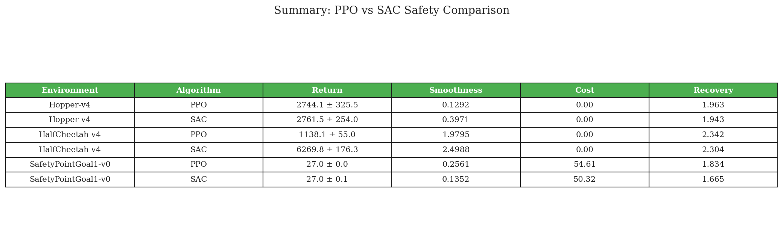
5. Results Overview
Mean ± standard error across 10 seeds, evaluated over 100 deterministic episodes each.

Slide 9
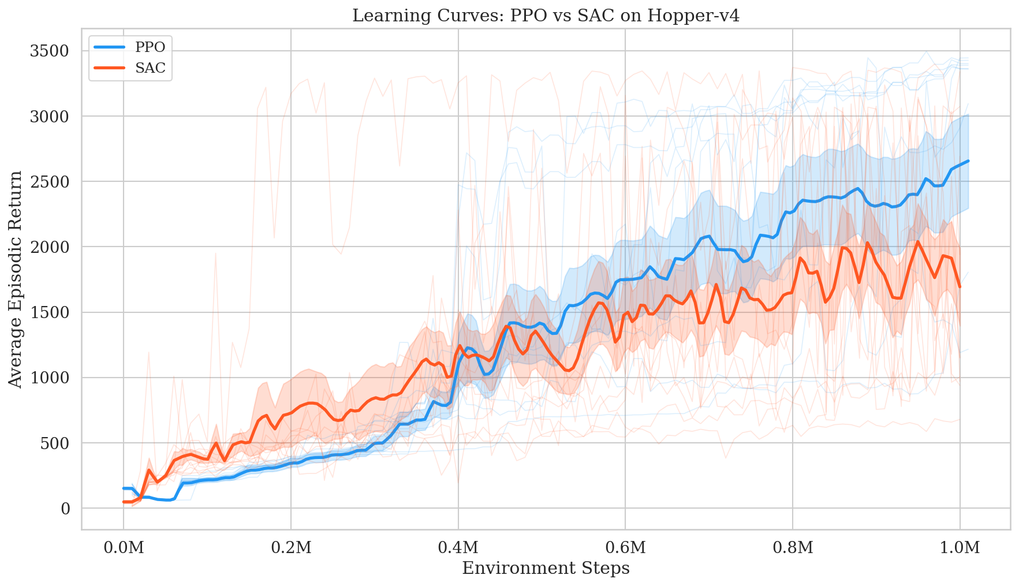
Hopper-v4 — Learning Curves
Key Finding:
PPO (~2744) and SAC (~2762) achieve nearly identical final returns. Both algorithms solve this balance task equally well within the 1M step budget.

Slide 10
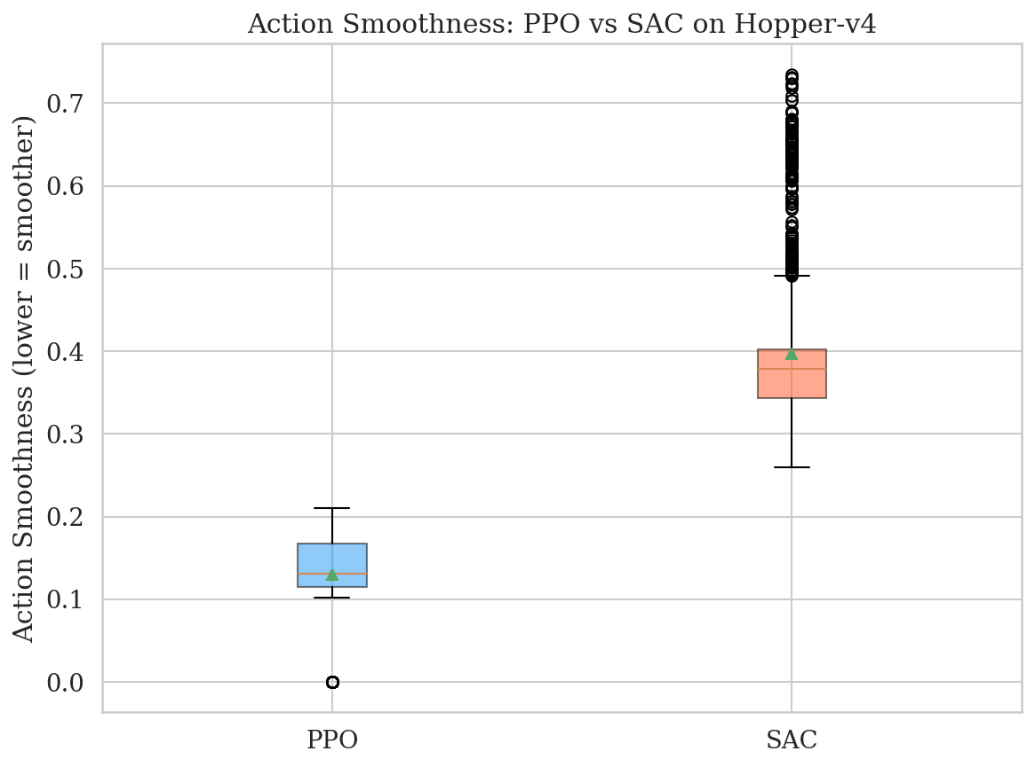
Hopper-v4 — Action Smoothness
PPO Smoothness
SAC Smoothness
0.129
0.397
PPO's actions are 3× smoother than SAC's. On a physical robot, SAC's jerky motor commands would cause severe mechanical wear. PPO's trust-region clipping naturally produces stable, deployment-safe control signals.

Slide 11
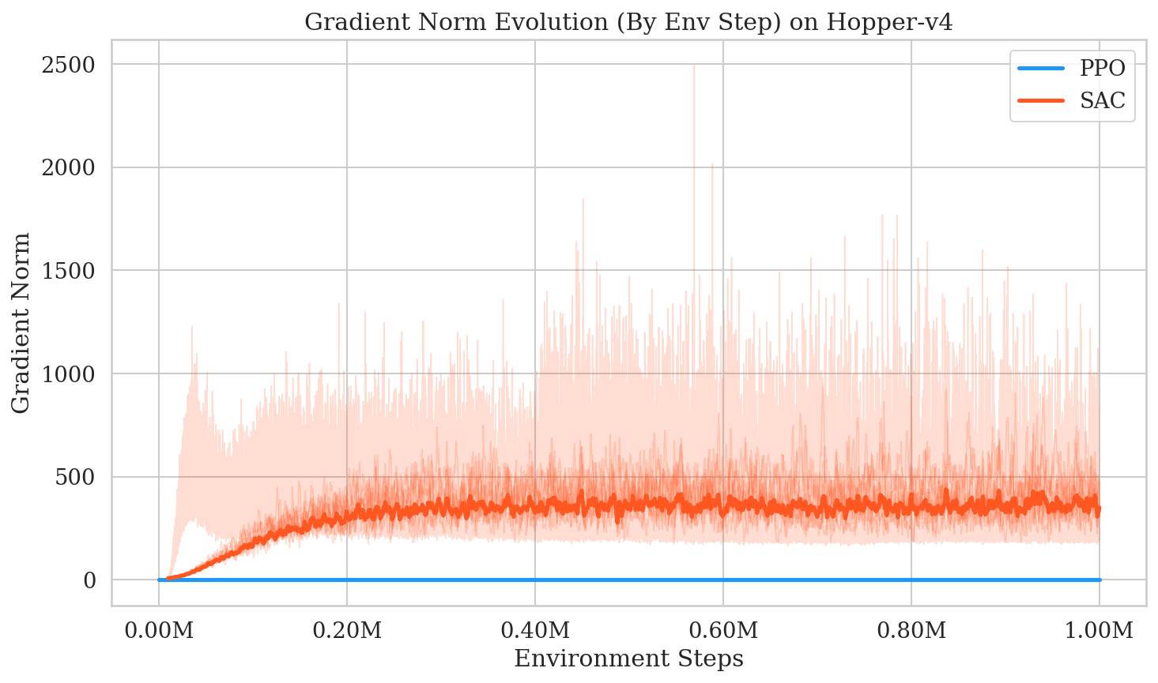
Hopper-v4 — Gradient Norm Evolution
Algorithmic Insight: PPO's gradient norms are flat and stable (clipped trust region). SAC's gradients spike violently (up to 2500), reflecting its aggressive entropy-maximizing exploration. This directly explains the 3× smoothness gap.

Slide 12
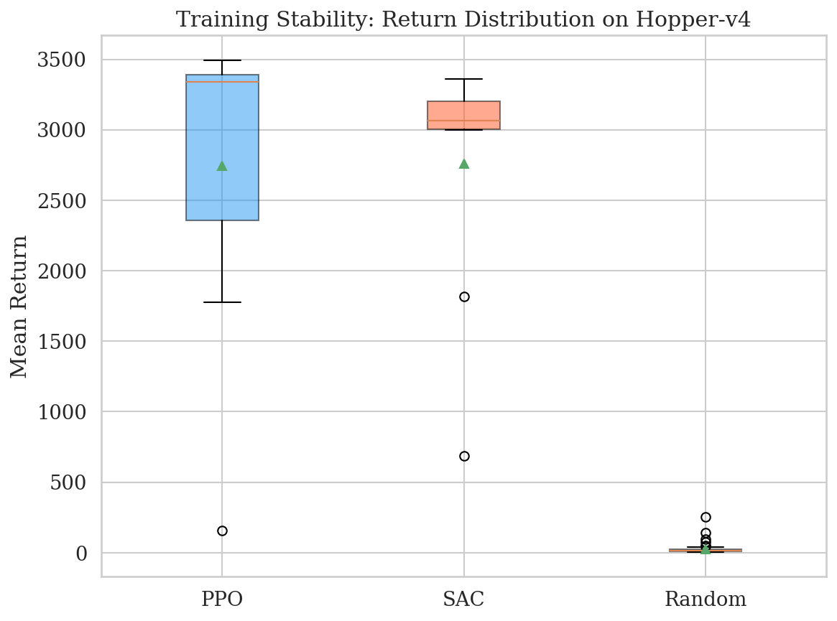
Hopper-v4 — Seed Variance
Both algorithms show consistent performance across all 10 seeds, confirming reproducibility.
SAC has a slightly tighter IQR (±254 vs ±326), suggesting more deterministic convergence on this simple task.

Slide 13
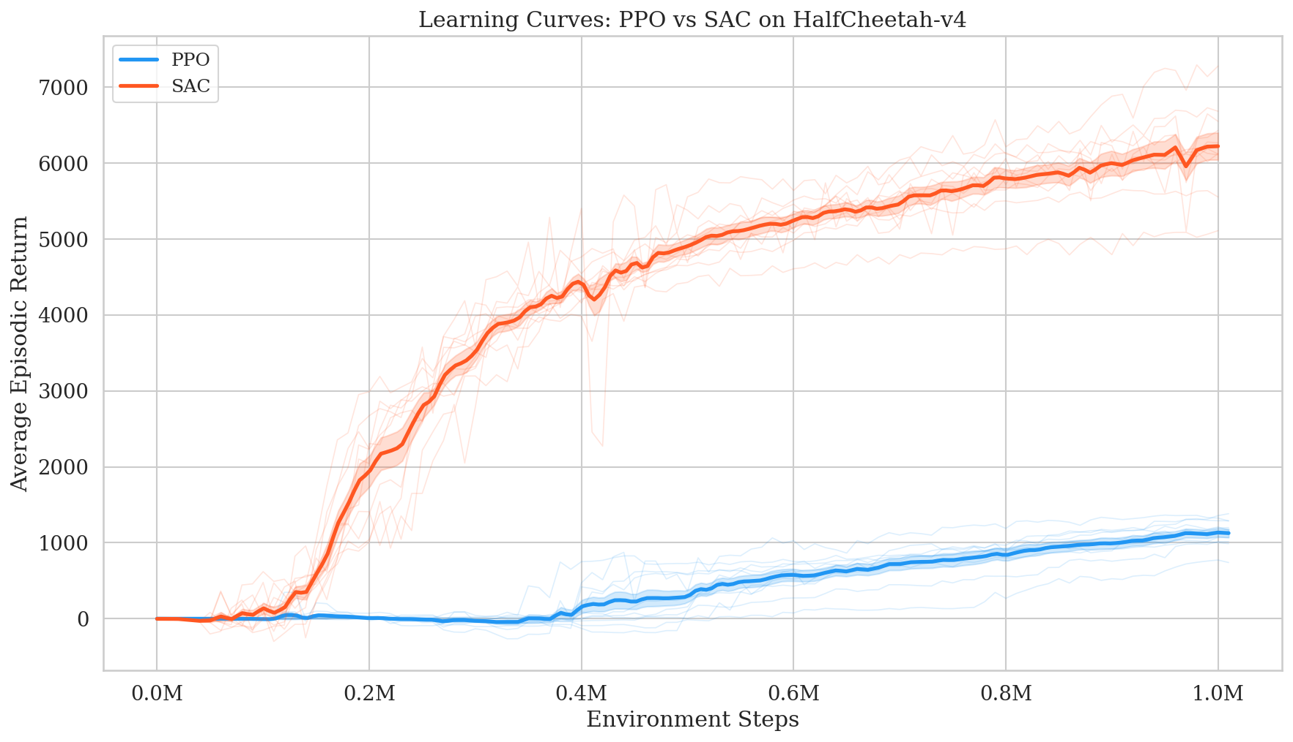
HalfCheetah-v4 — Learning Curves
Key Finding:
SAC (~6270) dominates PPO (~1138) by 5.5×. In an environment where failure is impossible, SAC's aggressive exploration pays off massively.

Slide 14
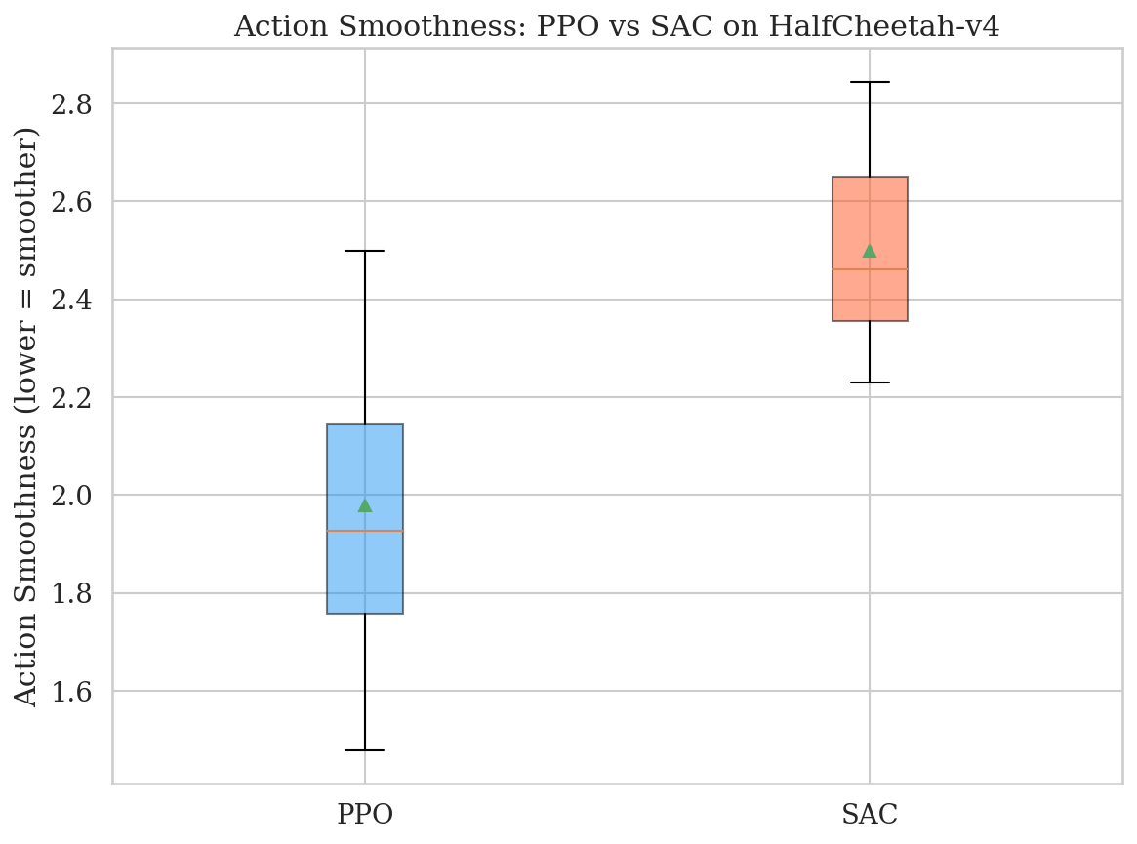
HalfCheetah-v4 — Reward Hacking Phenomenon
⚠ Reward Hacking Detected!
PPO's agent learned to run completely upside down, sliding on its head. Its trust region prevented risky corrections, trapping it in this local optimum (~1100).
SAC's entropy maximization forced it to keep trying chaotic movements, eventually discovering the upright running gait (~6270). This is a textbook stability-exploration tradeoff.

Slide 15
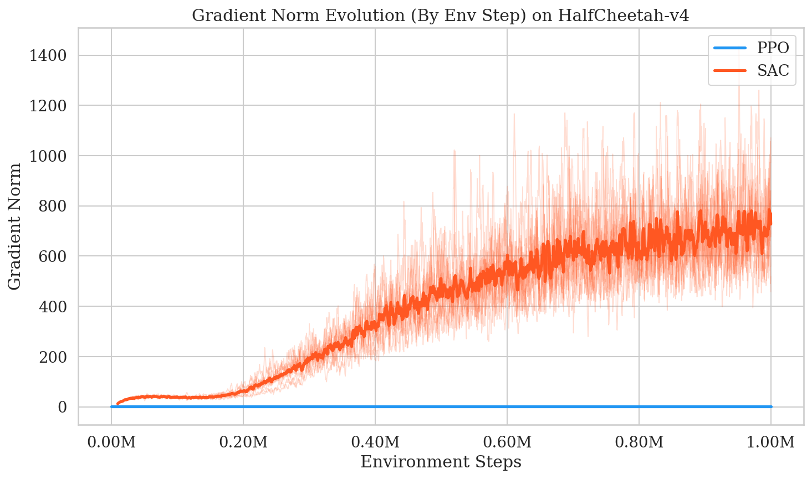
HalfCheetah-v4 — Gradient Norms & Q-Value Variance
SAC's Q-value variance on HalfCheetah: 3.44 (vs 0.27 on Hopper — a 13× increase). The critic network is far less certain, yet this very uncertainty drives better exploration and dramatically higher performance.

Slide 16
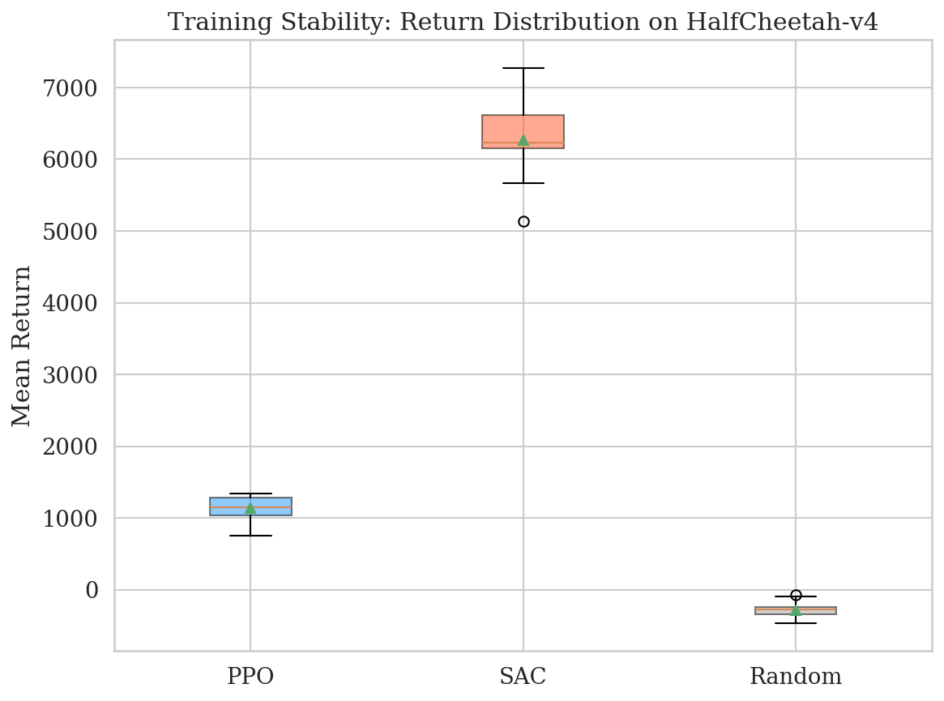
HalfCheetah-v4 — Seed Variance
PPO shows remarkably low variance (±55) because all 10 seeds converged to the same local optimum (upside-down sliding).
SAC has higher variance (±176) reflecting different exploration paths, but consistently achieves the superior upright gait.

Slide 17
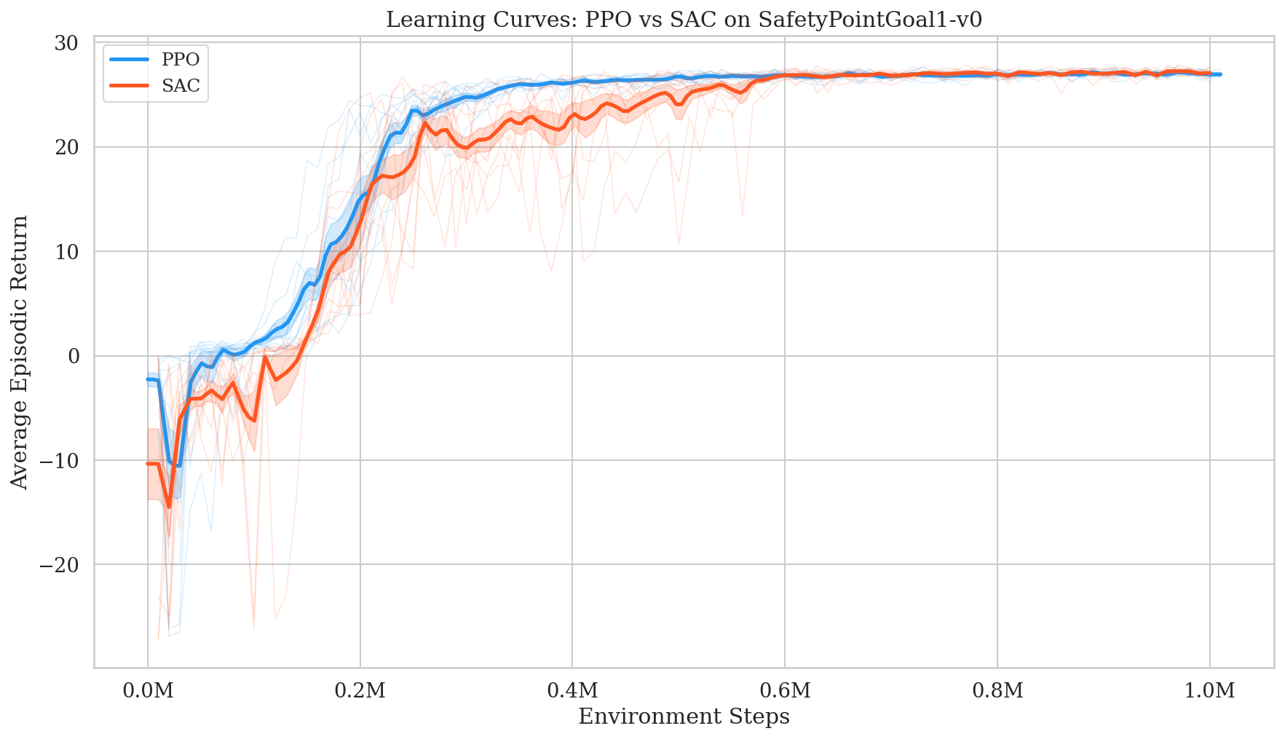
6. SafetyPointGoal1-v0 — Learning Curves
Both PPO and SAC achieve identical returns (~27.0). The real differentiation is in constraint violations, not reward.

Slide 18
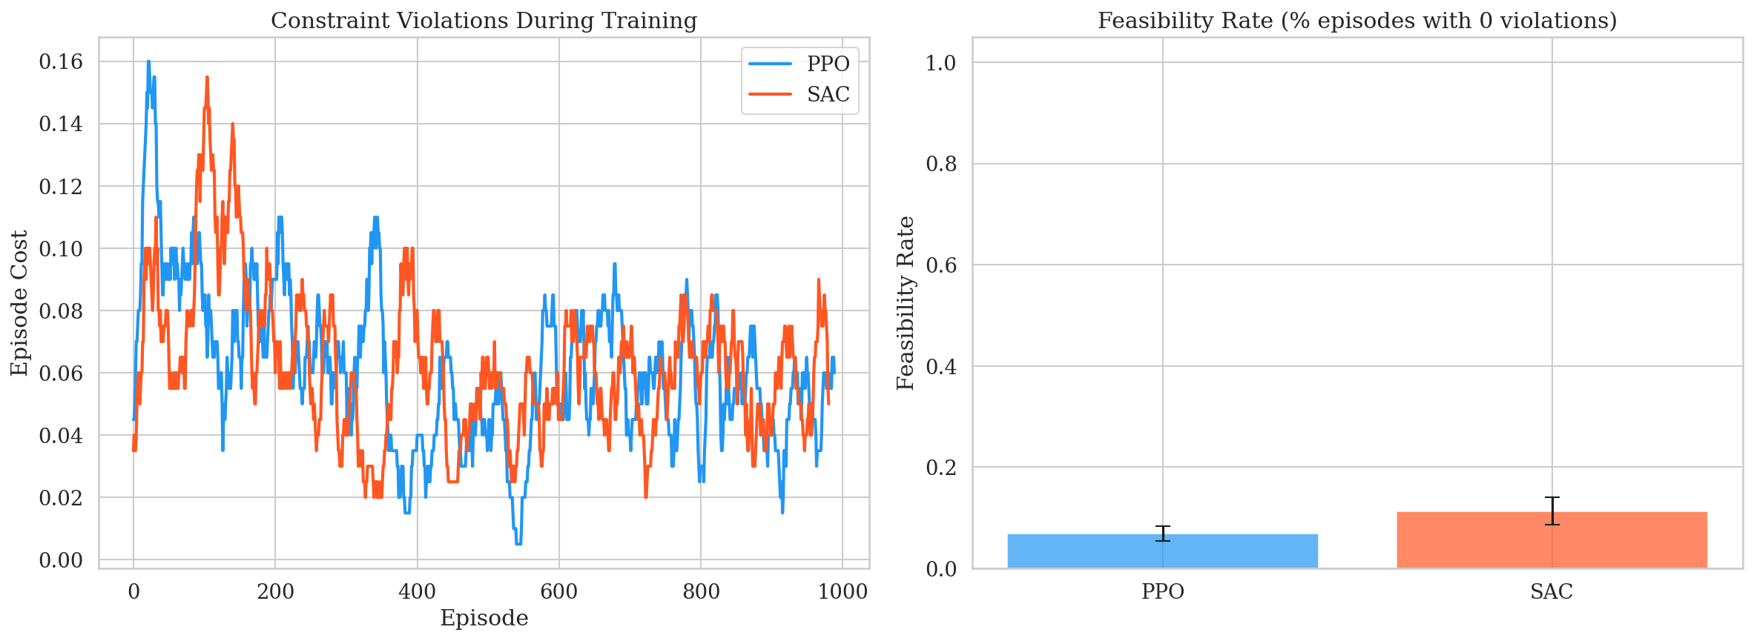
SafetyPointGoal1-v0 — Constraint Violations
PPO Mean Cost
SAC Mean Cost
54.6
50.3
PPO Feasibility
SAC Feasibility
8%
9%
Surprise Finding: SAC achieves ~8% fewer violations than PPO. SAC's replay buffer allows it to memorize hazard locations from past experiences.

Slide 19
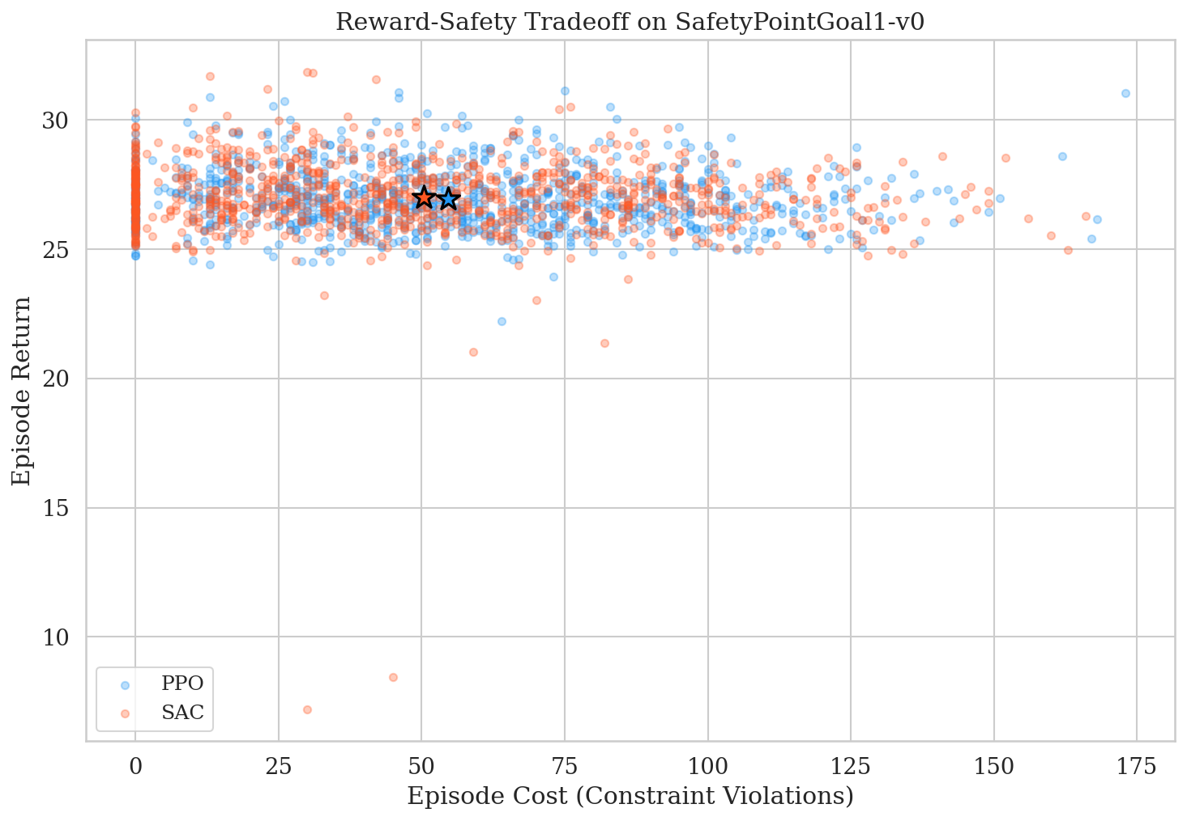
SafetyPointGoal1-v0 — Reward-Safety Tradeoff
Neither algorithm successfully learned to avoid hazards while maximizing reward. Both cluster in the high-cost region, highlighting the fundamental difficulty of safety-constrained RL without explicit cost penalties.

Slide 20
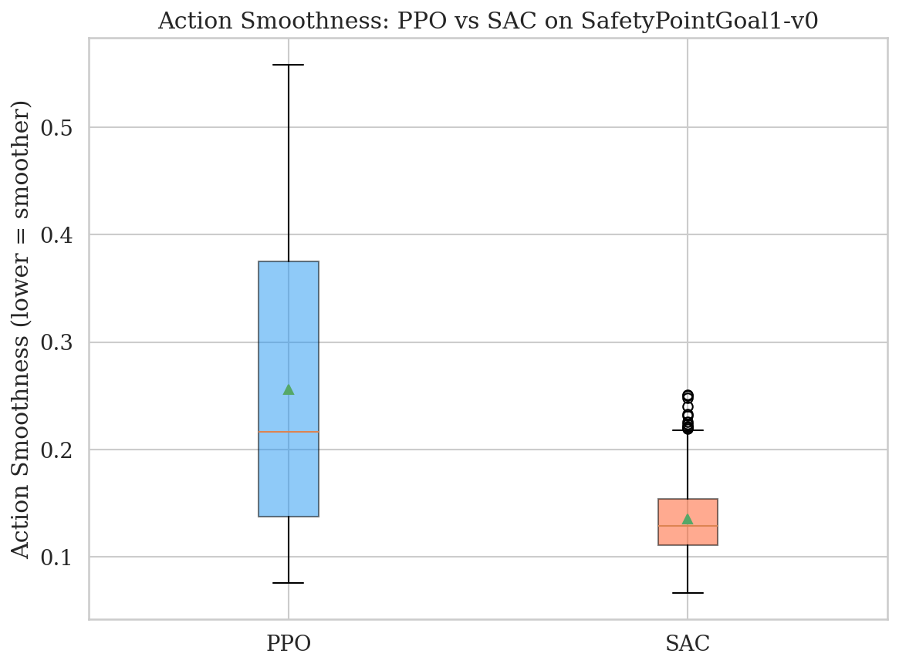
SafetyPointGoal1-v0 — Action Smoothness
PPO Smoothness
SAC Smoothness
0.256
0.135
Interestingly, SAC produces smoother actions on the Safety env. The navigation task rewards precise movements toward the goal — and SAC's replay buffer helps it refine these smooth trajectories over time.

Slide 21
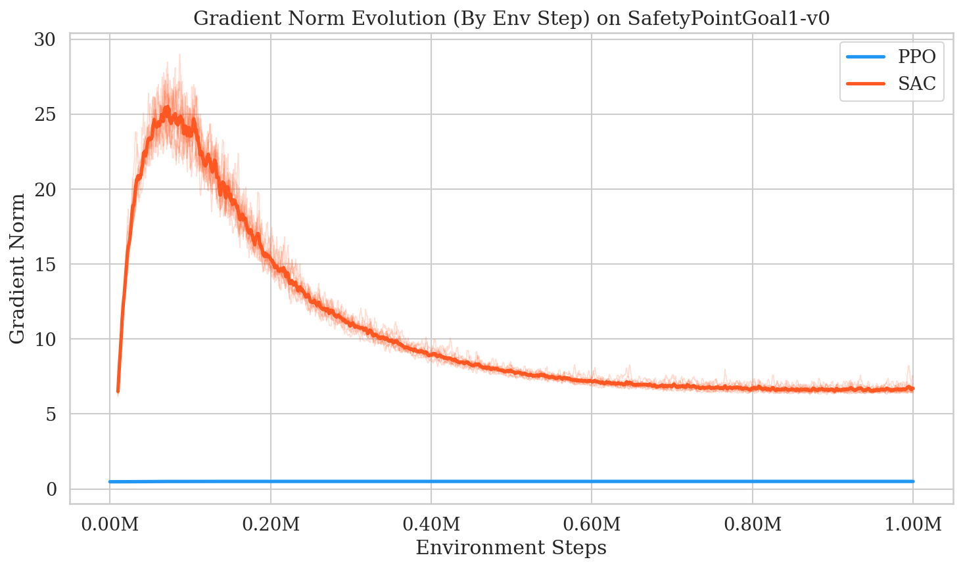
SafetyPointGoal1-v0 — Gradient Norms
Both algorithms show relatively stable gradient norms on this simpler navigation task, but SAC's occasional spikes correlate with episodes where the agent encounters novel hazard configurations.

Slide 22
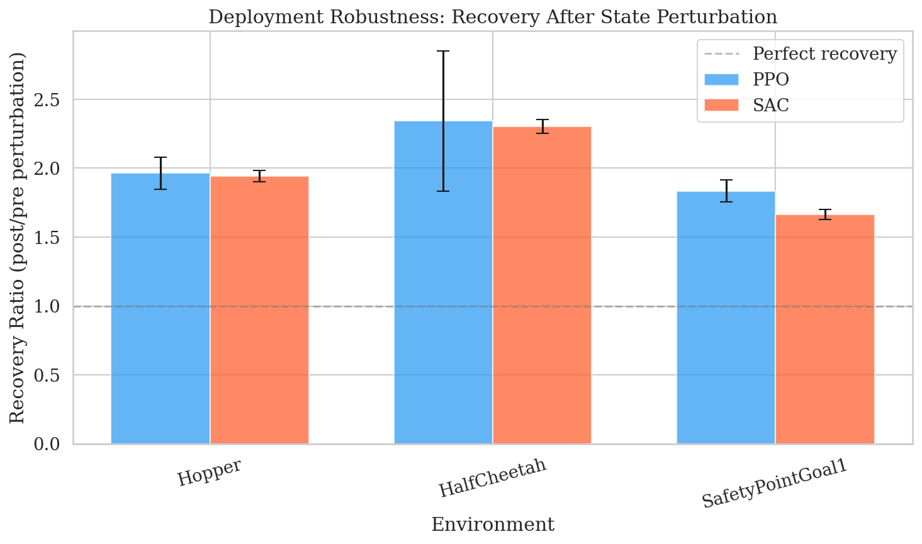
Recovery from Perturbations
Recovery Ratio > 1.0 means the agent performed better after perturbation.
All conditions show ratios above 1.0, indicating both algorithms are robust to unexpected state disturbances — a positive sign for deployment.
Environment | PPO | SAC
Hopper-v4 | 1.96 | 1.94
HalfCheetah-v4 | 2.34 | 2.30
SafetyPointGoal1 | 1.83 | 1.67

Slide 23
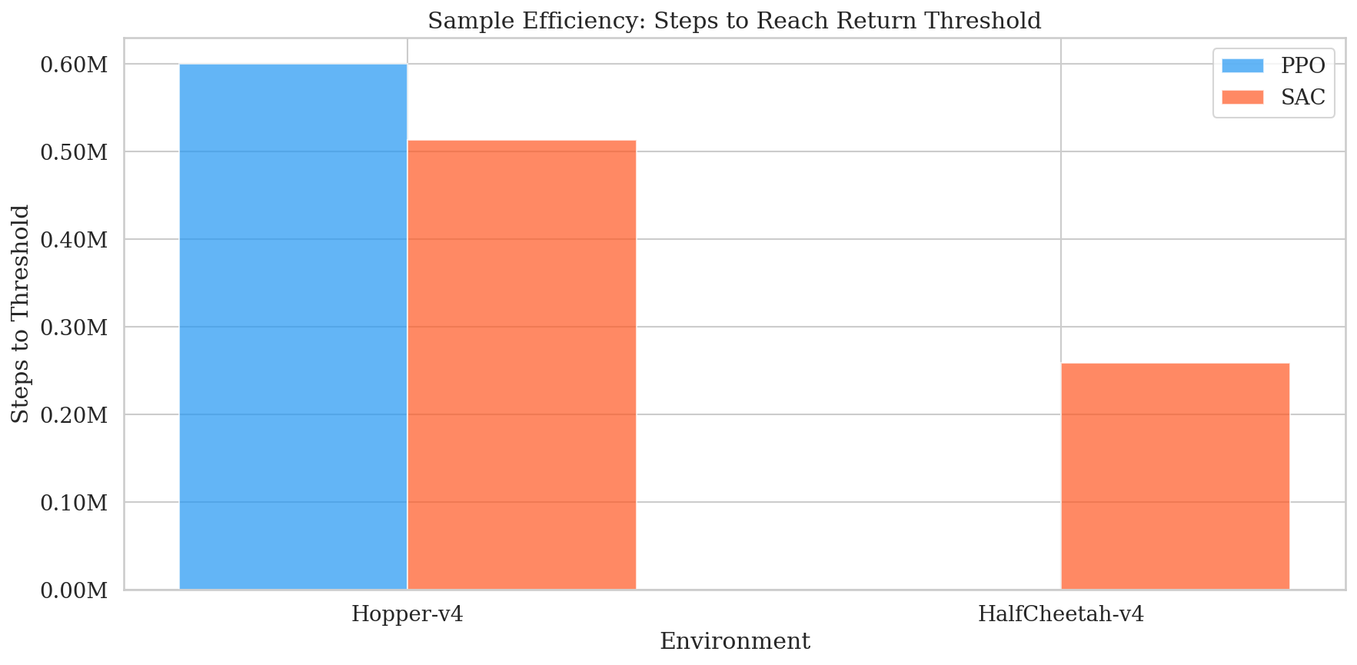
Sample Efficiency
SAC demonstrates superior sample efficiency on HalfCheetah, reaching performance thresholds significantly faster due to its replay buffer enabling data reuse. On Hopper, both algorithms converge at similar rates.

Slide 24
7. Qualitative Video Analysis
Video | Observed Behavior | Metric Correlation
hopper-v4_ppo | Stable, repetitive, cautious hopping rhythm | Smoothness: 0.129 ✓
hopper-v4_sac | Wild, explosive micro-adjustments | Smoothness: 0.397 ✗
cheetah_ppo | Running completely upside down! | Return: 1138 (local opt.)
cheetah_sac | Upright, fast sprinting gait | Return: 6270 (global opt.)
safety_ppo | Clips hazard boundaries frequently | Cost: 54.6 violations
safety_sac | Course-corrects faster near hazards | Cost: 50.3 violations
All videos rendered at 30 fps using headless EGL GPU rendering on RTX 3070.

Slide 25
8. Discussion — Answering the Research Questions
Primary RQ — When is PPO safer?
PPO is safer in physics-based balance tasks (Hopper) where its trust-region clipping produces 3× smoother actions. However, this same conservatism traps PPO in local optima (upside-down HalfCheetah), and in constrained navigation, SAC actually achieves fewer violations.
Secondary RQ — What mechanisms cause the differences?
• PPO's clipped surrogate objective → stable gradients → smooth actions → but risk of local optima entrapment
• SAC's entropy maximization → volatile gradients → jerky actions → but escapes local optima
• SAC's replay buffer → data reuse → faster learning of spatial constraints → fewer safety violations

Slide 26
The Core Insight
There is no universally "safer" algorithm.
PPO excels at deployment safety (smooth, predictable actions)
SAC excels at constraint compliance (fewer boundary violations)
The choice depends on what kind of safety matters most.
Safety Dimension | Winner | Evidence
Action Smoothness (Hopper) | PPO ✓ | 3× smoother (0.129 vs 0.397)
Exploration Robustness | SAC ✓ | Avoids local optima (6270 vs 1138)
Constraint Violations | SAC ✓ | 8% fewer violations (50.3 vs 54.6)
Gradient Stability | PPO ✓ | Flat norms vs SAC's violent spikes
Recovery from Perturbation | Tie | Both > 1.0 across all environments

Slide 27
9. Limitations & Future Work
Limitations
Future Work
• Only one safety environment tested
• Standard SB3 implementations — no constrained RL (CPO, FOCOPS)
• Fixed 1M step budget — longer training may change conclusions
• MLP architecture only — no CNN/attention
• No real-world hardware validation (sim-only)
• Add constrained RL algorithms (CPO, FOCOPS, SafePPO)
• Test more Safety-Gym environments (Car, Doggo)
• Increase budget to 5–10M steps
• Sim-to-real transfer on physical robot
• Lagrangian reward shaping for cost minimization
• Investigate reward hacking mitigation

Slide 28
10. Conclusion
• Performed a rigorous, reproducible safety comparison of PPO vs SAC across 3 environments, 10 seeds each, with 7 custom safety metrics
• PPO produces 3× smoother actions — critical for robotic deployment
• SAC achieves 5.5× higher performance in unconstrained environments
• SAC shows fewer constraint violations in safety-critical environments thanks to its replay buffer
• Discovered a reward hacking phenomenon in PPO (HalfCheetah) — a direct consequence of over-conservative trust-region optimization
• Recommendation: Use PPO when actuator wear matters; use SAC when constraint compliance matters
Code & Data: github.com/patelharsh15/Training-and-Deployment-Safety-in-On-Policy-and-Off-Policy-RL

Slide 29
References
[1] Schulman et al., "Proximal Policy Optimization Algorithms," arXiv:1707.06347, 2017.
[2] Haarnoja et al., "Soft Actor-Critic: Off-Policy Maximum Entropy Deep RL," ICML, 2018.
[3] Henderson et al., "Deep Reinforcement Learning That Matters," AAAI, 2018.
[4] Engstrom et al., "Implementation Matters in Deep RL: A Case Study on PPO and TRPO," ICLR, 2020.
[5] Andrychowicz et al., "What Matters in On-Policy RL? A Large-Scale Empirical Study," ICLR, 2021.
[6] Ray et al., "Benchmarking Safe Exploration in Deep RL," OpenAI Technical Report, 2019.
[7] Ji et al., "Safety-Gymnasium: A Unified Safe RL Benchmark," NeurIPS, 2023.
[8] Achiam et al., "Constrained Policy Optimization," ICML, 2017.

Slide 30
Thank You!
Questions?
Farina Salman • Rachna Sunilkumar Deshpande • Abdulaziz Al-Tayar • Harsh Patel
University of Ottawa — CSI 5180 / CEG 5270
GitHub: github.com/patelharsh15/Training-and-Deployment-Safety-in-On-Policy-and-Off-Policy-RL

