Slide 1
API Test Case Study
Stavan Shah
stavan2003@gmail.com
June 4, 2017

Slide 2
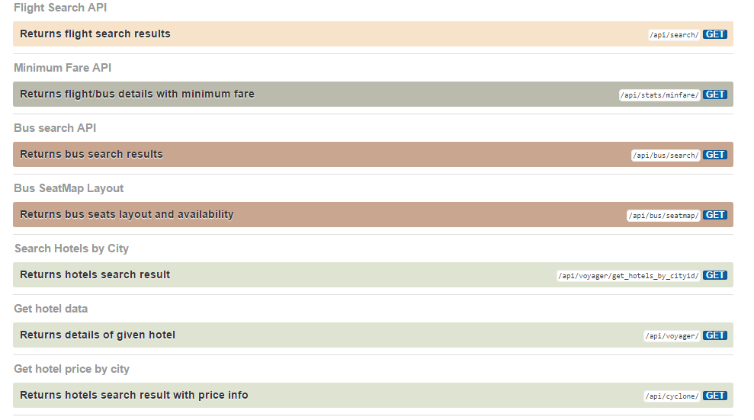
API Summary
https://goibibo.3scale.net/docs

Slide 3
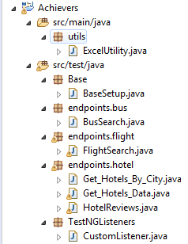
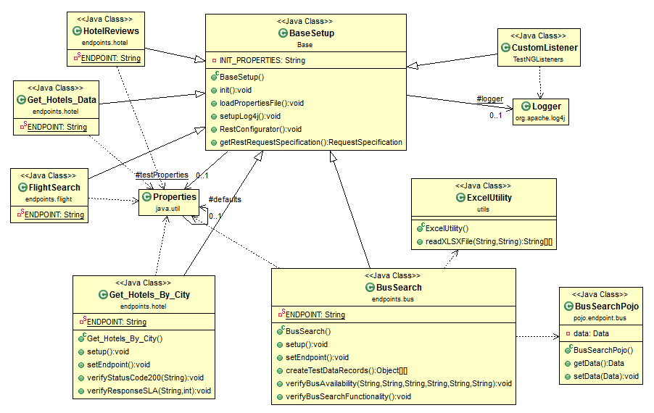
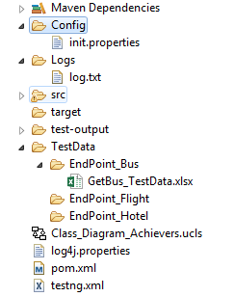
Framework

Slide 4

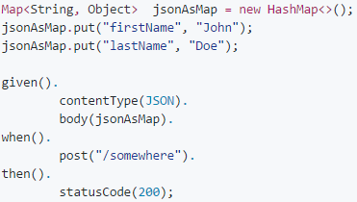
Tools Used
Java packages
Rest-Assured
Gson
Maven,
Log4j
Apache POI

Slide 5
High Level Test Areas
Functional
Validating all HTTP Error Codes e.g. 2xx, 3xx, 4xx, 5xx
Testing HTTP Calls and Their Responses with Valid/Boundary/Invalid Data
Sending Test JSON Data with POST Calls and verifying changes in DB/data structures as a result of the Add/Update/Delete
Validate response with supported authentication methods
Validating different response types - XML ,JSON, etc.
Schema validation - Validating JSON responses according to a schema
Reusing Data from a Previous Call to the Next One
Non Functional
Usability Tests – Well formedness of API
Multiple API requests – with Load
Validating Timeouts for the response
API Documentation accessibility
Security Tests
Integration Testing with other tool (if integrated)

Slide 6
Code Repository | https://github.com/stavan2003/ApiTest
References
Goibibo API/Data | https://goibibo.3scale.net/docs https://goibibo.3scale.net/data
REST Assured | http://rest-assured.io/ https://github.com/rest-assured/rest-assured/wiki/Usage https://semaphoreci.com/community/tutorials/testing-rest-endpoints-using-rest-assured
Gson | https://github.com/google/gson
POJO Converter | http://www.jsonschema2pojo.org/
Class Diagram | http://www.objectaid.com

