Slide 1
Hotel Reservation System 2.0 Upgraded with RESTful API
By SlackerHackers
Cole Siegel, Hemal Patel, Michael Corrales

Slide 2
Overview
A previous project we worked on is a hotel reservation management system
It supports use-cases for guests, users, and administrators
Features include room bookings, CRUD maintenance, and report generation
Various modules combine to form an enterprise level application:
- MySQL database for persistent storage
- EJB module to encapsulate session and entity beans
- Spring based web client for both guests and administrators
- Standalone Swing application for data maintenance

Slide 3
Service-Oriented Architecture
To upgrade our previous project, we wanted to implement a RESTful web service
Previously, we used SOAP-based API communications
RESTful will allow administrators and other systems to easily perform CRUD operations using simple HTTP requests and query strings
Using our RESTful API, users can insert, modify, update or delete key entities including:
- Customers
- Rooms
- Reservations

Slide 4
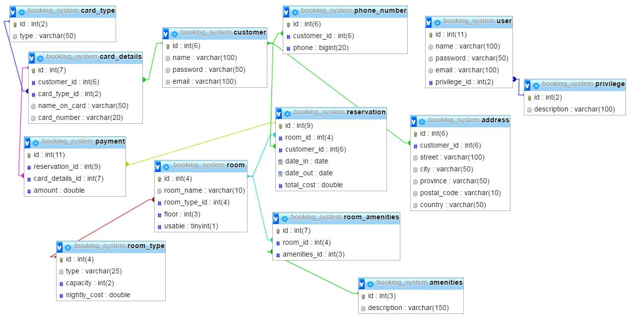
Database ERD

Slide 5
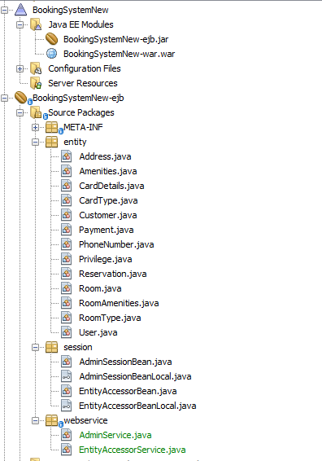
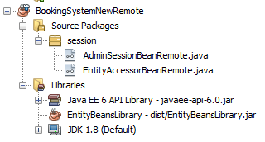
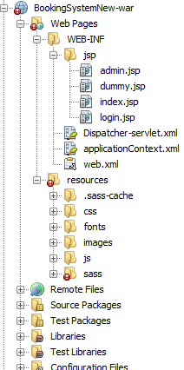
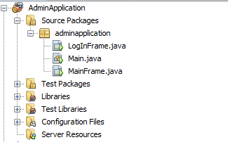
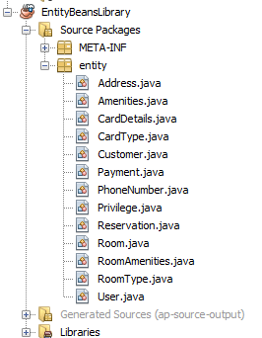
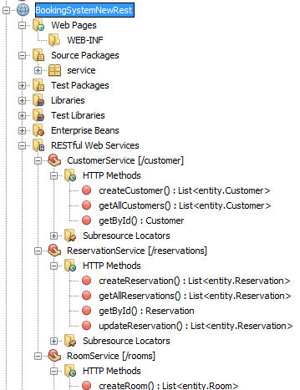


Slide 6
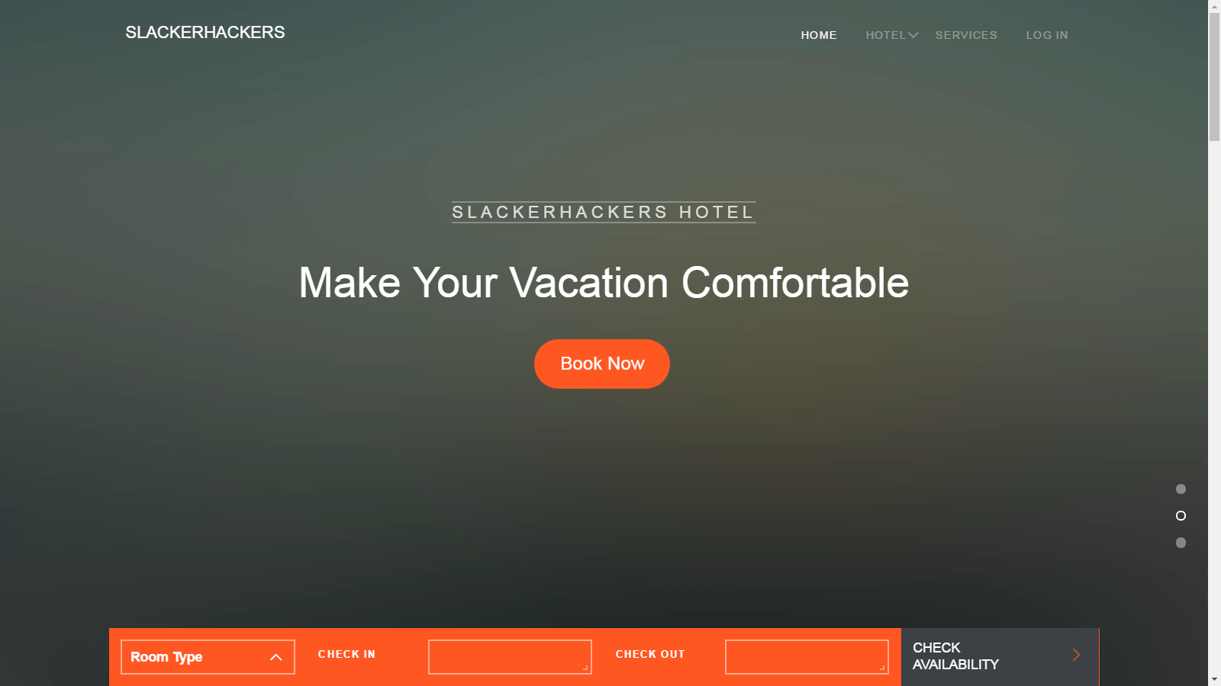
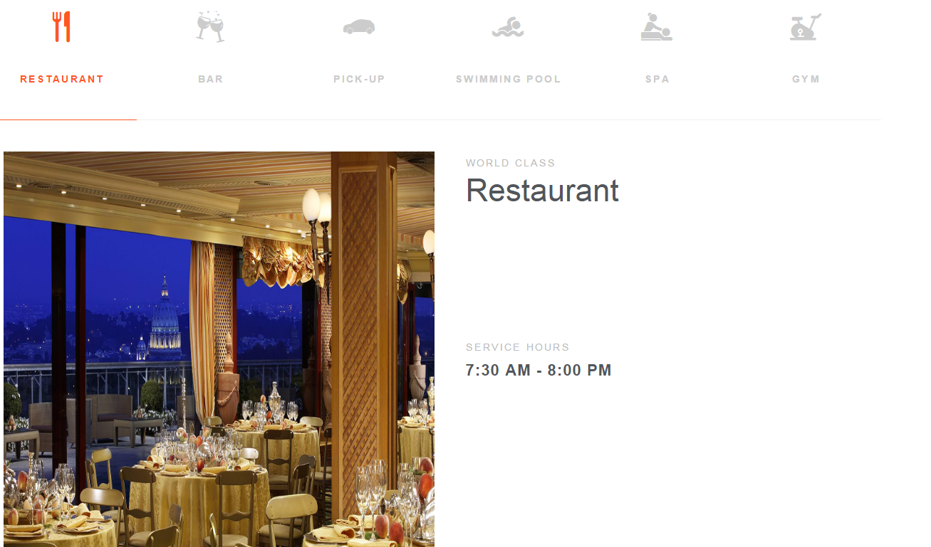
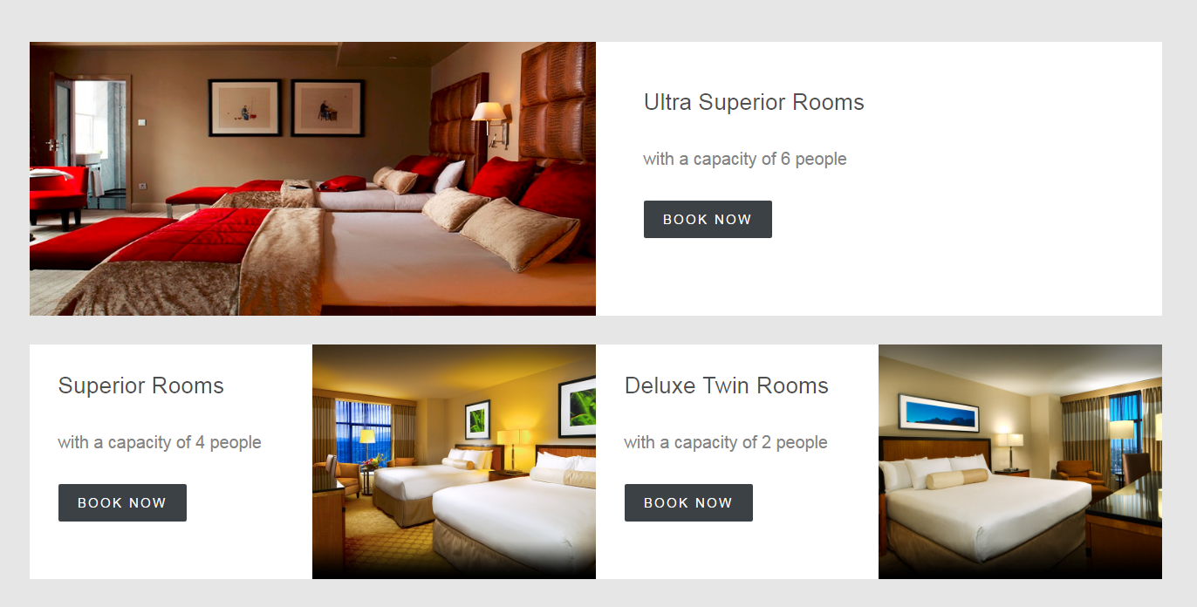

Slide 7
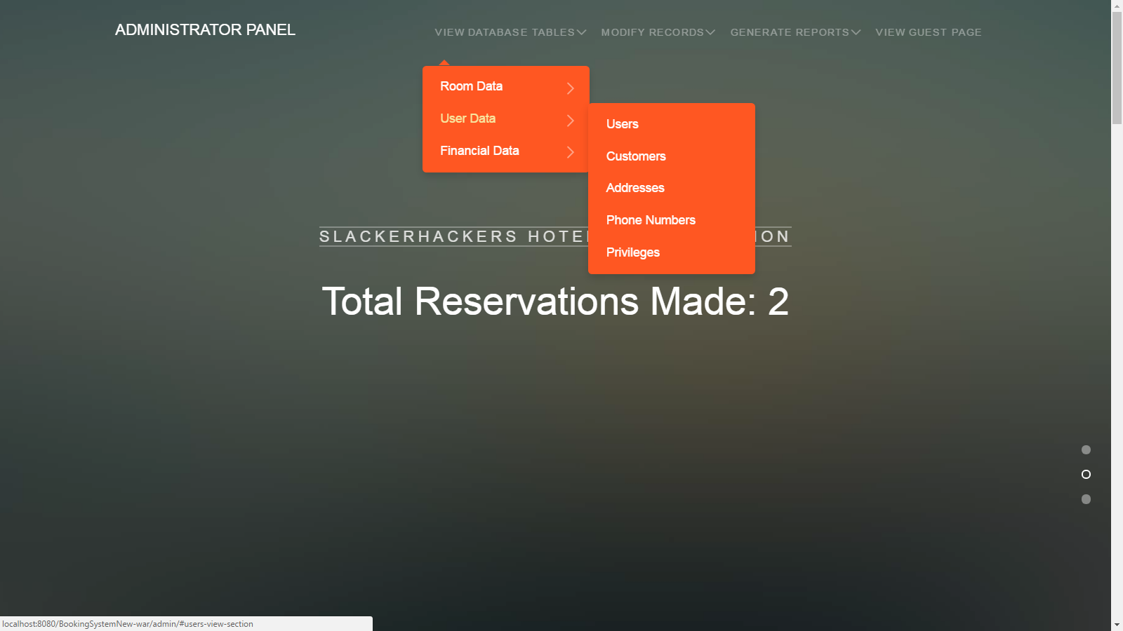
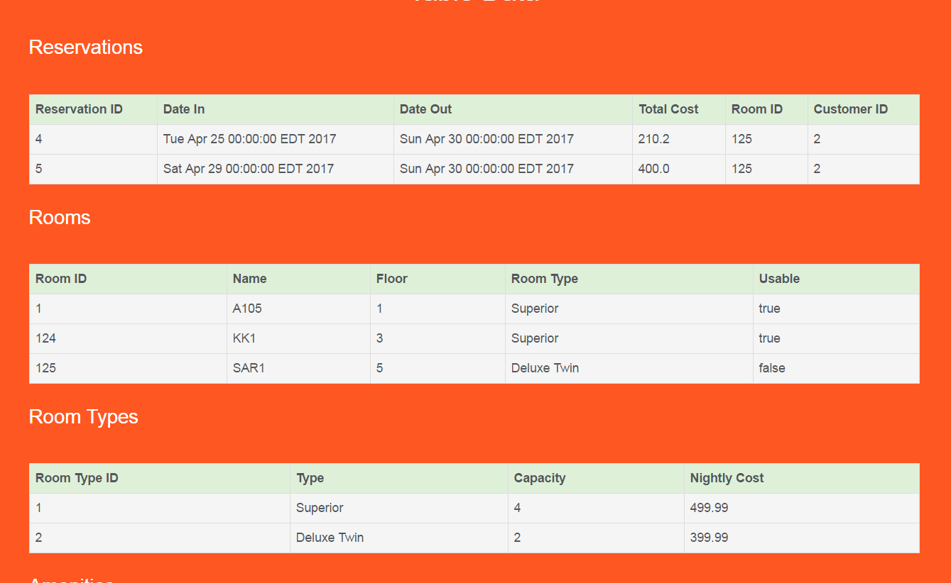
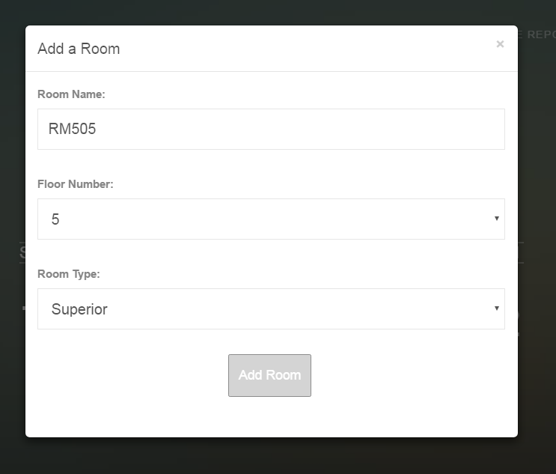
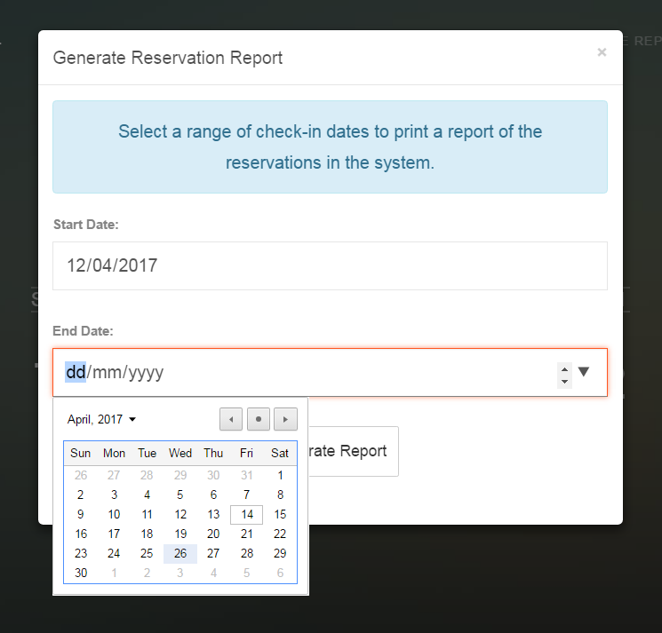

Slide 8
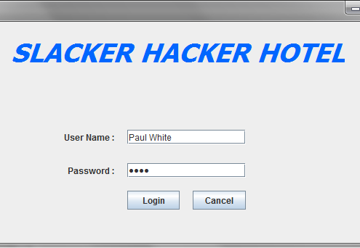
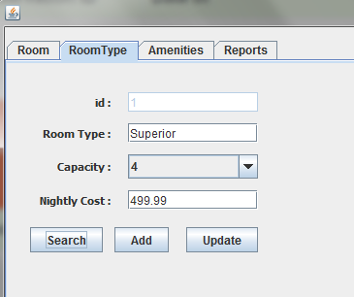
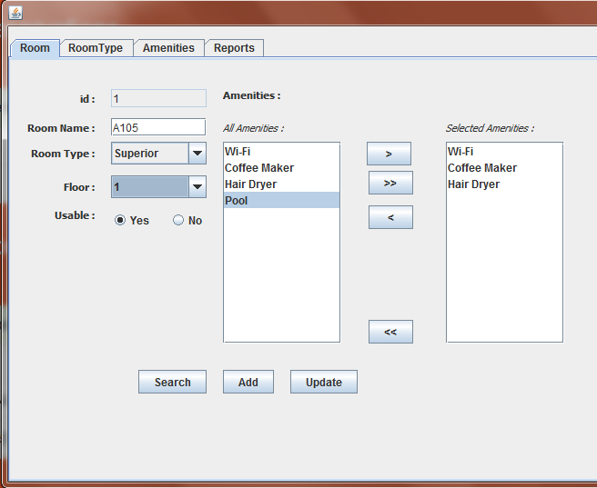
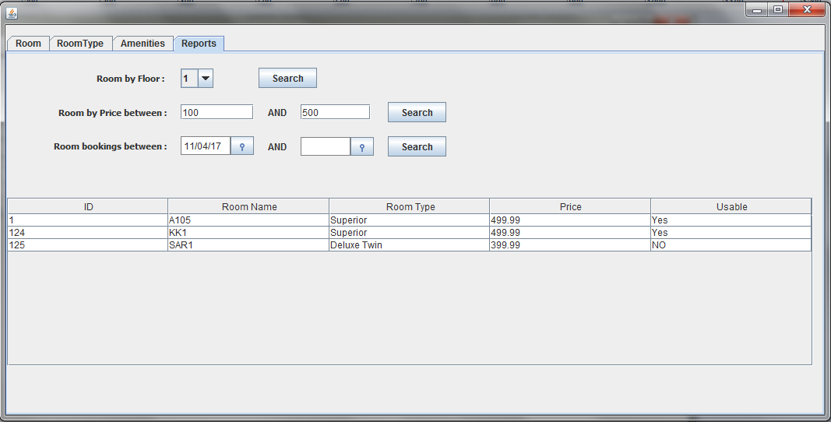

Slide 9
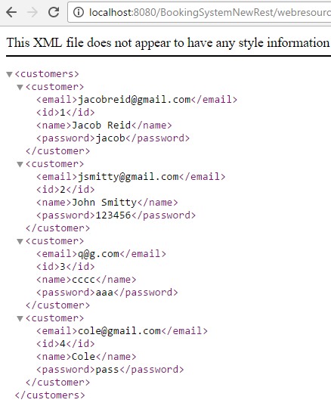
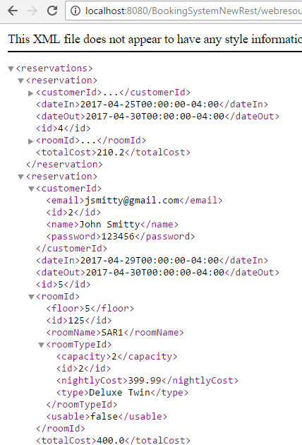
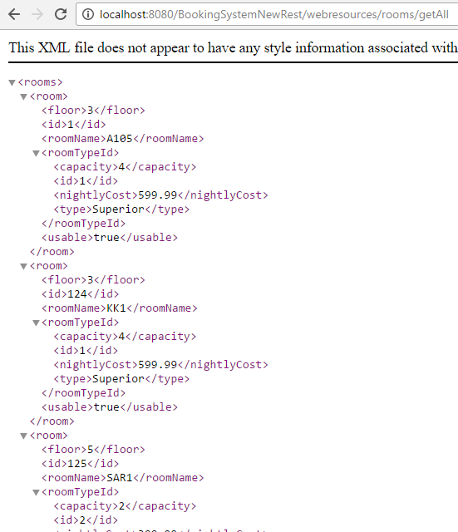

Slide 10
Live Demo

Slide 11
Conclusion
We upgraded a previous project into service-oriented architecture by implementing a RESTful web service
We utilized many technologies including EJB (session/entity beans), Spring, Swing, Restful APIs, MySQL, and more...
The various clients for our project include multiple web interfaces, a standalone admin application, and a RESTful API

Slide 12
Thank You!

