Slide 1
Hotel Reservation System
By SlackerHackers
Cole Siegel, Hemal Patel, Michael Corrales

Slide 2
Overview
Java based enterprise project for hotel reservation bookings
Supports use-cases for guests, users, and administrators
Features include room bookings, CRUD maintenance, and report generation
Various modules combine to form an enterprise level application:
- MySQL database for persistent storage
- EJB module to encapsulate session and entity beans
- Spring based web client for both guests and administrators
- Standalone Swing application for data maintenance
- SOAP based web services provide API access

Slide 3
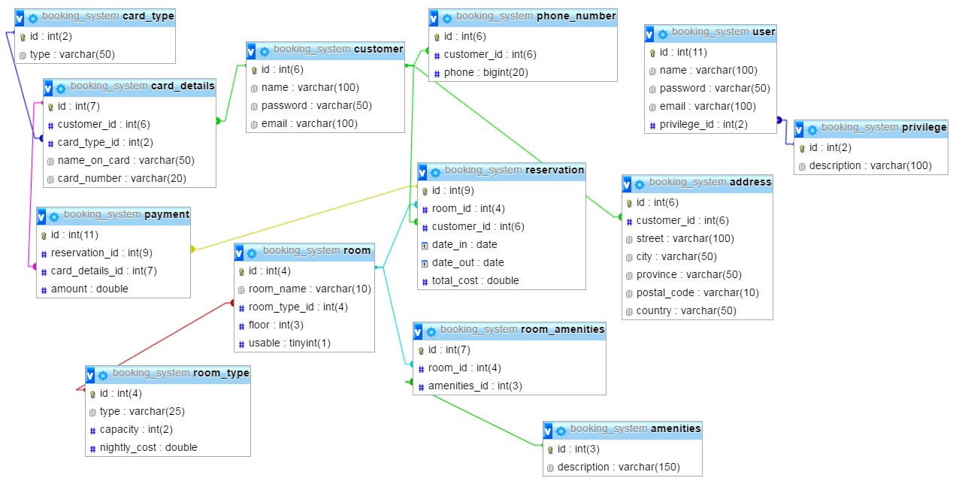
Database ERD

Slide 4
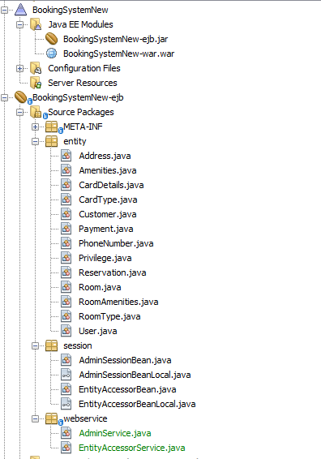
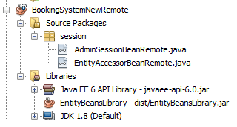
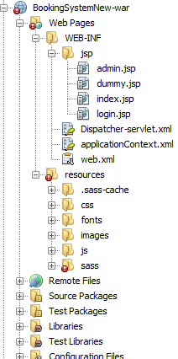
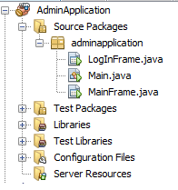
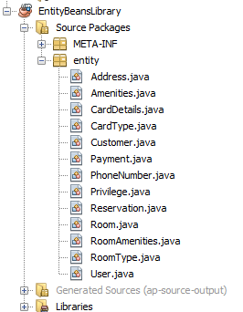
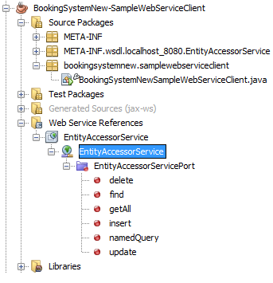

Slide 5
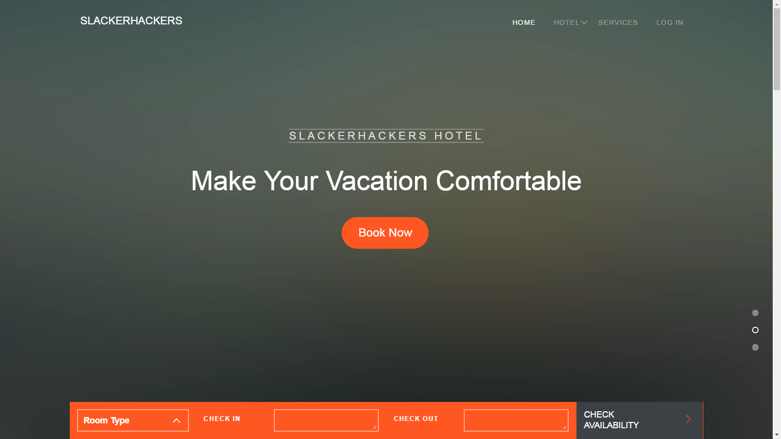
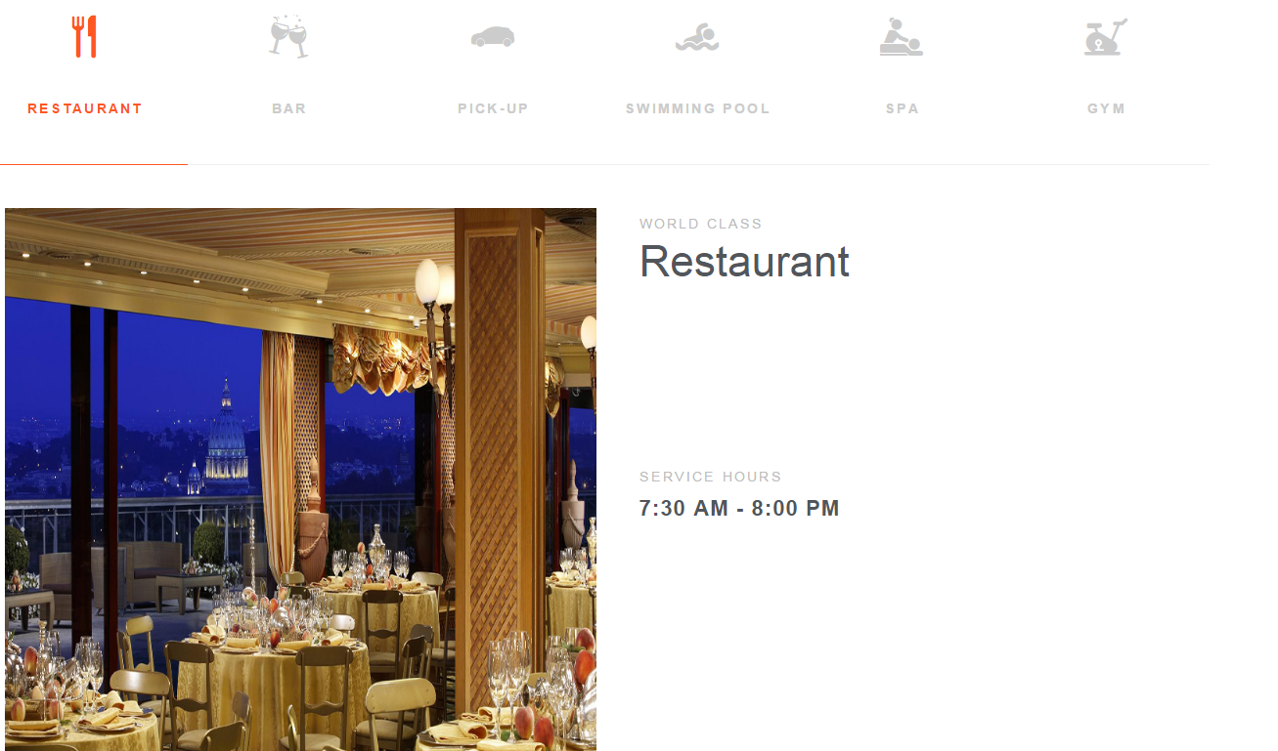
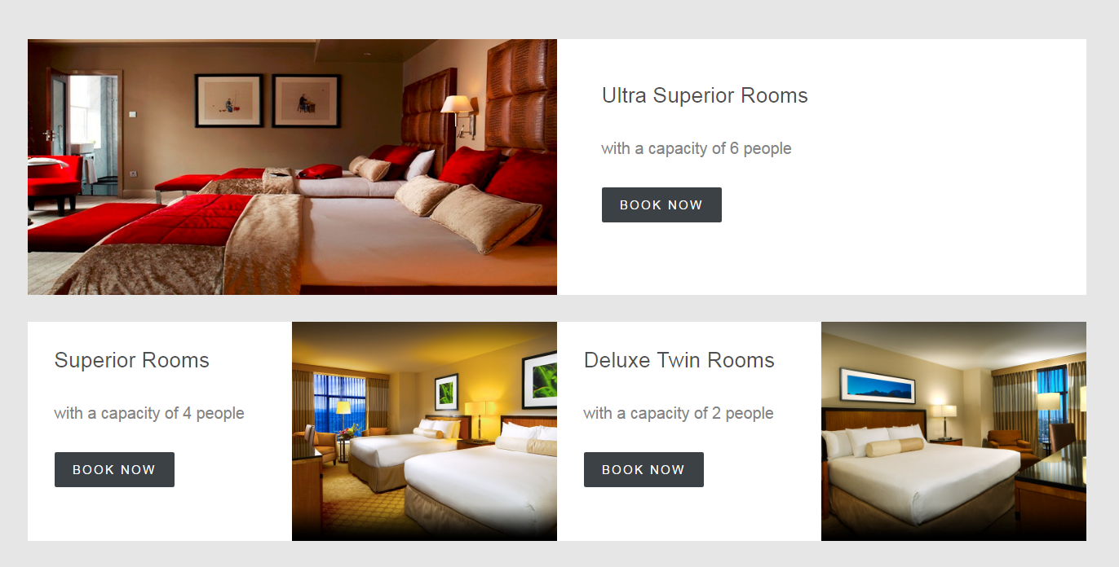

Slide 6
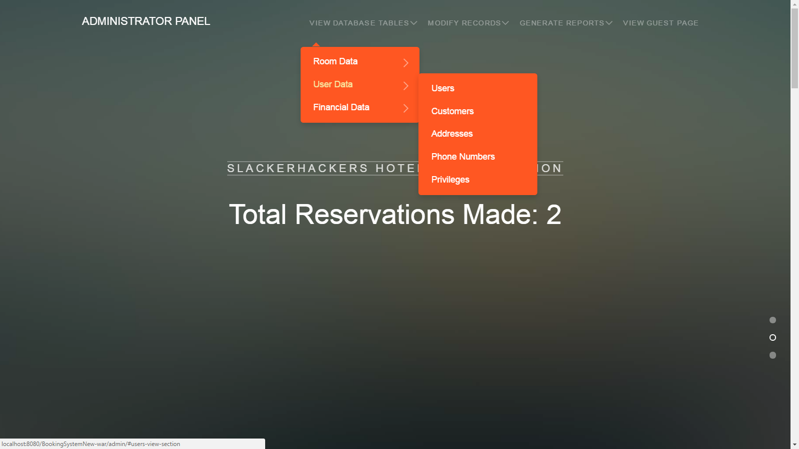
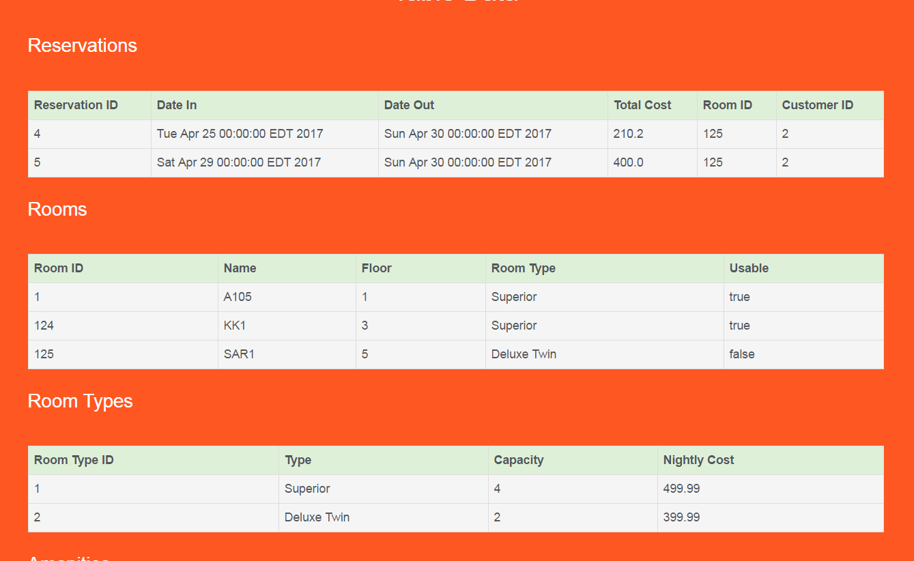
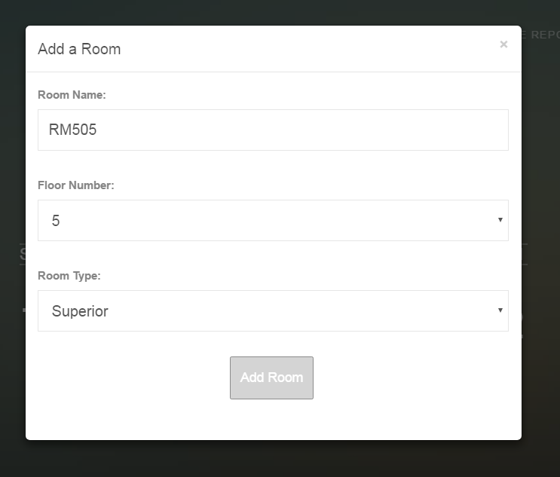
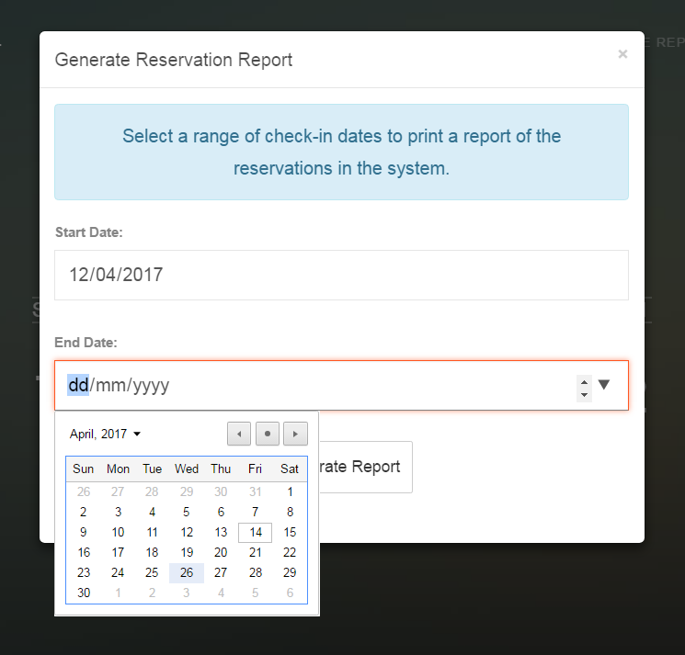

Slide 7
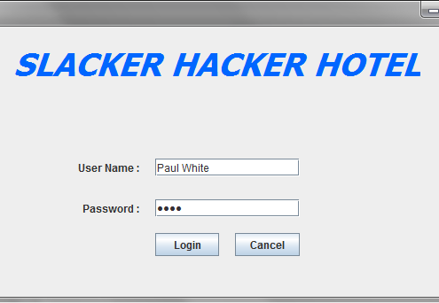
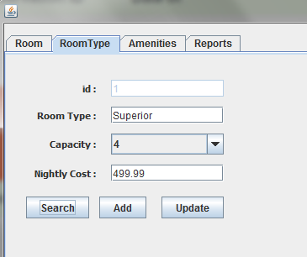
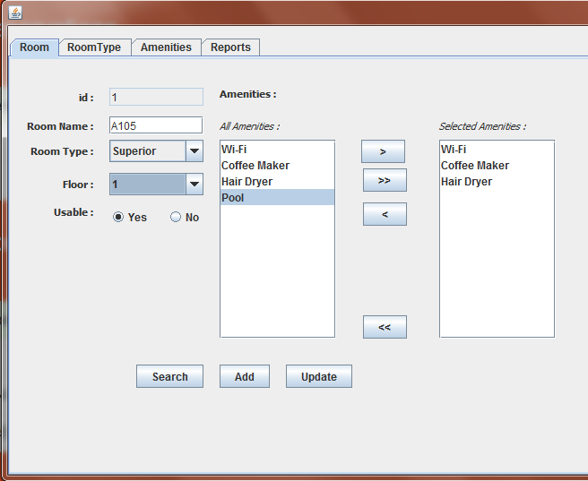
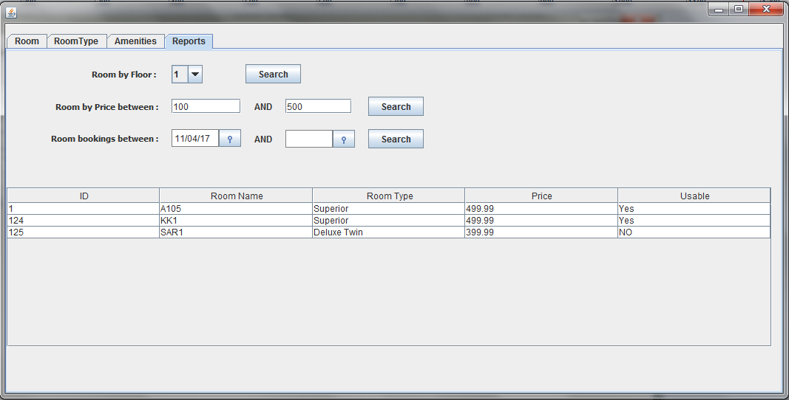

Slide 8
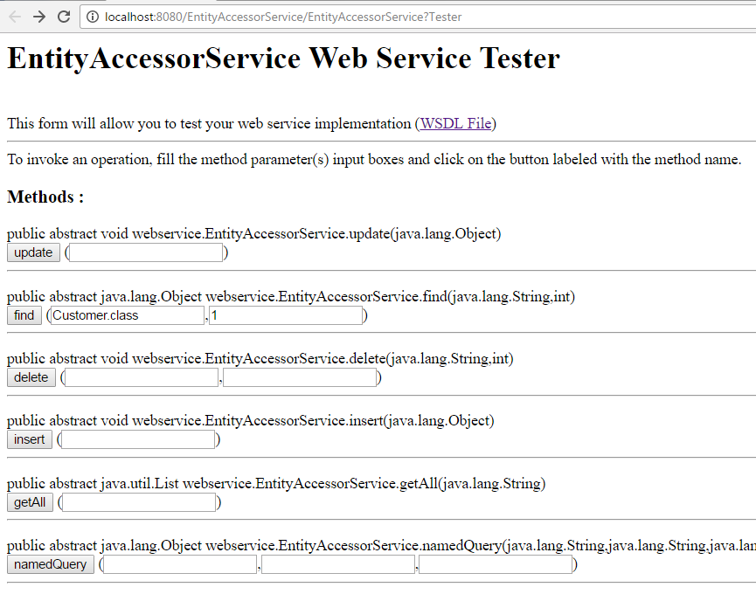
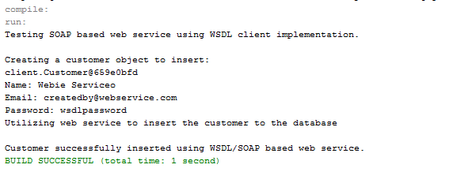
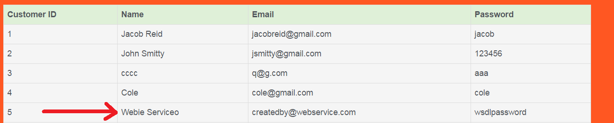

Slide 9
Live Demo

Slide 10
Conclusion
Our project is an enterprise-level Java project for hotel reservations
We utilized many technologies including EJB (session/entity beans), Spring, Swing, SOAP/WSDL, MySQL, and more...
The various clients for our project include multiple web interfaces, a standalone admin application, and a web service/API

Slide 11
Thank You!

