Slide 1
Ketomus: Option Trading Application
Group 5: FinTech Bootcamp Project 1

Slide 2
Project Proposal
Team intro: Ketan, Omar, Mustafa, Kwame
Our project seeks to develop an option trading application that provides pricing and analytics for trading stock options.
Key components include option and stock pricing API data feeds and option analytics based on the Black-Scholes model to evaluate option pricing.

Slide 3
Project Scope
We have selected an initial group of 16 liquid stocks to analyze (see Appendix)
Call and put options for 1 & 2 month term
Data source: IEX Cloud API
After evaluating APIs including Alpaca, Quandl, and Alphavantage we found that IEX offers a one stop solution for relevant market data
Use IEX API requests for stock selection
Retrieve End of Day option prices
Retrieve COB stock quotes
Load 1yr historical stock data to compute historical volatility
Retrieve COB Treasury yield curve
Apply Black-Scholes model to derive option analytics
Calculate the ‘Implied Volatility’ using Newton-Raphson Root solving method
The ‘Greeks’: compute delta & vega
Plot ‘volatility smiles’
Key model assumptions:
Non-dividend paying stocks
B-S model values European-style options vs American-style option pricing in datasets
Display option chain and analytics visualizations in a panel dashboard with user selection of stock and option term by dropdown

Slide 4
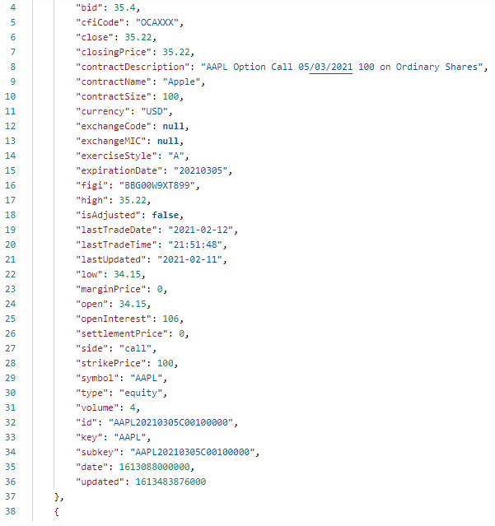
Raw data example:
IEX Option API request
First API call: retrieve available option maturities by ticker
Second API call: for each selected option maturity, import available call and put option pricing by strike price
Create 1 aggregate dataframe across tickers, option types, and maturities
Use csv files for ‘data warehousing’
Create ‘option chain’: use data slicing to select data columns and ‘crop’ option strike price range to ATM +/- 10 for
‘side’, ‘bid’, ‘ask’, ‘strike price’, ‘expiration date’, ‘volume’ and ‘open interest’
Separate presentation by calls / puts
Append option analytics to option chain

Slide 5
Data challenges
Free IEX subscription plan restricts data type and volume available via API, hence the need for a paid subscription
Use csv files for data warehousing and manage API traffic volumes
Inconsistent data availability
Delay in price updates
Need to convert API output data types
Matching of pricing timing across data sets incl. options and stocks

Slide 6
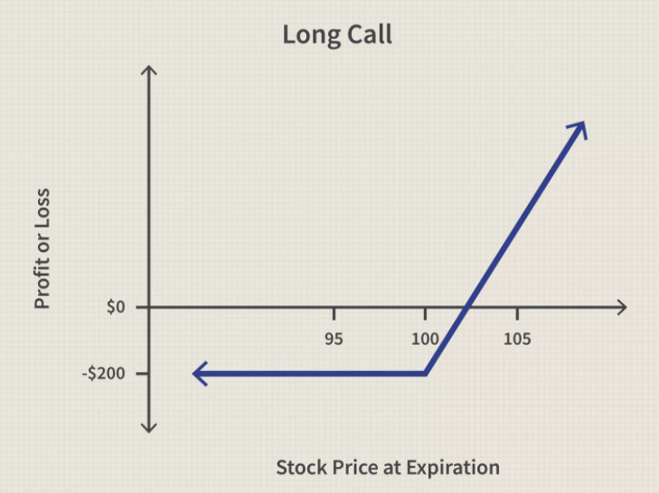
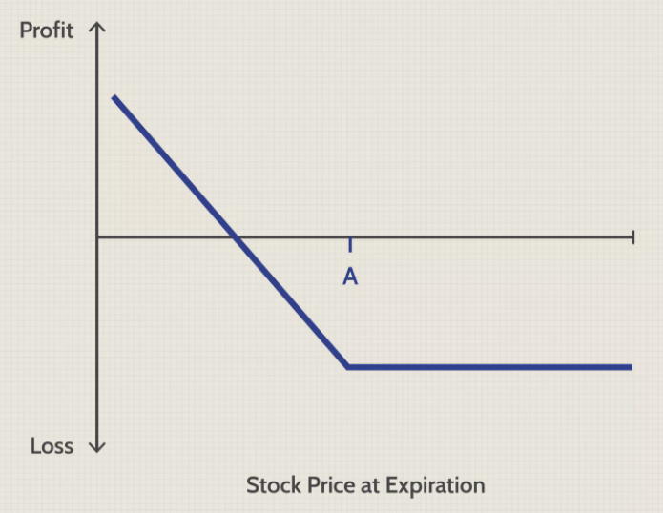
What are Options?
Option is a derivatives instrument on the underlying securities such as stocks, bond.
An option contract offers the buyer the opportunity to buy or sell—depending on the type of contract they hold—the underlying asset.
Call Option - is a right, but not an obligation, to buy an underlying security at a specified price within a specific time period
Put Option - is a right, but not the obligation, to sell an underlying underlying security at a specified price within a specified time frame

Slide 7

Black Scholes model
The Black Scholes model is a mathematical model for the dynamics of a financial market containing derivative investment instruments.
It shows that the option has a unique price given the risk of the security and its expected return.
The key idea behind the model is to hedge the option by buying and selling the underlying asset in just the right way and, as a consequence, to eliminate risk.
It is a partial differential equation, which describes the price of the option over time.

Slide 8
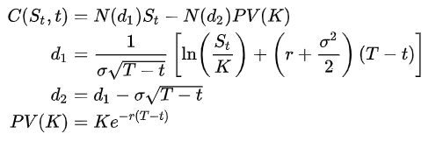
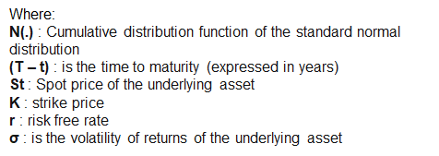

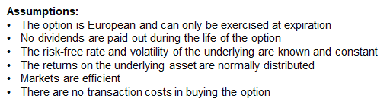
Black Scholes model
Solving the previous equation for the corresponding terminal and boundary conditions, we can obtain the formulas that calculate the price of European call and put options.
For call options:
For put options:

Slide 9
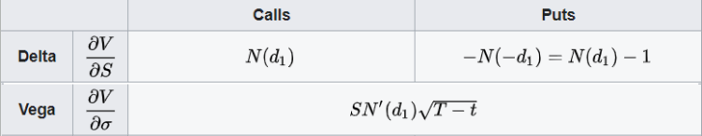
The Greeks
Delta - measures the rate of change of the theoretical option value with respect to changes in the underlying asset's price
Vega - measures sensitivity to volatility. Vega is the derivative of the option value with respect to the volatility of the underlying asset.

Slide 10
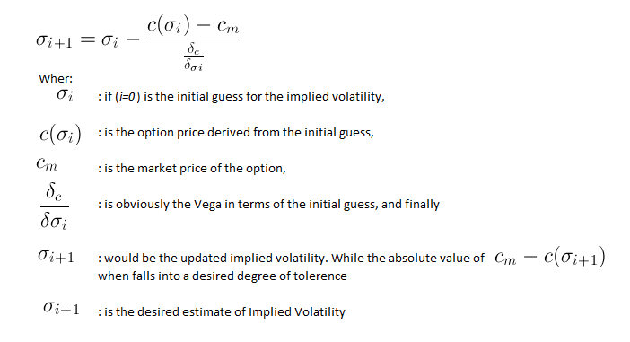
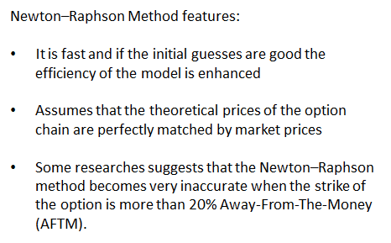
Implied Volatility Calculation
Newton-Raphson Method:
It is used in numerical analysis to find out root of real valued function.
This method can be derived using Taylor’s series

Slide 11
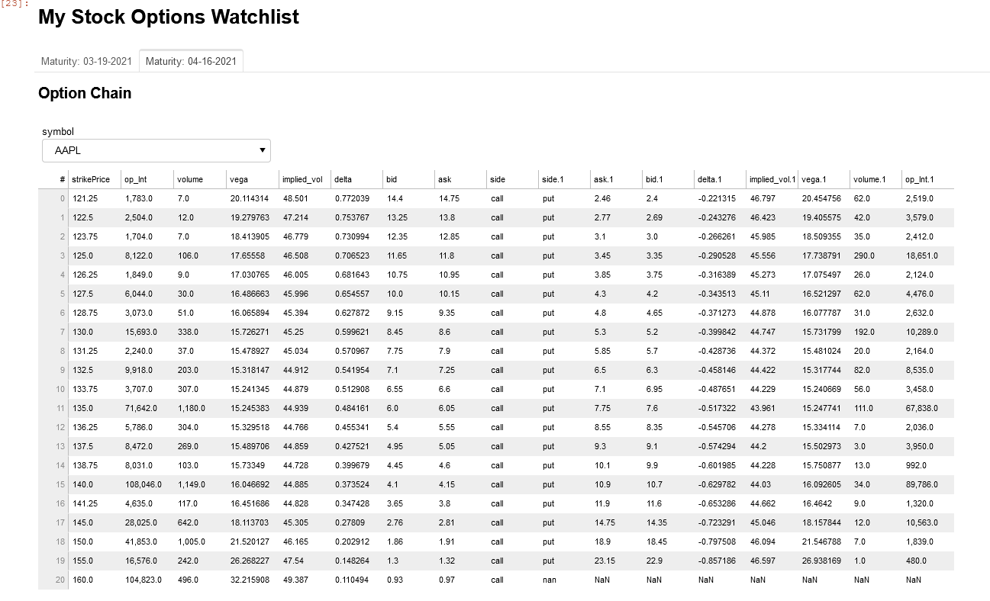
Dashboard demo

Slide 12
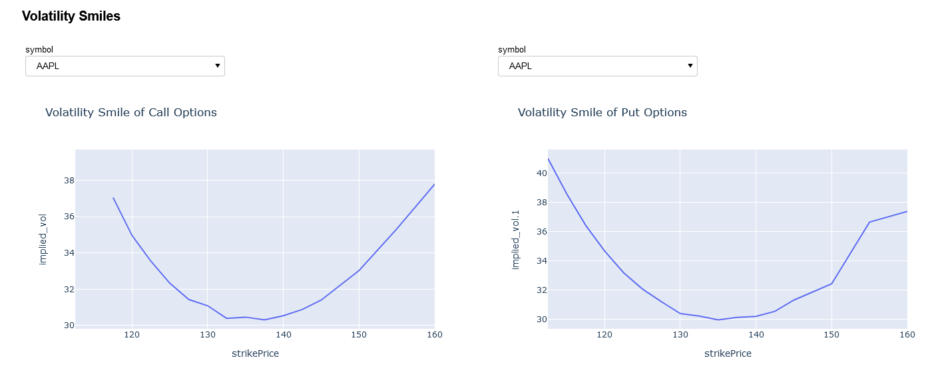
Dashboard Demo

Slide 13
Implications & Future Steps
Broader stock selection for user
More option maturities
Additional option analytics, eg Gamma, Theta & Rho
Monte carlo simulations for Option volatility and stock prices
More analytics visualizations
Enhance dashboard, eg full stock quotes
Other asset classes, eg cryptocurrencies, FX
NR - Method does not converge for all the data points in Option Chain (implement robust numerical method for American Option)
Create a website to host the dashboard

Slide 14
Appendix
Stock selection: 'AAPL', 'MSFT', 'GOOG', 'TSLA', 'TWTR', 'JPM', 'DAL', 'PFE', 'MRNA', 'XOM', 'CVX', 'AMZN', 'ZM', 'FB', 'GILD', 'SPY'

