Slide 1

AI Cybersecurity & Budget Tools
AI Cybersecurity &
Budget Tools:
Technical Deep Dive
Modular Design, Streaming AI, and Local-First Principles

Slide 2
High-Level Architecture Overview
Presentation Layer
Streamlit UI
(streamlit_app.py) for user
interaction and rendering.
Application Layer
Page controllers
(pages/*.py) managing
session state and routing.
Domain Layer
Core logic (budget_planner,
cyberguard, cybersec) with
zero framework imports for
100% testability.
Infrastructure
Layer
CSV storage
(data/expenses.csv), session
state hydration, and
environment config.

Slide 3
Budget Planner Domain Layer
Architecture
Models
Validators
Storage
Calculations
Dataclass-based
Fail-fast validation
Atomic write
Pure functions
Expense and
using pure functions
patterns using
operating on
BudgetPlan with
and frozenset for
pathlib to prevent
List[Expense] with
__post_init__
categories.
data corruption
proper decimal
validation.
during saves.
handling.

Slide 4
Streaming AI Implementation
1
2
Streamlit
3
Automatic fallback to synchronous chat if the
LLM Client
Integration
Real-time
streaming endpoint is unavailable.
Abstraction
Cursor
Create UI slot for
Wrap NIM
updates
Provide immediate
endpoints, yield
visual feedback
tokens

Slide 5
Cybersec Package Shared Security
Utilities
Rule-based phishing detection
Password
100% local entropy calculation
Heuristics
returning structured
Engine
inspired by zxcvbn
AnalysisResult dataclasses.
(dictionary/pattern attacks).
Unicode normalization and null-
Knowledge
Structured security facts used for
Sanitizer
byte stripping to prevent injection
Base
few-shot prompting in CyberGuard.
in heuristic rules.

Slide 6
Session State & Data Flow Patterns
State
Persistence
Management
Strategy
Pattern
Hydration from CSV
into st.ses-
Budget State
sion_state.plan;
Permanent (CSV)
mutation via domain
methods
Separated concerns
CyberGuard State
for client singletons,
Session-scoped and
chat history, and
ephemeral
user feedback

Slide 7
Testing Strategy: Isolating the
Domain
Running 160+ tests in ~2 seconds
by mocking external systems and
avoiding UI dependencies
Boundary Testing: Verifying
UI
Filesystem/Net-
business logic with zero Streamlit
Dependencies
work Calls
imports to enable TDD.
Hinders Test-Driven
External
Requires careful
Development
Systems
isolation
Mocking: Using pytest fixtures (like
Introduces
tmpdir) to isolate filesystem and
complexity and
network calls.
flakiness
Coverage: Comprehensive tests for
models, validators, heuristics, and
sanitization logic.

Slide 8
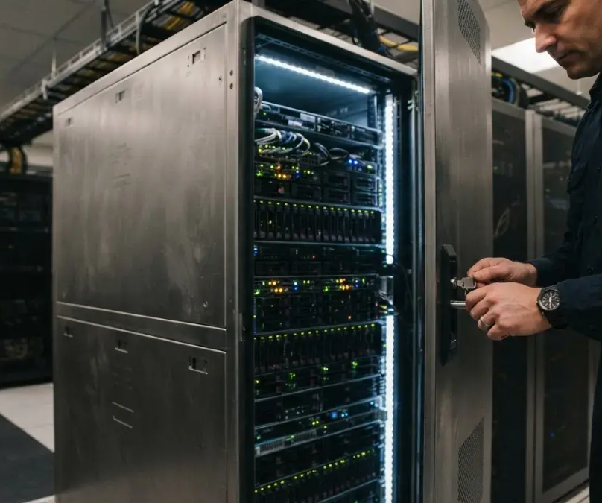
Security & Privacy
Architecture
Local-first design
The architecture ensures that sensitive data never
leaves the local environment.
API key management
API keys are managed via environment variables
and never logged.
Data sanitization
All user input passes through a multi-stage
sanitization pipeline before processing.
Local-first design and data minimization to ensure user
privacy and GDPR alignment

Slide 9
Performance & Scalability
Considerations
Simplicity
CSV offers ease of use but
has race conditions.
Scalability
SQLite provides better
Latency: Persistent HTTP connections target
data management for
<500ms for the first AI token.
future growth.
Memory Usage
Loading all expenses into
memory is suitable for
personal scale but not
large datasets.

Slide 10
Roadmap for Extensibility and
Future Enhancements
Near Term
Mid Term
Long Term
Enhancements
Enhancements
Enhancements
SQLite migration,
End-to-end
WebAssembly port
CSV import/export,
encryption with
for offline-first
and local expense
passphrase keys and
browser execution
categorization
PDF report
and plugin
models.
generation.
architecture.

Slide 11

Lessons Learned
& Reflections
The most valuable decision was recognizing that
personal finance and security are private activities.
01
02
Privacy-First Design
Architecture Strategy
By resisting the urge to add cloud sync or accounts, we created a tool that users
Strict separation of UI from logic was the key to maintaining velocity and quality.
truly own and control.

Slide 12

Conclusion
Thank You
&
Technical
Q&A
Explore the code: budget_planner/, cybersec/, and
tests/

