Slide 1

Forecasting Sales Prediction and Fraud Detection Using Machine Learning
GROUP 31 :
Rakesh Lokam
Mrunal Bhosale
Uday Kumar Reddy Somireddy
Krupali Patel

Slide 2

Problem Statement The main aim of this project is to predict the sales and fraud detection from the supply chain dataset. These prediction mitigate fraudulent transactionate delivery of orders, improve sales revenue and quantity of products Without these estimates, firms risk wasting money by overstocking a store or, even worse, losing income because a store lacks sufficient supplies to accommodate expected revenue

Slide 3
Dataset Under Consideration
A Dataset of Supply Chain used by the company DataCo Global is used for analysis. Dataset of Supply Chain , which allows the use of Machine Learning Algorithms
Types of Products : Clothing , Sports , and Electronic Supplies

Slide 4
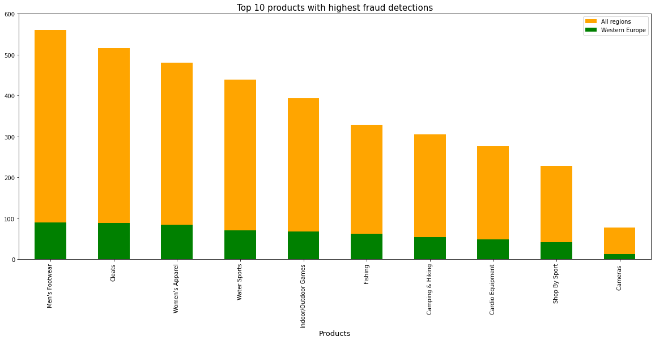
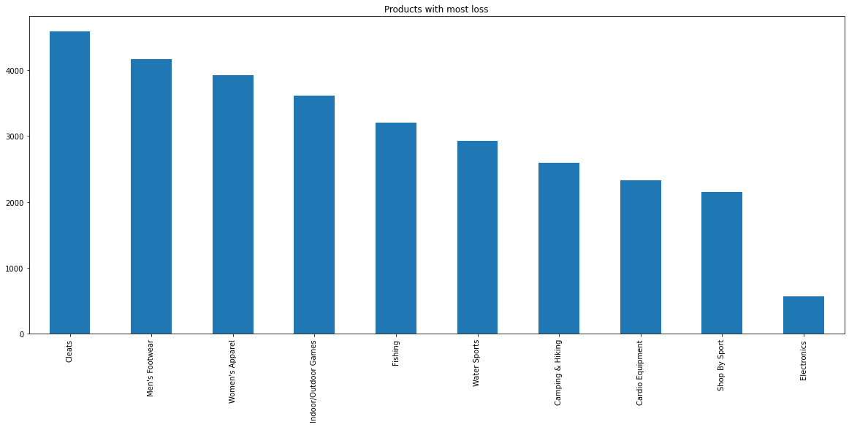
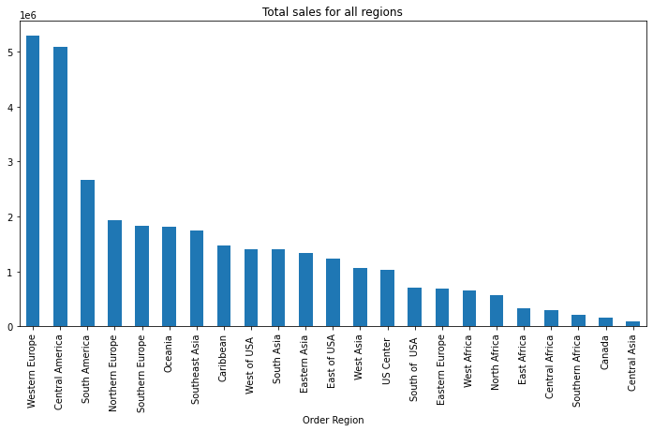
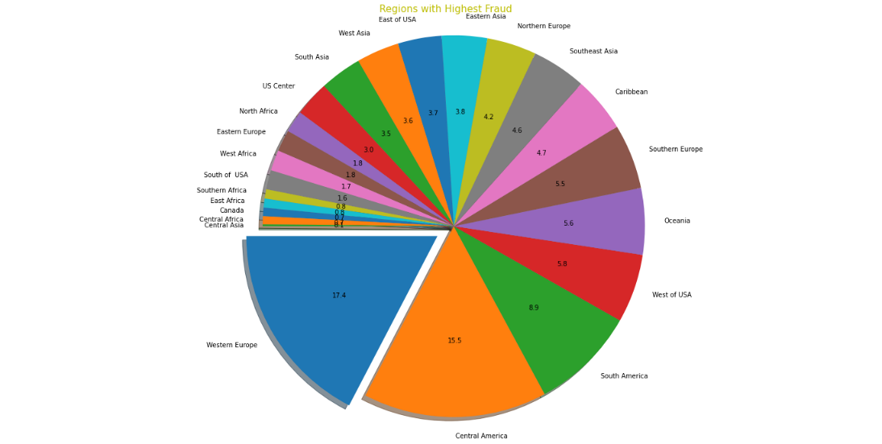
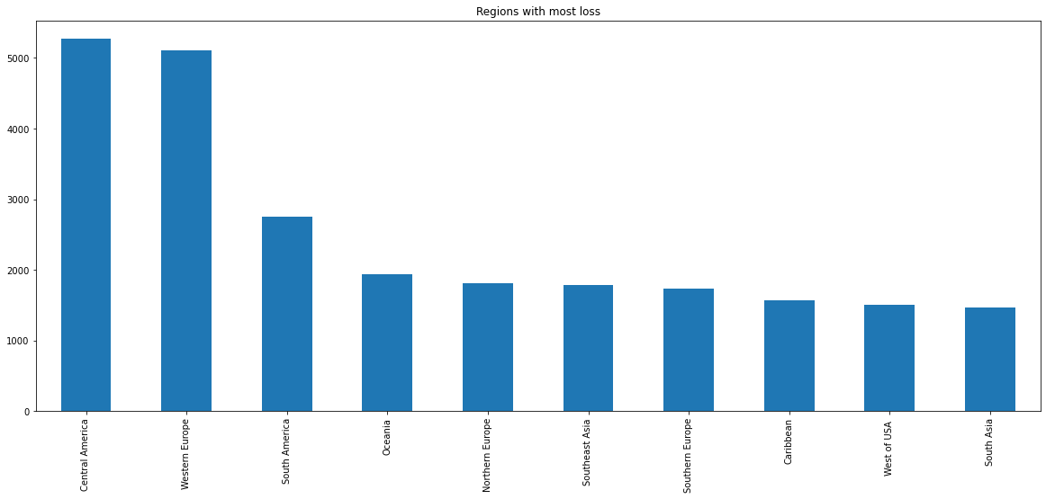
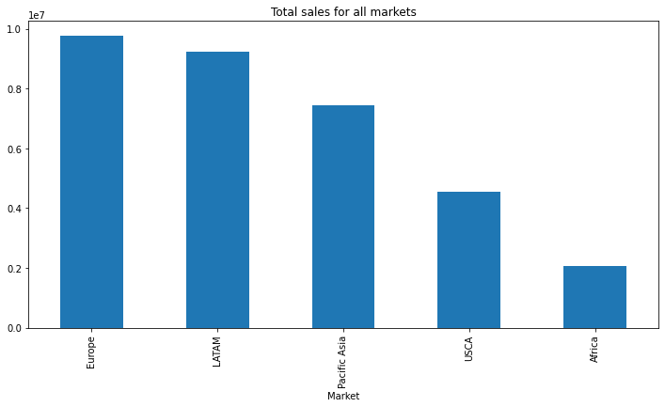
Data Analysis

Slide 5
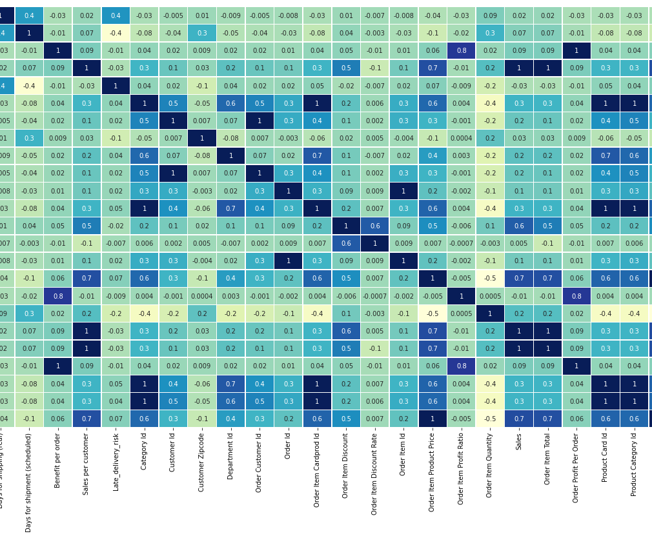
Normalizing the labels to encode non numerical values. Application of label encoder for NaN values. Deleting features which are highly correlated with other features to avoid multicollinarity.

Slide 6
Algorithms Implemented
Logistic Regression
Gaussian naive bayes model
Support vector machines
RandomForest Classifier
KNeighbors Classifier
XG Boost Classifier
Decision tree classifier
Neural Network Model for Classification

Slide 7
Classification Scores Comparison
Classification Model | Accuracy Score for Fraud Detection | Recall Score for Fraud Detection | F1 Score for Fraud Detection | Accuracy Score for Late Delivery | Recall Score for Late Delivery | F1 Score for Late Delivery
Logistic | 97.80 | 59.40 | 31.22 | 98.84 | 97.94 | 98.96
Gausian Naive bayes | 87.84 | 16.23 | 27.92 | 57.27 | 56.20 | 71.95
Support Vector Machines | 97.75 | 56.89 | 28.42 | 98.84 | 97.94 | 98.96
K nearest Neighbour | 97.36 | 41.90 | 35.67 | 80.82 | 83.45 | 82.26
Linear Discriminant Analysis | 97.88 | 56.57 | 49.20 | 98.37 | 97.68 | 98.52
Random Forest | 98.48 | 93.18 | 54.57 | 98.60 | 97.52 | 98.74
Extreme gradient boosting | 98.93 | 89.89 | 73.22 | 99.24 | 98.65 | 99.31
Decision tree | 99.12 | 82.53 | 81.00 | 99.37 | 99.44 | 99.42

Slide 8
Comparison for Regression Model Scores
Regression Model | MAE Value for Sales | RMSE Value for Sales | MAE Value for Quantity | RMSE Value for Quantity
Lasso | 1.5500 | 2.3300 | 0.9000 | 1.030
Ridge | 0.7500 | 0.9700 | 0.3400 | 0.520
Light Gradient Boosting | 0.4600 | 1.6600 | 0.0010 | 0.011
Random Forest | 0.1900 | 1.7900 | 0.0001 | 0.006
eXtreme gradient boosting | 0.1540 | 3.1300 | 0.0005 | 0.004
Decision tree | 0.0130 | 0.9180 | 3.6900 | 0.006
Linear Regression | 0.0005 | 0.0014 | 0.3400 | 0.520

Slide 9
Conclusion
Both Western Europe and Central America are the regions with the highest number of sales but also the company lost most revenue from these regions suspecting to the highest number of fraudulent transactions from wire transfer and orders with more late deliveries
The Neural Network classifier model trained for fraud detection outperformed all machine learning classifier models with an f1 score of 0.96.
Compared with other classification machine learning models Decision Tree model did a good job of identifying orders with later delivery and detecting fraudulent transactions with an f1 score of 0.80.
The Linear Regression model did better for predicting sales revenue, both Random forest and eXtreme Gradient Boosting Regression outperformed and predicted the demand more accurately with MAE and RMSE scores lower than the Neural Network model.

