Slide 1

COVID VACCINE MANAGEMENT
TEAM MEMBERS:
Krupali Bipin Patel 001096158
Geethashree Jagadishwara Raju 002198567
Nikhil Ailur Giri 002199760
Shayesta Parveen Reehan 001401028

Slide 2
The main objective of our project is to provide efficient covid vaccine management system.
OBJECTIVE

Slide 3
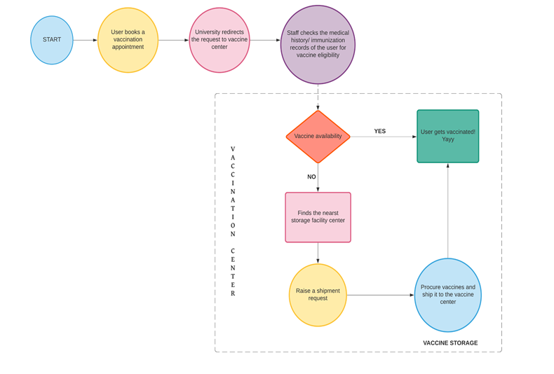
WORKFLOW

Slide 4
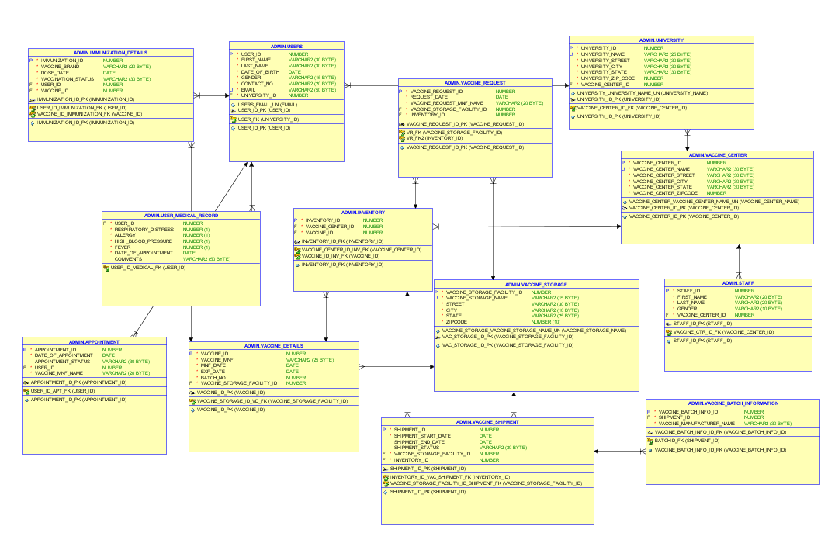
ER DIAGRAM

Slide 5
Users
User Medical Record
University
Vaccine Centre
Appointment
Immunization Details
Vaccine Details
Inventory
Vaccine Request
Vaccine Storage
Vaccine Shipment
Vaccine Batch Information
Staff
List of entities:

Slide 6
Book Appointment
Cancel Appointment
Check User Medical Record
Create Vaccine Storage
Update Table
Update University Table
Update User Table
Update Vaccine Center Table
Update Vaccine Storage Table
Procedures

Slide 7
Trigger for insert to Immunization table
Views for vaccine_manufacturer_shot_count, user_vaccination_status, vaccination_status_count, user_expanded_medical_record_view
Triggers and Views

Slide 8
- User Name Index on Users Table - Vaccination Status Index on Immunization Table - Vaccine Brand Index on Immunization Table
Indexes

Slide 9
THANK YOU

