Slide 1
AI in Marketing and Customer Experience
A practical AI solution for a consumer goods company
GROUP 05 | PROBLEM STATEMENT
A consumer goods company is finding it difficult to understand customer preferences and create effective marketing campaigns. Propose an AI solution for hyper-personalised marketing, sentiment analysis from customer feedback, and improved customer service.
Team:
Mahi Patel
Mahi Modi
Rahul Koshti
Mudit Parakh
Mukta Khedkar

Slide 2
Problem and proposed solution
What is going wrong, and how one AI platform fixes it
Concerns
Proposed AI solution
Scattered data
1 Hyper-personalised marketing
Sales, reviews and social data sit in separate systems.
2 Sentiment analysis of feedback
One message for all
3 Improved customer service
The same advert goes to everyone, so spend is wasted.
4 Data-driven decision making
Slow feedback
Complaints and product issues are noticed weeks later.
5 Continuous improvement
AI in Marketing and Customer Experience | 1

Slide 3
Hyper-personalised marketing
From one message for everyone to one message per person
AI solution
GOAL
Right product, to the right customer, at the right time
• Use K-Means clustering and RFM segmentation to group customers by buying behaviour and value.
• Build knowledge-graph relationships and use market-basket analysis to identify relevant products.
• Use generative AI to tailor emails, adverts, notifications and promotions to each customer.
• Apply reinforcement learning and multi-armed bandits to test campaigns and shift spend to better performers.
Targets after 18 months (assumed)
Measure | Today | Target
Conversion rate | 1.5% | 3.0%
Repeat purchases | 28% | 38%
Return on ad spend | 2.5x | 4.0x
AI in Marketing and Customer Experience | 2

Slide 4
Sentiment analysis from customer feedback
Turning opinions into clear insight
AI solution
GOAL
Know what customers like, dislike and expect
• Apply NLP with supervised classifiers to label feedback as positive, negative or neutral.
• Use topic modelling to uncover recurring themes, product issues and customer expectations.
• Use fuzzy logic to capture degrees of satisfaction rather than forcing every comment into a strict category.
• Present topic-level sentiment and emerging issues in dashboards for marketing and management teams.
Sample sentiment by topic (illustrative)
AI in Marketing and Customer Experience | 3

Slide 5
Improved customer service
AI handles the routine so people can handle the important
AI solution
GOAL
Faster replies, personal support and happier customers
• Deploy rule-based, intent-detection chatbots for FAQs and routine order-status queries, 24/7.
• Use fine-tuned large language models (LLMs) with session context to provide relevant, personalised replies.
• Connect agentic AI to approved tools/APIs to check deliveries and handle eligible service tasks.
• Use sentiment detection to flag frustration; route complex or sensitive cases to human staff through an escalation path.
Expected improvement (assumed)
Measure | Today | Target
First response | 12 hours | 2 min
Satisfaction (CSAT) | 68% | 82%
Cost per query | Rs 120 | Rs 70
AI in Marketing and Customer Experience | 4

Slide 6
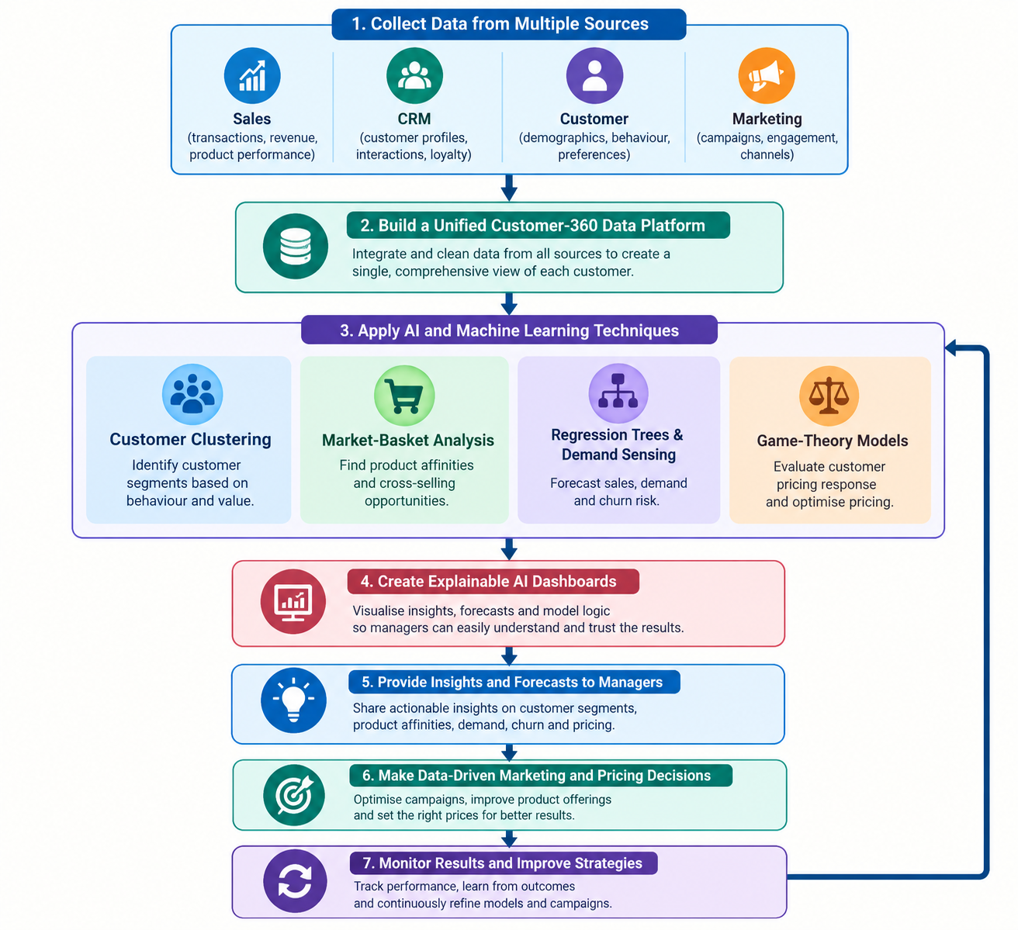
Data-driven decision making
Live numbers in place of guesswork
AI solution
GOAL
Faster, more accurate decisions backed by customer data
• Combine sales, CRM, customer and marketing sources into a unified customer-360 data platform.
• Use clustering and market-basket analysis to uncover customer segments, behaviour patterns and product affinities.
• Apply regression trees and demand-sensing models to forecast sales, demand and churn risk.
• Create explainable AI dashboards so managers can understand forecasts; use game-theory models to assess pricing responses.
AI in Marketing and Customer Experience | 5

Slide 7
Continuous improvement
The system keeps learning, so results keep getting better
AI solution
GOAL
Keep improving marketing results and customer satisfaction
• Create a closed-loop AI process: monitor campaign activity, evaluate results, adjust actions and measure outcomes.
• Use Bayesian updating to refresh estimates of campaign success as new feedback arrives.
• Track engagement, conversion and customer satisfaction; use fuzzy logic for less clear measures such as satisfaction.
• Run automated A/B tests and multi-armed-bandit experiments to favour better-performing campaign variants.
• Monitor model drift and retrain models when customer behaviour or performance changes.
Measure > Learn > Improve > Test > Repeat
AI in Marketing and Customer Experience | 6

Slide 8
Implementation roadmap
Four phases over 18 to 24 months, starting with a pilot
1. Foundation
Months 1-3
2. Pilot
Months 4-8
3. Scale
Months 9-15
4. Optimise
Months 16-24
Set goals, check data, choose tools, build the data platform
Launch chatbot and sentiment tool; test personalised campaigns on one product
Extend to all products and channels; launch live dashboards
Fine-tune models, automate testing, expand to new markets
Privacy first: follow India's DPDP Act 2023, take clear consent and keep humans in charge of key decisions.
AI in Marketing and Customer Experience | 7

Slide 9
Costs, benefits and ROI
Illustrative estimate for a mid-sized company (about Rs 500 crore revenue)
Rs 8.0 cr
total 3-year cost
Rs 17.5 cr
total 3-year benefit
119%
return on investment
16-17 months
payback period
Recommendation: approve a six-month pilot, then decide on full rollout.
AI in Marketing and Customer Experience | 8

