Slide 1

Scikitlearn – a tool for ML
Manish Patel

Slide 2
scikitlearn
Open source data mining and analysis library in Python
Classification, regression, and clustering algorithms
First released in 2007
Mostly written in Python:
Built using NumPy and SciPy
Integrates with matplotlib and plotly for plotting

Slide 3
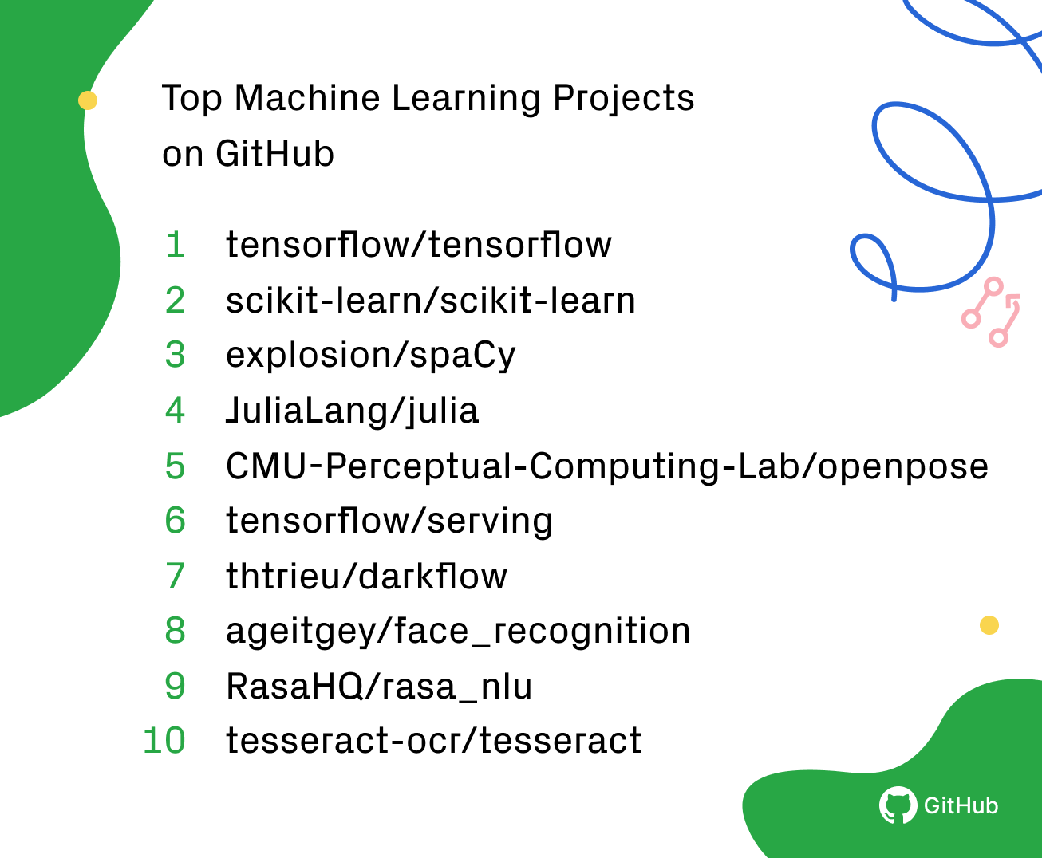
Why scikitlearn?

Slide 4
Scikitlearn features
Popular
Ranked as second top machine learning projects on GitHub
Simple
Fewer dependencies, makes for easier distribution
Efficient
Written in high level language, computation time is faster in comparison to other machine learning libraries in Python
Standard Python API interface
Sits on top of c libraries, LAPACK, LibSVM, and Cython
Open Source: BSD License (part of Linux)

Slide 5
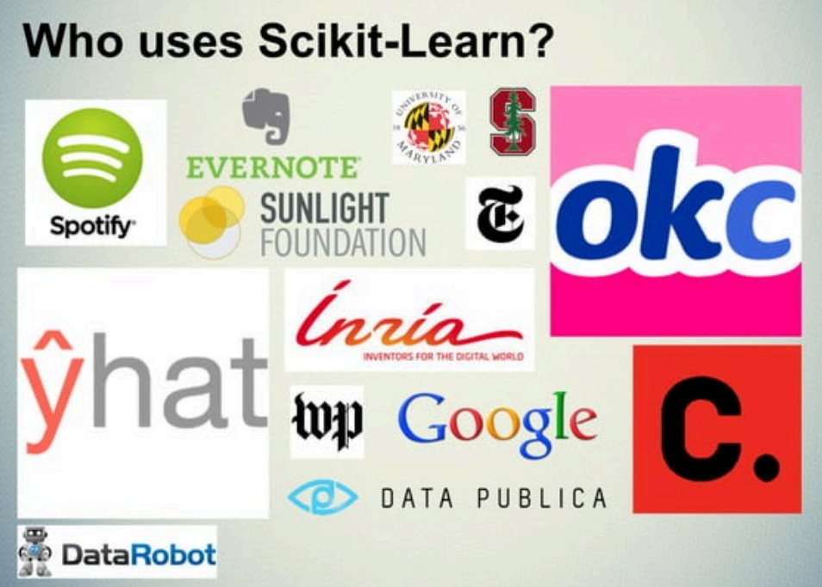

Slide 6
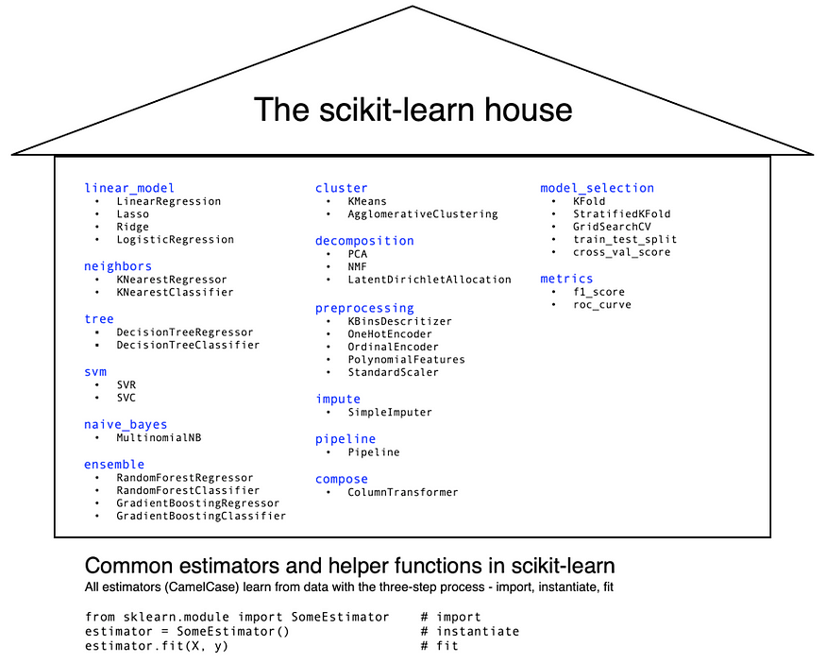

Slide 7
PIPELINE
A Pipeline consists of a chain of processing elements or functions arranged so that the output of each element is the input of the next.
It is a means of automating a workflow.
It is used in several fields such as Data Science, Machine Learning and DevOps ,Manufacturing as well as General Software development.

Slide 8
TYPES OF DATA SCIENCE PIPELINES
ETL/EDA Pipeline
NLP Pipeline
ML Pipeline
CI/CD Pipeline

Slide 9
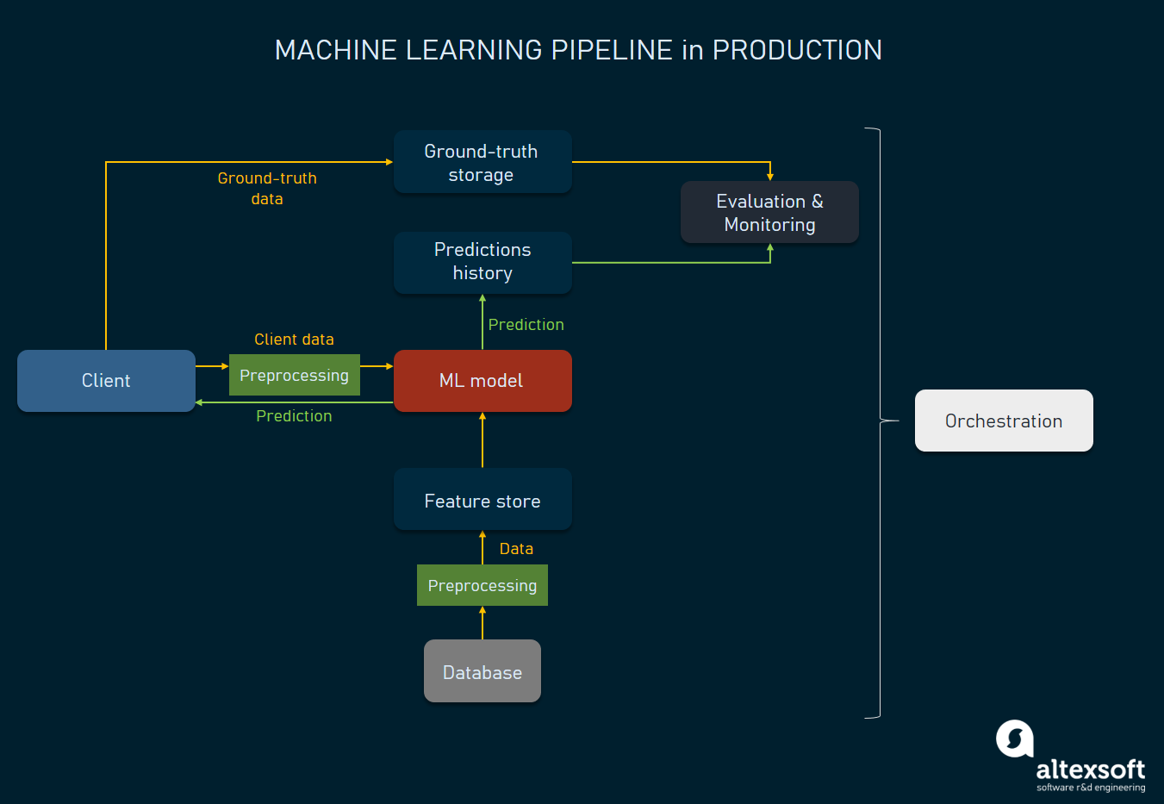

Slide 10
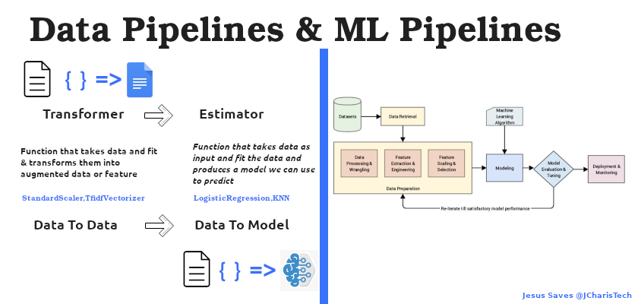

Slide 11
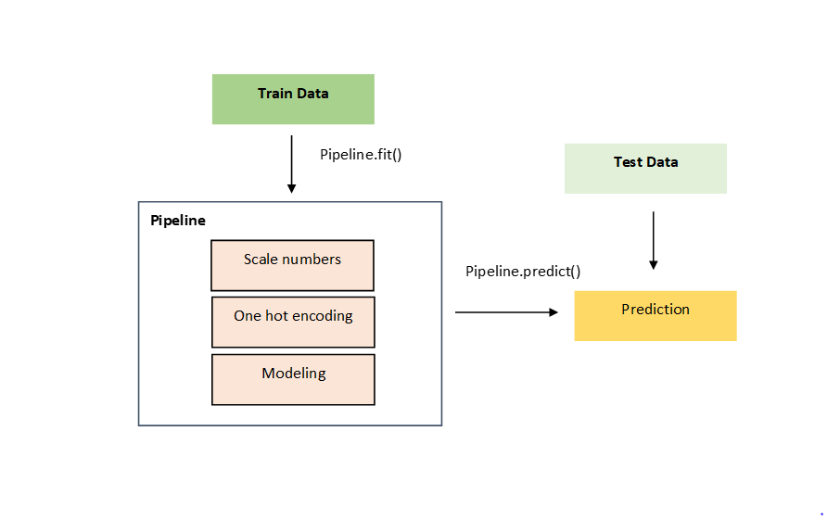

Slide 12
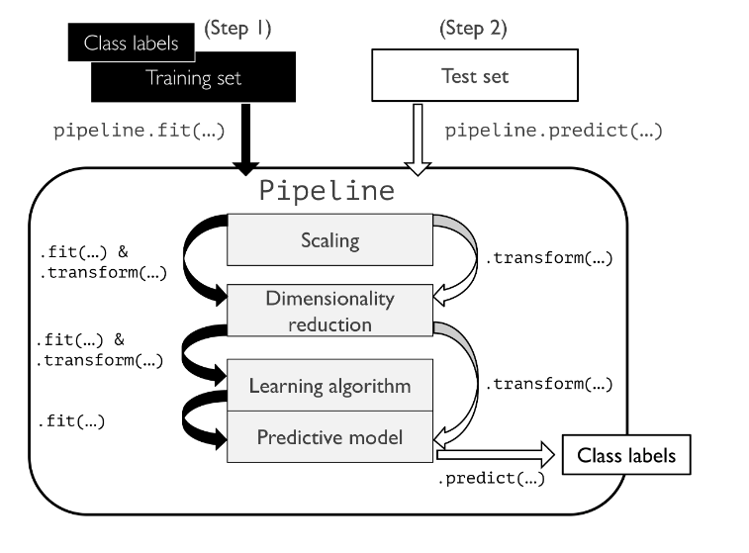
SCIKITLEARN PIPELINE

Slide 13
Data To Data Pipeline(Transformer Stage)
This involves the stage in which we take in or ingest data and then produce as an output data.
It is achieved via the use of Transformers.
A Transformer is a function that takes in data as input and convert/transforms that data into another form of data that is usually augmented or feature ready.
This starts from data ingestion to data cleaning to data transformation and verification as well as feature engineering

Slide 14
Data to Model Pipeline(Estimator Stage)
This is the stage in which we take in data (usually a prepared data) as input and then learns from it to produce a model.
We take in data and using an Estimator we fit the data and build a model that can be used on other dataset to perform predictive task
The main concept here is via the use of Estimators
An Estimator is a function that fit data and yields a model
eg All the ML Algorithms such as KNN, Logistic Regression,MLP etc

Slide 15
ESTIMATOR (CamelCase)
"An estimator is any object that learns from data; it may be a classification, regression or clustering algorithm or a transformer that extracts/filters useful features from raw data."
Regressors — Supervised learning with continuous data
Classifiers — Supervised learning with categorical data
Clusterers — Used in Unsupervised learning
Transformers — Transform the input/output data
Meta-estimators — Learn from other estimators

Slide 16
ESTIMATOR
- fit(X,y) sets the state of the estimator.
- X is usually a 2D numpy array of shape (num _ samples, num_features).
- y is a ID array with shape (n _ samples, )
predict(X) returns the class or value
predict_proba() returns a 2D array of shape (n _ samples, n_classes)

Slide 17
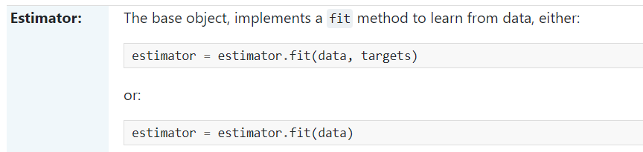
##### Estimators from sklearn.linear_model import LogisticRegression from sklearn.neighbors import KNeighborsClassifier from sklearn.tree import DecisionTreeClassifier

Slide 18
CHOOSING RIGHT ESTIMATOR

Slide 19


