Slide 1
State ,identity and behavior of objects

Slide 2
What is an Object?
“An object has state, behavior, and identity; the structure and behavior of similar objects are defined in their common class.”
Some things are not objects, but are attributes; e.g. age, color.
  Attributes may be properties of some object.

Slide 3
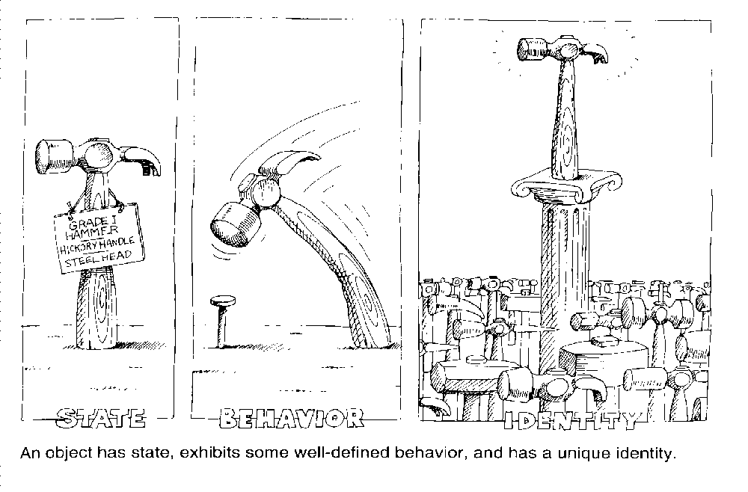
What is an Object

Slide 4
State
The state of an object consists of a set of data fields (its properties) with their current values.
  The state represents the cumulative results of an object’s behavior.
A property is an inherent characteristic, trait, or quality that distinguishes one kind of object from another (i.e. its class).
The properties in a class are usually static.

Slide 5
State
All properties have some value.
  May be a simple quantity.
    E.g. a person’s net worth is Rs 25000.
  Values are usually dynamic.
    E.g. a person’s net worth may go up or down.
  Occasionally a value is static.
    E.g. a car’s serial number.
The state of an object changes in response to events (i.e. a message sent to it), or by acting autonomously.

Slide 6
Behavior
“Behavior is how an object acts and reacts in terms of its state changes and message passing.”
When you send a message to an object, you actually invoke a method (i.e. execute some code).
Invoking a method will cause certain well-defined behavior, and may change the object’s state.
  The behavior may depend on the object’s current state

Slide 7
Behavior
A few kinds of operations that a client may perform on an object:
  Modifier: alters the state of an object.
    E.g. karan.setNetWorth(25000);
  Selector: accesses the state of an object, but does not alter it.
    E.g. age = s.getAge();
  Constructor: creates an object and initializes its state.
  Destructor: destroys an object (frees its memory).

Slide 8
Identity
“Identity is that property of an object which distinguishes it from all others.”
Every instance of a class has its own memory to hold its state.

Slide 9
Note:
An object has both state and behavior : the state defines the object whereas the behavior defines what the object does
Objects are the real time entity which are created through their template, their class.
By real time entity, I mean they would occupy a memory space in which they will save the values of its attributes. These values create a state of an object. Since Object occupy a space in memory so they have unique address in memory. This become the identity of an object.

Slide 10
Note:
For example : Pen is a class, which has weight and color as its attributes. They may have behaviour like write(). Still they don't occupy a space in memory. When I say My pen ,It will be an object of class Pen since it will have some values for weight like 10 gm and color like blue. This will occupy some memory to save these
values.

Slide 11
What is a class?
“A class is a set of objects that share a common structure and a common behavior.”
A class is an abstraction, a way of classifying similar objects.
An object is an instance of a class, a concrete entity that exists in time and space.

Slide 12
Class Interface
Is the outside view of a class.
Consists of declarations of methods and variables.
The accessibility of these declarations can be set:
  public: accessible to all clients.
  protected: accessible to the class itself, and all subclasses.
  private: accessible to only the class itself.
The variable declarations that represent the object’s state are usually declared private.

Slide 13
Class Implementation
Is the inside view of a class.
Consists of method definitions (i.e. code that implements behavior).

