Slide 1




Campus360
Student Academic Success, Subject Performance & Career Readiness Analytics Platform
Turning fragmented student data into actionable academic and career insights.
TEAM ID : 60
TEAM: NEURAL NEXUS
Presented By: Om Patel & Rahil Nagariya
Notes:
1

Slide 2


The Problem
Academic records are siloed
Attendance and lifestyle data are disconnected
Risk is often identified too late
Faculty cannot easily get a complete student picture
Limited Insight
Incomplete student picture
Disconnected Data
Scattered sources and silos
Notes:
2

Slide 3




Campus360: One Student, One View
Unified Student Data
Predictive Intelligence
Data stitching + centralized warehouse
Performance prediction + at-risk detection
GenAI Faculty Assistant
Converts analytics into understandable insights and action plans
Notes:
3

Slide 4
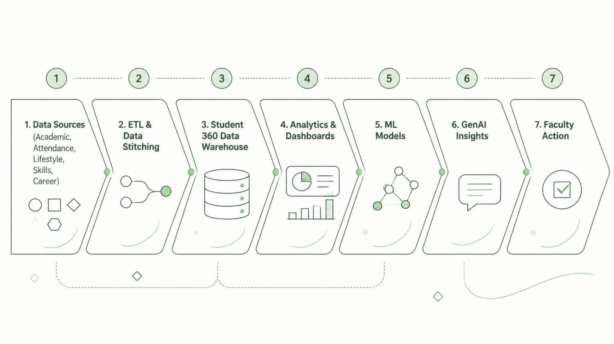
How Campus360 Works
Notes:
4

Slide 5



From Fragmented Data to Student 360
Campus360 transforms disparate data into a holistic student profile using a robust relational database and star schema design.
Domain-Specific Tables
Unified Analytical Layer
  academic_records: CGPA, academic history & performance data.
  exam_marks: Subject/examination marks.
  attendance: Attendance records.
  lifestyle: Sleep, stress, wellness & lifestyle indicators.
  skills: Technical and career-related skills.
  career_preferences: Career interests and preferences.
The student_master_stitched table combines validated information from all domain tables. This ETL-processed, unified dataset fuels ML models, analytics, and dynamic dashboards for comprehensive insights.
Notes:
5

Slide 6
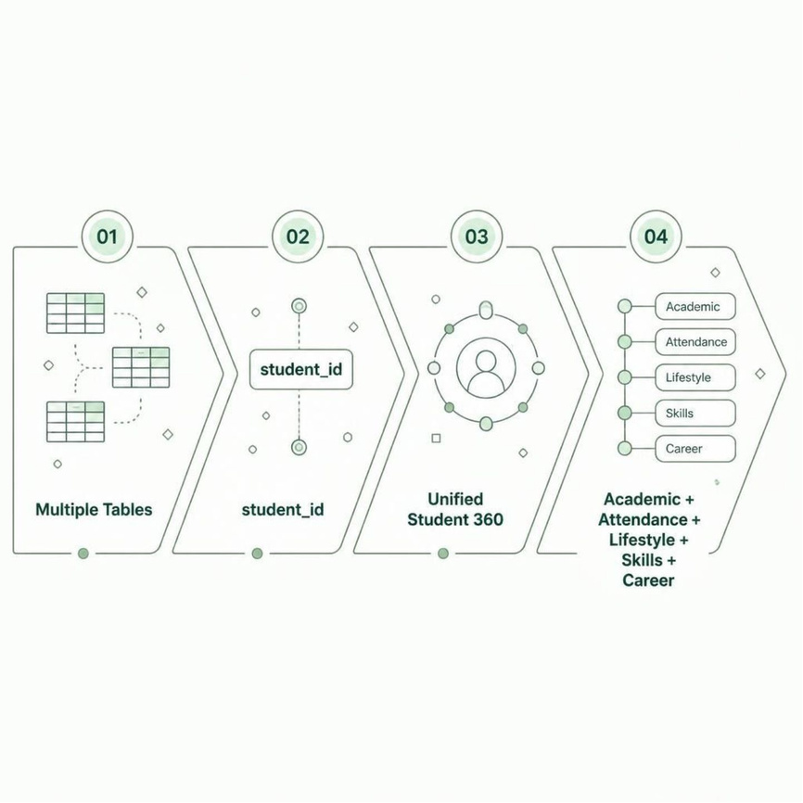
From Fragmented Data to Student 360
How It Works
  Multiple datasets are integrated using a common student identifier
  Strict key-based joins are used
  Data quality checks validate the integrated dataset
  Central warehouse provides a unified student profile
Notes:
6

Slide 7





Understand Student Performance
Subject/Academic Performance
Attendance
Lifestyle/Wellness
Career Readiness
Cohort-Level and Individual-Level Insights
Notes:
7

Slide 8
Predict Academic Performance
Input
Evaluation Metrics
Previous academic + behavioral indicators
  R²
  MAE
  RMSE
ML Model
Gradient Boosting Regression
Important Features/Drivers
Output
3–5 verified important features/drivers
Predicted future academic performance
Notes:
8

Slide 9
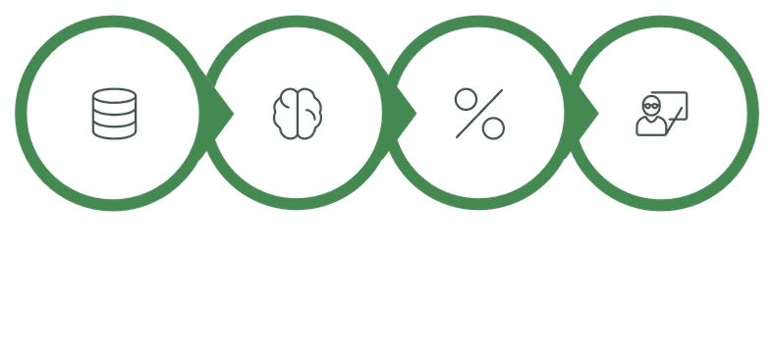
Identify Students Who May Need Early Support
Student Data
Risk Model
Risk Probability
Faculty Attention
How It Works
Verified Metrics
  Detect students who may require additional support
  Use behavioral/academic indicators available before intervention
  Threshold-based risk classification
  Faculty remains responsible for the final decision
  ROC-AUC
  Recall
  Precision
  F1
Notes:
9

Slide 10
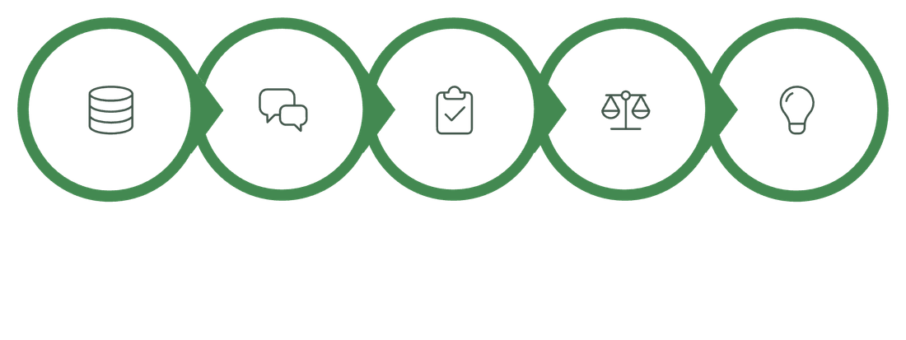


From Prediction to Action
ML + 360 Data
GenAI Briefing
Assessment
Risks & Strengths
Action Plan
Natural-Language Insights
Risk Factors & Strengths
Actionable Recommendations
Highlights important risk factors and strengths
Converts complex analytics into natural-language insights
Generates structured, actionable recommendations for faculty
AI supports faculty decisions — it does not replace them.
Notes:
10

Slide 11



Interactive Student Predictor & Real-Time AI Counseling
Upload & Predict
Interactive Student Predictor
Real-Time AI Counseling
  Student/Faculty can upload a CSV file
  System automatically validates the required columns
  Only supported dataset fields are accepted
  ML model generates predictions based on available student data
  AI analyzes the student's prediction and risk factors
  Generates a personalized student assessment
  Highlights:
    Critical Risk Factors
    Strengths & Positive Indicators
    Recommended Actions
    14-Day Improvement Plan
  Enter or upload student academic data
  Predict next-semester performance
  Identify at-risk students
  View prediction results instantly
  Batch prediction supported for multiple students
Notes:
11

Slide 12





Why Campus360?
✓ Unified student information
✓ Earlier identification of academic risk
✓ Data-driven faculty intervention
✓ Career-readiness visibility
"Campus360 transforms student data into timely intelligence for better-informed academic support."
Notes:
12

Slide 13

Thank You
For your time and attention.
We are happy to answer any questions you may have about Campus360.
Notes:
13

