Slide 1
UK-Bank-Customers-Dashboard
File created on: 6/20/2021 3:42:33 PM

Slide 2
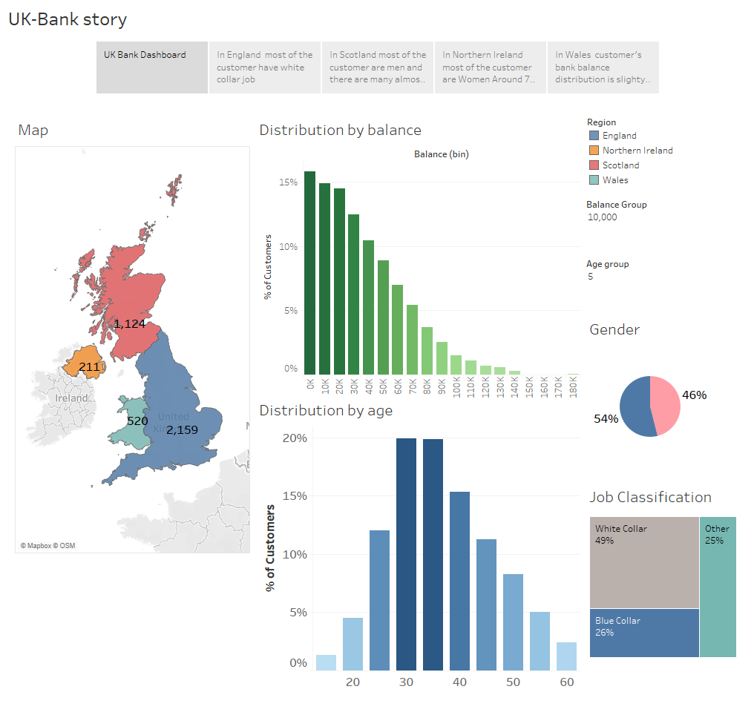

Slide 3
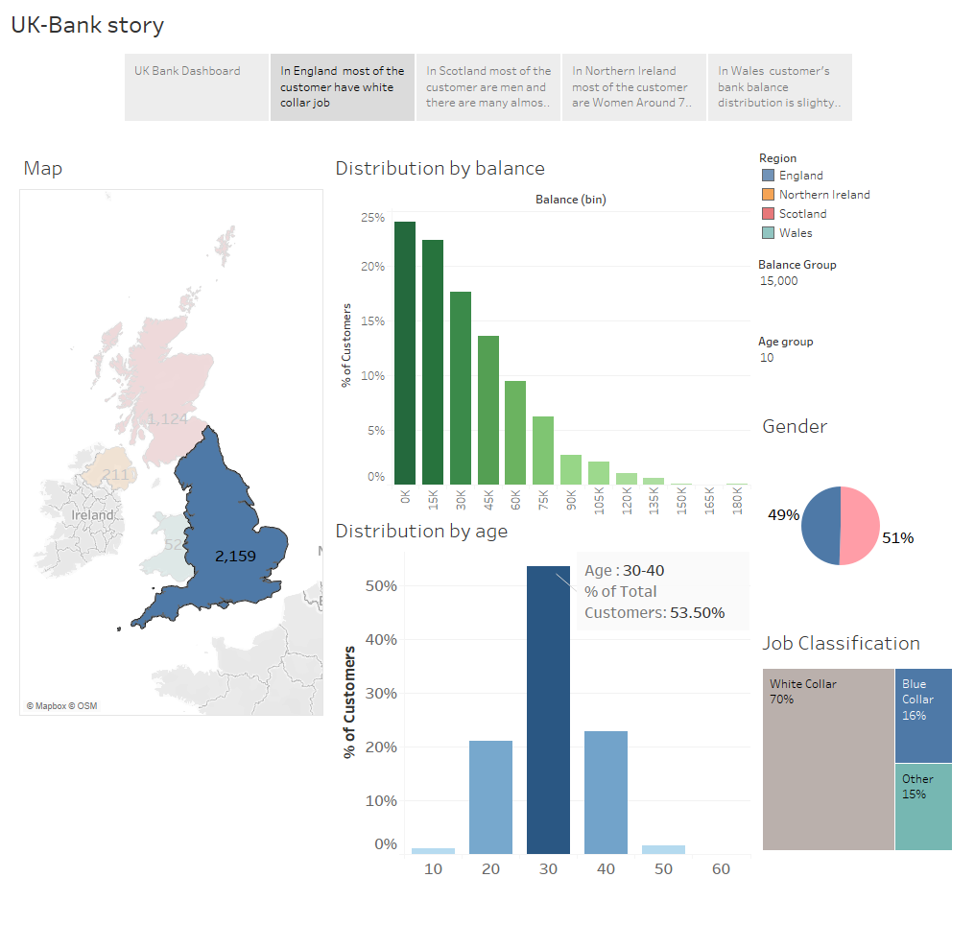

Slide 4
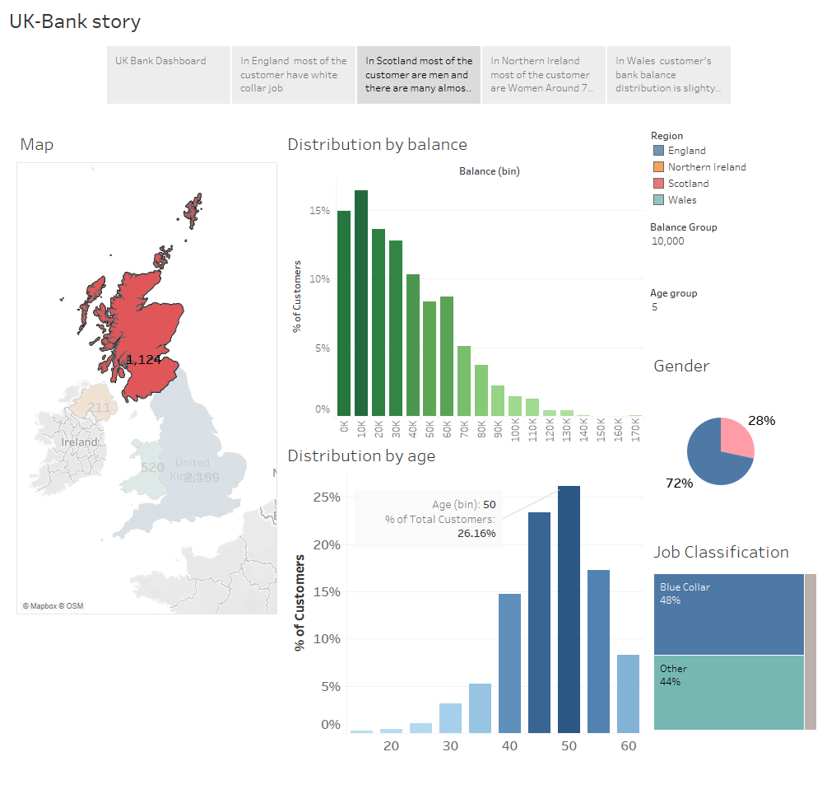

Slide 5
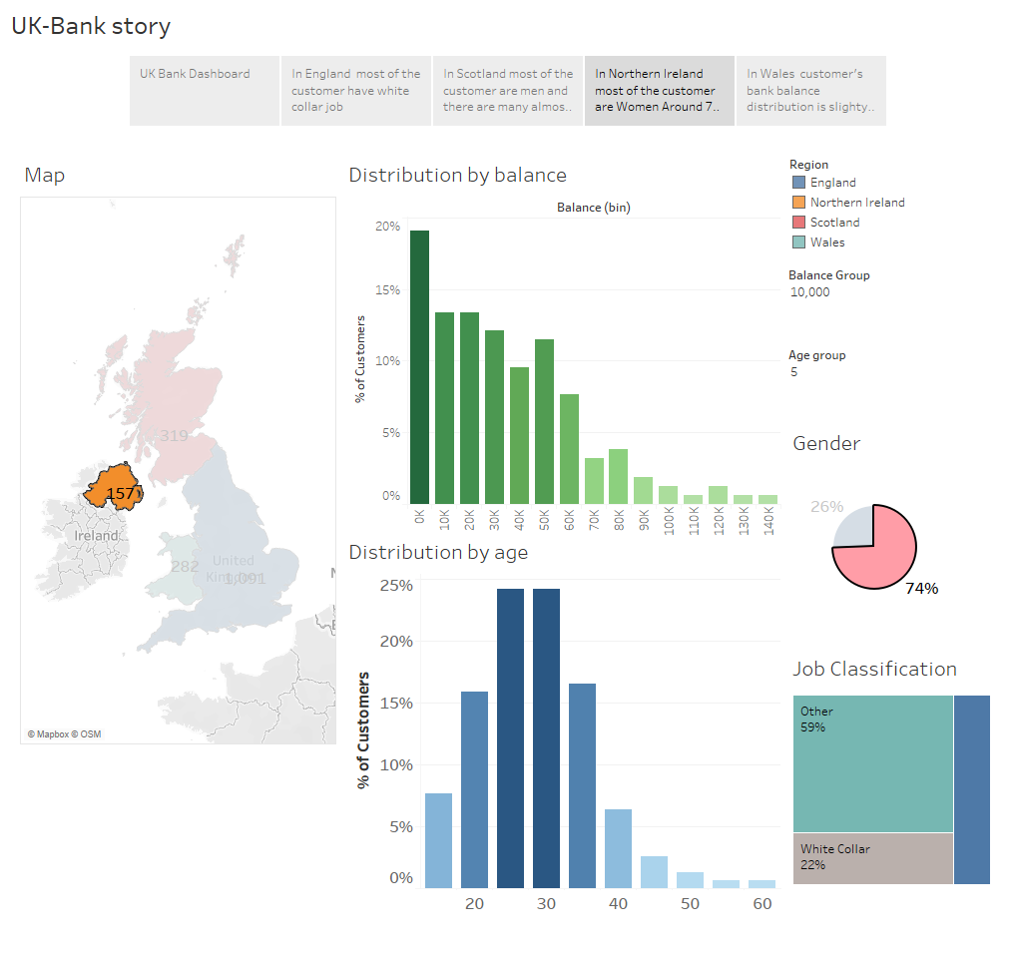

Slide 6
