Slide 1
Website Classification using Spark Mlib
Rajenkumar Patel (rvp140030)
Naimish Patel (njp130330)
Bhoomi Shah (bss130430)
Poojan Khanpara (pdk130130)
Deep Shah (dss130230)
Parth Trivedi (pxt131830)
Pooja Jain (pxj131230)
Guided By: Dr. Latifur Khan

Slide 2
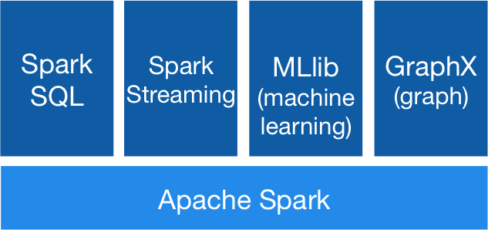
Architecture
Apache Spark Mlib machine learning Library
Scala programming language

Slide 3
Training Data
Popular Reuters 21578 collection of documents
appeared on Reuters newswire in 1987 as a training set
http://archive.ics.uci.edu/ml/machine-learning-databases/reuters21578-mld/
And specially hand chosen training data
Online shopping websites
Social networking websites
Universities websites

Slide 4
Custom training set
University
Wikipedia page
www.utdallas.edu
www.gtu.ac.in
Shopping Websites
Amazon
Ebay
Aliexpress
Social Network websites
Facebook
Twitter
Instagram

Slide 5
Lets Train THE classifier

Slide 6
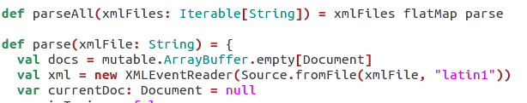
Step 1
Parsed the training XML data into labels and body
Simple API for XML parser (SAX parser)

Slide 7
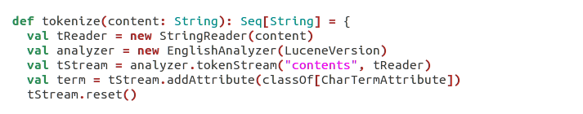
Step 2
Tokenized the training data using Apache Lucene
And stemmed it using English Stemmer
Running and ran -> run

Slide 8

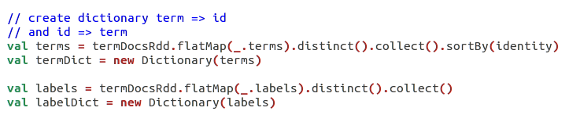
Step 3
Initialized the Spark context using 5 workers
Create term and label dictionary

Slide 9
Step 4
Based on dictionary calculated IDF based on each term
idf(term, docs) = (number of documents) / (number of documents containing term)

Slide 10
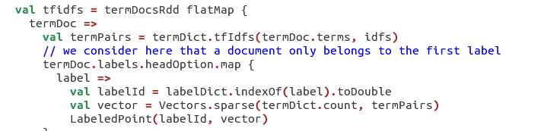
Step 5
Vectorize each document using TF-IDF score

Slide 11

Step 6
Convert into label points which represents label id and sparse vector using Mlib regression library

Slide 12
Step 7
Train Naïve Bayesian classifier
Training completed!!

Slide 13
Classification
Extract the web page content using Goose developed by gravity labs
Read console input using jline console reader
And classify the web page content to a particular label using naïve Bayesian model that we trained

Slide 14
Screenshots of Demo
Input is url of website to classified
Output label to which website is classified based on Naïve Bayesian model that we trained

Slide 15
Future work
More training data to improve the efficiency
Add more and diverse labels
Calculate confidence level along with label
Check error using Cross Validation

Slide 16
Conclusion
Even though Mlib has less Machine learning algorithms implemented than mahout, it is much faster at what it does

Slide 17
Demo

