Slide 1
Analysis: separating stress from effort
Wearable data from nurses, aligned and cleaned so movement does not masquerade as stress
15
nurses (Empatica E4 sensors)
1,250+
hours of physiological data
5 > 1 Hz
sensor streams on one timeline
1
Align
2
Smooth
3
Track motion
4
Model
Down-sampled 32-64 Hz sensor streams to a common 1 Hz timeline
60-second rolling averages to keep sustained arousal, drop brief spikes
Accelerometer data separates physical exertion from stress
Mixed-effects model with a baseline for each nurse
Objective Biomarkers of Nurse Stress | Sanius Health Analytics Assessment | Sariya Patel
1

Slide 2
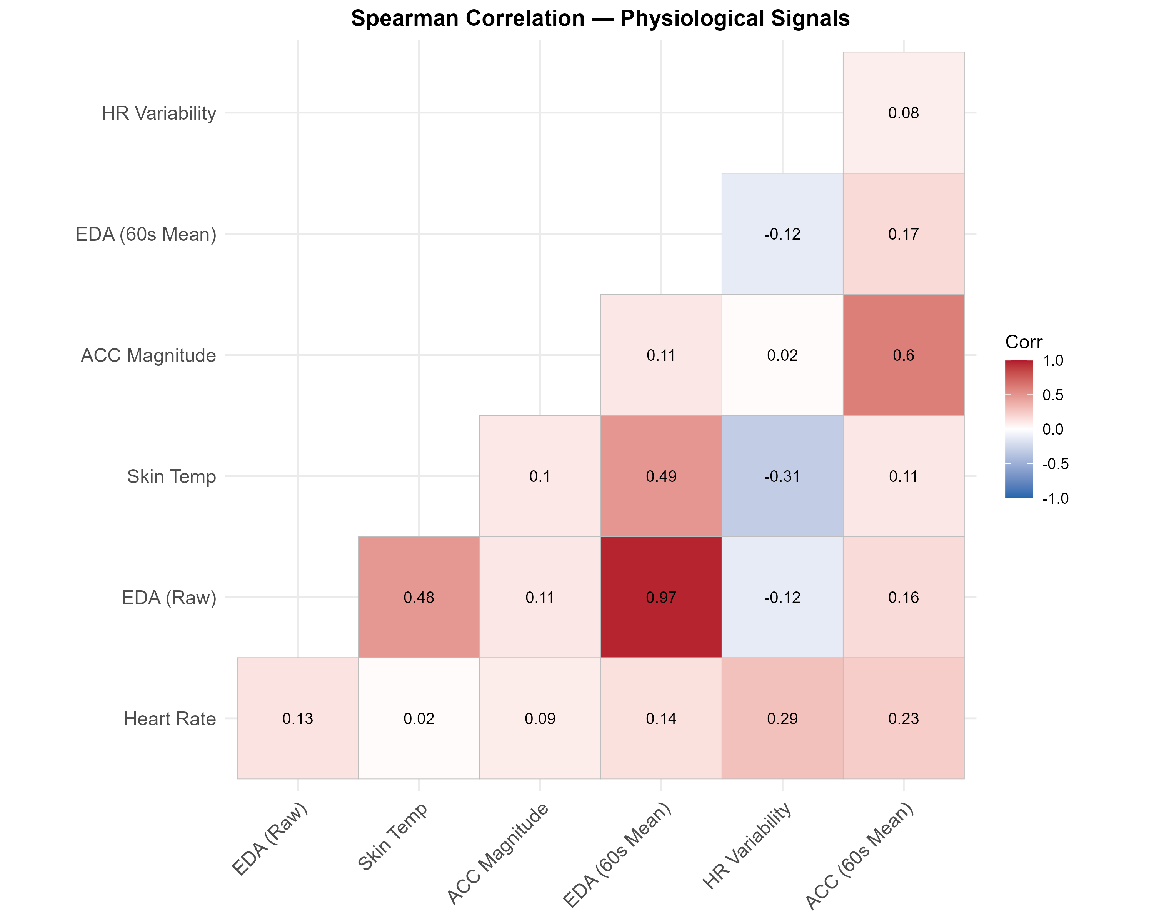
Findings: what the data show
Stress alerts should be motion-aware and personalised to each nurse
1
EDA is the strongest stress signal
Skin conductance tracked heart-rate rises, even after adjusting for movement.
2
Movement can mimic stress
Without accelerometer data, physical effort looks like psychological arousal.
3
No single threshold fits everyone
Baselines differ widely between nurses, so alerts need to be personalised.
Spearman correlations between physiological signals
Objective Biomarkers of Nurse Stress | Sanius Health Analytics Assessment | Sariya Patel
2

Slide 3
Limitations and next steps
Promising signal, but not yet ready for clinical use
Limitations
Data gaps: sensors detach during intense patient care.
Time dependence: repeated readings over time are not fully modelled; auto-regressive terms are needed.
Small cohort: 15 nurses limits how far results generalise.
Next steps
Supervised models: combine self-reported stress labels with time-aligned signal windows.
Real-time alerts: test alerts built on personalised, rolling baselines.
Validation: repeat in a larger, multi-site cohort.
Objective Biomarkers of Nurse Stress | Sanius Health Analytics Assessment | Sariya Patel
3

