Slide 1
Xray Lung Classifier
Shehbaz Rafiq Patel

Slide 2
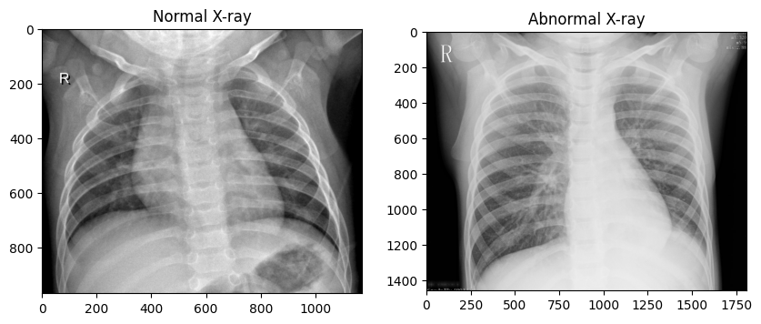
Description
This project involves the development of a convolutional neural network (CNN) model to differentiate between normal and pneumonia chest X-ray images. Utilizing PyTorch and transfer learning techniques. This project addresses the need for an automated system to provide fast and reliable classification of chest X-ray images.

Slide 3
Methodology
Transformation: for training data, we used ToTensor(), RandomRotation(), RandomHorizontalFlip(), RandomResizedCrop(), Normalized(), for testing data, we used ToTensor(), Resize(), Normalize().
The project employs a ResNet34 model pre-trained on ImageNet as the foundation. It is fine-tuned with a dataset comprising normal and pneumonia chest X-ray images. The model undergoes training, validation, and testing phases.

Slide 4
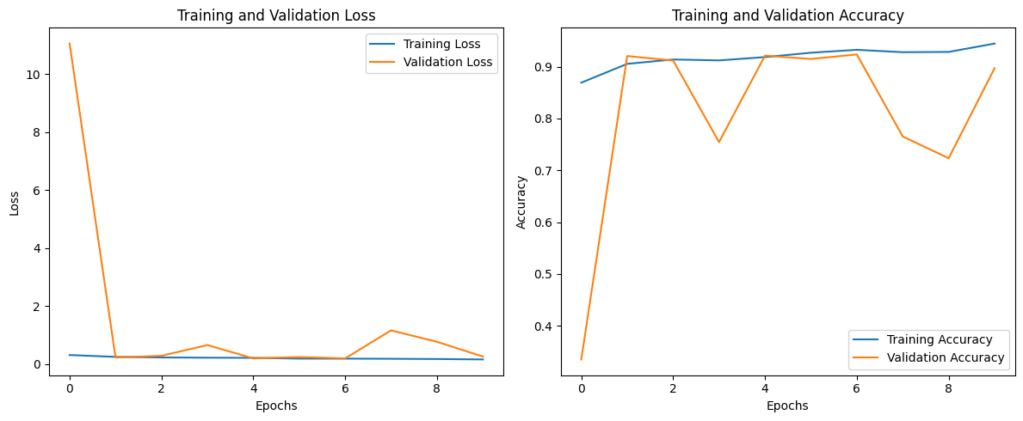
Training process
Training Loss and Accuracy: the training loss decreases and accuracy increases over epochs, indicating the model is learning and improving on the training dataset.
Validation Loss and Accuracy: There are some fluctuations in validation loss and accuracy across epochs, with significant improvements . The highest validation accuracy achieved is around 92.36% in epoch 7, which is captured as the best model performance.

Slide 5
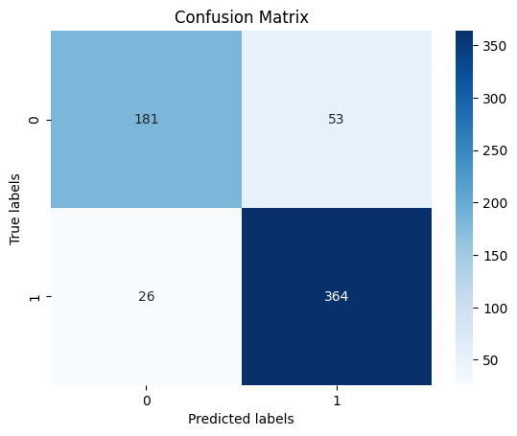
Confusion Matrix
True Positives (TP): The bottom right cell (364) shows the true positives, indicating the number of pneumonia cases correctly identified by the model.
True Negatives (TN): The top left cell (181) shows the true negatives, indicating the number of normal cases correctly identified by the model.
False Positives (FP): The top right cell (53) shows the false positives, where the model incorrectly identified normal cases as pneumonia.
False Negatives (FN): The bottom left cell (26) shows the false negatives, where the model incorrectly identified pneumonia cases as normal.

Slide 6
Accuracy, Recall, Precision, F1-Score
Test Accuracy: 0.8733
Recall of 0.93: This indicates that the model is very good at identifying the positive cases for pneumonia. It suggests that out of all actual pneumonia cases, the model correctly identifies 93% of them.
Precision of 0.87: This means that when the model predicts pneumonia, it is correct about 87% of the time.
F1 Score of 0.90: The F1 Score is a harmonic mean of precision and recall, and a high value shows that the model has a good balance between the two.

Slide 7
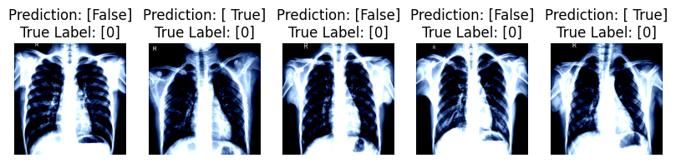

Test samples
True indicates pneumonia and False indicates normal
0 indicates normal and 1 indicates pneumonia.

