Slide 1
IMAGE-TO-BIOMASS PREDICTION
USING COMPUTER VISION AND DEEP LEARNING
Final Documentation Report
Project Report Submitted for Internship Project Submission
Submitted By:
Shivam Subedar Patel (Intern, AI/ML)
Organization:
Data Vidwan
Mentor:
Meet Mistry
Date of Submission:
10/07/2026
Python | Computer Vision | Deep Learning | PyTorch | OpenCV | Streamlit | Scikit-Learn | Pandas | NumPy

Slide 2
SECTION 1
1. Project Objective
The objective of this project is to develop an AI-driven agricultural decision support system that helps farmers and agronomists evaluate their pasture biomass yields automatically, replacing the traditional labor-intensive ‘clipping and weighing’ method. The system uses deep learning-based visual feature extraction (EfficientNet-B0), traditional computer vision for semantic segmentation, and environmental metadata processing to predict dry biomass yields.
The project includes:
Dataset Preprocessing and Augmentation
Semantic Segmentation Model Implementation (DeepLabV3+ / HSV)
Biomass Regression Model Training (EfficientNet-B0)
Zero-Download Computer Vision Depth Estimation
Grad-CAM Heatmap Interpretability
Interactive, Premium Streamlit Dashboard Deployment
2

Slide 3
SECTION 2
2. Requirement Coverage
Requirement | Status | Project File / Output
Semantic Segmentation | Completed | src/models/segmentation_model.py / dashboard/app.py
Biomass Prediction Model | Completed | models/best_model.pth
Depth Estimation | Completed | dashboard/app.py (CV PseudoDepth)
Visual Heatmaps | Completed | src/visualization/gradcam.py
Streamlit Dashboard | Completed | dashboard/app.py
3. Dataset
Multi-category biomass data: Green Dry Matter, Dead Material, and Clover.
Includes environmental metadata (NDVI, Canopy Height, Species, Geographic State).
3

Slide 4
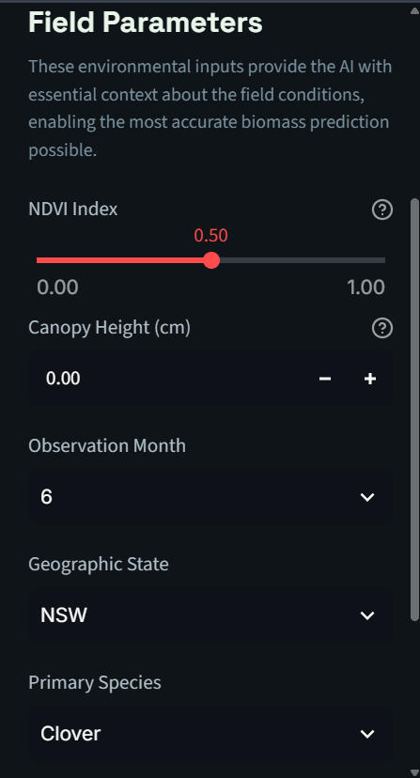
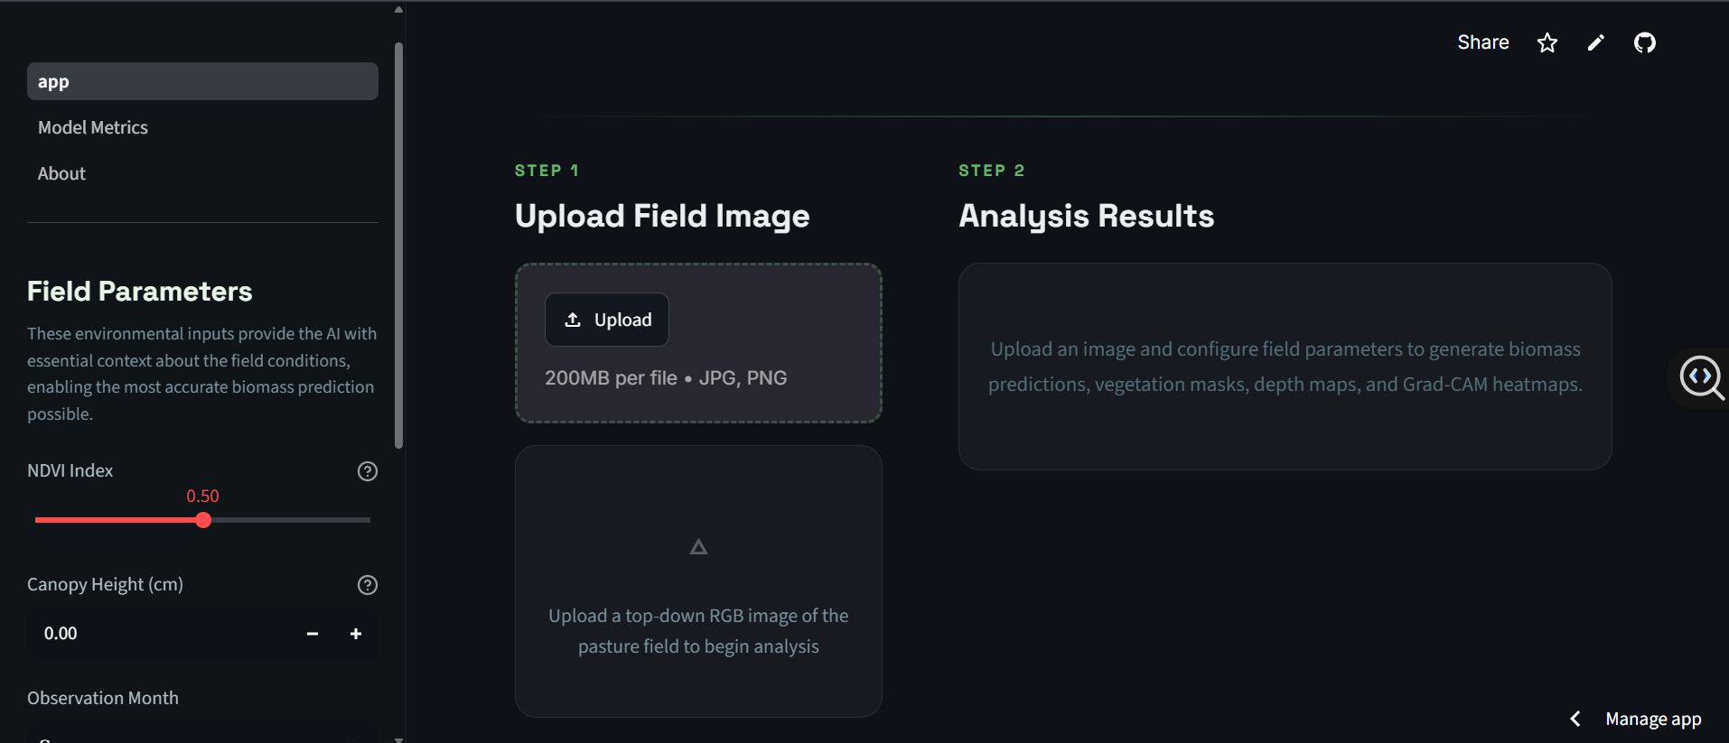
DASHBOARD WALKTHROUGH
8. Streamlit Application — Field Setup
The assessment flow begins with the Field Parameters sidebar, where the user provides environmental context (NDVI, canopy height, observation month, geographic state, species) before uploading the field image.
Fig. 2 — Upload Field Image & Analysis Results (Steps 1–2)
Fig. 1 — Field Parameters panel
4

Slide 5
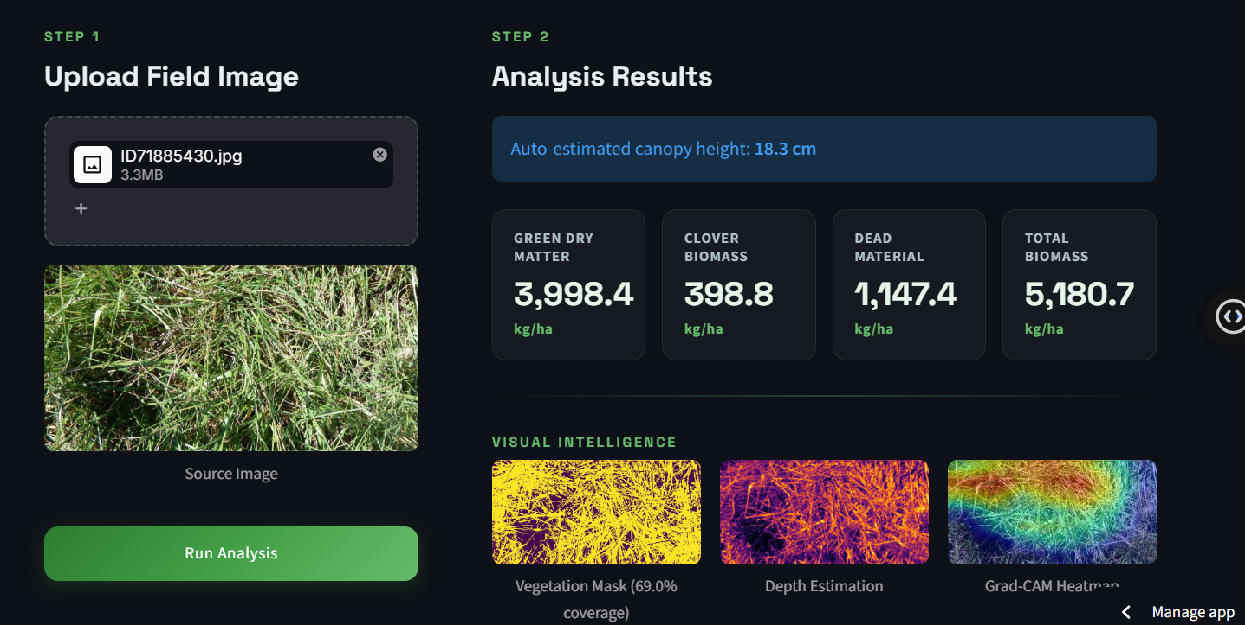
DASHBOARD WALKTHROUGH
8. Streamlit Application — Analysis Results
Once an image is uploaded and analysis is run, the dashboard returns numerical biomass predictions across four categories along with a Visual Intelligence suite: vegetation mask, pseudo-depth map, and Grad-CAM heatmap.
5

Slide 6
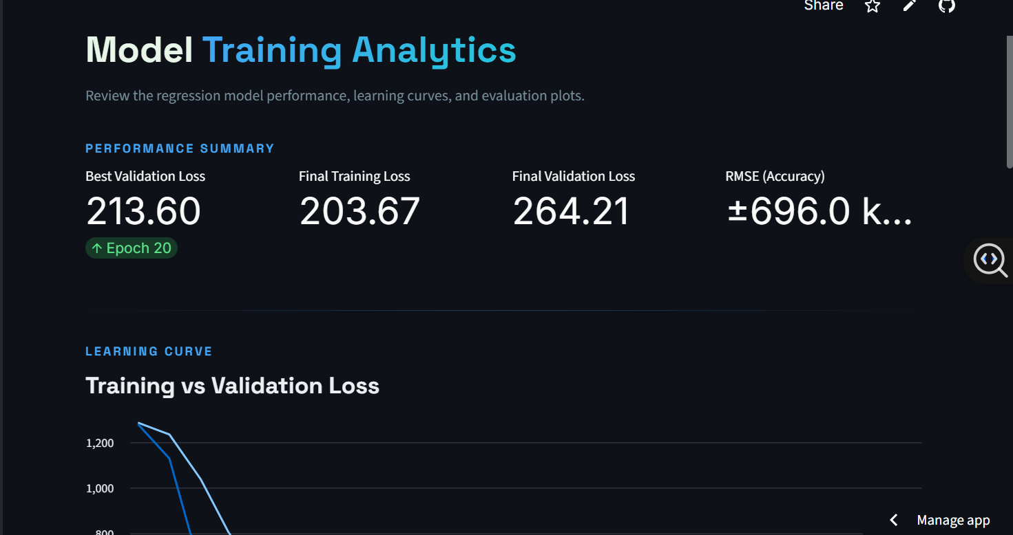
SECTION 6
6. Model Training — Performance Summary
The regression model's training was monitored through a dedicated analytics page, tracking best validation loss, final training/validation loss, and RMSE across 20 training epochs.
Fig. 3 — Model Training Analytics: Performance Summary
213.60
203.67
264.21
±696.0 kg/ha
Best Validation Loss
Final Training Loss
Final Validation Loss
RMSE (Accuracy)
6

Slide 7
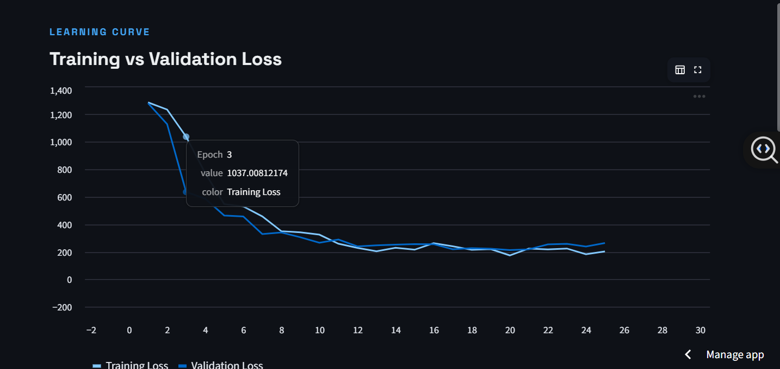
SECTION 6
6. Model Training — Learning Curve
Training and validation loss converge steadily across epochs, with both curves stabilizing after approximately epoch 12 — indicating the model generalizes without significant overfitting.
7

Slide 8
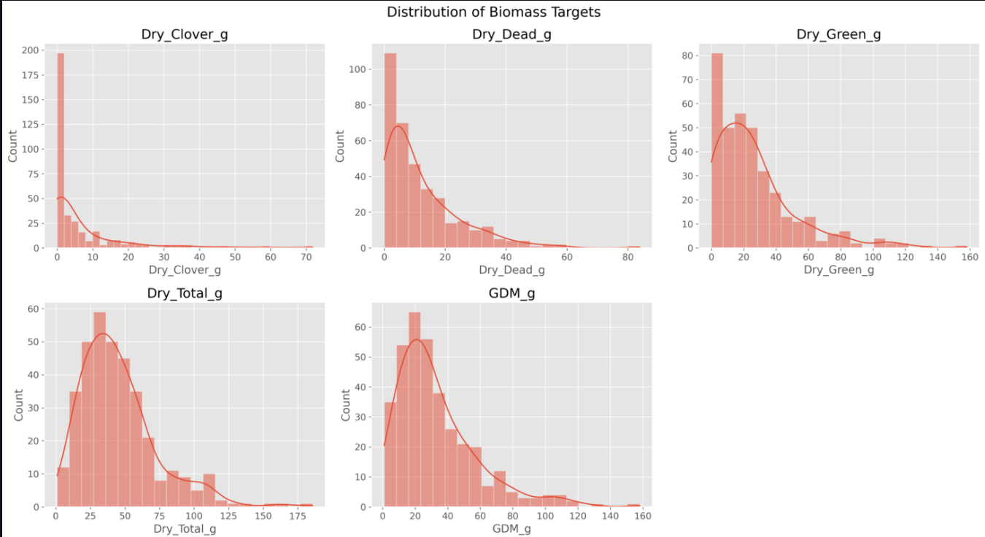
SECTION 9
9. Key Findings — Distribution of Biomass Targets
All five biomass targets are right-skewed, with most field samples containing low biomass and a smaller number of high-yield samples — typical of natural pasture variability.
8

Slide 9
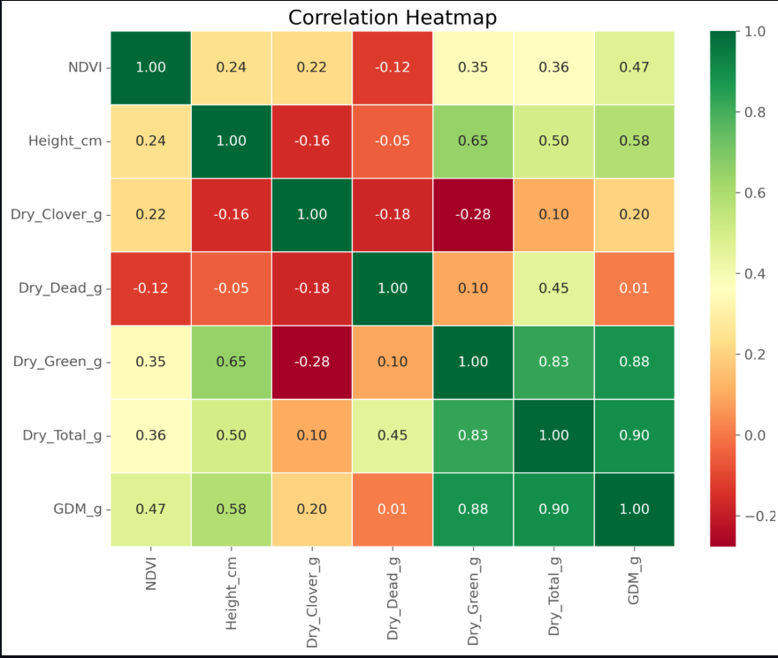
SECTION 9
9. Key Findings — Feature Correlation
Key Findings
Fusing environmental metadata (NDVI, Height) with visual features significantly outperformed single-modality image evaluations.
Geographic state and species inclusion stabilizes highly-variant visual predictions.
Canopy height and green biomass are strongly correlated (0.65–0.88), confirming metadata's predictive value.
Traditional CV algorithms (HSV, Grayscale) provided faster and equally actionable visual insights compared to heavy deep learning models (MiDaS).
Fig. 4 — Correlation heatmap of environmental and biomass variables
9

Slide 10
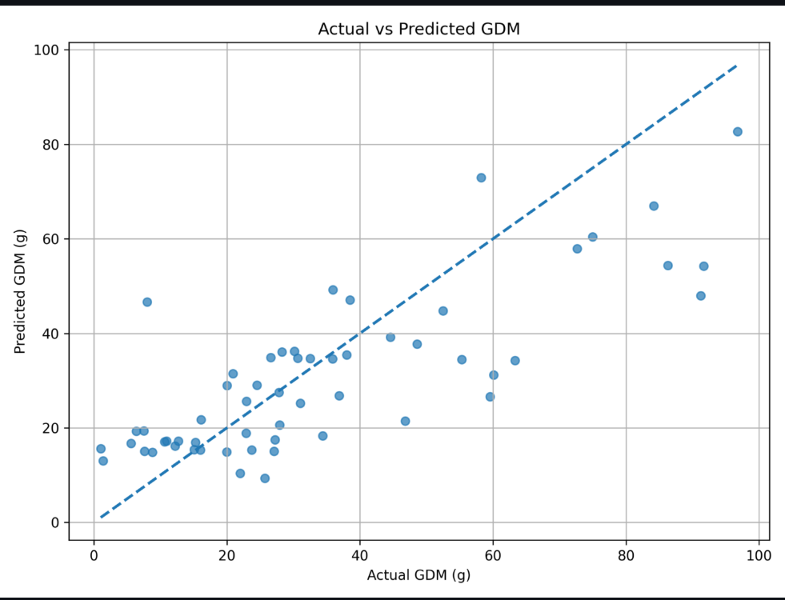
SECTION 9
9. Key Findings — Model Evaluation
The Actual vs. Predicted GDM scatter plot shows a reasonable fit along the ideal diagonal, with some prediction spread at higher biomass values — an expected limitation given the dataset's natural variability.
10

Slide 11
SECTIONS 10–12
11–10. Achievements, Limitations & Recommendations
Achievements
Limitations
Multimodal feature extraction (Image + Metadata).
Independent deep learning model training and validation.
Dual-input PyTorch architecture implementation.
End-to-End Streamlit dashboard deployment with a stylized 'Precision Pasture' UI.
Real-time computer vision processing and Grad-CAM generation.
Relies heavily on a top-down orthogonal camera angle; angled photos may reduce accuracy.
Free-tier deployment uses CV approximation for depth rather than true stereoscopic or neural depth mapping.
Recommendations
Use Grad-CAM heatmaps to verify the model focuses on vegetation, not anomalies (e.g., equipment in the field).
Encourage accurate NDVI and Canopy Height metadata input to ensure optimal precision.
11

Slide 12
15. Final Conclusion
The Precision Pasture AI platform successfully delivers an end-to-end multimodal machine learning solution for agricultural biomass assessment. By seamlessly integrating deep convolutional image analysis with critical environmental metadata, the system minimizes the blind spots of single-modality AI. Delivered via a highly interactive and beautifully stylized Streamlit dashboard, this project provides farmers and agronomists with immediate, data-driven insights and a highly scalable alternative to manual field harvesting.
How to Run
pip install -r requirements.txt
python -m streamlit run dashboard/app.py
Thank You

