Slide 1

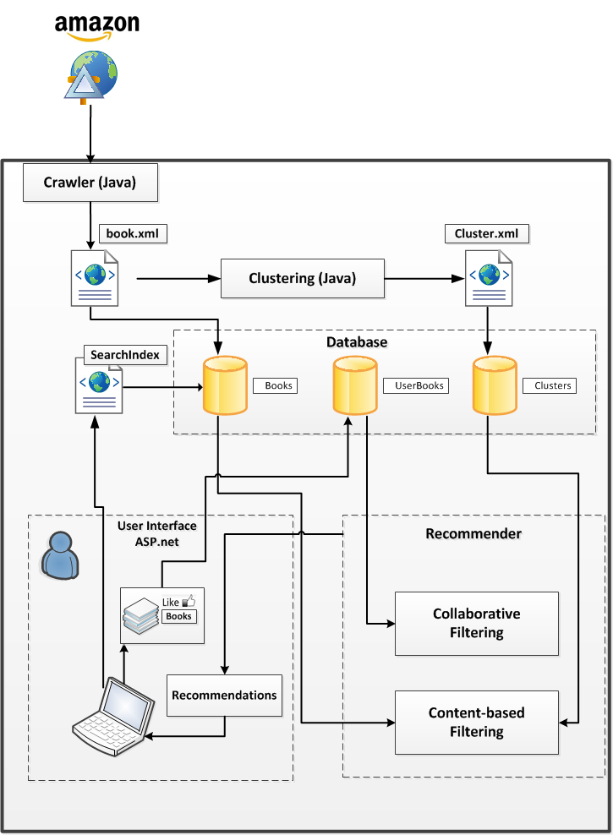
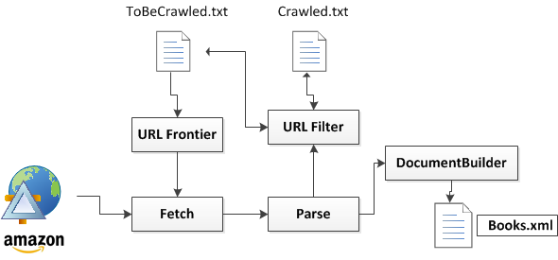
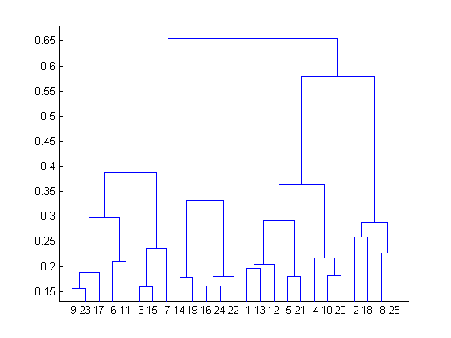
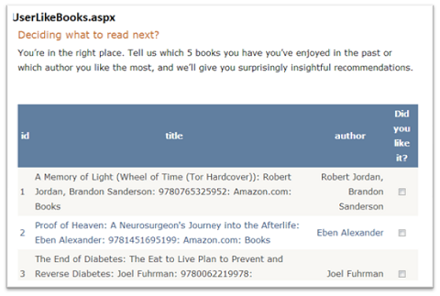
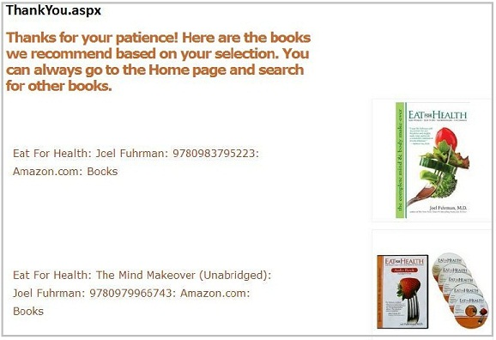
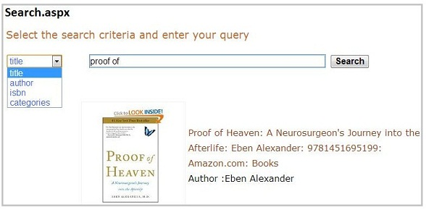
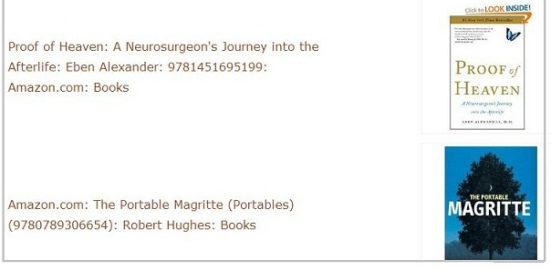
Boogle
Meet your next favourite book!
Dept. Computer Science, TU Eindhoven, The Netherlands
1. Focused crawl (amazon.com)
2. Clustering
Goal:
Offer a solution to the cold-start problem by taking the users’ input during the registration process.
Architecture
3. Sign-up process
4. Content-based
recommendations
Challenges:
Differentiating relevant book URLs from Amazon
Similarity function between books
Boogle in 6 Steps
5. Search & Rate
6. Collaborative-recommendations
Future work:
Get feedback on recommendations
Implement a numeric rating system instead of binary
Contact: S.R. Patra (s.r.patra@student.tue.nl); J. Santillan (j.u.santillan.arenas@student.tue.nl); D. Vangjeli (d.vangjeli@student.tue.nl); M. Zeeshaan (mohammed.zeeshaan@student.tue.nl)

