Slide 1
Git…

Slide 2
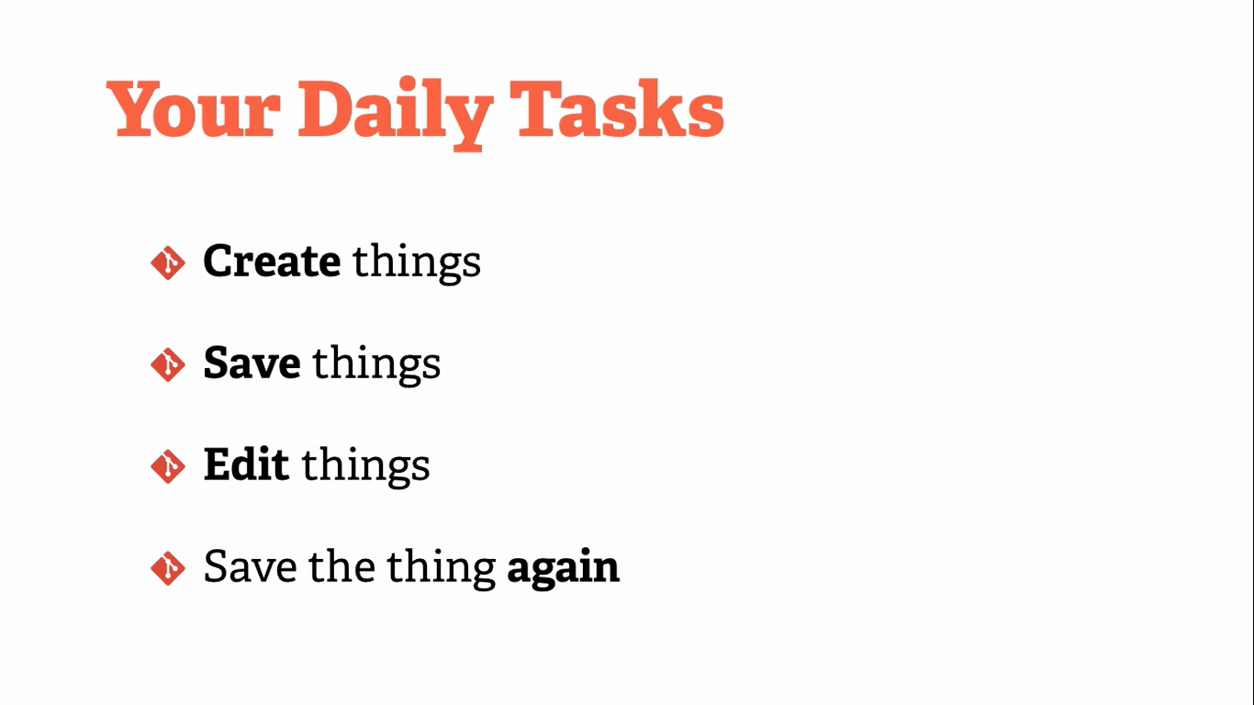

Slide 3
When You Save The Things Again
When You did it?
Why you did it?
What the contents of the changes were?This is open for a view any time in future.

Slide 4
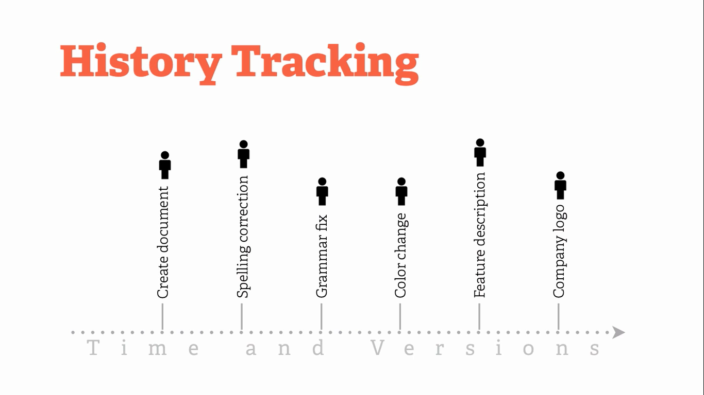

Slide 5
History Tracking
If we look at the above tracking history one would do for editing the file and for saving the file multiple time.
But it would be easy for an individual to perform all the above tasks, but what if we have a group of a people working on the same document and then we have to handle it?

Slide 6
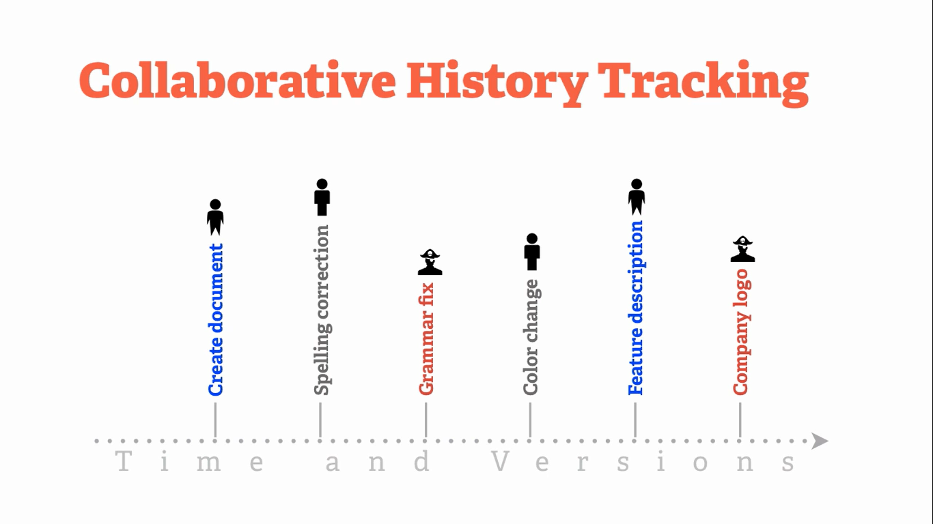

Slide 7
Collaborative History Tracking
In the collaborative work suppose there is a team that work on the same document.
There are some problem then arise which are as follow:-
1)Who change it?
2)Why change it?
3)When change it?

Slide 8
Power of Git
Git is fast and mordern implementation of Version Control.
Git provides a history of content changes.
Git facilitates collaborative changes to file.
Git is easy to use for any kind of knowledge worker.

Slide 9


Slide 10
Local Git
Distributed so that connectivity doesn’t block work.
Easy so that learning its commands can happen progressively.
Note:-
The admin of the project has to initialize it for the first time by using init command.
If the project is collaborative then all the members other than admin has to clone the project to make the local and global changes to the file by using the following command:-
Command:-
Git clone url

Slide 11
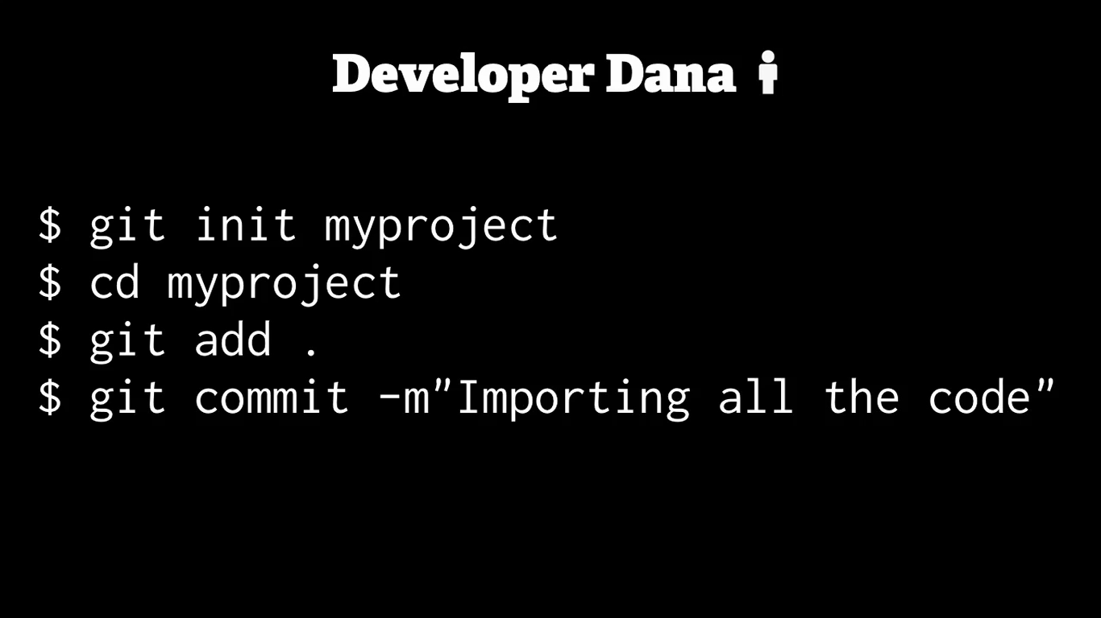

Slide 12
Distributed git
Team-centric so that collaboration happen naturally.

Slide 13
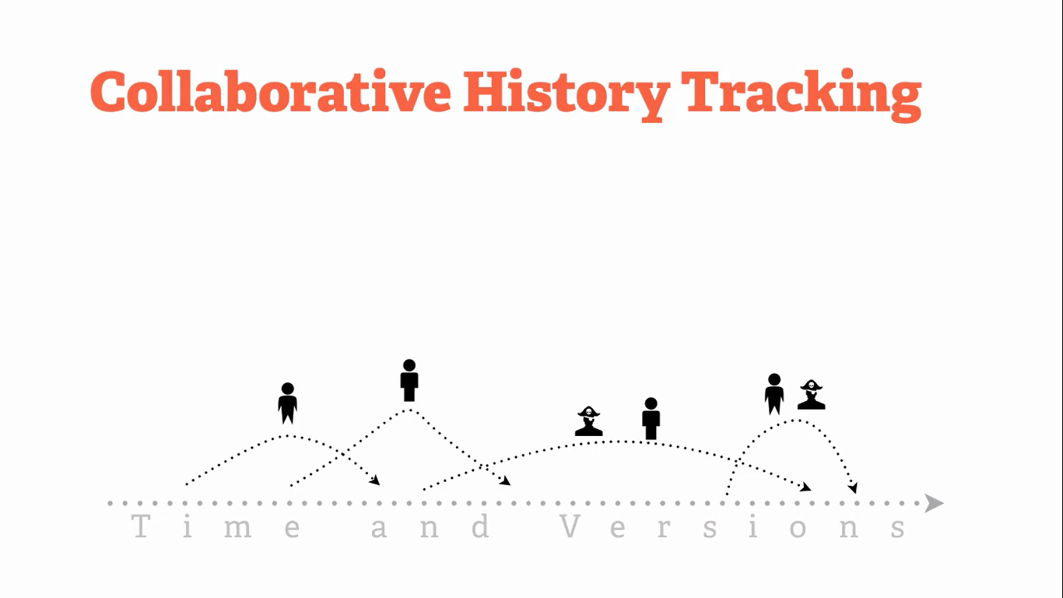

Slide 14
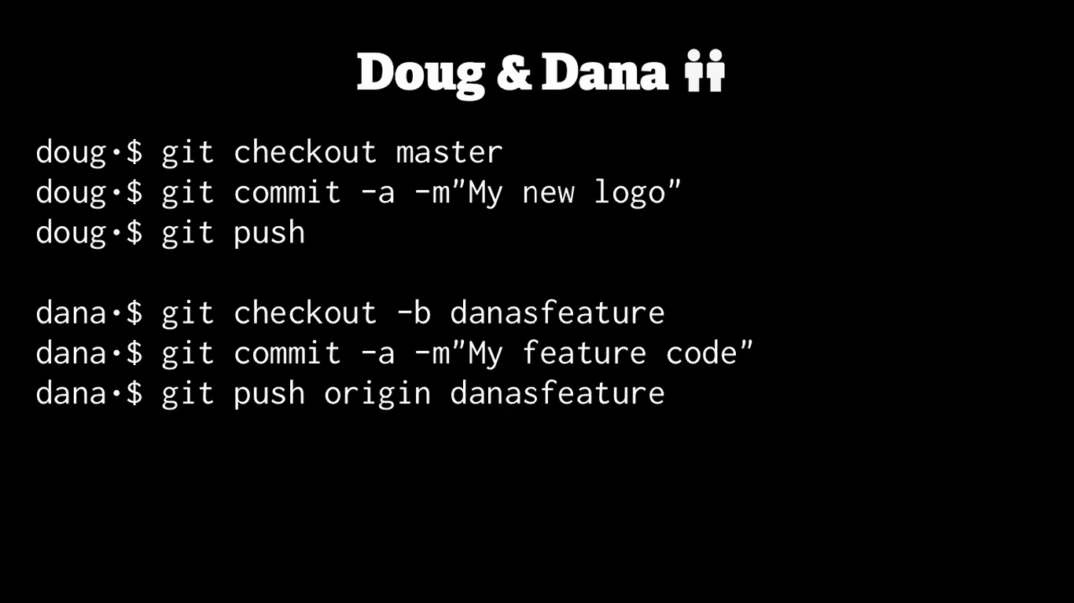

Slide 15
.Gitignore File
Git sees every file in your working copy as one of three things:
1)tracked - a file which has been previously staged or committed;
2)untracked - a file which has not been staged or committed; or
3)ignored - a file which Git has been explicitly told to ignore.

Slide 16
.Gitignore File
Ignored files are usually build artifacts and machine generated files that can be derived from your repository source or should otherwise not be committed. Some common examples are:
Dependency caches, such as the contents of /node_modulesor /packages ,compiled code, such as .o, .pyc, and .class files, build output directories, such as /bin, /out, or /target, files generated at runtime, such as .log, .lock, or .tmp, hidden system files, such as .DS_Store or Thumbs.db, personal IDE config files, such as .idea/workspace.xml

Slide 17
.Gitignore Patterns
Pattern | Example Matches | Explanation
**/logs | logs/debug.log logs/monday/foo.bar build/logs/debug.log | You can prepend a pattern with a double asterisk to match directories anywhere in the repository.
**/logs/debug.log | logs/debug.log build/logs/debug.log but not logs/build/debug.log | Patterns defined after a negating pattern will re-ignore any previously negated files.
/debug.log | debug.log but not logs/debug.log | Prepending a slash matches files only in the repository root.
debug.log | debug.log logs/debug.log | By default, patterns match files in any directory.

Slide 18
.Gitignore Patterns
Pattern | Example Matches | Explanation
logs | logs logs/debug.log logs/latest/foo.bar build/logs build/logs/debug.log | If you don't append a slash, the pattern will match both files and the contents of directories with that name. In the example matches on the left, both directories and files named logs are ignored.
logs/ | logs/debug.log logs/latest/foo.bar build/logs/foo.bar build/logs/latest/debug.log | Appending a slash indicates the pattern is a directory. The entire contents of any directory in the repository matching that name – including all of its files and subdirectories – will be ignored
logs/debug.log | logs/debug.log but not debug.log build/logs/debug.log | Patterns specifying a file in a particular directory are relative to the repository root. (You can prepend a slash if you like, but it doesn't do anything special.)

Slide 19
Git Conflicts
Version control systems are all about managing contributions between multiple distributed authors ( usually developers ). Sometimes multiple developers may try to edit the same content.
If Developer A tries to edit code that Developer B is editing a conflict may occur.

Slide 20
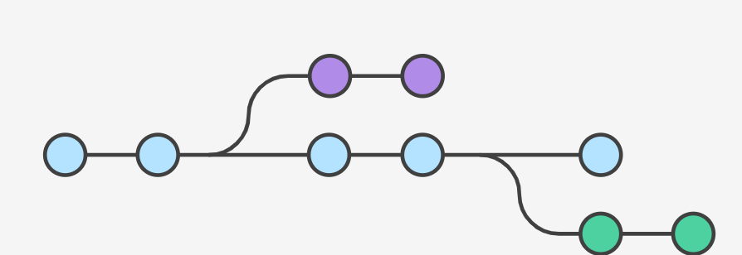
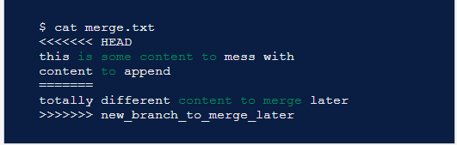
Branch Structure

Slide 21
Git Basics Commands
Number | Command | Description
1 | git init [repository name] | This command is used to start a new repository(foldername).
2 | git clone url | This comand is used to obtain a repository from existing url.
3 | Git remote –v | List all configured repository.
4 | git branch | List all the branch in the current working directory.
5 | git checkout –b branchname | Create a new branch and switch in to it .
6 | git status | This command list all the files that have to be commited.
7 | git add . (Or) git add [file name] | This command add one or more files to the working directory.
8 | Git commit –m “message” | Commit changes.
9 | Git push origin branchname | Push a branch to remote repository.
10 | Git pull origin branchname | Pull the changes from the remote repository.
11 | Git checkout branchname | Switched to the branch.

Slide 22
Git Commands
Number | Command | Description
11 | Git branch –d branchname | Delete a branch.
12 | Git push origin –delete branchname | Delete a remote branch.
13 | Git log | View changes.
14 | Git rm filename | Used to delete file from the current working directory or collection of files.
15 | Git reset . | It will reset the current working directory.
16 | Git checkout . | It will prepare for working on a branch.
17 | Git clean -f | It will used for undoing the changes that are commited.
18 | Git -rm –r –cached directoryname | It will remove the directory and r is used for recursive that means every files in the directory will be removed.

Slide 23
THANK YOU.

