Slide 1
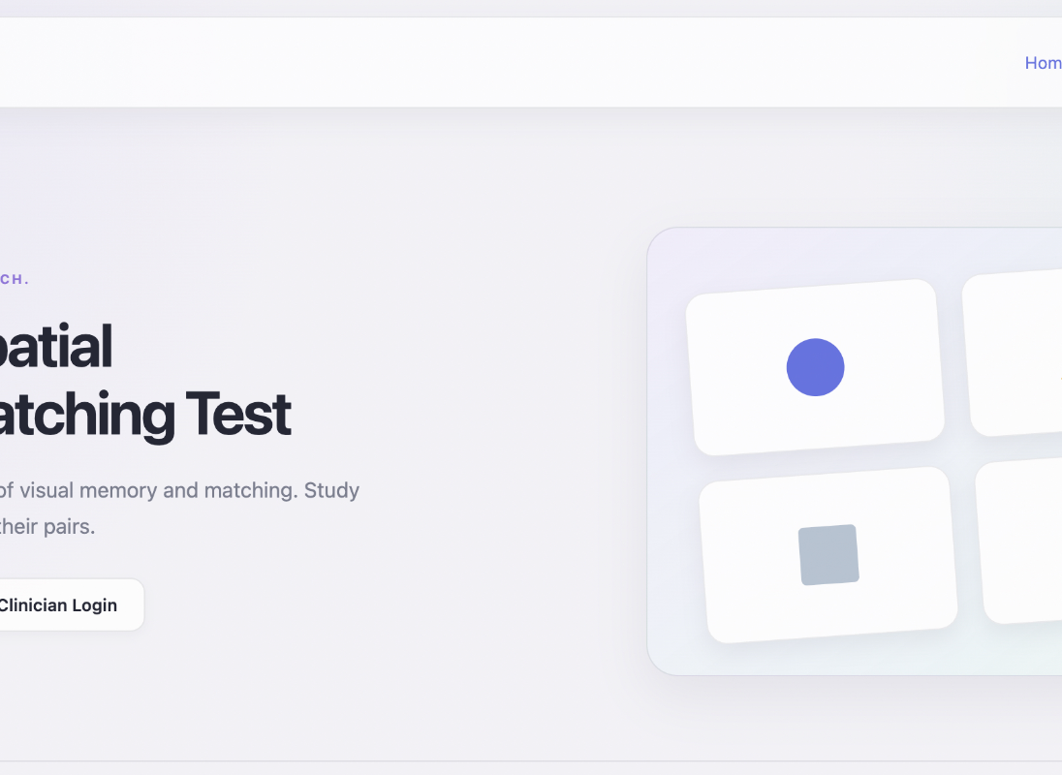
COMPUTER SCIENCE SENIOR PROJECT
Final Backend Design
Visuospatial Assessment
Django backend design for persistent patient sessions, response-time data, clinician review, and spreadsheet export.
View functions
Database models
Test data
Doctor dashboard
CSV export
Current frontend prototype
Backend goal
Move session state and results from browser memory into validated, persistent server-side records.

Slide 2
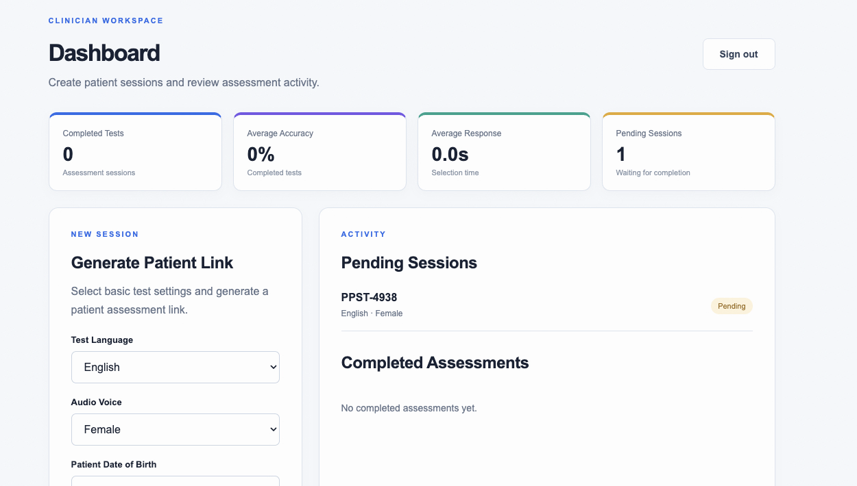
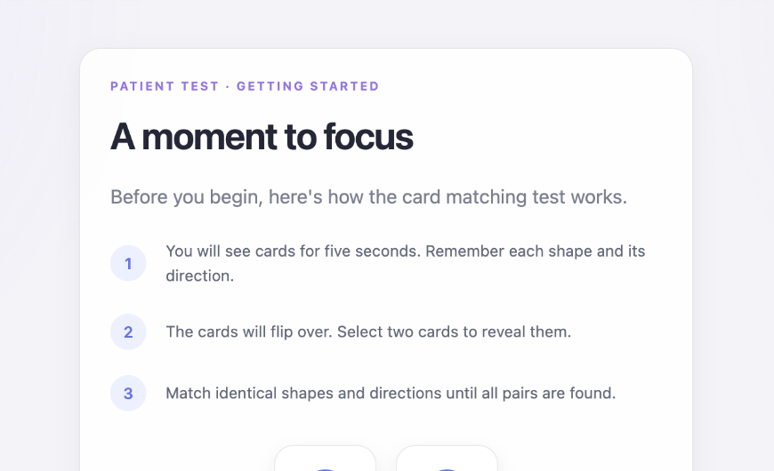
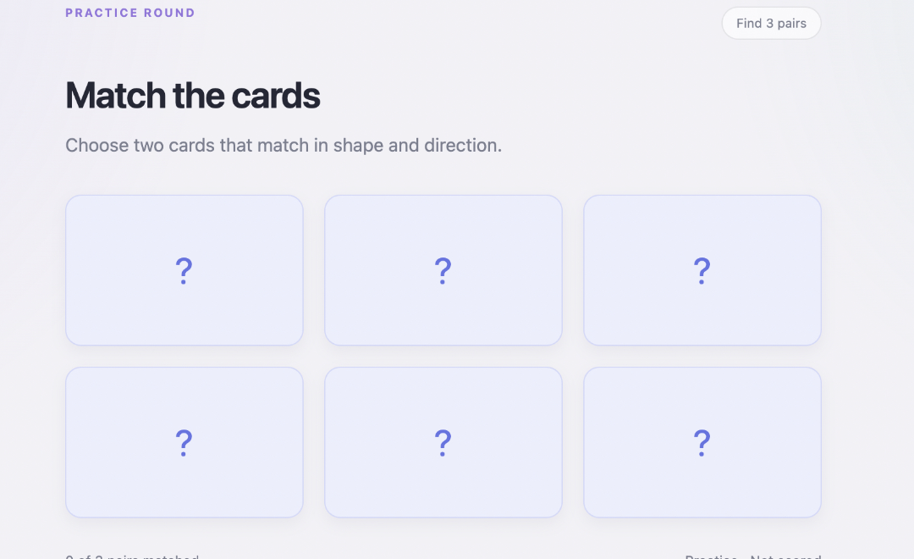
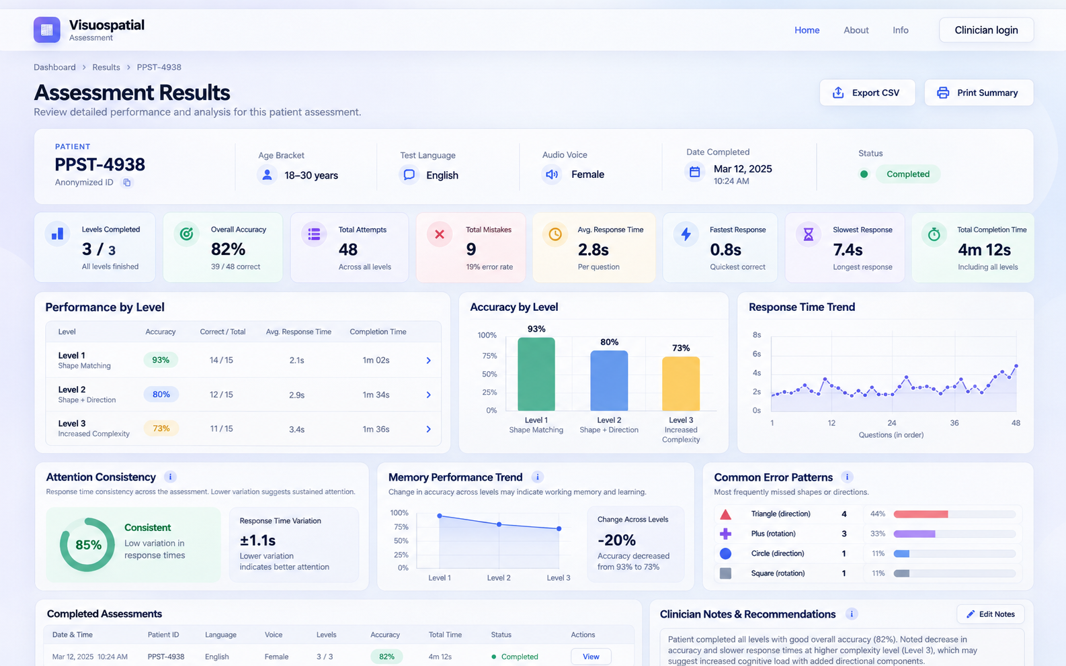
FROM FRONTEND TO BACKEND
Every page maps to a server responsibility
The current frontend is already defined; the backend now supplies persistence, validation, authorization, and data services.
Clinician dashboard
Patient instructions
Assessment page
Final results design
Dashboard
Instructions
Assessment
Results
Authenticate clinician
Read sessions/results
Create patient links
Validate session token
Load test configuration
Mark test started
Accept attempt data
Store response latency
Return progress state
Aggregate metrics
Authorize access
Export CSV
Design boundary: the frontend controls presentation and interaction; Django becomes the source of truth for users, sessions, attempts, and results.

Slide 3
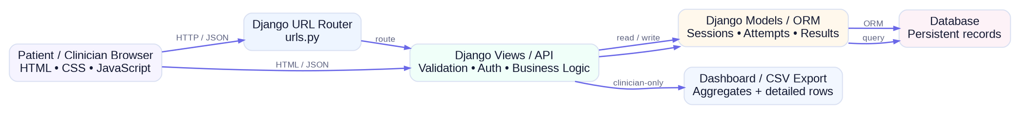
SYSTEM ARCHITECTURE
End-to-end backend flow
A small Django application can support the full clinician → patient → result workflow.
Browser / JavaScript
Django backend
Database / outputs
Render pages and collect clicks
Authenticate / authorize
Store sessions and attempts
Measure response latency
Validate requests
Drive doctor dashboard
Send JSON to Django
Calculate and persist results
Produce CSV rows

Slide 4
VIEW FUNCTIONS
Planned Django views and API endpoints
Each frontend action has one clear server-side entry point.
Method
Endpoint
Frontend use
Main backend action
POST
/login/
Clinician sign-in
Authenticate user; start session
POST
/api/sessions/
Generate patient link
Validate settings; create pending session + token
GET
/patient/<token>/
Open patient test
Validate token; load config; mark started
POST
/api/sessions/<id>/attempts/
Submit attempt
Validate selection; save latency and correctness
POST
/api/sessions/<id>/complete/
Finish assessment
Aggregate attempts; create result; mark completed
GET
/dashboard/
Dashboard
Read clinician-owned pending/completed sessions
GET
/api/results/<id>/
Result detail
Read summary + attempt detail
GET
/api/results/<id>/export.csv
Spreadsheet export
Stream CSV for authorized clinician
POST
/logout/
Sign out
End clinician session
All patient write endpoints must validate the session token; all clinician result endpoints must verify ownership.

Slide 5
VIEW LOGIC
Plain-English logic for the critical backend functions
These are the main behaviors the implementation should follow.
create_session()
open_patient_test()
Require authenticated clinician.
Hash/lookup invitation token.
Validate DOB, language, voice, difficulty, and mode.
Reject expired or already completed sessions.
Create UUID session + random expiring token.
Set status = IN_PROGRESS and started_at once.
Store status = PENDING and return patient URL.
Return test configuration to the patient page.
submit_attempt()
complete_assessment()
Validate session + attempt payload.
Load all stored attempts for the session.
Save card choices, correctness, attempt number, and latency_ms.
Calculate accuracy, errors, timing, and per-level summary.
Return updated progress; never trust derived client totals.
Create/update AssessmentResult inside a transaction.
Keep attempt rows append-only for auditability.
Mark session COMPLETED and return result ID.

Slide 6
DATABASE INTERACTIONS
What each view reads and writes
This mapping directly answers which database accesses are required by each view function.
View
Reads
Writes
Why
create_session
ClinicianProfile
AssessmentSession
Creates patient invitation and configuration
open_patient_test
AssessmentSession
AssessmentSession.started_at/status
Validates invitation and starts session
submit_attempt
AssessmentSession, AssessmentRound
ResponseEvent
Stores one immutable attempt row
complete_assessment
ResponseEvent, AssessmentRound
AssessmentResult, AssessmentSession
Calculates final summary in transaction
dashboard
AssessmentSession, AssessmentResult
—
Clinician-scoped counts and averages
result_detail
AssessmentResult, ResponseEvent
—
Summary + per-round/shape detail
export_csv
AssessmentSession, AssessmentResult, ResponseEvent
—
Streams doctor/spreadsheet export
Transaction boundary: completing an assessment should save the result and update session status together so the dashboard never sees a partial completion.

Slide 7
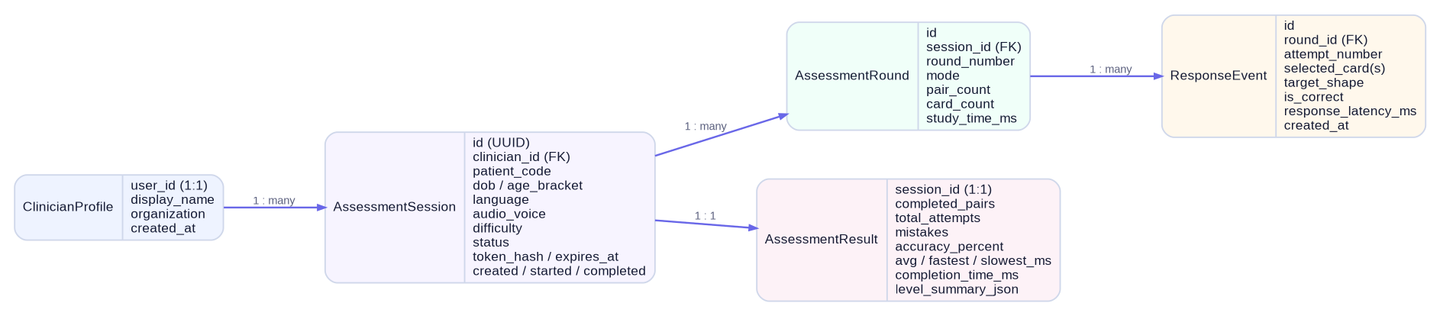
MODEL CLASSES
Database schema and relationships
The combined database needs resolve into five small Django model classes.
ClinicianProfile
AssessmentSession
AssessmentRound
user, display_name, organization
UUID, clinician, patient_code, DOB/age bracket, language, voice, difficulty, status, token expiry, timestamps
session, round_number, mode, pair_count, card_count, study_time_ms
ResponseEvent
AssessmentResult
round, attempt_number, selections, target shape, correct?, response_latency_ms, timestamp
session, pairs, attempts, mistakes, accuracy, avg/fastest/slowest latency, completion time, level summary

Slide 8
TEST DATA COLLECTION
Response latency and attempt-level data
The professor emphasized that the test data must support both the doctor dashboard and spreadsheet export.
Attempt data saved
Derived result metrics
Example JSON payload
session / round ID
accuracy %
{
"session_id": "VSA-4938",
"round": 2,
"attempt": 7,
"selected": [3, 6],
"is_correct": true,
"response_latency_ms": 2840
}
attempt number
total attempts
selected card(s)
mistakes / error rate
target shape (target-match mode)
completed pairs
correct or mismatch
average latency
response_latency_ms
fastest / slowest latency
timestamp
total completion time
Latency is measured in JavaScript with performance.now(); the server stores the submitted value and computes summaries from persisted attempt rows.

Slide 9
DOCTOR DASHBOARD + SPREADSHEET
How stored data becomes useful clinician output
The backend queries the same records for dashboard summaries, age-group comparisons, individual results, and CSV export.
Dashboard queries
Pending/completed counts
Average accuracy and response time
Completed tests grouped by age bracket
Per-level accuracy and timing
Most common error shapes / directions
Age categories
Example groups: Under 18 • 18–29 • 30–44 • 45–59 • 60+
Calculated from DOB at query time or stored as a derived bracket.
CSV export columns
session ID • age bracket • date • mode • difficulty • attempts • mistakes • accuracy • avg latency • completion time
Final results design

Slide 10
SECURITY AND VALIDATION
Controls required before real patient data is stored
The prototype is local and in-memory; production behavior must move trust and authorization to the server.
01
Clinician authentication
02
Ownership checks
Use Django auth; protect dashboard, result, and export endpoints.
A clinician can only read sessions/results created by that clinician or authorized clinic.
03
Expiring patient links
04
Server validation
Store only a hash of a random token; enforce expiration and one-session scope.
Validate mode, card indexes, attempt numbers, status transitions, and required fields.
05
Data minimization
06
Atomic completion
Prefer anonymous patient code + DOB/age bracket; avoid unnecessary identifying data.
Calculate result and mark COMPLETED inside one transaction.
07
Error handling
08
Audit timestamps
Return clear 400/401/403/404 responses without exposing internal details.
Keep created, started, completed, and attempt timestamps for review and debugging.

Slide 11
BACKEND DESIGN COMPLETE
Requirements covered and implementation order
This design is ready to move into the first two-week sprint.
Professor requirements
Recommended Sprint 1 order
✓
View functions described in plain English / pseudocode
1
Create Django app + models
Run migrations and verify admin records.
✓
Database reads and writes mapped per view
2
Clinician authentication
Protect dashboard and result routes.
✓
Model classes and fields defined
Create session + token
Generate persistent patient links.
3
✓
Relationships between models identified
4
Attempt submission API
Save response latency and correctness.
✓
Response latency and attempt data specified
5
Completion + result logic
Aggregate attempts and mark completed.
✓
Doctor dashboard data needs supported
6
Dashboard + CSV
Read stored results and export rows.
✓
Spreadsheet / CSV export supported
Final design document can now combine the completed frontend deck with this backend deck.

