Slide 1
Project Topic:
Motion Based message conveyor for Paralytic/Disabled Person.

Slide 2
INTRODUCTION
Among the large number of advancements done in the medical sector, very few actually focus on helping patients with disabilities to communicate.
Monitoring Systems make it easier for doctors to collect and observe a patient’s vitals.
In the current scenario , the patient has to be dependent on a family member or mostly a ward boy both of which have to attend to the patient constantly.
Our objective is to make such patients independent to communicate with the nurse by the simple task of tilting a device located on his finger or any other part of the body that is capable of movement.
This will not only help the patient but also easy out the nurse’s job.
As a single nurse is responsible for a number of patients, the time required for each nurse to visit every patient to meet his needs will be saved.
After the patient sends the message the nurse can remotely monitor their requests and provide assistance without any further delay. A buzzer located at the nurse’s desk will alert the nurse in case of an emergency.

Slide 3
Problem of Paralytic Persons.
The person who is affected with paralysis is not able to move any part of body .
So therefore he/she is not able to speak properly.
Due to this the Nurse / Family member is not able to get what the patient want to say to you.
There are various types of Paralysis .

Slide 4
Solution
The motion based message conveyor is a hardware that can help the patient.
Consider An example that an patient has a paralytic attack in which his finger is only working.
If the patient want to call the nurse he/she has to tilt the finger in any direction.
when the patient tilt finger the message will sent to nurse who is sitting on her desk in another room.
So the nurse can fulfill the requirements of the patient easily and Faster.

Slide 5

Software Requirement
Keil :
Keil is a development tool that is used to develop code for microcontroller. Keil is the first Embedded C . Keil also help use to create HEX file that is used by the Microcontroller. It is same as C . It also have Complier , Debugger , Library Manager and many more.

Slide 6

Proteus :
The Proteus Design Suite is a proprietary software tool suite used primarily for electronic design automation. The software is used mainly by electronic design engineers and electronic technicians to create electronic schematics and electronic prints for manufacturing printed circuit boards.

Slide 7
Hardware Requirement
8051 Microcontroller.
RF Receiver & RF Transmitter.
PCB/GPP.
And many more
(Register ,Capacitor ,Relay ,Diode ,Crystal ,LDR , Push button Etc……)

Slide 8
8051 Microcontroller
AT89C51 is an 8-bit Microcontroller and belongs to Atmel's 8051 family. ATMEL 89C51 has 4KB of Flash programmable and erasable read only memory (PEROM) and 128 bytes of RAM. It can be erased and program to a maximum of 1000 times.
There are 40 Pins in AT89C51, there are four designed as P1,P2,P3 and P0. All these ports are 8-bit bi-directional ports ,i.e., they can be used as both input and output ports.

Slide 9
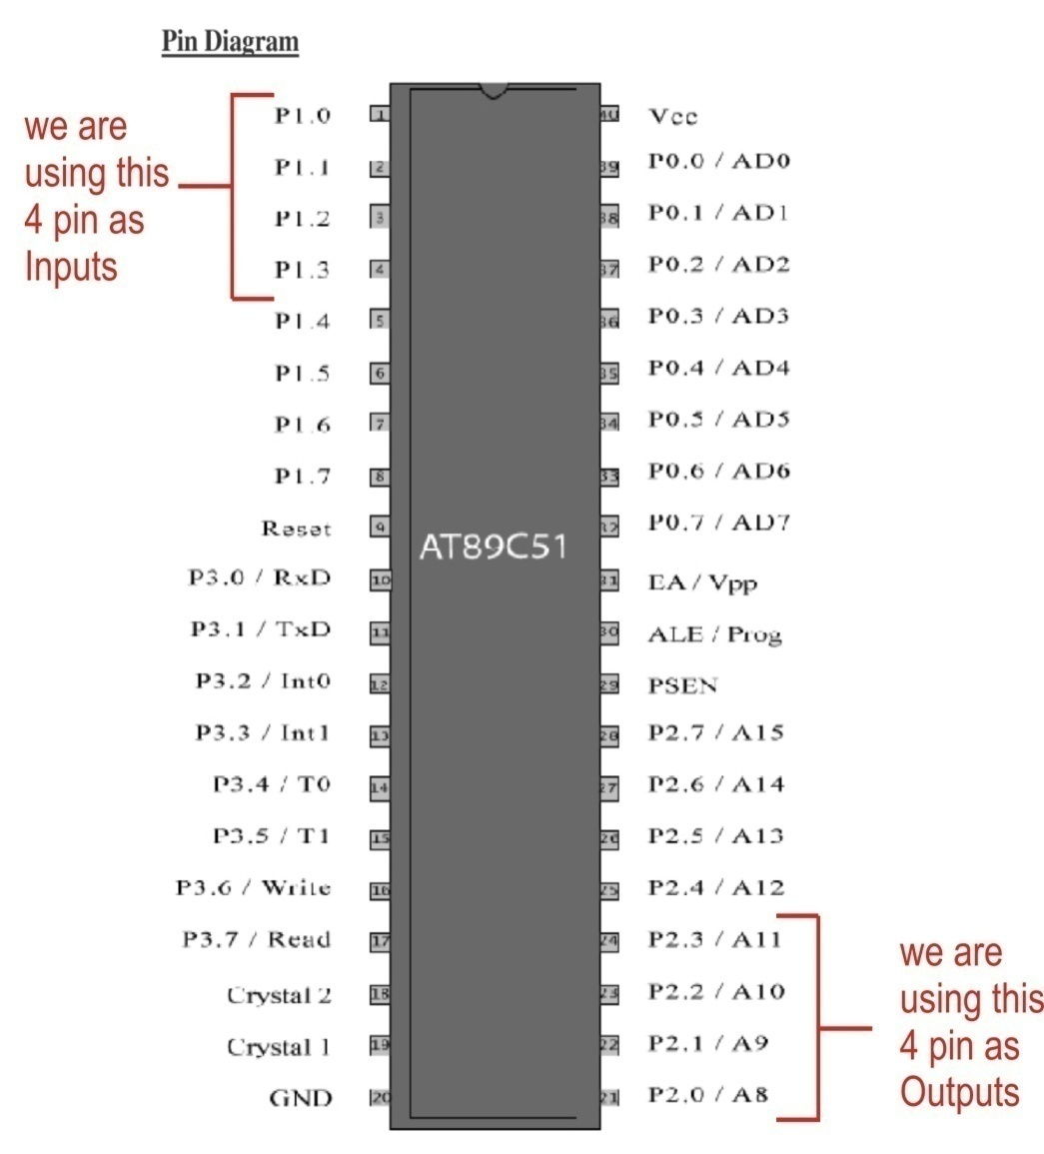
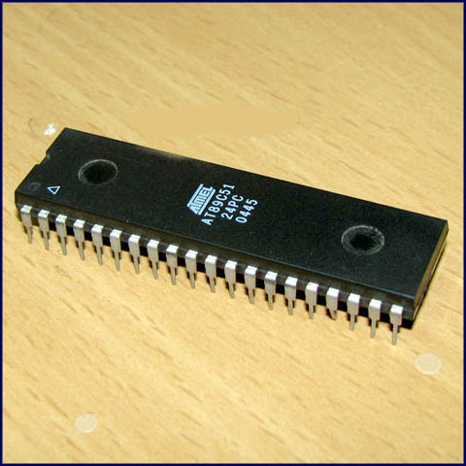
Pin Diagram

Slide 10
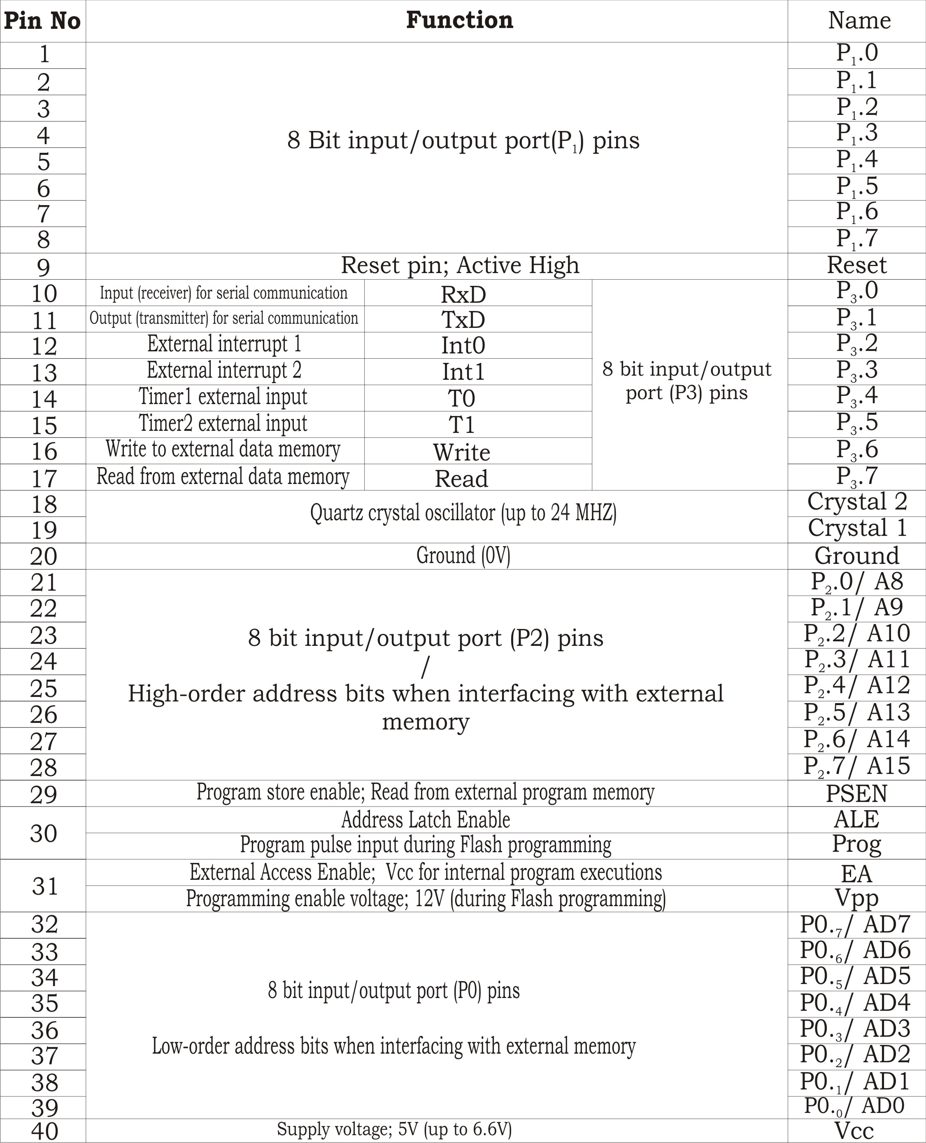
Pin Description

Slide 11
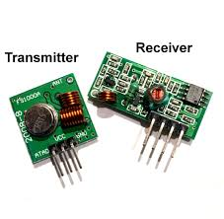
RF Transmitter & Receiver
An RF module (radio frequency module) is a (usually) small electronic device used to transmit and/or receive radio signals between two devices. In an embedded system it is often desirable to communicate with another device wirelessly. This wireless communication may be accomplished through optical communication or through radio frequency (RF) communication.
Transmission through RF is better than IR (infrared) because of many reasons. Firstly, signals through RF can travel through larger distances making it suitable for long range applications. Also, while IR mostly operates in line-of-sight mode, RF signals can travel even when there is an obstruction between transmitter & receiver. Next, RF transmission is more strong and reliable than IR transmission. RF communication uses a specific frequency unlike IR signals which are affected by other IR emitting sources.

Slide 12
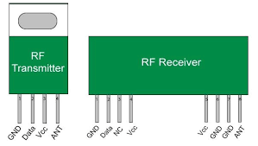
RF Transmitter & Receiver Pin Diagram

Slide 13
Pin Description
For Transmitter
For Receiver
Pin No | Function | Name
1 | Ground (0V) | Ground
2 | Serial data output pin | Data
3 | Linear output pin; not connected | NC
4 | Supply voltage; 5V | Vcc
5 | Supply voltage; 5V | Vcc
6 | Ground (0V) | Ground
7 | Ground (0V) | Ground
8 | Antenna input pin | ANT
Pin No | Function | Name
1 | Ground (0V) | Ground
2 | Serial data input pin | Data
3 | Supply voltage; 5V | Vcc
4 | Antenna output pin | ANT

Slide 14
Block Diagram of Our ckt

Slide 15
Advantage
It is low Cost . If we made device more in quantity.
It is easy to use and it is user friendly device.
Using this device we find what the patient want to say.
No longer wire is need to send data from patient to nurse.

Slide 16
Disadvantage
This device is not waterproof.
This device can give only four output. In future we can make make more output .
It may suffered from dust or the hardware may get damage after sometime. To protect them from dust and water Silicon Gel is used. But if we use Silicon Gel it will get fixed.
It will not work for those person whose hand is not working because we have made the device for only hand.

Slide 17
References:
http://www.atmel.com/images/doc0265.pdf This link contain information about 8051 Micro Controller.
https://www.engineersgarage.com/electronic-components/rfmodule-transmitter-receiver This link contain information about RF transmitter & Receiver.
http://datasheet.octopart.com/A000066-Arduino-datasheet -38879526.pdf This link contain information about Arduino.
https://www.sparkfun.com/datasheets/Components/SMD/ adxl335.pdf This link contain information about Accelerometer.

Slide 18
Thank You!!!!!

