Slide 1
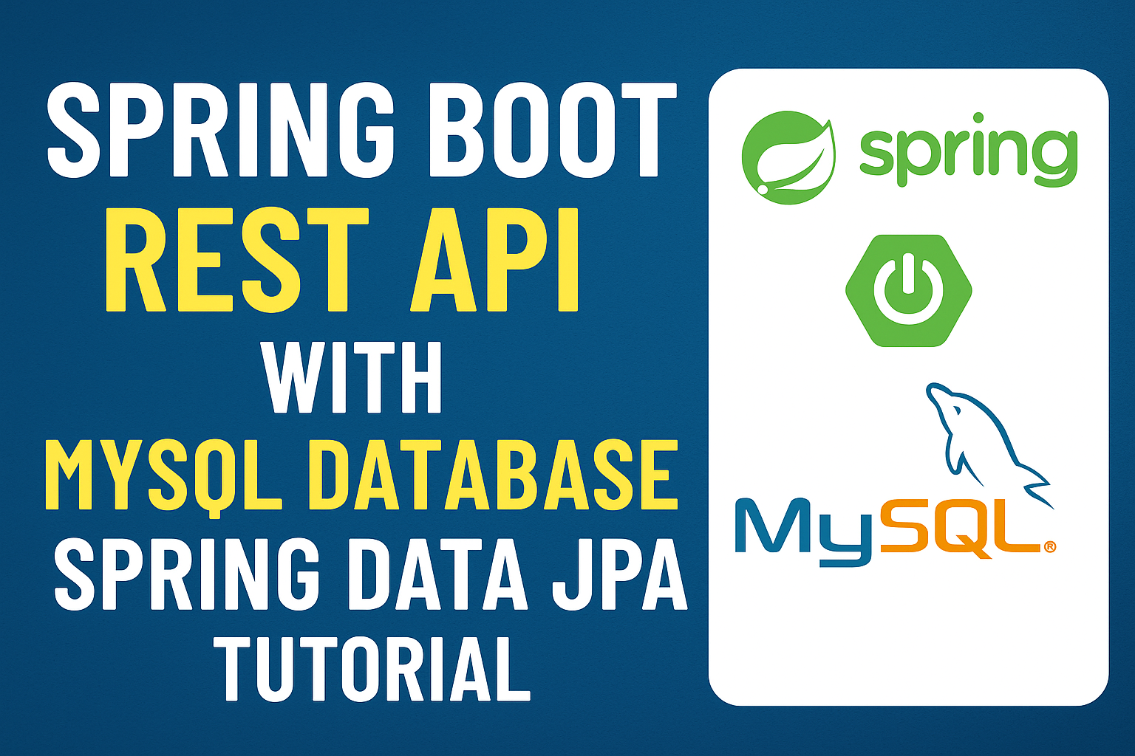

Slide 2
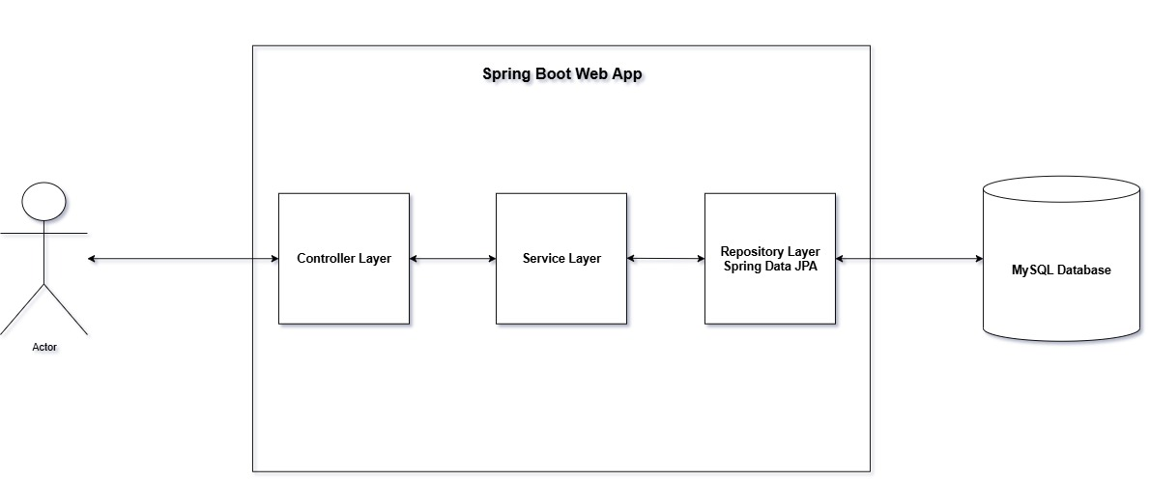

Slide 3
Agenda
Introduction to our topic
Refer to my previous Spring Boot video to get started. Go to Github for the same
What we are going to cover show that diagram and explain high level
Start with
Pom.xml -> add dependency
Application.yaml config
Repository layer
Entity
Update service layer
Test API via Postman

