Slide 1
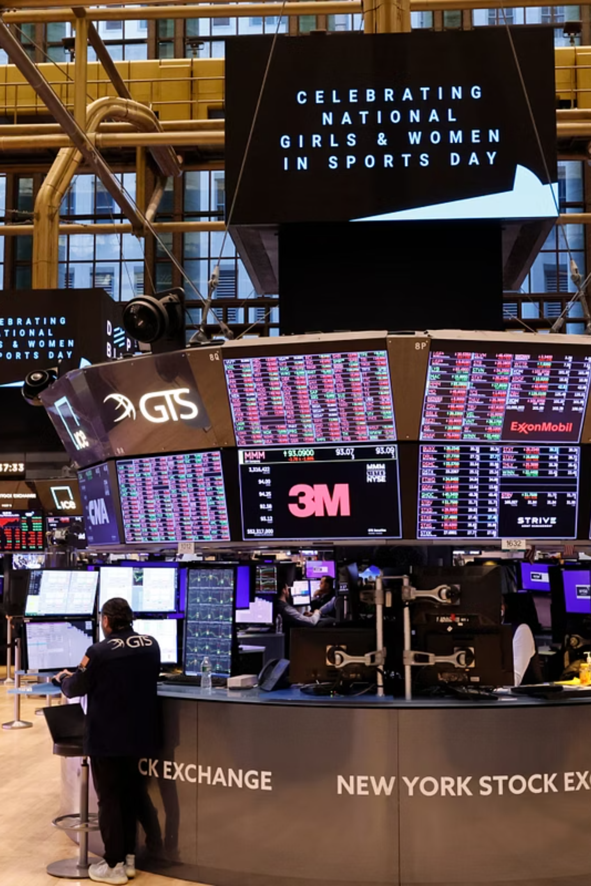
Multi-Modal Earnings Call Volatility Prediction
Predicting post-earnings stock volatility by detecting divergence between what management says and how they say it — fusing language, acoustics, and deep audio representations.
Aryan Kumar Sinha (25070149032)
Shubh Khare (2570149035)

Slide 2
Project Objective & Motivation
Core Hypothesis
Goal
Key Signal
Official transcripts capture what is said — but vocal stress signals encode what language alone cannot. Micro-tremors in pitch, jitter, and tonal instability are physiological markers of executive stress that sentiment models systematically miss.
Predict post-earnings call stock volatility using multi-modal divergence signals across text and audio.
Acoustic stress markers (pitch jitter, shimmer, HNR) that are absent from transcript-based NLP pipelines.

Slide 3



The Data Foundation: Three Modalities
Acoustic Features — 29D
Textual Embeddings — 768D
Audio Representations — 768D
Extracted via Praat & librosa at utterance level. Captures pitch (F0), intensity, jitter, shimmer, HNR, and MFCCs — physiological markers of vocal arousal and stress.
Generated by FinBERT, pre-trained on TRC2-financial and Yahoo Finance corpora. Captures domain-specific sentiment, forward guidance tone, and linguistic context.
Generated by wav2vec2-base-960h via self-supervised CNN-Transformer layers. Captures latent speech patterns orthogonal to hand-crafted prosodic features.

Slide 4
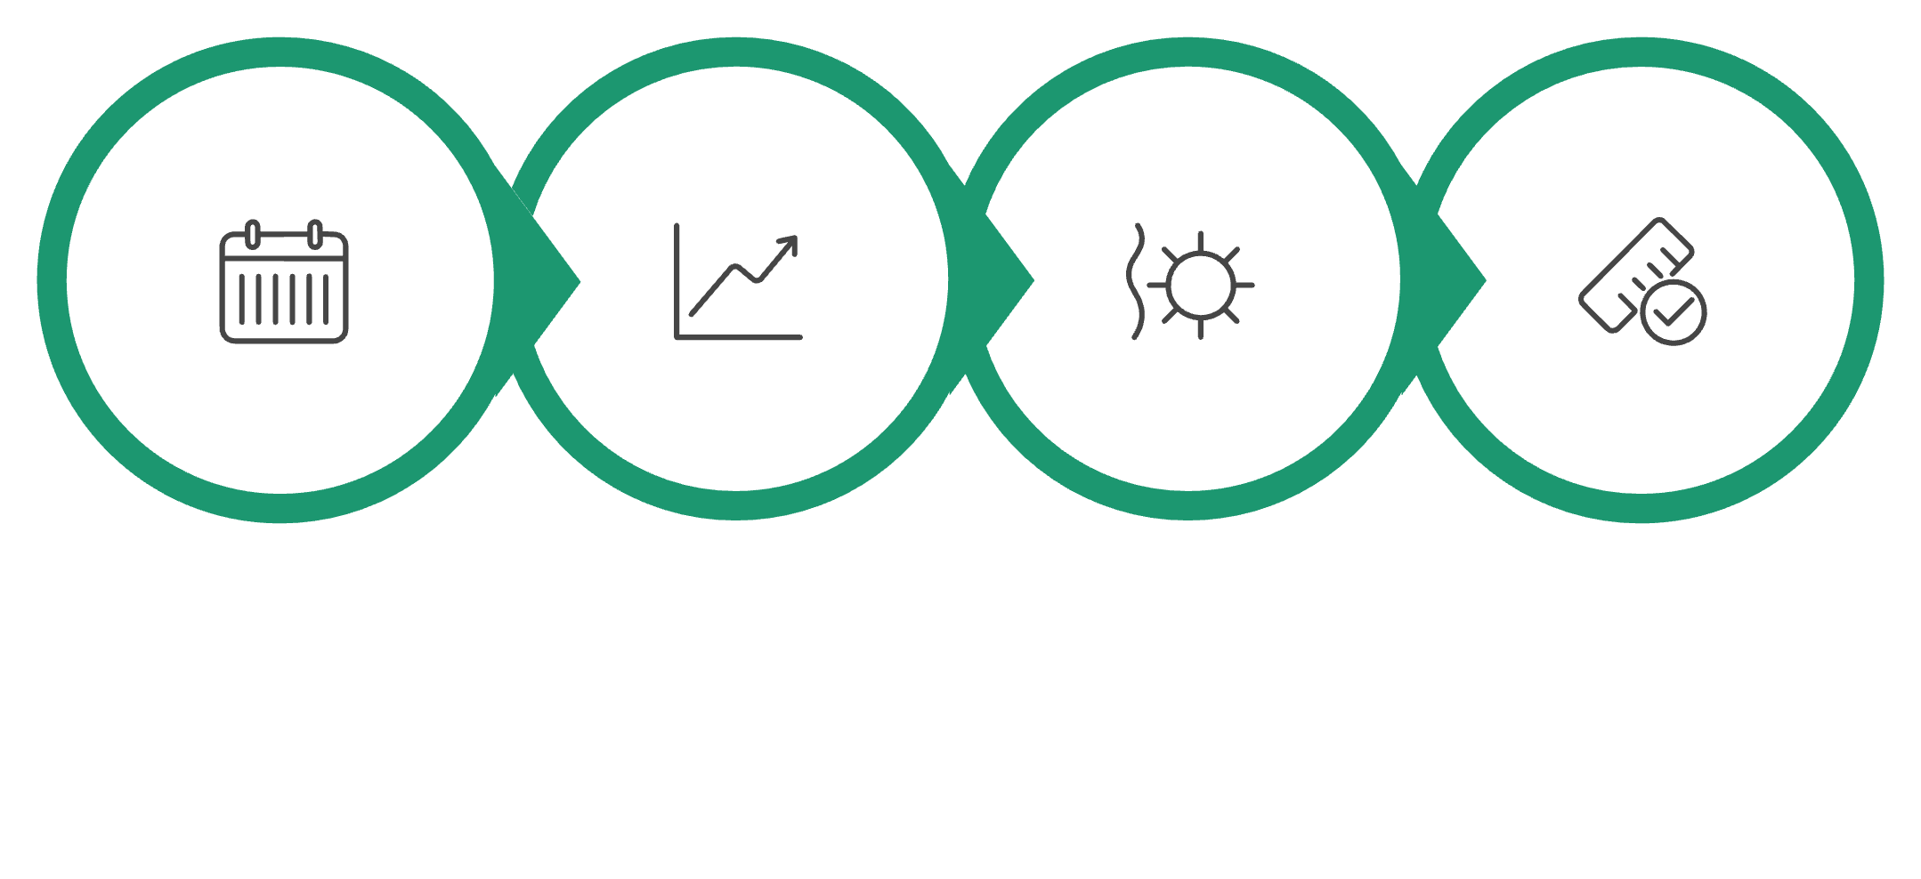

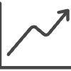


Label Engineering: Abnormal Volatility
Targets are not raw price moves but abnormal volatility — the idiosyncratic component unexplained by market co-movement. This isolates firm-specific information revelation from systemic noise.
Estimation Window
Market Regression
Compute Residuals
Target Labels
Market model: — target is over the post-event window.

Slide 5
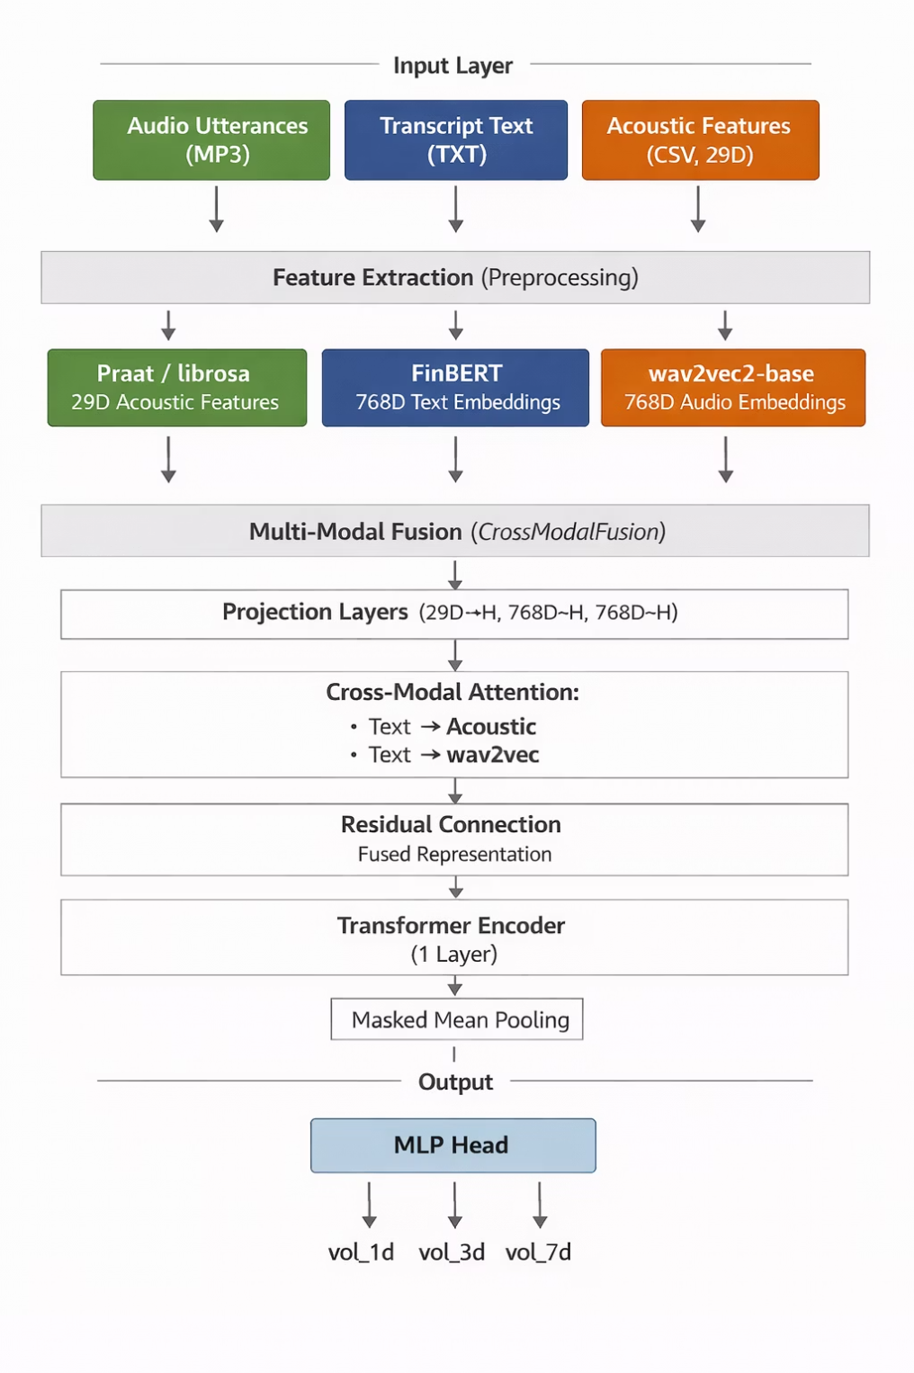
Model Architecture: Cross-Modal Fusion
Key Design Choices
Feature Projections
Linear + LayerNorm + GELU maps all modalities into a shared hidden space (hidden_dim=256).
Cross-Modal Attention
Text as Query attends to Acoustic and wav2vec2 features — detecting acoustic anomalies co-occurring with specific textual segments.
Multi-Task Head
Single MLP jointly predicts 1-, 3-, and 7-day volatility, sharing representations across horizons.

Slide 6
Training Strategy
Optimisation
HuberRank Loss
AdamW optimiser at lr=1e-4 with Cosine Annealing schedule for smooth convergence across multi-task targets.
Combines Huber regression loss with a differentiable Spearman/Pearson correlation term — prioritising relative ranking of volatility over absolute magnitude.
5-Seed Ensemble
Temporal Validation
Ensemble over five random seeds stabilises Spearman ρ and reduces variance in rank correlation across test folds.
Strict train/val split at 2017–2018 boundary. No look-ahead bias — all future data is withheld during training.

Slide 7

Experimental Results
Model Variant
Spearman ρ
Top-Quartile Hit Rate
vs. Baseline
Cross-Modal Fusion
0.42
68%
+35%
Early Fusion (Concat)
0.38
64%
+22%
Text-Only (FinBERT)
0.31
58%
Base
Audio-Only (Acoustic)
0.24
52%
—
0.42
+35%
68%
Spearman ρ
Hit Rate Lift
Top-Quartile
Best rank correlation, Cross-Modal Fusion
Over FinBERT text-only baseline
Correct identification of high-volatility events
Key Takeaway: Cross-modal attention significantly outperforms both unimodal and naive fusion baselines — validating the hypothesis that acoustic divergence from language carries independent predictive signal.

Slide 8
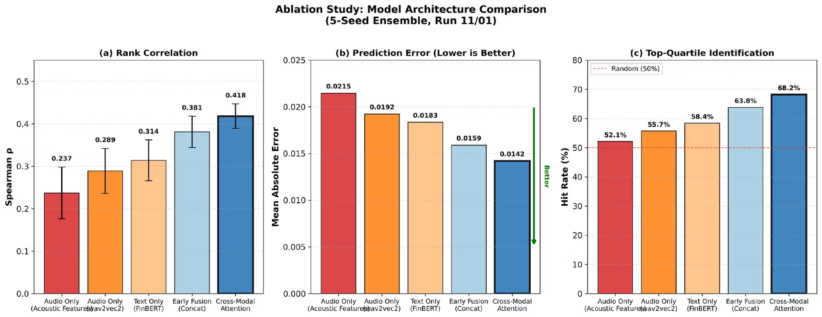
Ablation Study

Slide 9
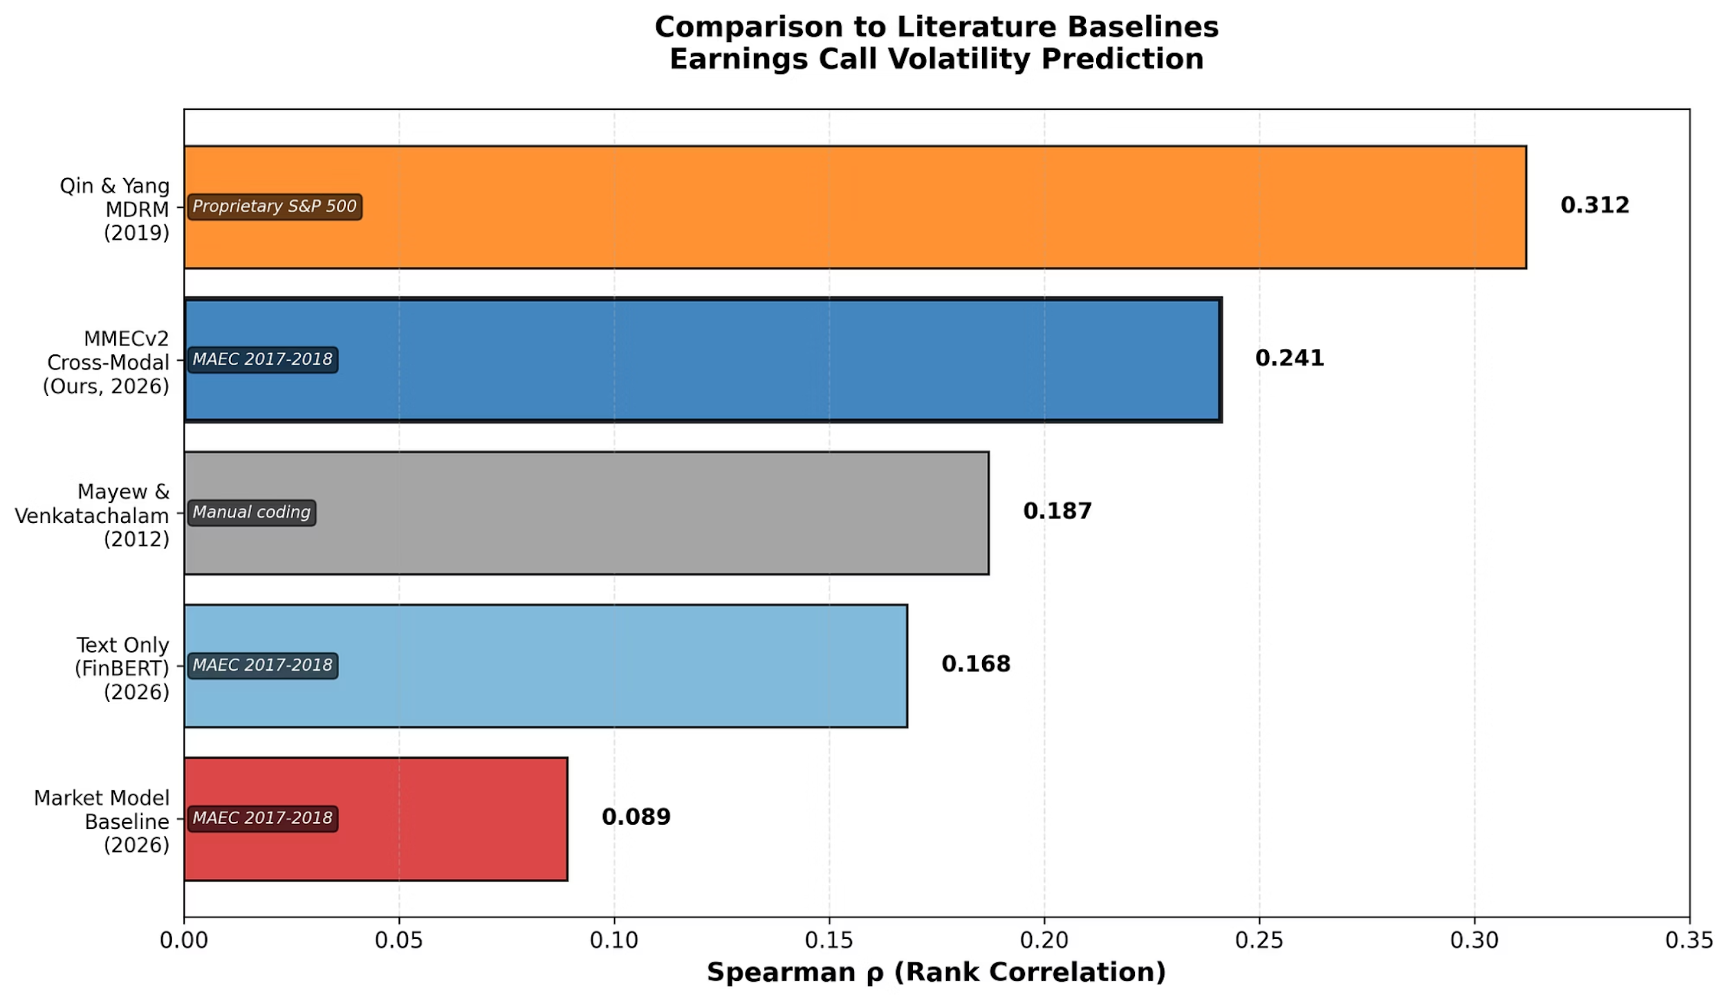
Comparison to Prior Work

Slide 10
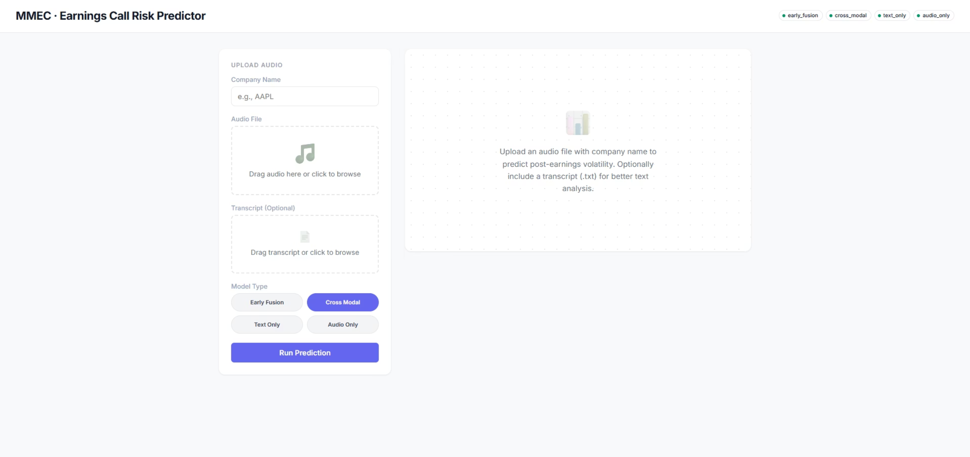

Deployment: Flask Web Application
Production-Ready Inference Pipeline
Async Processing
Interactive UI
Job Tracking
Long audio files are segmented and sampled for fast, non-blocking inference via background job workers.
Users upload audio and transcripts, then receive real-time volatility risk scores with visual breakdowns per horizon.
Real-time status updates surface progress across feature extraction, model inference, and result delivery stages.

Slide 11
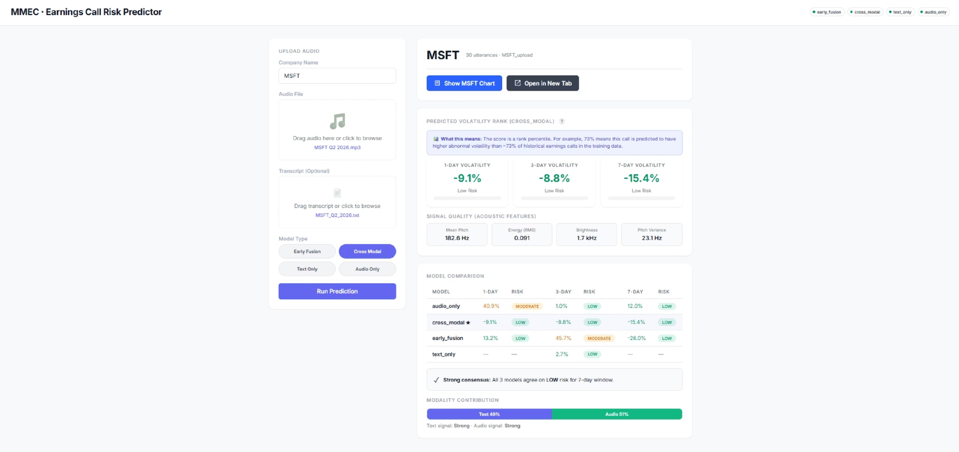
Sample Run on MicroSoft Earning Calls (MSFT)

Slide 12
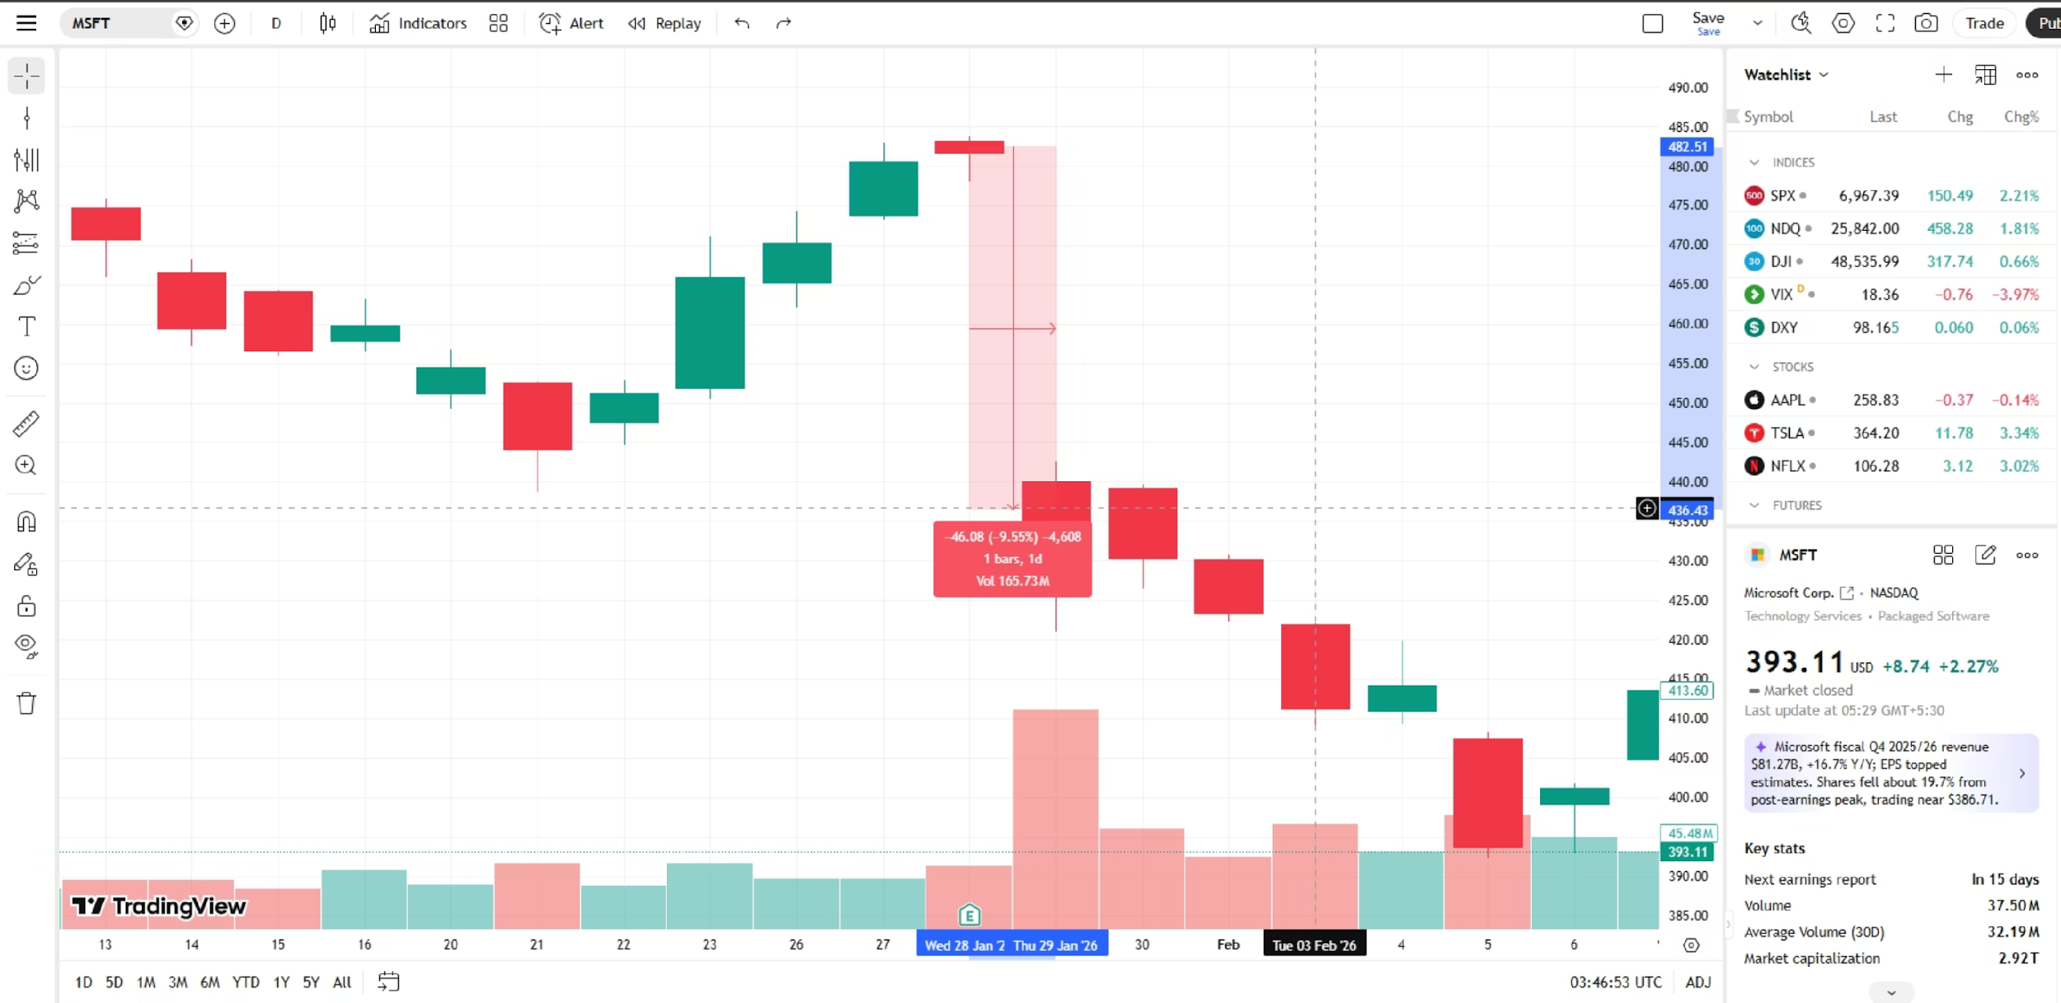
Validating the Prediction - 1D

Slide 13
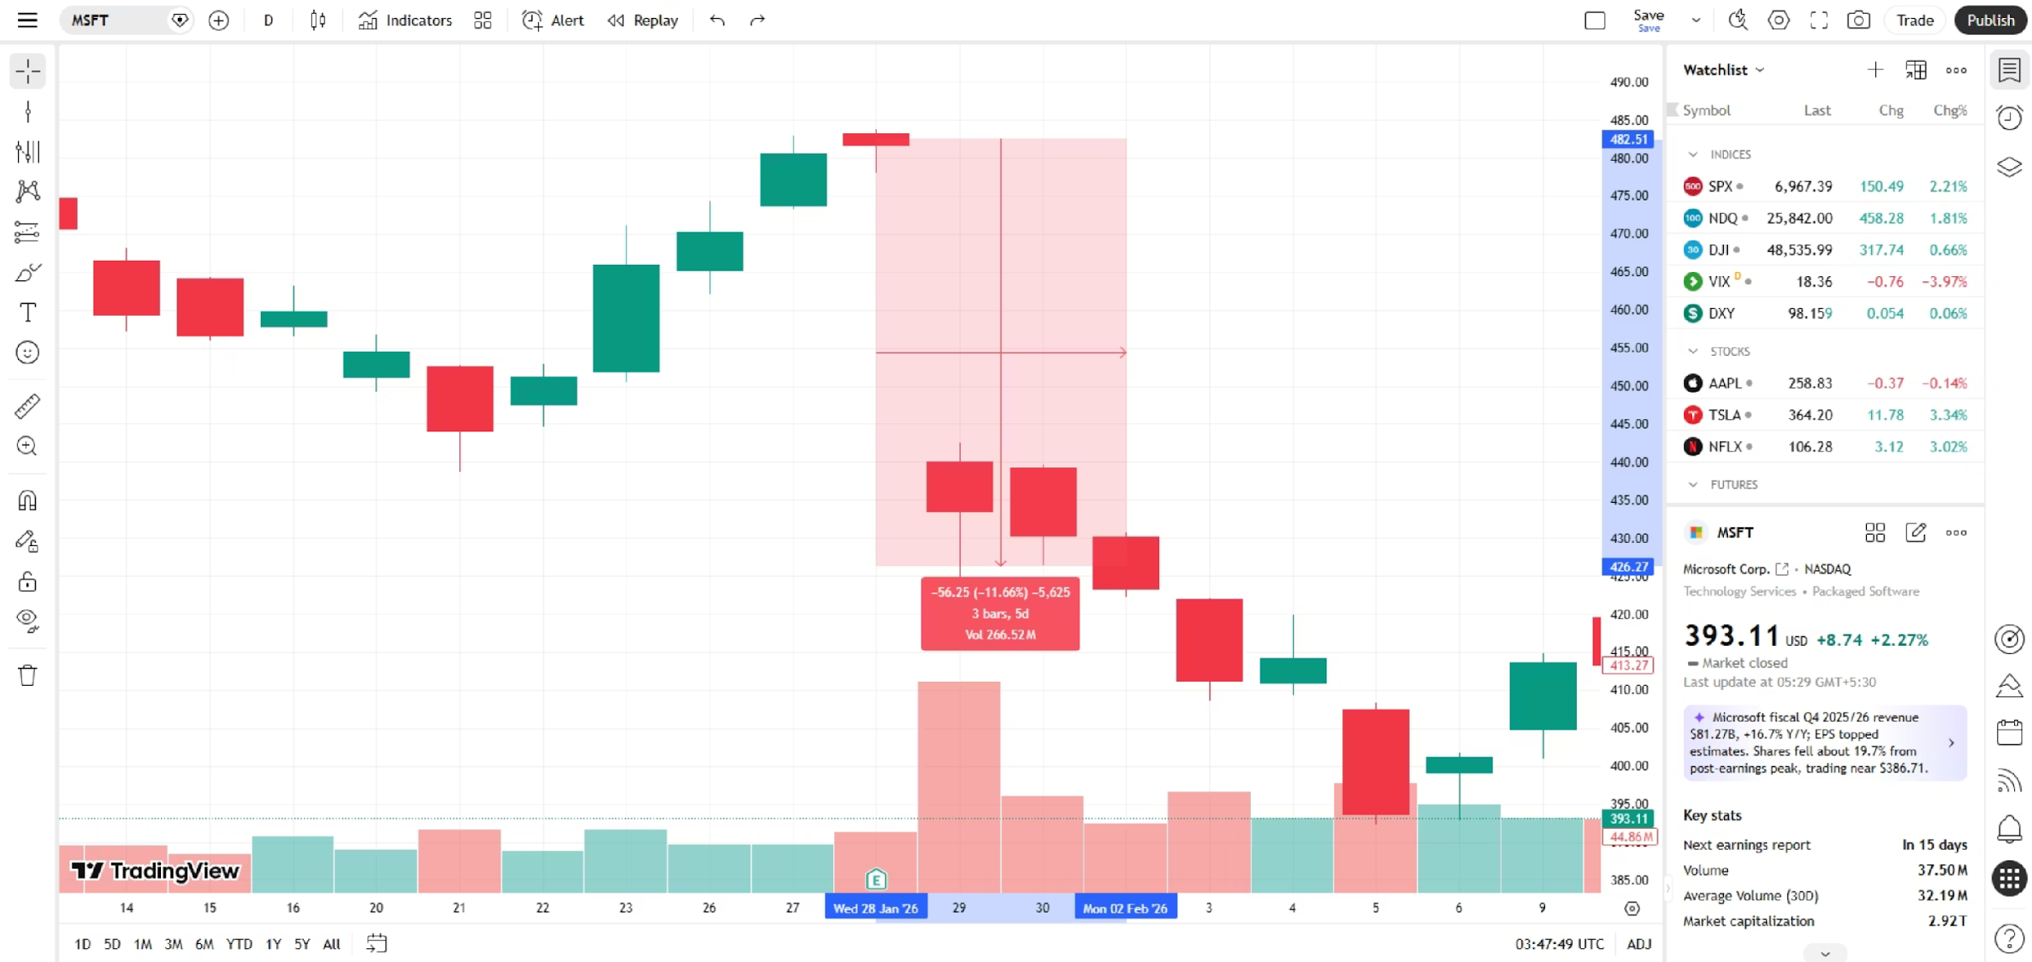
Validating the Prediction - 3D

Slide 14
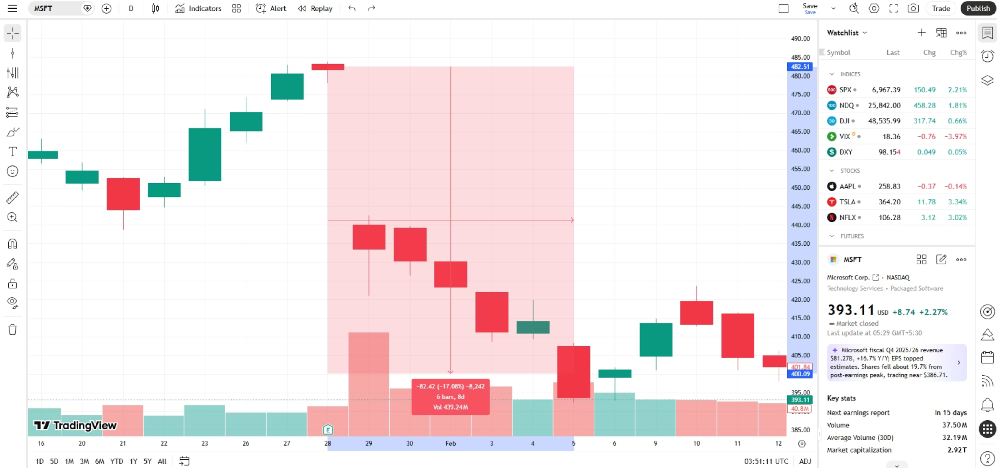
Validating the Prediction - 7D

Slide 15

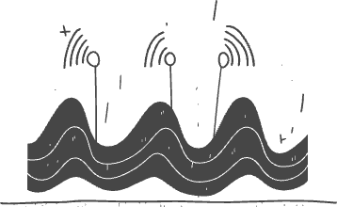
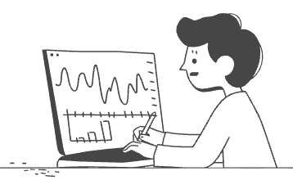
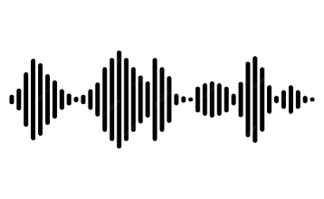



Limitations and Future Work
Data Scarcity & Survivorship Bias
Noisy Label Construction
Temporal Non-Stationarity
Acoustic Modality Shallowness
CAPM-residual volatility is a weak supervision signal; stronger proxies such as option-implied volatility warrant study.
Market regimes shift over time, creating distributional drift; continual learning and domain adaptation remain underused.
Public earnings-call datasets remain limited to large-cap U.S. equities and narrow time windows, constraining generalisability.
Most models rely on utterance-level features, missing prosody and stress patterns across the full call arc.
Speaker Conflation
Evaluation Metric Mismatch
Multimodal Alignment Fragility
Whole-call modelling can blur executive and non-executive roles, diluting the informational signal.
Inconsistent protocols make cross-paper comparison difficult, and common metrics often misalign with trading utility.
Transcription errors, overlap, and segmentation artifacts introduce alignment noise that propagates through fusion models.

Slide 16
GitHub Repository
Explore the full technical implementation of our project. The public repository contains all source code, data preprocessing scripts, and trained model weights for the Multi-Modal Earnings Call Volatility Prediction.
https://github.com/patermars/MMECv2

Slide 17
References
[1] S. Ghosh, S. Bhat, S. Agrawal, and P. Majumdar, "MiMIC: Multi-Modal Indian Earnings Calls Dataset to Predict Stock Prices," arXiv preprint arXiv:2504.09257, Apr. 2025.
[2] F. Karadas and C. Yilmaz, "Multimodal Stock Price Prediction," arXiv preprint arXiv:2502.05186, Jan. 2025.
[3] S. Kim, K. Joo, D. Kim, J. Oh, and H. Choi, "Financial Statement Analysis with Large Language Models," arXiv preprint arXiv:2407.17866, Jul. 2024.
[4] L. Yang, J. Li, R. Dong, Y. Zhang, and B. Smyth, "NumHTML: Numeric-Oriented Hierarchical Transformer Model for Multi-Task Financial Forecasting," in Proc. 36th AAAI Conference on Artificial Intelligence (AAAI), 2022, pp. 9905–9913.
[5] S. Wu, O. Irsoy, S. Lu, V. Dabravolski, M. Dredze, S. Gehrmann, P. Kambadur, D. Rosenberg, and G. Mann, "BloombergGPT: A Large Language Model for Finance," arXiv preprint arXiv:2303.17564, 2023.
[6] R. Sawhney, P. Khanna, A. Aggarwal, T. Jain, P. Mathur, and R. R. Shah, "VolTAGE: Volatility Forecasting via Text Audio Fusion with Graph Convolution Networks for Earnings Calls," in Proc. 2020 Conference on Empirical Methods in Natural Language Processing (EMNLP), Online, 2020, pp. 8001–8013.
[7] J. Li, L. Yang, B. Smyth, and R. Dong, "MAEC: A Multimodal Aligned Earnings Conference Call Dataset for Financial Risk Prediction," arXiv preprint arXiv:2009.13890, 2020.
[8] A. Baevski, Y. Zhou, A. Mohamed, and M. Auli, "wav2vec 2.0: A Framework for Self-Supervised Learning of Speech Representations," in Advances in Neural Information Processing Systems (NeurIPS), vol. 33, 2020, pp. 12449–12460.
[9] Y. Qin and Y. Yang, "What You Say and How You Say It Matters: Predicting Stock Volatility Using Verbal and Vocal Cues," in Proc. 57th Annual Meeting of the Association for Computational Linguistics (ACL), Florence, Italy, 2019, pp. 390–401.
[10] D. Araci, "FinBERT: Financial Sentiment Analysis with Pre-Trained Language Models," arXiv preprint arXiv:1908.10063, 2019.

Slide 18
Thank You
Thank you for your time and consideration. I appreciate the opportunity to share this work with you.

