Slide 1
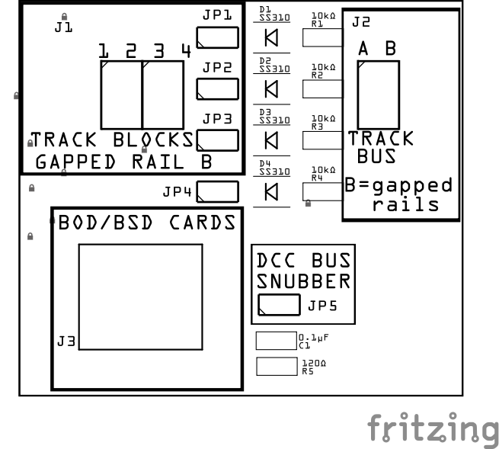


BLOCK BREAKOUT BOARD
AN INSIDE LOOK
LCC Fusion Project
Understanding the Hardware
Behind Block Detection
Pat Fleming
Email: PatFlemingHTC@Gmail.com
LCC Fusion Project - © 2025 Pat Fleming
Notes:
(voice: Nelson)
Welcome to this LCC Fusion Project presentation.
In this session, we’re grounding the Fusion system in hardware — specifically, one of the simplest but most important boards in the entire ecosystem: the Block Breakout Board.
(pause: 1.5)
(voice: Nelson)
So before we jump into the components, what exactly is a breakout board?
Is this like a smaller card that feeds a bigger one?
(pause: 1.0)
(voice: Harrison)
Exactly.
A breakout board lets us bring external wiring — like track feeders — into the Fusion system in a clean, organized, and reliable way.
Today we’re going to go inside the simplest one: the B O D Breakout Board.
(voice: Harrison)
This breakout board is where track power, block wiring, and the BOD Card all meet.
Understanding this board helps you understand other breakout board in the project.

Slide 2
WHAT THIS BOARD DOES
Purpose of the Block Breakout Board
Connects track blocks to the BOD Card
Provides isolation diodes for multiple blocks
Brings the track bus forward
Optional DCC snubber circuit on-board
Mounts under the layout close to feeders
LCC Fusion Project - © 2025 Pat Fleming
Notes:
(voice: Nelson)
Okay, so what’s the point of this little board?
It looks simple — a few connectors and some diodes.
Why do we even need this?
(pause: 0.9)
(voice: Harrison)
Because it’s part of how the layout knows whether a train is actually in a block.
Block occupancy detection works by checking for current flow in each block.
Any locomotive — or any piece of rolling stock with a resistor wheelset — draws a tiny current when it’s in the block.
If there’s current, the block is occupied.
If there’s no current, the block is empty.
(pause: 1.0)
(voice: Nelson)
So this board is measuring that current?
(pause: 0.6)
(voice: Harrison)
Not quite — and that’s an important distinction.
The breakout board doesn’t measure anything.
It simply passes the block’s current directly to the BOD Card using the one feeder wire from each block.
The breakout board isolates the blocks, organizes the feeders, and keeps everything clean and consistent — but it does not analyze the current.
(pause: 1.0)
(voice: Harrison)
The BOD Card is the device that measures the current and determines whether a block is occupied.
Once it knows that, it sends a logic signal to the Node Card, and the Node Card publishes that occupancy event onto the kanbus.
(pause: 1.0)
(voice: Nelson)
So the breakout board is basically the wiring hub.
It carries the raw current from each block, and the BOD Card does the actual sensing.
(pause: 0.6)
(voice: Harrison)
Exactly.
That’s why this board looks simple — it’s the clean wiring interface, not the electronics that do the detection.

Slide 3
TOP VIEW OVERVIEW
LCC Fusion Project - © 2025 Pat Fleming
Notes:
(voice: Nelson)
Here’s the top view.
Everything the installer interacts with is right here — the connectors, the jumpers, and the B O D Card header.
And looking at this… everything seems grouped into little zones.
Is that intentional, or did these parts just end up where they fit?
(pause: 1.2)
(voice: Harrison)
Very intentional.
The layout of the board follows the way you actually wire a layout:
the block connections on the left,
the track bus connector on the right,
the diodes and resistors centered,
and the BOD Card connection down on the lower left.
Grouping the components like this keeps the wiring simple, predictable, and easy to follow under the layout.

Slide 4
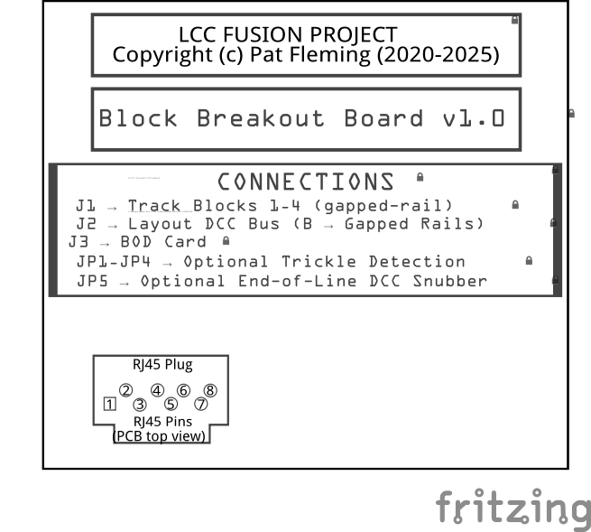
BOTTOM VIEW OVERVIEW
LCC Fusion Project - © 2025 Pat Fleming
Notes:
(voice: Nelson)
Alright, here’s the bottom view… but this looks totally different from what I expected.
I don’t see any copper, no traces, none of the electronics.
It’s just text.
Why even show this?
(pause: 1.2)
(voice: Harrison)
That’s a good observation.
On this board — and on many breakout boards in the Fusion system — the bottom side is silkscreen only.
The purpose isn’t to expose copper routing or circuitry; it’s to give the installer and the planner a few important reminders.
(pause: 1.0)
(voice: Harrison)
On this particular Block Breakout Board, the bottom is pretty minimal:
the name of the board, the version, a copyright notice, and just a few placement guides.
But on our more complex cards, the bottom silkscreen may include very practical information:
voltage ratings, current limits, bus definitions, pin numbering, jumper legends, and warnings.
(pause: 1.2)

Slide 5
BOTTOM VIEW OVERVIEW
LCC Fusion Project - © 2025 Pat Fleming
Notes:
(voice: Nelson)
So the bottom is kind of like a cheat sheet?
(pause: 0.7)
(voice: Harrison)
Exactly.
It’s a quick reference — a form of documentation printed right on the card.
And even if this specific board doesn’t have much down here, the pattern will be the same for other Fusion cards you’ll encounter.
(pause: 1.0)
(voice: Nelson)
I also notice on some boards there’s a little picture of an RJ45 pinout printed on the bottom.
Why is that there?
(pause: 0.8)
(voice: Harrison)
That’s there for installers who may not be using a premade network cable.
Some people free-wire their connections, or they’re troubleshooting a cable and want to confirm which conductor maps to which pin.
Having the RJ45 pinout printed right on the board makes it clear how the socket is wired without having to look up a diagram.
(pause: 1.0)
(voice: Nelson)
So it’s basically a reminder:
“If you’re wiring this by hand, here’s the correct orientation.”
(pause: 0.6)
(voice: Harrison)
Exactly.
It’s optional, but it’s a convenience feature that’s saved more than a few headaches.

Slide 6
BOD BREAKOUT CONNECTORS
J1 connects 1-4 gapped-rail blocks
J2 connects the layout DCC bus
J3 connects the BOD Card
JP1-JP4 configure optional Trickle Detection
JP5 configures optional DCC BUS Snubber
LCC Fusion Project - © 2025 Pat Fleming
Notes:
(voice: Nelson)
Okay, so J1 says it connects one through four blocks.
Are these just the feeder wires coming down from the layout?
(pause: 0.8)
(voice: Harrison)
Exactly.
J1 handles all four gapped-rail blocks.
And because it uses a standard 2.54 mm, or 0.1-inch pin spacing, you can install whatever connector style you prefer — spring terminals, screw terminals, or even standard pin headers.
The goal is flexibility: use whatever matches your layout wiring style.
(pause: 1.0)
(voice: Nelson)
Nice.
Now J2… that says “DCC bus.”
Is that just the main track bus coming from the command station?
(pause: 0.8)
(voice: Nelson)
Now J2… that says “DCC bus.”
Is that just the main track bus coming from the command station?
(pause: 0.8)
(voice: Harrison)
Mostly, yes — but there’s an important detail here.
For this breakout board, Rail B is required, because that’s the gapped rail and that’s the side used for block detection.
Rail A is optional.
You only bring Rail A through J2 if you are intentionally gapping and routing that rail as well.
(pause: 1.0)
(voice: Harrison)
If Rail A is not being gapped, you can keep it as a continuous bus under the layout and skip J2 entirely for that rail.
Only Rail B must be routed through this board.
(pause: 0.9)
(voice: Nelson)
So Rail A can go straight across the layout, and Rail B gets routed through the breakout board?
(pause: 0.6)
(voice: Harrison)
Exactly.
Rail B is the one you gap and feed through each block’s diode steering network.
J2 just gives you a clean, organized place to bring that B rail in and carry it forward without making splices under the benchwork.
(pause: 1.0)
(voice: Nelson)
Got it.
And then J3 connects the… BOD Card?
(pause: 0.8)
(voice: Harrison)
Right.
J3 is the interface to the BOD Card itself. A network cable allows the breakout board to be close to the track, while the BOD Card
Is located close to the Node Card, centralized with other cards. Any voltage drops thru the network cable are minimal and the current easily
detected using the BOD Card circuitry.

Slide 7
BOD BREAKOUT CONNECTORS
J1 connects 1-4 gapped-rail blocks
J2 connects the layout DCC bus
J3 connects the BOD Card
JP1-JP4 configure optional Trickle Detection
JP5 configures optional DCC BUS Snubber
LCC Fusion Project - © 2025 Pat Fleming
Notes:
(voice: Nelson)
Okay, now about these four jumpers — JP1 through JP4.
What am I actually turning on or off here?
(pause: 0.8)
(voice: Harrison)
Those enable the optional Trickle Detection feature.
When a block’s Rail A is turned off — say, during power routing — trickle detection injects a very small current using a 10k resistor and a Schottky diode.
That tiny current is enough to let the BOD Card continue detecting whether a train is still in the block.
Each jumper controls one block:
You only enable what you need.
(pause: 1.2)
(voice: Nelson)
Okay, but one thing I’m not clear on.
When you say “enable” JP1 or JP2… how do I actually do that?
Is there a switch? A button? What am I looking for on the board?
(pause: 0.9)
(voice: Harrison)
Good question — and it’s a very common one.
These are jumper selections, which means each JP position has two pins, side by side.
To “select” the jumper, you place a jumper cap over those two pins, which closes the circuit.
If the cap is not installed, the feature is off.
(pause: 0.8)
(voice: Nelson)
So just like old computer motherboards — put a little plastic jumper cap over the pins you want to turn on?
(pause: 0.5)
(voice: Harrison)
Exactly like that.
One cap per jumper, and each jumper controls one block’s trickle path.

Slide 8
BOD BREAKOUT CONNECTORS
J1 connects 1-4 gapped-rail blocks
J2 connects the layout DCC bus
J3 connects the BOD Card
JP1-JP4 configure optional Trickle Detection
JP5 configures optional DCC BUS Snubber
LCC Fusion Project - © 2025 Pat Fleming
Notes:
(voice: Nelson)
Alright, then JP5 is separate.
So what’s this one for?
(pause: 0.8)
(voice: Harrison)
JP5 turns on the optional DCC BUS Snubber.
A snubber reduces high-frequency ringing on long DCC wiring runs.
And here’s the important part:
You only enable JP5 when this breakout board is connected to a block at the physical end of a DCC bus run — that’s where reflections and noise tend to collect.
If the blocks are not at the end of the DCC bus, JP5 stays off.
(pause: 1.1)
(voice: Nelson)
One last thing — what about the components that go with these jumpers?
Like the snubber, or the trickle detection parts.
Do I need to install all of those on every board?
(pause: 0.8)
(voice: Harrison)
Great question — and the answer is no.
This board is designed so you can install only the components you actually need for your layout.
(pause: 0.8)
(voice: Harrison)
For example, if you’re not using the DCC snubber, you simply leave JP5, C1, and R5 unpopulated.
The board will function perfectly without them.
(pause: 0.7)
(voice: Harrison)
And the same idea applies to trickle detection.
If you don’t need trickle current on Block 1, you leave JP1, D1, and R1 uninstalled.
Only install those parts for the blocks you want trickle detection on.
(pause: 0.9)
(voice: Nelson)
So the board really scales based on what you want — full build, partial build, or just the basics.
(pause: 0.5)
(voice: Harrison)
Exactly.
You assemble only the circuitry you plan to use, and the rest can stay empty without affecting anything else on the board.

Slide 9
HOW IT FITS INTO THE SYSTEM
How the Block Breakout Board Fits Into LCC Fusion
Mounts near the track feeders
Connects directly to the BOD Card and BSD Card
BOD/BSD Cards connect to the Node Card
Node Card sends occupancy events onto the CAN Bus
Breakout board itself has no logic — it’s purely electrical
Clean under-layout wiring structure
LCC Fusion Project - © 2025 Pat Fleming
Notes:
(voice: Nelson)
Okay, I understand how the breakout board works… but where does it actually fit into the Fusion system?
Is this something the Node reads directly?
(pause: 1.0)
(voice: Harrison)
Great question.
The breakout board is strictly electrical — it doesn’t talk on kanbus and doesn’t generate events by itself.
It simply organizes your block feeders and conditions the electrical signal.
The BOD Card and BSD Card do the real work.
It plugs into J3 and reads the voltage signals.
The BOD and BSD Cards then sends occupancy events to the Node Card, which sends them onto the kanbus network.
(pause: 1.1)
(voice: Nelson)
So this breakout board is basically “the clean wiring side” of the system.
(pause: 1.1)
(voice: Harrison)
Exactly.

Slide 10
TYPICAL UNDER-LAYOUT INSTALLATION
Typical Installation
Mounted under the layout near track feeders
Mounts using a UM50 Profile PCB housing / screws
BOD Card and BSD Card plug directly onto J3
Track Bus (J2) passes through
J1 receives the block feeder drops
Optional features populated as needed
LCC Fusion Project - © 2025 Pat Fleming
Notes:
(voice: Nelson)
How does someone actually install this under the layout?
Is there a right place for it?
(pause: 0.9)
(voice: Harrison)
Yes — ideally you mount it close to where the block feeders drop through the benchwork.
That keeps wire runs short and organized.
The BOD Card and BSD Card plug in at J3, the DCC bus comes in and out through J2, and the block feeders land on J1.
If you’re using the snubber, this board would also be the last one on the DCC bus.
(pause: 1.0)
(voice: Nelson)
Okay… and what’s the best way to mount it?
Do I need special hardware, or is there a preferred method?
(pause: 1.0)
(voice: Harrison)
You have several options, and they’re all supported by the design.
The most flexible and professional option is to use a UM 50 Profile PCB housing — a 50-millimeter slide-in plastic enclosure that this board is shaped to fit.
Most of the Fusion breakout boards share this same width so they all work with the same housing system. The housing can then be mounted to the layout using a DIN rail system,
2-side foam tape, or screws.
(pause: 1.0)
(voice: Harrison)
But you don’t have to use the PCB housing.
The board also includes drill holes if you prefer 3-millimeter screws or plastic standoffs.
Some installers mount a small wooden strip under the layout and screw the board to that.
And for lighter or temporary setups, two-sided foam tape works surprisingly well.
(pause: 1.2)
(voice: Nelson)
So it’s pretty flexible — housing, screws, standoffs, or even tape.
(pause: 0.6)
(voice: Harrison)
Exactly.
The UM 50 PCB housing gives you the cleanest installation, but the board supports all the common ways modelers mount electronics under the layout.

Slide 11
COMPONENT POPULATION OPTIONS
Optional Component Population
Only install trickle components for the blocks you need
Only install snubber components if mounted at the end of a DCC bus
Can build “minimal” version or “full feature” version
Silkscreen guides placement for optional footprints
Empty pads are normal
LCC Fusion Project - © 2025 Pat Fleming
Notes:
(voice: Nelson)
You mentioned earlier that some components can be left off.
How common is that?
(pause: 1.0)
(voice: Harrison)
Very common.
The breakout boards — and most Fusion boards — are designed so only the parts you actually use need to be installed.
If you don’t want trickle detection, leave JP1 through JP4 and their R and D components empty.
If you don’t want the snubber, leave JP5, R5, and C1 empty.
This creates a clean, minimal build.
(pause: 1.1)
(voice: Nelson)
So if I look at a board and see empty pads… that’s normal?
(voice: Harrison)
Completely normal — and intentional.

Slide 12
TROUBLESHOOTING & COMMON MISTAKES
Common Mistakes to Avoid
Mixing up J1 (blocks) and J2 (bus)
Forgetting the jumper cap on JP1–JP5
Installing trickle components when not needed
Not enabling JP5 when installed at the end of a DCC bus
LCC Fusion Project - © 2025 Pat Fleming
Notes:
(voice: Nelson)
Alright, so once this is installed under the layout, what are the most common mistakes people actually run into?
(pause: 1.0)
(voice: Harrison)
There are a few worth keeping an eye on.
One of the most common is mixing up the connectors — J1 for the block feeders and J2 for the main DCC bus.
They’re labeled, but under the layout it’s easy to land wires on the wrong one.
(pause: 0.9)
(voice: Harrison)
Another one is related to the jumpers.
If you forget to put a jumper cap on JP1 through JP4, that block’s trickle detection is actually disabled.
Or you might accidentally enable trickle on a block that doesn’t need it.
And with the snubber, some installers populate C1 and R5 but forget to place the jumper on JP5 — which means the snubber never activates.
(pause: 1.1)
(voice: Nelson)
What about polarity?
Can somebody wire something backward here?
(pause: 0.8)
(voice: Harrison)
The blocks on J1 can’t really be reversed — you’re only connecting one feeder wire per block.
But the track bus on J2 has two rails, labeled A and B.
You want those labels to stay consistent across the entire layout so that Rail B is always the same rail — and on this breakout board, B is the gapped rail.
Keeping that consistent avoids confusion with accessories and detection.
(pause: 1.0)
(voice: Nelson)
So as long as I keep A and B straight, and I land block feeders on J1 instead of the bus, I should be fine.
(pause: 0.5)
(voice: Harrison)
Exactly.
Those are the main things to watch out for.

Slide 13
KEY TAKE AWAYS
The breakout board organizes block wiring
Optional features enhance detection
Clear silkscreen makes installation easier
Connects cleanly to the BOD and BSD Cards
Forms the “physical layer” of BOD & BSD detection
Moves us toward understanding the BOD and BSD Cards themselves
LCC Fusion Project - © 2025 Pat Fleming
Notes:
(voice: Nelson)
Before we wrap up, can you give me a quick summary of what this breakout board actually does?
Just the big picture.
(pause: 0.9)
(voice: Harrison)
Absolutely.
First, the breakout board organizes all the block wiring.
Instead of feeders scattered everywhere under the layout, J1 brings four gapped-rail blocks into one clean place.
That alone makes installation and troubleshooting much easier.
(pause: 1.0)
(voice: Harrison)
It also gives you optional features that you can enable only if you need them.
Trickle detection can keep a block detectable even when Rail A is turned off.
And if this board is at the end of a DCC bus run, you can enable the snubber using JP5 to help stabilize the signal.
(pause: 1.0)
(voice: Harrison)
The breakout board then connects directly to the BOD and BSD Cards at J3, giving the card a clean, well-isolated signal from each block.
This lets the BOD and BSD Cards focus on the logic — and later send occupancy events onto the kanbus.
(pause: 1.0)
(voice: Harrison)
And finally, the layout is intentionally simple and consistent.
Track blocks on the left.
Track bus on the right.
Diodes and resistors centered.
BOD and BSD Cards connector at the bottom.
Everything is arranged to make under-layout wiring predictable and repeatable.
(pause: 1.0)
(voice: Nelson)
So the breakout board is basically the “hardware layer” for occupancy detection?
It gets the wiring in order so the BOD and BSD Cards can do its job.
(pause: 0.6)
(voice: Harrison)
Exactly.
This board is the foundation.
In the next sessions, we’ll look at the BOD and BSD Cards themselves and how it interprets those signals and publishes occupancy events on the kanbus.

