Slide 1
Developing REST Web Services using WCF
Pat Gannon
www.patrickgannon.net

Slide 2
What is REST?
REST stands for Representation State Transfer
REST is about accessing resources through a universal interface
Conceived in 2000 as a doctoral dissertation by Roy Fielding (a principal author of HTTP protocol)
RESTful URLs are addressable - Sample: http://www.mysite.com/Products/Trek8300
Links to related data

Slide 3
Universal Interface: HTTP verbs
GET
  Retrieves a resource
  Guaranteed not to cause side-effect (SAFE)
  Cacheable
POST
  Creates a new resource
  Unsafe, effect of this verb isn’t defined by HTTP
PUT
  Updates an existing resource
  Used for resource creation when client knows URI
  Can call N times, same thing will always happen (idempotent)
DELETE
  Remove a resource
  Can call N times, same thing will always happen (idempotent)

Slide 4
What is not REST?
Any HTTP-GET operation that is not reproducible, or other misuse of HTTP verbs
  ASP.NET Viewstate
  Server-side session information
A URL scheme that is not resource-based
  mombospizza.com/index.php?id=Menu
Envelope within HTTP body

Slide 5
Why REST?
Scalability of your site through caching and lack of session state
Scalability of the web
Nice URLs that can be guessed
SEO
Consistency with the design of the World Wide Web
Can leverage generic client components (eg. jQuery controls) and dev skills

Slide 6
Why not REST?
If you need advanced collaboration between applications like distributed transactions (WS-*)
If you need to use a protocol other than HTTP

Slide 7
REST and .NET
Websites: ASP.NET MVC
Web services: WCF

Slide 8
Creating a REST Web Service
Services process HTTP requests from applications or websites
Come up with list of resources and ways they will implement universal interface
Create service interface that maps URL scheme to service methods
Create data contracts and service class
(see IOrderService.cs and Order.svc.cs in sample code)

Slide 9
Hosting the service
The host is the process that listens for HTTP requests on behalf of the service
(see ServiceForm.cs)

Slide 10
Calling the service from an app
(see OrderForm.cs in sample code)

Slide 11
Securing the service
Authentication
  behavior.Security.Mode = TransportCredentialOnly
  behavior.Security.Transport = Basic | Digest | Ntlm | Windows
Authorization - options
  Impersonation and PrincipalPermission attribute or IsInRole()
  Create class inheriting from ServiceAuthorizationManager
  Roll-your-own using cookies
SSL
  behavior.Security.Mode = Transport
  behavior.Security.Transport = None | Certificate (or other…)

Slide 12
Other capabilities
Call the service from client-side code (eg. jQuery)
  ResponseFormat=WebMessageFormat.Json
Host services in IIS
POCO data contracts (.NET 3.5 SP 1)
Generate proxy classes for data contracts
Integration with WF
Create RSS feeds

Slide 13
ADO.NET Data Services
Formerly known as Astoria
Provides automatic REST service on top of any Linq data source
Will output XML or JSON based on HTTP “accepts” header
Included in Visual Studio 2008 SP 1

Slide 14
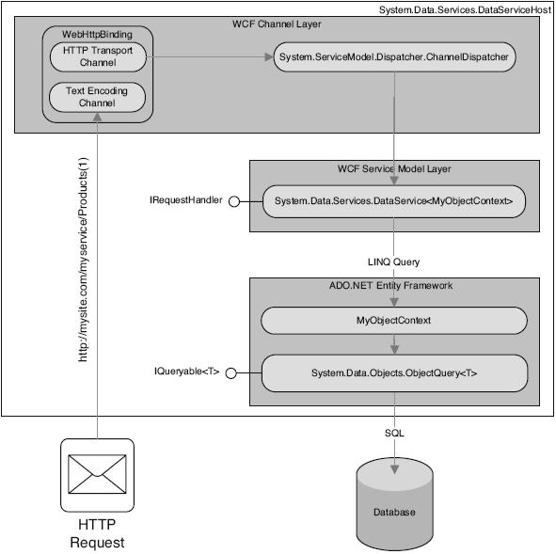

Slide 15
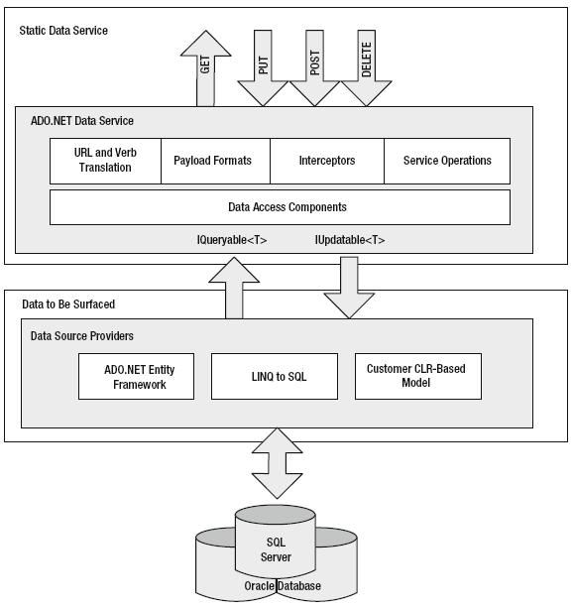

Slide 16
Creating a data service
Step 1: Add new “ADO.NET Data Service” to project
Step 2: Edit MyAppService.svc.cs
public class MyApp : DataService<MyDataSource>
{
public static void InitializeService(IDataServiceConfiguration config)
{
config.SetEntitySetAccessRule(“*”, EntitySetRights.AllRead);
config.SetServiceOperationAccessRule(“*”, ServiceOperationRights.All);
}
}

Slide 17
More information
ADO.NET Data Services samples from book: “ADO.NET Data Services: Working with RESTful Data” by John Shaw and Simon Evans
All other samples and slide deck will be available on blog starting tomorrow night: www.patrickgannon.net
For more information, read “RESTful .NET” by Jon Flanders

Slide 18
Conclusion
Email: PatrickJosephGannon@yahoo.com
Blog: http://www.patrickgannon.net/
Twitter: @patgannon
Questions/Comments?

