Slide 1
THESIS INVESTIGATION UPDATE
Latent Noise Dynamics
in the CEWF Framework
Marginal and temporal correlation analysis of the inverted latent-space noise εₜ
Trace · Linköping University

Slide 2
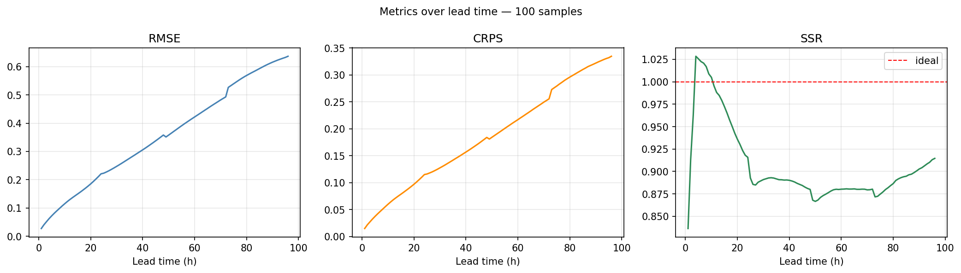
BASELINE
Forecasting Performance
SSR sits near ideal at short lead, drifts below 1 through the mid-range, and jumps slightly at 48h / 72h — the AR-rollout boundaries.
Latent Noise Dynamics — Investigation Update
2

Slide 3
INVESTIGATION PLAN
Three Guiding Questions
1
2
3
Is the forecast trajectory physically meaningful?
What dynamics does the inverted trajectory imply?
Can we design a method to learn that dynamics?
Priority: Q2 and Q3 first — Q1 becomes supplementary evidence, examined once the noise dynamics are understood.
Latent Noise Dynamics — Investigation Update
3

Slide 4
RATIONALE
Why Q2 and Q3 Come First
PROPERTY 1 — MARGINAL PRESERVATION
PROPERTY 2 — DETERMINISTIC ODE
Stochastic interpolants train between samples from N(0, I) and the physical data — so the latent-space noise must preserve N(0, I) marginally.
The velocity is the function driving an ODE — so the sampling process is fully reversible and deterministic.
If the marginal distribution breaks, forecasts lose physical meaning — understanding the noise dynamics (Q2, Q3) matters more than testing Q1 directly.
Latent Noise Dynamics — Investigation Update
4

Slide 5
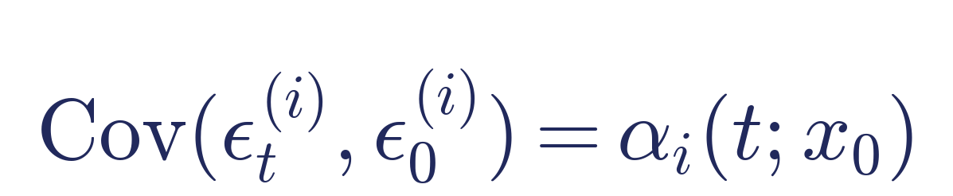
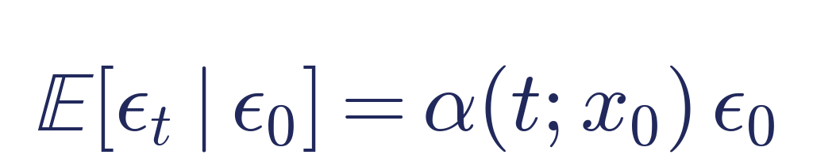
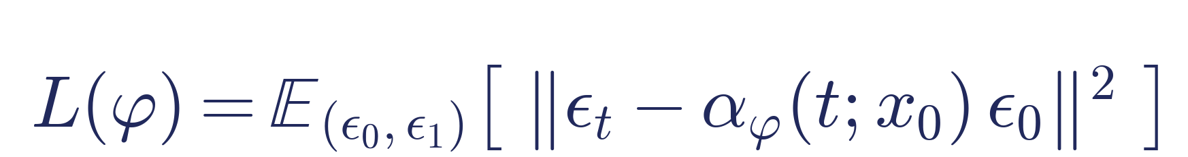
THEORY
Learning the Noise Process — Key Relations
COVARIANCE STRUCTURE
CONDITIONAL MEAN ESTIMATOR
TRAINING LOSS
Assumption: εₜ ~ 𝒩(0, I) marginally ⇒ each coordinate of εₜ evolves independently.
Latent Noise Dynamics — Investigation Update
5

Slide 6
EXPERIMENT 1
Marginal Check — Method
A
Moments & Kurtosis
B
Spatial Power Spectrum
Test whether the marginal of εₜ matches N(0,1) per lead time — mean, std, skewness, excess kurtosis.
Check flatness of the radial power spectrum — white noise ⇒ flat spectrum ⇒ coordinates evolve independently.
Preprocessing: inverted latents pooled across trajectories, analyzed separately per lead τ — different τ means a different mapping.
Latent Noise Dynamics — Investigation Update
6

Slide 7
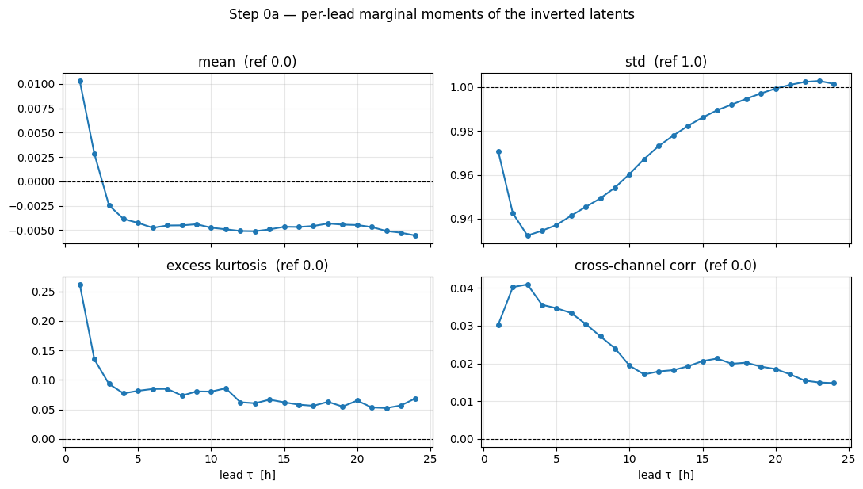
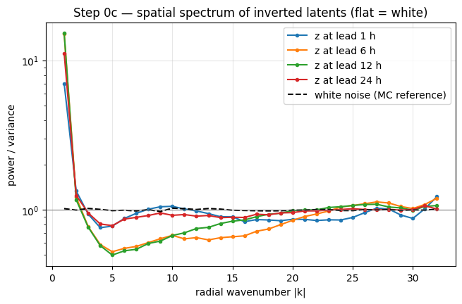
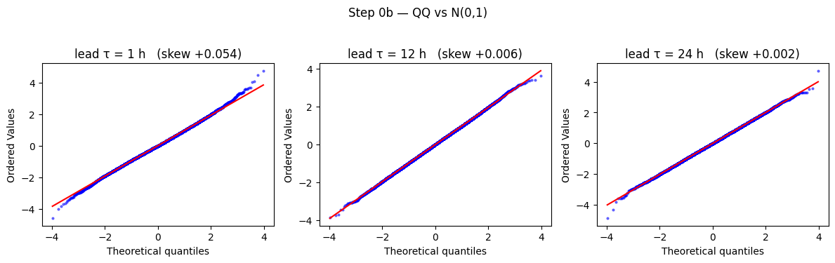
EXPERIMENT 1
Marginal Check — Results
εₜ ~ N(0, Σ), not N(0, I) — but each εₜ is spatially stationary.
Latent Noise Dynamics — Investigation Update
7

Slide 8
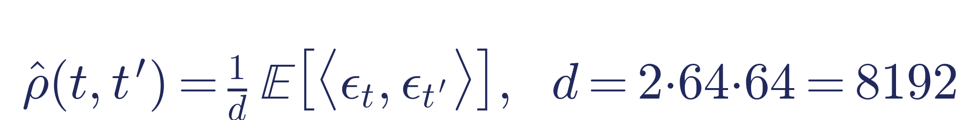
EXPERIMENT 2
Empirical Temporal Correlation
Computed under the N(0, I) assumption — the decay pattern is visible, but a rigorous fit must account for Σ.
a
Stationarity
b
Exponential decay
c
x₀-dependence
Does ρ̂ depend only on |t − t'|?
Is log ρ̂ linear in Δ (OU process)?
Does ρ̂ vary with the anchor state?
Latent Noise Dynamics — Investigation Update
8

Slide 9
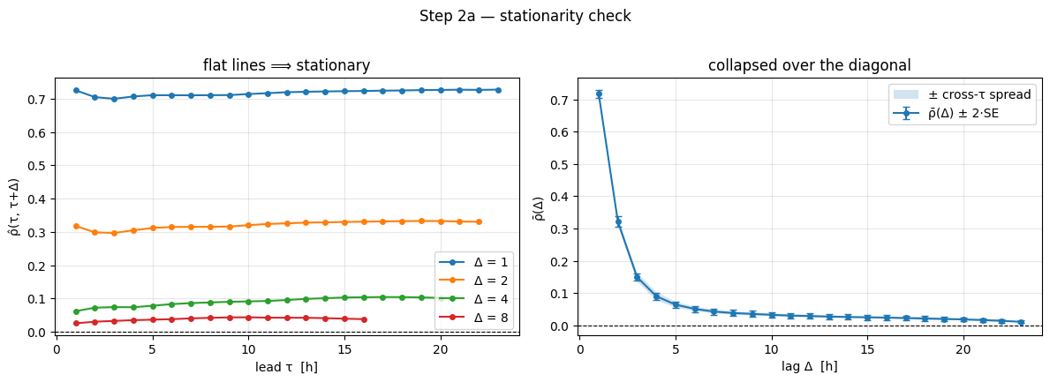
EXPERIMENT 2A
Stationarity Check
ρ̂ depends only on the lag |t − t'| — a single function of Δ suffices to describe the correlation.
Latent Noise Dynamics — Investigation Update
9

Slide 10
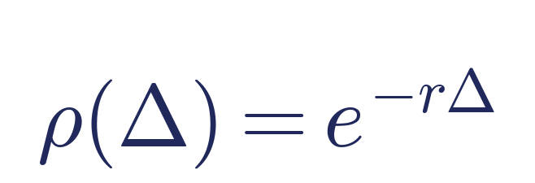
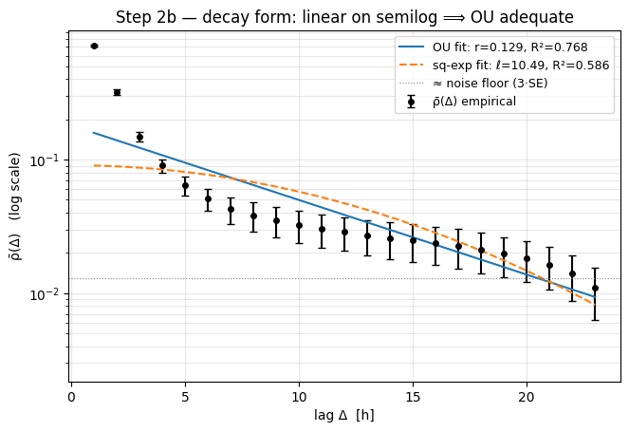
EXPERIMENT 2B
Exponential Decay Test
OU process predicts this decay — equivalently, log ρ̂ should be linear in Δ (one semi-log plot tests it).
Decay is neither cleanly exponential (R²=0.77) nor squared-exponential (R²=0.59) — a neural network is needed to fit α(t).
Latent Noise Dynamics — Investigation Update
10

Slide 11
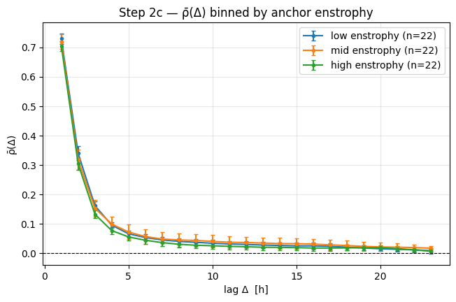
EXPERIMENT 2C
Dependence on Anchor Enstrophy
ρ̂(Δ) is independent of anchor enstrophy — a scalar α(t) suffices; no x₀-conditioning is needed.
Latent Noise Dynamics — Investigation Update
11

Slide 12
SUMMARY
What We Learned
✓
Good News
!
Open Challenge
The temporal correlation is stationary and independent of x₀ — the estimator reduces to a single scalar function α(t).
The decay is neither exponential nor squared-exponential — fitting α(t) will require a neural network rather than a closed form.
Latent Noise Dynamics — Investigation Update
12

Slide 13
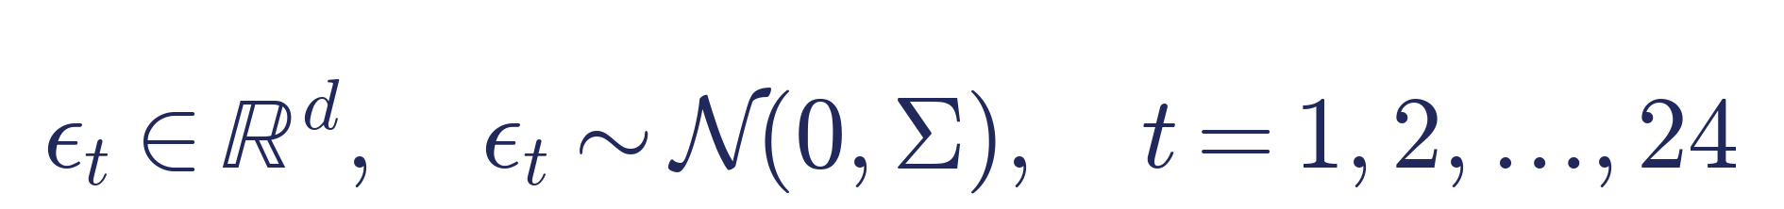
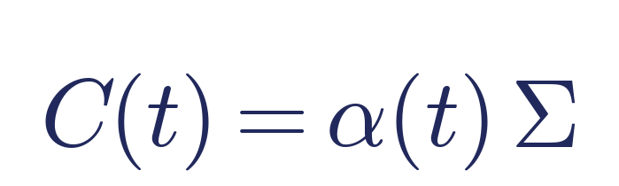
OPEN PROBLEM
Does Spatial Correlation Break the Estimator?
CONDITION 1 — SEPARABLE
CONDITION 2 — NON-SEPARABLE
A single α(t) is inadequate — we need a spatially weighted α(t), e.g. one value per Fourier mode.
Temporal and spatial factors decouple — a single scalar α(t) suffices.
Latent Noise Dynamics — Investigation Update
13

Slide 14
NEXT STEPS
Further Investigation Plan
Examine whether the spatial correlation Σ is stationary (present evidence is visual only).
Examine whether the space–time structure is separable: C(t) = α(t)Σ.
1
2
If not: eigendecompose Σ on a 2D Fourier basis and infer an estimator with spatial weights.
Justify the estimator and perform the estimation.
3
4
Latent Noise Dynamics — Investigation Update
14

