Slide 1
Introduction
NAME : TUSHAR CHAKRADHAR PATHADE
MIS : 111903114
DIV : 2
BATCH : S2
PROJECT : SPELL ANALYZER

Slide 2
Short Introduction
This projects checks for correctness of a English words and tells if it's spelled correctly or not. If not it gives suggestions for misspelled words.
User can choose any suggestion for that word and that word will be replaced with selected word.
This project also includes prefix search. It takes prefix as a input and gives some words that starts with given prefix.

Slide 3
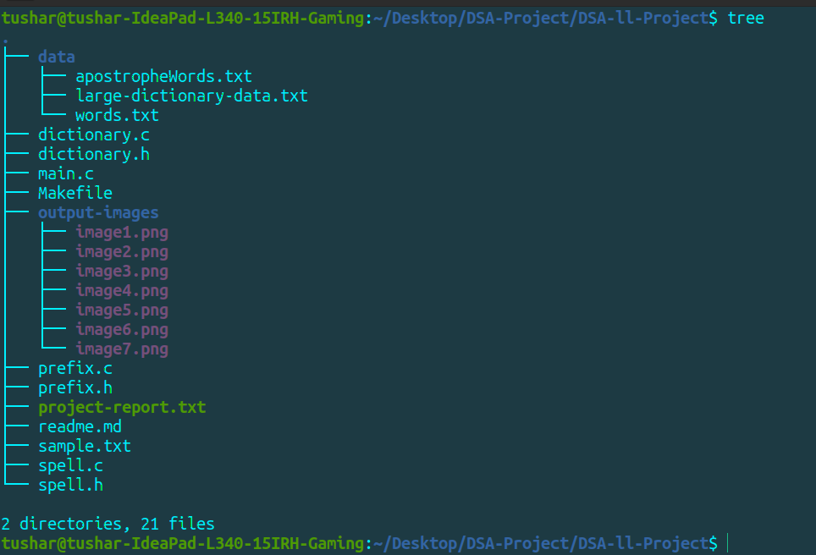
Project Directory Structure
data directory : It contains
large-dictionary-data.txt - 354939 words
words.txt file - 173535 words
apostropheWords.txt file - 60 words
I have used words.txt and apostropheWords.txt
as a dataset in this project.
output-images directory:
It has some images of output of program.
sample.txt:
This text file is sample input for this project.
Makefile:
It is an Makefile which is used to build this
project.
readme.md:
It has instructions for how to run this project.
Rest all are code files.

Slide 4
Data Structure Used And ADT Definition
Data structure used: Trie data structure
ADT:
typedef struct node{
char letter; // Stores letter of a word
int isWordComplete; // 1 if letter is last letter of word / word is complete' else 0
struct node *next[SIZE]; // Array of 27 pointers of type node which stores letter
'a' - 'z': 0 - 25 and 26 for apostrophe ‘
} node;
typedef node *DICT;

Slide 5
Dictionary.h And Dictionary.c
dictionary.h:
It has ADT structure and function declarations that are used in dictionary.c file.
dictionary.c:
node *getNode(const char Letter);
It returns a new node having data as given letter.
void insertWord(DICT *dict, const char *word);
It insert the given word into dictionary dict.
int LoadData(DICT *dict, char *filepath);
It insert/loads all words from given file into dictionary dict. It returns total words on successful insertion of all words. Else terminate the whole program.
int checkWord(DICT *dict, const char *word);
It checks for a given word in a dictionary dict. Returns 1 if found else returns 0.
void UnloadData(DICT *dict);
It recursively unload/delete all words loaded from dictionary dict.
void traverse(DICT dict, int level, char word[]);
Recursive function to view all words loaded into dictionary dict.

Slide 6
Prefix.h And Prefix.c
prefix.h:
It has function declarations of all functions that are used in prefix.c file.
prefix.c:
int isLeafNode(node *Node);
It returns 1 if given node is Leaf Node / last node in its branch, else returns 0.
int getPrefixSuggestions(char *prefixWord);
It returns 0 if given prefix is not valid. Else it calls prefixSuggestions function and returns 1.
void prefixSuggestions(node *Node, char prefixWord[], int *maxSuggestions, int index);
Recursive function which gives words starting with given prefix at most count mentioned in argument named maxSuggestions.

Slide 7
Spell.h And Spell.c
spell.h:
It has function declarations of all functions that are used in spell.c file.
spell.c:
int isWordEnd(char ch);
It returns 1 if given character ch represents end of word else returns 0.
int editDistance(const char *s1, int l1, const char *s2, int l2);
Recursive function which returns the edit distance between given two strings s1 and s2.
It uses 2D array of order (l1+1)x(l2+2). It stores the edit distance between each character of one string and all possible subtrings of other string in corresponding location.
It runs recursively depending upon edit operation(insert, delete, replace). At the end, value stored at location (l1)x(l2) gives the edit distance between string s1 and s2.
void getSuggestions(DICT dict, int level, const char *wrongWord, char suggestedWord[], int *maxSuggestions, char suggestions[], int *indexForSuggestions, int EditDistance);
It traverse dictionary dict recursively and prints words whose edit distance with given wrong word is equal to EditDistance (see function arguments).
It prints words at most count mentioned in argument named maxSuggestions and also stores them into array named suggestions (passed in function arguments).
int wordSegmentation(const char *misspelledWord, int startIndex, int endIndex, char arr[], int *index, int *found);
This function will be called if no suggestions found from edit distance approach. This function try to break given words into multiple meaningful words by inserting spaces at appropriate position.
It recursively search for subwords and if it found then add it's ending position in an array named arr (passed in function arguments).

Slide 8
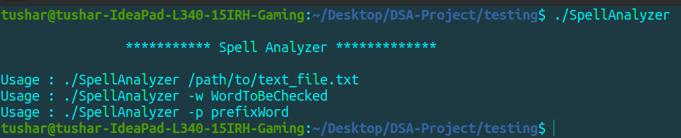
Commands…
./SpellAnalyzer /path/to/text_file.txt
./SpellAnalyzer -w WordToBeChecked
./SpellAnalyzer -p prefixWord

Slide 9
main.c
main.c:
int main(int argc, char *argv[]);
It takes commandline arguments and calls required fucntion accordingly.
For every command, first this function initialize the dictionary dict and loads all data into dict.
For command ./SpellAnalyzer /path/to/text_file.txt:
It checks for each word for in a given text_file line by line by calling checkWord function.
If word not found then it calls printLine function which displays the line with highlighting the misspelled word.
Then further it calls getSuggestions function to get suggested words. It then prints suggestions on console.
If no suggestions found from getSuggestions function then it calls wordSegmentation function and prints segmented words found to the console.
If still not found it prints message "No suggestions :(".

Slide 10
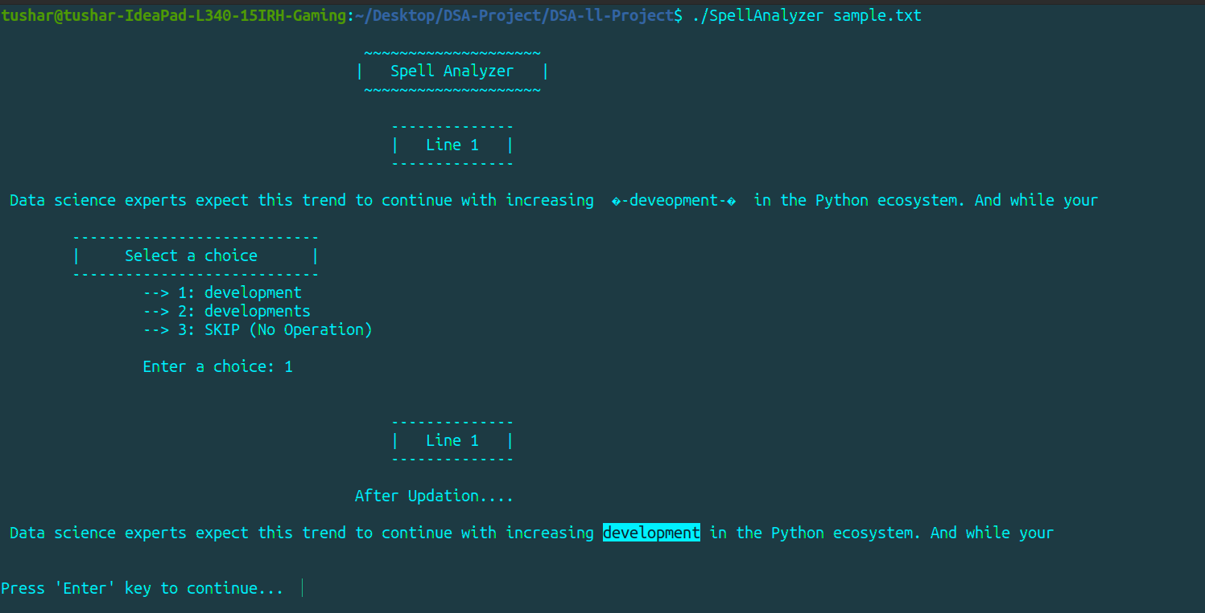
main.c continued…
If found then it ask user for choice number corresponding to the suggested word from all suggestions displayed.
Then it replace the misspelled word with corresponding suggestedWord and prints that line on the console with changes made.
After checking for each words, it then stores all changes made in a new text file named 'text_file_new.txt’.

Slide 11
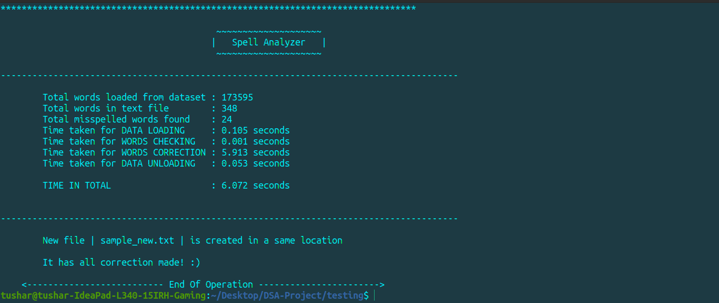
main.c continued…
At the end, it calls getTimeDetails function which then displays the time details of the program.

Slide 12
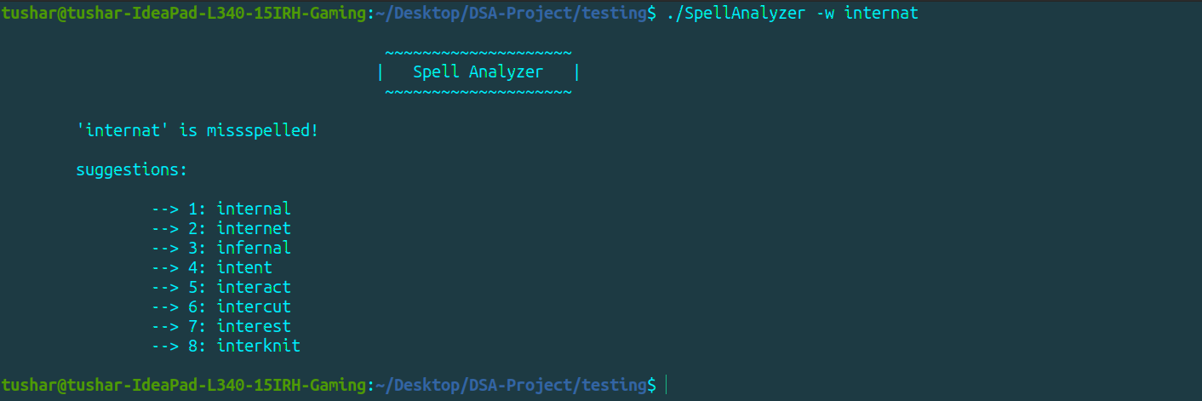
main.c continued…
For command ./SpellAnalyzer -w WordToBeChecked:
It works same as for above command but instead of
checking for a file it checks for a given word 'WordToBeChecked'.

Slide 13
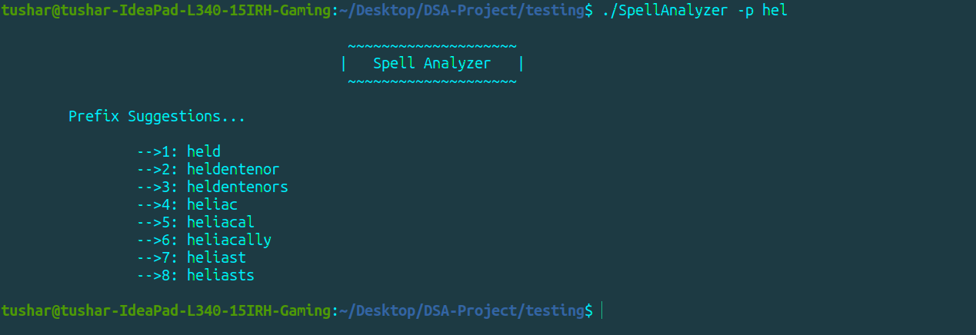
main.c continued…
For command ./SpellAnalyzer -p prefixWord:
It calls getPrefixSuggestions and prefixSuggestions to get words starting with given word 'prefixWord' and print them on the console.

Slide 14
main.c continued…
void printLine(char LineContents[], int startIndex, int endIndex, int lineCount, int indexForLineContents);
It prints line whose content is stored in LineContents array with highlighting words whose starting and ending index in that array are startIndex and endIndex respectively. (see function arguments).
void getTimeDetails();
It prints that time details of the program to the console.double calculate(const struct rusage *b, const struct rusage *a);
It returns the time difference (in sec) between member ru_utime(time spent in user mode) and ru_stime(time spent in kernel mode) of struct a and b.

Slide 15
References
https://www.geeksforgeeks.org/data-structure-dictionary-spell-checker/
https://stackoverflow.com/questions/10017808/best-data-structure-for-implementing-a-dictionary
https://youtu.be/We3YDTzNXEk
https://youtu.be/UsWDLWuBUls
https://youtu.be/b6AGUjqIPsA

