Slide 1

Rate My Project
A forum for sharing ideas and gathering feedback

Slide 2



The Problem
Feedback from outside groups rarely happen at the production level; mostly through focus groups
Developers work independently of each other, unless already part of large groups. Not enough place for idea exchange.
Collaborative spaces for dev projects are either too technical or display completed apps.

Slide 3
The Solution
“
As users, developers will be able to showcase their projects (using GitHub repos) with information on their functioning, possibly alongside GIFs/videos of their functioning. They can assign existing users of the app to rate and review their projects on various metrics. They can also invite their family/friends via email/text messages to come and check out their projects and leave feedback or suggest changes.

Slide 4
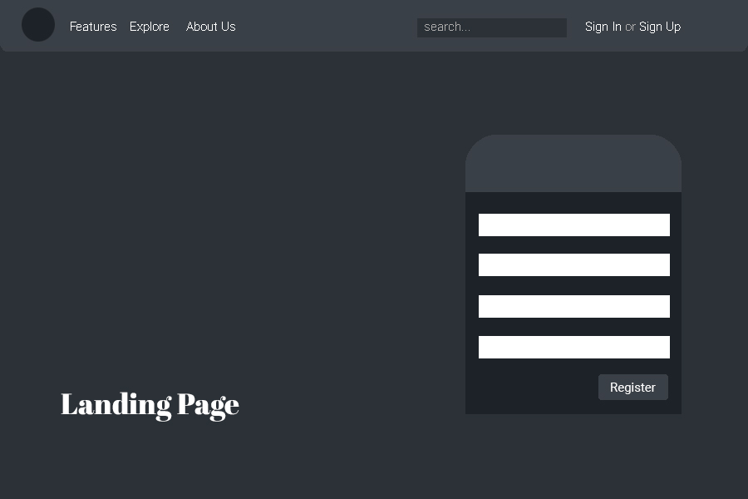
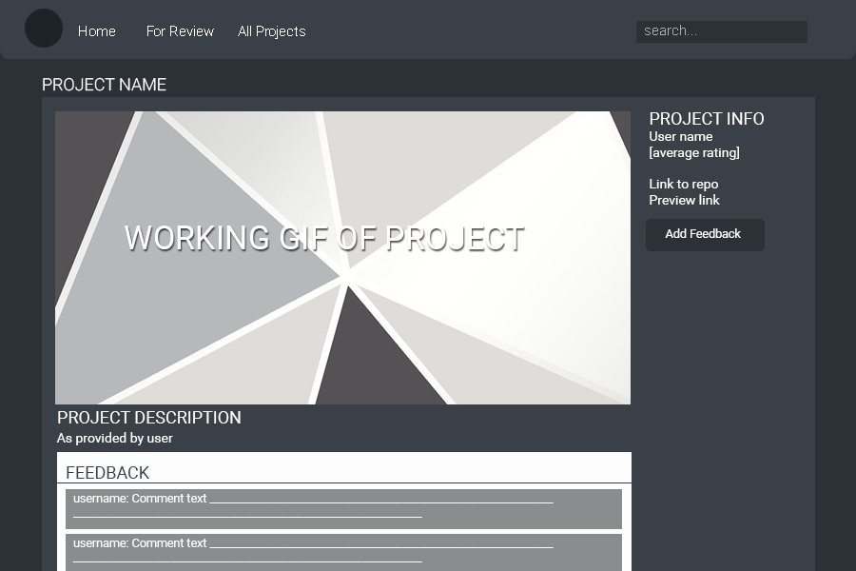
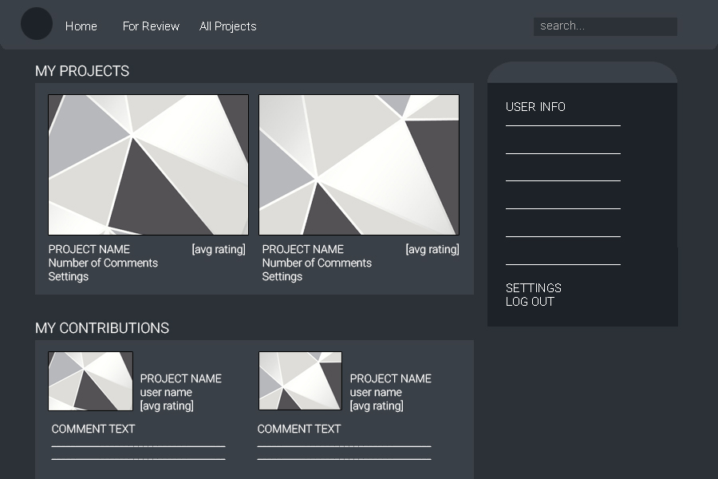
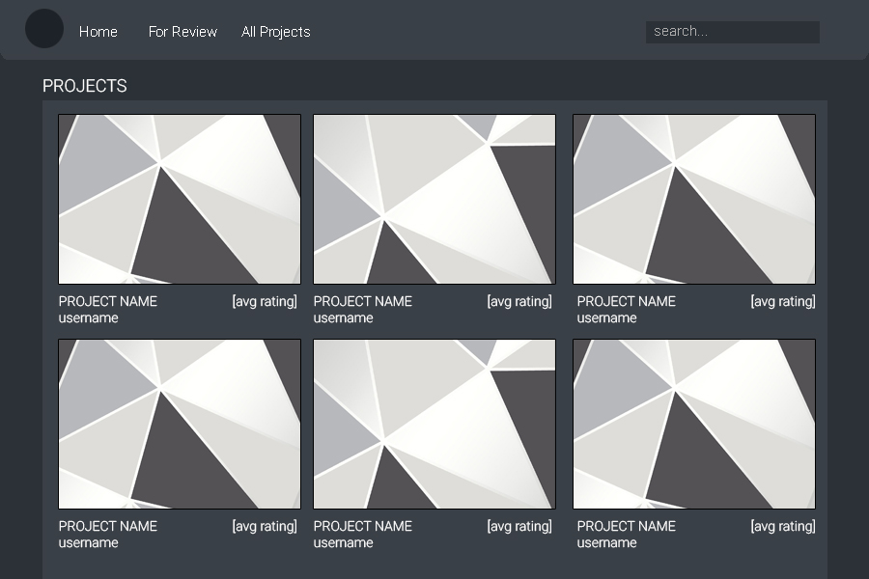
User Flow

Slide 5
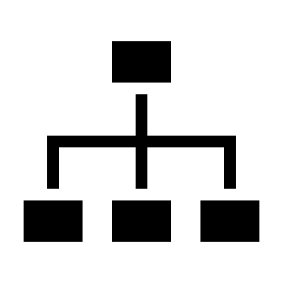


Workflow
Create the backend: set up models, user authentication, and any additional packages we need to obtain, process and save data.
Create a front-end shell with React for the required views.
Create the interactions, set up the server and API routes.

Slide 6



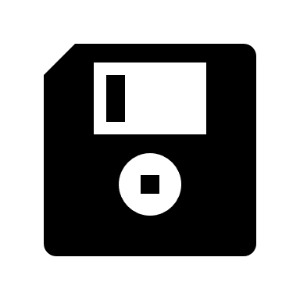
Technologies
MONGODB
EXPRESS.JS
REACT
NODE.JS
BOOTSTRAP
MULTER

Slide 7
Looking back
Smart User Matching:
Connecting a user based on his abilities

Slide 8
In the future

Slide 9
Rate My Project
A marketplace for sharing ideas and feedback

