Slide 1

INSAID Telecom
Consulting Report | Group 1004 | 24 May 2021

Slide 2
Table of Contents
Introduction
Problem Definition & Business Context
Background of Dataset
Summary of key findings & inferences
Proposed Solution
Conclusion
Tools & References

Slide 3
Introduction
INSAID Telecom

Slide 4
INSAID Telecom, one of the leading telecom players, understands that personalizing offering is very important for its business to stay competitive. Currently, INSAID Telecom is seeking to leverage behavioral data from more than 60% of the 50 million mobile devices active daily in India to help its clients better understand and interact with their audiences. In this consulting project, we are expected to build a dashboard to understand user's demographic characteristics based on their mobile usage, geolocation, and mobile device properties. This analysis report will help millions of developers and brand advertisers around the world pursue data-driven marketing efforts which are relevant to their users and customized to their preferences.
Note: The Capstone Project is a team-based project.
This was planned for a span of 4 Weeks. Each Week, we were assigned a set of Tasks. Instructions regarding each Week's Tasks was circulated.
This capstone project is developed by team no: 1004 as part of our term assignment from INSAID.
Group was decided by INSAID team.
Expectation from each individual was to communicate and sync like a proper professional team.

Slide 5
Problem Definition & Business Context
INSAID Telecom

Slide 6
Problem Definition
Database was given for the leading Telecom company INSAID Telecom.
Objective was to understand user behavior and plan for attractive Offers.
Background
It's always wonderful to see services customized to your needs.
Businesses try to understand your behavior and adjust their offerings so as to ensure you feel attached to their services.
Insaid Telecom, one of the leading telecom players, understands that customizing offering is very important for its business to stay competitive.
Currently, Insaid Telecom is seeking to leverage behavioral data from more than 60% of the 50 million mobile devices active daily in India to help its clients better understand and interact with their audiences.
In this consulting assignment, it was expected to build a dashboard to understand user's demographic characteristics based on their mobile usage, geolocation, and mobile device properties.
Doing so will help millions of developers and brand advertisers around the world pursue data-driven marketing efforts which are relevant to their users and catered to their preferences
Goal of this exercise arrive at what should be done to improve customer experience and thereby improve profitability

Slide 7
Why Personalize offerings? Business Context

Slide 8
About the Dataset
Content / About dataset
This dataset contains XXXX
Missing Data XXXX

Slide 9
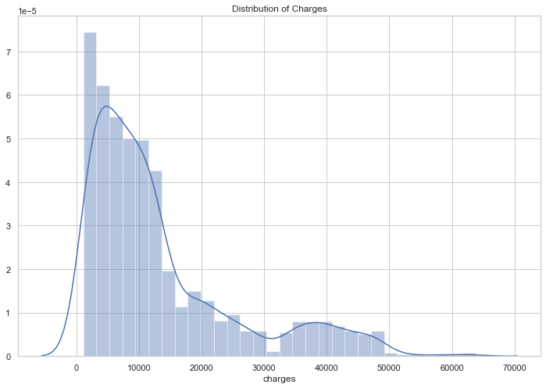
How is the dataset distributed?
Key Observations:

Slide 10
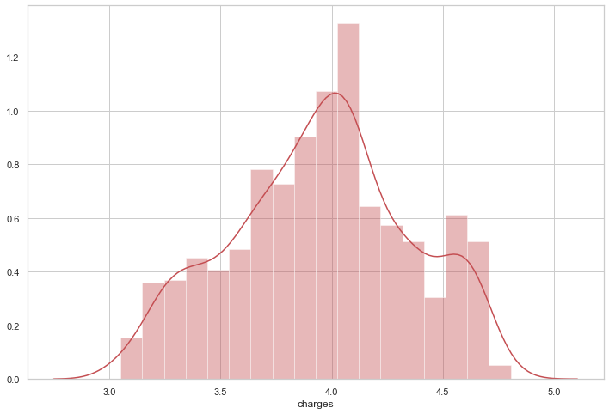
How is the dataset distributed?

Slide 11
Summary of key findings & inferences
Health Insurance Data

Slide 12
Finding 1:
Key Observation:

Slide 13
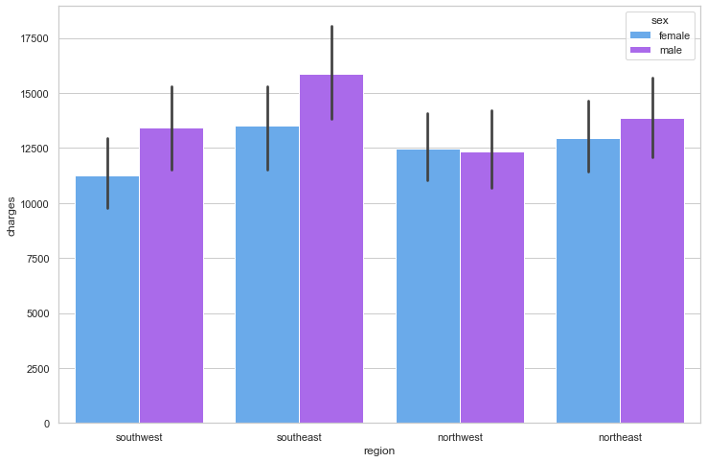
Finding 2:
Key Observation:

Slide 14
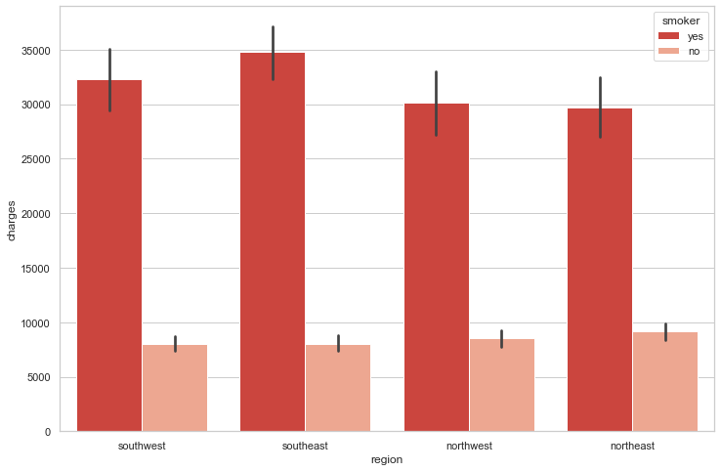
Finding 3:
Key Observation:

Slide 15
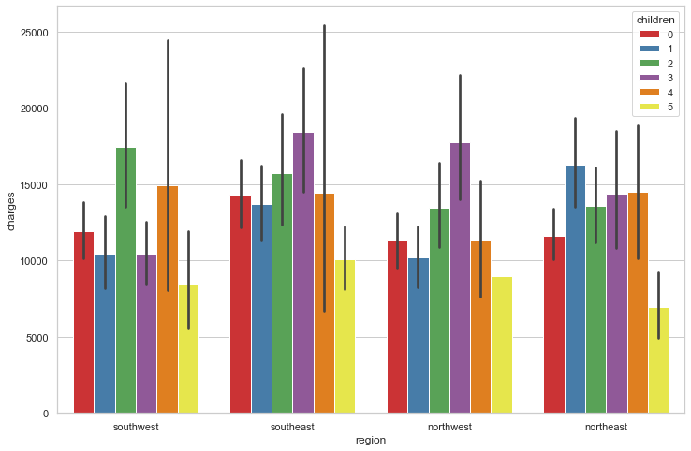
EDA Inference Summary - I
1.
2.
3.

Slide 16
EDA Inference Summary II
Key Observation:

Slide 17
EDA Inference Summary III
Key Observation:
Key Observation:

Slide 18
Feature Correlation
Key Observation:

Slide 19
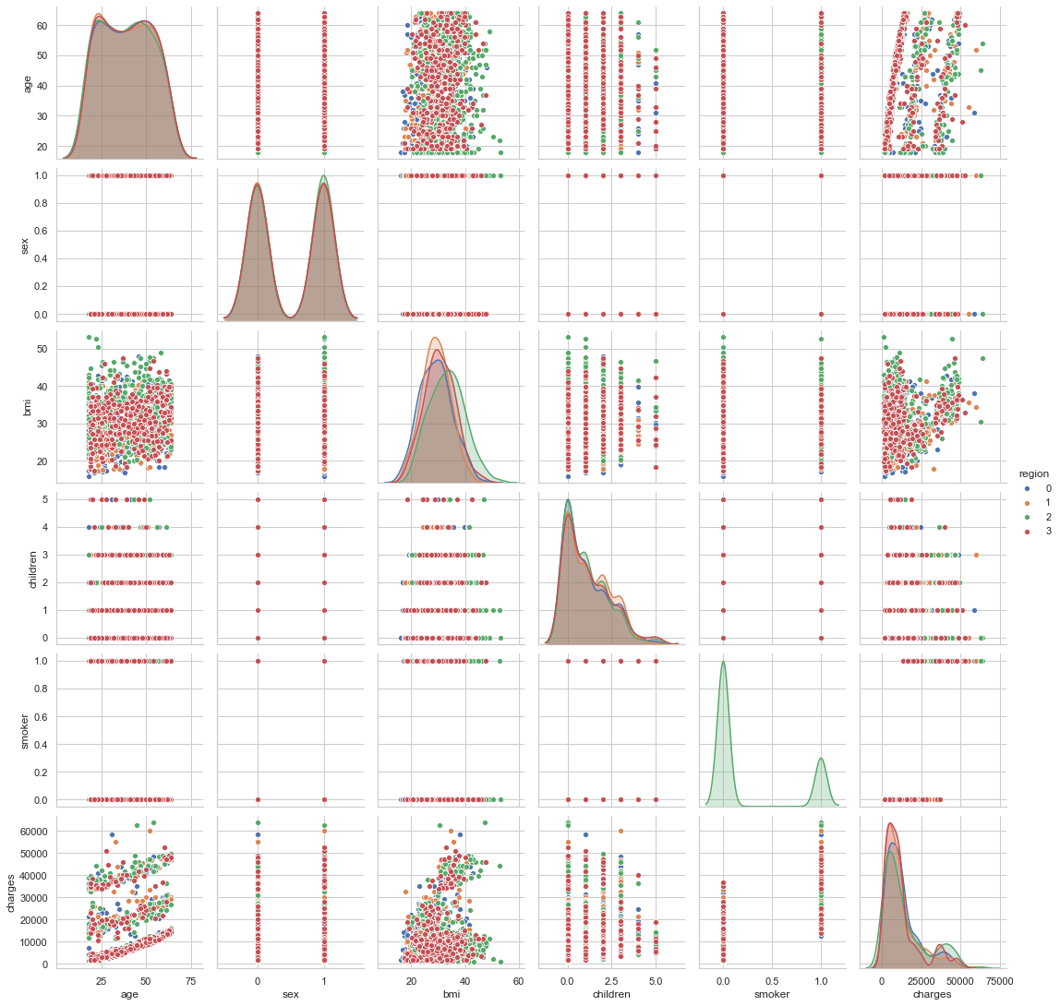
Key Observations :

Slide 20
Summary (of key observations)
xxxxxxx
xxxxxxxxxxxxxxxx
xxxxxxxxxxxx
xxxxxxxxxxxxx
xxxxxxxxxxxxxx
xxxxxxxxxxx

Slide 21
Model Build & Evaluation
Proposed Solution & next steps…

Slide 22
Summary
Conclusion: xxxxxxxxxxxxxxxxxxxxx
Results: xxxxxxxxxxxxxxxxxx

Slide 23
Actions / Next Steps..
XXXXXXXXXXXXXXXXX
XXXXXXXXXXXXXXXXXXX
XXXXXXXXXXXXXXXX

Slide 24
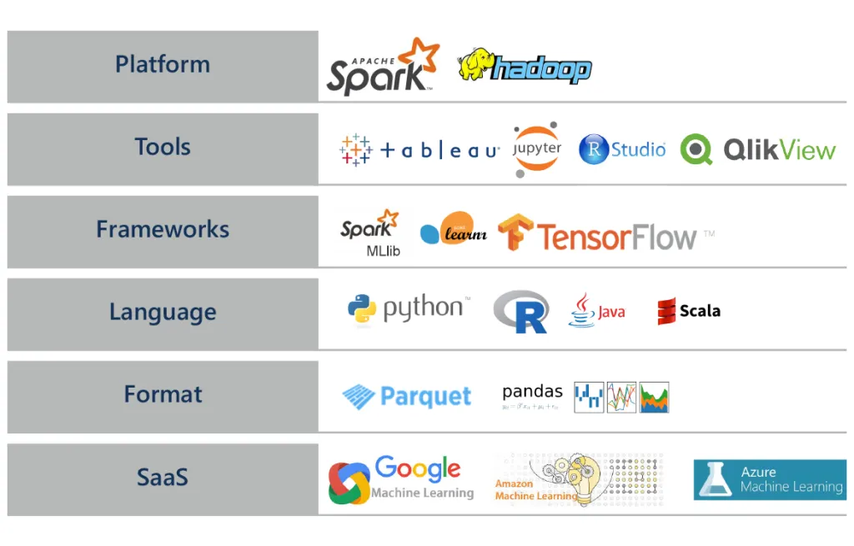
DS Tools & References

Slide 25
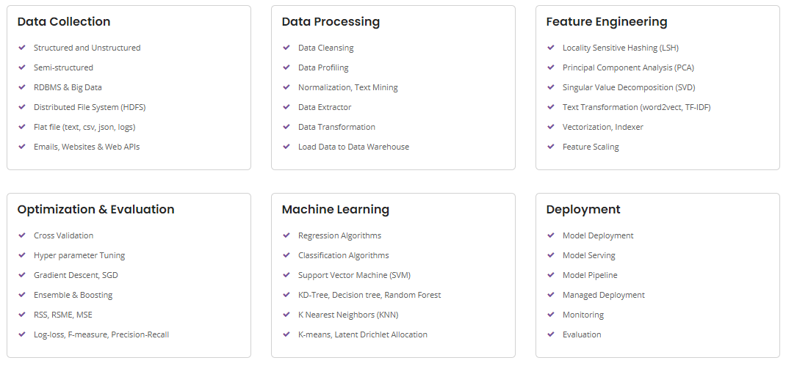
Our Data Science services help customers meet the demands of today, plan for tomorrow and quickly realize tangible business benefits through data integrity and actionable insights.

