Slide 1
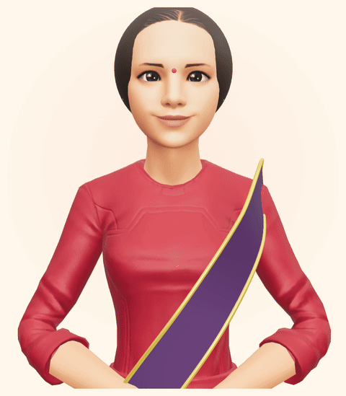
🙏
जनसेवक JanSewak
AI copilot for any government website.
Talk in any Indian language — she finds the right portal,
watches your screen, and guides every click.
jansewak.vercel.app
नमस्ते! मैं जनसेवक हूँ 🙏
Build What Moves India · 2026 — Finals

Slide 2
THE PROBLEM
Every Indian — farmer or engineer — needs a guide on sarkari websites.
900M+
20.4%
11.4%
internet users in 2025 — growth driven by Indic-language adoption (IAMAI–Kantar)
of households need someone else's help to use digital services (NCAER 2026)
of households access government services online — everyone else is left out (NCAER)
🗺️ Which portal? Which of the 40 links? Is this site even real?
📺 Even educated citizens hunt YouTube tutorials — thousands exist, mostly outdated, never about your screen or your case
📷 “Photo must be under 50KB” — a full stop for most citizens
📰 Paste clipping
“Citizens lost over ₹22,845 crore to cyber criminals in 2024” — Business Standard, Jul 2025
📰 Paste clipping
“Elderly couple under ‘digital arrest’ for 2 weeks, duped of ₹14 crore” — Deccan Herald, Jan 2026
Sources: IAMAI–Kantar “Internet in India 2024” · NCAER “Digital Inclusion” 2026 · MHA / I4C, Lok Sabha Jul 2025
jansewak.vercel.app

Slide 3
MEET JANSEWAK
She talks in your language.
She sees your screen.
She shows every click.
A lifelike 3D sahayak — like sitting beside a real agent, not typing at a bot.
▶ LIVE DEMO — watch a citizen file a cyber crime complaint on the actual govt website, just by talking
jansewak.vercel.app

Slide 4
WHAT SHE DOES
One sahayak, every sarkari need.
🗣️ Voice-first, major Indian languages — switch mid-sentence: “मराठी में बोलो”
🖥️ Live screen guidance — yellow highlights in an auto pop-out, always-on-top guide with live captions
⚡ Auto-fill mode — her inbuilt agent types the form herself, narrating each field — no screen share needed
📋 Copy-ready form text — on-device profile, DigiLocker fetch (demo), share-by-link for family
🏛️ Right portal & scheme discovery — official sites only; any govt website works day one
🚨 Cyber-fraud first aid — call 1930 in the golden hours, freeze the account, then file on cybercrime.gov.in
📁 Photo & signature resize — to exact govt KB limits, built in
🔒 Safe by design — never asks OTP, Aadhaar or passwords; profile stays on device
jansewak.vercel.app

Slide 5
WHY WE BUILT IT LIKE THIS
Works on every govt website — today.
🏛️ Zero changes needed from government — she reads the real site's screen; portal redesigns take years, this ships now
📺 A tutorial that's never outdated — YouTube videos show someone else's 2019 screen; she guides on your live screen, your case, your language
👁️ Showing beats telling — chatbots recite steps; she highlights the exact button and hands you the text to paste
🔒 Trust built in — profile stays on device; she never asks for OTP, Aadhaar or passwords
jansewak.vercel.app

Slide 6
IMPACT
From “sarkari websites are hard” to “बस बोलिए.”
98%
₹22,845 Cr
~10,000/day
of Indian internet users engage with content in Indic languages — JanSewak speaks theirs (IAMAI–Kantar)
lost to cyber fraud in 2024 alone — golden-hour first aid can still freeze the money (I4C / MHA)
cyber-fraud complaints in 2024 — she gets victims to 1930 and files in minutes (MHA)
🌾 Last-mile scheme delivery — schemes fail at the form, not the policy; she walks every citizen through in their own words
🚨 Golden-hour fraud response — she gets victims to 1930 and cybercrime.gov.in in minutes, when money can still be frozen
🧓 Dignity, not dependence — no more waiting for a grandson or paying a cyber café to click for you
jansewak.vercel.app

Slide 7
THE ROAD AHEAD
Aaj: she guides on any screen.
Kal: integrated into every govt website, with government support — no screen share needed.
The copilot lives inside the portal itself — and JanSewak is the bridge that works today.
हर सरकारी काम, अपनी भाषा में — बोलकर।
jansewak.vercel.app
जनसेवक · Build What Moves India

Slide 8
🙏
धन्यवाद · Thank You
Questions? Ask JanSewak — she answers in your language.
jansewak.vercel.app
Build What Moves India · 2026 — Finals

Slide 9
EXTRA · HOW WE BUILT IT
One browser tab ⇄ Gemini Live. No backend state, no scraping.
🎙️ Citizen's browser
Next.js on Vercel · mic → 16kHz PCM · screen frames only when pixels change · 3D agent lip-syncs to her live voice
✨ Gemini Live (native audio)
hears + sees in real time · speaks major Indian languages · Google Search fallback · auto-resumes dropped sessions
⇄
🔐 Ephemeral tokens
API key never leaves the server — browser gets single-use tokens
🛠️ Function calls drive the UI
highlight_region → yellow box · provide_text → copy chips · open_file_tool → photo resizer
Latency engineered, not hoped for: ~3s to first word · 400ms end-of-speech VAD · echo gating · background-tab-proof capture · auto pop-out always-on-top guide with live captions.
github.com/pathakcodes/jansewak

Slide 10
EXTRA · PRODUCT
JanSewak in action
🖼️ Paste screenshot
Homepage — agent speaking
🖼️ Paste screenshot
Live guide pop-out with highlights
🖼️ Paste screenshot
Inbuilt form agent auto-filling
🖼️ Paste screenshot
Copy-ready text + photo resizer
jansewak.vercel.app

Slide 11
EXTRA · RECORDED DEMO
2-minute recorded walkthrough
🎬 Insert demo video here
Google Slides: Insert → Video → Google Drive (upload demo.mp4 first)
Recording: jansewak.vercel.app/pitch/demo.mp4 · cyber crime complaint filed end-to-end by voice
jansewak.vercel.app

