Slide 1
Algorithmic Trading Model for BTC/USDT Market
Maximizing Returns with Effective Risk Management
Team Blind:
Aayush Ujjwal
Pavithra M
Ratikesh Singh
Suraj Kumar

Slide 2
Navigating Volatility: Algorithmic Trading in the BTC/USDT Market
Explore model for dynamic BTC/USDT market.
Navigate volatility using algorithmic trading strategies.
Model design, rationale, backtesting, risk management approach.
BTC/USDT demands sophisticated strategies. Showcase efficacy.

Slide 3
Data Used
Utilized preprocessed historical BTC/USDT data.
Timeframe: January 1, 2018, to January 31, 2022.
Eight diverse frequency datasets, ranging from 3 min – 6 hour datasets.

Slide 4
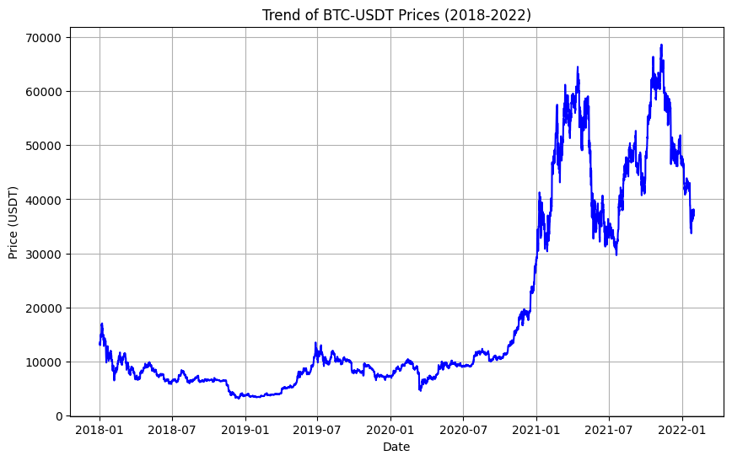

Slide 5
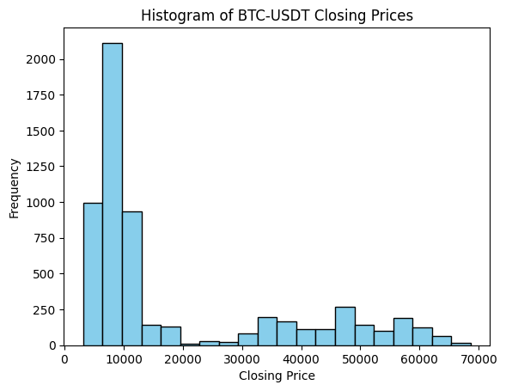

Slide 6
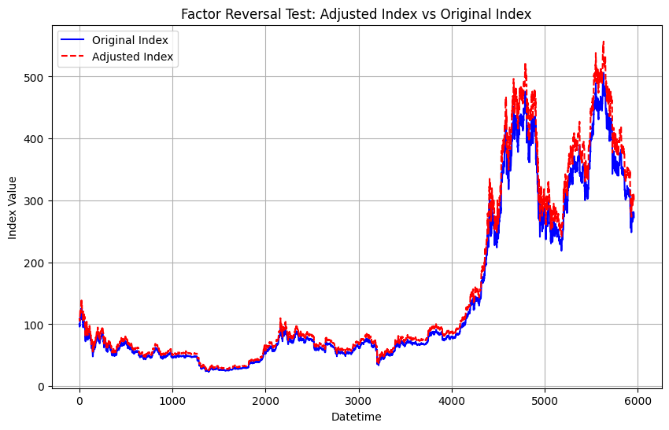

Slide 7
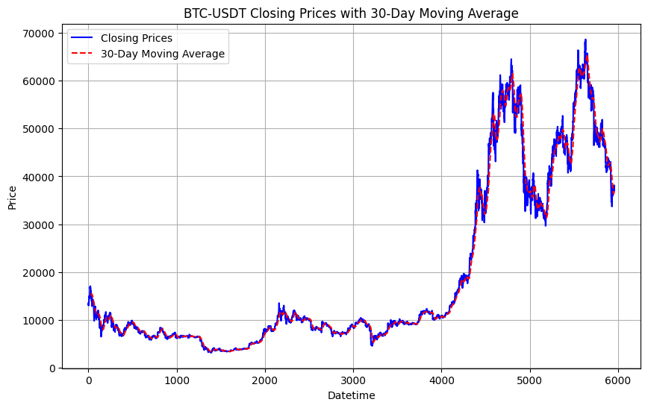

Slide 8
Model Design - Indicators
Implementing Buy-Sell-Hold Indicators:
Indicators Used: SMA, EMA, Mean Reversion.
Final Signal: Generated using bitwise conditions.
This final signal guides our trading decisions.

Slide 9
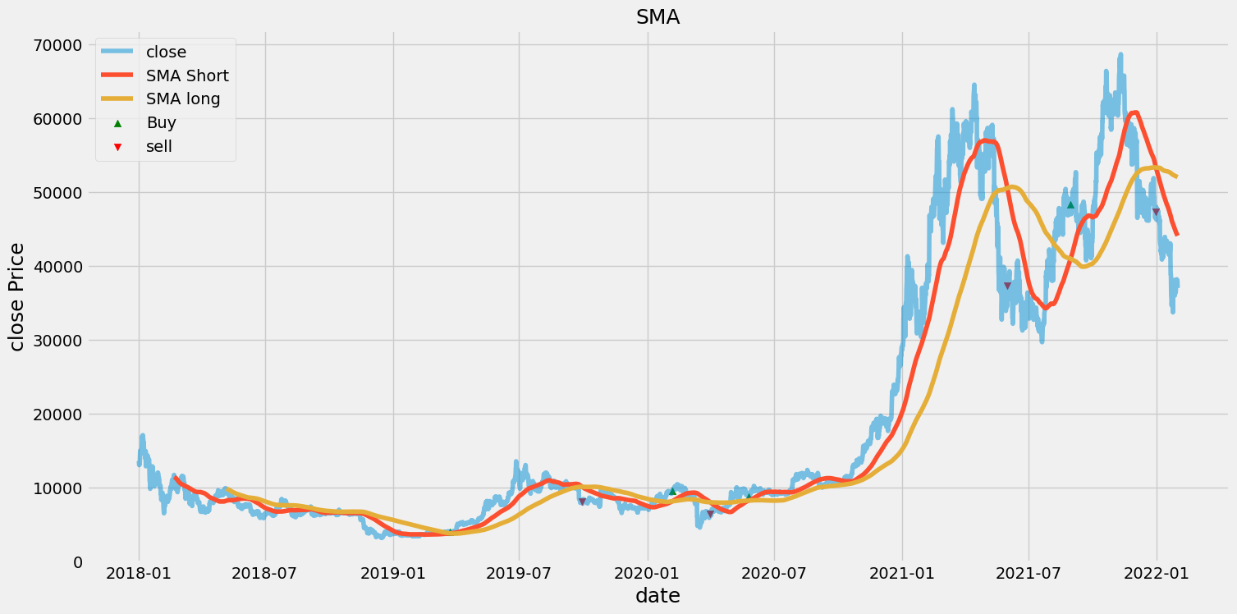
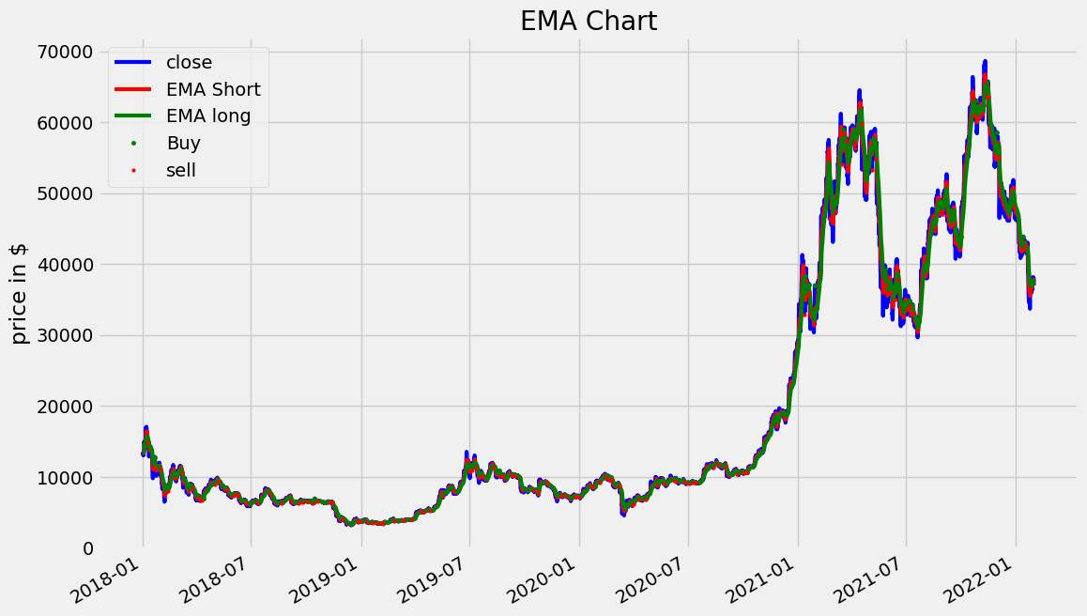
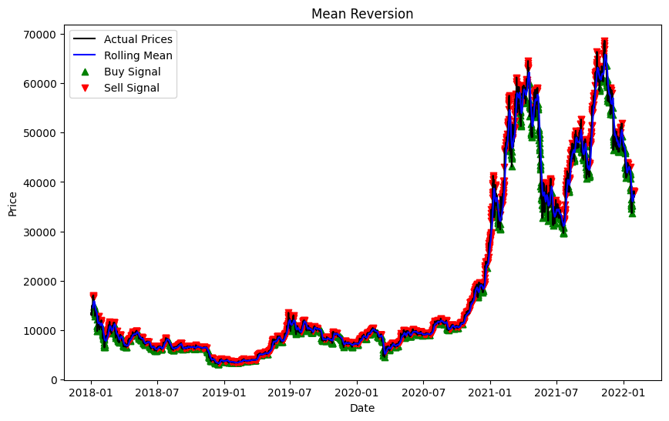
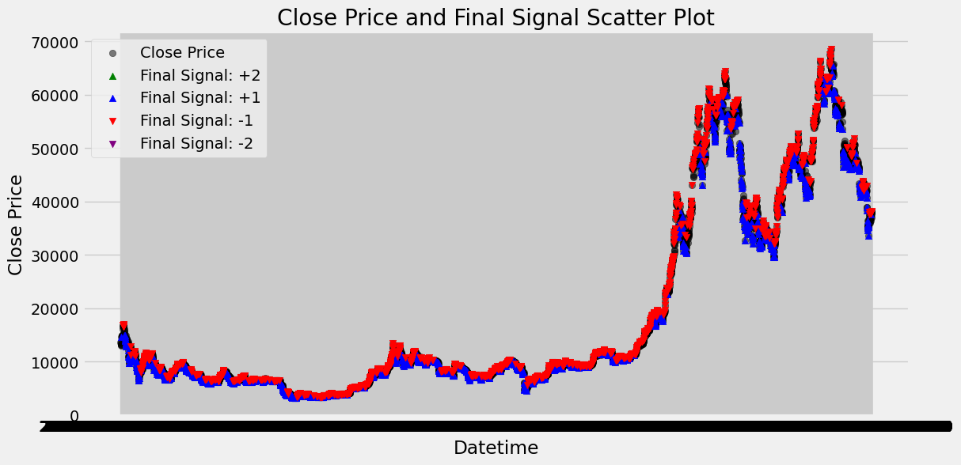

Slide 10
Model Design - Final Signal
Final signal assignment based on indicator conditions.
Signal Definitions: Strong buy, buy, sell, strong sell, or hold.
This signal serves as our guiding principle for executing trades.

Slide 11
Model Design - Risk Modes
Low Risk Mode: Executing strong buy and strong sell trades.
High Risk Mode: Executing buy and sell trades.
This adaptability allows us to navigate different market scenarios effectively.

Slide 12
Risk Management
Rules:
Stop Loss:
Varied between 1% to 8% to manage downside risk.
Buy Trade Execution:
Low Risk Strong Buy: Invest entire wallet.
High Risk Strong Buy: Invest half of the wallet.
Low Risk Buy: Invest 2% of the wallet.
Sell Trade Execution:
Low Risk Sell: Sell all holdings.
Low Risk Strong Sell: Sell all holdings.
Otherwise: Hold the existing holdings.

Slide 13
Backtesting
Conducting extensive backtesting using historical data
Evaluating performance with a focus on transaction costs and slippage
Considering costs at a rate of 0.15 percent per transaction
Compute Gross Profit/loss, Net Profit, Total Closed Trades, Win Rate, and Max Drawdown for performance assessment.
Average Winning/Losing Trades, Buy and Hold Return, Largest Losing /Winning Trades for risk and reward insights.

Slide 14
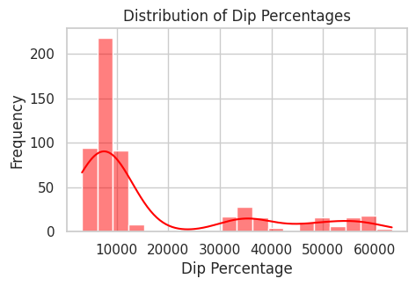
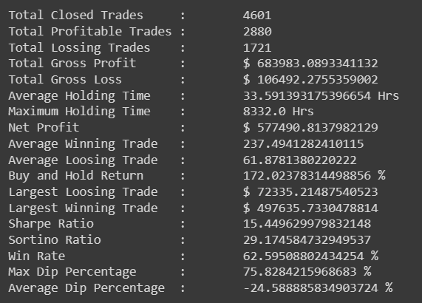
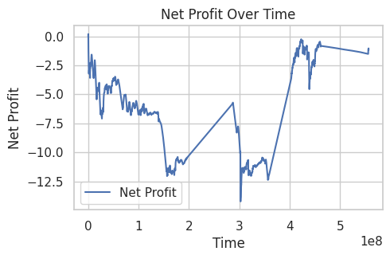

Slide 15
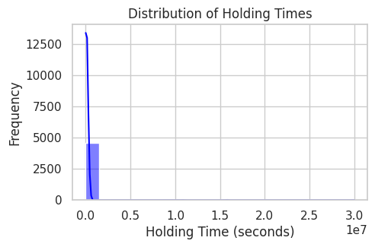
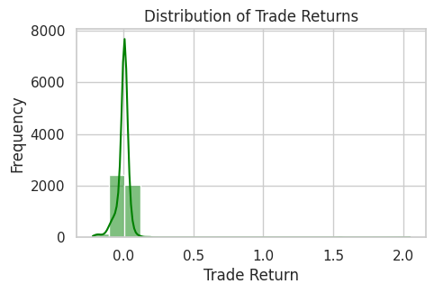
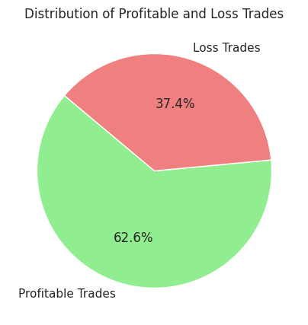

Slide 16
Optimization
Fine-Tuning short look back period and long look back period for SMA strategy and similarly for EMA and Mean Reversion strategies.
Fine-tuning stoploss levels based on backtesting results.
Optimizing high-risk and low-risk mode thresholds.

Slide 17
THANK YOU

