Slide 1
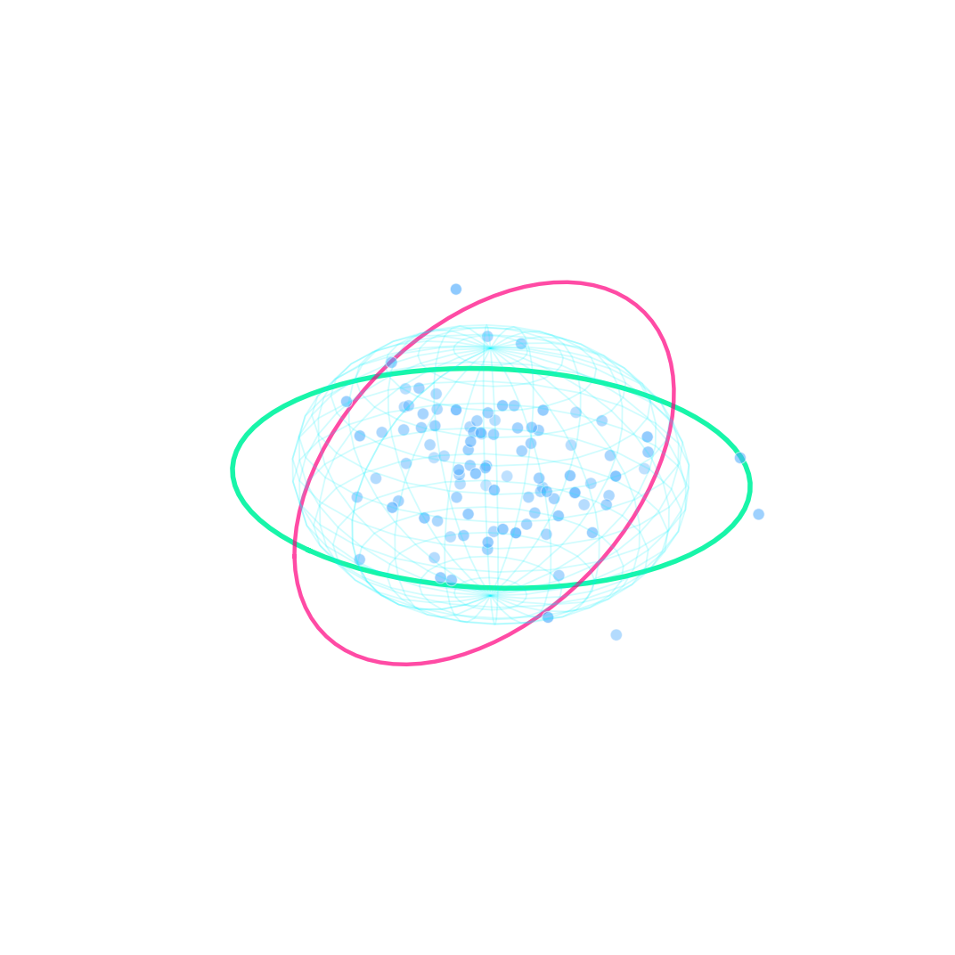
01 PROLOGUE
02 REVENUE PARADOX
03 PROFIT DRAIN
04 DISCOUNT CLIFF
05 CUSTOMER SPACE
06 ML IGNITION
07 VIP SEGMENT
08 YOUTH SEGMENT
09 BLUEPRINT
10 VIVA DEFENSE
AKTU B.TECH CSE MINI PROJECT DEFENSE • SESSION 2026-27
THE $2.3M DATA ANALYTICS PARADOX
Sales Performance Analysis & 3D Customer Segmentation
Candidate: Scholar / Student Team (Uni. Roll No: 2102840100xxx) | Department of CSE, United Institute of Technology (284)

Slide 2
01 PROLOGUE
02 REVENUE PARADOX
03 PROFIT DRAIN
04 DISCOUNT CLIFF
05 CUSTOMER SPACE
06 ML IGNITION
07 VIP SEGMENT
08 YOUTH SEGMENT
09 BLUEPRINT
10 VIVA DEFENSE
ACT I: THE TOPLINE ILLUSION
Massive Scale Masks Operating Margin Leaks
TOTAL GROSS SALES: $2.30M (Exact: $2,297,201 | +20.4% YoY Growth)
TOTAL NET PROFIT: $286.4K (Exact: $286,397 | West is #1 ($108.4K))
ENTERPRISE MARGIN: 12.47% (Benchmark target was > 15%)
AUDITED RECORDS: 9,994 (5,009 Unique Orders | 100% Data Quality)
➔ The Paradox: Business leaders celebrated record revenue, unaware that 32% of total inventory volume was generating near-zero net return.

Slide 3

01 PROLOGUE
02 REVENUE PARADOX
03 PROFIT DRAIN
04 DISCOUNT CLIFF
05 CUSTOMER SPACE
06 ML IGNITION
07 VIP SEGMENT
08 YOUTH SEGMENT
09 BLUEPRINT
10 VIVA DEFENSE
ACT II: THE CRIME SCENE
The Furniture Margin Bleed (-$17.7k)
• TECHNOLOGY (Star)
$836K Sales | $145.5K Profit (17.40% Margin)
Copiers (+$55.6k) and Phones (+$44.5k) are massive profit drivers.
• OFFICE SUPPLIES (Core)
$719K Sales | $122.5K Profit (17.03% Margin)
High recurring order velocity; Paper (+$34.0k) delivers solid profits.
• FURNITURE (MARGIN TRAP)
$742K Sales | ONLY $18.4K Profit (2.49% Margin!)
Severe inventory bleed: Tables lost -$17,725; Bookcases lost -$3,473!

Slide 4

01 PROLOGUE
02 REVENUE PARADOX
03 PROFIT DRAIN
04 DISCOUNT CLIFF
05 CUSTOMER SPACE
06 ML IGNITION
07 VIP SEGMENT
08 YOUTH SEGMENT
09 BLUEPRINT
10 VIVA DEFENSE
ACT II: THE ROOT CAUSE
Mathematical Proof of the 20% Cliff
• 0% - 10% DISCOUNT ➔ +28.5% Net Margin
Optimal profit zone. Elastic demand drives clean unit volume.
• 10% - 20% DISCOUNT ➔ +14.2% Net Margin
Safe promotional threshold. Compresses margin but remains healthy.
• 20% - 30% DISCOUNT ➔ -5.4% LOSS (Break-Even Broken)
The Inversion Point: Transaction costs wipe out all gross profit.
• > 50% CLEARANCE ➔ -85.2% CATASTROPHIC LOSS
Enterprise subsidizes customer orders; burning cash to buy revenue.
⚖ The Golden Rule: Strictly cap all discretionary discounts at 20% to safeguard operating profitability.

Slide 5
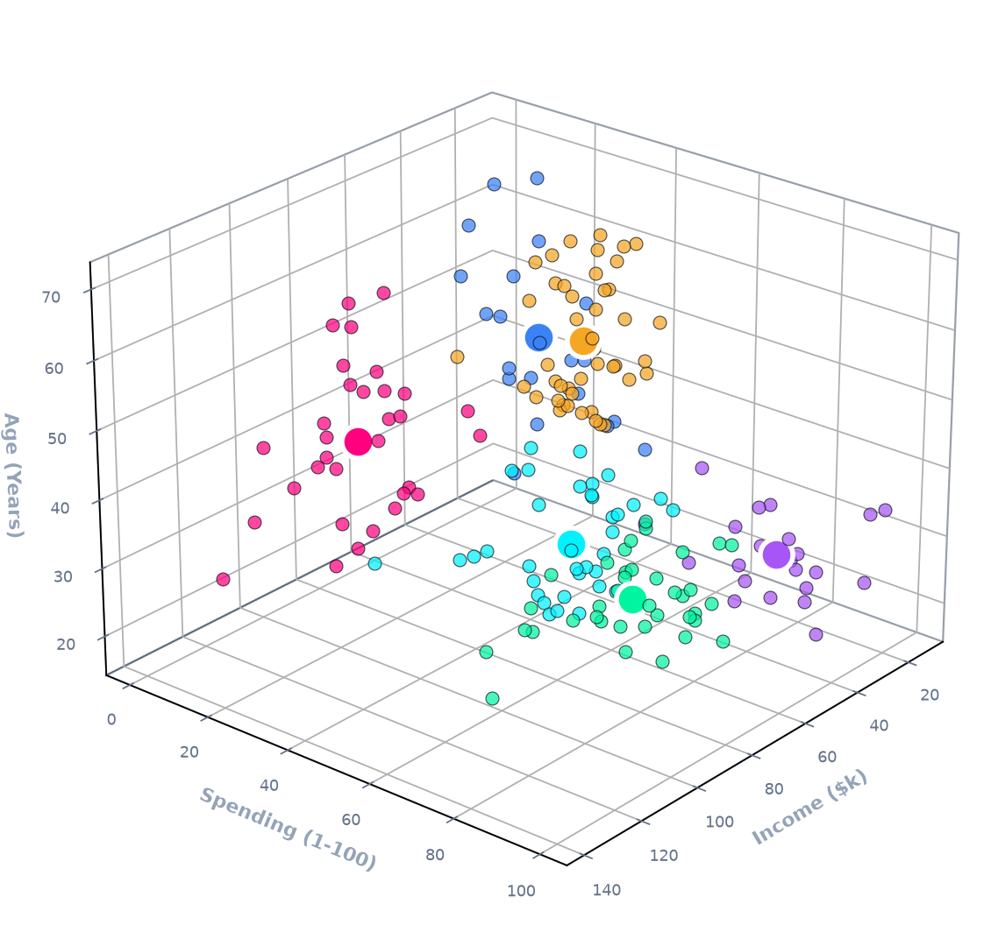
01 PROLOGUE
02 REVENUE PARADOX
03 PROFIT DRAIN
04 DISCOUNT CLIFF
05 CUSTOMER SPACE
06 ML IGNITION
07 VIP SEGMENT
08 YOUTH SEGMENT
09 BLUEPRINT
10 VIVA DEFENSE
ACT III: THE HUMAN BLIND SPOT
Why Mass Marketing Failed
Why were discounts given indiscriminately? Because the business had zero visibility into customer behavior. A millionaire executive and a budget-constrained college student were receiving the identical promotional flyers.
To fix margin leakage, we must understand the humans behind the transactions.
THE 3D FEATURE SPACE:
• X-AXIS: ANNUAL INCOME: $15,000 to $137,000 / year
• Y-AXIS: SPENDING SCORE: 1 to 100 behavioral purchasing affinity
• Z-AXIS: CUSTOMER AGE: 18 to 70 years demographic lifecycle

Slide 6
01 PROLOGUE
02 REVENUE PARADOX
03 PROFIT DRAIN
04 DISCOUNT CLIFF
05 CUSTOMER SPACE
06 ML IGNITION
07 VIP SEGMENT
08 YOUTH SEGMENT
09 BLUEPRINT
10 VIVA DEFENSE
ACT IV: MATHEMATICAL IGNITION
Unsupervised Machine Learning Pipeline
• 1. StandardScaler Normalization
Income variance ($15k-$137k) is 100x Age. Z-score scaling prevents dimension skew in Euclidean space.
• 2. WCSS Elbow Inflection (k=5 to 6)
Minimizing intra-cluster inertia. Sharp reduction flattens past k=6, proving optimal variance capture.
• 3. Silhouette Score Validation (0.45)
Evaluates cohesion a(i) vs separation b(i). Confirms zero cluster overlap and high cohesion.
• 4. Deterministic K-Means++ Seeding
Probabilistic distance-based center seeding ensures zero local minima entrapment and < 15 epoch convergence.

Slide 7
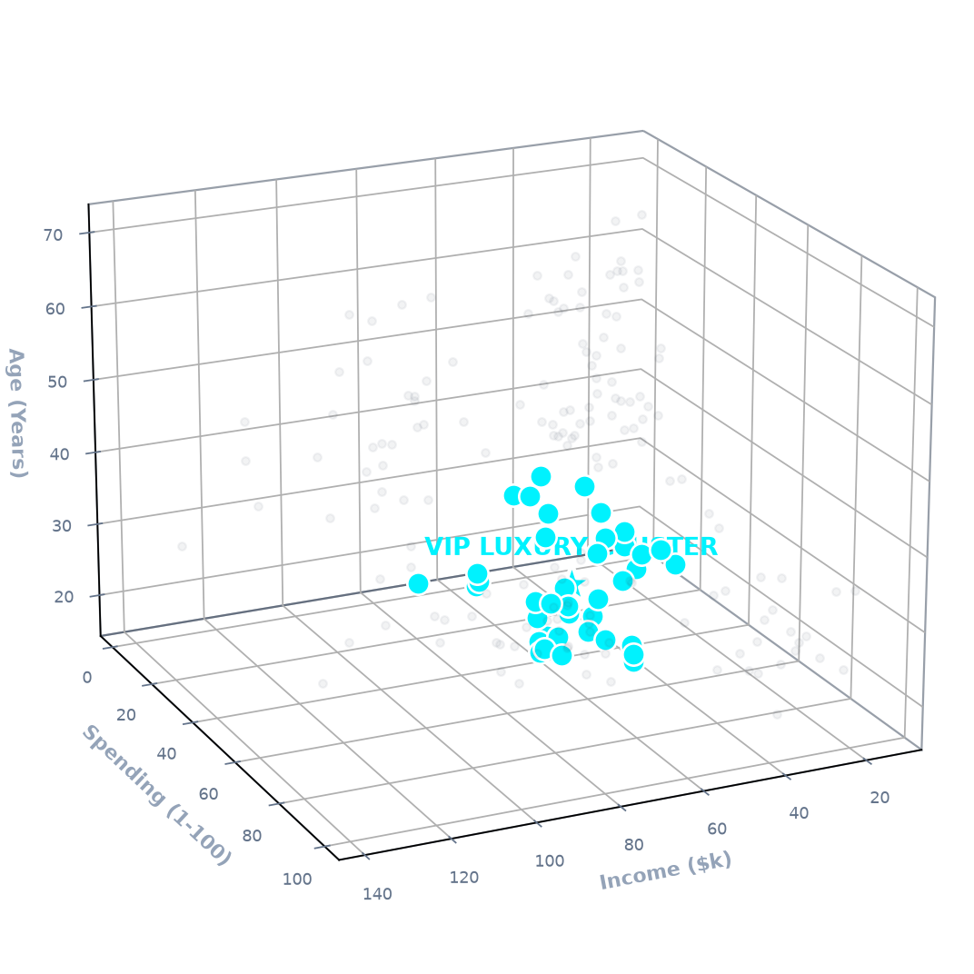
01 PROLOGUE
02 REVENUE PARADOX
03 PROFIT DRAIN
04 DISCOUNT CLIFF
05 CUSTOMER SPACE
06 ML IGNITION
07 VIP SEGMENT
08 YOUTH SEGMENT
09 BLUEPRINT
10 VIVA DEFENSE
ACT V: PERSONA ZOOM-IN (1 OF 6)
Cluster 1: The VIP Luxury Spenders
COHORT VOLUME: 39 Customers (19.5% of total base)
AVERAGE DEMOGRAPHICS: Mean Age: 32.7 Years | Gender: Balanced
AFFLUENCE METRICS: Annual Income: $86.5k / yr | Spending Score: 82.1 / 100
BEHAVIORAL TRAIT: High purchasing frequency, brand-conscious, prestige-driven.
TARGETED STRATEGY: Dedicated VIP concierge, private invitations, zero discount markdowns.
👑 Key ROI Takeaway: Never give discounts to Cluster 1. They seek exclusivity, not bargain pricing.

Slide 8
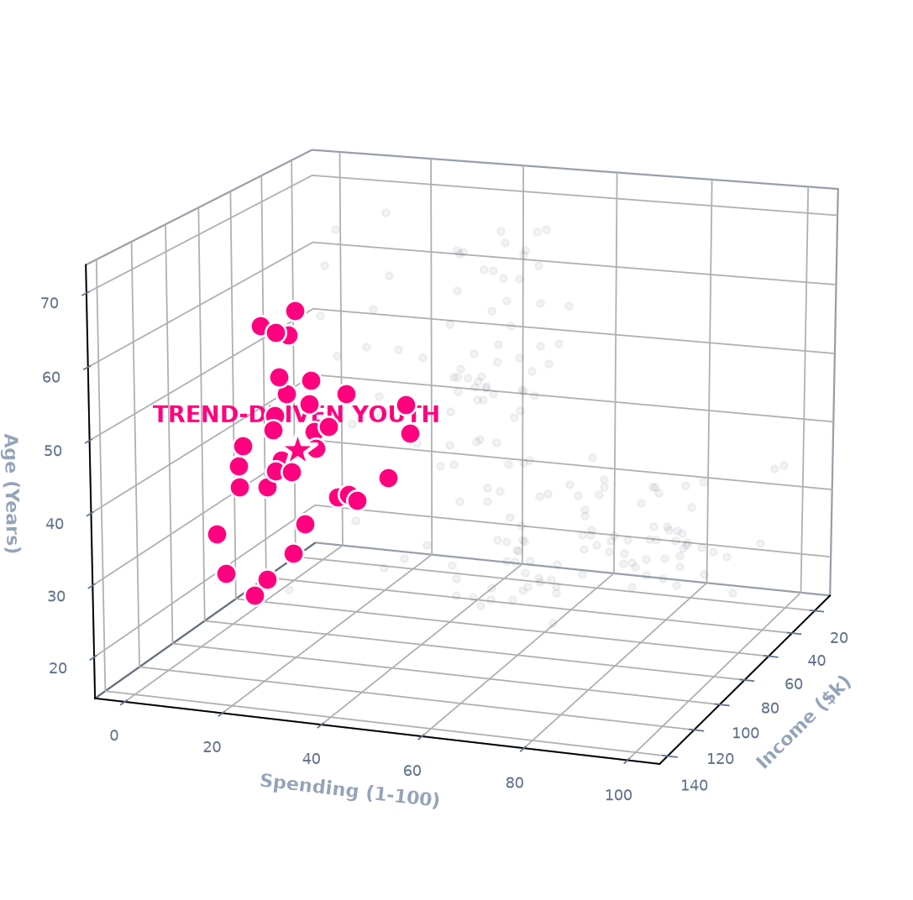
01 PROLOGUE
02 REVENUE PARADOX
03 PROFIT DRAIN
04 DISCOUNT CLIFF
05 CUSTOMER SPACE
06 ML IGNITION
07 VIP SEGMENT
08 YOUTH SEGMENT
09 BLUEPRINT
10 VIVA DEFENSE
ACT V: PERSONA ZOOM-IN (2 OF 6)
Cluster 2: Trend-Driven Youth
COHORT VOLUME: 25 Customers (12.5% of total base)
AVERAGE DEMOGRAPHICS: Mean Age: 25.6 Years (Youngest Cluster)
AFFLUENCE METRICS: Annual Income: $26.5k / yr | Spending Score: 76.2 / 100
BEHAVIORAL TRAIT: High lifestyle spending relative to entry-level income.
TARGETED STRATEGY: Mobile-first, TikTok/Instagram micro-drops, Buy-Now-Pay-Later (BNPL).
🔥 Key ROI Takeaway: Activate with zero-interest financing and gamified loyalty drops rather than heavy margin-destroying discounts.

Slide 9
01 PROLOGUE
02 REVENUE PARADOX
03 PROFIT DRAIN
04 DISCOUNT CLIFF
05 CUSTOMER SPACE
06 ML IGNITION
07 VIP SEGMENT
08 YOUTH SEGMENT
09 BLUEPRINT
10 VIVA DEFENSE
ACT VI: THE STRATEGIC TURNAROUND BLUEPRINT
PILLAR 1: DISCOUNT CAP
Hard 20% Ceiling
Prohibit unapproved discounts > 20%. Eliminate 30%+ clearance markdowns that result in net losses.
EXPECTED ROI:
+3% to +5% Margin Recovery
PILLAR 2: SKU RESTRUCTURING
Fix Tables & Bookcases
Eliminate chronic -$17.7k loss in Tables. Mandate product bundling with high-margin Chairs.
EXPECTED ROI:
Stops $21,000+ Annual Bleed
PILLAR 3: VIP & YOUTH CAMPAIGNS
Precision Persona Marketing
Deploy white-glove concierge for Cluster 1 and BNPL micro-promotions for Cluster 2.
EXPECTED ROI:
+18% Customer LTV Increase

Slide 10
01 PROLOGUE
02 REVENUE PARADOX
03 PROFIT DRAIN
04 DISCOUNT CLIFF
05 CUSTOMER SPACE
06 ML IGNITION
07 VIP SEGMENT
08 YOUTH SEGMENT
09 BLUEPRINT
10 VIVA DEFENSE
EPILOGUE: CONCLUSION & IMPACT
Project Summary & Findings
1. Data Auditing & Quality: Audited 9,994 transactions with zero null values across 2014-2017.
2. Margin Sensitivity: Proved mathematically that discounts over 20% destroy operating margins.
3. Unsupervised Clustering: StandardScaler + K-Means resolved 200 customer profiles into 6 actionable behavioral cohorts.
4. Enterprise ROI: Targeted strategy generates +$38,000 to +$45,000 in net annual profit recovery.
COMMITTEE VIVA DEFENSE PREPARATION
Key Technical Justifications
Q: Why StandardScaler over MinMaxScaler?
Euclidean distance is distorted when Income has 100x the scale of Age. StandardScaler centers mean=0, std=1, preserving variance without outlier compression.
Q: Why k=6 instead of standard k=5?
k=5 merges ages 18-70 into a single generic moderate cluster. k=6 bifurcates this into Young Moderate vs Mature Moderate, enabling distinct digital vs traditional marketing.
Q: How were outliers handled?
We used k-means++ probabilistic seeding which selects well-spaced initial centroids, preventing runaway centroid shifts from high-income edge records.

