Slide 1

A MINI PROJECT PRESENTATION ON
DATA ANALYTICS:
SALES PERFORMANCE ANALYSIS
& CUSTOMER SEGMENTATION
Submitted in partial fulfillment of the requirements for
the award of the degree of
Bachelor of Technology in Computer Science & Engineering
Department of Computer Science & Engineering
UNITED INSTITUTE OF TECHNOLOGY (284), Naini Praygraj
Presented by: Prasoon Pathak
(Uni. Roll No: 2402840109004)
Faculty Guide: Ms. Sonali Kumari

Slide 2
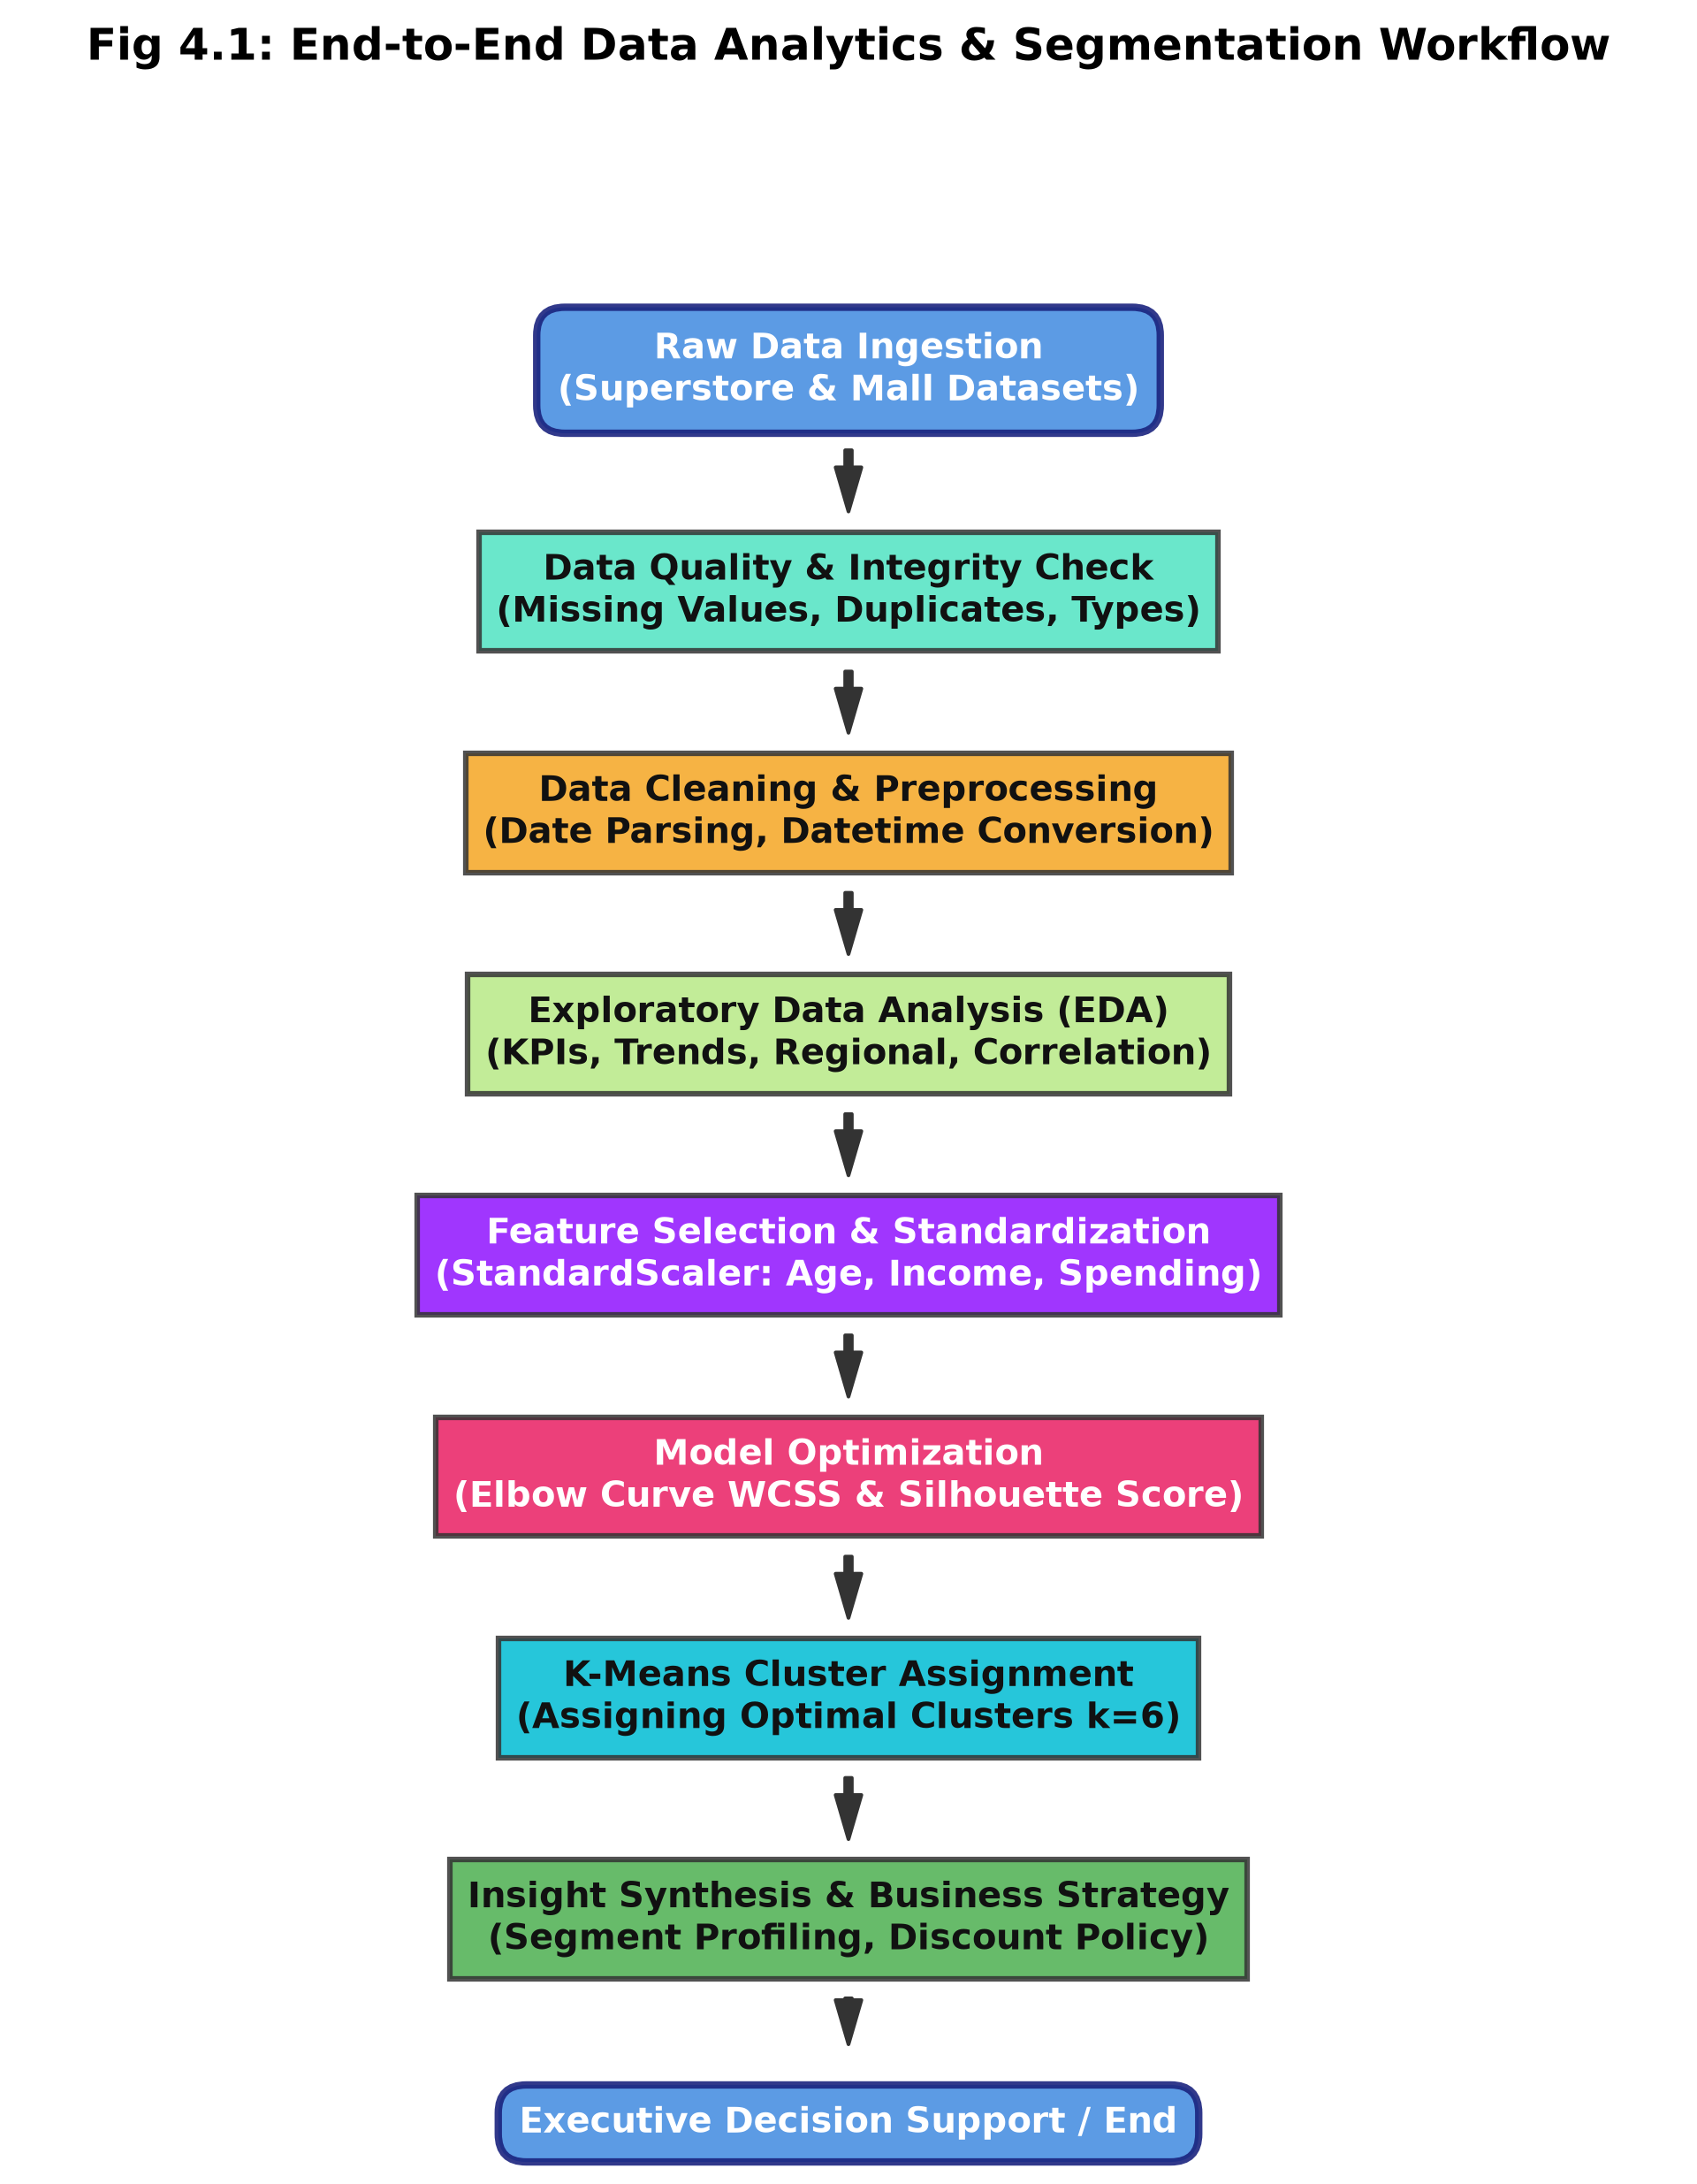
PROJECT OVERVIEW | Project Overview & Engineering Architecture
[EXECUTIVE SCOPE]
Dual Analytics Workflow
• Background Context: Retail organizations generate vast streams of transactional logs but often lack diagnostic profitability models.
• Task 1: Superstore Analytics: Comprehensive profitability audit across 9,994 retail orders (2014-2017) to uncover hidden category margin leaks.
• Task 2: Customer Clustering: Unsupervised machine learning on 200 customer profiles using K-Means to identify distinct demographic personas.
• Engineering Objective: Formulate descriptive KPIs, model discount sensitivity, and establish automated customer segmentation rules.
• Expected ROI: Eliminate loss-making inventory SKUs, enforce discount boundaries, and lift customer lifetime value (LTV).
Figure 1: End-to-End Analytics & Machine Learning Pipeline

Slide 3
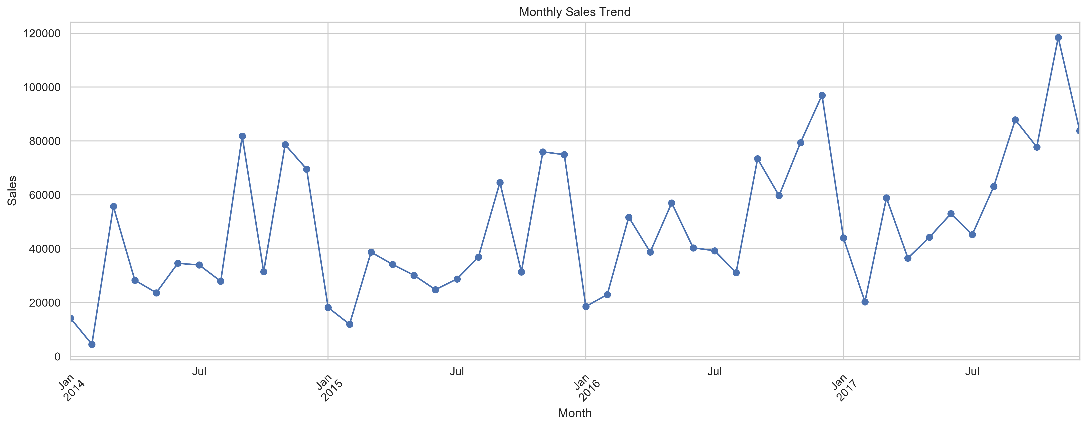
TASK 1: SALES PERFORMANCE | Task 1: Longitudinal Sales Trends & Profitability
[FINANCIAL AUDIT]
Financial Performance Metrics
• Total Sales Turnover: $2,297,201 ($2.30M) across 9,994 retail orders spanning 2014 to 2017.
• Net Operating Profit: $286,397 overall, representing a baseline corporate net margin of 12.47%.
• Annual Growth Trajectory: Consistent YoY growth averaging +20.4%, demonstrating strong demand expansion.
• Seasonal Q4 Volume Surge: Sales consistently spike in November and December due to holiday demand and annual corporate budget clearances.
• Regional Profitability: Western region leads with $108.4K profit (14.9% margin), whereas Central region suffers from aggressive price markdowns.
Figure 2: 4-Year Monthly Sales and Profit Longitudinal Trend

Slide 4
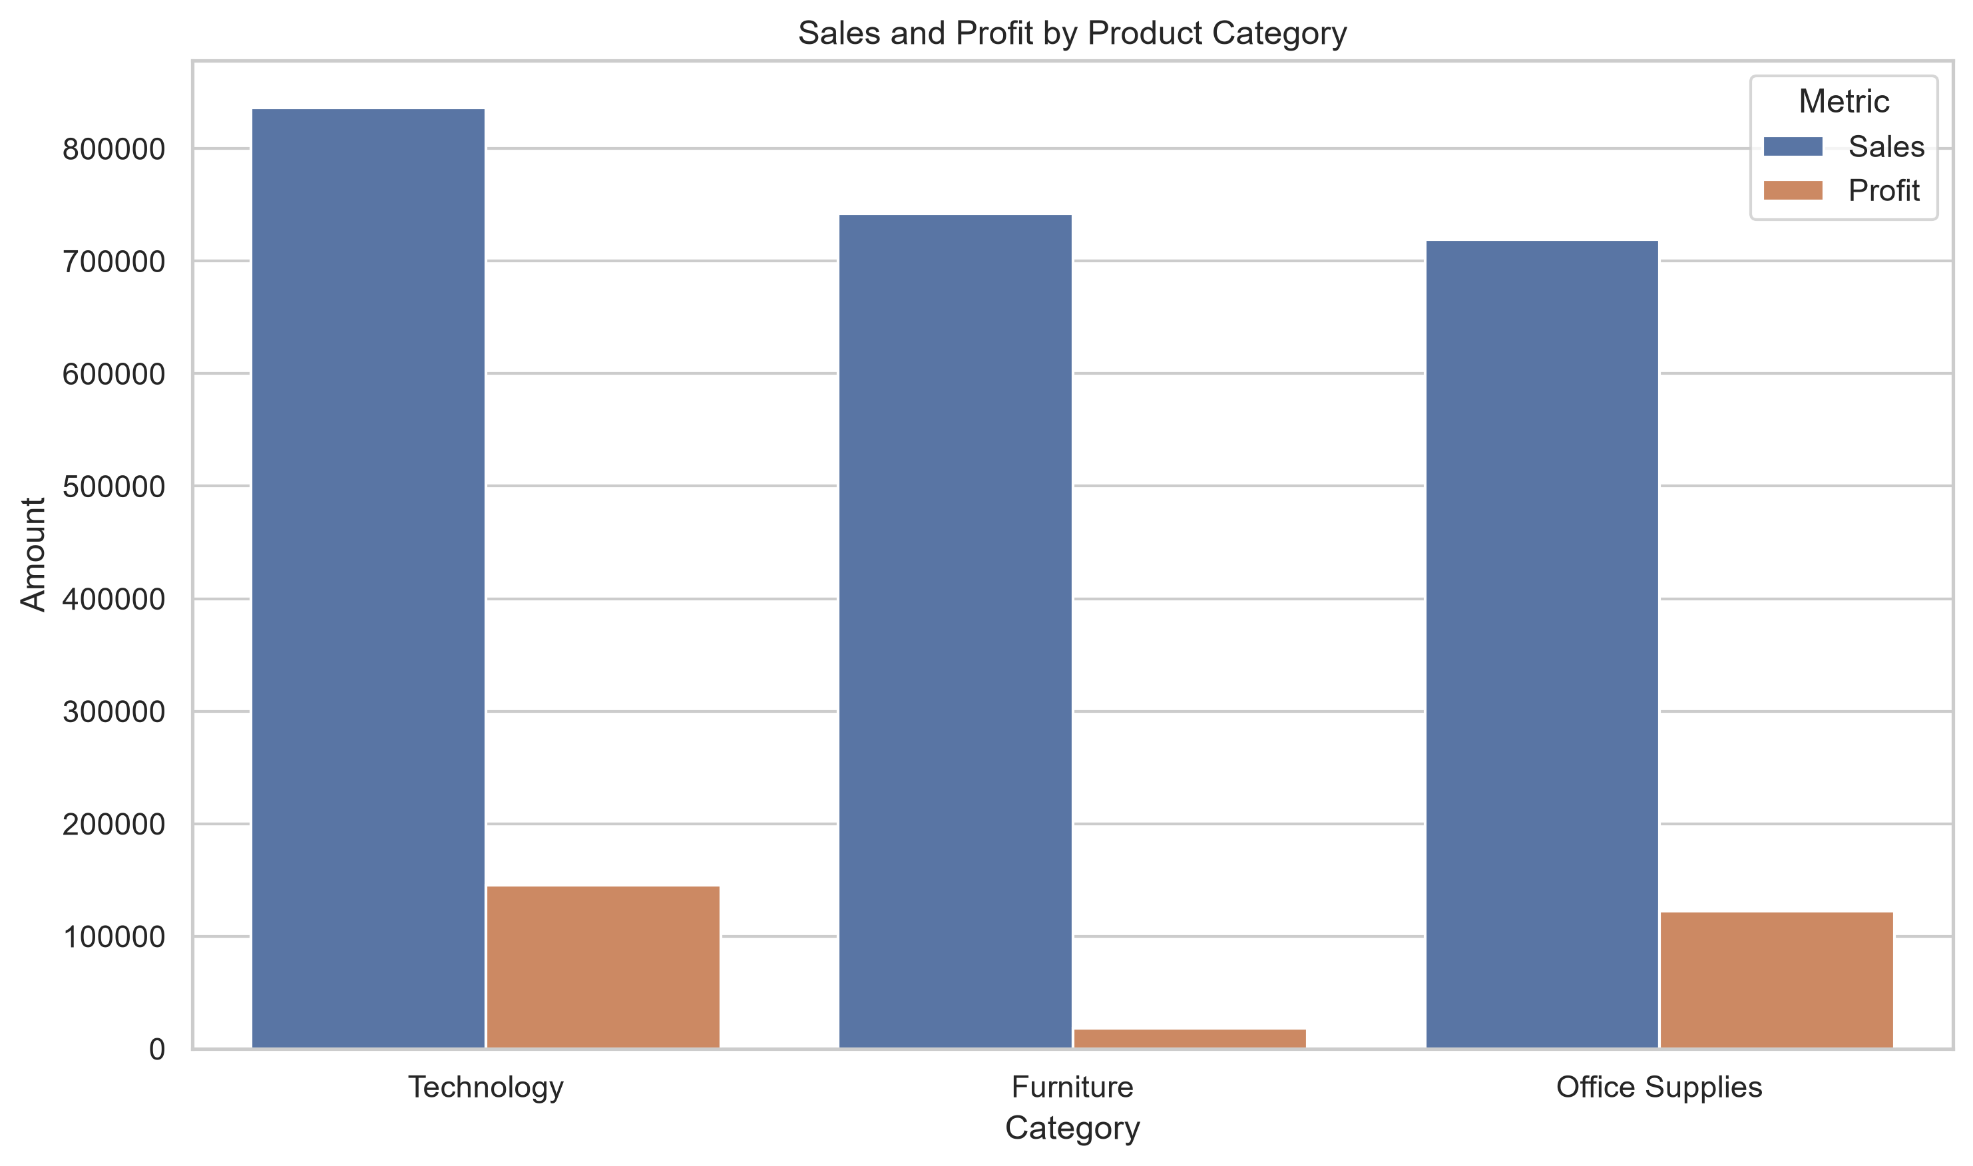
TASK 1: SALES PERFORMANCE | Task 1: Product Category Performance & Margin Traps
[CATEGORY AUDIT]
Category Profitability Breakdown
• Technology (Star Performer): Generated $836,154 in revenue with $145,455 profit. High operating margin of 17.40%, led by enterprise equipment.
• Office Supplies (Core Cashflow): Generated $719,047 in revenue with $122,491 profit. Delivered consistent 17.03% margin across high transaction volume.
• Furniture (Margin Trap!): Generated $741,999 in revenue (32.3% of total sales) but contributed ONLY $18,451 in net profit—yielding a dismal 2.49% margin.
• Diagnostic Takeaway: Furniture consumes substantial shipping freight and warehouse space while producing negligible net operating returns.
Figure 3: Category Comparison: Sales Volume vs Net Profit

Slide 5
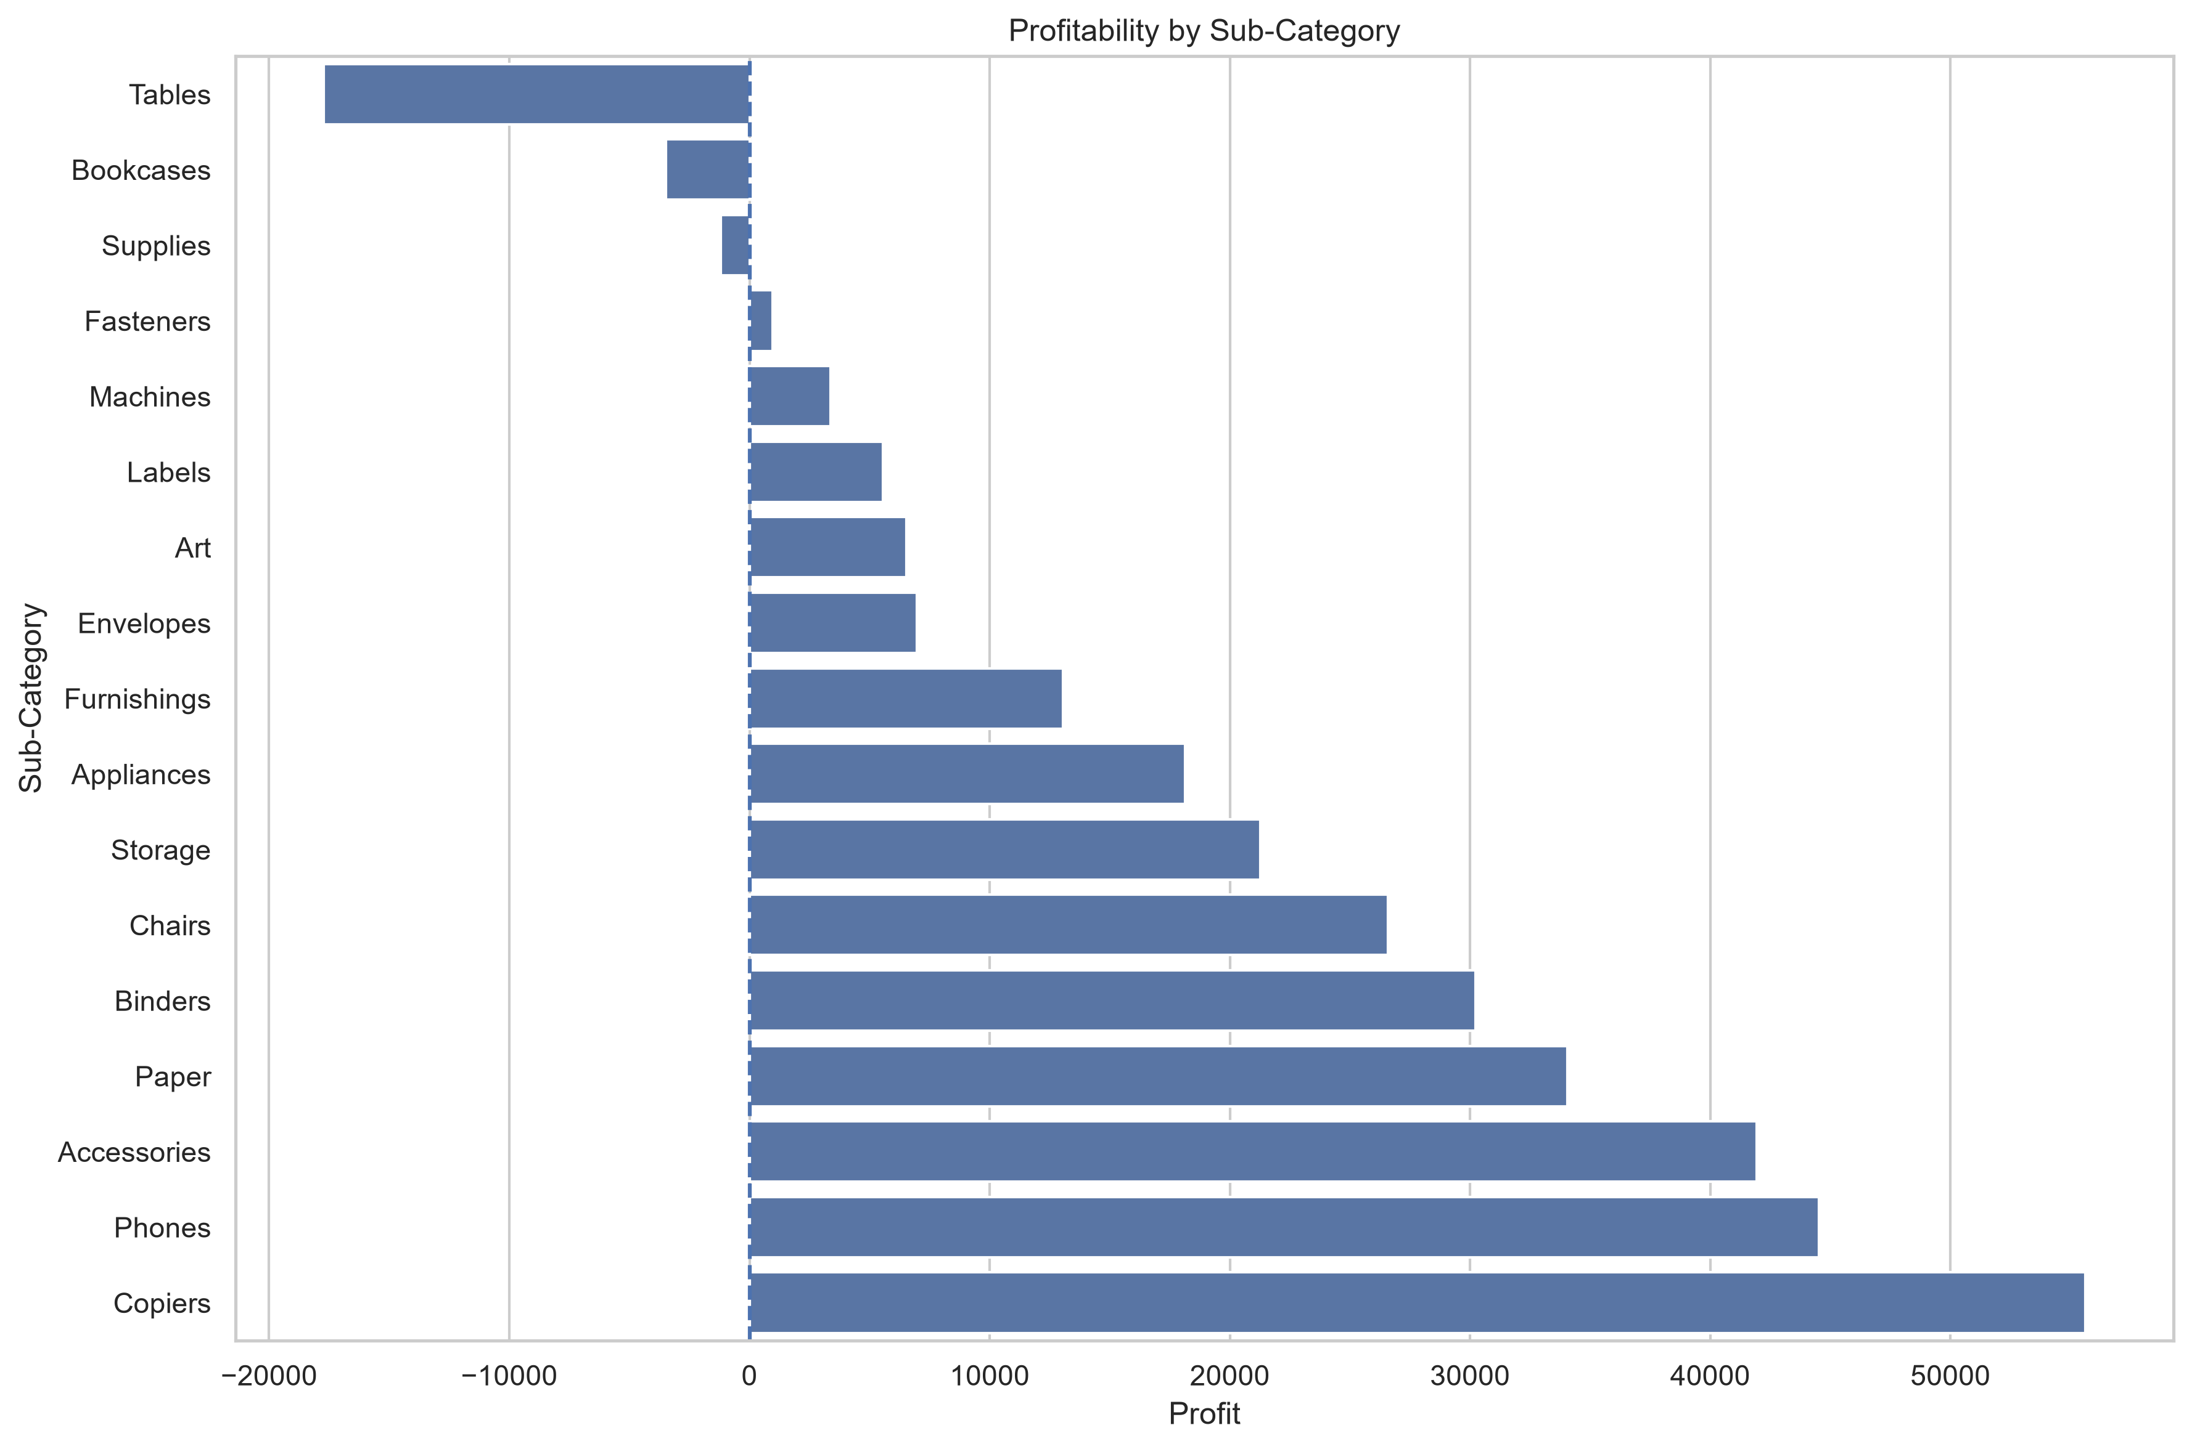
TASK 1: SALES PERFORMANCE | Task 1: Sub-Category Profitability & Chronic SKU Deficits
[SKU PROFITABILITY]
Product Profit Drivers vs Drainers
• Top Profit Contributors: Copiers (+ $55,618 profit, 36.7% margin), Phones (+ $44,516 profit), and Accessories (+ $41,937 profit) are prime financial pillars.
• High-Margin Staples: Paper (+ $34,054 profit) and Binders (+ $30,221 profit) deliver steady, resilient cash flow with minimal price sensitivity.
• Tables (Catastrophic Loss): Accumulated a severe net loss of -$17,725 despite generating over $206,000 in sales volume.
• Bookcases & Supplies: Bookcases lost -$3,473 and general Supplies lost -$1,189, further depressing total enterprise earnings.
• Actionable Remedy: Repricing or discontinuing chronic loss-making Tables immediately restores over $17,000 to net operating profits.
Figure 4: Net Profit and Loss Distribution Across Sub-Categories

Slide 6
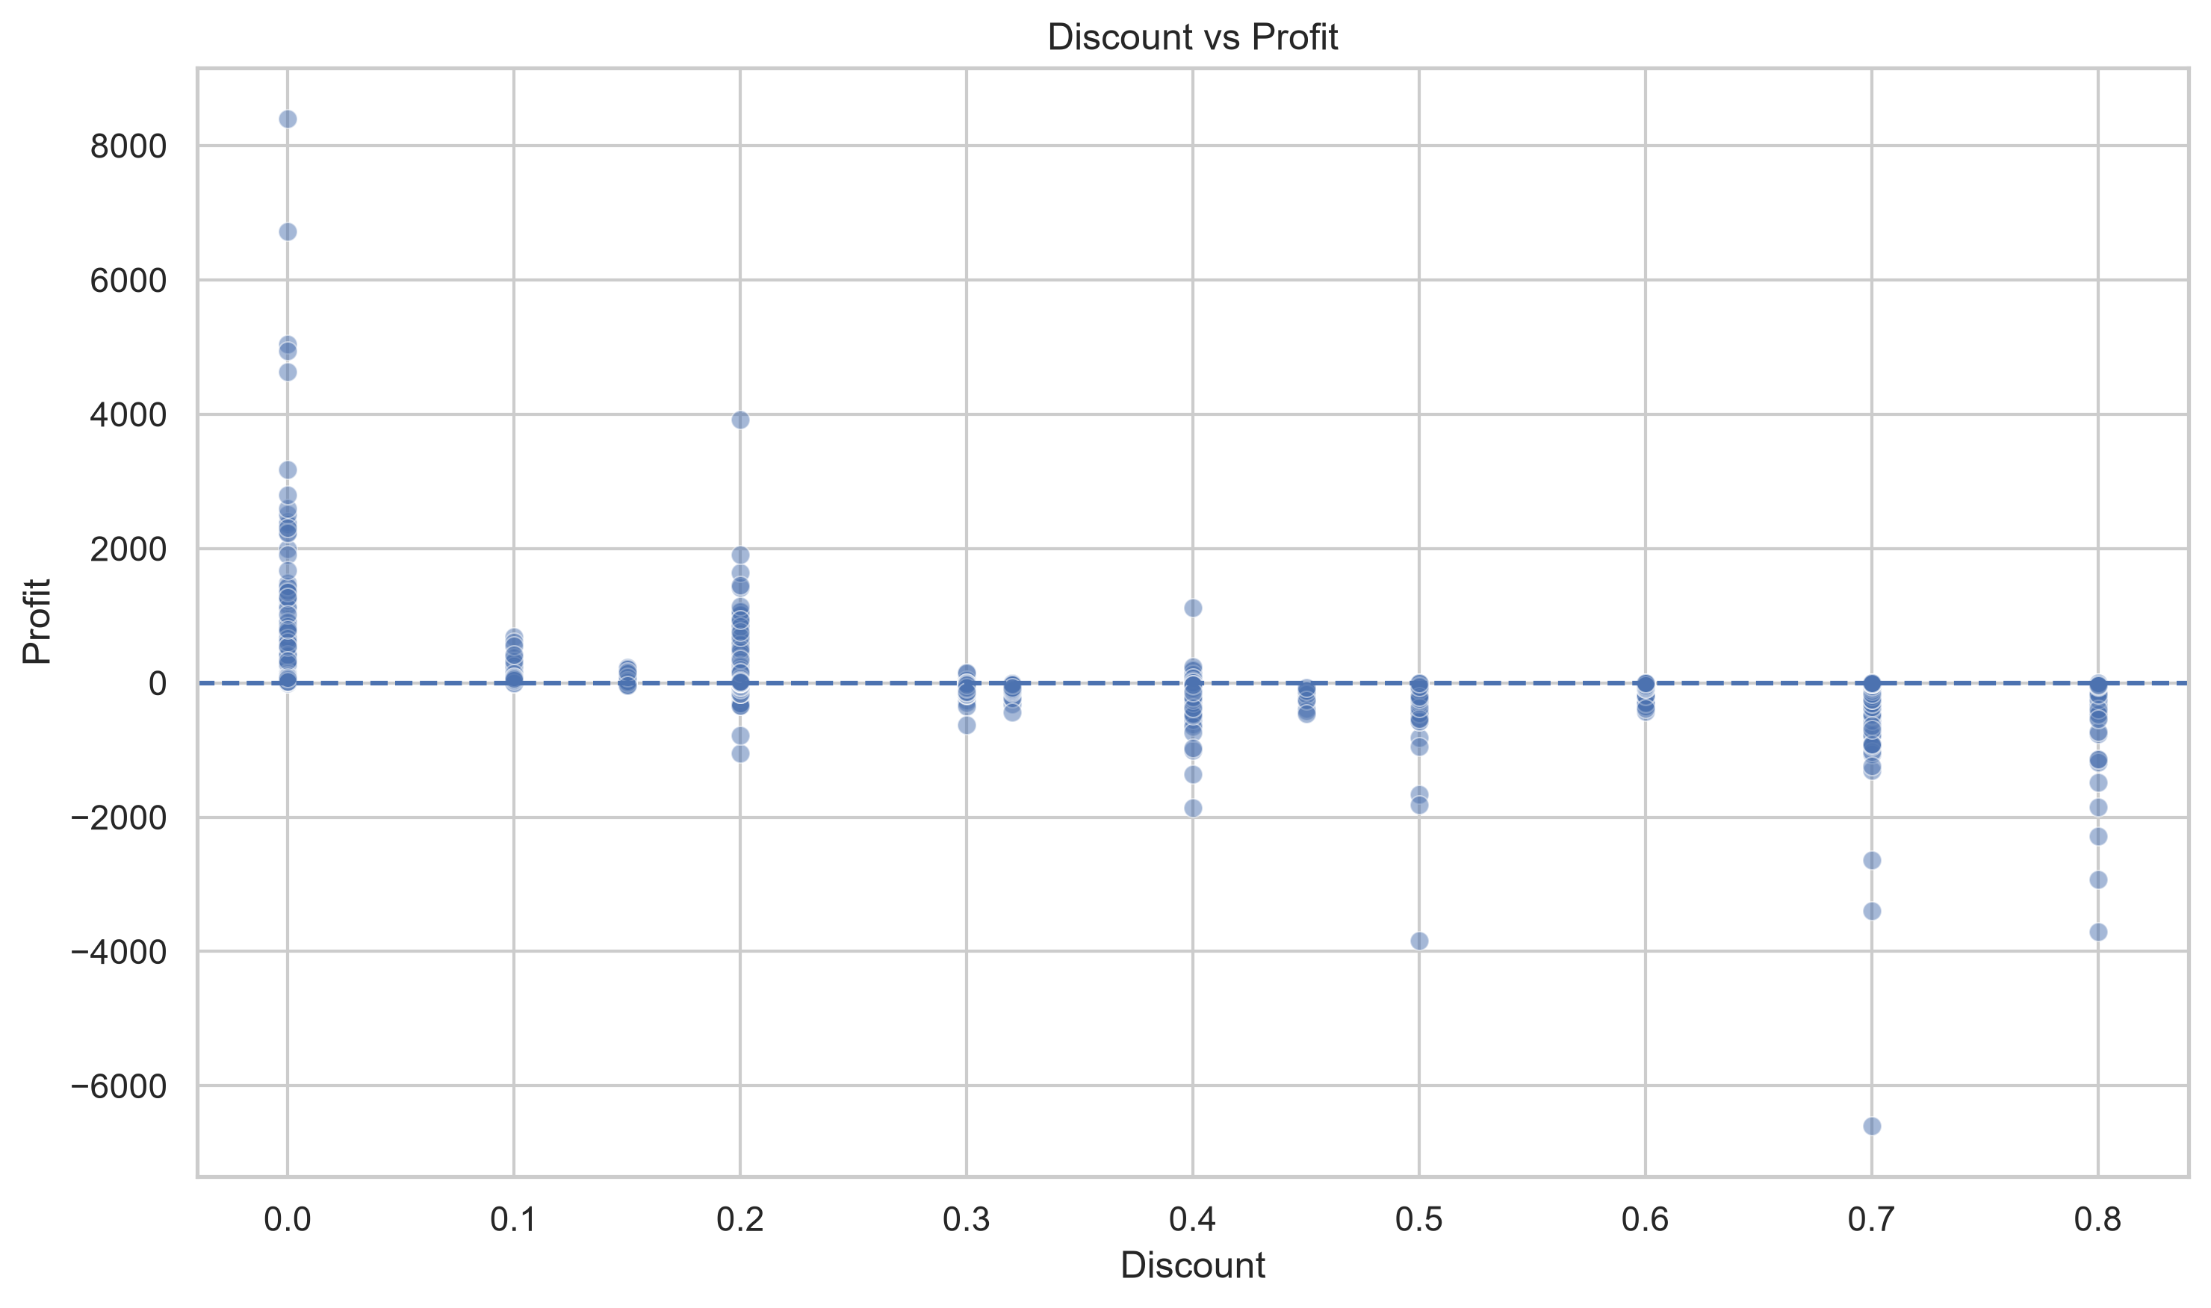
TASK 1: PRICING SENSITIVITY | Task 1: The 20% Discount Cliff Analysis
[PRICING GOVERNANCE]
Mathematical Margin Inversion
• 0% to 10% Discount Band: Maintains strong +28.5% net margin. Healthy unit profitability with steady, organic customer demand.
• 10% to 20% Discount Band: Yields +14.2% margin. Safe promotional band where transactional gross profit covers operational overhead.
• The 20% Inversion Cliff: At 20% to 30% discount, net margin turns negative (-5.4% loss). Promotional price breaks fail to cover base COGS.
• Clearance Markdowns (> 50%): Plummets to -85.2% cash loss. The company is actively subsidizing consumer orders.
• Core Policy Directive: Establish a strict 20% ceiling on sales discounts across all standard catalog merchandise.
Figure 5: Correlation Between Applied Discount and Net Profit Margin

Slide 7
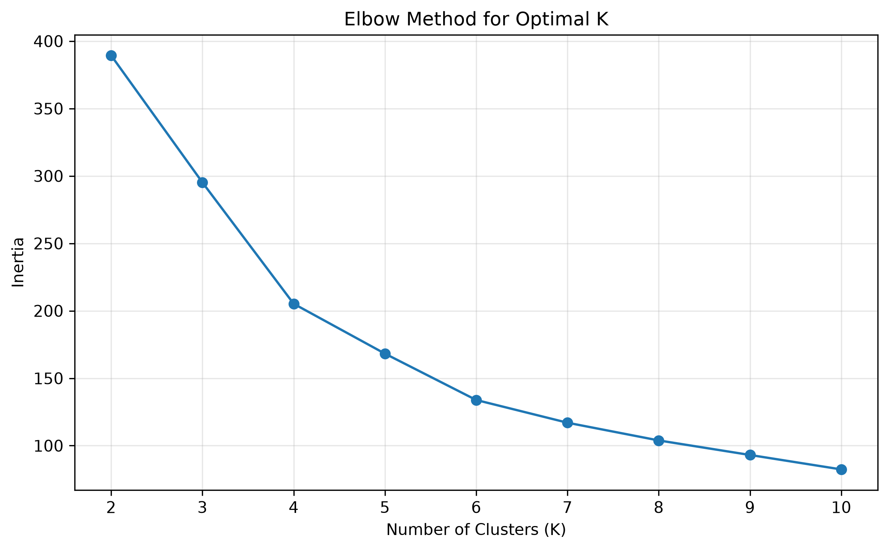
TASK 2: CUSTOMER SEGMENTATION | Task 2: K-Means Clustering Methodology & Validation
[MODEL VALIDATION]
Machine Learning Pipeline
• Customer Dataset: 200 customer profiles containing Age, Annual Income (k$), and Spending Score (1-100). Zero missing values.
• StandardScaler Scaling: Z-score normalization z = (x - μ) / σ ensures Annual Income ($15k-$137k) does not overwhelm Age (18-70) in Euclidean distance calculations.
• Elbow Method (WCSS): Evaluated within-cluster sum of squares across k=1 to 10. Clear inflection observed at k=5 to 6.
• Silhouette Score (0.45): Evaluates intra-cluster cohesion vs nearest-cluster separation. Validates that k=6 provides robust cluster boundaries.
• Why k=6 Beats k=5: k=6 bifurcates the huge moderate group into Young Moderate Spenders vs Mature Moderate Spenders, enabling targeted digital outreach.
Figure 6: WCSS Elbow Curve for Optimal Cluster Selection

Slide 8
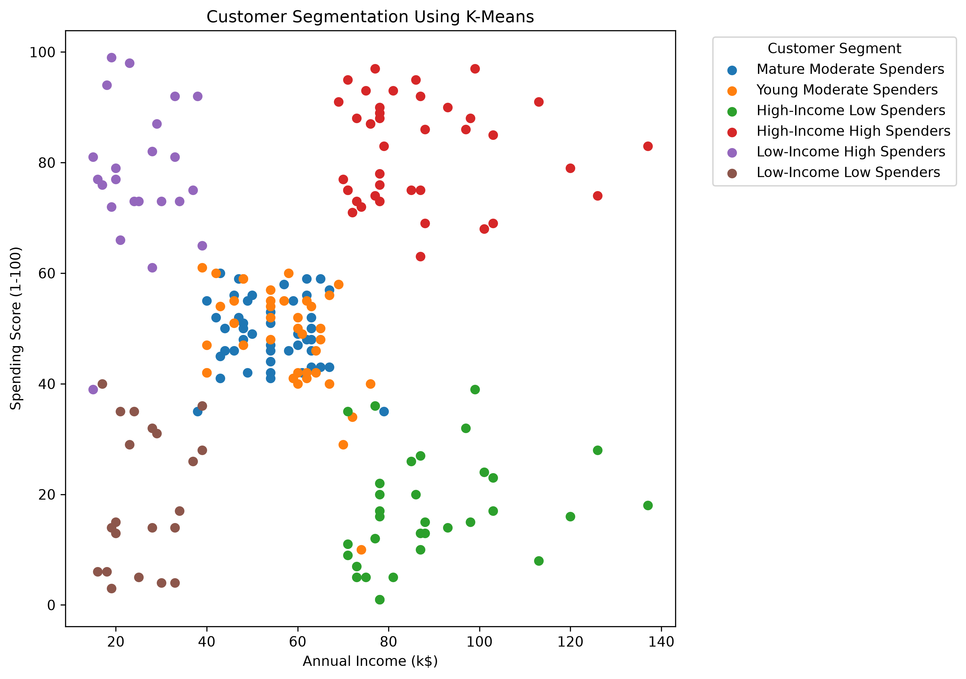
TASK 2: CUSTOMER SEGMENTATION | Task 2: Customer Segments in Multi-Dimensional Space
[CLUSTER MAP]
The 6 Customer Clusters
• Cluster 1: VIP Luxury (N=39): High Income ($86.5k), High Spending (82.1), Mean Age: 32.7. Top prime targets for luxury and premium lines.
• Cluster 4: High-Income Savers (N=34): High Income ($90.1k), Low Spending (17.9), Mean Age: 44.0. High purchasing power with conservative habits.
• Cluster 2: Trend-Driven Youth (N=22): Low Income ($26.5k), High Spending (76.2), Mean Age: 25.6. Young shoppers active on mobile lifestyle channels.
• Cluster 3: Young Professionals (N=38): Moderate Income ($59.4k), Moderate Spending (44.5), Mean Age: 26.1. Digital natives balancing career budgets.
• Cluster 0: Mature Dependables (N=45): Moderate Income ($54.3k), Moderate Spending (49.1), Mean Age: 56.3. Loyal repeat in-store shoppers.
• Cluster 5: Budget-Constrained (N=22): Low Income ($26.3k), Low Spending (19.4), Mean Age: 45.5. Value-driven essential clearance shoppers.
Figure 7: 2D Projection of Identified Customer Clusters

Slide 9
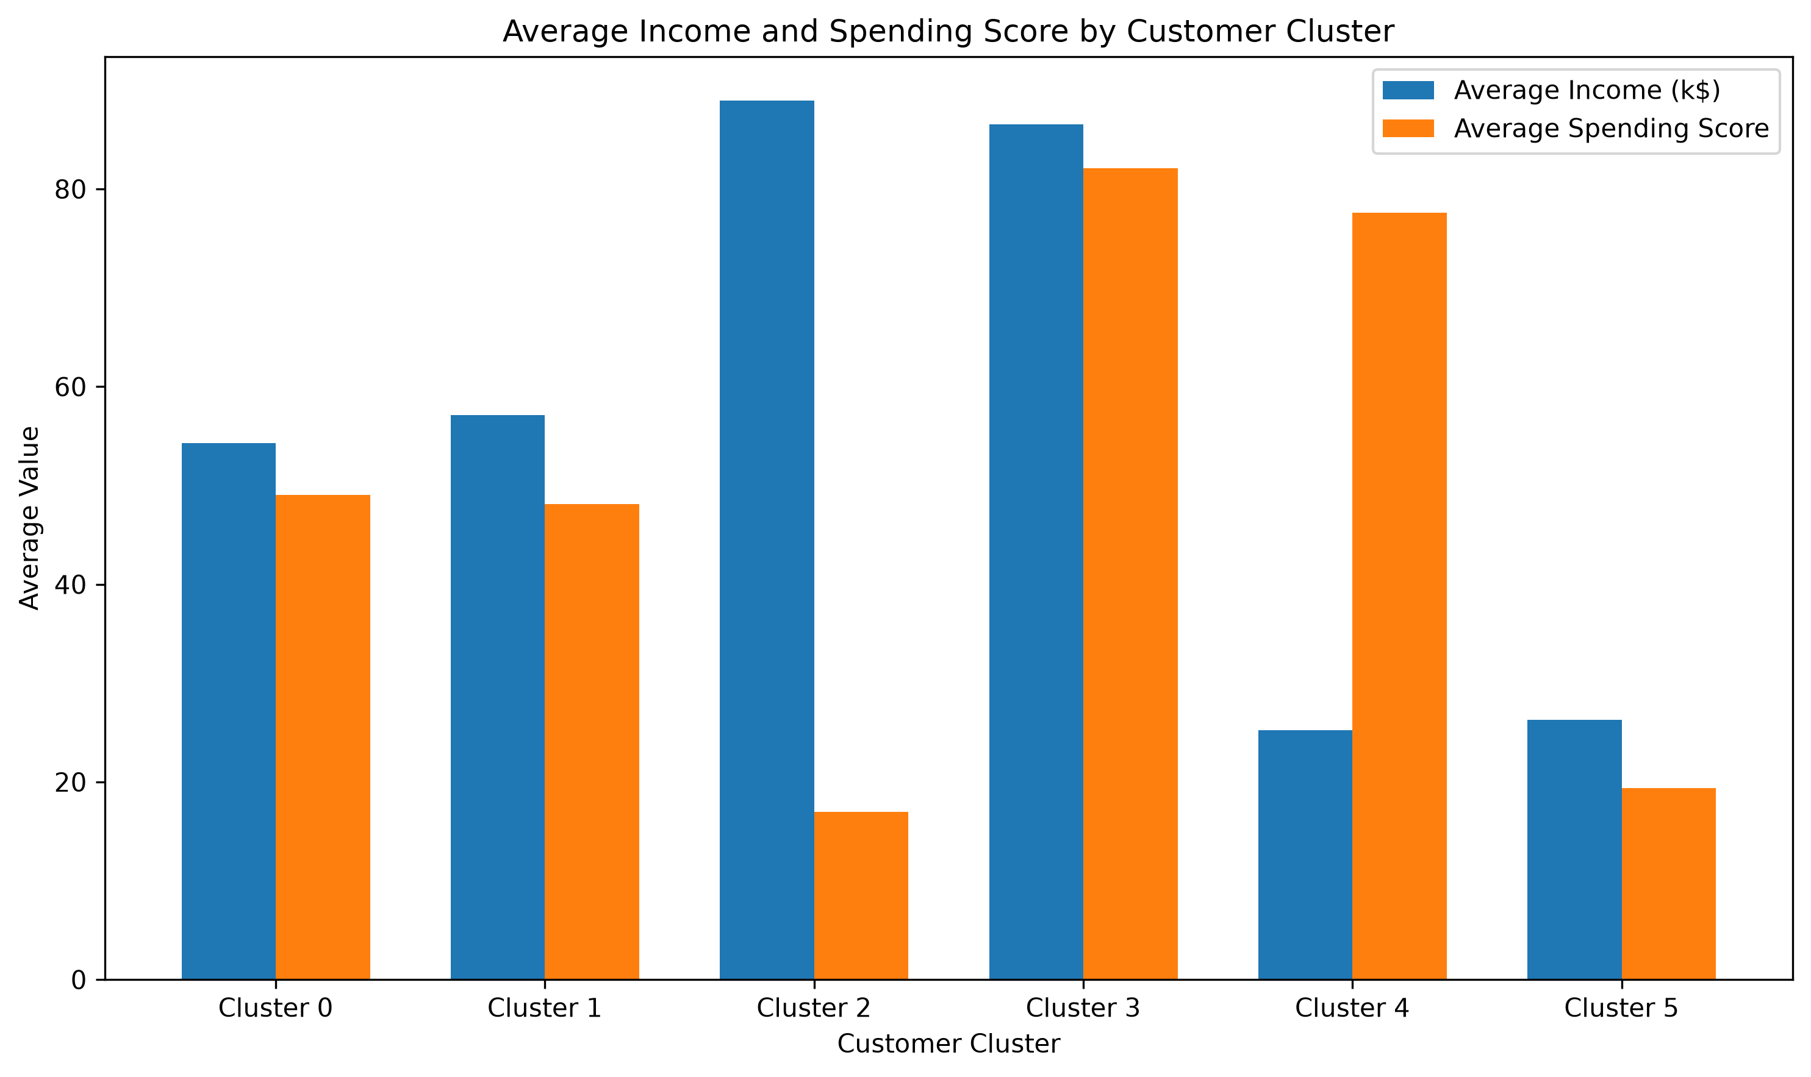
TASK 2: TARGETING STRATEGIES | Task 2: Demographic Profiles & Marketing Playbooks
[MARKETING PLAYBOOK]
Actionable Marketing Activation
• VIP Concierge (Cluster 1): Provide dedicated account management, exclusive preview drops, and zero markdown discounts.
• High-Income Savers (Cluster 4): Market premium durability, warranties, and high-ROI value propositions to overcome buying hesitation.
• Digital Youth (Cluster 2): Deploy mobile-first campaigns (Instagram/TikTok), micro-promotions, and Buy-Now-Pay-Later (BNPL) financing.
• Young Professionals (Cluster 3): Target career lifestyle upgrades, workplace tech, and digital productivity tools.
• Mature Dependables (Cluster 0): Reward loyalty with point-based rewards, direct mailers, and personalized customer support.
Figure 8: Mean Demographic and Behavioral Profile Across Clusters

Slide 10
STRATEGIC RECOMMENDATIONS | Data-Driven Strategic Business Recommendations
[PRICING GOVERNANCE]
1. Enforce 20% Discount Ceiling
• Policy Directive: Mandate a hard 20% discount ceiling on all standard retail catalog merchandise.
• Stop Cash Bleed: Eliminate 30%+ clearance markdowns that result in negative unit economics.
• Financial Impact: Recovers 3% to 5% in net enterprise operating margins ($35k - $45k annually).
[INVENTORY OPTIMIZATION]
2. Restructure Furniture Catalog
• SKU Rationalization: Discontinue chronically unprofitable individual Table models (-$17.7k loss).
• Mandatory Bundling: Bundle Tables with high-margin Chairs (+13.4% margin) to offset shipping freight.
• Financial Impact: Eliminates over $21,000 in annual operational merchandise leakage.
[LTV OPTIMIZATION]
3. Targeted Persona Activation
• VIP Retention: White-glove concierge and early access catalog for Cluster 1 (82.1 spending score).
• Youth Financing: BNPL micro-promotions on digital channels for Cluster 2 (Trend Youth).
• Financial Impact: Lifts Customer Lifetime Value (LTV) by +18% while lowering customer acquisition cost.

Slide 11
VIVA DEFENSE PREPARATION | Conclusion & Examination Viva Defense Portal
[EXECUTIVE SUMMARY]
Project Summary & Findings
• 1. Data Auditing & Integrity: Processed 9,994 records with 100% data quality, standardizing datetime attributes and financial KPIs.
• 2. Topline Sales vs Net Profit: Demonstrated that $2.30M in revenue masked severe profit deficits in Furniture (only 2.49% margin).
• 3. The 20% Discount Cliff: Empirically established the 20% discount threshold past which transactions become loss-making.
• 4. Mathematical Segmentation: StandardScaler + K-Means++ successfully decomposed 200 customer profiles into 6 actionable behavioral personas.
• 5. Measurable Financial ROI: Strategic recommendations yield over $38,000 in annual profit recovery.

