Slide 1
Variability in grapheme-phoneme association learning
Vǂriabiխty in gra¢eme-¢onem asoccciatiƺn l$rning
Patrick Haller, Msc candidate,
Department of Child and Adolescent Psychiatry
University of Zurich, Switzerland
Notes:
For some children, making sense of symbols and successfully mapping them to sounds is an extremely difficult task. Subsequently, learning how to read poses immense problems. Not being able how to read is a severe limitation in our society. This developmental disorder was coined developmental dyslexia

Slide 2
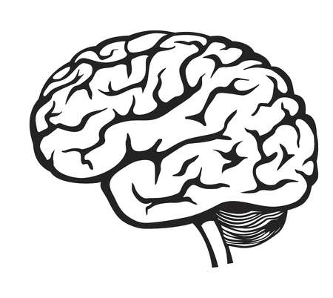

Background & Aims
?
Dyslexia
Disorder of reading acquisition
Prevalence range 5 – 10%
Multi-causal nature
Problems linking letters with corresponding speech sounds
→ characterizing individual differences in learning how to read
→ disentangle dynamics of grapheme-phoneme association learning
Neurobiological correlates of variability?
Notes:
In the lab where I‘m doing my MSc thesis we want to

Slide 3
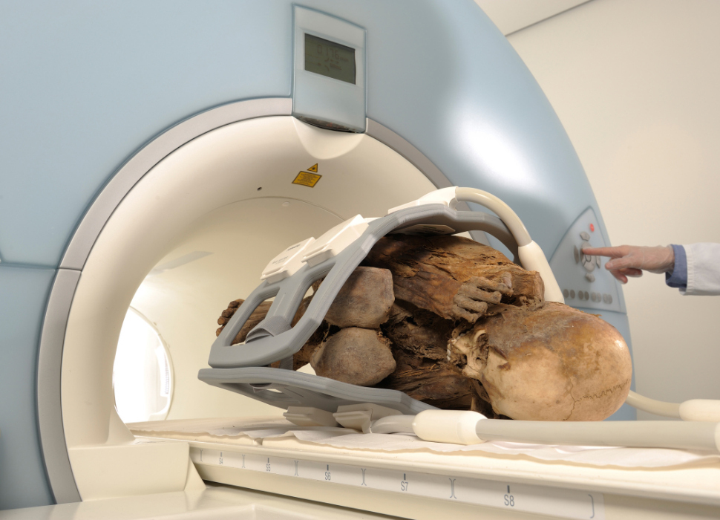
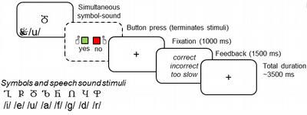
Methods
Learning task completed during fMRI
Study design
Test ability to learn sound - symbol associations
Decision whether presented pair is correct or not
Learning of correct pairs via (deterministic) feedback
2 blocks à 36 trials
Sample
Proof of concept subjects: ~ 15 adults
Core study: 20-25 children (1st – 3rd grade)

Slide 4
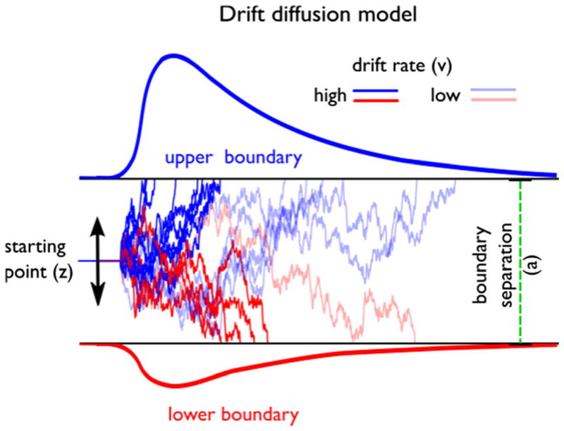
Modeling of behavioural data
Basic performance analysis: accuracy and reaction time (RT) analysis
May not capture actual differences among dyslexics vs. typical readers
Drift Diffusion Model: simultaneously fitting response time and accuracy
Hierarchical Bayesian Analysis for parameter estimation
RT distribution
Parameter | Encoding | Constraints
alpha (a) | Boundary separation; Speed-accuracy trade-off | 0 < alpha
beta (b) | Initial bias, for either response | 0 < beta < 1
delta (v) | Drift rate | 0 < delta
tau (ter) | Non-decision time + Motor response time + encoding time | 0 < tau [s]
Yes
No
Notes:
Assumes that choices are made by continuously sampling noisy decision evidence accumulating until a decision boundary is reached in favor of one of two alternatives.
Key advantage: simultaneously fitting response time (RT; and the distributions thereof) and accuracy (or choice direction) data
Bayesian Approach: We assume prior beliefs/distributions and update the priors into posterior distributions given the data
Our theta set:
This implementation estimates the drift rate, boundary separation, starting point, and non-decision time; but not the between- and within-trial variances in these parameters.
Goal: Statements such as Threshold/boundary separation is significantly higher in dyslexics, suggesting they need to accumulate more evidence before making a decision

Slide 5
Modeling of behavioural data
Reinforcement learning drift diffusion (RLDD) model
Simultaneous estimation of reinforcement-learning and drift diffusion model parameters [3]
Additional parameter: Learning rate
Extraction of trial-by-trial model-based regressors
Correlate with neural activity
e.g. is decision threshold modulated on a trial-to-trial basis as a function of BOLD signals from ROI (e.g. parts of auditory association cortex [2]
Notes:
The benefit of using the DDM as the choice rule in an RL model is that a combined model can capture various factors, including the sensitivity to expected rewards, how they are updated by prediction errors, and the trade-off between speed versus accuracy during response selection. This endeavor can help decompose mechanisms of choice and learning in a richer way than could be accomplished by either RL or DDM models alone.
Wiener first-passage time distribution
Drift rate varies from trial to trial as a function of the difference in the expected rewards, m is a scaling parameter

Slide 6
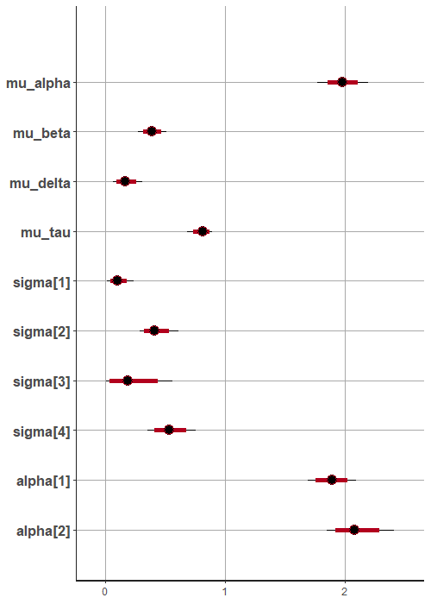
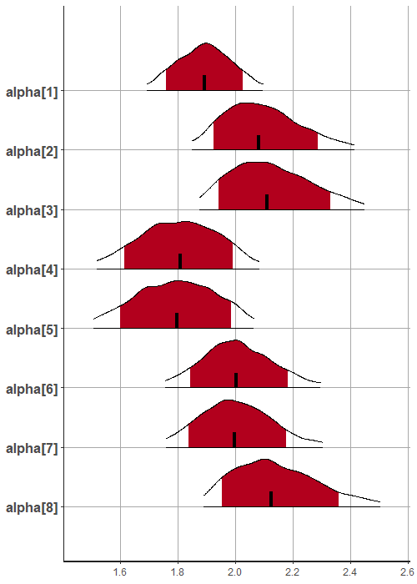
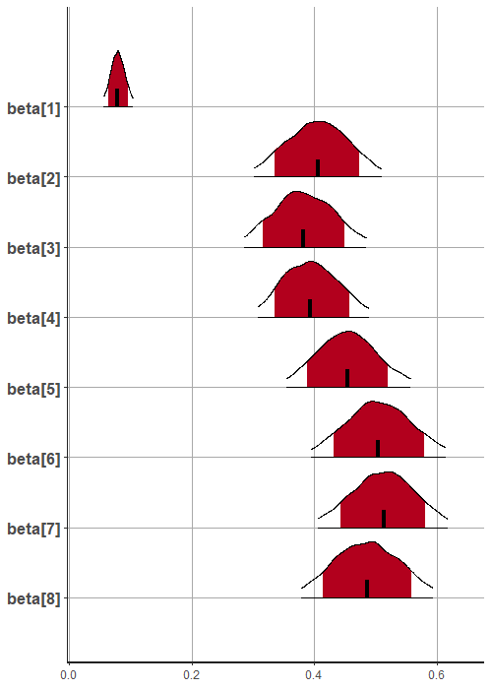
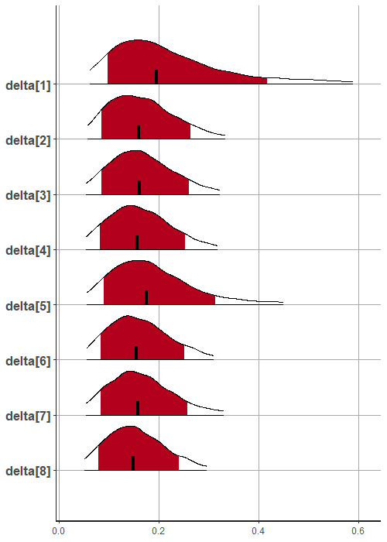
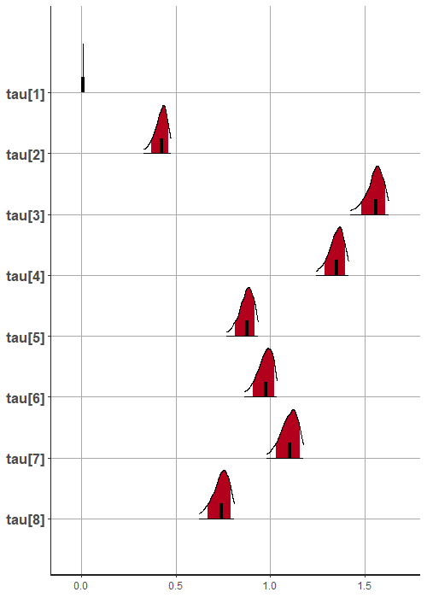
First modeling attempts with pilot data (n=8)
Parameter distribution
Parameters per individual subject
Boundary separation
Initial bias
Drift rate
Non-decision time
high alpha ~ high accuracy
beta > 0.5 ~ bias towards “upper” response
High tau ~ slow encoding, execution
high alpha ~ high accuracy
beta > 0.5 ~ bias towards “upper” response
Delta close to 0 ~ ambiguous stimulus or weak ability

Slide 7


Thank you for your attention!
https://www.kjpd.uzh.ch/de/multimod/neuroimaging.html

Slide 8
References
[1] Ahn, W.-Y., Haines, N., & Zhang, L. (2017). Revealing neuro-computational mechanisms of reinforcement learning and decision-making with the hBayesDM package. Computational Psychiatry, 1, 24-57.
[2] Karipidis, Iliana I., et al. "Simulating reading acquisition: the link between reading outcome and multimodal brain signatures of letter–speech sound learning in prereaders." Scientific reports 8.1 (2018): 7121.
[3] Pedersen, Mads Lund, Michael J. Frank, and Guido Biele. "The drift diffusion model as the choice rule in reinforcement learning." Psychonomic bulletin & review 24.4 (2017): 1234-1251.

Slide 9
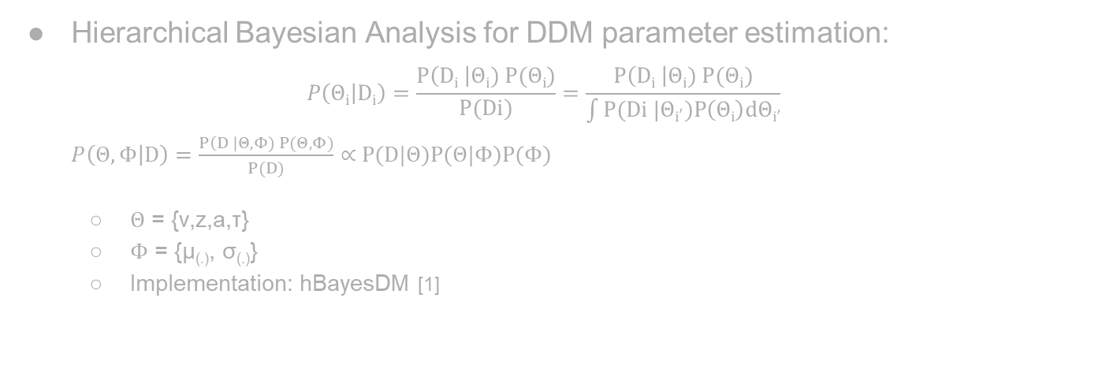
Modeling of behavioural data
Hierarchical Bayesian Analysis for DDM parameter estimation: $P\left(Θi | Di\right)=\frac{P\left(Di \right|Θi) P(Θi)}{P(Di)}=\frac{P\left(Di \right|Θi) P(Θi)}{\int{P(Di |{Θi}^{′})P\left(Θi\right)dΘi′}}$ $P\left(Θ,Φ | D\right)=\frac{P\left(D \right|Θ,Φ) P(Θ,Φ)}{P(D)}∝$ P(D|$Θ$)P($Θ$|$Φ$)P($Φ$)
$Θ$ = {v,z,a,τ}
$Φ$ = {μ_{(.)}, σ_{(.)}}
Implementation: hBayesDM [1]
Notes:
Assumes that choices are made by continuously sampling noisy decision evidence accumulating until a decision boundary is reached in favor of one of two alternatives.
Key advantage: simultaneously fitting response time (RT; and the distributions thereof) and accuracy (or choice direction) data
Bayesian Approach: We assume prior beliefs/distributions and update the priors into posterior distributions given the data
Our theta set:
This implementation estimates the drift rate, boundary separation, starting point, and non-decision time; but not the between- and within-trial variances in these parameters.
Goal: Statements such as Threshold/boundary separation is significantly higher in dyslexics, suggesting they need to accumulate more evidence before making a decision

Slide 10

Modeling of behavioural data
Reinforcement learning drift diffusion (RLDD) model
$RT\left(x\right)\sim WFPT[a,Ter,z,v\left(t\right)]$ (1)
$v\left(t\right)=\left[Vupper\left(t\right)−Vlower\left(t\right)\right] ∗m$, V: reward expectations (2)
$Vi\left(t\right)=Vi\left(t−1\right)+η[Rewardi\left(t−1\right)−Vi\left(t−1\right)]$ (3)
Notes:
The benefit of using the DDM as the choice rule in an RL model is that a combined model can capture various factors, including the sensitivity to expected rewards, how they are updated by prediction errors, and the trade-off between speed versus accuracy during response selection. This endeavor can help decompose mechanisms of choice and learning in a richer way than could be accomplished by either RL or DDM models alone.
Wiener first-passage time distribution
Drift rate varies from trial to trial as a function of the difference in the expected rewards, m is a scaling parameter

