Slide 1
Piloting data School class Kloten
11./18.06.2019

Slide 2
Overview
 | n | n_trials | mean RT | mean accuracy | Missed (fraction)
2x3 | 16 | 24 | 1.25 | 0.68 | 0.1
2x3 | 12 | 32 | 1.27 | 0.68 | 0.14
2x4 | 17 | 32 | 1.28 | 0.64 | 0.1
2x3 (24)
2x3 (32)
2x4 (32)
5 incomplete blocks
6 subjects only completed 1 block
Mean accuracy
B1: 0.64
B2: 0.73
Overall: 0.68
Mean RT
B1: 1.24s
B2: 1.26s
Overall: 1.25s
All subjects completed all blocks
Mean accuracy:
B1: 0.68
B2: 0.68
Overall: 0.68
Mean RT:
B1: 1.27
B2: 1.27
Overall: 1.27
All blocks completed
3 subjects only completed 1 block
Mean accuracy:
B1: 0.62
B2: 0.67
Overall: 0.64
Mean RT:
B1: 1.27s
B2: 1.29s
Overall: 1.28s

Slide 3
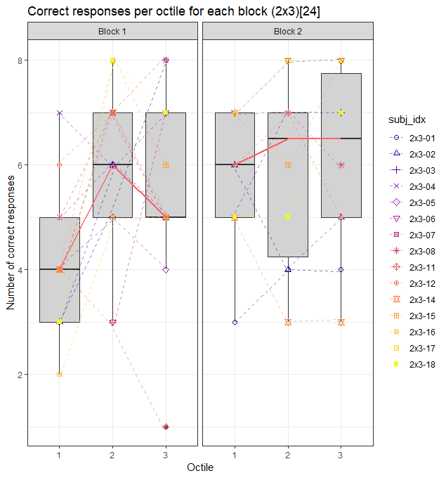
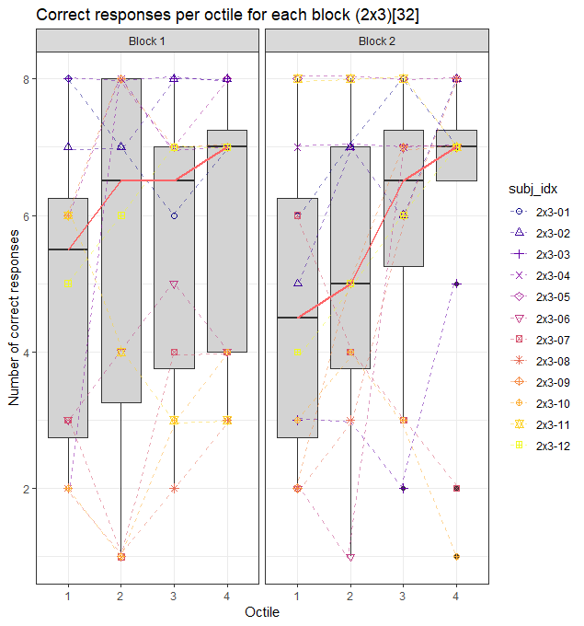
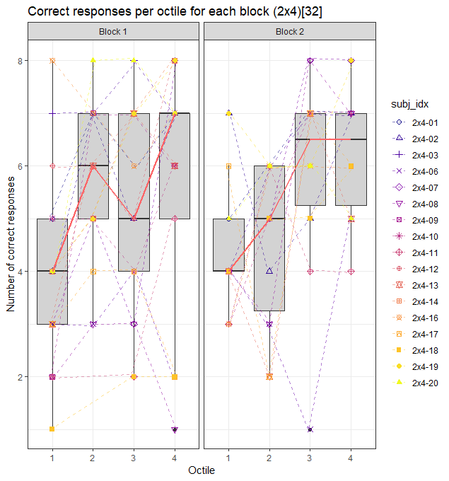
Mean accuracy

Slide 4
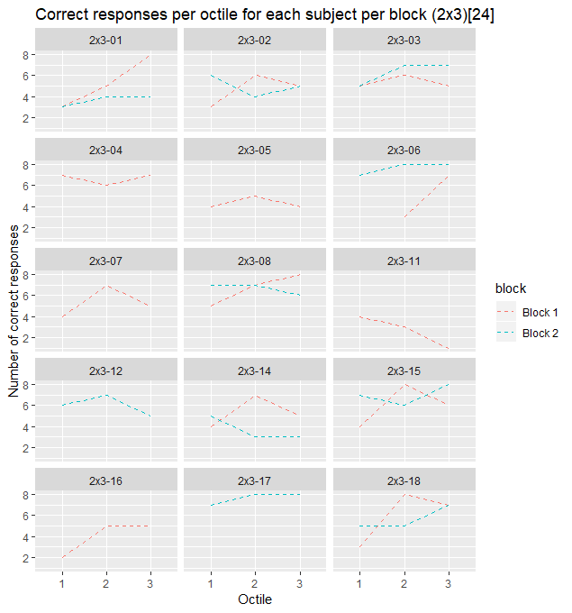
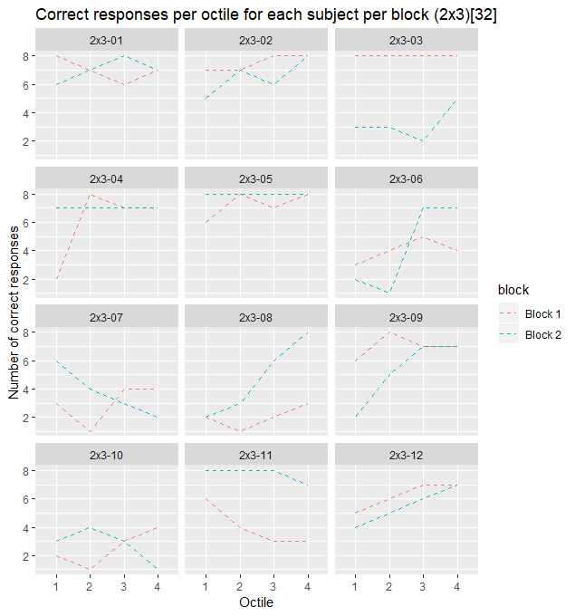
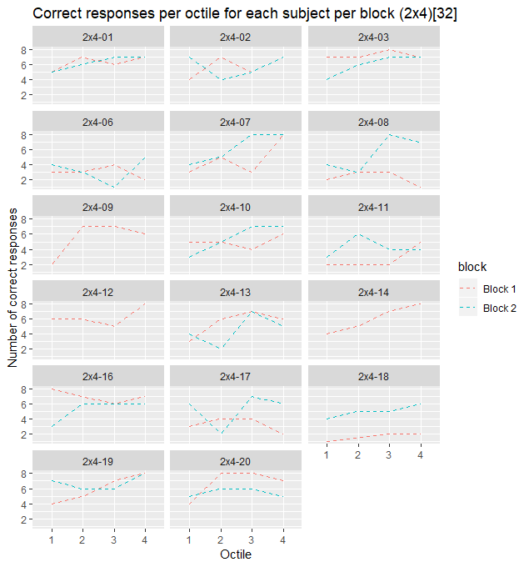
Individual trajectories per block

