Slide 1
Thesis project overview Variability in phoneme-grapheme association learning
Patrick Haller
Lab Meeting, 26.06.2019

Slide 2
Background & aims
Linking letters with corresponding speech sounds​
characterize individual differences in learning how to read​
disentangle dynamics of grapheme-phoneme association learning​
​
Neurobiological correlates of variability?

Slide 3
Methods
Learning task completed during fMRI​
Study design​
Test ability to learn sound - symbol associations​
Decision whether presented pair is correct or not​
Learning of correct pairs via (deterministic) feedback​
2 blocks à 36 trials​
Sample​
Proof of concept subjects: ~ 15 adults​
Core study: 20-25 children (1st – 3rd grade)

Slide 5
Model
Drift-diffusion model
Reinforcement-learning model
Used to model decision making

Slide 6
Piloting data School class Kloten
11./18.06.2019

Slide 7
Overview
2x3 (24)
2x3 (32)
2x4 (32)
5 incomplete blocks
6 subjects only completed 1 block
Mean accuracy
B1: 0.64
B2: 0.73
Overall: 0.68
Mean RT
B1: 1.24s
B2: 1.26s
Overall: 1.25s
All subjects completed all blocks
Mean accuracy:
B1: 0.68
B2: 0.68
Overall: 0.68
Mean RT:
B1: 1.27
B2: 1.27
Overall: 1.27
All blocks completed
3 subjects only completed 1 block
Mean accuracy:
B1: 0.62
B2: 0.67
Overall: 0.64
Mean RT:
B1: 1.27s
B2: 1.29s
Overall: 1.28s
 | n | n_trials | mean RT | mean accuracy | Missed (fraction)
2x3 | 16 | 24 | 1.25 | 0.68 | 0.1
2x3 | 12 | 32 | 1.27 | 0.68 | 0.14
2x4 | 17 | 32 | 1.28 | 0.64 | 0.1

Slide 8
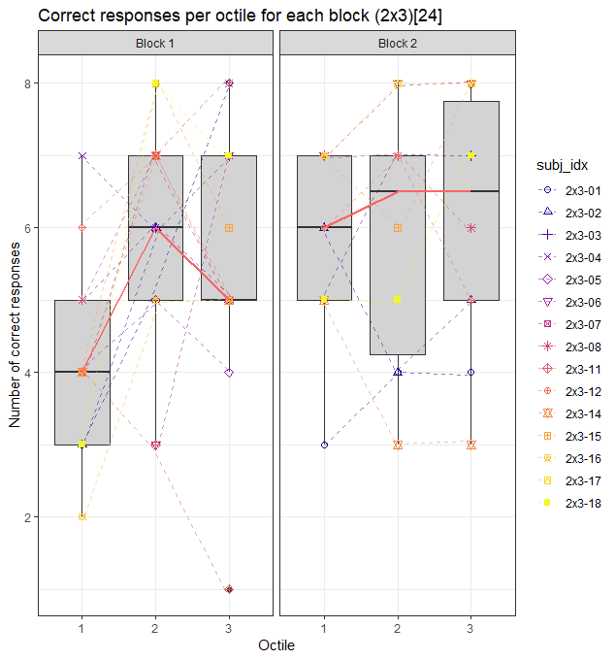
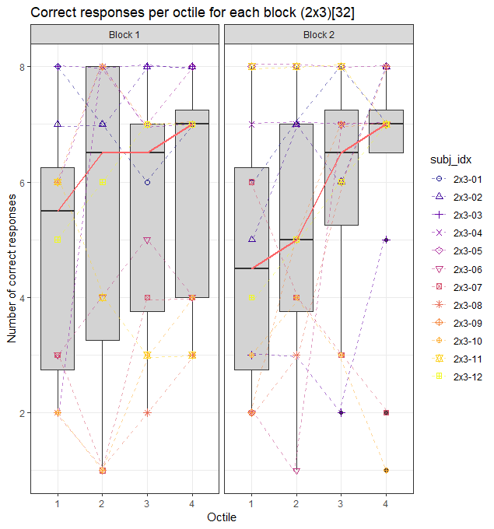
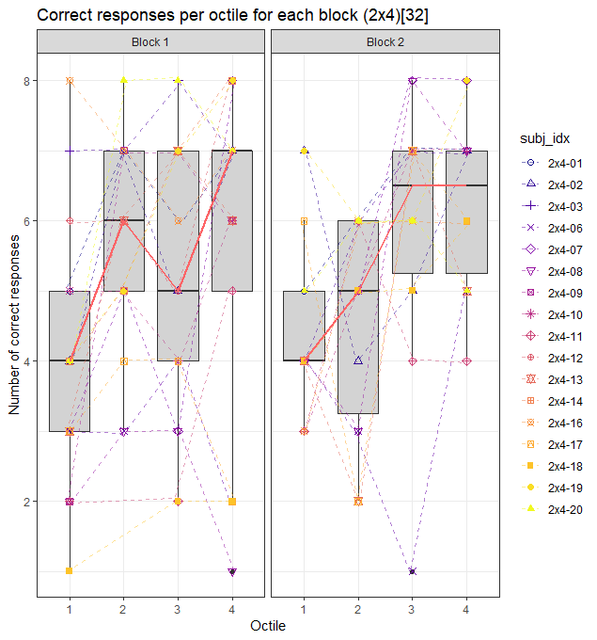
Mean accuracy
tertile
quartile
quartile

Slide 9
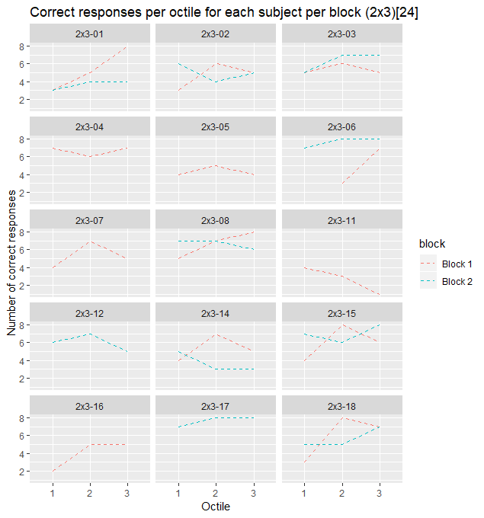
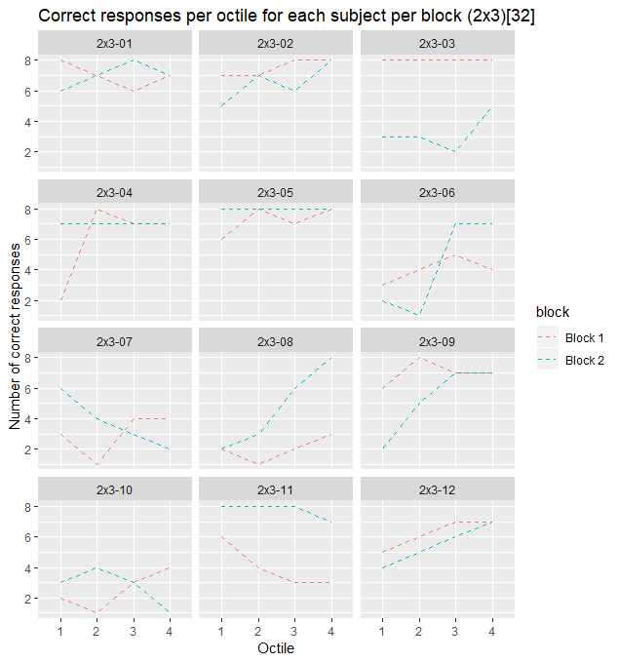
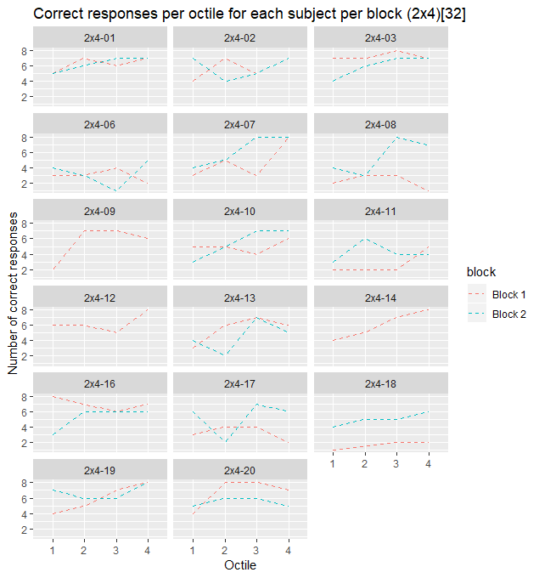
Individual accuracy trajectories per block
tertile
quartile
quartile

Slide 10
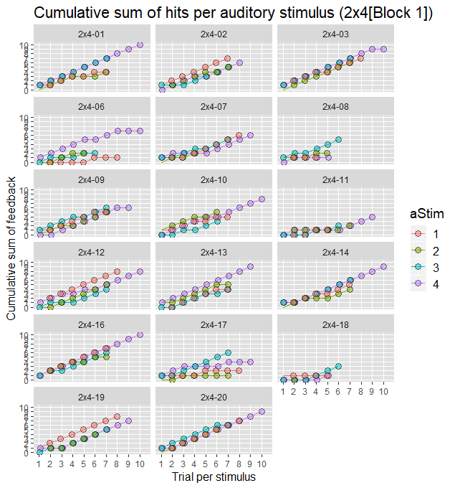
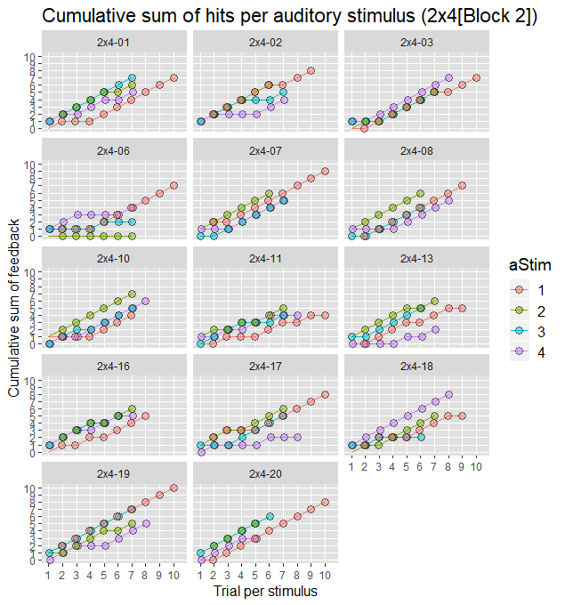
Learning trajectories 2x4
Subj | Block | Accuracy
2x4-01 | 1 | 0.78125
2x4-02 | 1 | 0.71875
2x4-03 | 1 | 0.90625
2x4-06 | 1 | 0.37500
2x4-07 | 1 | 0.59375
2x4-08 | 1 | 0.28125
2x4-09 | 1 | 0.68750
2x4-10 | 1 | 0.62500
2x4-11 | 1 | 0.28125
2x4-12 | 1 | 0.78125
2x4-13 | 1 | 0.68750
2x4-14 | 1 | 0.75000
2x4-16 | 1 | 0.87500
2x4-17 | 1 | 0.40625
2x4-18 | 1 | 0.15625
2x4-19 | 1 | 0.75000
2x4-20 | 1 | 0.84375
Subj | Block | Accuracy
2x4-01 | 2 | 0.78125
2x4-02 | 2 | 0.71875
2x4-03 | 2 | 0.75000
2x4-06 | 2 | 0.40625
2x4-07 | 2 | 0.78125
2x4-08 | 2 | 0.68750
2x4-10 | 2 | 0.68750
2x4-11 | 2 | 0.53125
2x4-13 | 2 | 0.56250
2x4-16 | 2 | 0.65625
2x4-17 | 2 | 0.65625
2x4-18 | 2 | 0.62500
2x4-19 | 2 | 0.84375
2x4-20 | 2 | 0.68750

Slide 11
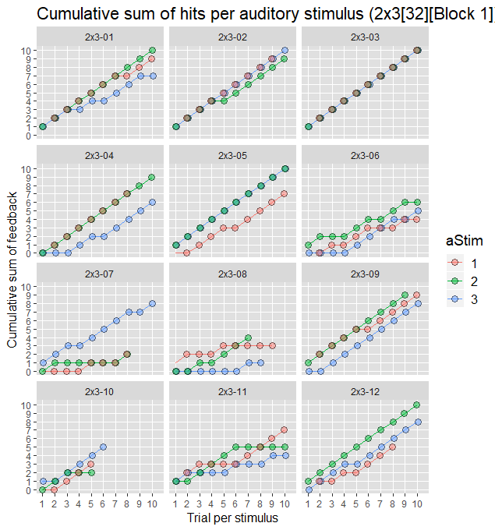
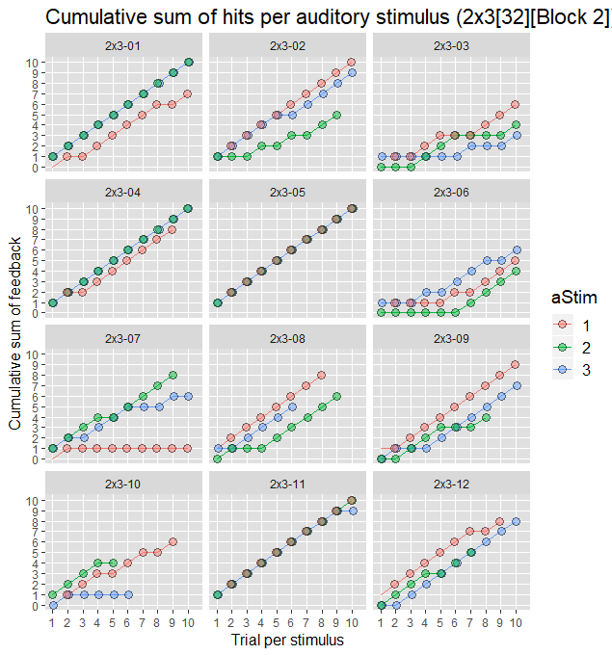
Learning trajectories 2x3 [32]
Subj | Block | Accuracy
2x3-01 | 1 | 0.87500
2x3-02 | 1 | 0.93750
2x3-03 | 1 | 1.00000
2x3-04 | 1 | 0.75000
2x3-05 | 1 | 0.90625
2x3-06 | 1 | 0.50000
2x3-07 | 1 | 0.37500
2x3-08 | 1 | 0.25000
2x3-09 | 1 | 0.87500
2x3-10 | 1 | 0.31250
2x3-11 | 1 | 0.50000
2x3-12 | 1 | 0.78125
Subj | Block | Accuracy
2x3-01 | 2 | 0.87500
2x3-02 | 2 | 0.81250
2x3-03 | 2 | 0.40625
2x3-04 | 2 | 0.87500
2x3-05 | 2 | 1.00000
2x3-06 | 2 | 0.53125
2x3-07 | 2 | 0.46875
2x3-08 | 2 | 0.59375
2x3-09 | 2 | 0.65625
2x3-10 | 2 | 0.34375
2x3-11 | 2 | 0.96875
2x3-12 | 2 | 0.68750

Slide 12
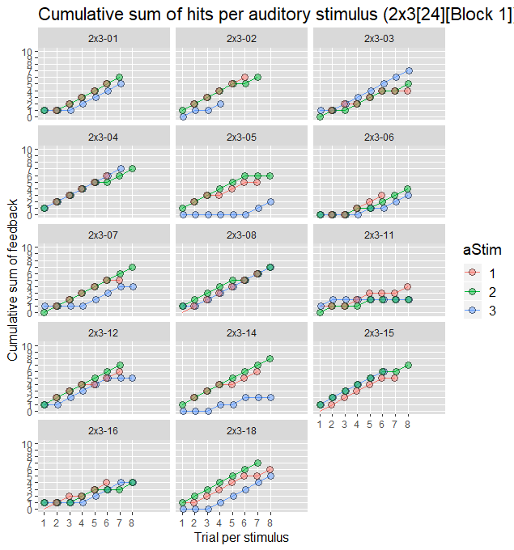
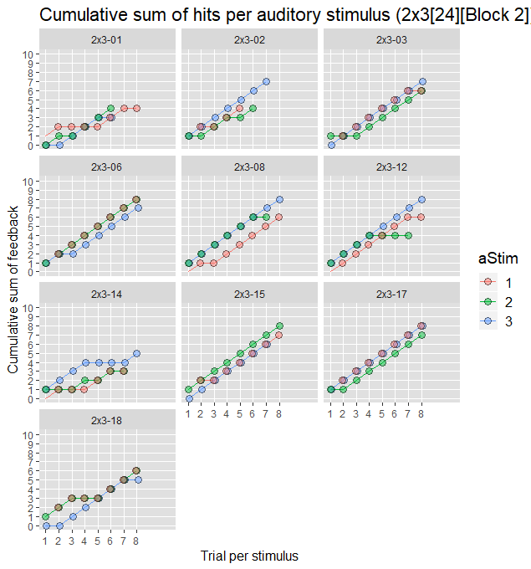
Learning trajectories 2x3 [24]
Subj | Block | Accuracy
2x3-01 | 1 | 0.6666667
2x3-02 | 1 | 0.5833333
2x3-03 | 1 | 0.6666667
2x3-04 | 1 | 0.8333333
2x3-05 | 1 | 0.5416667
2x3-06 | 1 | 0.4166667
2x3-07 | 1 | 0.6666667
2x3-08 | 1 | 0.8333333
2x3-11 | 1 | 0.3333333
2x3-12 | 1 | 0.7500000
2x3-14 | 1 | 0.6666667
2x3-15 | 1 | 0.7500000
2x3-16 | 1 | 0.5000000
2x3-18 | 1 | 0.7500000
Subj | Block | Accuracy
2x3-01 | 2 | 0.4583333
2x3-02 | 2 | 0.6250000
2x3-03 | 2 | 0.7916667
2x3-06 | 2 | 0.9583333
2x3-08 | 2 | 0.8333333
2x3-12 | 2 | 0.7500000
2x3-14 | 2 | 0.4583333
2x3-15 | 2 | 0.8750000
2x3-17 | 2 | 0.9583333
2x3-18 | 2 | 0.7083333

