Slide 1
Piloting data School class Kloten
11./18.06.2019

Slide 2
Overview
2x3 (24)
2x3 (32)
2x4 (32)
5 incomplete blocks
6 subjects only completed 1 block
Mean accuracy
B1: 0.64 ± 0.15
B2: 0.73 ± 0.18
Overall: 0.68 ± 0.17
Mean RT
B1: 1.24s ± 0.15
B2: 1.26s ± 0.18
Overall: 1.25s ± 0.16
0 incomplete blocks
All subjects completed all blocks
Mean accuracy:
B1: 0.68 ± 0.27
B2: 0.68 ± 0.22
Overall: 0.68 ± 0.24
Mean RT:
B1: 1.27 ± 0.16
B2: 1.27 ± 0.14
Overall: 1.27 ± 0.15
0 incomplete blocks
3 subjects only completed 1 block
Mean accuracy:
B1: 0.62 ± 0.23
B2: 0.67 ± 0.11
Overall: 0.64 ± 0.19
Mean RT:
B1: 1.27s ± 0.16
B2: 1.29s ± 0.16
Overall: 1.28s ± 0.16
 | n | n_trials | mean RT | mean accuracy | Missed (fraction)
2x3 | 16 | 24 | 1.25 ± 0.16 | 0.68 ± 0.17 | 0.1
2x3 | 12 | 32 | 1.27 ± 0.15 | 0.68 ± 0.24 | 0.14
2x4 | 17 | 32 | 1.28 ± 0.16 | 0.64 ± 0.19 | 0.1

Slide 3
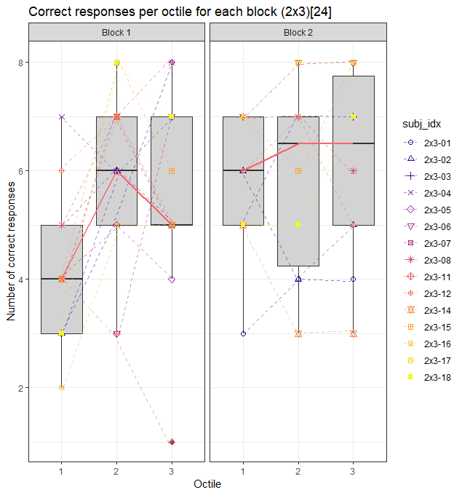
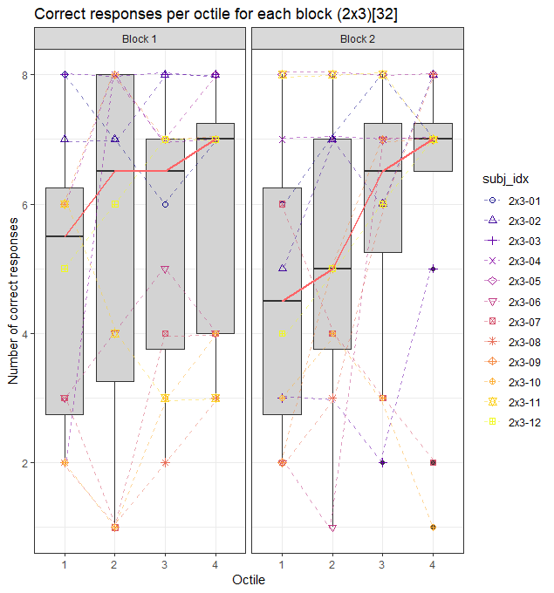
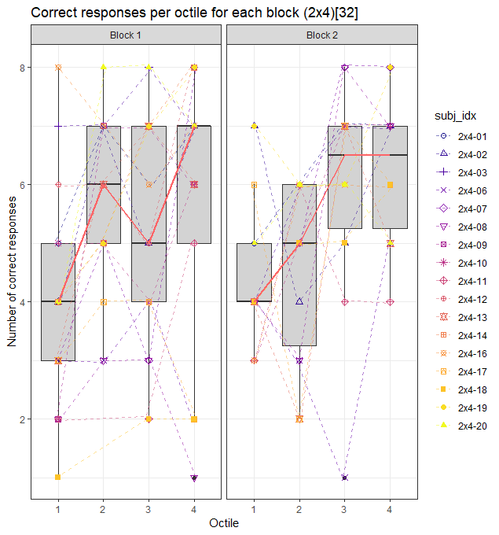
Mean accuracy
tertile
quartile
quartile

Slide 4
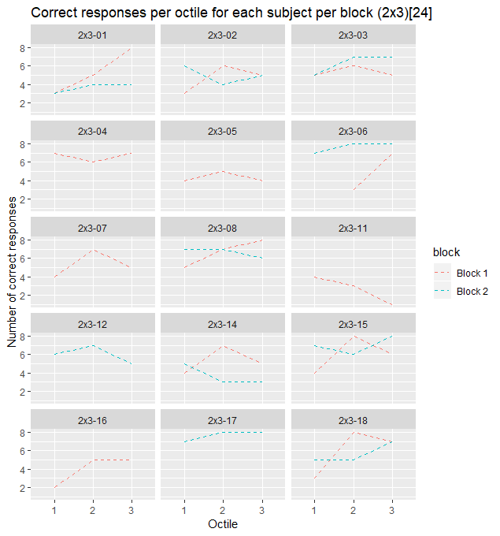
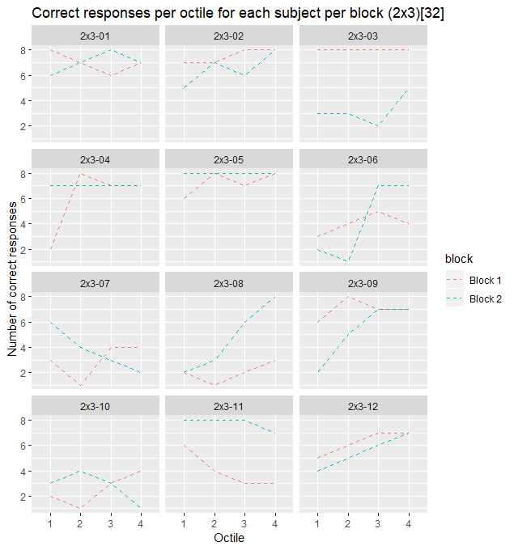
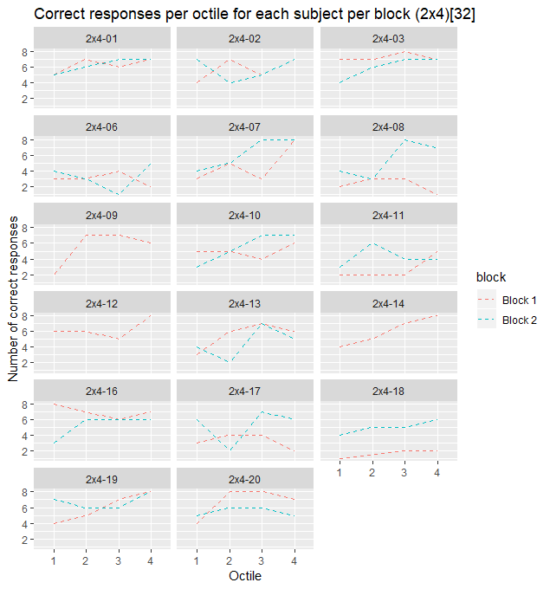
Individual accuracy trajectories per block
tertile
quartile
quartile

Slide 5
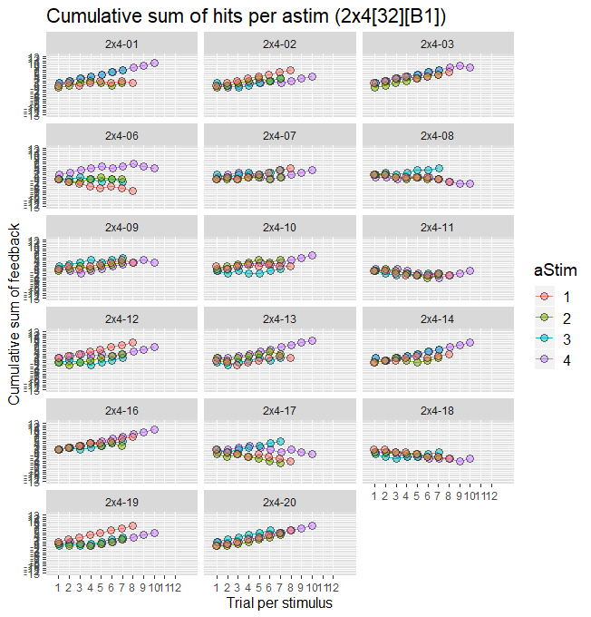
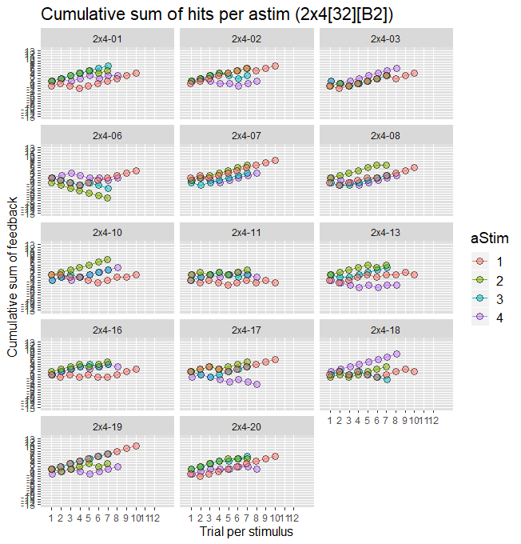
Learning trajectories 2x4
Subj | Block | Accuracy
2x4-01 | 1 | 0.78125
2x4-02 | 1 | 0.71875
2x4-03 | 1 | 0.90625
2x4-06 | 1 | 0.37500
2x4-07 | 1 | 0.59375
2x4-08 | 1 | 0.28125
2x4-09 | 1 | 0.68750
2x4-10 | 1 | 0.62500
2x4-11 | 1 | 0.28125
2x4-12 | 1 | 0.78125
2x4-13 | 1 | 0.68750
2x4-14 | 1 | 0.75000
2x4-16 | 1 | 0.87500
2x4-17 | 1 | 0.40625
2x4-18 | 1 | 0.15625
2x4-19 | 1 | 0.75000
2x4-20 | 1 | 0.84375
Subj | Block | Accuracy
2x4-01 | 2 | 0.78125
2x4-02 | 2 | 0.71875
2x4-03 | 2 | 0.75000
2x4-06 | 2 | 0.40625
2x4-07 | 2 | 0.78125
2x4-08 | 2 | 0.68750
2x4-10 | 2 | 0.68750
2x4-11 | 2 | 0.53125
2x4-13 | 2 | 0.56250
2x4-16 | 2 | 0.65625
2x4-17 | 2 | 0.65625
2x4-18 | 2 | 0.62500
2x4-19 | 2 | 0.84375
2x4-20 | 2 | 0.68750

Slide 6
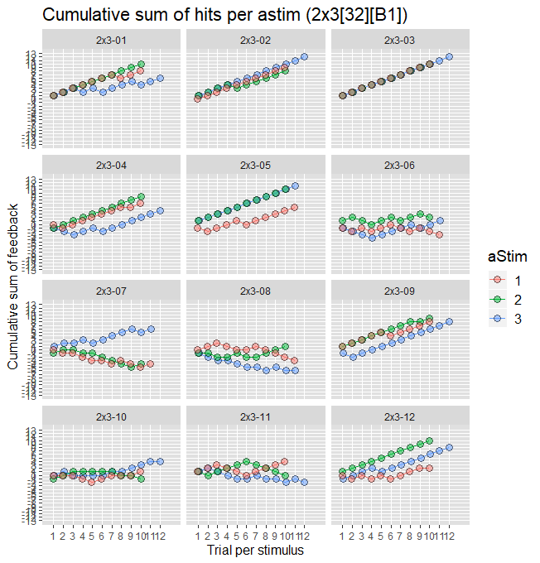
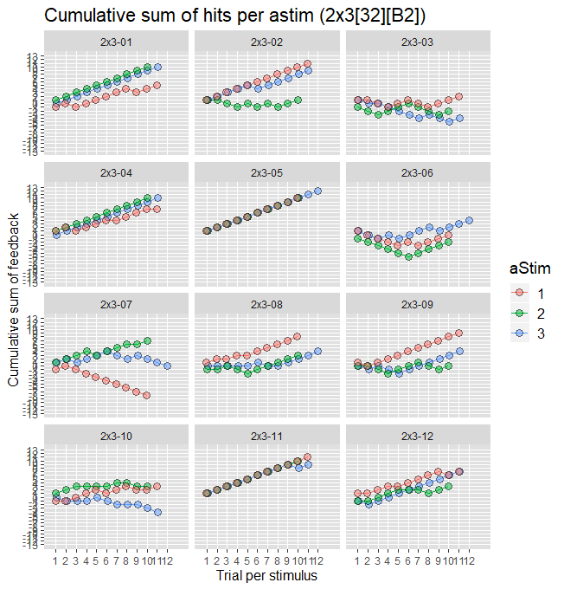
Learning trajectories 2x3 [32]
Subj | Block | Accuracy
2x3-01 | 1 | 0.87500
2x3-02 | 1 | 0.93750
2x3-03 | 1 | 1.00000
2x3-04 | 1 | 0.75000
2x3-05 | 1 | 0.90625
2x3-06 | 1 | 0.50000
2x3-07 | 1 | 0.37500
2x3-08 | 1 | 0.25000
2x3-09 | 1 | 0.87500
2x3-10 | 1 | 0.31250
2x3-11 | 1 | 0.50000
2x3-12 | 1 | 0.78125
Subj | Block | Accuracy
2x3-01 | 2 | 0.87500
2x3-02 | 2 | 0.81250
2x3-03 | 2 | 0.40625
2x3-04 | 2 | 0.87500
2x3-05 | 2 | 1.00000
2x3-06 | 2 | 0.53125
2x3-07 | 2 | 0.46875
2x3-08 | 2 | 0.59375
2x3-09 | 2 | 0.65625
2x3-10 | 2 | 0.34375
2x3-11 | 2 | 0.96875
2x3-12 | 2 | 0.68750

Slide 7
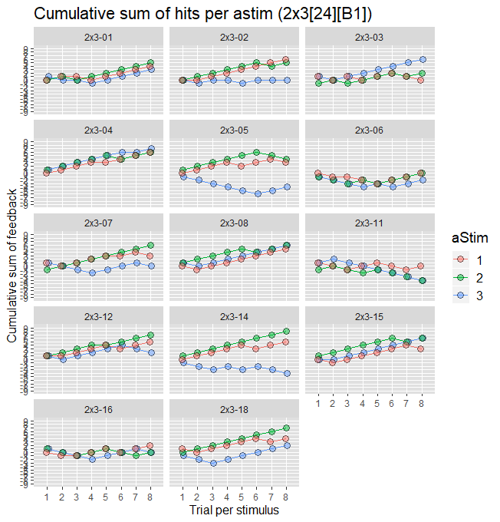
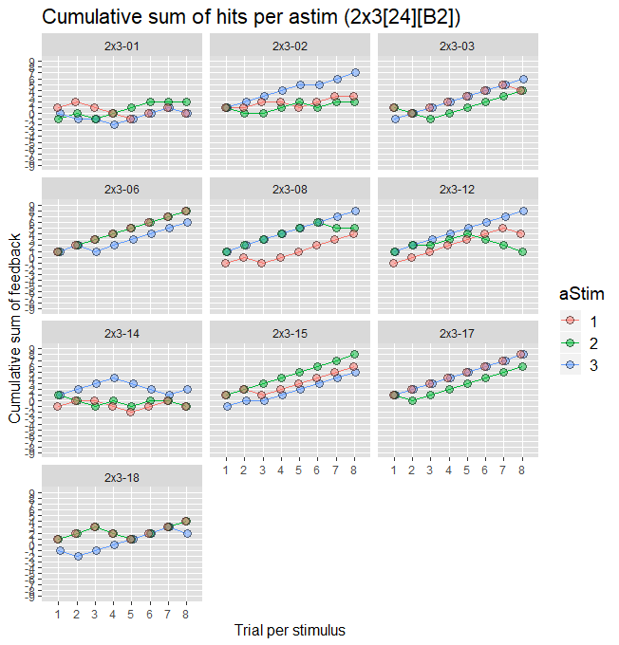
Learning trajectories 2x3 [24]
Subj | Block | Accuracy
2x3-01 | 1 | 0.6666667
2x3-02 | 1 | 0.5833333
2x3-03 | 1 | 0.6666667
2x3-04 | 1 | 0.8333333
2x3-05 | 1 | 0.5416667
2x3-06 | 1 | 0.4166667
2x3-07 | 1 | 0.6666667
2x3-08 | 1 | 0.8333333
2x3-11 | 1 | 0.3333333
2x3-12 | 1 | 0.7500000
2x3-14 | 1 | 0.6666667
2x3-15 | 1 | 0.7500000
2x3-16 | 1 | 0.5000000
2x3-18 | 1 | 0.7500000
Subj | Block | Accuracy
2x3-01 | 2 | 0.4583333
2x3-02 | 2 | 0.6250000
2x3-03 | 2 | 0.7916667
2x3-06 | 2 | 0.9583333
2x3-08 | 2 | 0.8333333
2x3-12 | 2 | 0.7500000
2x3-14 | 2 | 0.4583333
2x3-15 | 2 | 0.8750000
2x3-17 | 2 | 0.9583333
2x3-18 | 2 | 0.7083333

Slide 8
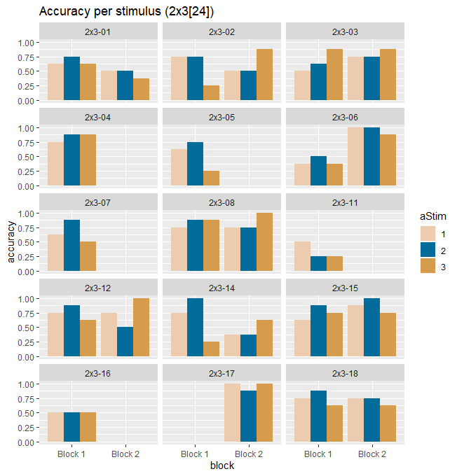
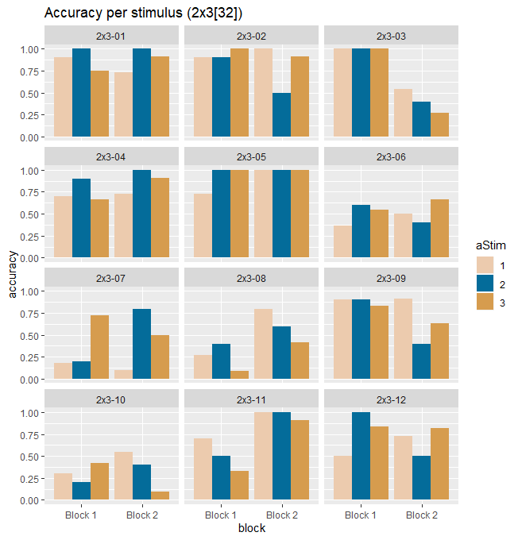
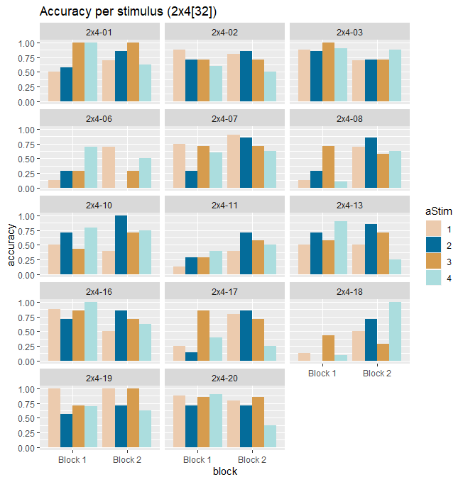
Accuracies per stimulus

Slide 9
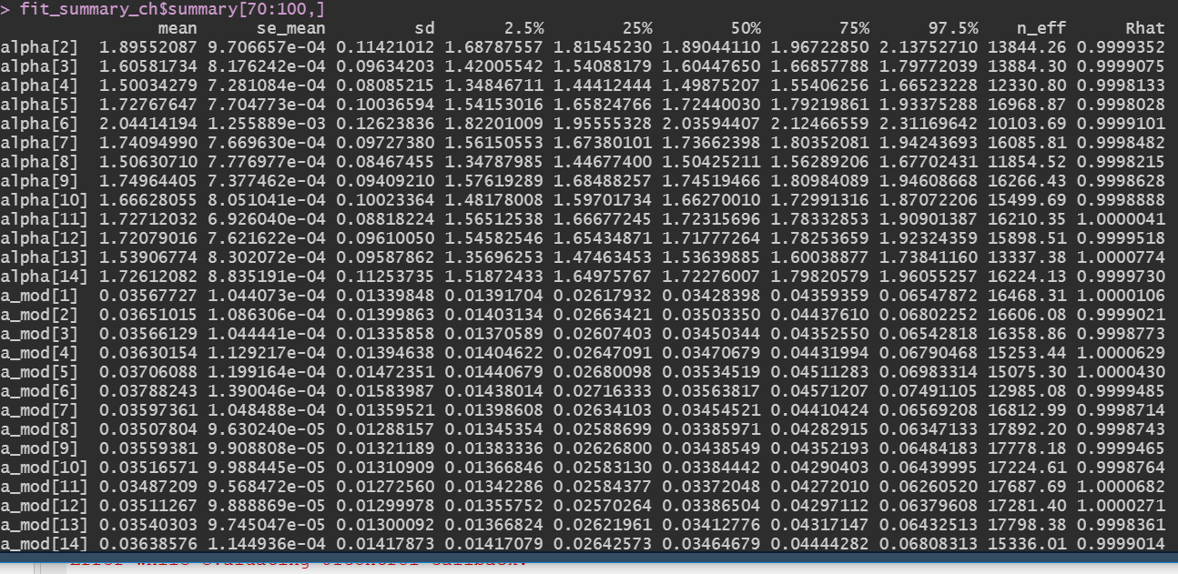
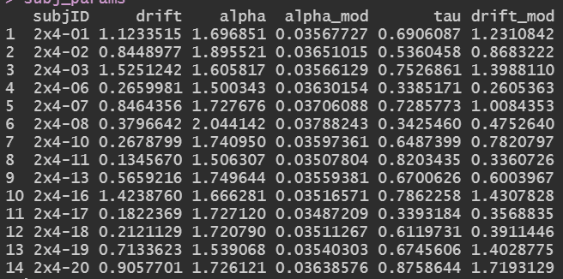
Model fitted for 2x4
Rhat: degree of convergence of a random Markov Chain
Convergence if Rhat < 1.05
Rhat: degree of convergence of a random Markov Chain
Convergence if Rhat < 1.05

