Slide 1
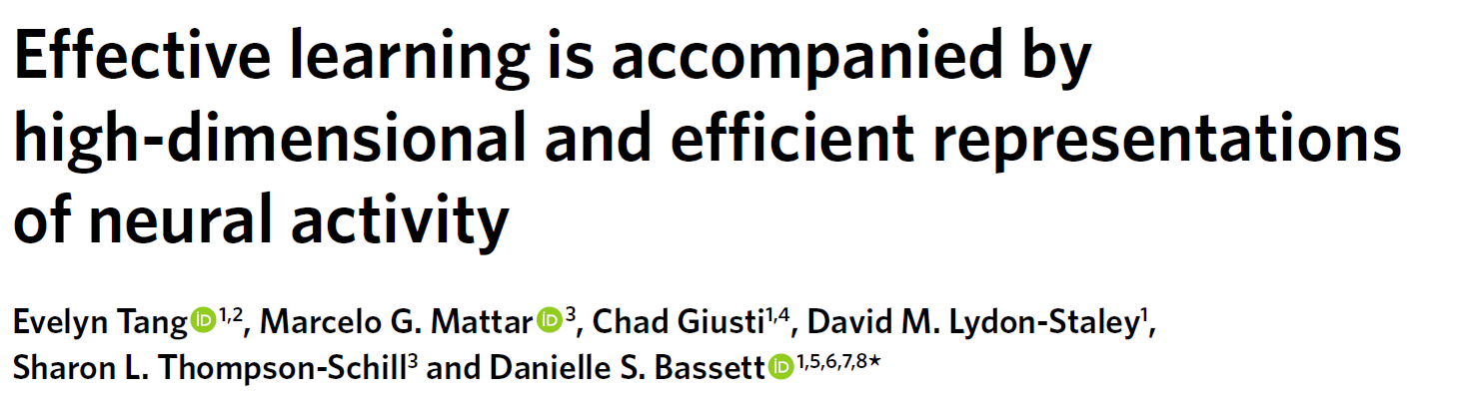
INI Journal Club, 10.10.2019
Patrick Haller

Slide 2
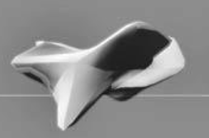
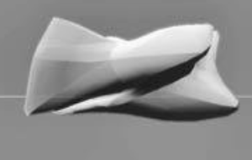
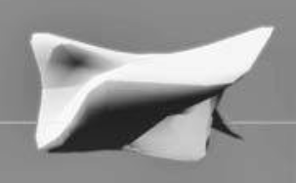



Background
~5 $
~1 $
~500 $
Mapping of value (and identity) onto objects
Categorisation:
Notes:
Assume you were on a cruise and in the middle of nowhere, you suffer a shipwreck. You wake up on an island and find a city not far from the shore. As you come closer people are very friendly, greet you but you don’t speak their language. … and you have to learn the values of these bills. You observe people paying different things with these bills.
… so you would categorize the bill on the right as “valuable” and the ones on the right as “less valuable”.

Slide 3
Background
Activity pattern of neural circuitry →
Which identities / categories are meaning- and useful for us?
Constraints of visual system
Number of neurons
Metabolic energy required for neural activity
Barlow: Efficient coding hypothesis
spikes in the sensory system formed a neural code for efficiently representing sensory information
By efficient Barlow meant that the code minimized the number of spikes needed to transmit a given signal.
Notes:
Which identities / categories are meaning- and useful for us: Training particular situations will enable us to categorize certain objects more fine-grained

Slide 4
Goal of study
Many studies that looked at coding efficiency in neural responses to low-level sensory stimuli
Similar principles of efficiency for more abstract representations such as cogition?
What is the space and organization of that mapping?

Slide 5
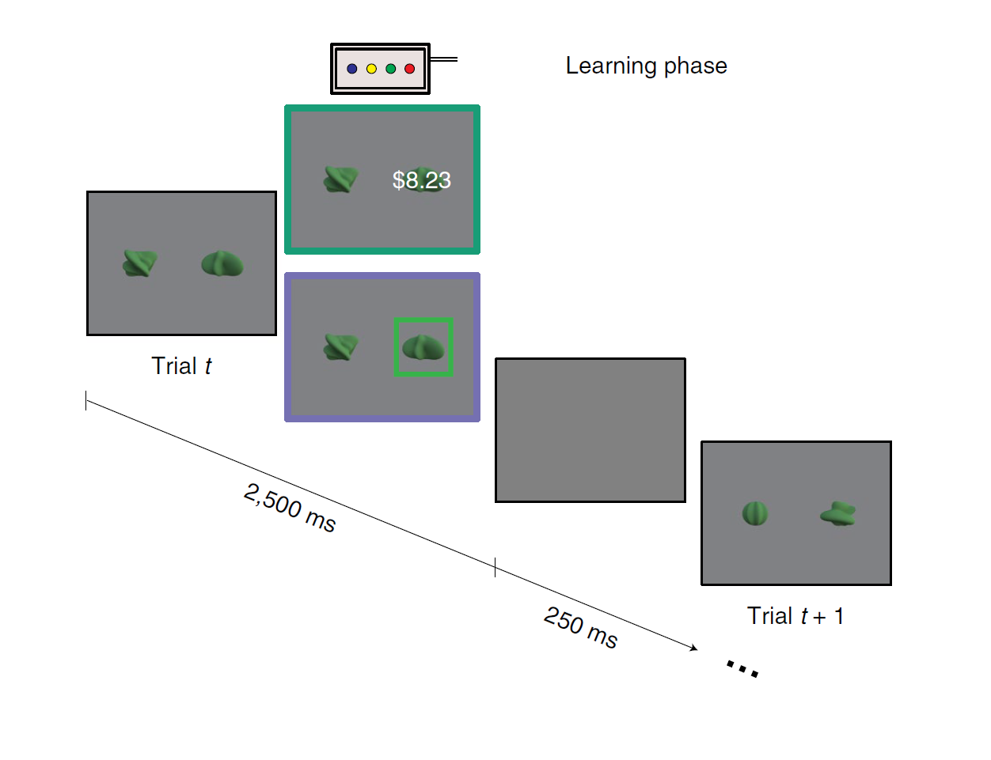
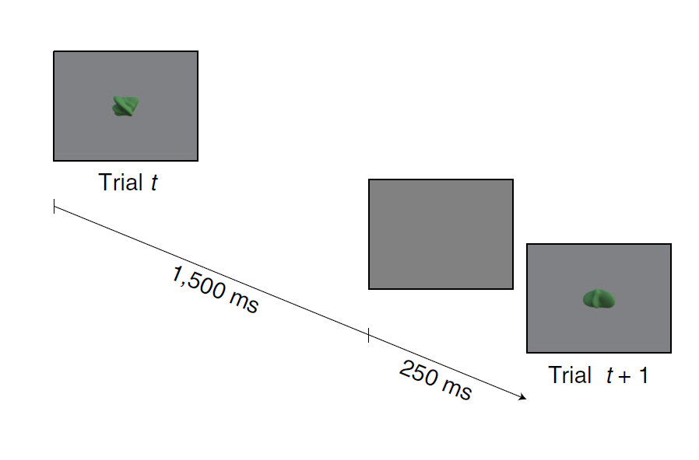
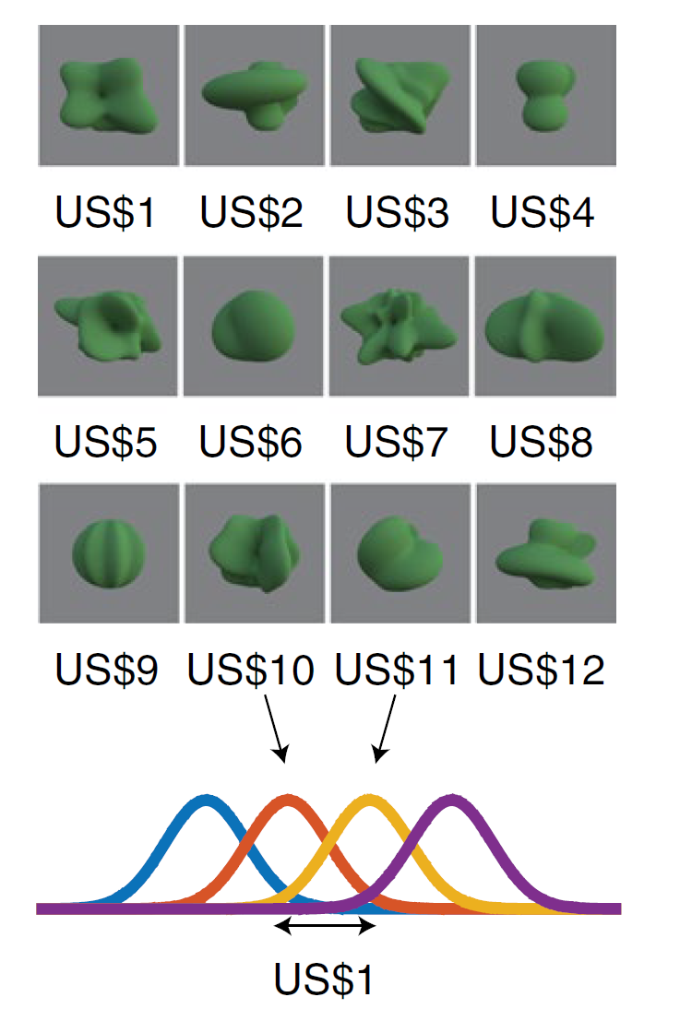
Experimental paradigm: tasks
Learning phase
Value judgement task
Shape - Value correspondences
Notes:
All these tasks were completed during fMRI

Slide 6
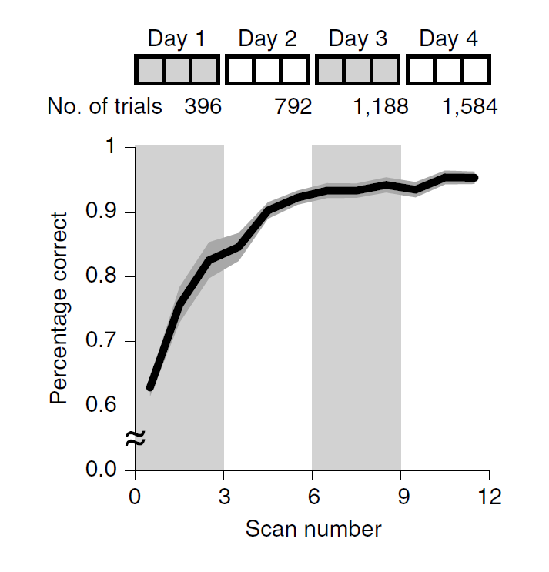
Experimental paradigm: protocol
Experiment conducted over 4 consecutive days
Each day
Size judgement task
Learning phase (3 blocks)
Size judgement task
Value judgement task
Sample data for value judgement task

Slide 7
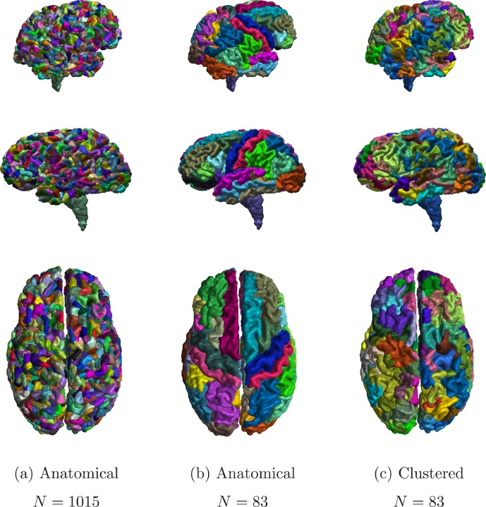
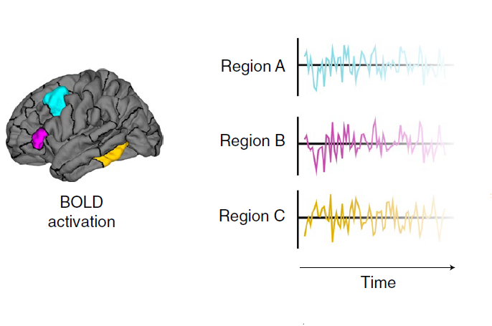
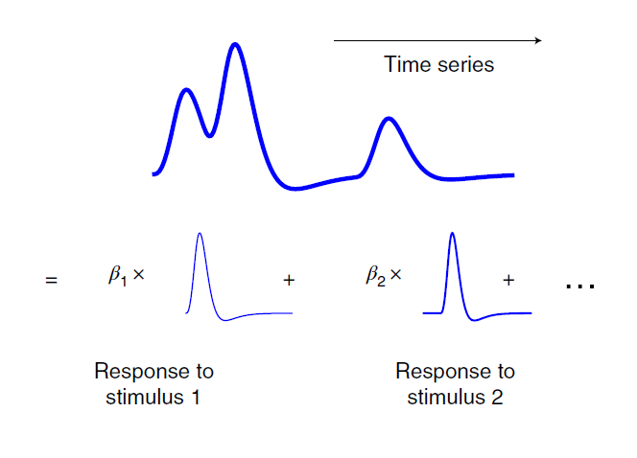
From BOLD signal …
Parcellation in 83 ROI
Obtain BOLD time series for each ROI
Interpolation: 2/s → 1/1.75s (stimulus frequency)
Deconvolve hemodynamic response function from BOLD time series

Slide 8
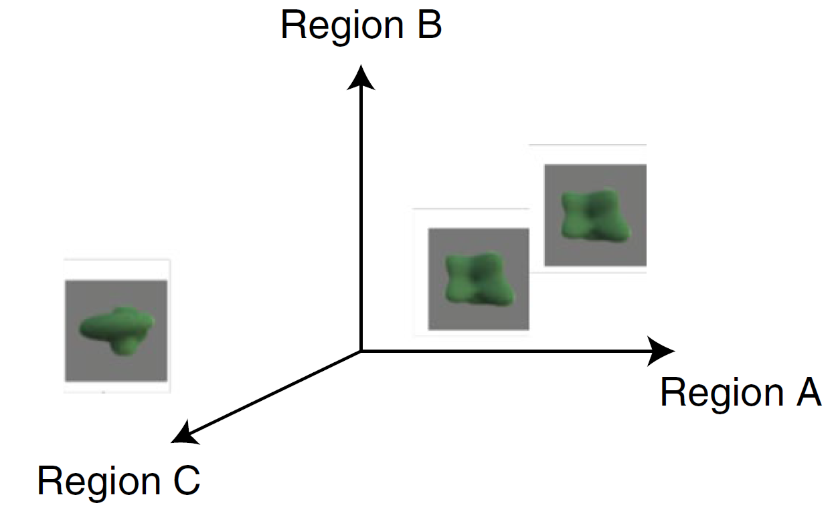
… to approximate neural responses
Each stimulus: 83-dimensional vector containing approximate neural responses from each ROI
How can we quantify the geometric organisation of these neural responses?
Notes:
3 aspects of geometric representation of these neural responses

Slide 9
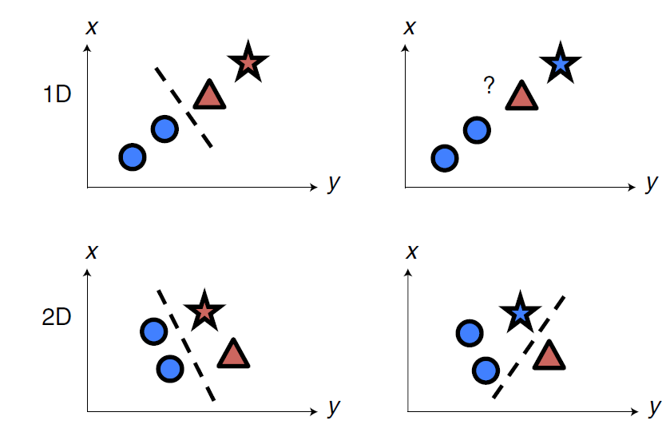
Geometric representations (1) Stimulus dimension
Average linear separability of binarised neural responses
Split shapes into 2 groups (4 vs. 8)
Test linear separability with linear SVM (5-fold CV)
Assess average test error over folds
Repeat for 20 different binarisations
→ average separability

Slide 10
Geometric representations (2) Embedding dimension
Assign random label to each

Slide 11
