Slide 1

TellCo Telecom Data Analysis & Unsupervised Machine Learning
Submitted to: NHIS | Prepared by: Sanskar Pandey

Slide 2
Objectives
• Analyze telecom customer behaviour.
• Understand customer engagement.
• Analyze network experience.
• Estimate customer satisfaction.
• Provide business recommendations for TellCo acquisition.

Slide 3

Dataset
Dataset Information
• 150,001 Records
• 55 Features
• Telecom xDR Dataset
Major Categories
• User Information
• Network Information
• Traffic Information
• Application Usage
• Device Information

Slide 4
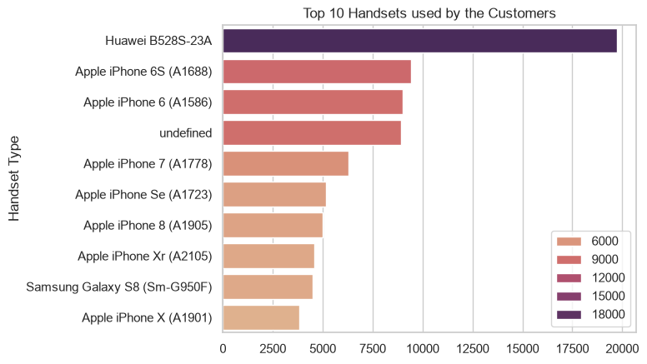
User Overview Analysis
Findings
• Apple dominate.
• Few handset models account for majority of users.

Slide 5
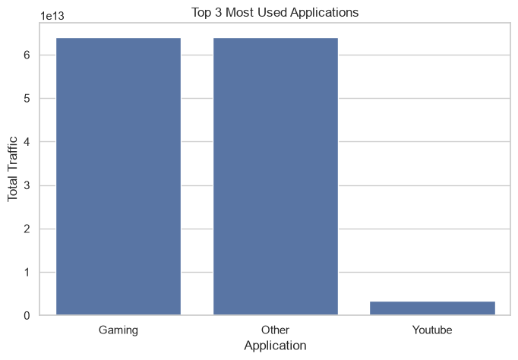
User Engagement
Findings
• Gaming generated highest traffic.
• YouTube and Netflix follow.
• Heavy multimedia usage observed.

Slide 6
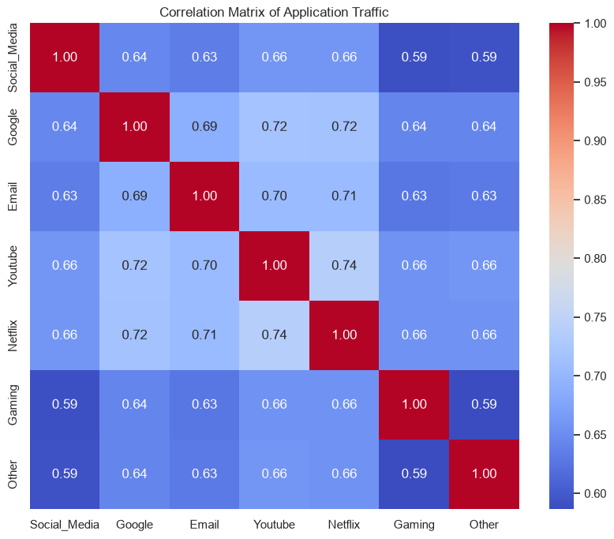
Correlation
Insights
• Strong positive correlation between
Session Duration
Traffic
Application Usage
• High traffic users tend to remain active longer.

Slide 7
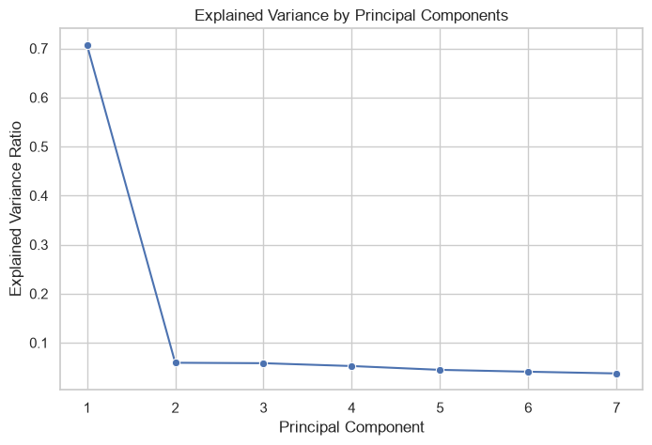
PCA
PCA reduced the dimensionality while preserving most information.
Useful for visualization and clustering.

Slide 8
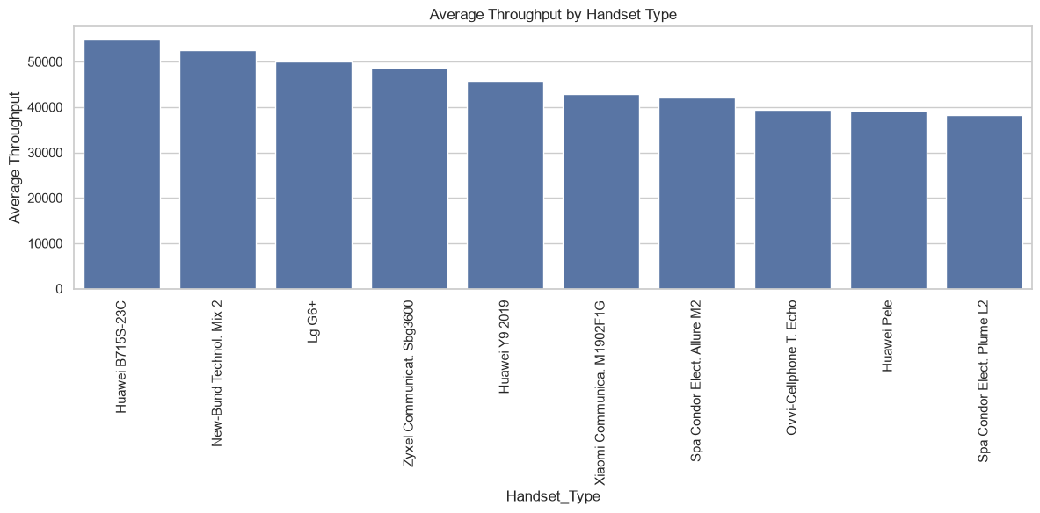
User Experience
Findings
• Throughput varies across handset types.
• Device capability influences user experience.

Slide 9
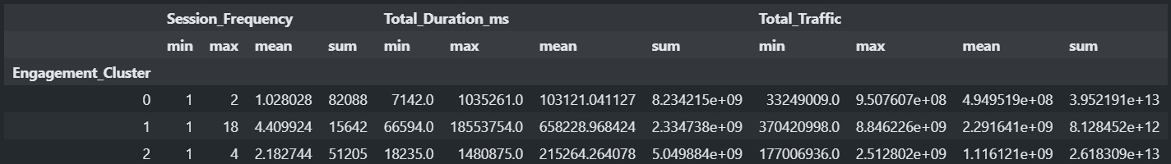
Clustering
Users segmented into
Low Engagement
Medium Engagement
High Engagement

Slide 10
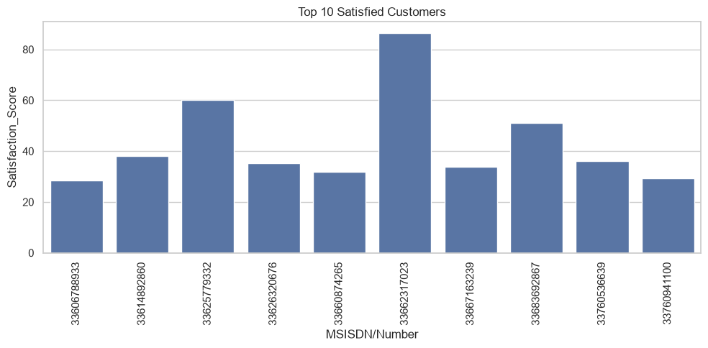
Satisfaction
Customer satisfaction estimated using
Engagement Score
Experience Score
Top customers identified.

Slide 11
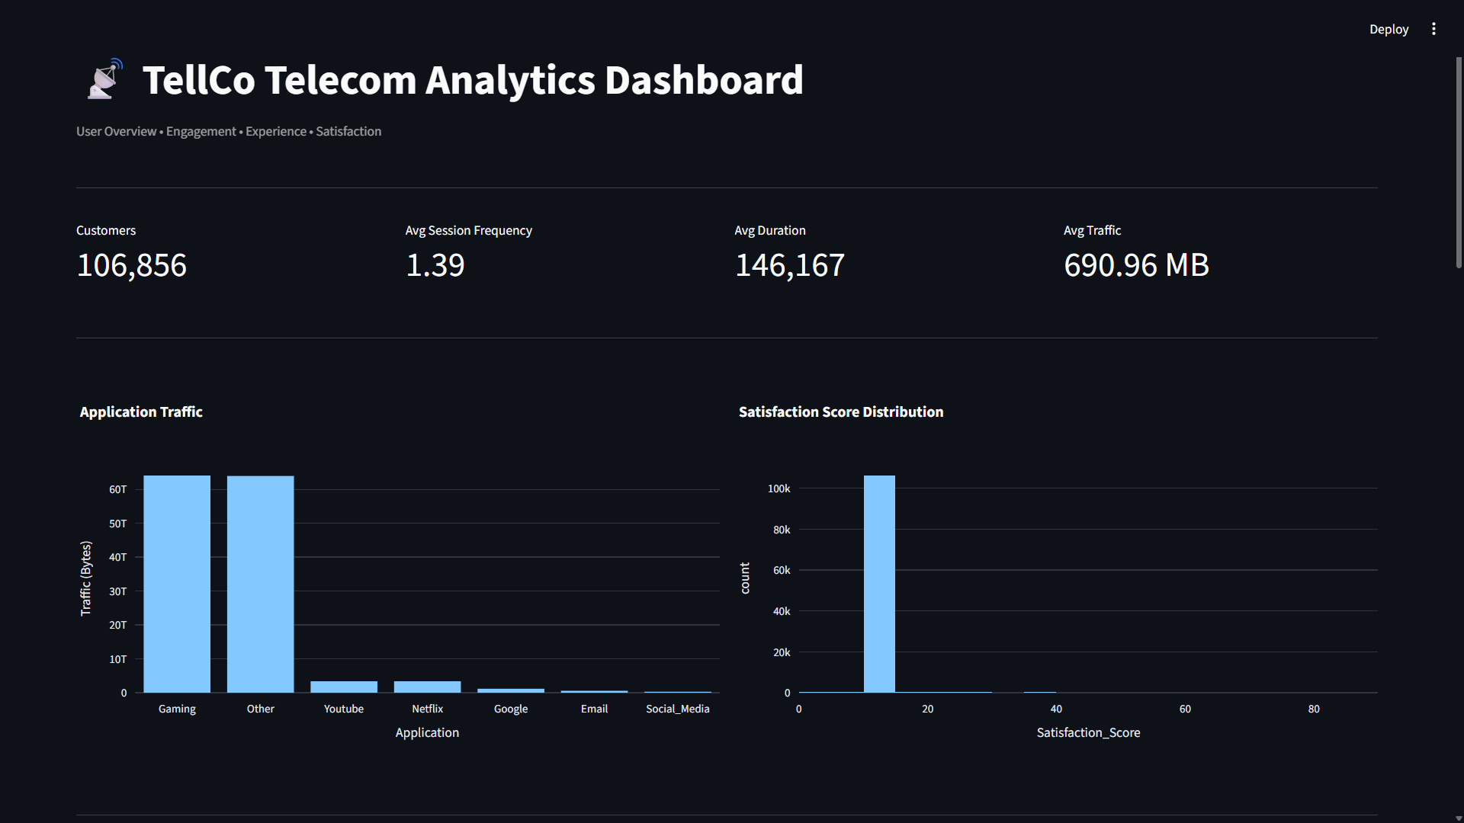
Dashboard

Slide 12

Business Recommendations
Recommendations
Improve network quality
Target high engagement customers
Optimize low experience regions
Promote premium plans
Monitor heavy application users

Slide 13

Conclusion
✔ Successfully analyzed telecom users.
✔ Segmented customers.
✔ Identified high-value customers.
✔ Estimated customer satisfaction.
✔ Dashboard developed for visualization.

