Slide 1

INTERNSHIP ON CYBERSECURITY
Nmap (Network -Mapper) for Cyber Security
Batch ID: 23-SEP-24-SKL-CSPP-BUN-750-WDA14-HYD
Project ID: PTID-CHE-JAN-25-069
BY :Pathan Farhana

Slide 2


Slide 3
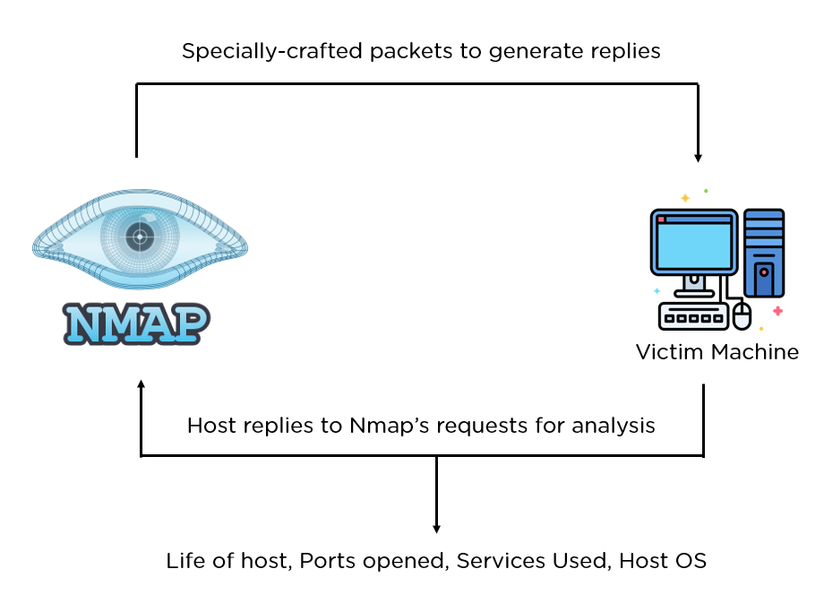
What is Nmap?
Nmap (Network Mapper) is a free and open-source network scanning tool used for network discovery and security auditing. It is one of the most popular tools in cybersecurity and is included in Kali Linux by default.
How Does N-Map Work?
Nmap scans networks by sending data packets to devices and analyzing their responses to detect active hosts, open ports, and running services.

Slide 4
Key Features of Nmap
Network Discovery – Finds active devices on a network.
Port Scanning – Identifies open ports on a system.
Service & Version Detection – Detects running services and their versions.
OS Fingerprinting – Determines the target’s operating system.
Vulnerability Detection – Uses scripts to find security weaknesses.
Firewall Evasion – Bypasses some security measures for deeper scans.
Benefits of Nmap:
Free & Open-Source – No cost, widely supported.
Fast & Efficient – Scans networks quickly.
Customizable – Supports scripting for advanced scans.
Cross-Platform – Works on Windows, Linux, and macOS.
Essential for Security – Helps in penetration testing and network auditing.

Slide 5
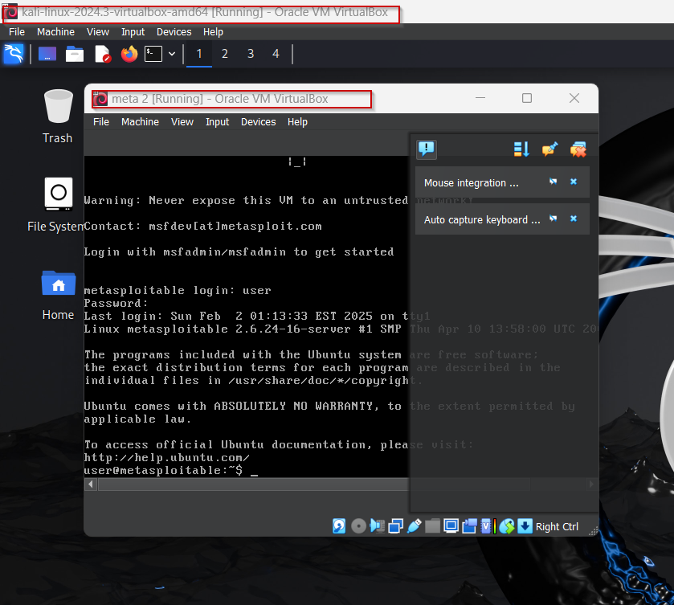
Make sure you turn on both Kali Linux and the Metasploit machine and connect to the same network

Slide 6
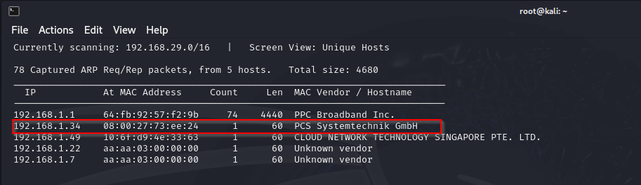
Firstly, we need to determine the IP address of our target machine using the ‘netdiscover’ command.
Note: Kali Linux must be run as root
Command : $ netdiscover

Slide 7
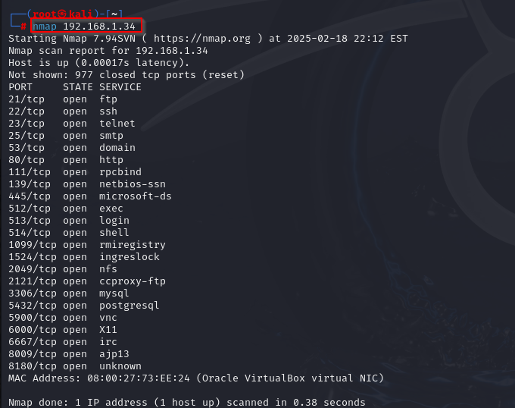
Common Nmap Commands:
Command : nmap <IP Address>
Performs a basic scan on the target IP, checking the most common 1000 ports to identify open ports and running services.

Slide 8
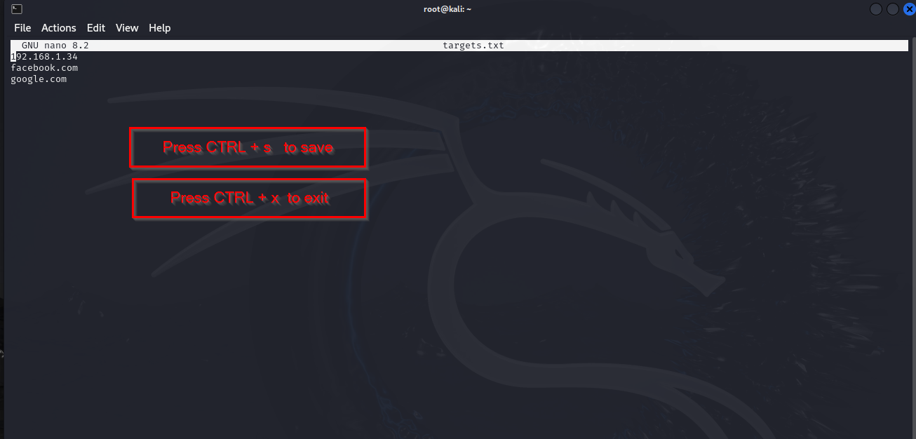
Command : nmap -iL targets.txt
The command nmap -iL targets.txt allows Nmap to read multiple target IP addresses or domain names from a file named targets.txt and scan them all in one go. This is useful for automating scans on multiple hosts without manually entering each target. The file should contain one IP or domain per line. This method is efficient for large-scale network scanning and penetration testing.
Note : To create and save a text file named targets.txt using the nano command

Slide 9
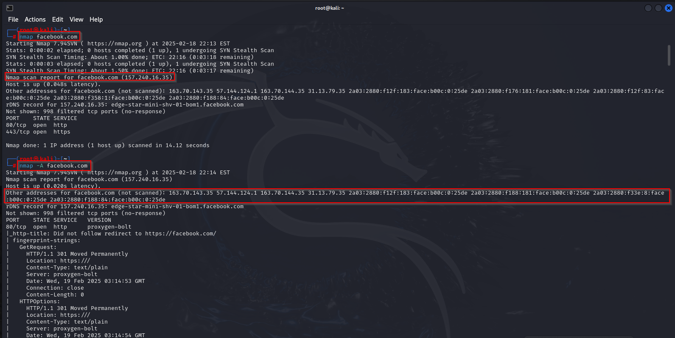
Command : nmap facebook.com
Command : nmap -A facebook.com # For detailed scanning (if not blocked by security measures)
The command nmap facebook.com performs a basic scan on Facebook’s domain to check for open ports. For a more detailed scan, you can use nmap -A facebook.com, but results may be limited due to security measures.

Slide 10
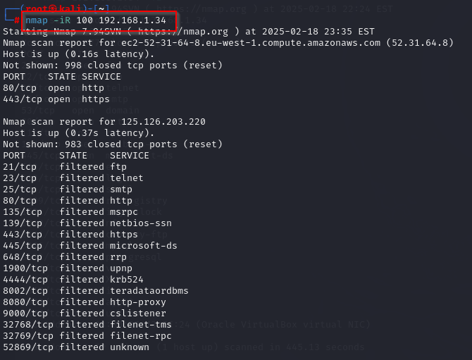
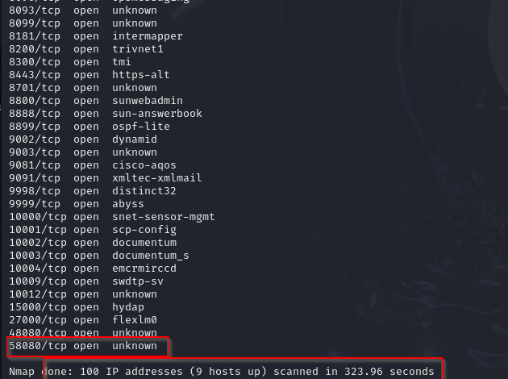
Command : nmap -iR 100 <ip address>
The command nmap -iR 100 randomly picks 100 IP addresses from the internet and scans them for open ports. It does not target specific hosts but selects them at random. This is useful for research but may trigger security alerts or be considered suspicious activity.

Slide 11
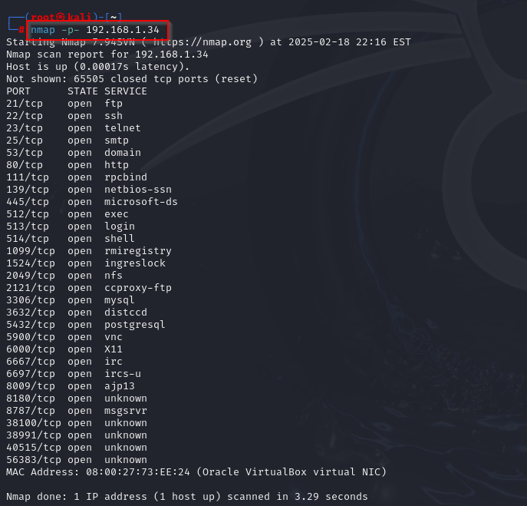
Command : nmap -p- <IP Address>
The command nmap -p- <IP Address> scans all 65,535 ports on the target, instead of just the default 1000 most common ports. This provides a more comprehensive scan to identify any open port. It can take longer to complete due to the large number of ports being scanned.

Slide 12
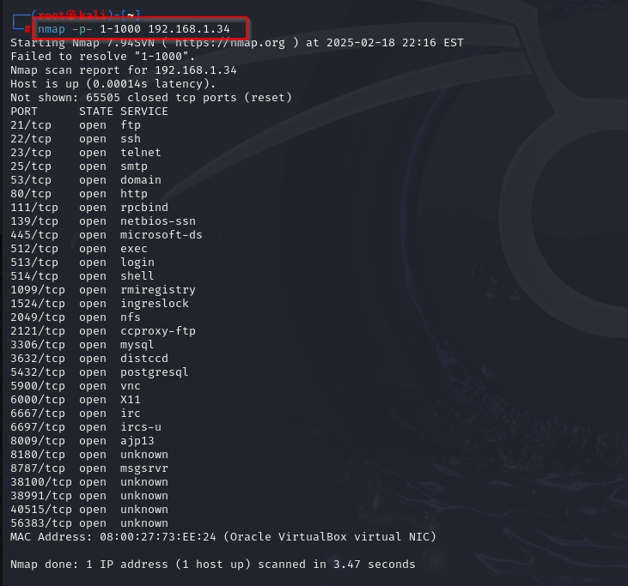
Command : nmap -p 1-1000 <IP Address>
The command nmap -p 1-1000 <IP Address> scans ports 1 through 1000 on the target IP address. This is useful for discovering open ports within the commonly used range. It provides a balance between speed and thoroughness, as it scans a specific range of ports.

Slide 13
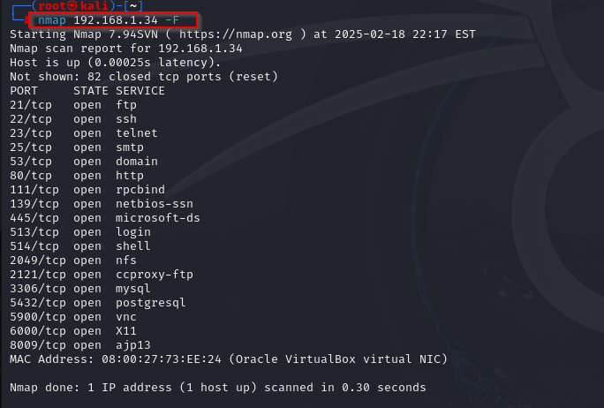
Command : nmap <IP Address> -F
The command nmap <IP Address> -F performs a fast scan, checking only the most common 100 ports on the target IP. It is quicker than a standard scan, but less comprehensive. This is useful for quick network reconnaissance when you need faster results.

Slide 14
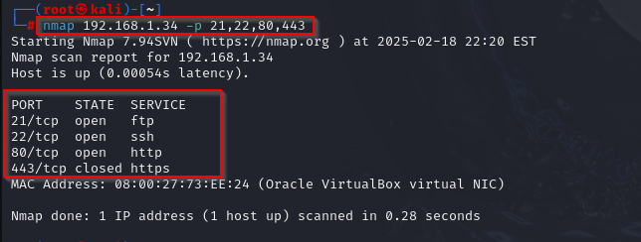
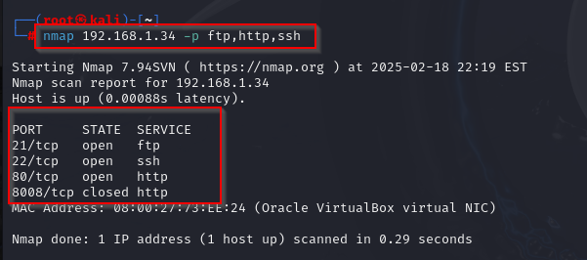
Command : nmap <IP Address> 21,22,80,443
This command scans the specific ports 21 (FTP), 22 (SSH), 80 (HTTP), and 443 (HTTPS) on the target IP address.
You can list specific ports separated by commas to scan only those ports.
Command : nmap <IP Address> http, ftp, ssh
This command scans for the HTTP, FTP, and SSH services by name instead of port numbers.
Nmap automatically resolves the service names to their default ports (HTTP = 80, FTP = 21, SSH = 22).

Slide 15
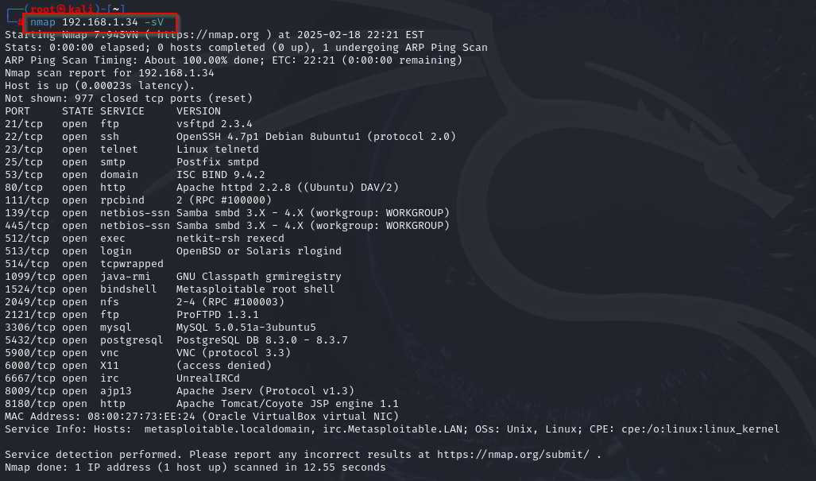
Command : nmap <IP Address> -sV
Performs a service version detection scan on the target IP.
It identifies open ports and tries to determine the version of the services running on those ports (e.g., HTTP server version, SSH version).
This is useful for identifying vulnerabilities associated with specific service versions.

Slide 16
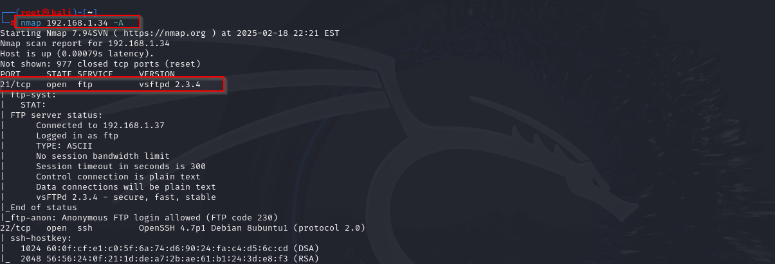
Command : nmap <IP Address> -A
Performs an aggressive scan on the target IP.
It includes several advanced options:
OS detection to identify the operating system of the target.
Service version detection to determine versions of services running on open ports.
Script scanning using Nmap’s built-in scripts to check for vulnerabilities.
Traceroute to map the network path to the target.

Slide 17
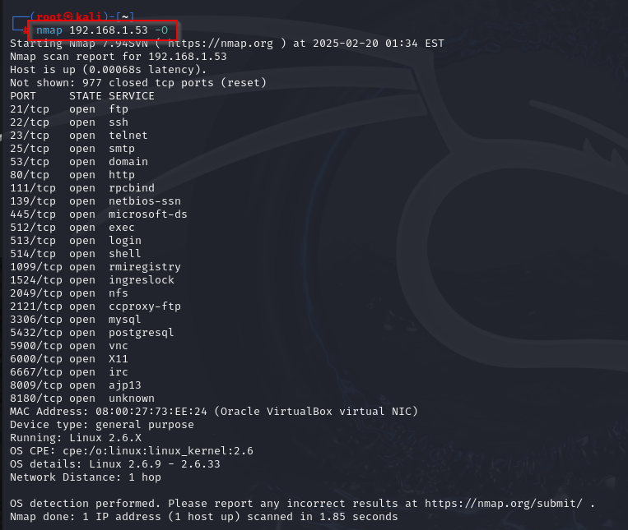
Command : nmap <IP Address> -O
It checks what operating system (Windows, Linux, etc.) is running on the target computer.
You need admin (root) access to run this.
Sometimes, it may not detect the OS correctly.
If it fails, try --osscan-guess to improve results.

Slide 18
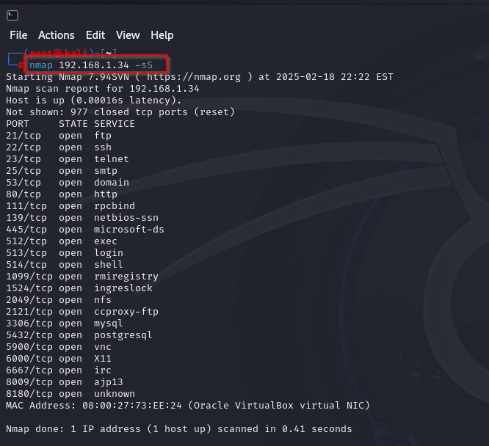
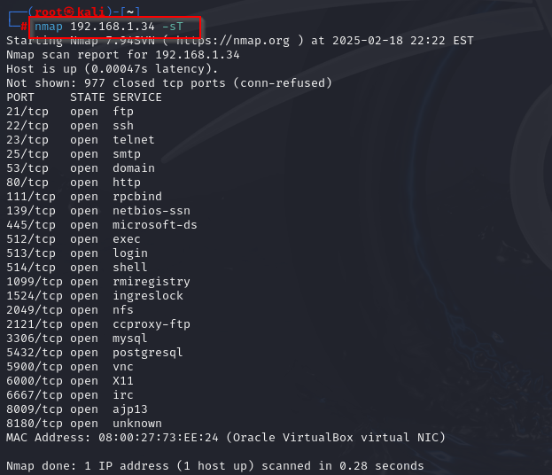
Command : nmap <IP Address> -sS
The command nmap <IP Address> -sS performs a TCP SYN scan (stealth scan) on the target IP. It sends SYN packets to ports, making it harder to detect compared to a full TCP connection scan.
Command : nmap <IP Address> -sT
Performs a TCP connect scan on the target IP.
It establishes a full TCP connection to each open port, making it more detectable compared to a SYN scan (-sS). This scan is useful when SYN scanning is not allowed or blocked.

Slide 19
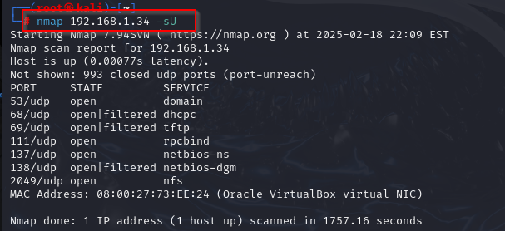
Command : nmap <IP Address> -sU
Performs a UDP scan on the target IP to detect open UDP ports.
Unlike TCP, UDP is connectionless, so this scan helps identify services running on UDP ports like DNS, SNMP, and others.

Slide 20
Timing Templates (-T0 to -T5)
-T0 (Paranoid): Very slow scan, designed to avoid detection.
Paranoid mode is the slowest and least noticeable scan in Nmap.
It sends requests one by one with long gaps in between.
This helps hide the scan from security systems like firewalls and IDS.
-T1 (Sneaky): Slow, less likely to trigger security systems.
Sneaky mode is a very slow and careful scan in Nmap.
It sends requests with small delays to avoid detection.
Useful for stealth scanning while being faster than Paranoid mode.

Slide 21
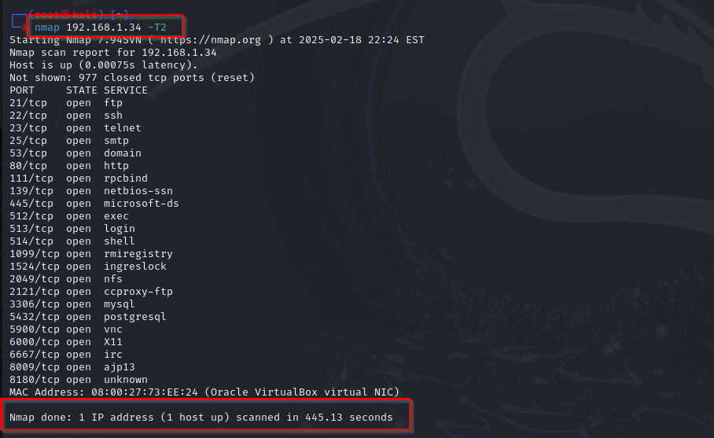
Command : nmap <IP Address> -T2
-T2 (Polite): Slows down the scan to reduce load on the target.
It reduces the scan speed to prevent putting too much load on the target network.
This mode is useful for scanning without causing disruptions, especially on busy or sensitive networks.

Slide 22
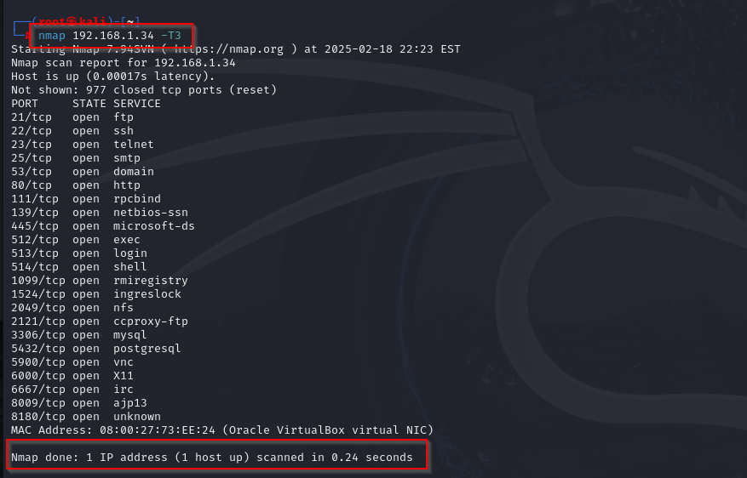
Command : nmap <IP Address> -T3
-T3 (Normal): Default scan speed, balanced between speed and stealth
It provides a balance between speed and stealth, making it suitable for most situations.
This mode is fast enough for general use without being too aggressive.

Slide 23
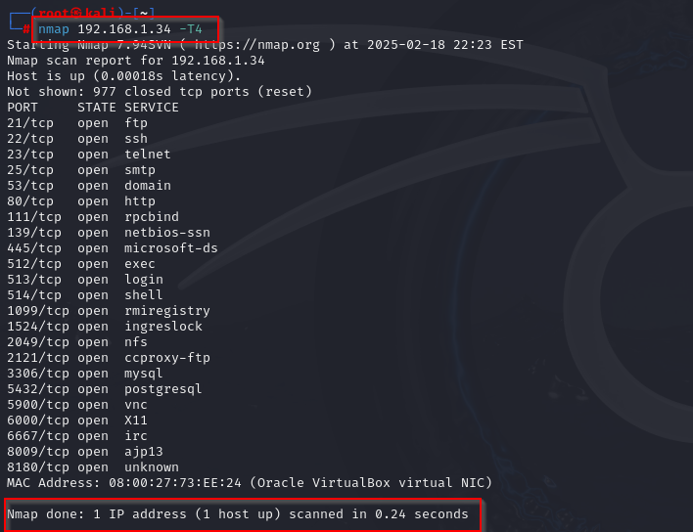
Command : nmap <IP Address> -T4
-T4 (Aggressive): Faster scan, but more likely to be detected.
It is good for quick scanning but may be easier to detect by security systems.
Best used on stable and trusted networks where speed matters more than stealth.

Slide 24
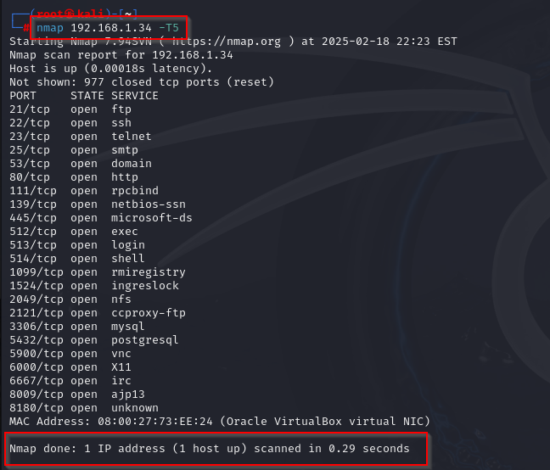
Command : nmap <IP Address> -T5
-T5 (Insane): Fastest scan, may cause packet loss or trigger alarms.
It sends requests very quickly, which can overload networks and get detected easily.
Best for very fast scans on stable and trusted networks only.

Slide 25


