Slide 1
Html

Slide 2
Introduction Basics
Elements
Attributes
Paragraphs
Styles & Formatting
Colors (RGB, HEX, HSU8. Links/Charset)
Images
Tables
Lists
Block & Inline
Class, ID

Slide 3
Introduction of HTML

Slide 4
What is HTML?
HTML stands for Hyper Text Markup Language
HTML is the standard markup language for creating Web pages
HTML describes the structure of a Web pages
HTML consists of a series of elements
HTML elements tell the browser how to display the content
HTML elements label pieces of content such as "this is a heading", "this is a paragraph", "this is a link", etc.

Slide 5
Example of HTML Page Structure
<!DOCTYPE html>
<html>
<head>
<title>Page Title</title>
</head>
<body>
<HTML>
<h1>ky First Heading</h1>
<p>ly in paragraph.</p>E5
</body>
</html>

Slide 6


Slide 7
HTML Documents
All HTML documents must start with a document type declaration:
!DOCTYPE
The HTML document itself begins with <html> and ends with </html>
The visible part of the HTML document is between <body> and </body>

Slide 8


Slide 9
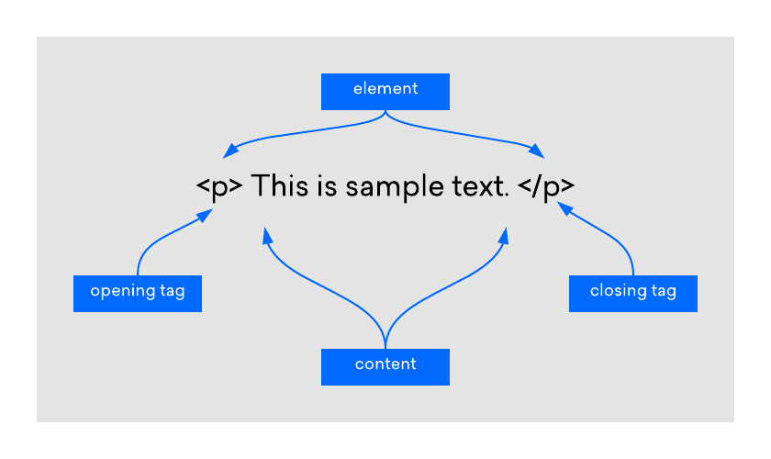
An HTML element is defined by a start tag, some content, and an endtag.

Slide 10
HTML ELEMENTS
<html>...</html>
Declares the Web page to be written in HTML
<head>...</head>
It is meta tag it is use to seo
<title>...</title>
It is used to give the title of the page
<body>...
Delimits the page's body
</body>

Slide 11
Html headings
<h1>NIPUNA technologies</h1>
<h2>NIPUNA technologies</h2>
<h3>NIPUNA technologies</h3>
<h4>NIPUNA technologies</h4>
<h5>NIPUNA technologies</h5>
<h6>NIPUNA technologies</h6>

Slide 12
Paragraphs & text formatting
<p>nipuna technologies is best it center in Vijayawada</p>
<b>bold</b>
<strong>strong</strong>
<i>italic text</i>
<mark>mark the </mark>
<del>delete</del>
<sub>subscript text
<sup>super script
<u>underline</U>

Slide 13
style
<h1 style=“color:=red; backgroung-color: “>welcome to Nipuna</h1>
Color site: flatuicolor.com
Google font
<button>
<a herf=https://nipunatechnologies.com/ target=“_blank” style=“text-decoration: none; “ title=“click to visit”>NIPUNA</a>
</Button>

Slide 14
images
<img src=“flodername/imagename,png: with=“400” height=“200” alt=“nomatch”>
<br>
<hr>

Slide 15
table
<table>
<tr><table row>
<Th><table heading></th>
<Th><table heading></th>
<Th><table heading></th>
<Th><table heading></th>
<tr>

Slide 16
<tr>
<th colspan=“1”>hi</th>
<th>hi</th>
</table>
<table border=“1”cellspecing=“0” cellpading=“0”>

Slide 17
List
in html is two types of list
Oder list
Under list
<p>list of shopping</p>
<Ul type =“square,circle,disc>
<Li>laptop<li>
<Li>laptop<li>
<Li>laptop<li>
<Li>laptop<li>
<Li>laptop<li>
</ul>

Slide 18
Oder list
<Ol type=“A,a,”>
Li>laptop<li>
<Li>laptop<li>
<Li>laptop<li>
<Li>laptop<li>
<Li>laptop<li>
</ol>

Slide 19
Form
<label>user Name</label>
<input type=“text” placeholder=“enter the name”><br><br>
<label>password</label>
<input type=“password”><br><br>
<label>user Name</label>
<input type=“text”><br><br>
<label>user email</label>
<input type=“text”><br><br>
<label>mobile</label>
<input type=“text”><br><br>

Slide 20
Option& text area
<select>
<option>select your plain</option>
<option vale=“personal”>select your plain</option>
<option value =“business”>select your plain</option>
</select>
Text
<Textarea cols=“10” rows=“2”>

Slide 21
html4

