Slide 1
MARKETING & RETAIL ANALYSIS Milestone 1 - DSBA
By,
Pathanjali Srinivasan.

Slide 2
Content
Agenda & Executive Summary of the data
Exploratory Data Analysis and Inferences
RFM Segmentation
Customer Segmentation using RFM analysis
KNIME Workflow & RFM Analysis
Inferences from RFM Analysis and identified segments
(
Notes:
In Slide Show mode, click the arrow to enter the PowerPoint Getting Started Center.

Slide 3

Agenda
Agenda of this project is to find the underlying buying patterns of the customers of an automobile part manufacturer. based on the last 3 years of the Company's transaction data and recommend them customized marketing strategies for different segments of customers.
* Reference image from Google image search result

Slide 4
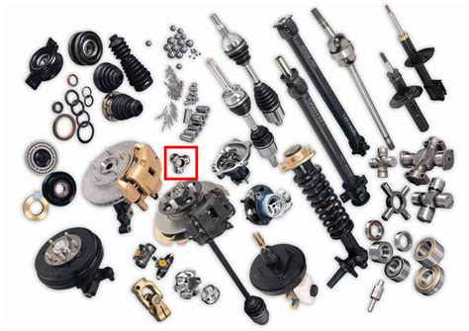
Executive Summary
We have received the 3 years data of automobile part manufacture. Consisting 2747 entries with 20 variable details regarding the demography of the product and customer information.
* Reference image from Google image search result

Slide 5
Problem Statement
An automobile parts manufacturing company has collected data of transactions for 3 years. They do not have any in-house data science team, thus they have hired us as their consultant. Our job is to use your magical data science skills to provide them with suitable insights about their data and their customers.
ORDERNUMBER : | Order Number | CUSTOMERNAME : | customer
QUANTITYORDERED : | Quantity ordered | PHONE : | Phone of the customer
PRICEEACH : | Price of Each item | ADDRESSLINE1 : | Address of customer
ORDERLINENUMBER : | order line | CITY : | City of customer
SALES : | Sales amount | POSTALCODE : | Postal Code of customer
ORDERDATE : | Order Date | COUNTRY : | Country customer
DAYS_SINCE_LASTORDER : | Days_ Since_Lastorder | CONTACTLASTNAME : | Contact person customer
STATUS : | Status of order like Shipped or not | CONTACTFIRSTNAME : | Contact person customer
PRODUCTLINE : | Product line – CATEGORY | DEALSIZE : | Size of the deal based on Quantity and Item Price
MSRP : | Manufacturer's Suggested Retail Price
PRODUCTCODE : | Code of Product

Slide 6
About Data
The data is about an automobile parts manufacturing company. They have provided the data collected of transactions for last 3 years.
The data has 2747 entries (0 To 2746) of rows and 20 columns. The data has 1 datetime64 , 2 foat64, 5 int64,and 12 Object data types.
The dataset has no null values and no duplicate rows of data.
This data more or less reflects the purchasing behavior of customers in different categories . The company is into automobile part manufacture, and they have different product line like Classic car , Motorcycle, plane, train, ship, Bus truck, vintage cars etc.
The data maintained each transactions entry as order number and for each order number maintained all required information like customer identity details , and product details like price , quantity , product code, and sales for each customer.
We noticed that one order number has many different entries with different product codes.
Manufacturer's Suggested Retail Price(MSRP) for each product code is decided but we found that this is not matching with Price of Each item & is inconsistent with MSRP

Slide 7
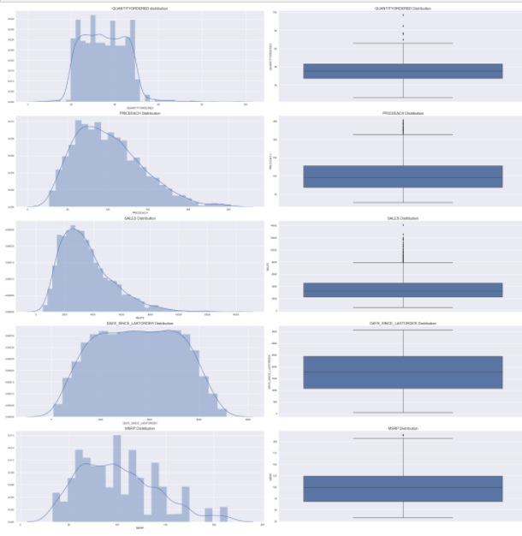
Exploratory Data Analysis
Distplot and Boxplot inference:
There is presence of outliers in variables such as Quantity ordered, Price and Sales.
Variable ‘Sales’ has highest positive skewness (0.784) and Variable ‘Days_since_lastorder’ has lowest negative skewness(-0.002)
We can clearly see that outlier is present in each product line category and it is present in large deal size.

Slide 8
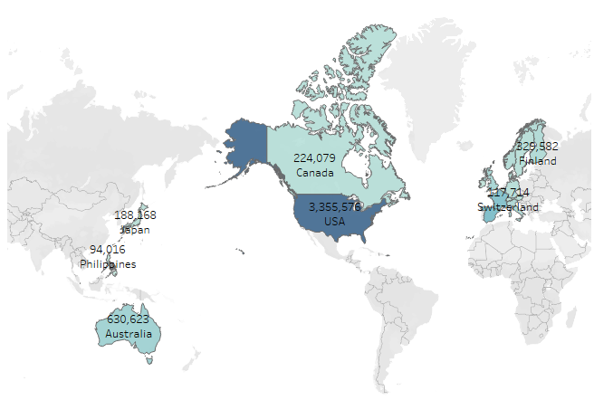
Exploratory Data Analysis
Bivariate Analysis:
Company is having a viable market in almost 19 countries
This graph shows the sales across different countries
USA is the primary market of the company contributing maximum to its turn-over
Some European countries like Spain and Switzerland shows good number of sales following USA

Slide 9
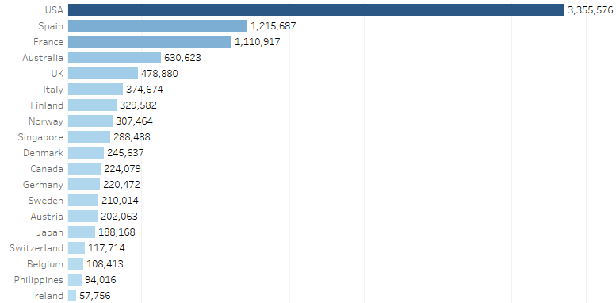
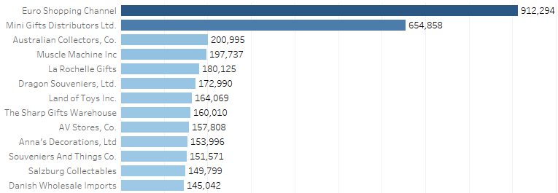
Exploratory Data Analysis
Bivariate Analysis:
USA is having most orders shipped and high sales with 3 on hold and 1 cancelled.
This is followed by France, and so on order of decreasing sales.
‘Euro Shopping channel’ is the customer having highest sales and orders shipped followed by ‘Mini Gifts Distributers ltd’.
‘Euro Shopping Channel’ is also having orders in cancelled, Disputed status – again an inference for company to check

Slide 10
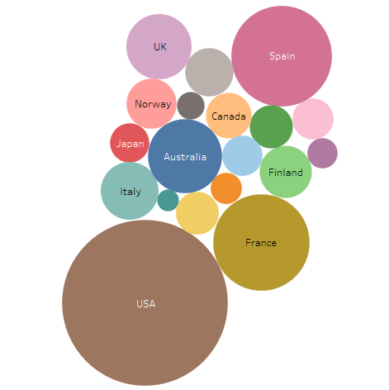
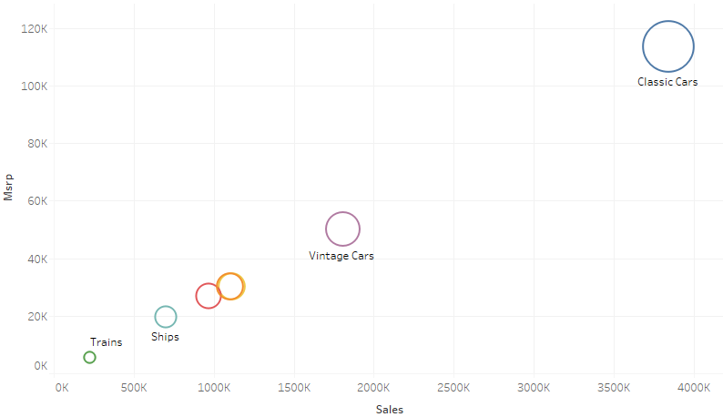
Exploratory Data Analysis
Bivariate Analysis:
‘Classic cars’ are visibly the most selling product line followed by ‘Vintage cars’ and so on..
Countries that have highest orders are USA, followed by Spain and France.
Ireland and Philippines are the least consuming countries.

Slide 11
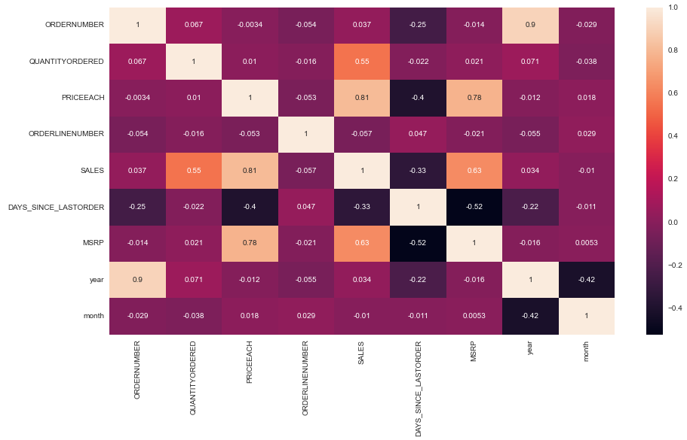
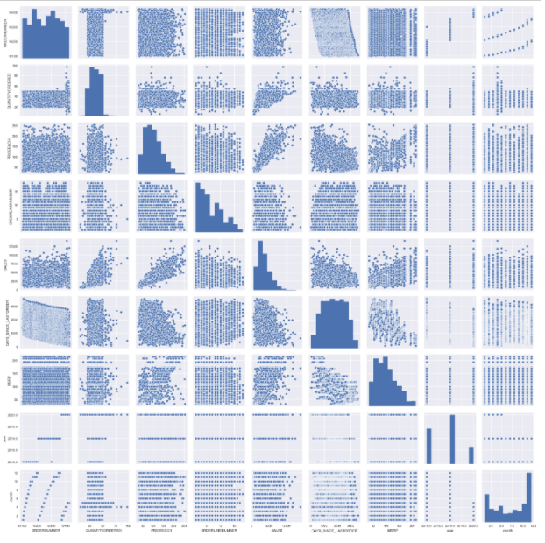
Exploratory Data Analysis
Multivariate analysis
The heatmap shows the high correlation between two variables SALES and PRICEEACH. Also variable MSRP and PRICEEACH have a high correlation shown in above heatmap

Slide 12
Exploratory Data Analysis
Multivariate analysis inference:
Variables ‘Sales’ and ‘Price each’ have highest positive Correlation(0.81) and Variables ‘Days_since_lastorder’ and ‘MSRP’ have highest negative Correlation(-0.52)
From the previous plots , we can see that none of the variables are symmetric.
Variables ‘Sales’ and ‘Price each’ have almost linear relation ship between them.
From the plots , we can see there is higher spread of data along the trend line for MSRP compared to Price each so we need to maximize sales by identifying respective items for which there is higher price change.
The pair plot shows the data in most variables are normally distributed
There’s visible correlation between Quantity Ordered, Sales, MSRP and Price each.
Other variables don’t show any signs of correlation

Slide 13
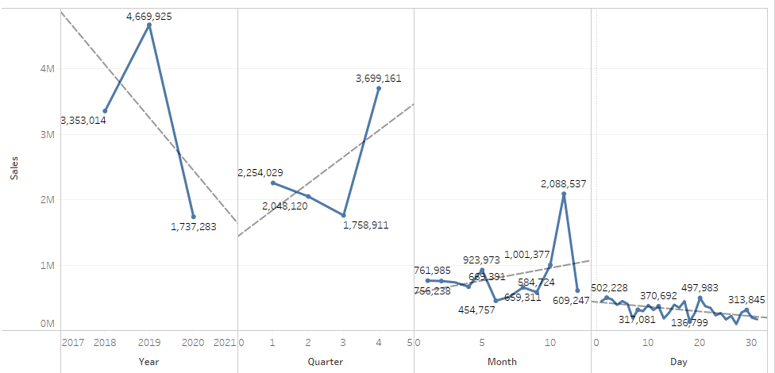
Exploratory Data Analysis
Sales trend per different time period :
Yearly trend in sales decreasing in 2020 from 2018 with 2019 having highest sales.
Quarterly & Monthly sales having increasing trend with seasonality – indicating sales increases in Q4

Slide 14
Inferences & Summary
The sales of large size deal is almost remain stagnant over the years and it can be presumed that the company should focus on getting large size chunk projects.
Maximum number of deals are medium type of deal size
Deals having larger deal size across sales are minimum as compared to medium and smaller deal size
In sales across product line classic cars have higher number of sales as compared to other cars
The sales of product line like Trucks, buses and motorcycles is in saturation stage and there is very less scope in them.
The major chunk of sales comes from 4 – 5 customers therefore company should focus more on customer scouting in a rational way because incase there is client churn’s it will impact the sales of the company greatly.
Company have higher amount of Sales in country USA as compare to other country.
Euro shopping channel is the most loyal customer.
Company drives export revenue mainly from large size deals followed by medium size deals and small size deals therefore we can infer that large size deals is mainly from foreign customers and company should focus on domestic sales as well.

Slide 15
RFM Segmentation
Recency, frequency, monetary value (RFM) is a marketing analysis tool used to identify a firm's best clients based on the nature of their spending habits.
An RFM analysis evaluates clients and customers by scoring them in three categories: how recently they've made a purchase, how often they buy, and the size of their purchases.
RFM analysis helps firms reasonably predict which customers are likely to purchase their products again, how much revenue comes from new (versus repeat) clients, and how to turn occasional buyers into habitual ones.
Customer Segmentation is done by using KNIME & MS Excel by dividing the data based on Recency, Frequency and Monetary variables by grouping data by variable ‘Order Number’.

Slide 16
RFM Segmentation
Recency (R) is the most recent customer order which is calculated by taking difference of Order date & current date in Days.
RECENCY in Days = ORDERDATE – Current Date
Frequency (F) is how often the orders are placed by customers, from the excel sheet the variable
DAYS_SINCE_LASTORDER.
Monetary (M) sales can be used and we used the calculation of price & Quantity:
Monetary = QUANTITYORDERED * PRICEEACH
Following assumptions are made for RFM segmentation:
Assumption 1 – All the prices & sales figure are in same currency.
Assumption 2 – Sales & (Quantity * Price) may or may not be same.

Slide 17
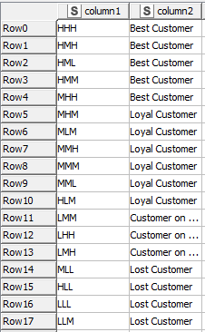
Customer Segmentation using RFM analysis
A new column is created called Recency based on the formula mentioned previously.
In sales column we get sales amount for each transaction. We can use sales parameter and using an assumption of sum of aggregation which we created as a new column called Monetary
Then we created 3 different bin for each Recency, frequency & Monetary using percentile range (0.0, 0.25, 0.75, 1.0). Based on 3 bin assumption we have considered segments like Low (L), Medium (M) & High (H).
Finally based on the combination assumption we have considered 4 segments like Loyal , Best , Lost and the customers on the verge of Churn.

Slide 18
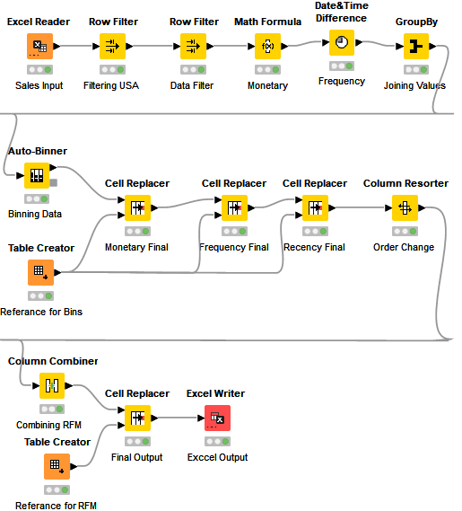
KNIME Workflow
KNIME has been used in areas such as CRM customer data analysis, business intelligence, text mining and financial data analysis or modeling, data analysis and visualization without, or with only minimal, programming.
KNIME Workflow

Slide 19
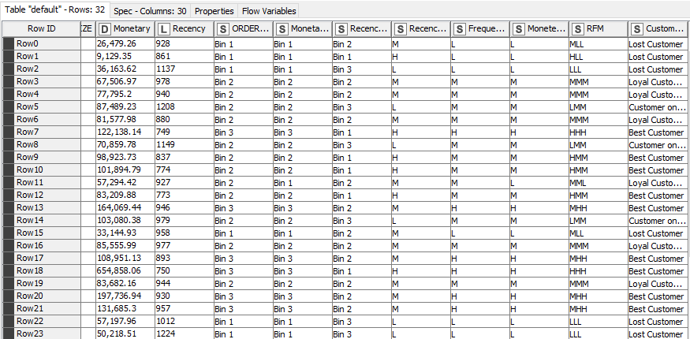
Final Output of the Workflow

Slide 20
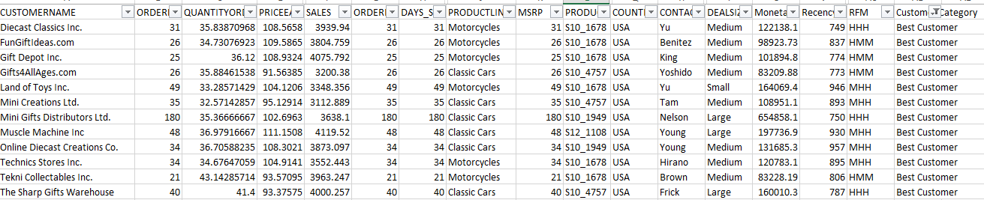
Inferences from RFM Analysis and identified segments
Best Customers
On basis on Recency, frequency & monetary we have grouped our top customers.
We have given the most significance to recency parameter as these customers has recently purchased our products.
Also according to RFM model the most importance is given to recency. Hence we have kept it as our first parameter for selecting top customers.
We should not loose these customers at any cost as they are the biggest contributors of the business.

Slide 21
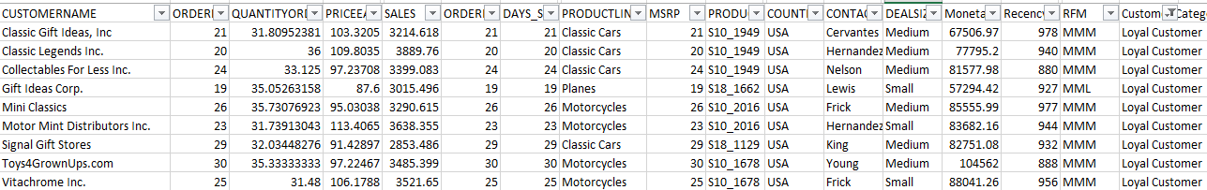
Inferences from RFM Analysis and identified segments
Loyal Customers
On basis on Recency, frequency & monetary we have grouped our loyal customer's. These customers have purchased multiple times with good monetary value.
If we focus more on this segment of customers, we can easily turn them into our top best customers too. Also, in this segment we can see the customers for product line - classic cars are many.
These are the still valuable customers as they are with better level in all aspects Frequency and Monetary. We have to look after the needs of these customers to bring them into the pool of best.

Slide 22
Inferences from RFM Analysis and identified segments
Customers on the verge of churn
On basis on Recency, frequency & monetary we have grouped our Customers who are on verge of churning. We should definitely focus on this group before we lose them and try to convert them into our regular customers.
If the company pays more attention and fulfill their requirement, then we can easily turn them into our regular customer and we can save them from churning out.
We can still concentrate on them to increase business as they have got High Recency level.

Slide 23
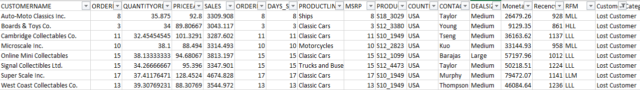
Inferences from RFM Analysis and identified segments
Lost Customers
On basis on Recency, frequency & monetary parameters we have grouped our Customers who we’d lost
Their recency is very low and hasn’t made any purchase since long so we can say these are our lost customers. If taken feedback from them and fulfill their demand we might bring them back to being a good customer.
But suggestion is to not to invest much time on these type of customers as these are the most avoidable customers as they are with lowest level in all aspects Recency, Frequency and Monetary. There is no point in spending time and effort to maintain business with these customers.

Slide 24
Inferences & Recommendations
Using Recency, frequency & monetary parameters we have grouped our Top , loyal, on the verge of churning and lose customers. Customers with good recency has been our top customers were as we also have lost customer lists.
Customers on verge of churning can be saved and can be converted into a good buyer.
RFM model is used for deriving the customers types like Loyal, top or best, on verge of churning & lost customers.
Recency, frequency & monetary parameters were widely used to bifurcate the types of customer's.
This model can be very helpful to the company to maintain its sales and customers and can focus on how the company has lost the customers & can take various actions to bring them back.
It is vital for the company to convert the customers who are on verge of churning into a regular customer or at least maintain them and also how to increase the sales ratio can be identified.
USA is also having most at risk customers, followed by France, Australia and Finland. If shipping issues could be handled better for these countries, it would be better for business.

Slide 25
Thank You!

