Slide 1
DH Steel IBA Data Profile
Process-Defect Correlation Analysis Report
2026.03.31 | Analysis: 2025.05~08 + 2026.01~02
Customer Requirements (5 Items) + Additional Requests

Slide 2
Executive Summary
Key Findings — Direct Answers to Customer Questions
# | Question | Answer | Key Evidence
Q1 | Variability first or defect first? | BOTH confirmed (3 forward + 3 reverse) | RUN filter separates true/false signals
Q2 | Furnace or Torque leads first? | FURNACE leads | Stand8 vs Furnace rho = -0.722
Q3 | Management standards? | Provided by grade (Alternative B) | D4 Gas Flow Gap = -75.2%
Q4 | Why Stand14 / Block Mill small? | avg NOT significant std IS significant | std rho = 0.351***
Q5 | ML vs Stat ranking mismatch? | Reconciled Top-5 PR3 Torque = #1 | 3/3 grades converge 11 counter-examples

Slide 3
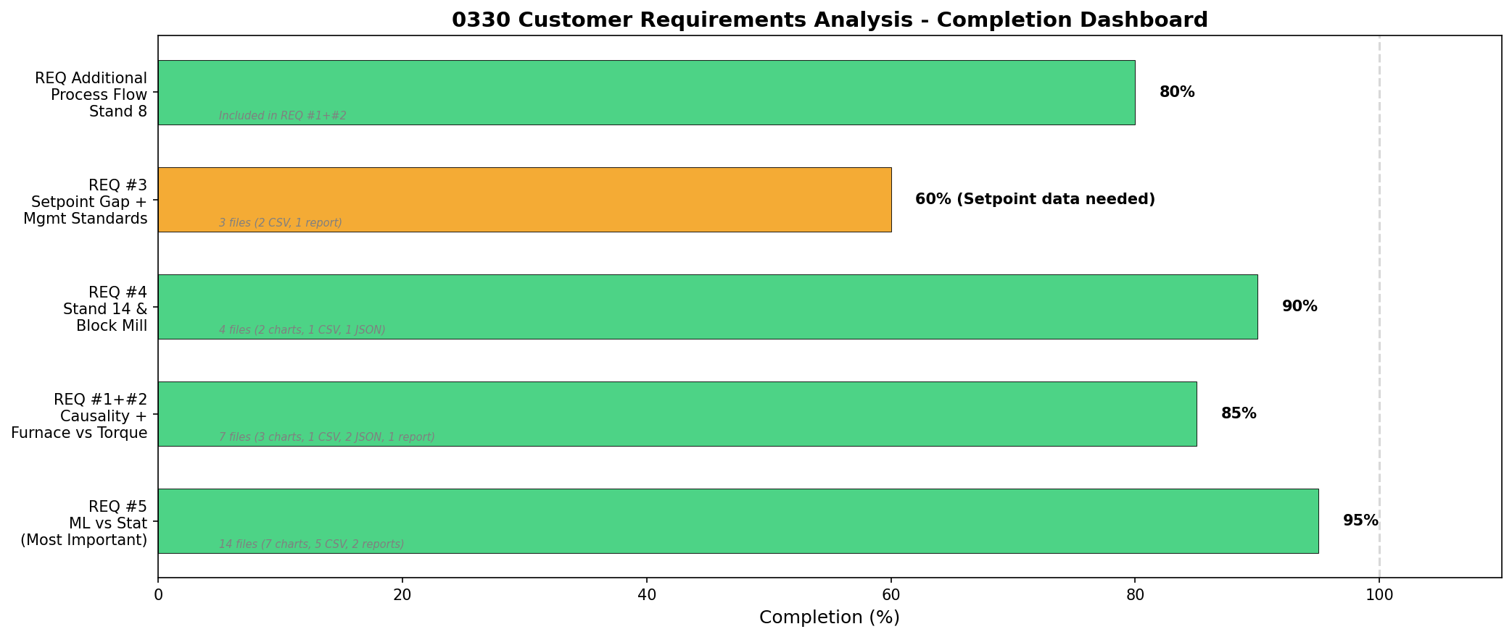
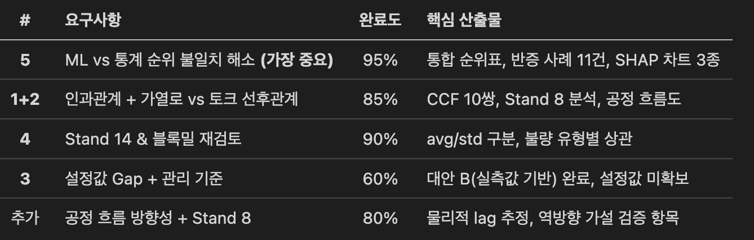
Analysis Completion Status
5 Requirements + Additional Requests
# | Requirement | Done | Key Deliverables
5 | ML vs Stat Ranking Reconciliation (Most Important) | 95% | Reconciled Ranking, 11 Counter-examples, SHAP x3
1+2 | Causality + Furnace vs Torque Priority | 85% | CCF 10 pairs, Stand 8 Analysis, Process Flow
4 | Stand 14 & Block Mill Re-examination | 90% | avg/std Separation, Defect Type Correlation
3 | Setpoint Gap + Management Standards | 60% | Alternative B (Measurement-based), Setpoint N/A
Add | Process Flow Direction + Stand 8 | 80% | Physical Lag Estimation, Reverse Hypothesis

Slide 4
Q5: Reconciled Feature Ranking Top-5
MOST IMPORTANT — Unified ranking for field recommendation
Rank | Tag | Stat | ML | Score | Action
1 | PR3 Torque (Pinchroll 3) | 1 | 2 | 0.941 | Pinchroll tension mgmt
2 | FB Slave Torque (Block Mill) | 10 | 1 | 0.933 | Block mill load mgmt
3 | PR6L2 Torque | 2 | 4 | 0.876 | Pinchroll 6 mgmt
4 | Waste Gas Pressure | 15 | 3 | 0.825 | Furnace pressure mgmt
5 | PR9L1 Torque | 9 | 5 | 0.745 | Pinchroll 9 mgmt
PR3 Torque: #1 across ALL steel grades (D5, N5, B5) — highest confidence
FB Slave Torque: Stat rank 10 -> ML rank 1 — ML captures nonlinear effect
Score = 0.4 x Stat(normalized) + 0.6 x ML(normalized)
ML weight 0.6 reason: controls confounding, consistent with RUN filter results, no reverse causality errors

Slide 5
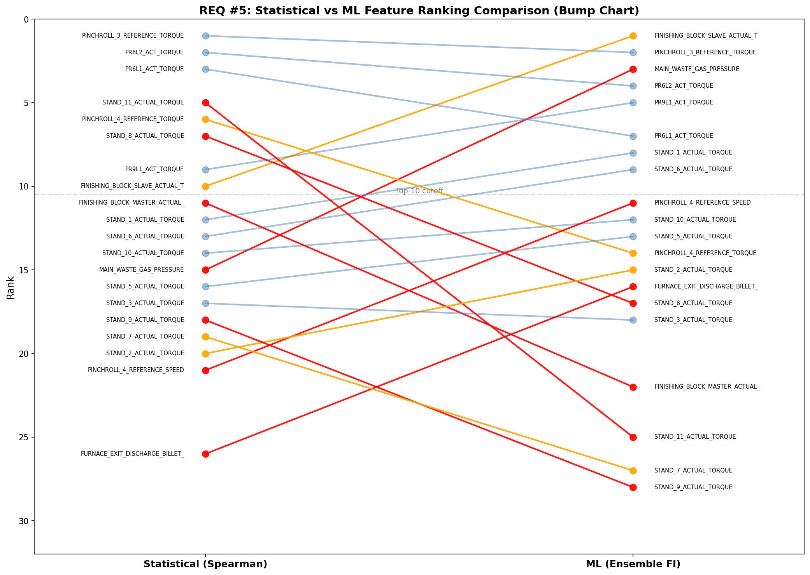
Q5: Ranking Comparison — Statistical vs ML
Red lines = Large rank difference (>5 positions)

Slide 6
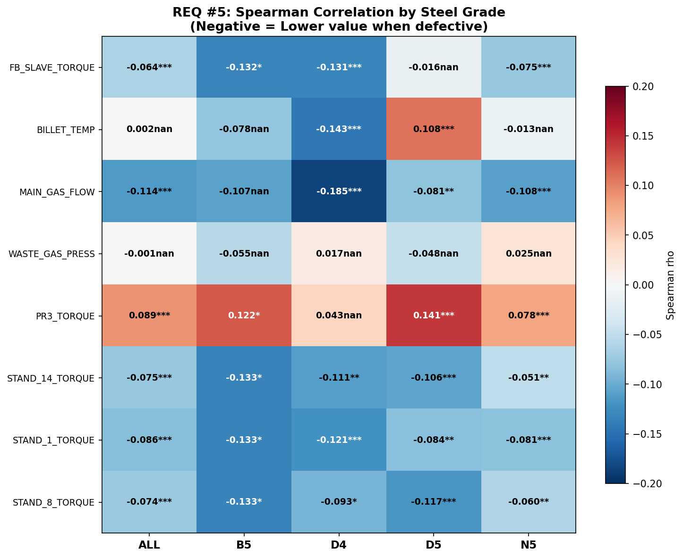
Q5: Grade-Specific Convergence
PR3 Torque = #1 across all steel grades
Tag | All | D5 | N5 | D4 | Converge?
PR3 Torque | 1st | 1st | 1st | - | YES (3/3)
GAS FLOW | 8th | 5th | 8th | 1st | D4 only
Stand 8 Torque | 5th | 8th | 5th | 3rd | Varies
FB Slave Torque | 4th | 3rd | 6th | 6th | Consistent
PR3 Torque: #1 regardless of grade — most reliable tag
MAIN_GAS_FLOW: strongest for D4 (rho=-0.185)
B5: only 2 defects — excluded from grade analysis
Coil-IBA matching: 4,952 coils, 100% match rate

Slide 7
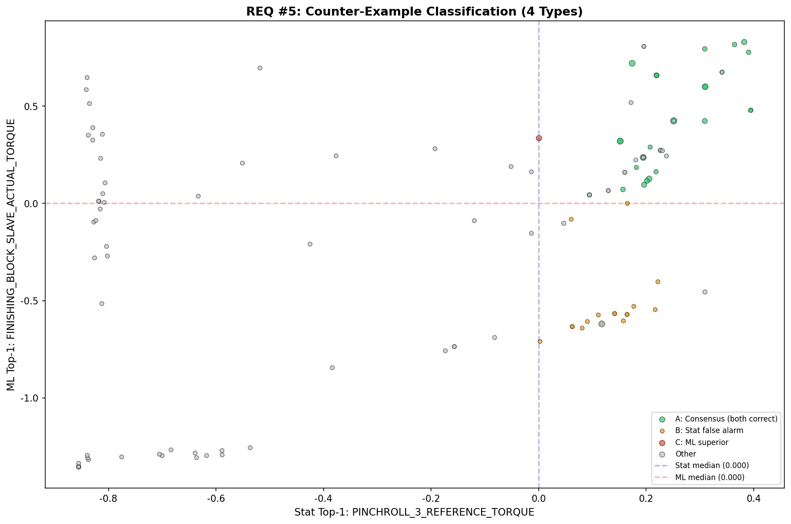
Q5: Counter-Example Analysis
Data-driven proof for field persuasion
Type | Days | Meaning | Implication
A Consensus | 26 | Both agree, actual defect | Both reliable
B Stat Alarm | 18 | Stat only risk, actually normal | 14% false alarm if Stat only
C ML Superior | 1 | ML only detects, actual defect | ML catches 1 more case
D Undetected | 0 | Both miss, actual defect | Combined = 0 miss
Stat alone: 14% false alarm rate (18/127 days)
Combined: 0% undetected (Type D = 0)
"Stat and ML answer different questions"

Slide 8
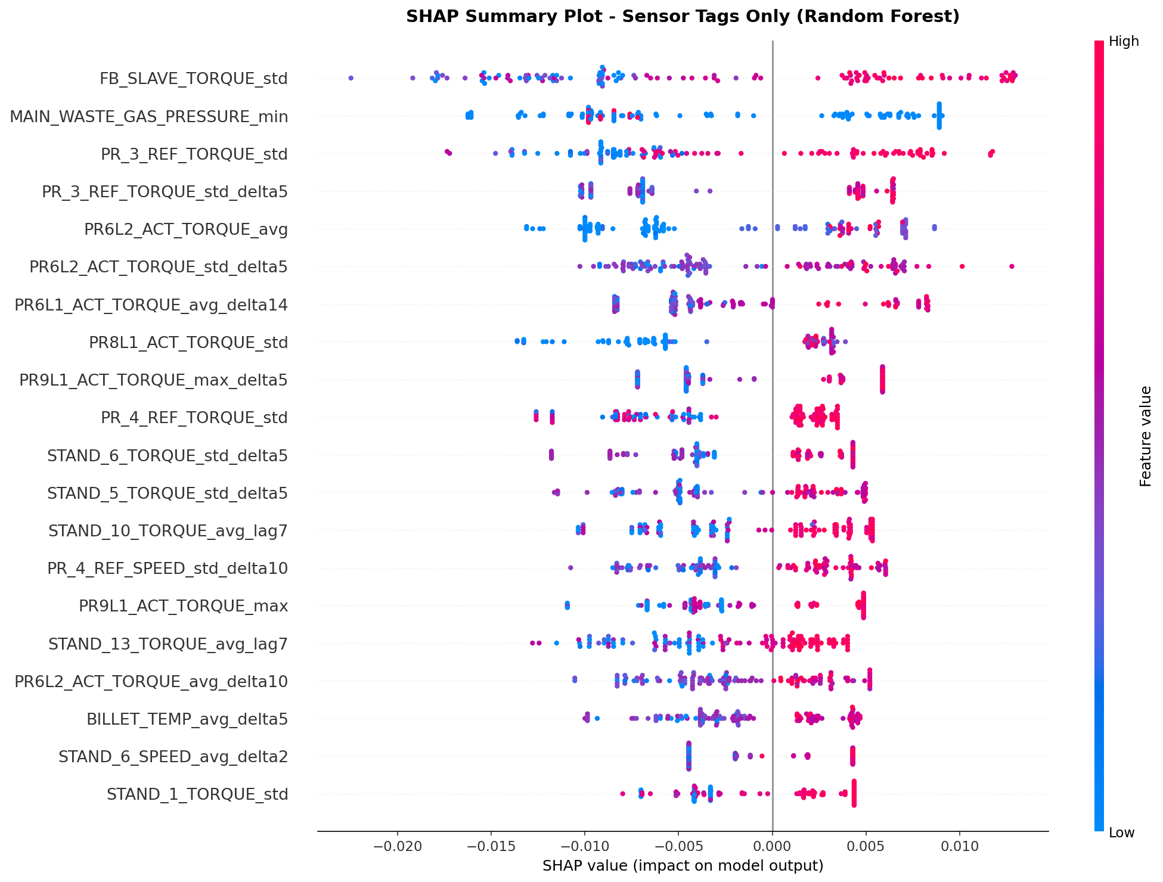
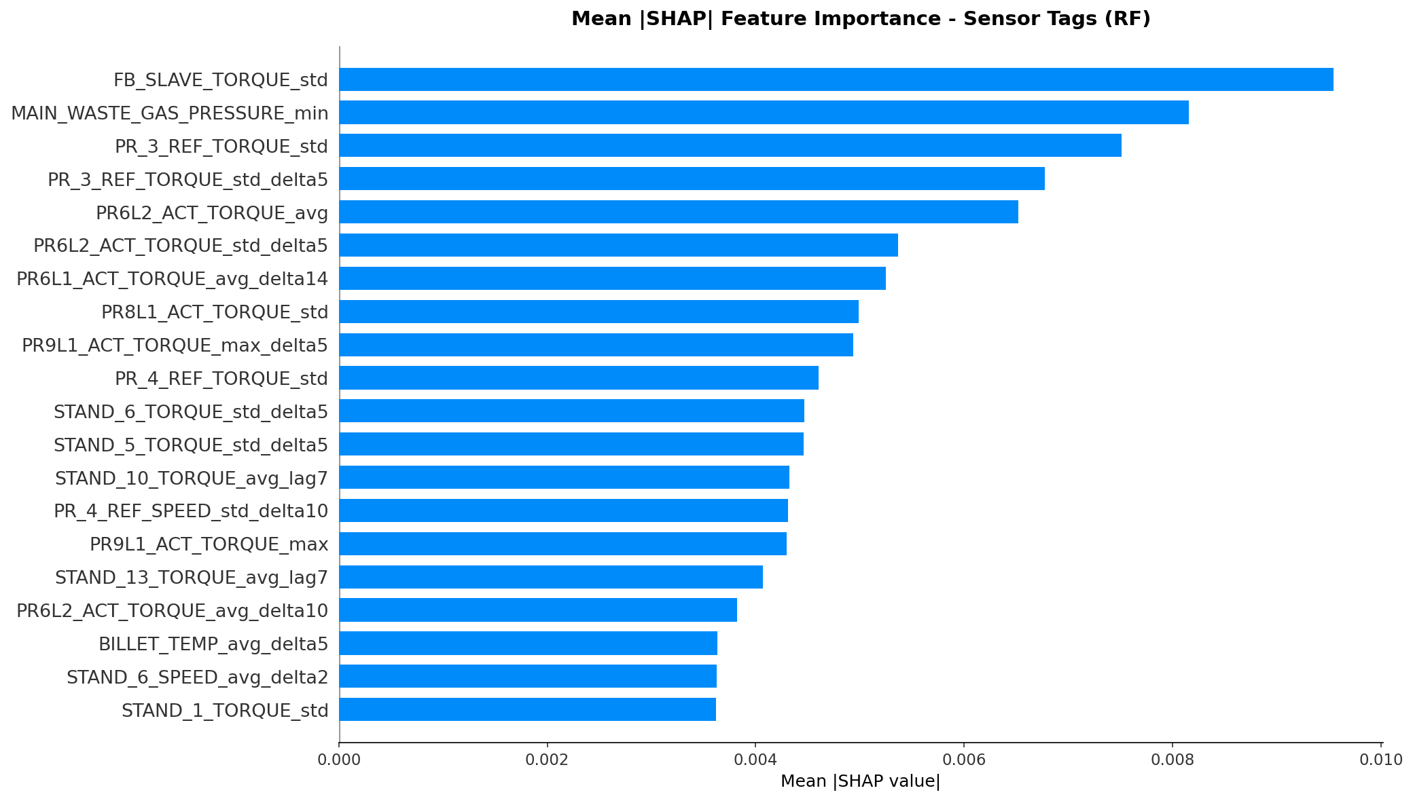
Q5: SHAP — ML Decision Transparency
Sensor tags only (defect features excluded)

Slide 9
Q1+Q2: Causality — Forward vs Reverse
3 forward confirmed + 3 reverse confirmed
Relationship | Direction | Evidence | Verdict
PR3 Torque deficit -> Torsion defect | FORWARD | RUN p=0.000011 OR=15.7 | CONFIRMED
Furnace Pressure drop -> Defect | FORWARD | RUN p=0.000021 All grades consistent | CONFIRMED
TRANS/IDLE state -> Coiling defect | FORWARD | Defect rate 5.5x higher in non-RUN | CONFIRMED
Stand Torque variation -> Defect | REVERSE | RUN: 0.0% gap p=0.259 | Reverse causality
Billet Temp +32.5C -> Defect | REVERSE | Coil-level: p=0.877 | Reverse causality
Furnace Upper Temp -> Defect | REVERSE | Coil-level: p=0.174 | Reverse causality
KEY: RUN filter (normal operation only) is the decisive tool for separating true vs false signals

Slide 10
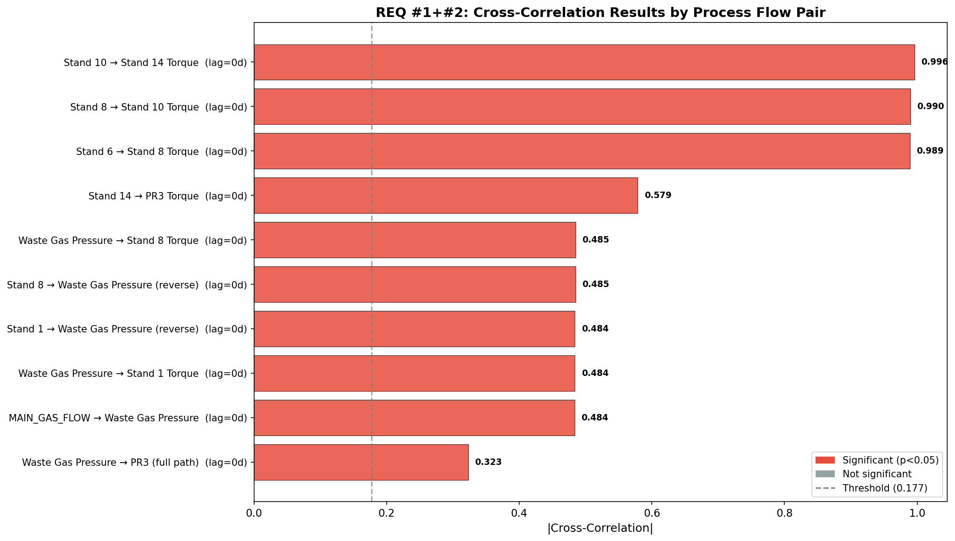
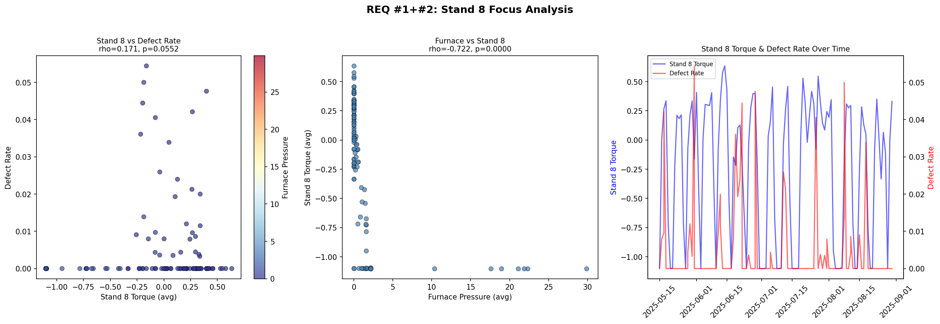
Q1+Q2: Process Flow — Furnace Leads
Stand 8 vs Furnace Pressure: rho = -0.722 (p<0.001)
Stand 8 vs Furnace: rho=-0.722 (p<0.001)
Furnace pressure down -> Stand 8 torque up
Furnace Pressure vs Defect: rho=-0.263 (p=0.003)
Cross-Correlation 10 pairs: all significant
But lag=0 (daily aggregation limitation)
Physical lag estimate: ~1-2 min
Priority actions:
1. Furnace pressure <= 0.48: ALERT (all grades)
2. MAIN_GAS_FLOW management (D4: Gap -75%)
3. PR3 Torque < 10: ALERT (D5-D10)

Slide 11
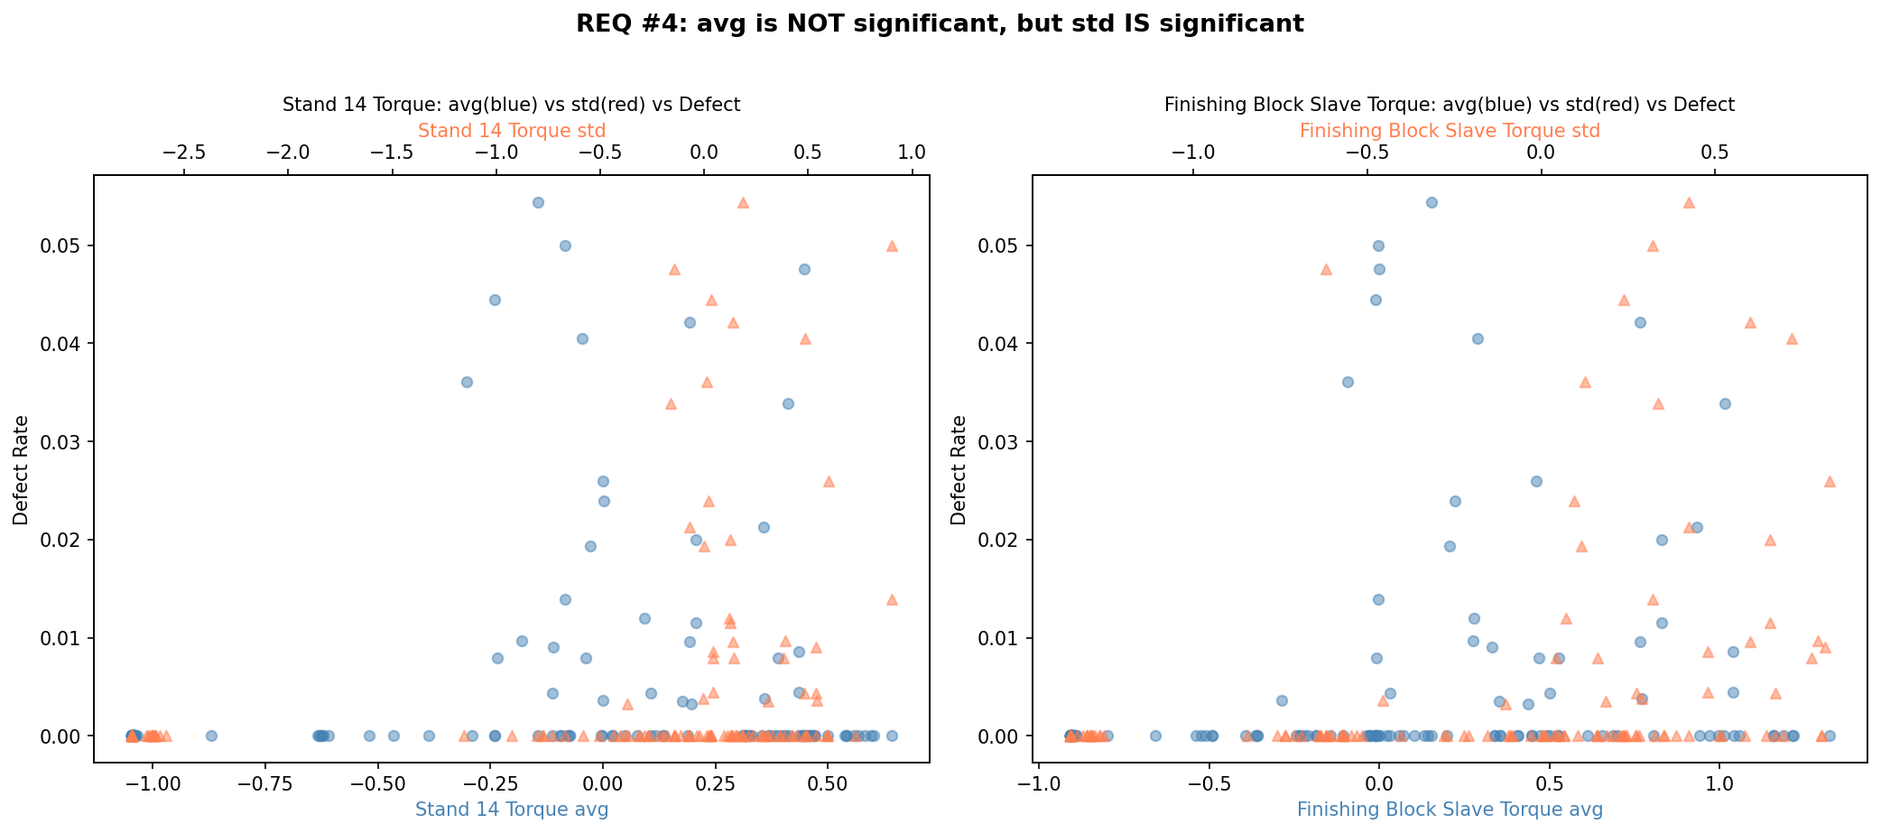
Q4: Stand 14 & Block Mill — avg vs std
"Average is NOT significant, but Variability IS significant"
Tag | avg rho | avg p | std rho | std p | Verdict
Stand14 Torque | 0.087 | n.s. | 0.351 | 0.00005*** | std ONLY
FB Slave Torque | - | - | 0.491 | <0.001*** | ML #1
FB Master Torque | 0.322*** | 0.0002 | 0.491*** | <0.001 | Both
Stand14 Speed | 0.202* | 0.023 | 0.363*** | 0.00003 | std > avg
"Small signal" was because avg was used
Variability (std) = real indicator of instability
FB Slave Torque std = ML #1 + rho=0.491
Previous "weak signal" verdict must be REVISED

Slide 12
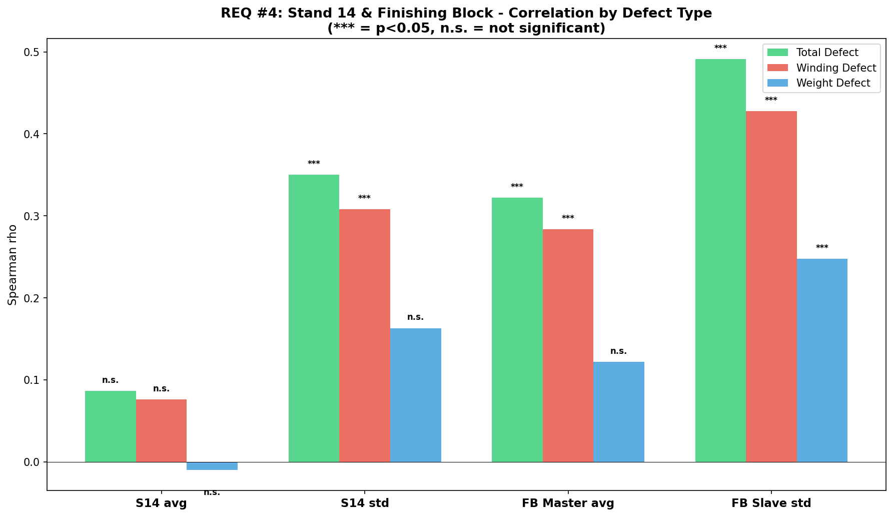
Q4: Defect Type Breakdown — Stand 14 & Block Mill
FB Slave Torque std: significant across ALL defect types

Slide 13
Q3: Management Standards by Grade
Measurement-based (Setpoint data not yet available)
Tag | Grade | Normal (Q10~Q90) | Defect Mean | Gap | Alert
MAIN_GAS_FLOW | D4 | 701~2,680 | 471 | -75.2% | Gas flow drop
MAIN_GAS_FLOW | N5 | 1,191~2,932 | 1,326 | -40.6% | Gas flow drop
PR3 Torque | D5 | 25~100 | 89.8 | +87.6% | Excessive
PR3 Torque | N5 | 35~100 | 72.3 | +41.5% | High
Stand 8 Torque | D4 | 2.7~45.5 | 20.3 | -43.9% | Deficit
Billet Temp | D5 | 1,052~1,156 | 1,094 | +5.0% | Low temp
Setpoint (SP) data needed from MES/Level 2 for true Gap analysis
Current: Alternative B — normal coil Q10~Q90 as provisional standard
Seasonal consideration: only winter (Jan-Feb) data — spring/summer comparison pending

Slide 14
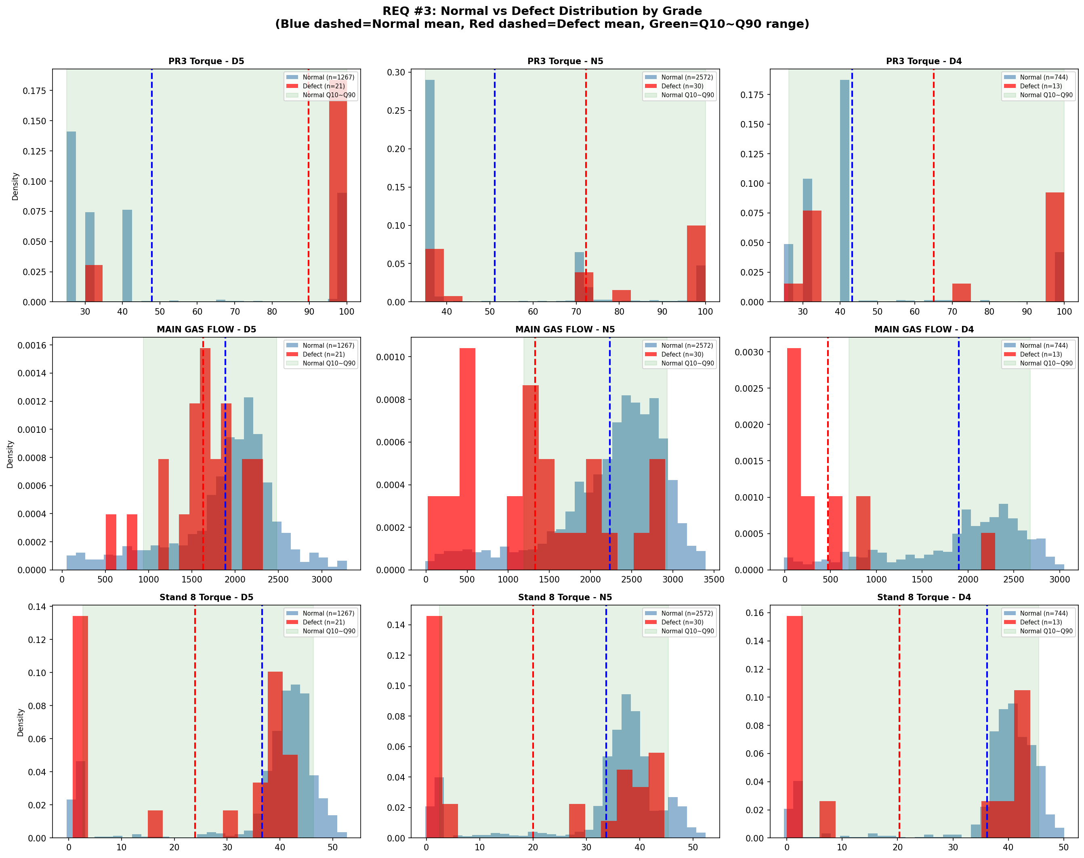
Q3: Normal vs Defect Distribution by Grade
Blue=Normal, Red=Defect, Green band=Q10~Q90

Slide 15
Recommended Actions — Equipment & Tag Priority
Top-5 targets based on Reconciled Ranking
Priority | Equipment | Tag | Standard | Action
1 | Pinchroll PR3 | PR3_REF_TORQUE | 35~100 | Alert when <10 (D5-D10)
2 | Block Mill | FB_SLAVE_TORQUE | 4~61 (D5) | Monitor std variability
3 | Furnace | WASTE_GAS_PRESS | 10.1~35.3 | Alert when <=0.48
4 | Furnace | MAIN_GAS_FLOW | 701~2,680 (D4) | D4: Gap -75% alert
5 | Stand 8 | STAND_8_TORQUE | 0~40 | Furnace propagation
Field confirmation needed:
Specific adjustment methods per equipment (direction, amount)
Responsible personnel and adjustment protocols
Alert system integration
Data collection & system design should also reflect these findings

Slide 16
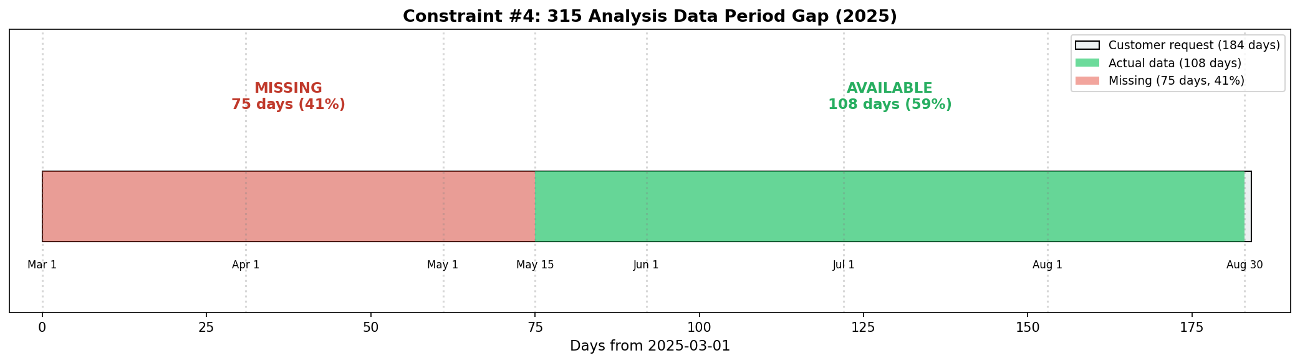
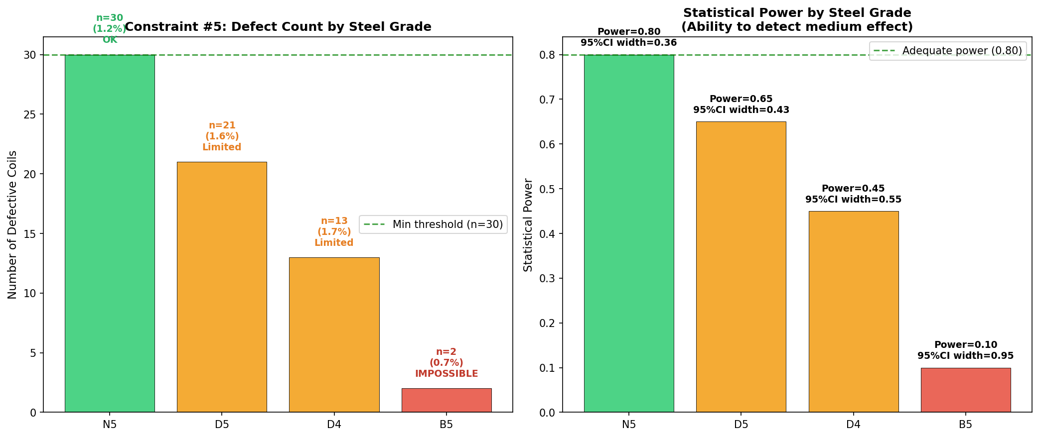
Constraints & Next Steps
Items requiring external data or time
# | Constraint | Severity | Owner | Resolution
1 | OPERATION_STATUS not in CSV | High | Internal | Preprocessing script
2 | Furnace Setpoint data missing | High | FIELD | MES/Level 2 CSV export
3 | 315 analysis: 75 days missing | High | FIELD | Raw data request
4 | B5 grade: only 2 defects | High | - | Exclude + 3-6mo accumulate
5 | Daily lag=0 limitation | Medium | Internal | 1-min CCF (after #1)

Slide 17
Thank You
DH Steel IBA Data Profile — Process-Defect Analysis
2026.03.31

