Slide 1
Optimization Data Analyst
Case Study
$
Patrícia do Nascimento - May 2026

Slide 2
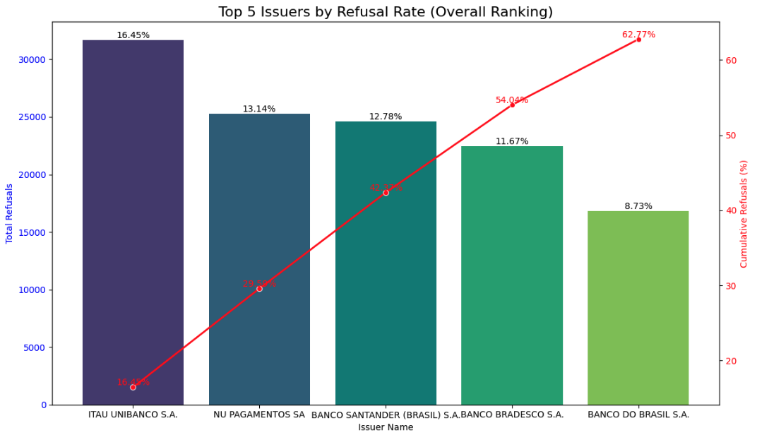
The Baseline
The current state: Platform-wide authorization rate sits at 79.3%.
The false assumption: The bottom 10 worst-performing issuers only account for 13.25% of total rejections.
The real opportunity: 62.7% of all rejections originate from just five major institutions.

Slide 3
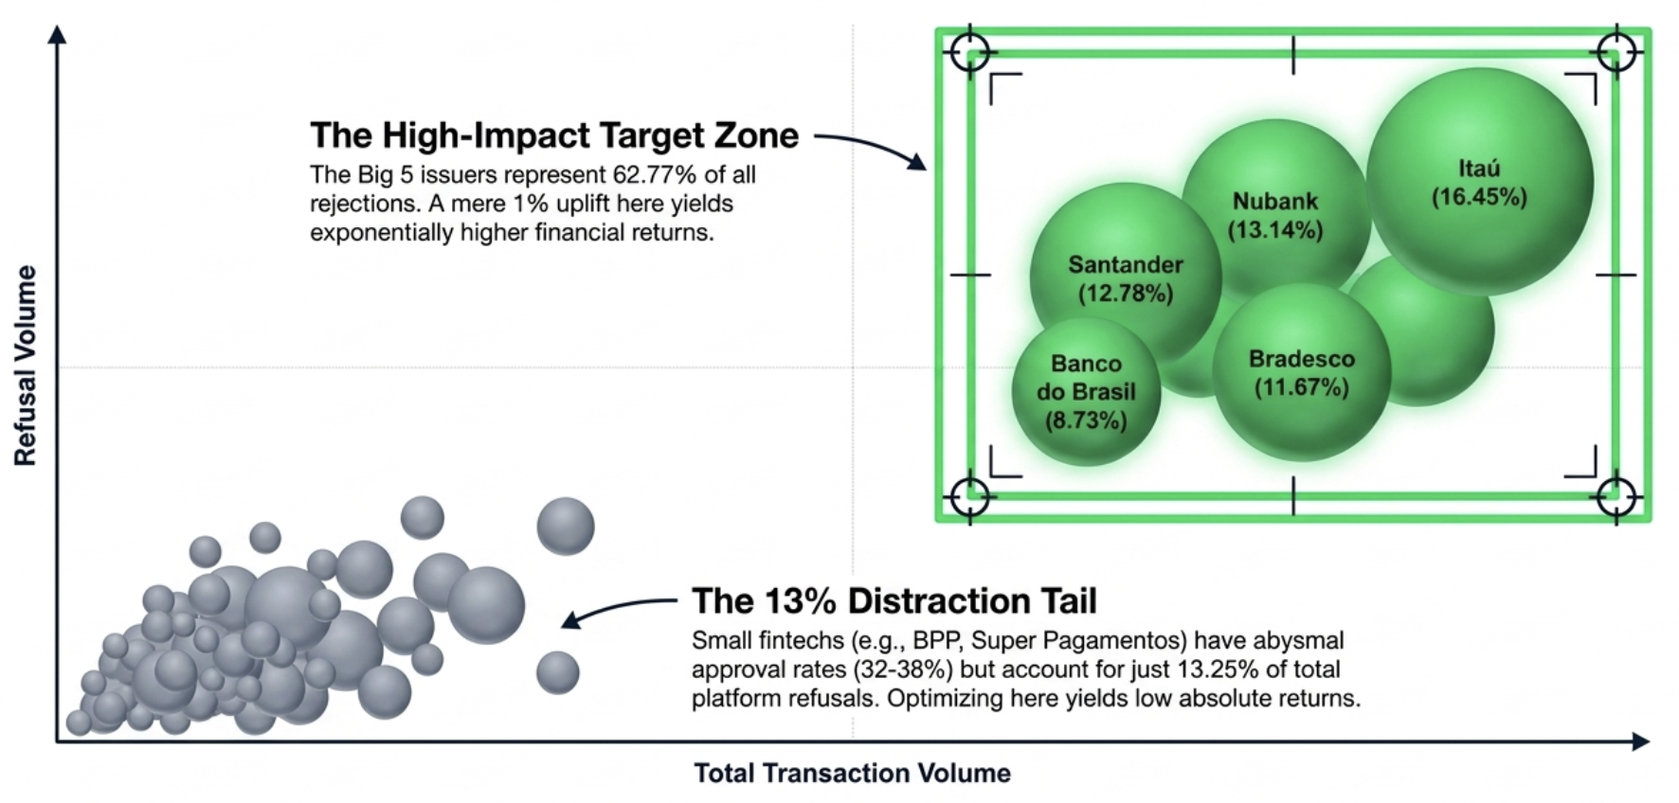
The 80/20: Focus on the Big 5

Slide 4
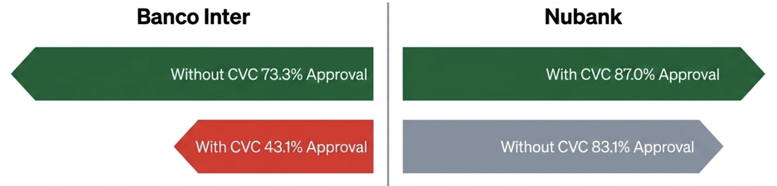
The CVC Paradox
The Industry Norm: Submitting a CVC actually correlates with lower authorization rates for most major banks.
The Nubank Exception: Hypothesis testing (p < 0.05) confirms Nubank actively penalizes transactions missing a CVC.
Static checkout flow leave money on the table. Forcing CVC globally hurts Inter, but making it optional globally hurts Nubank. Dynamic routing is required.

Slide 5
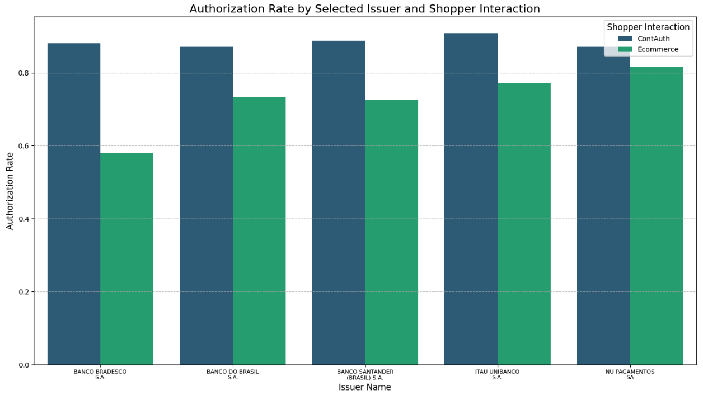
Recurrence as a Signal of Trust
The Finding: ContAuth (recurring/saved card) transactions outperform standard Ecommerce transactions.
The Evidence: Banco Inter jumps from 54% (Ecom) to 74.5% (ContAuth).
Statistical Validation: p < 0.05 confirms issuers inherently trust saved-card network tokens over raw PAN entries.
Converting one-off shoppers to tokenized ConAuth users immediately unlocks double-digit approval lifts for digital banks.
Notes:
PAN Entry: Primary Account Number Entry

Slide 6
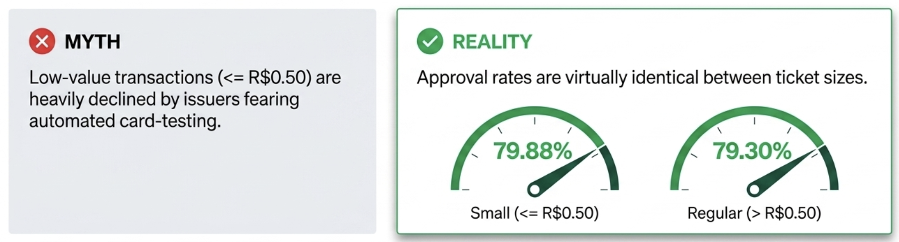
Small Amounts Aren't the Enemy
Statistical Proof: Z-test revealed no statistical evidence (p > 0.05) that small amounts have lower approval rates.
Adyen's upstream fraud systems already catch malicious card-testing. Legitimate micro-transactions should not be unnecessarily penalized by custom merchant rules.

Slide 7
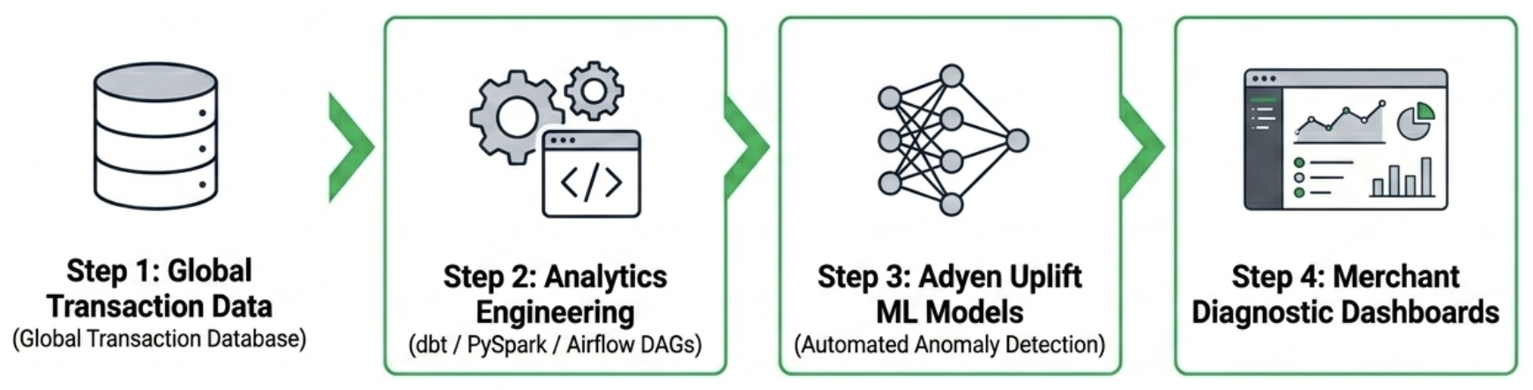
Scaling The Analytics Framework
From Notebook to Pipeline: Convert ad hoc Jupyter analyses into robust data models.
By establishing single-source-of-truth data marts, Commercial teams can instantly generate customized performance diagnostics for any merchant globally.

Slide 8
Recommended Action Plan
Priority | Initiative | Expected Impact | Complexity
🟥High | Dynamic CVC strategy by issuer | Immediate auth uplift | Medium
🟥High | Increase ContAuth/tokenization adoption | Double-digit approval gains | Medium
🟨Medium | Focus optimization on Top 5 issuers | Highest rejection recovery opportunity | Low
⬜Low | Remove unnecessary low-value blocking rules | Reduce false positives | Low
Focus on issuer-specific optimization instead of applying global checkout rules.
Authorization performance is primarily driven by issuer behavior, trust signals, and transaction context.

Slide 9
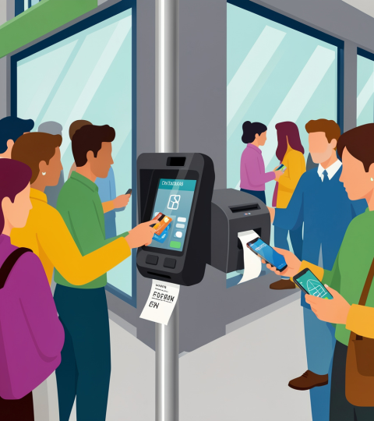
Thank you!

