Slide 1
Exceptions Errors and Data Structures

Slide 2
Exceptions
Throwable
Error
Exception
RuntimeException

Slide 3
Checked vs Unchecked Exceptions
Checked exceptions are those which are caught by your compiler, or at compile time.
If some code with a method throws a checked exception, the method must either handle the exception, or must request that the exception is handled later.
Unchecked exceptions are exceptions that are not checked at compile time. Technically, you do not have to handle them…but you still should!
Runtime exceptions are unchecked exceptions (because the code was able to compile and run).

Slide 4
Anatomy of a Method – Java (Revisit)
Access Mod Non-Access Mod Return Type Name (Parameters) throws declaration { Method Body }
Ex:
private static int sumOddNumbers (int num1, int num2)
throws EvenNumberException {
if (num1 % 2 == 0 || num2 % 2 == 0) {
throw new EvenNumberException(“Input was Even!”);
}
return num1 + num2;
}

Slide 5
Example – Creating Custom Exceptions
Custom Exception can be created by extending the Exception Class, or the Throwable Class.
Typically, this is done by extending the Exception class to provide more structure to the newly created exception.
public class EvenNumberException extends Exception{
public EvenNumberException(String message){
super(message);
}
public EvenNumberException(){}
}

Slide 6
Example – Using Custom Exceptions
public class DoStuff{
public static void main(String[] args){
try{
sumOddNumbers(1,2);
} catch(EvenNumberException ex){
ex.printStackTrace();
} catch(Exception ex){
ex.printStackTrace();
} finally{ // Finally blocks will ALWAYS run}
}
public static int sumOddNumbers(int num1, int num2)throws EvenNumberException{
if(num1 % 2 == 0 || num2 % 2 == 0)
throw new EvenNumberException(“Input is even”);
return num1 + num2;
}
}

Slide 7
Reading Stacktraces
When a Java application throws an exception, it generates a “stacktrace”
A report that traces the method calls that generated the exception back through the application stack.
When an application runs, its instructions are stacked on top of each other, and resolved top-to-bottom.
When the application calls a function, that function is placed “on top of the stack”. The function must be resolved before execution can continue.
Functions can call other functions, etc.

Slide 8
Stacktraces Cont.
public class Test {
public static void main(String[] args) {
mathInvoker(1, 0);
}
public static void mathInvoker(int a, int b) {
division(a, b);
}
public static void division(int a, int b) {
System.out.println("a / b:" + (a / b));
}
}
Exception in thread "main" java.lang.ArithmeticException: / by zero
at samples.Test.division(Test.java:11)
at samples.Test.mathInvoker(Test.java:8)
at samples.Test.main(Test.java:5)

Slide 9
Reading Stacktraces to Debug Code
Exception in thread "main" java.lang.ArithmeticException: / by zero
at samples.Test.division(Test.java:11)
at samples.Test.mathInvoker(Test.java:8)
at samples.Test.main(Test.java:5)
- The exception type (Arithmetic Exception)
- A description of the exception (if possible)
- The method where the exception probably occurred
- The line of code where the exception occurred or where the next function was called
main() invoked mathInvoker() at line 5, which invoked division() at line 8, which generated an exception at line 11.

Slide 10
Stacktrace Considerations
The source of a problem isn’t always where the exception occurs. In the previous example, the source of the error was in the bad data provided in main(), even though the exception occurred in division()
Exception descriptions are not always useful, but generally are
When using some libraries, the actual method invocation that caused the exception could be buried in the stack, as the library continues to put its own function calls on top of the stack after the exception.

Slide 11
Using Stacktraces to Find Help
Copy/paste the first line of a stacktrace into Google will find a solution 9 times out of 10.
Someone else has likely had the same or a similar problem in the past.
This won’t always work if you’re using the newest version of a library or tool. New versions have new ways of breaking, and less support
Stackoverflow is your friend
Remove any proprietary or specific info from the query first. There are not going to be any solutions for org.Revature.myfirstproject.classes.model.MyClass

Slide 12
A Quick Word on Capitalization
Java has standard ‘rules’ about capitalization.
Another developer should be able to identify structures at a glance
SomeExample : class
The first letter of every word is capitalized
someExampleVariableHasThisConvention : variable
The first letter of the first word is lower-case
SomeExample() : constructor
As classes, but with parameter-parenthesis
someExample() : method
As variables, but with parameter-parenthesis
some.example : package
Always lowercase, packages separated by ‘.’
**Package + Class name = “fully qualified class name”

Slide 13
Array Based Structures
We are familiar with arrays- array-based structures simply use an array in the background.
Saving data in particular positions that each have corresponding indices. Then we can modify how these values are accessed if we wrap the array in another class.
Info
Index: 0
Info
Index: 1
Info
Index: 2
Info
Index: 3
Info
Index: 4
Info
Index: 5

Slide 14
Node Based Structures
Stores information in Nodes which may have one or more references to other Nodes.
Remember that any non primitive variable holds a reference, so if you have a variable Node next;
next really holds a reference to a Node object in memory.
Ex:
Info
Info

Slide 15
Simple Node Class
public class Node {
// Data
private Integer data = 0;
// Reference to next node
private Node next = null;
// Constructors
public Node(Integer data) {
this.data = data;
}
public Integer getData() { return data; }
public void setData(Integer data) { this.data = data; }
public Node getNext() { return next; }
public void setNext(Node next) { this.next = next; }
@Override
public String toString() {
return "Node: data ="+this.data;
}
}
We could structure this Node differently if we wanted to support a different data structure.

Slide 16
Stack
Many data structures can be supported differently with either nodes or arrays behind the scenes – for example:
public class ArrayStack {
private int[] stack = new int[5];
private int lastElementIndex = 0;
public void push(int element) {
if(lastElementIndex >= stack.length) {
int[] newStack = new int[stack.length*2];
for(int j = 0; j<stack.length; j++) {
newStack[j] = stack[j];
}
stack = newStack;
}
stack[lastElementIndex] = element;
lastElementIndex++;
}
public Integer pop() {
if (lastElementIndex> 0)
return stack[--lastElementIndex];
else
return null;
}
public int peek() {
return stack[lastElementIndex-1];
}
}
public class Stack {
Node top;
public void push(int element) {
Node node = new Node(element);
push(node);
}
public void push(Node node) {
node.setNext(top);
top = node;
}
public Node pop() {
Node poppedNode = top;
top = top.getNext();
poppedNode.setNext(null);
return poppedNode;
}
public Node peek() {
return top;
}
}

Slide 17
The Collection Interface
The Collection interface defines a set of behaviors common to all collections in Java
Except Maps…
https://docs.oracle.com/javase/8/docs/api/java/util/Collection.html
Collection-interface-collections can are generally different types of Lists, Sets, and Queues
List, Set, and Queue are their own interfaces as well

Slide 18
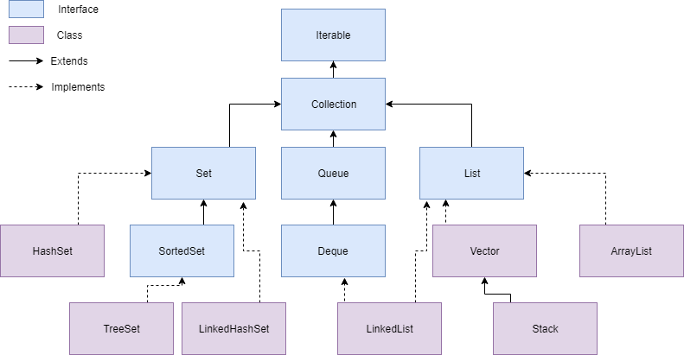
Collection Hierarchy

Slide 19
Collection Interface
Iterable – Everything can be “iterated through”. i.e. you can look at data within these items, one by one.
Collection – An Interface in Java that provides an architecture to store and manipulate objects
Set – A collection which cannot contain duplicate elements.
HashSet, LinkedHashSet, SortedSet
Queue – An ordered collection of objects which utilizes a First-in-first-out principle.
Priority Queue, Deque
List – An ordered collection of objects which utilizes indexes.
ArrayList, Vector, LinkedList

Slide 20
Lists
*ArrayList
Implementation of List interface that uses a dynamic array to store elements.
Not synchronized.
Vector
Similar to ArrayList; however, it is synchronized.
*Stack
Implementation of a Vector that processes data in a last-in, first-out order, like a stack of dinner plates.
*LinkedList
Implementation of the List interface that uses a doubly linked list to store the elements.
Lists use the add() method to add new information to the list, and the remove() method to remove information.

Slide 21
Sets
*HashSet
Algorithmically* hashes** data to store information. Uses a HashTable as it’s underlying data storage
LinkedHashSet
Similar to HashSet, however is stores data using a HashTable and a doubly linked list to maintain insertion order of elements.
SortedSet
Stores elements and sorts them based on natural ordering or the implementation of the Comparable interface of the elements in the collection.
Sets also use the add() method to add new information to the set, and the remove() method to remove information.
*An algorithm is simply a fancy way of saying “A step-by-step approach to solve a problem”.
**Hashing is the process of converting any information into numerical representation.

Slide 22
Queue
Dequeue
A collection where both the “front” and “back” support insertion and removal. Allowing it to be used as a list and stack simultaneously.
Priority Queue
A collection that removes elements based on sorted priority that is based on natural ordering or the implementation of the Comparator interface for the elements in the collection.
Queues use the add() method to add new information to the queue, and can use the poll() method to retrieve the top element of the queue and remove it

