Slide 1
Jumping
Pathum Egodawatta

Slide 2
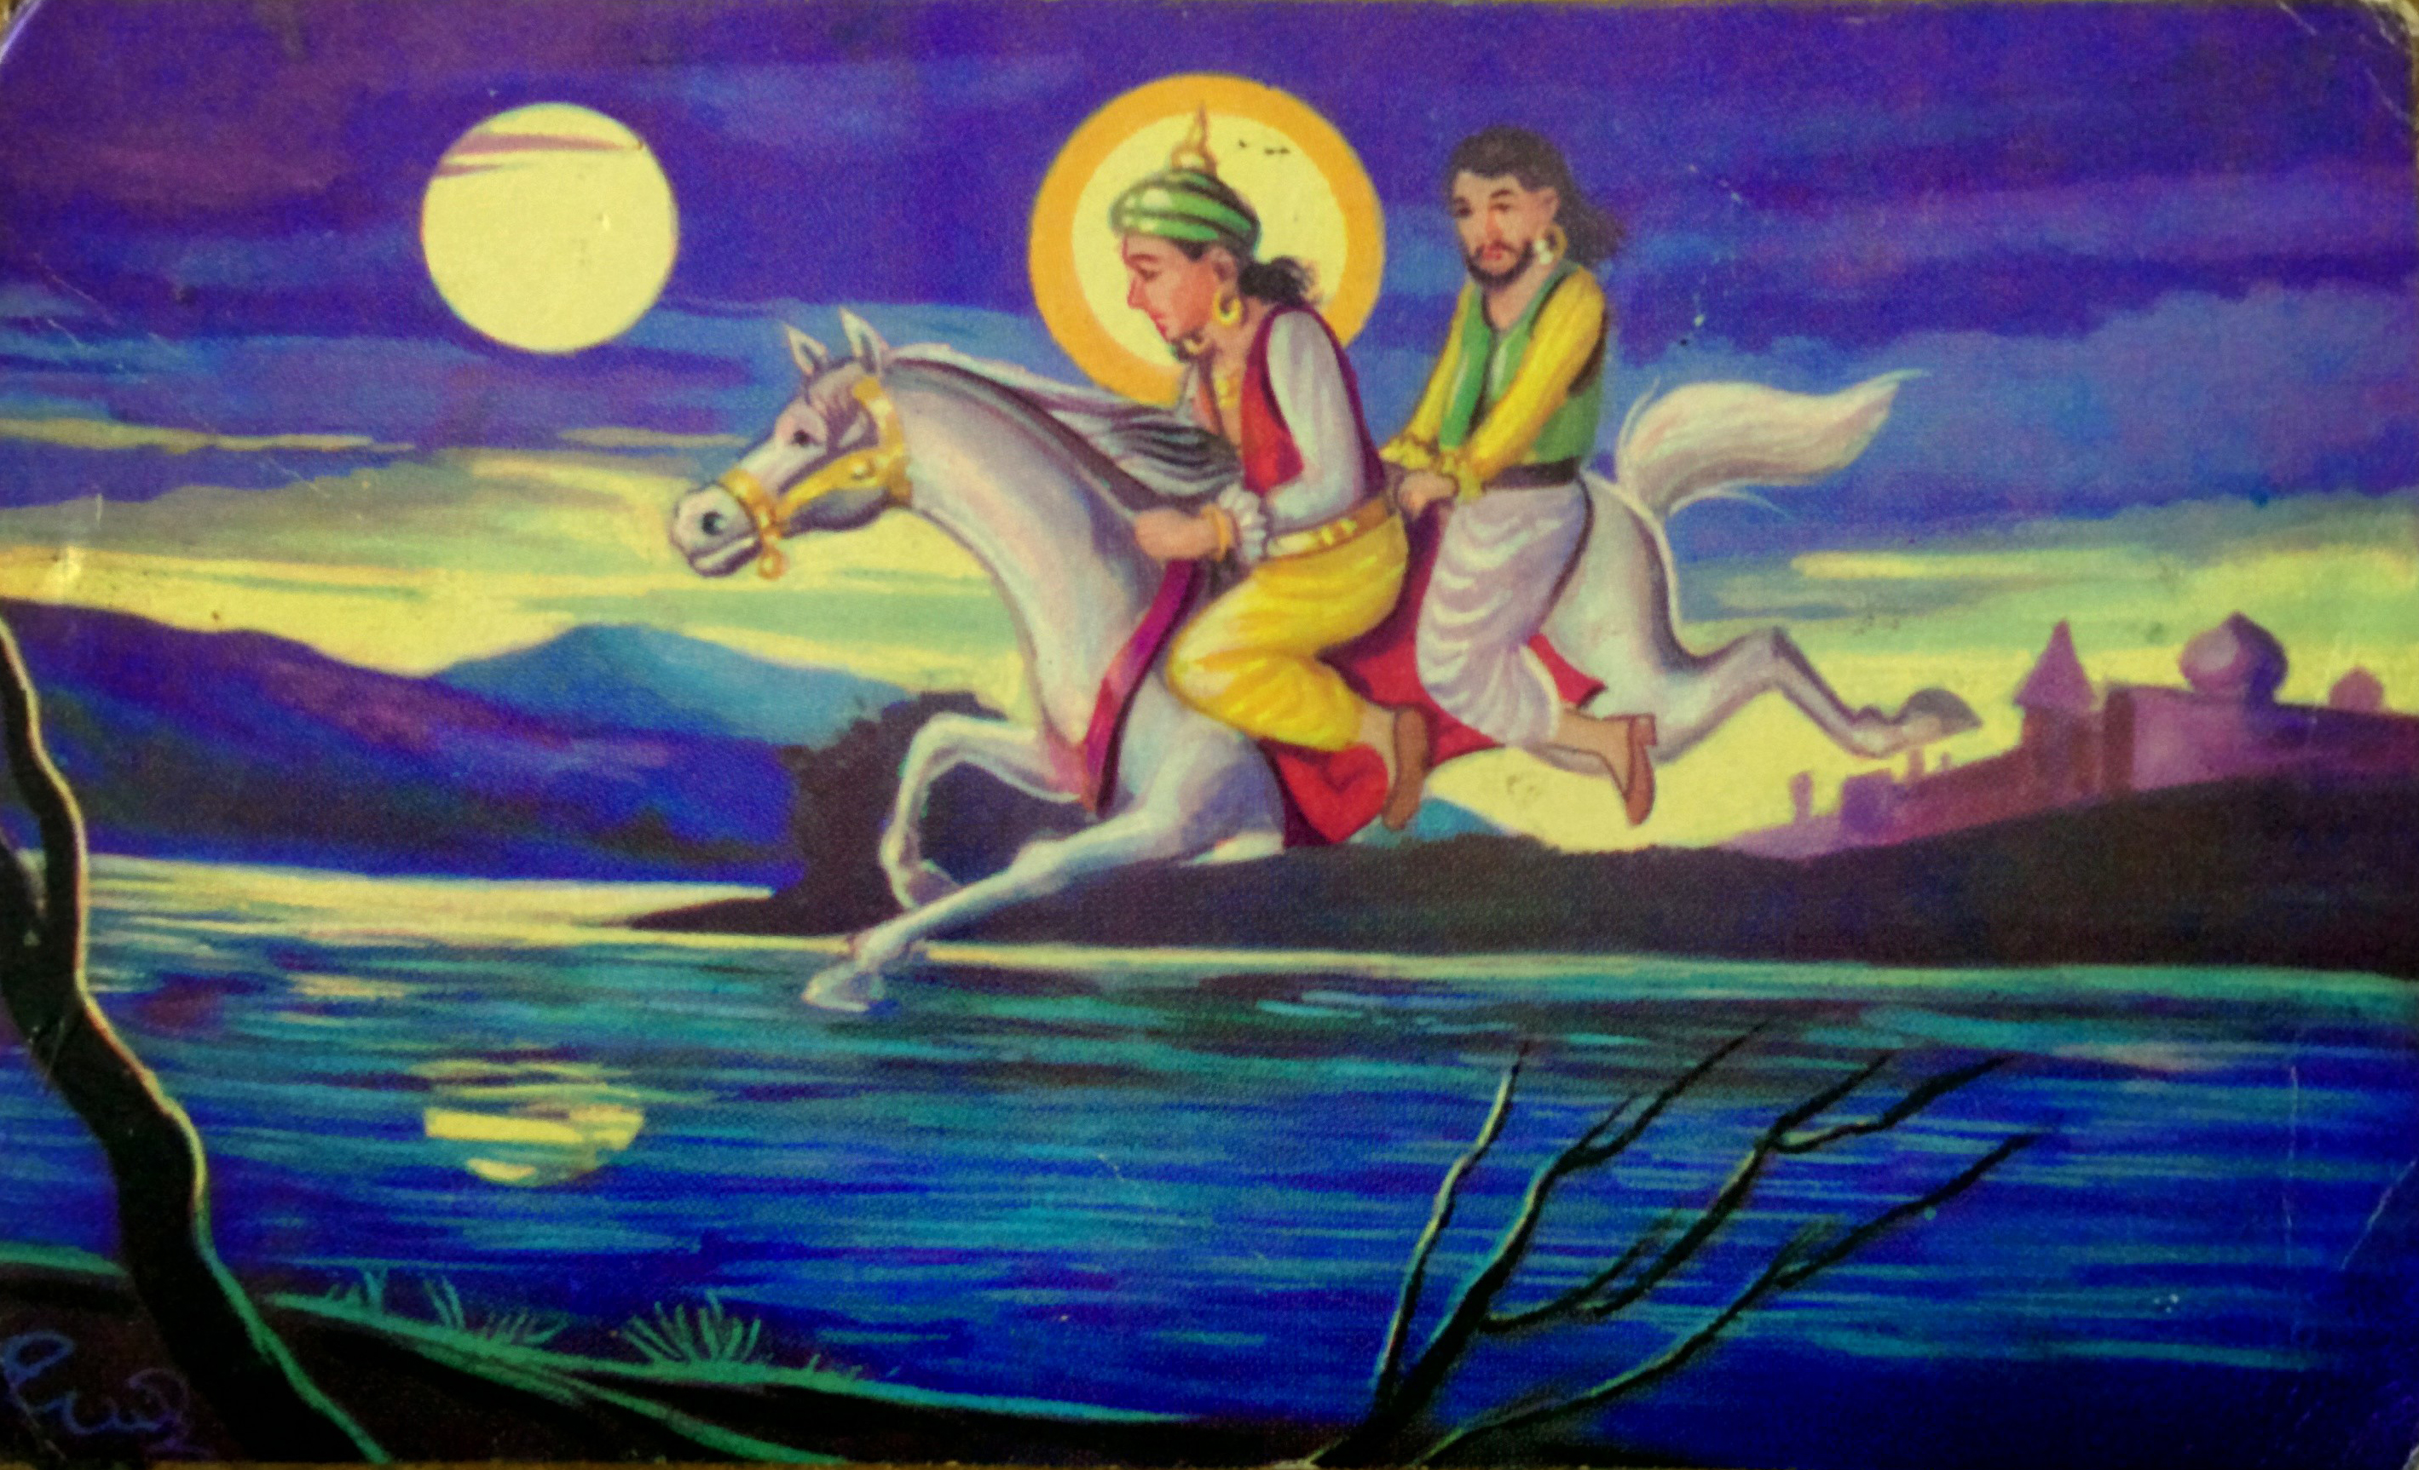
Jumping

Slide 3
The Illusion
Never be unhappy aka 'its perfect'

Slide 5
CoralDraw
'the industry standard'

Slide 6
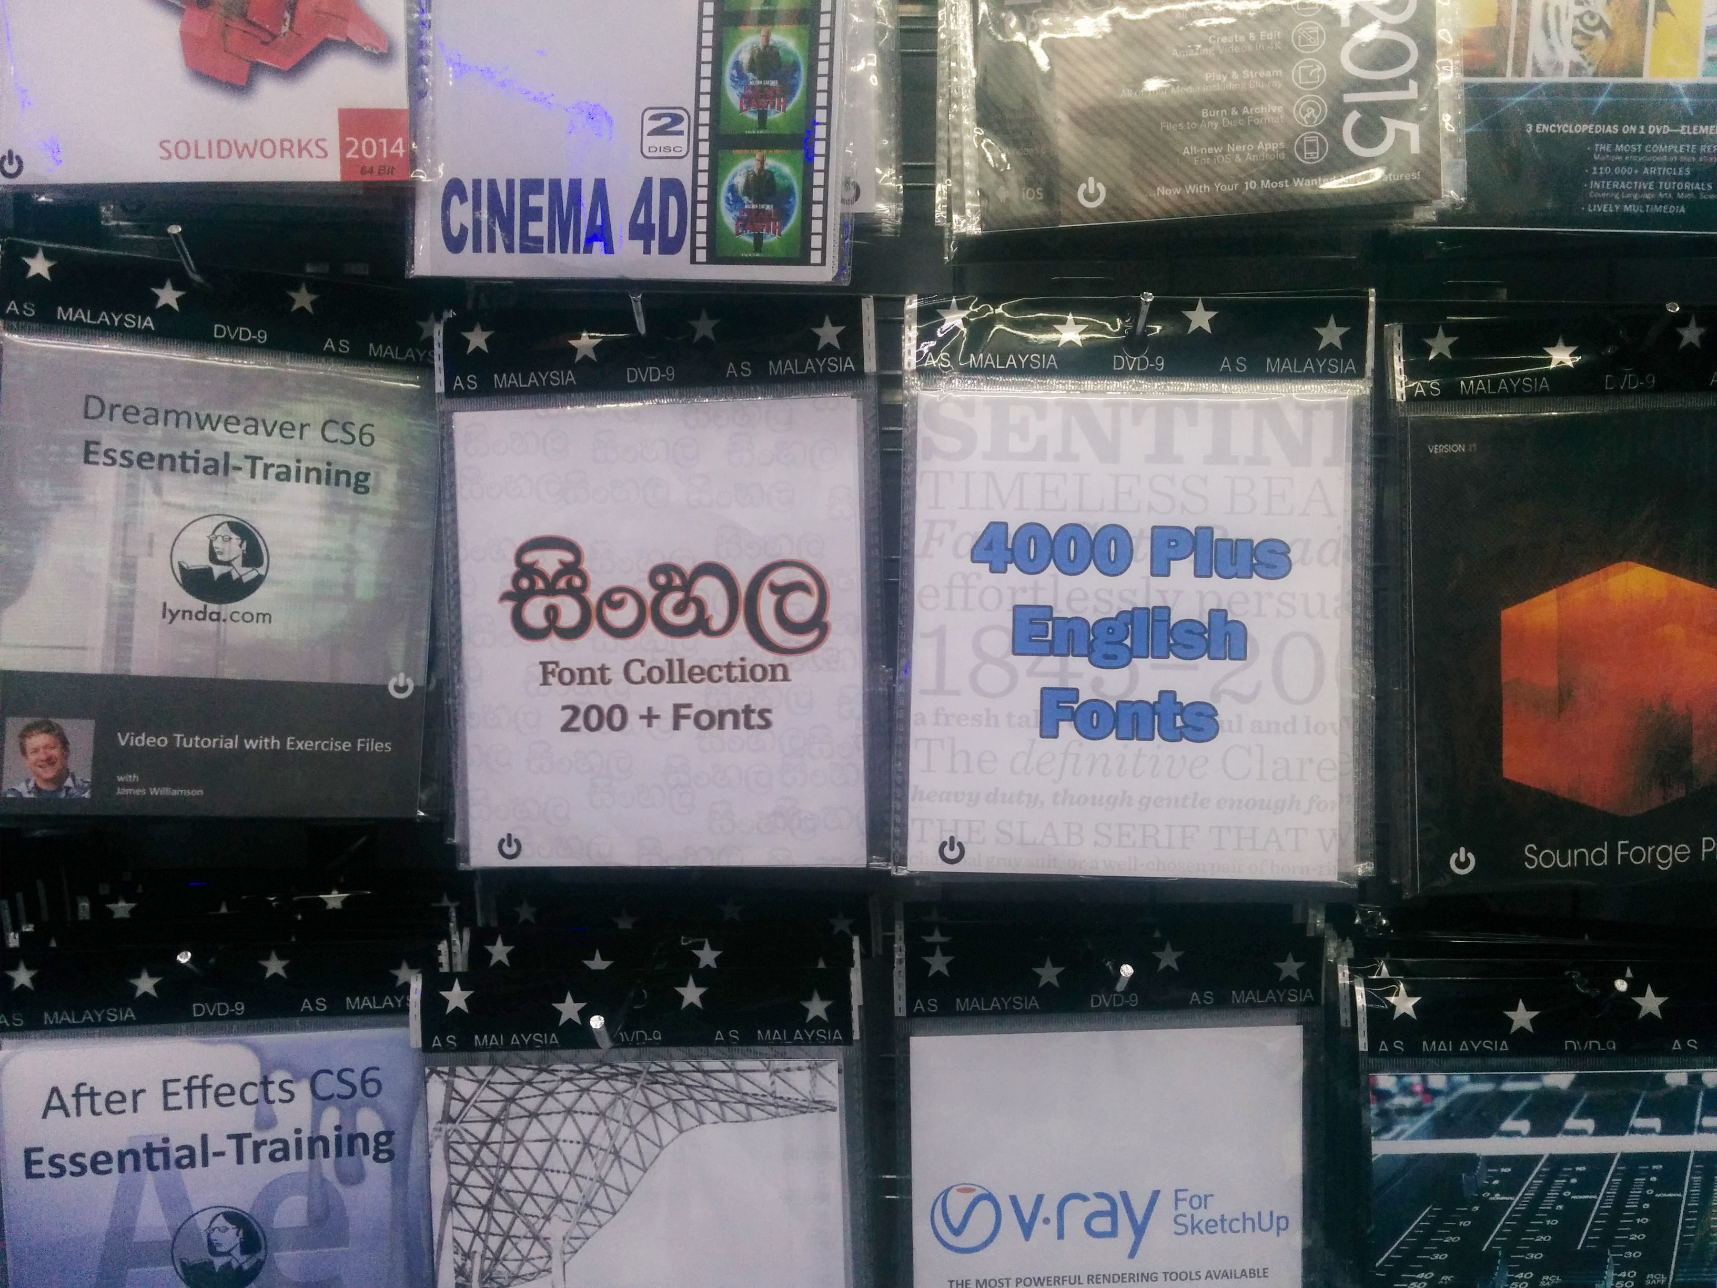

Slide 7
The Encounters
Signs aka 'Finding Inkscape'

Slide 8
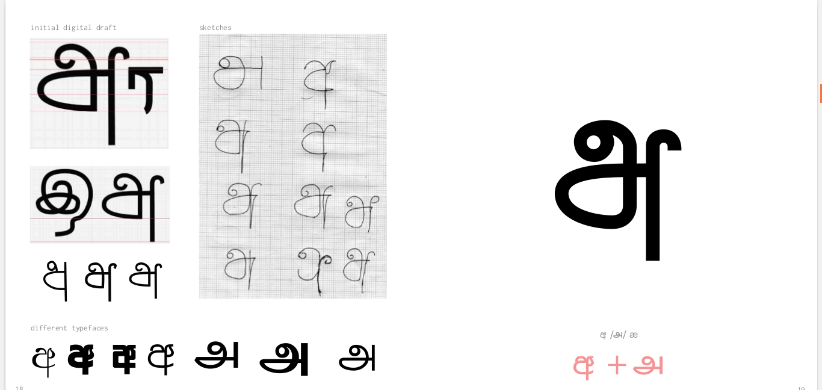

Slide 9
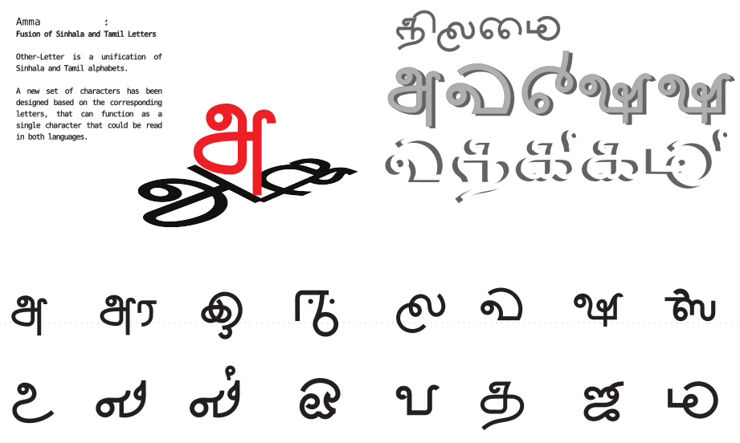

Slide 10
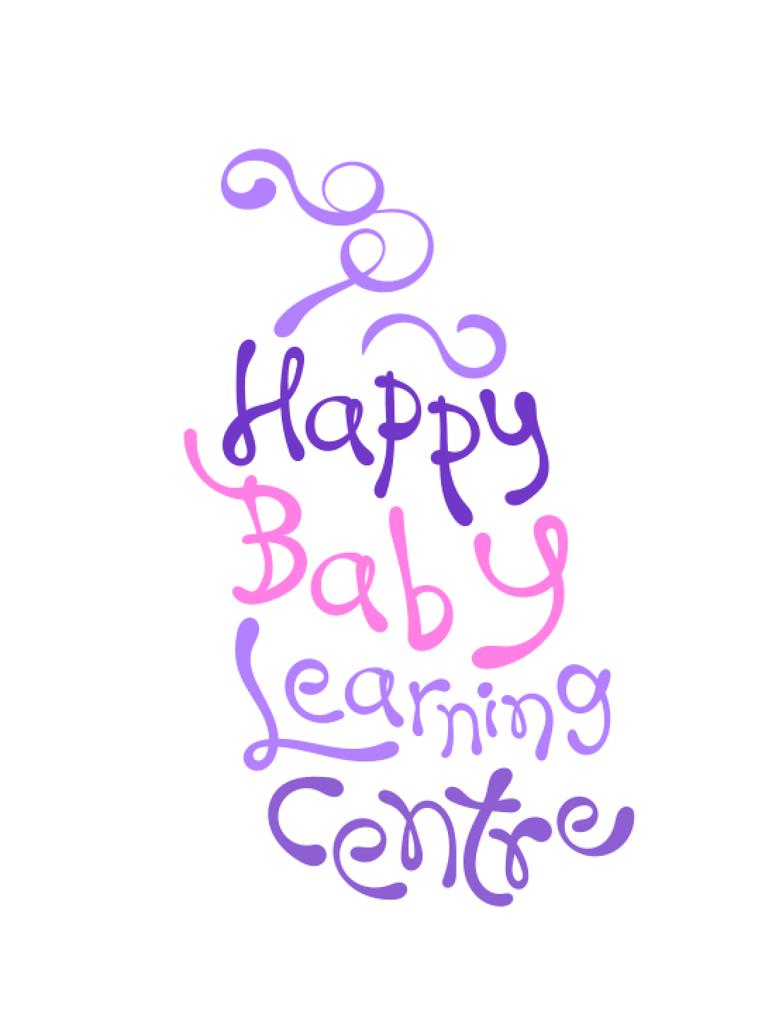
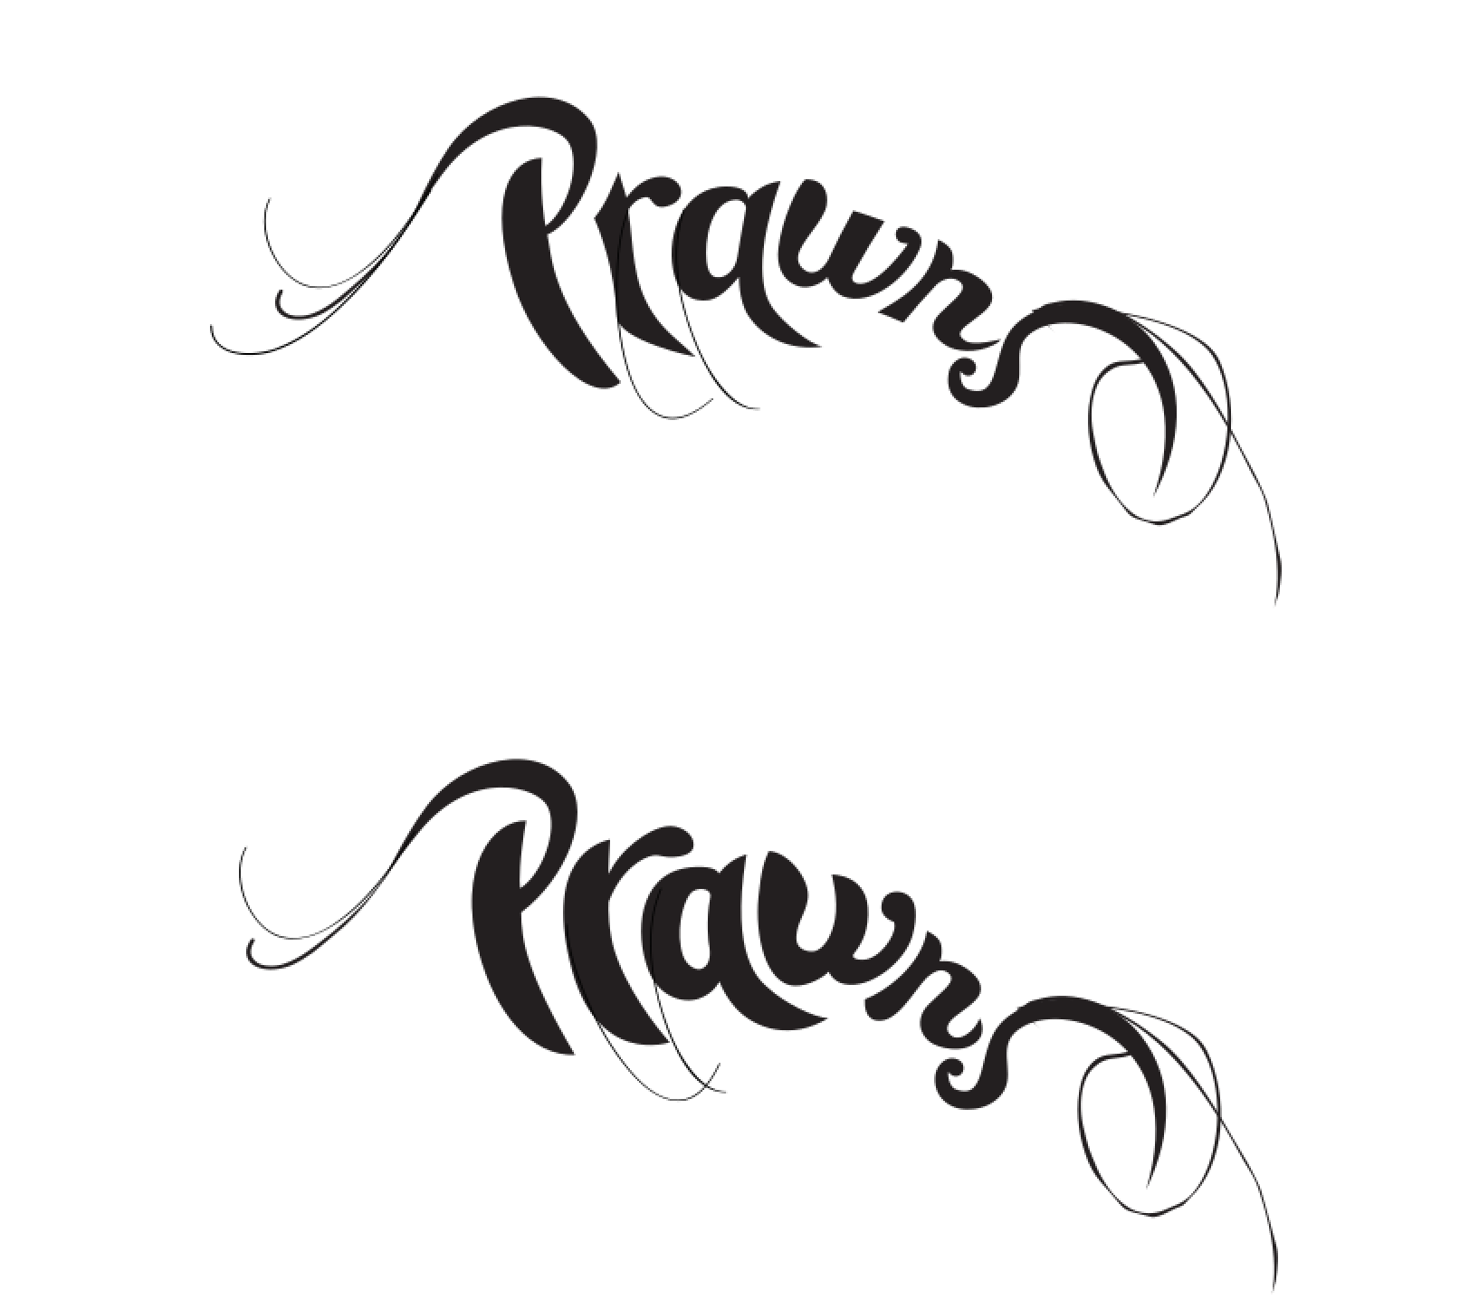

Slide 11
The Doubts
New horizons aka 'WTF Gimp'

Slide 12
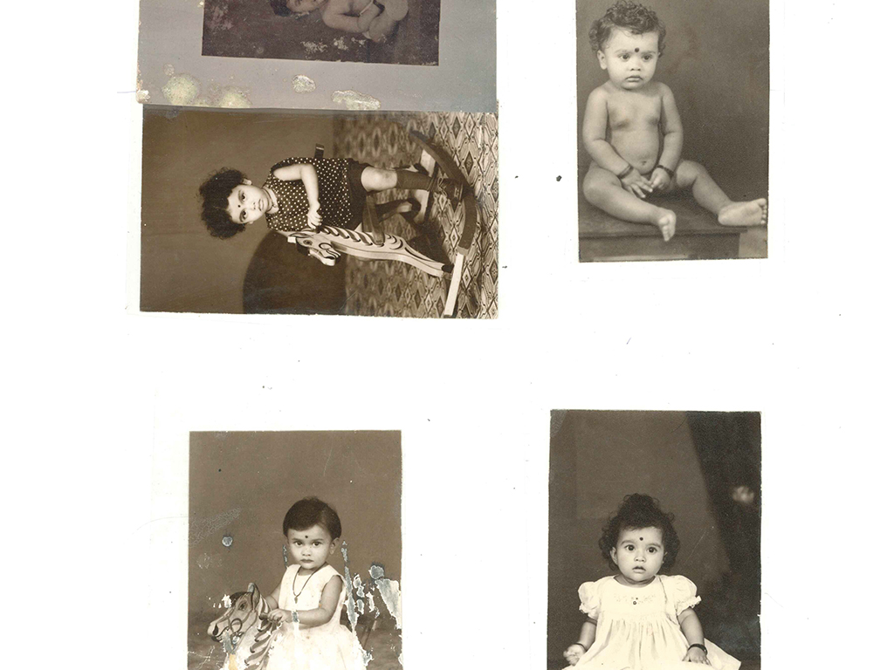

Slide 13
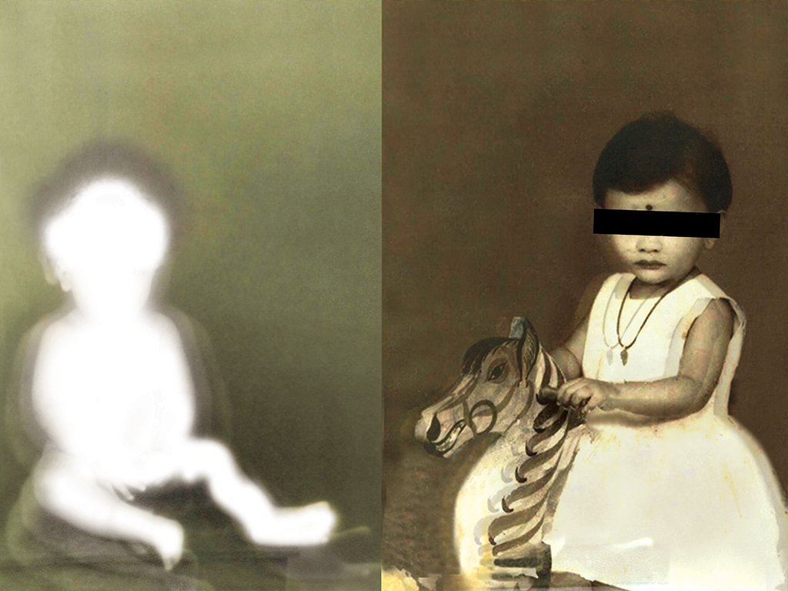

Slide 14
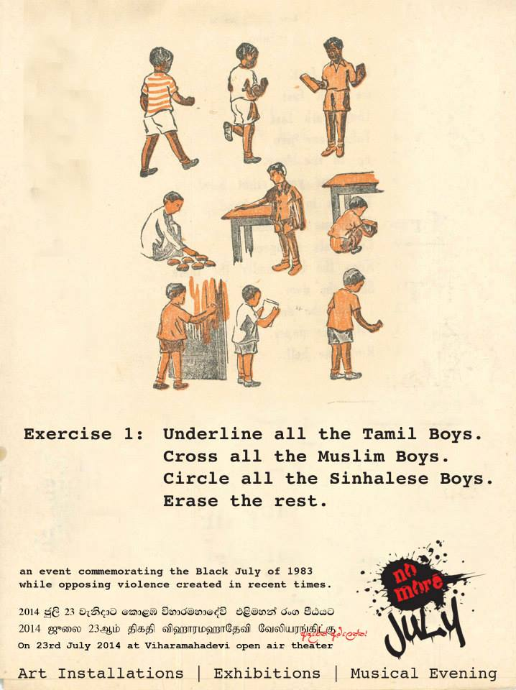
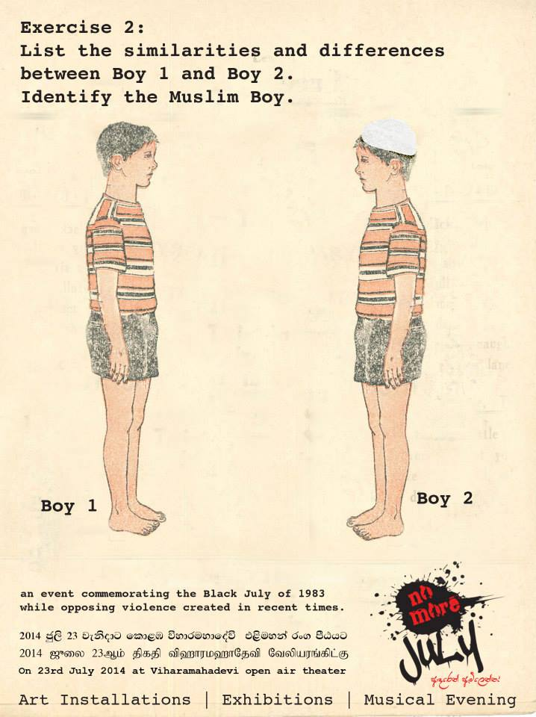

Slide 15
Austerities
The different schools of suffering aka
'Why there is not just one way'

Slide 16
The suffering
Different builds
Build my own
Experimental??
Which Linux

Slide 17
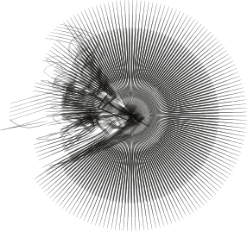
mooniak.com

Slide 18
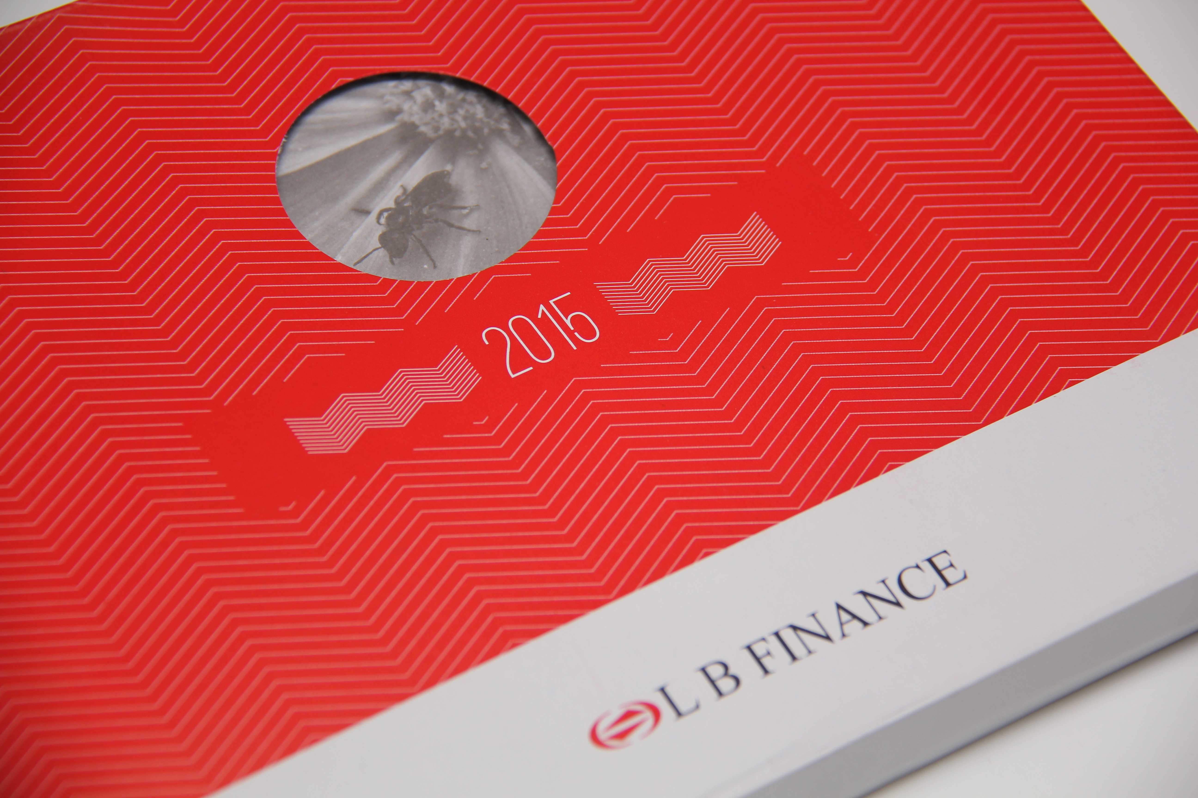

Slide 19
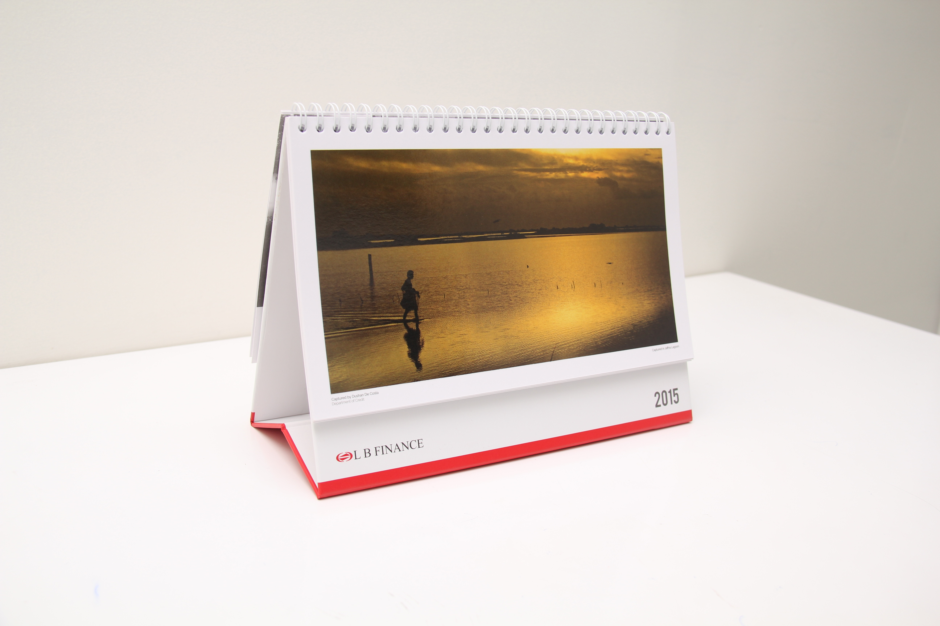

Slide 20
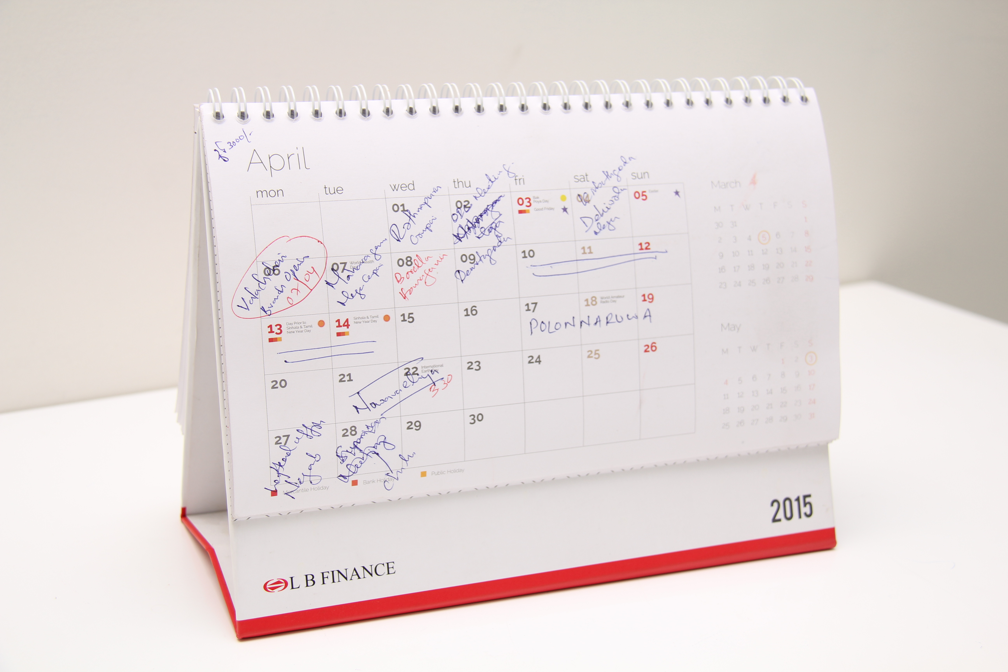

Slide 21
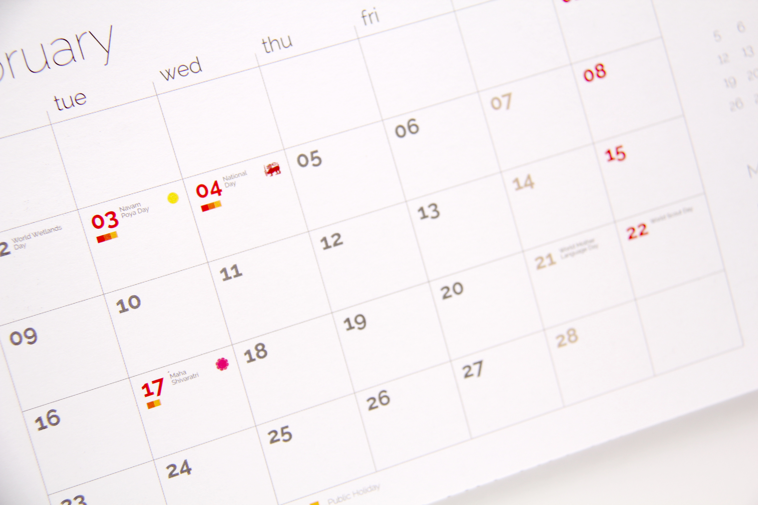

Slide 22
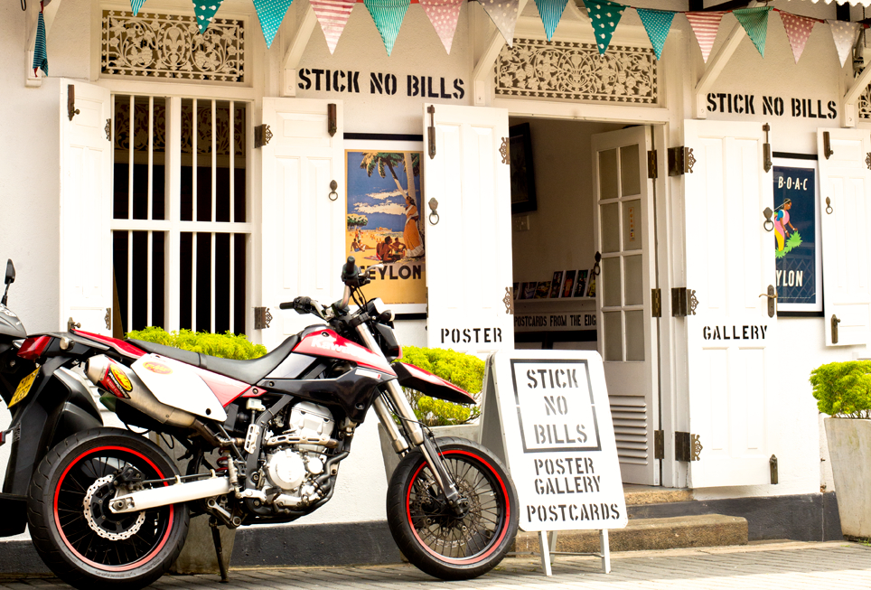

Slide 23
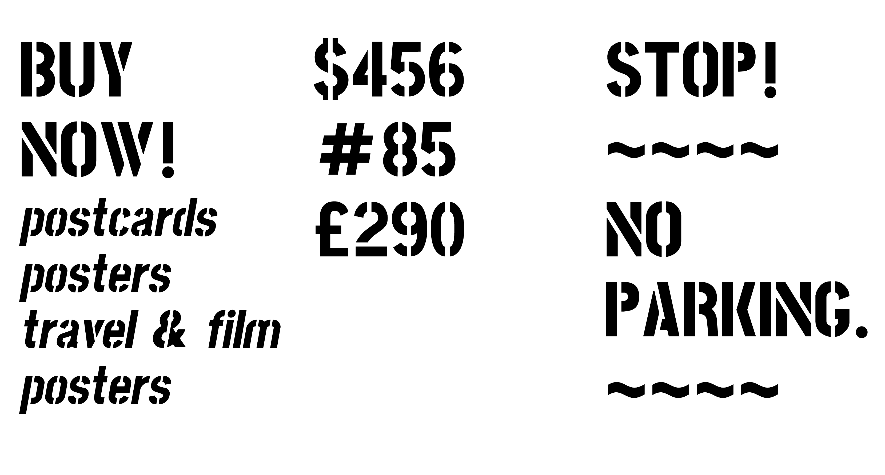

Slide 24
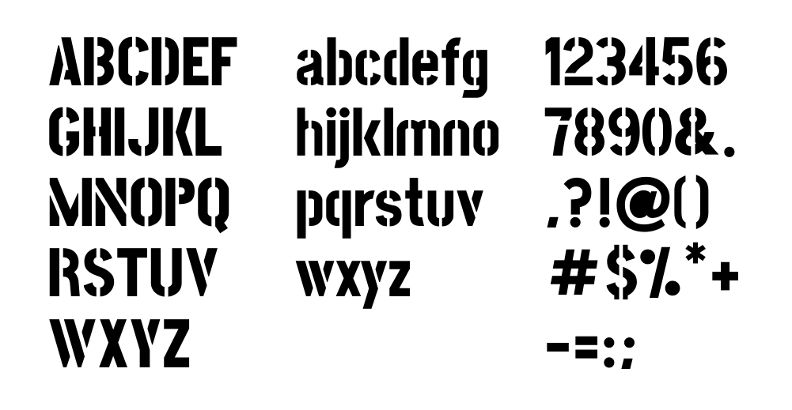

Slide 25
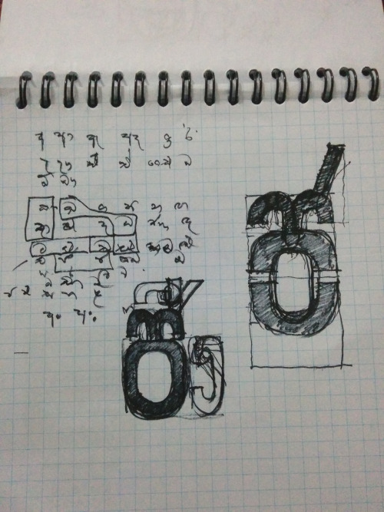
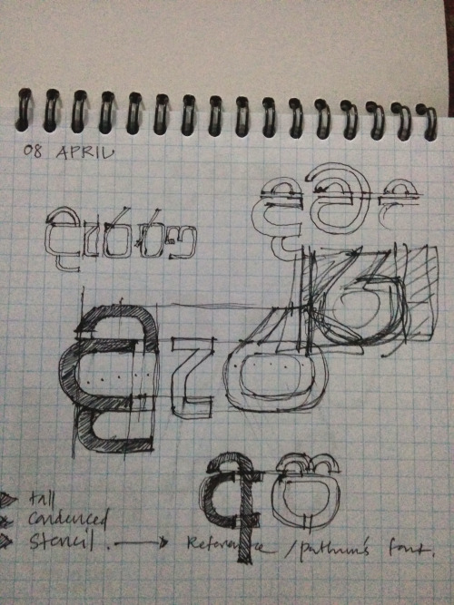

Slide 26
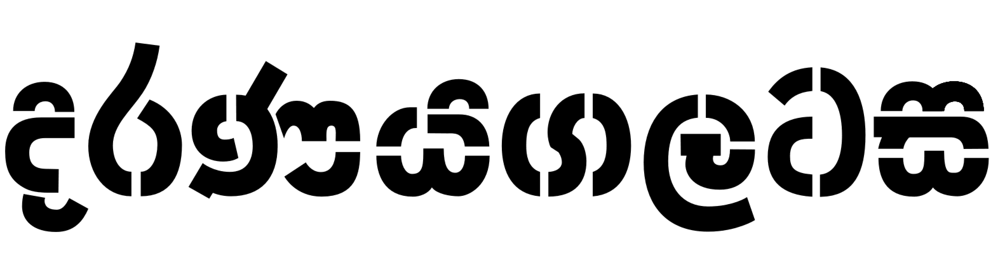

Slide 27
The Conversions
Join my faith aka 'Try this dude!'

Slide 28
Software
Stock Images
ClipArt / Icons
Fonts

Slide 29
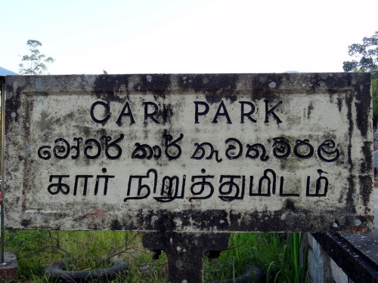
Found
Type
Lanka
foundtypelanka.tumblr.com

Slide 30
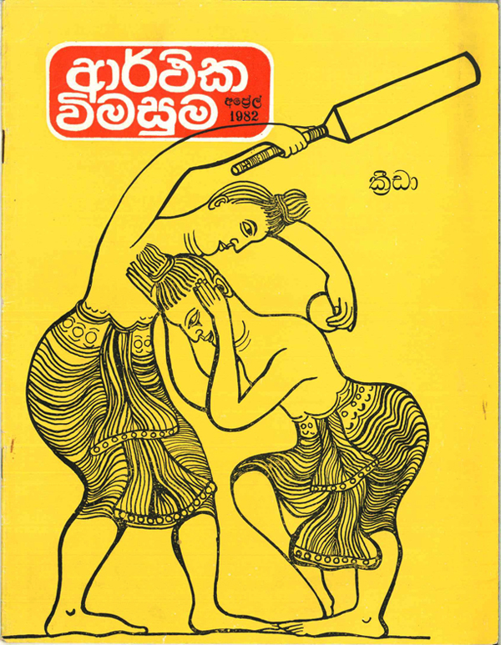
Ceylon Display
ceylondisplay.com

Slide 31
Real Jump

Slide 32
The Path to Enlightenment
Find your own path aka 'Contribute!!!'

Slide 33
FontForge
Improve Initiation easy
Documentation translation
Reporting

Slide 34
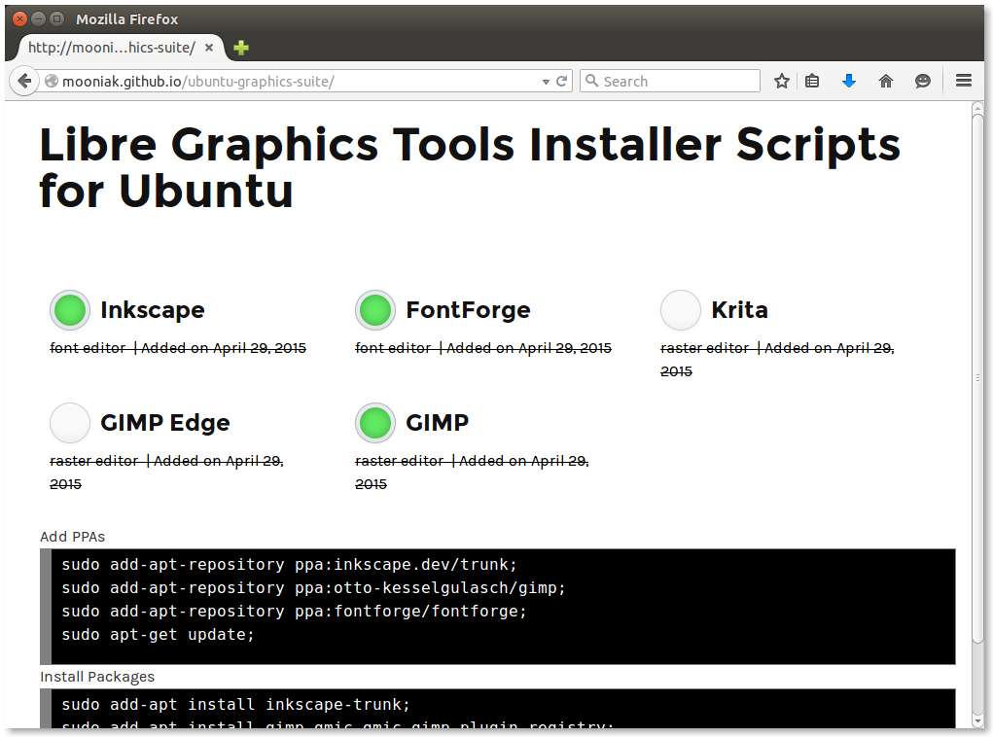

Slide 35
A word about here...

Slide 36
Industry
- Stuck with old DTP fonts
- Depends on CoralDraw / Adobe
- Contributors might be there

Slide 37
Sri Lanka:
Highest number of GSoC Participants
265 Student over 9 year
http://google-opensource.blogspot.com/2012/04/moratuwa-sri-lanka-google-summer-of.html

Slide 38
Sri Lanka:
Sahana
FOSS Disaster Management tools project
http://sahanafoundation.org/about-us/history/

Slide 39
Time is a bit cheaper over there..

Slide 40
animager animate

Slide 41
mooniak.com github.com/mooniak
@pathumego pathumego.github.io

