Slide 1
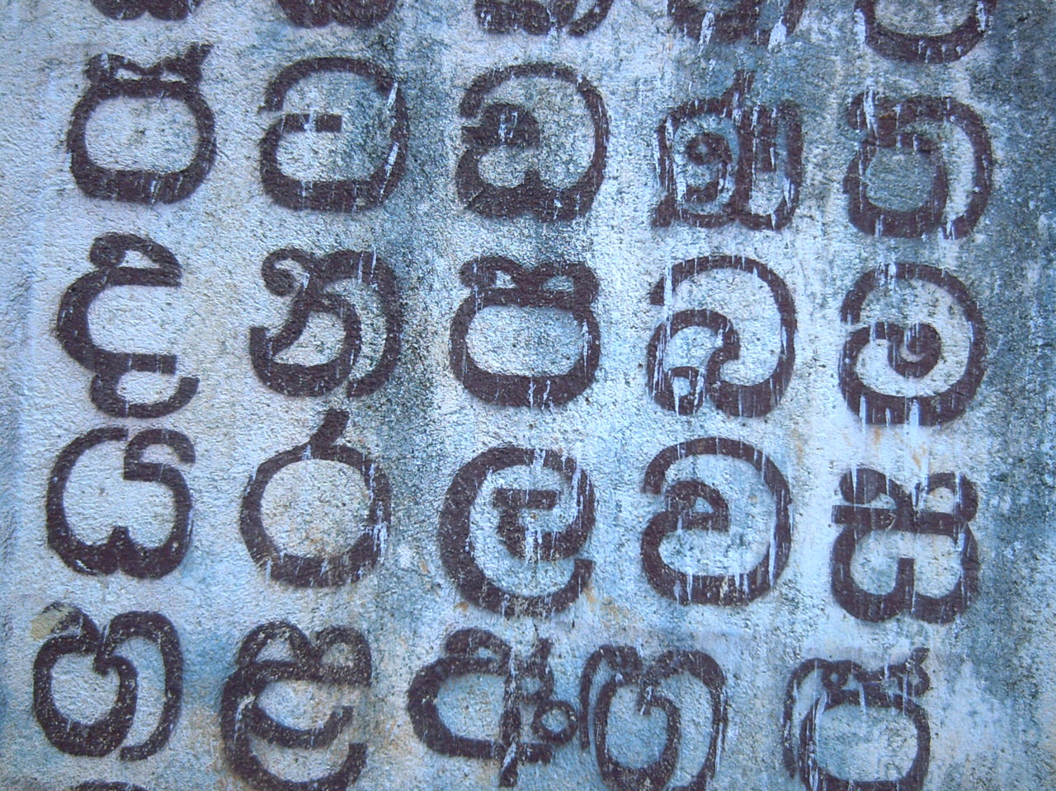
Which Sinhala Fonts
Do Users Love To Read On Screen?
Pathum Egodawatta, Sri Lanka

Slide 2
An obvious story about the
Type preferences of the common man....

Slide 3
First,
Relationship of Type and the Society

Slide 4
What we have seen so far....

Slide 5
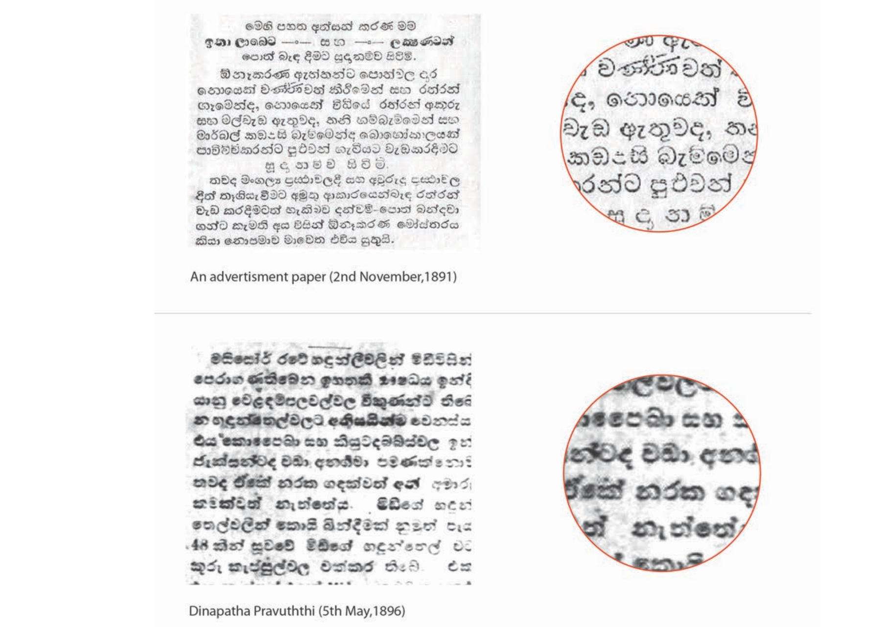

Slide 6
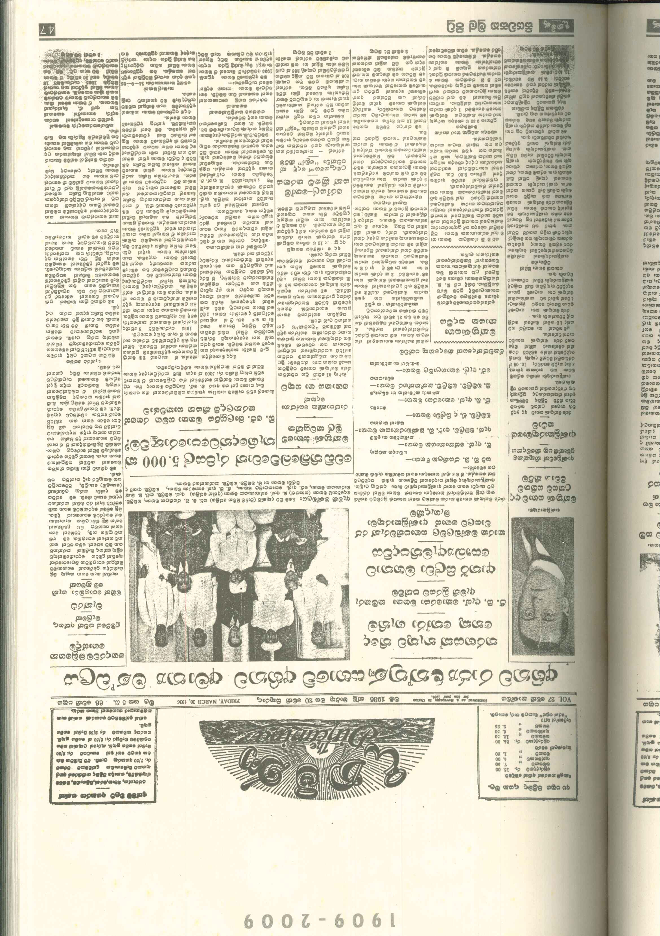
==

Slide 7
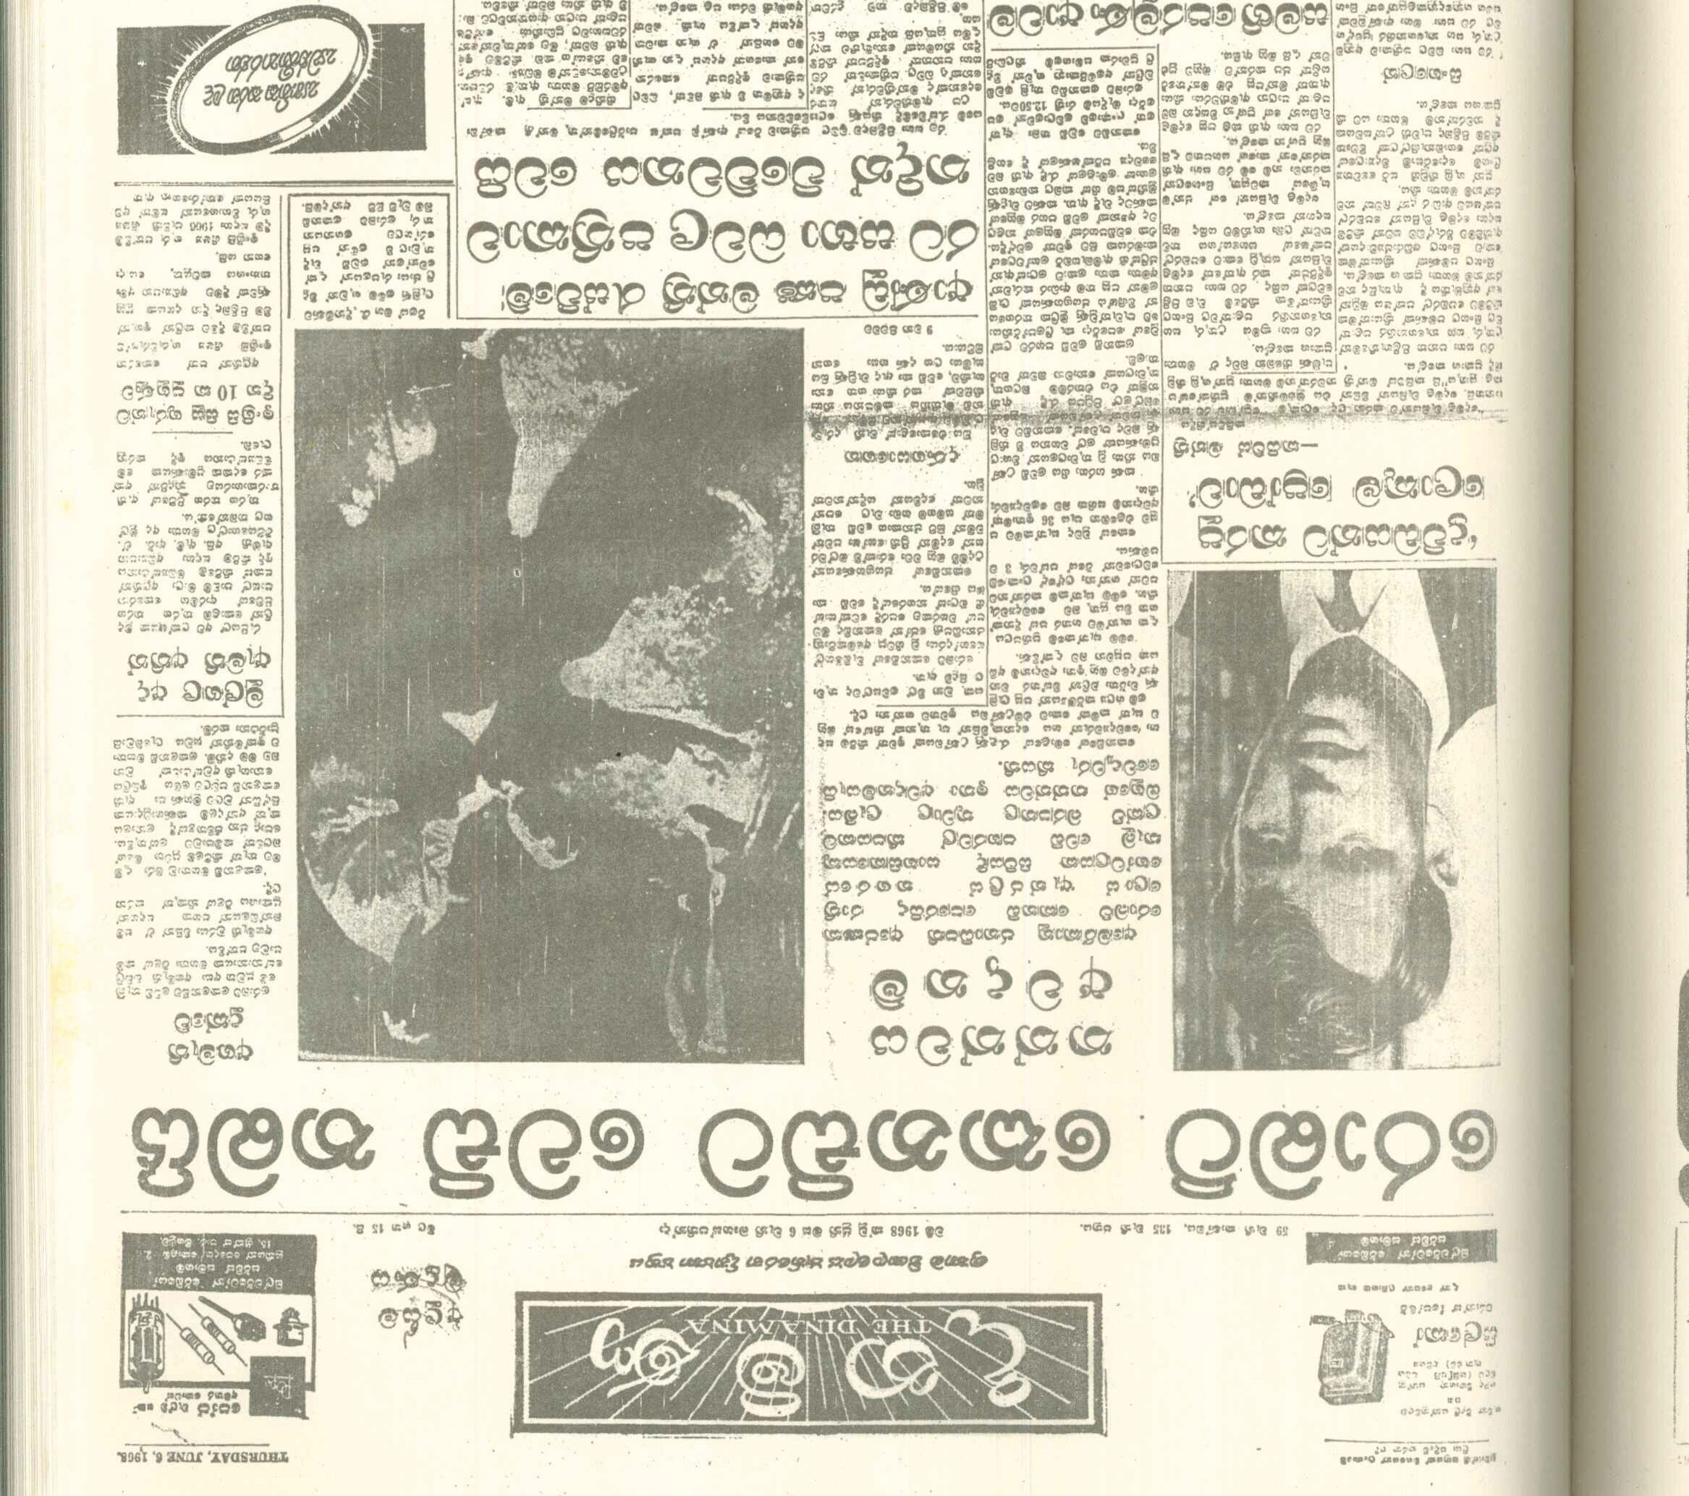
=

Slide 8
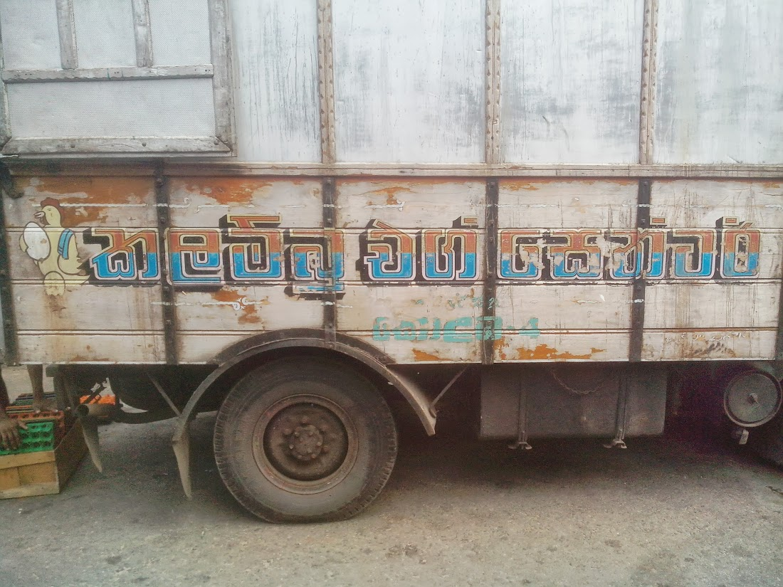

Slide 9
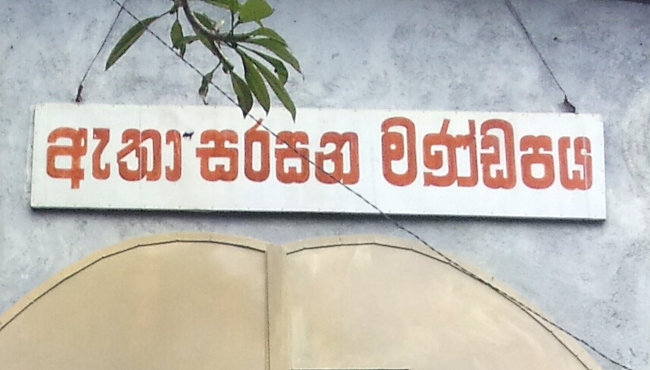

Slide 10
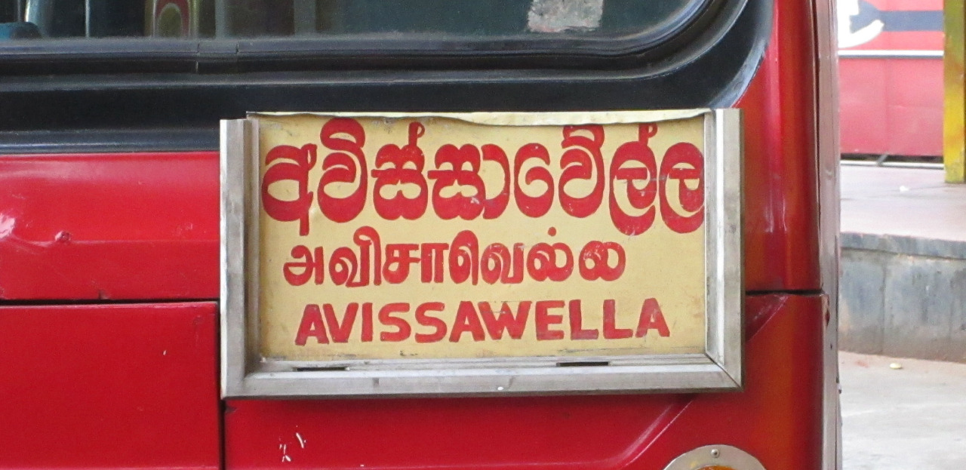

Slide 11


Slide 12


Slide 13
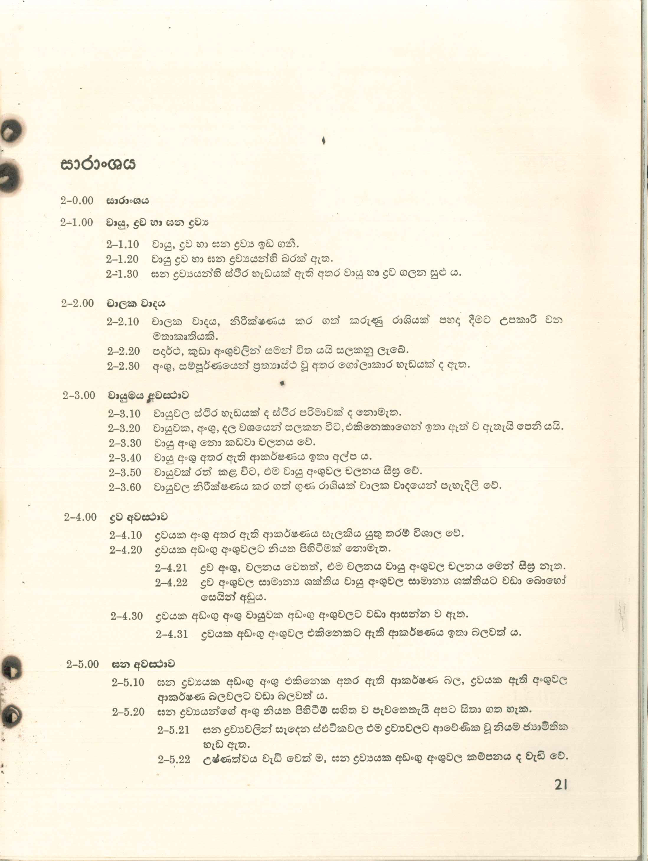

Slide 14
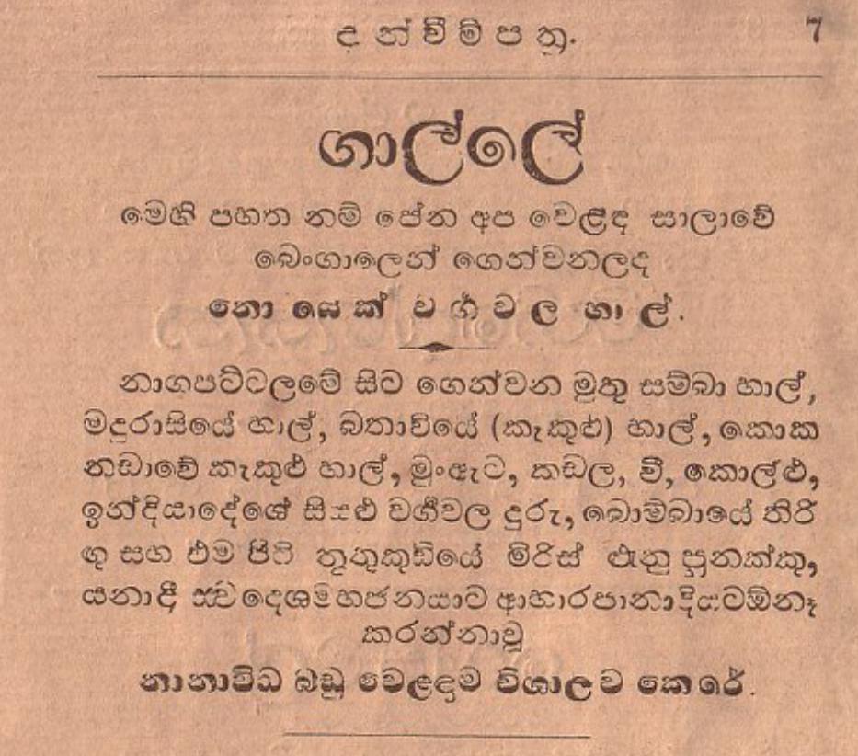

Slide 15
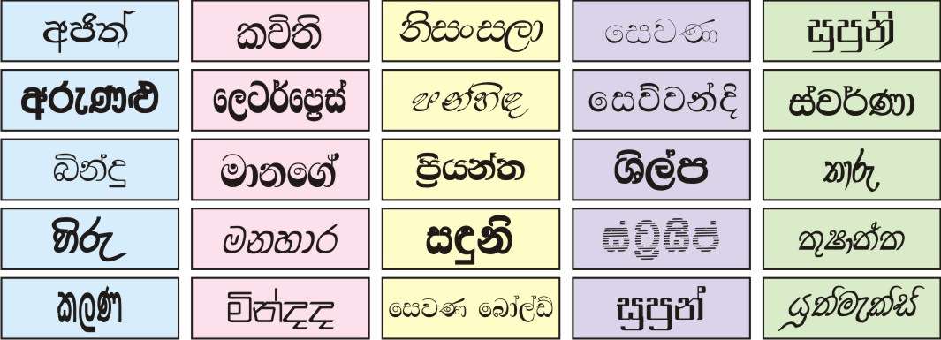
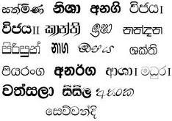

Slide 16
One of these fonts was banned....

Slide 17
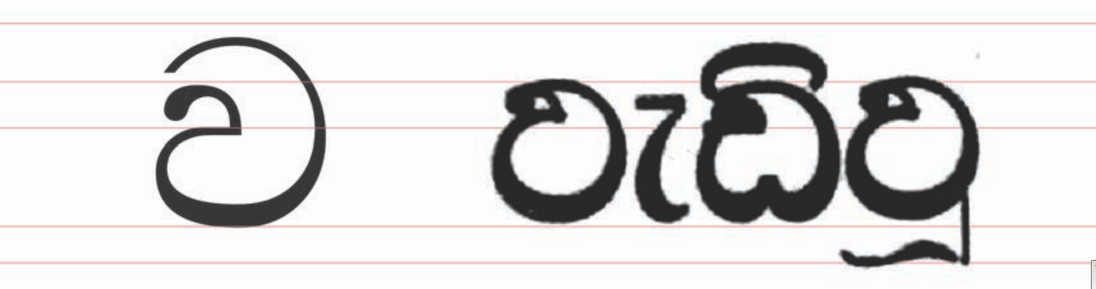

Slide 18


Slide 19
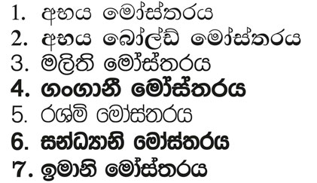
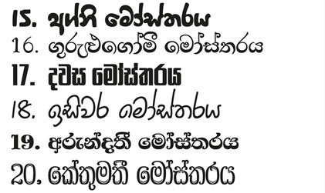
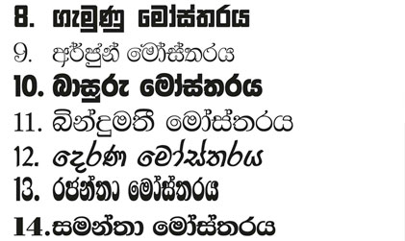
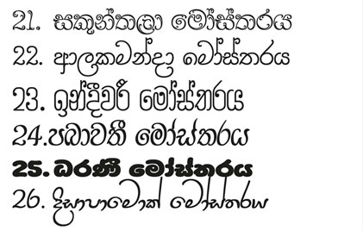
The Font Master Catalog, by Pushpananda Ekanayake, Sri Lanka (1997,2008)

Slide 20
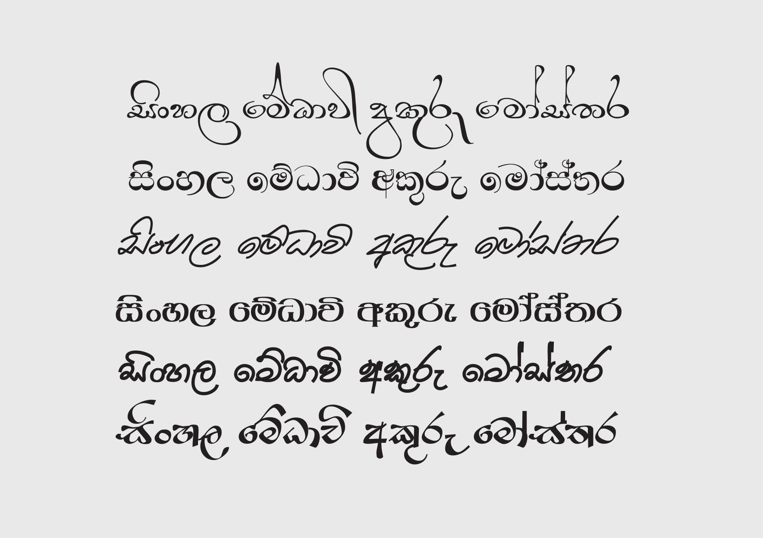
Medhavee Catalog, by Nimal Jayasinghe , Sri Lanka (2000)

Slide 21
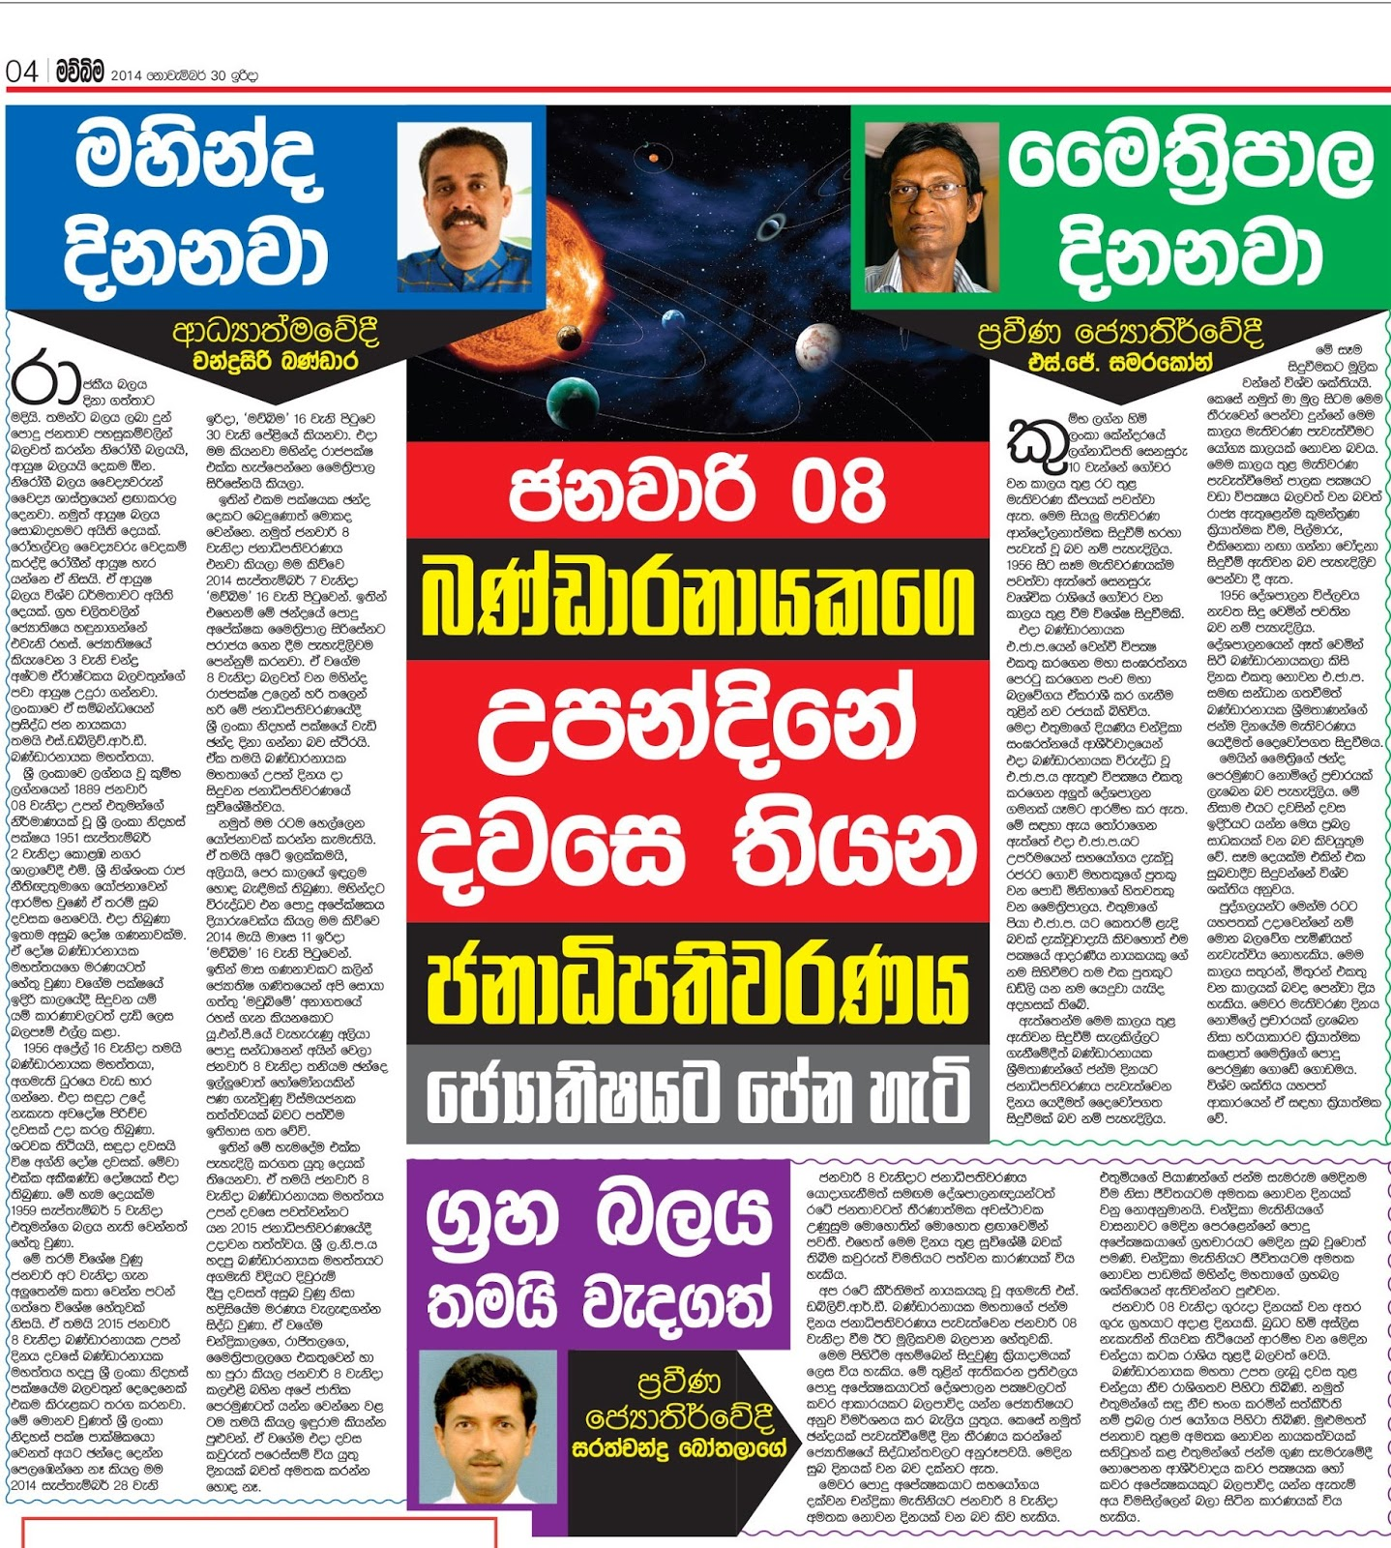



Slide 22
From the research...

Slide 23
Tested System Fonts by non-native designers
- Niramla UI on Windows by Tire
- Sinhala Sangam MN on MacOS
- Noto Sans Sinhala on Android
Tested Fonts by native designers
- FM Malithi by Pushapanada Ekanayake
- Abhaya New by Pushapanada Ekanayake

Slide 24
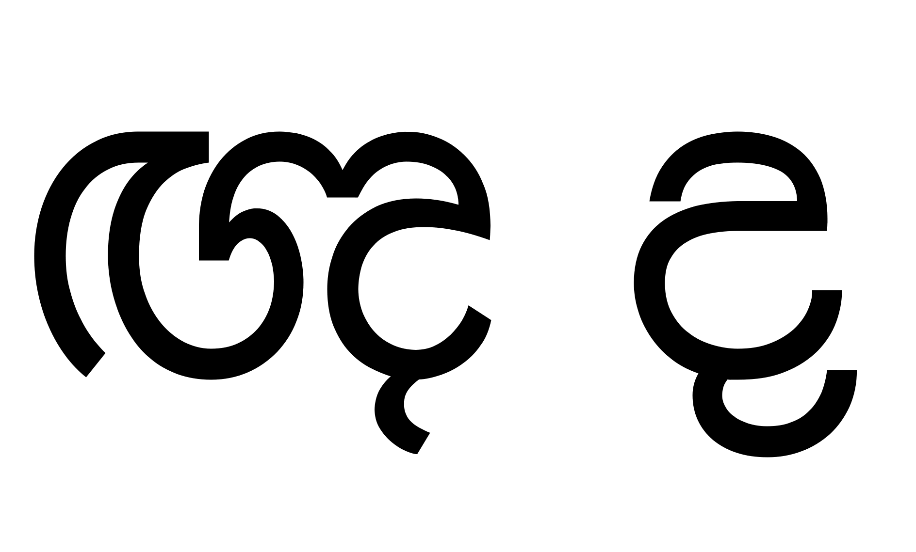
Nnya and Da of Sinhala Sangam by Muthu Nedumaran.

Slide 25
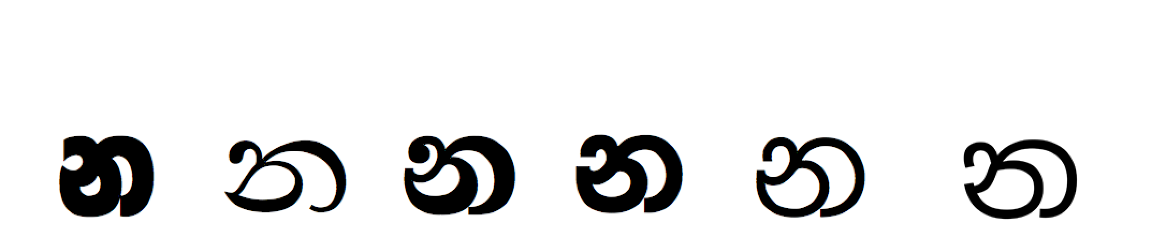

Slide 26
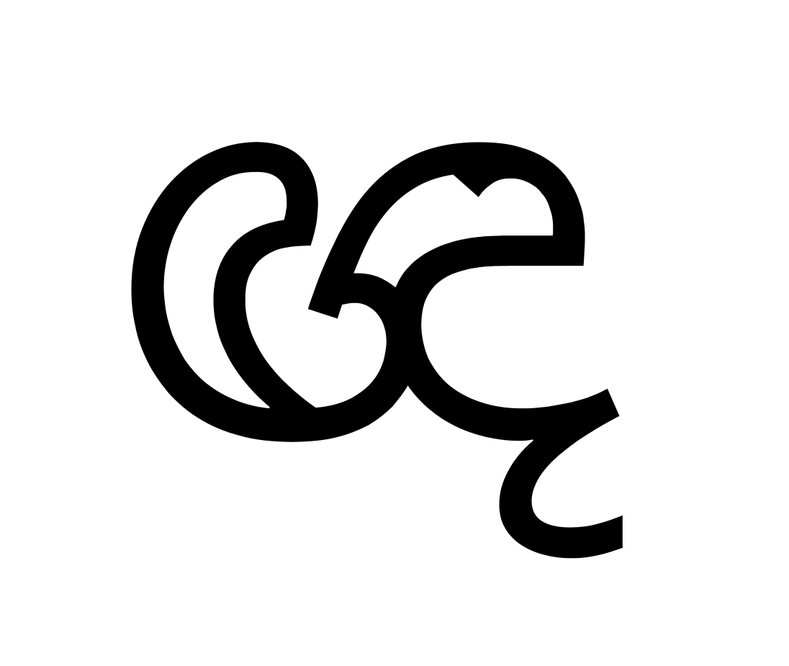
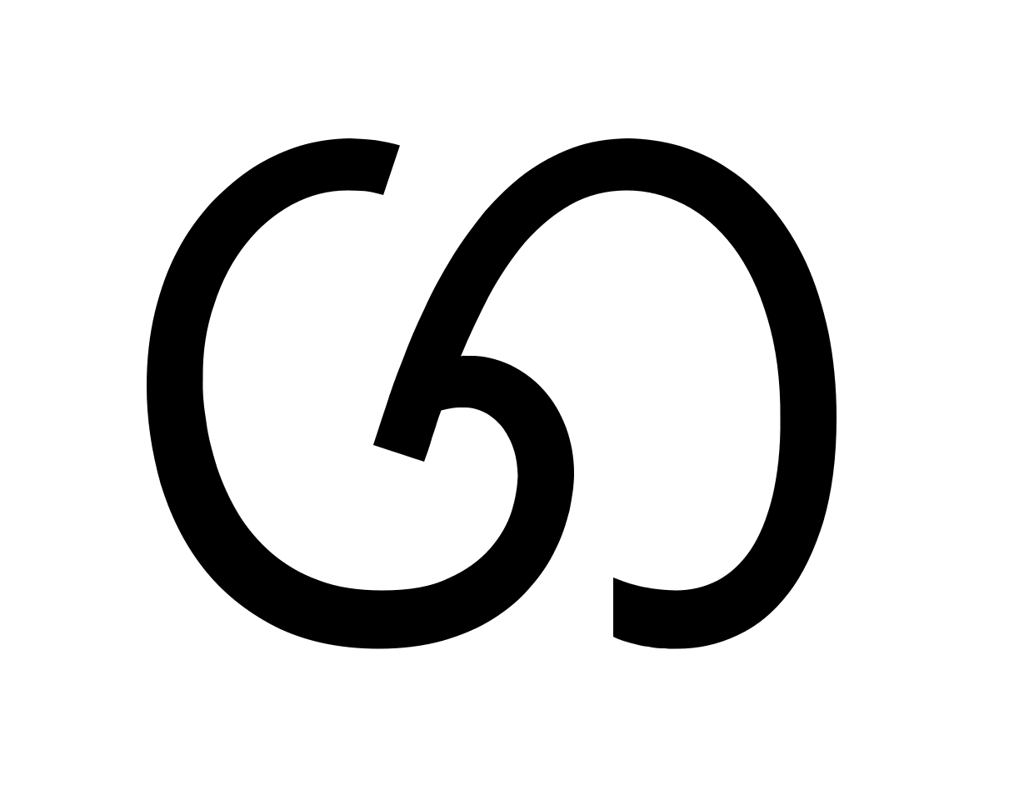
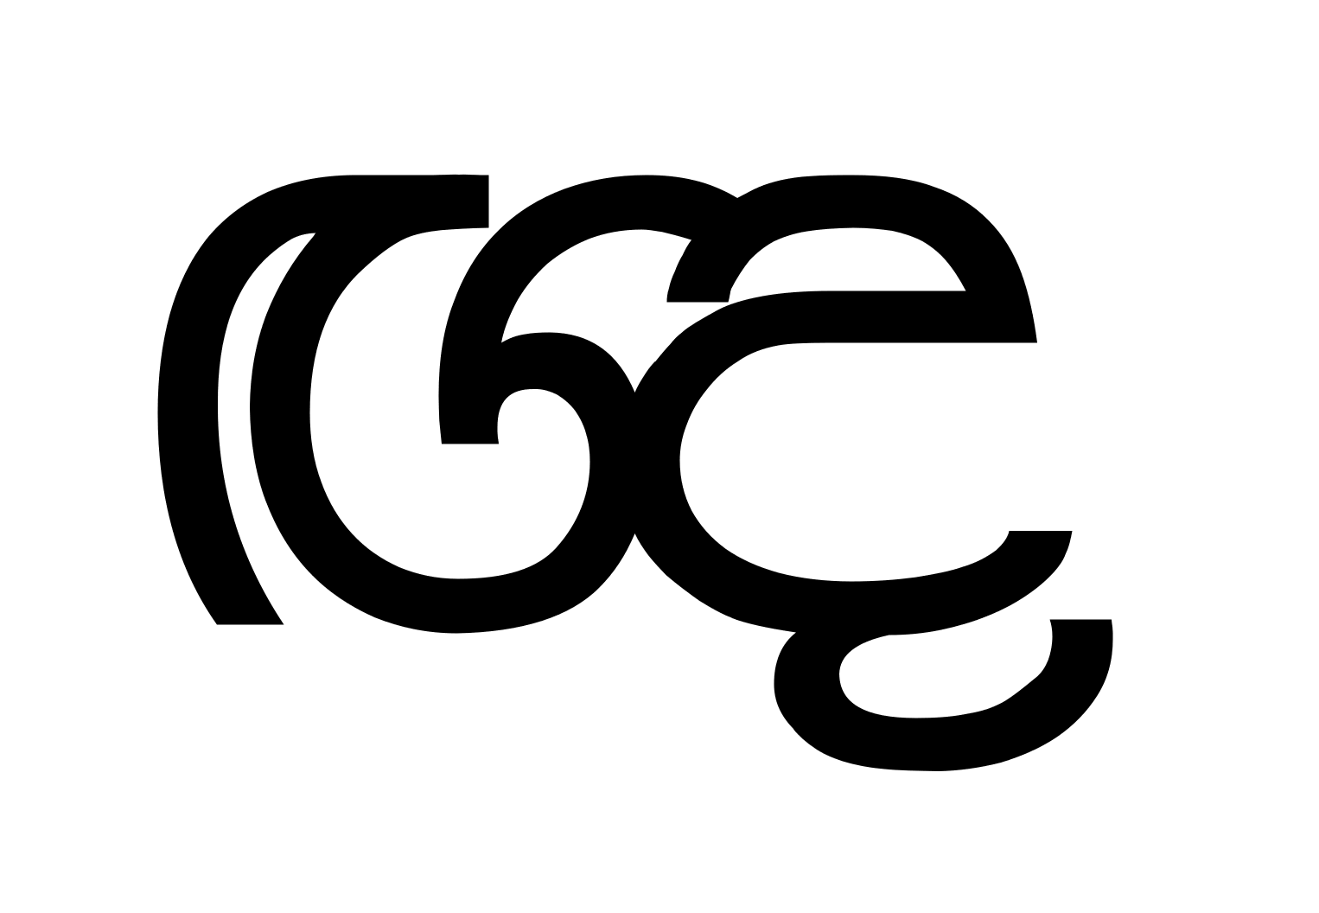
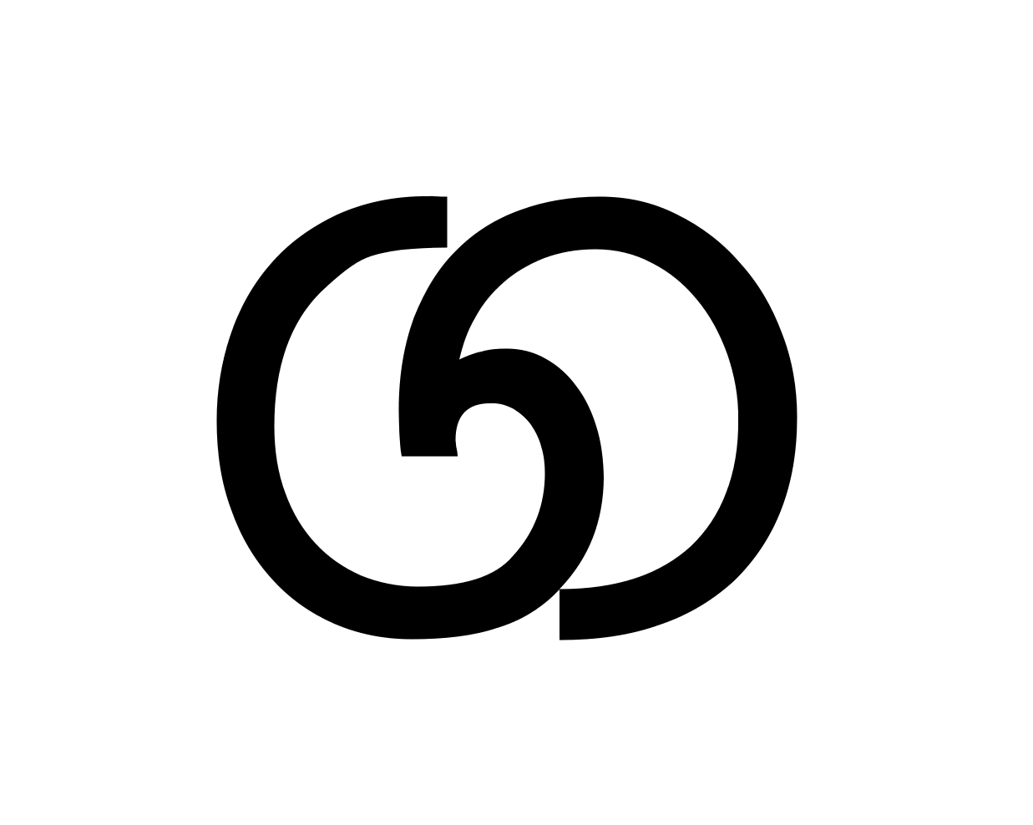
Nirmala UI by Tiro
Malithi by Pushpananda Ekanayake

Slide 28
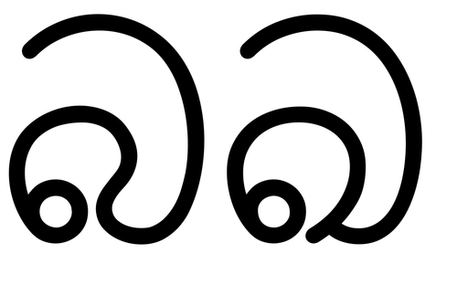
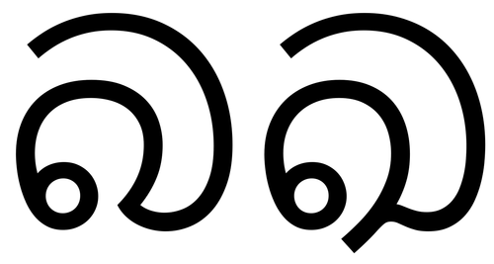
Ba and Kha of Bhashitha by ICTA Sri Lanka
Ba and Kha of Nirmala UI by Tiro

Slide 29
Common comments
- Nice Display Font!
- Weird shapes?
- Is that Kha?

Slide 30
A Font serves a function, a purpose...
- For system info/ menu display
- Serves as a general basic
Notes:
Test

Slide 31
System Fonts are Infrastructure!
- 99% of the content on web is rendered with them.
- Adoption of web fonts is really, really slow.
- And there are no web fonts.

Slide 32
So, Which Sinhala Fonts
Do Users Love To Read On Screen?

Slide 33
What to Do?
Foundries and Companies
- More collaboration with native designers
- Be aware, there are no standards yet...
- Adhering to standards set by locals.
- Open work flow / testing with locals.

Slide 34
What to Do?
Locals
- Documentation
- Testing Documents / Systems
- Adhering to international standards.
- Participation / training
- And most important and obvious fact...............................

Slide 35
Learn Type Design and
Design Fonts!!!

Slide 36
Obviously,
Users Love to with fonts designed by Natives.....

Slide 37
Thank you!
@pathumego mooniak.com

