Slide 1
Jumping
Pathum Egodawatta

Slide 2
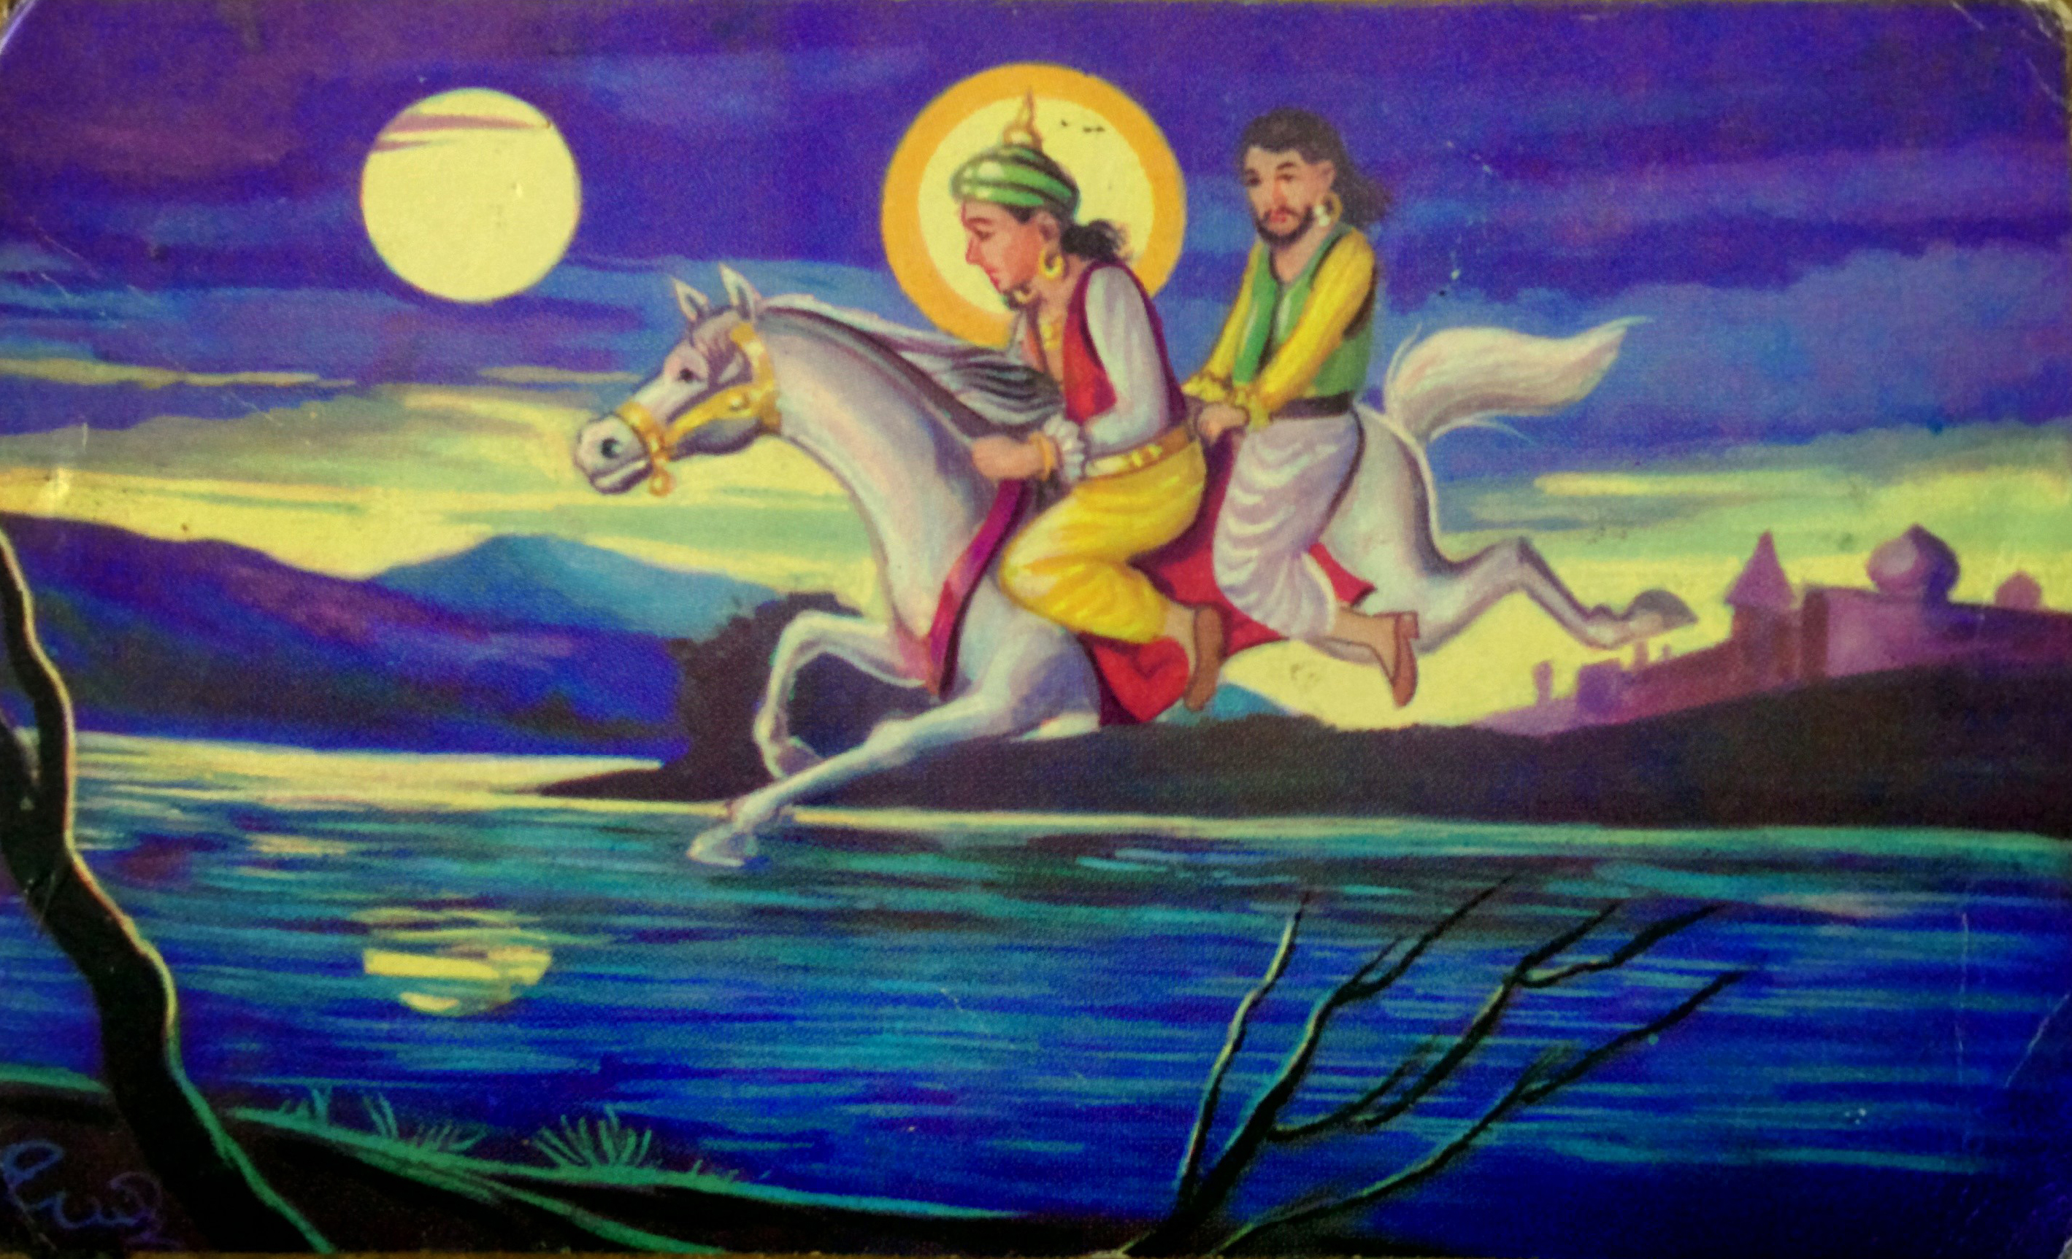
Jumping

Slide 3
The Illusion
Never be unhappy aka 'its perfect'

Slide 5
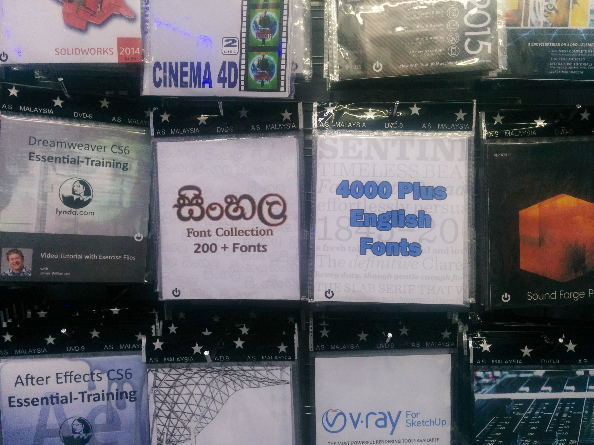

Slide 6
The Encounters
Signs aka 'Finding Inkscape'

Slide 7
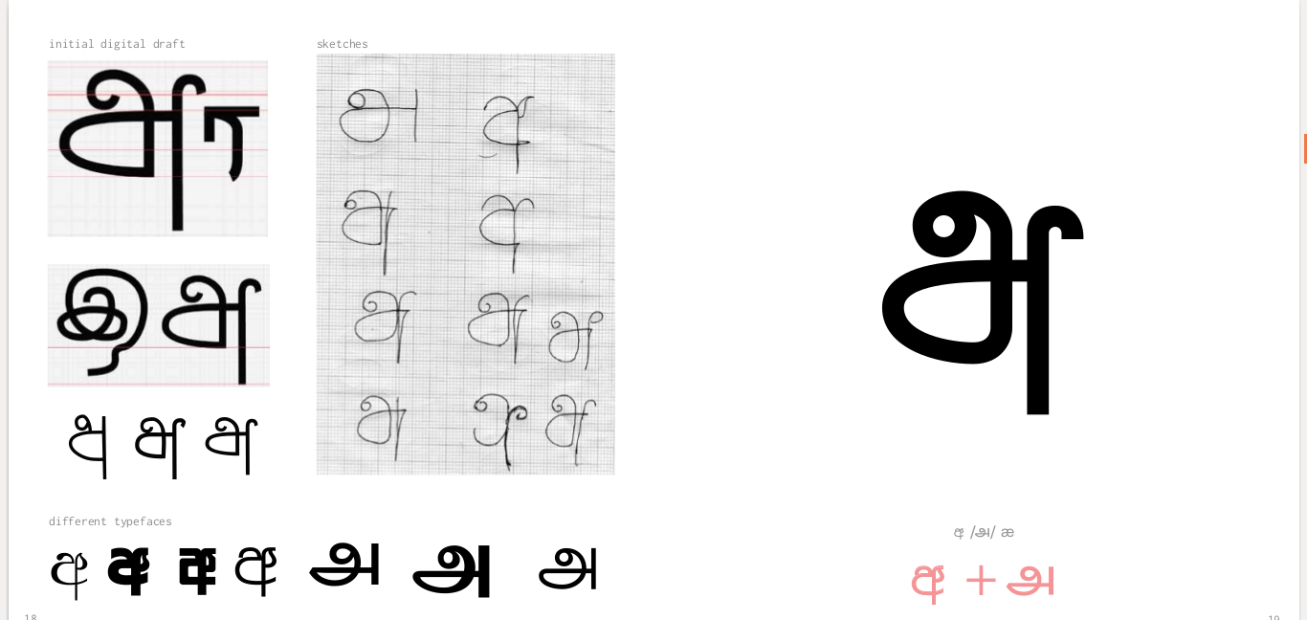

Slide 8
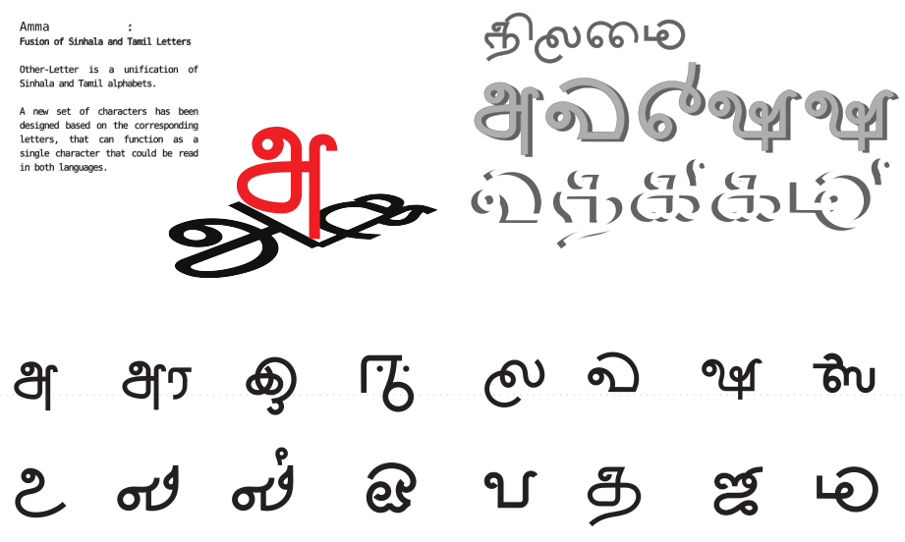

Slide 9
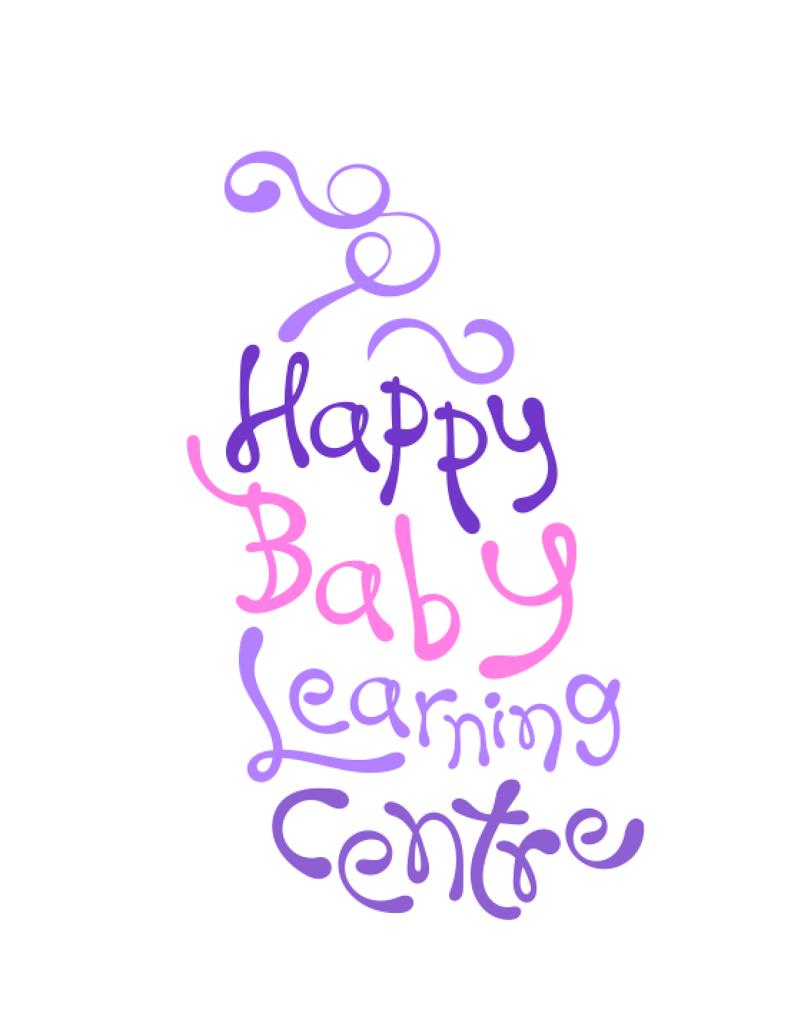
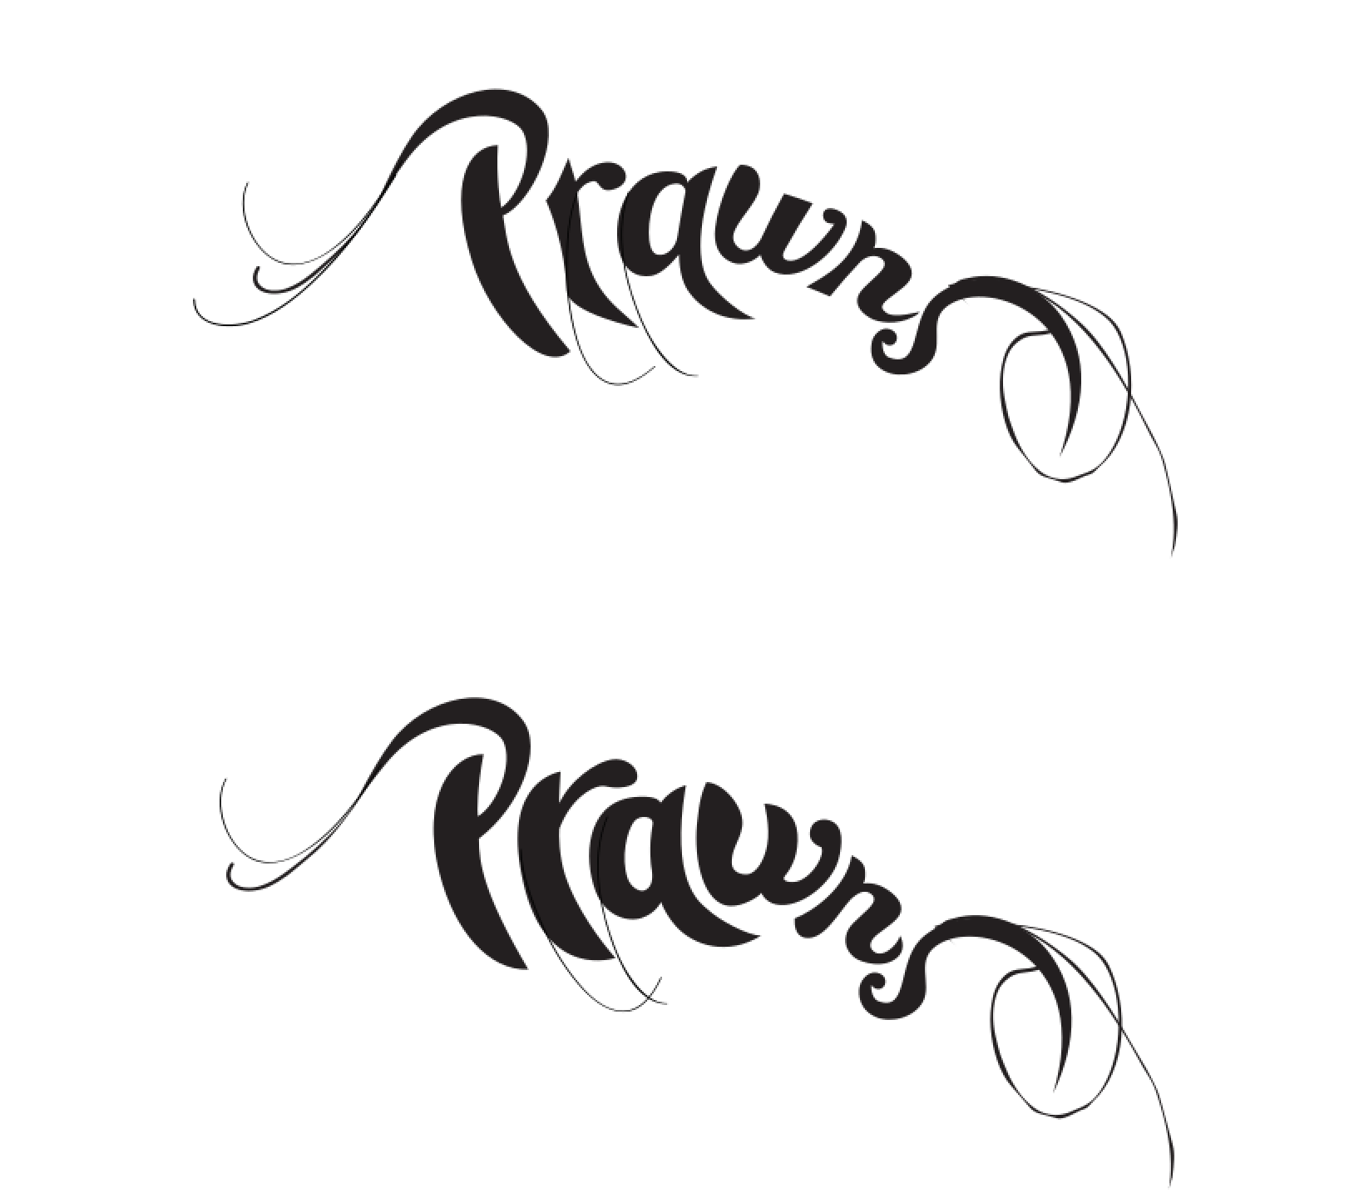

Slide 10
The Doubts
New horizons aka 'WTF Gimp'

Slide 11
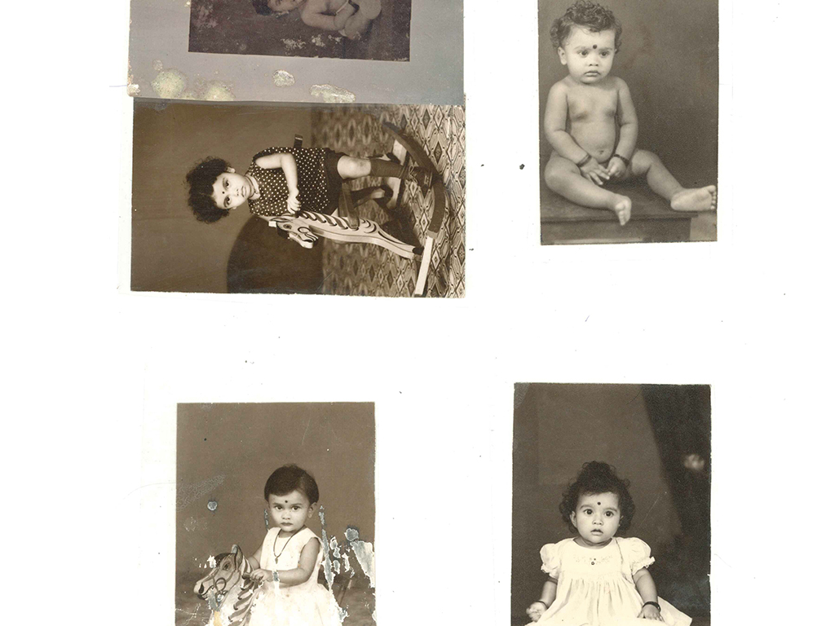

Slide 12
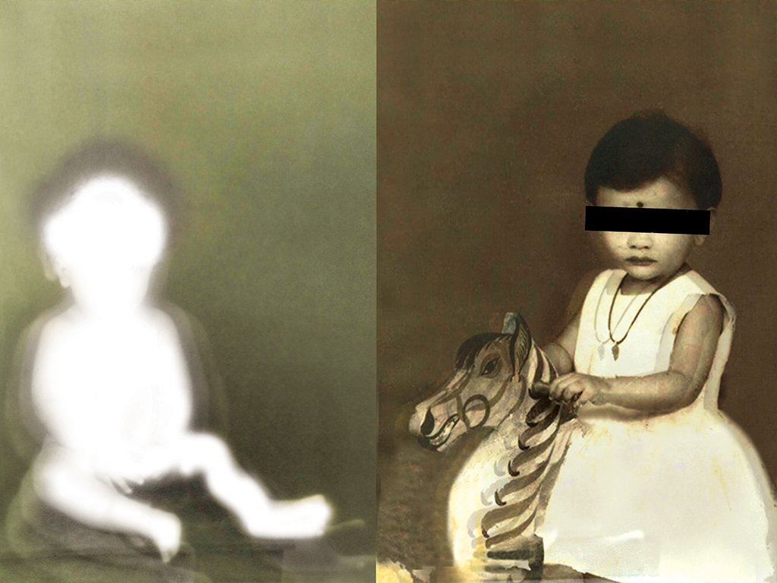

Slide 13
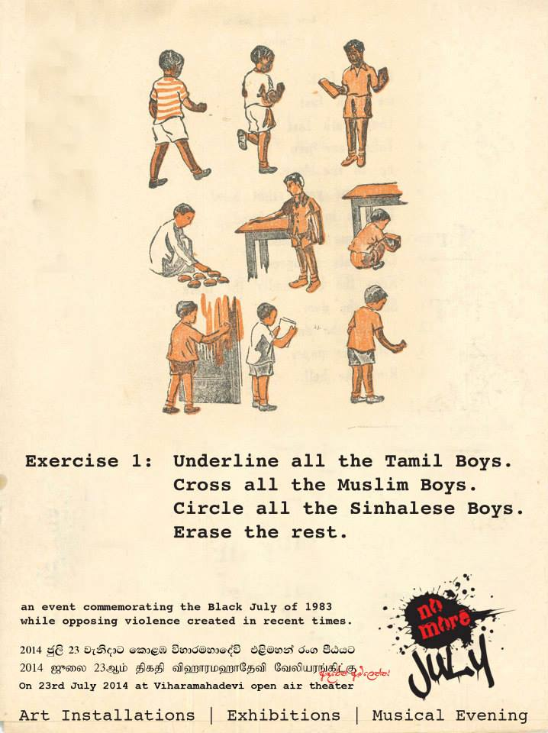
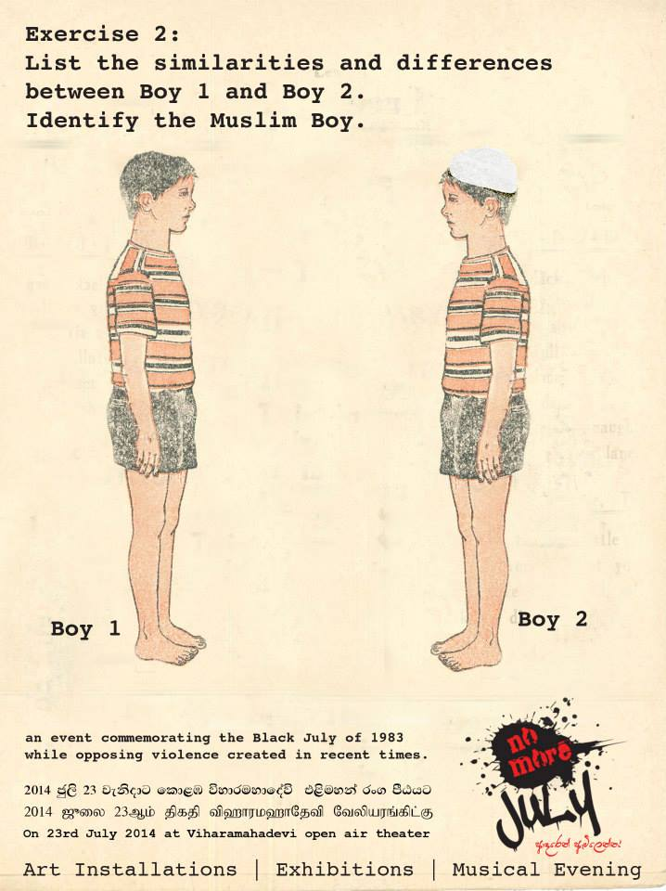

Slide 14
Austerities
The different schools of suffering aka
'Why there is not just one way'

Slide 15
The suffering
Different builds
Build my own
Experimental??
Which Linux

Slide 16
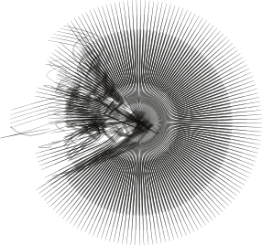
mooniak.com

Slide 17


Slide 18
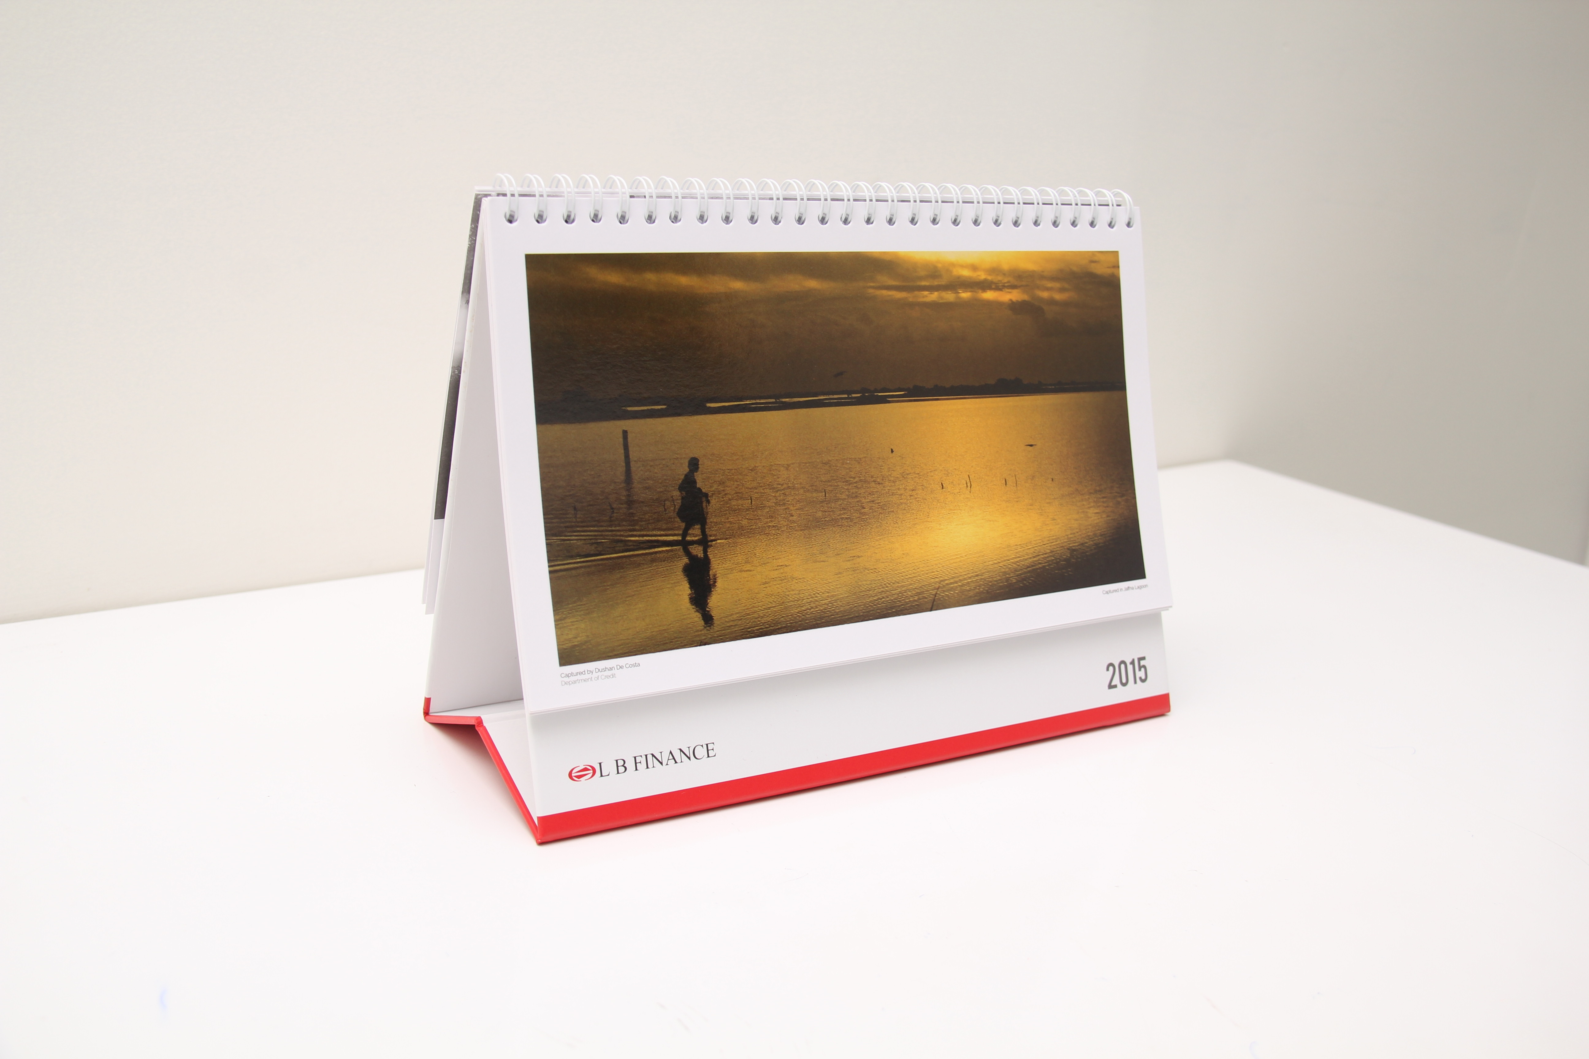

Slide 19
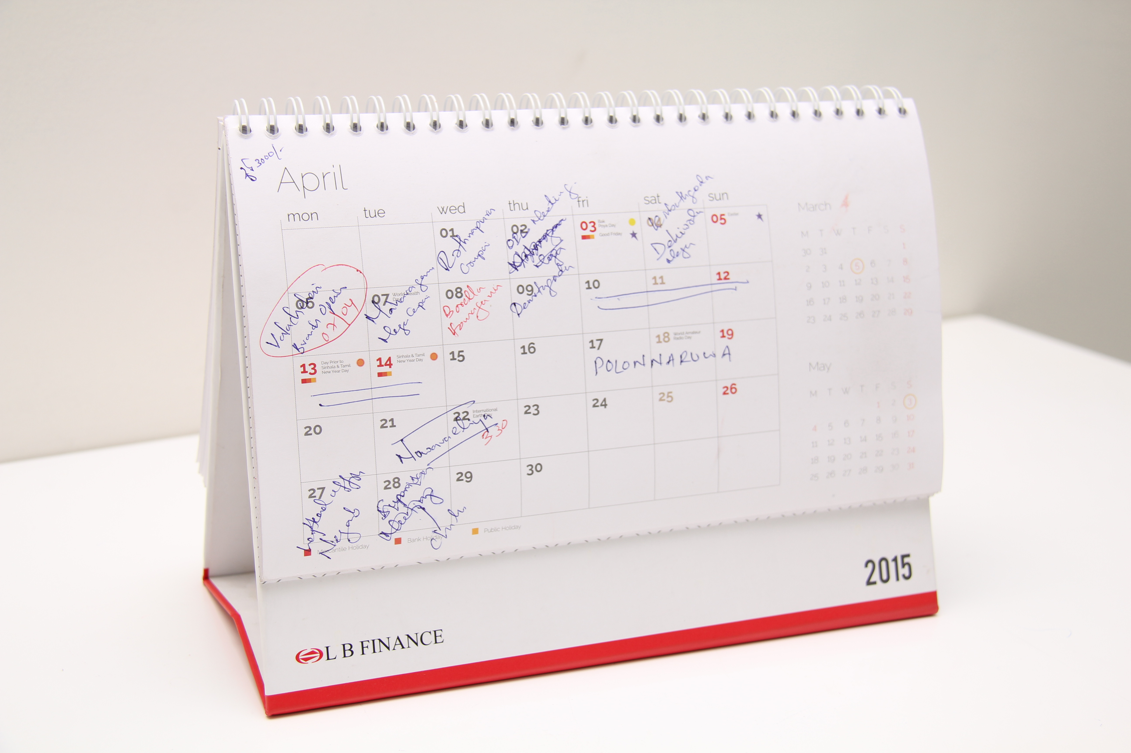

Slide 20


Slide 21
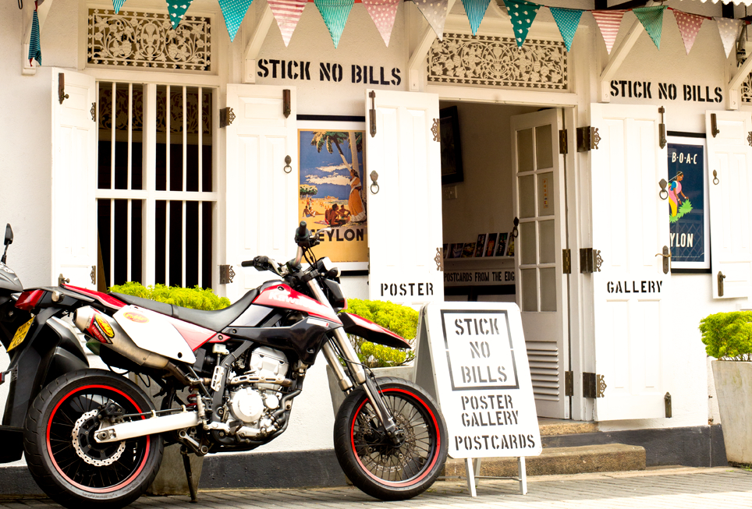

Slide 22


Slide 23
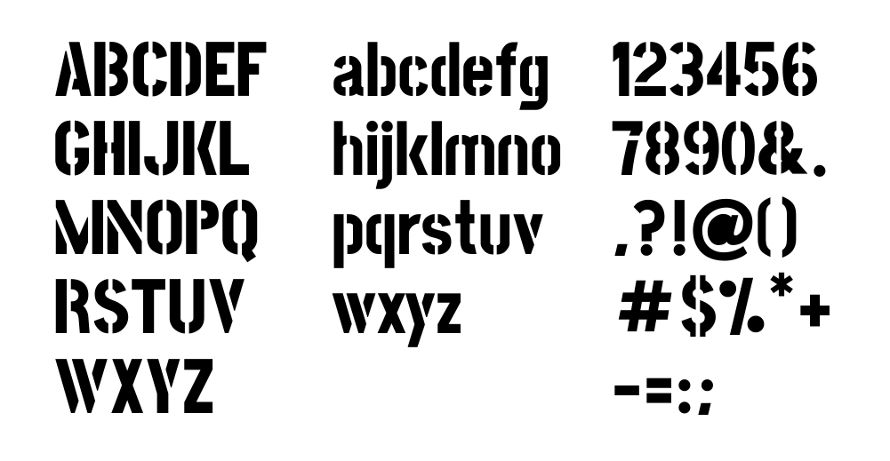

Slide 24
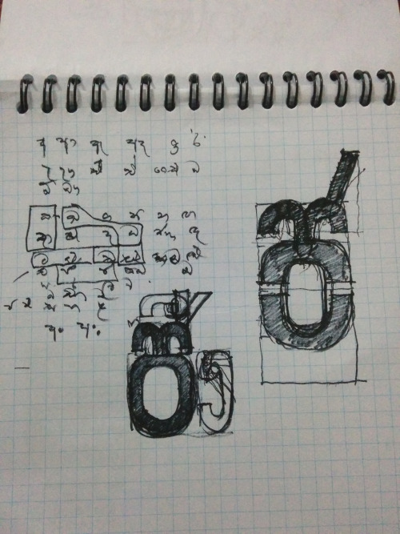
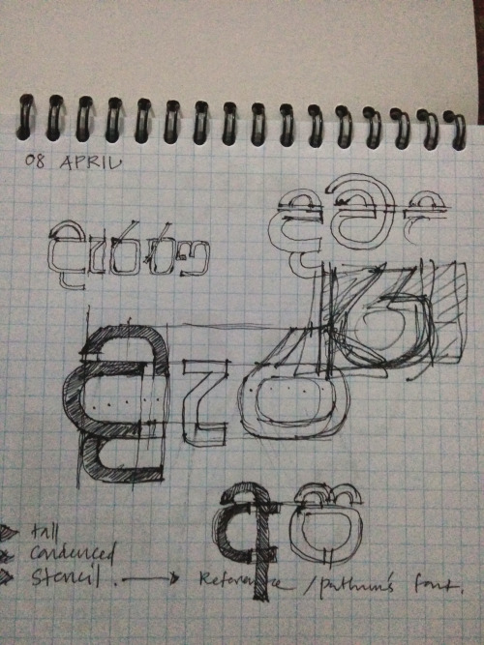

Slide 25


Slide 26
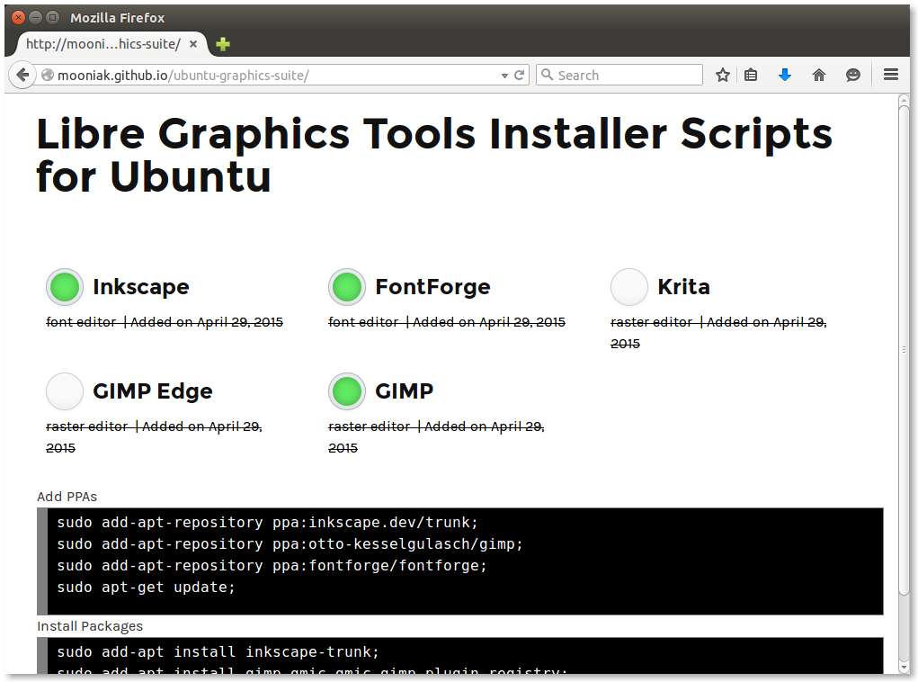

Slide 27
The Conversions
Join my faith aka 'Try this dude!'

Slide 28
Software
Stock Images
ClipArt / Icons
Fonts

Slide 29
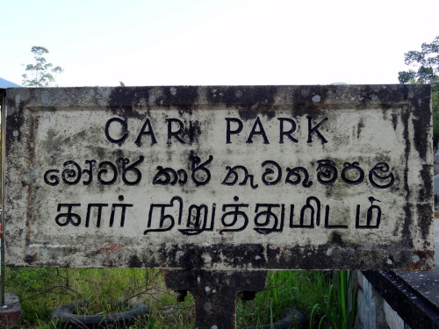
Found
Type
Lanka
foundtypelanka.tumblr.com

Slide 30
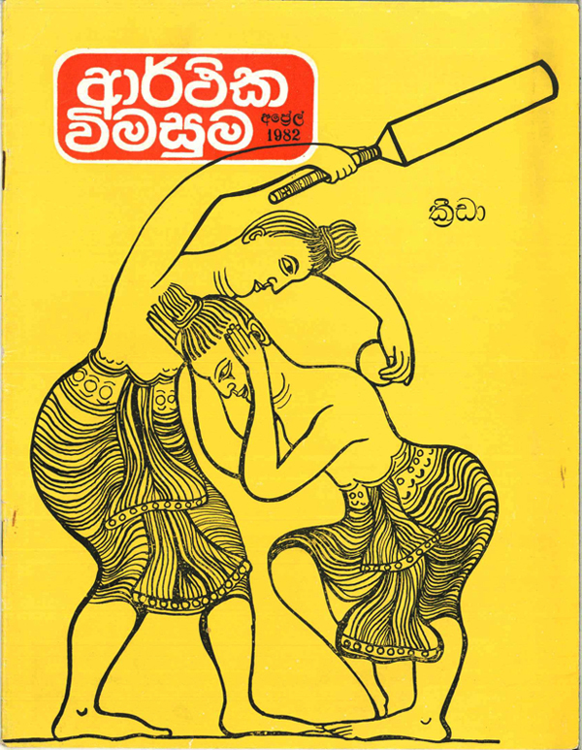
Ceylon Display
ceylondisplay.com

Slide 32
The Path to Enlightenment
Find your own path aka 'Contribute!!!'

Slide 33
FontForge
Stock Images
ClipArt / Icons
Fonts

Slide 34
animager animate

Slide 35
Community Participation

Slide 36
Time is a bit cheaper over there..

Slide 37
Sri Lanka:
Highest number of GSoC Participants
265 Student over 9 year
http://google-opensource.blogspot.com/2012/04/moratuwa-sri-lanka-google-summer-of.html

Slide 38
mooniak.com github.com/mooniak
@pathumego

