Slide 1
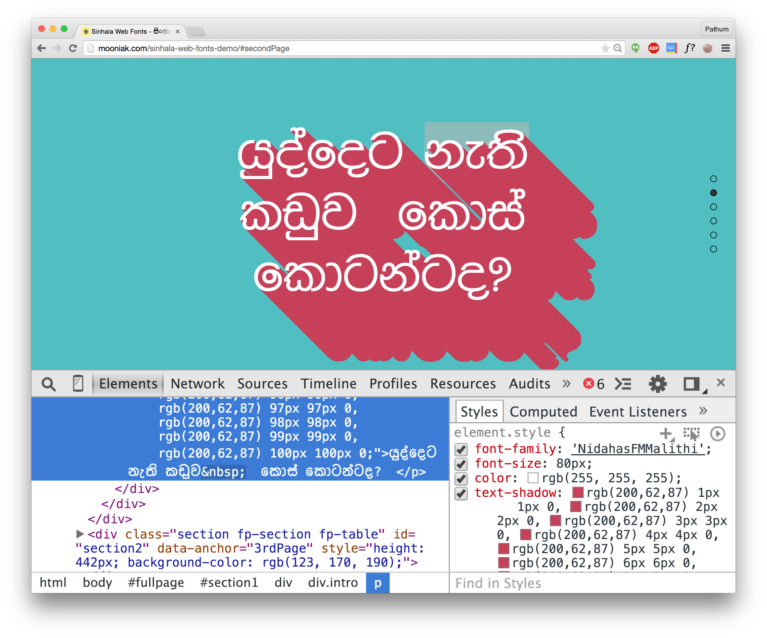

Slide 2
Sinhala Web Fonts?
Pathum Egodawatta

Slide 3
Internationalization
Internationalization is the process of designing a software application so that it can potentially be adapted to various languages and regions without engineering changes.

Slide 4
Localization
Localization is the process of adapting internationalized software for a specific region or language by adding locale-specific components and translating text

Slide 5


Slide 6


Slide 7
Image Credtis
http://www.tombraiderchronicles.com/tr7/walkthrough/images/bolivia12.jpg
http://exploresrilanka.lk/wp-content/gallery/from-a-kitchen/6.jpg

Slide 8

mooniak.com github.com/mooniak
@pathumego pathumego.github.io

